Slide 1
RAMP Manual
Entering a Game Sheet

Slide 2
Where to Go to enter a Score:
When Signed in to Ramp Choose League Games from the Dashboard
Choose appropriate Games and Click on Gamesheet Button
Hometeam is required to enter in the gamesheet within 48 hours of Game
Visiting Team Must go in and Verify with in 48 hours of hometeam submitting.
Directors will be checking weekly to ensure all Games are up to date.

Slide 3
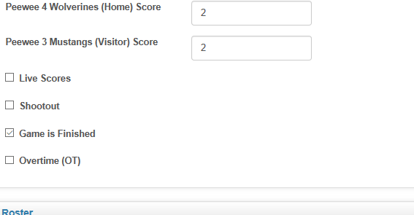
Update The Score
The first step of entering the game sheet information is to enter the score and click “Game is Finished”. •
Click submit and the score will show on the front end of the Hockey FMMHA website.

Slide 4
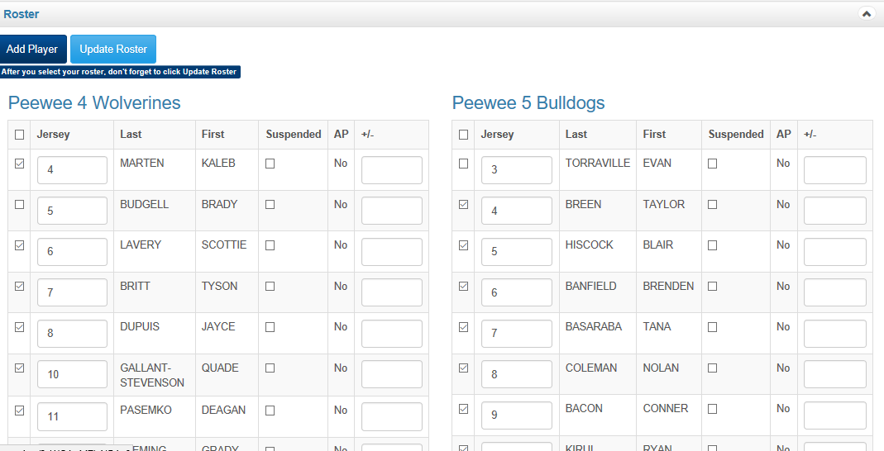
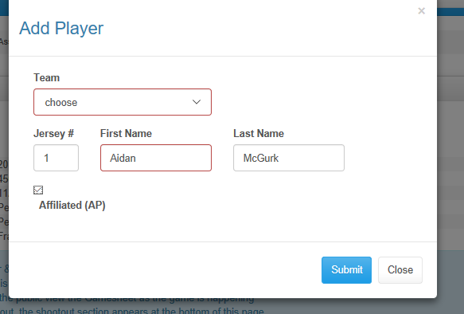
Update the Game Roster
Both the Home and Visitor team rosters should appear here. If this is not the case either the Home or Visitor team have not entered their rosters. In the event please contact your Division Director.
Click the check box next to the names of each athlete that is listed on the game sheet. Please do not simply click the top box as this will check every name and may account for misleading information on games affiliate players have played.
If players are Missing Please click add Player (example affiliate players or emergency Goalies)
Click Update Roster at top or Bottom of this window

Slide 5
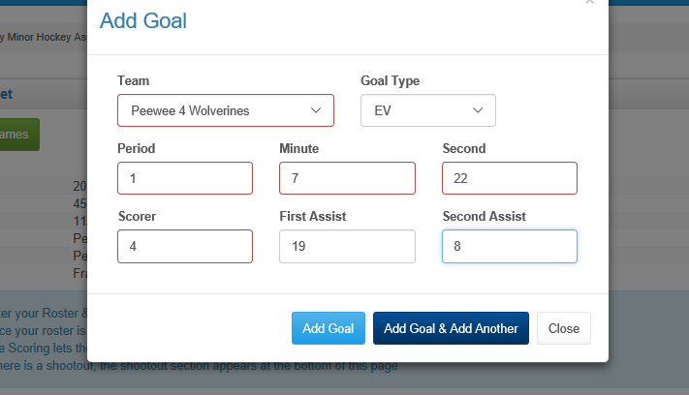
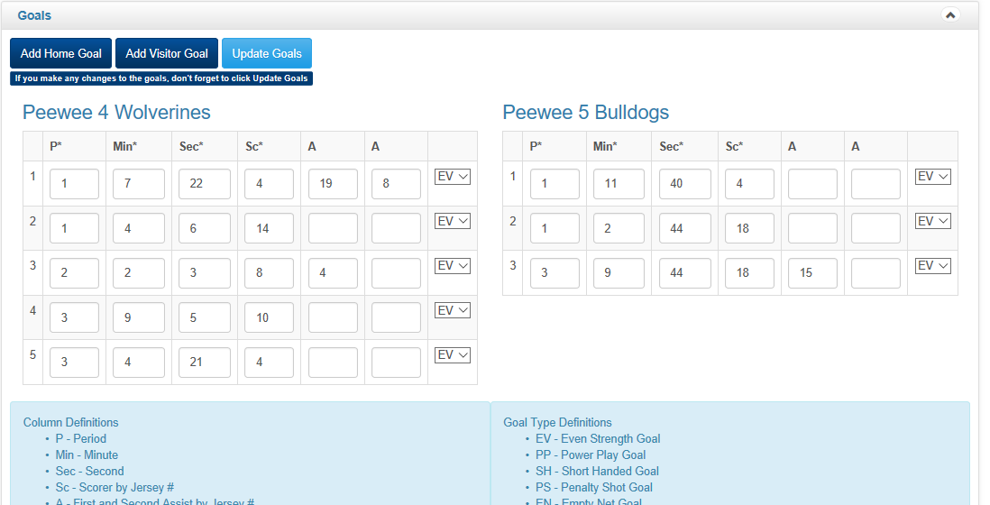
Add in the Goals
Please enter goal information exactly as listed on the game sheet.
If a player was wearing a different Jersey number update the roster ( a player is normally 13, forgot his jersey and borrowed #8) 8 should have been updated in step above and should be used through out entry.
Webstats will reflect his regular number.

Slide 6
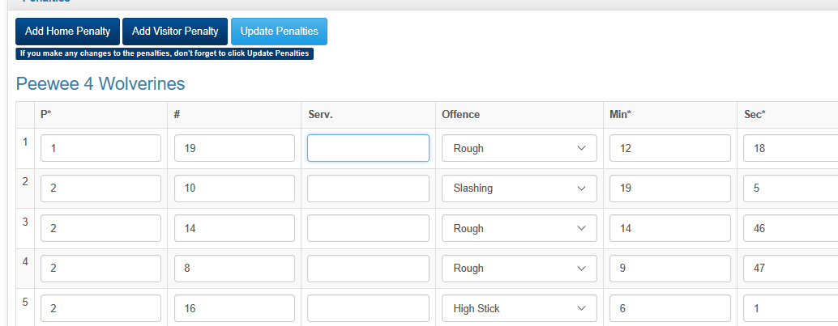
Add In the Penalty’s
Please enter penalty l information exactly as listed on the game sheet.
If the Penalty is missing from drop down select Closest penalty and record in notes, please email VP OPS to add penalty to list

Slide 7
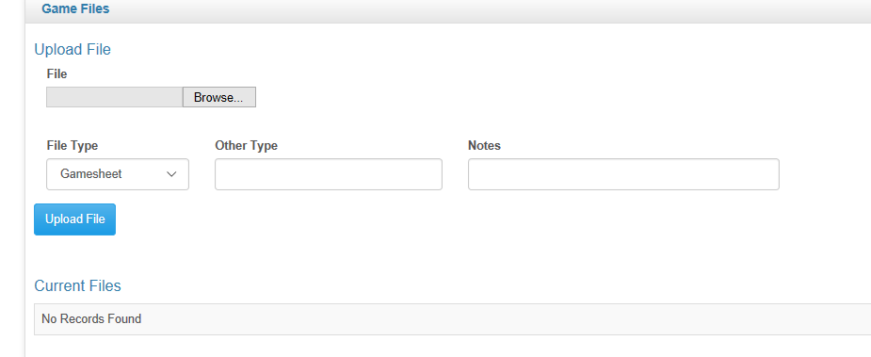
Add in Gamesheet
Please load a picture of the Gamesheet here!

Slide 8
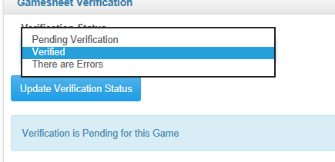
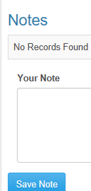
Visiting Team MUST Verify
Click on Verify and review Gamesheet entry against your Copy.
If all is accurate Choose Verified
If in accurate choose there are errors and fill in the notes field

