Slide 1
How to Fill Out a
Game Sheet

Slide 2
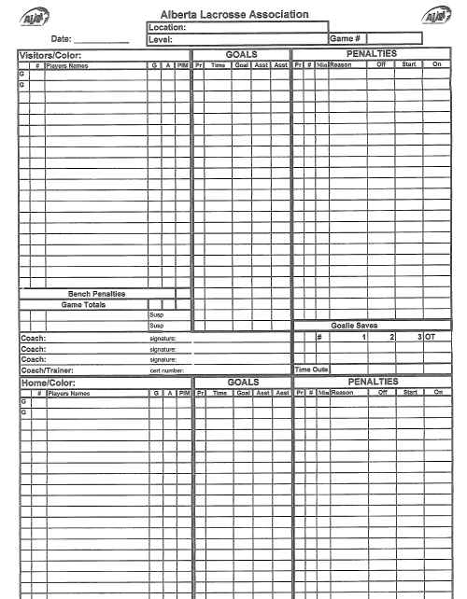
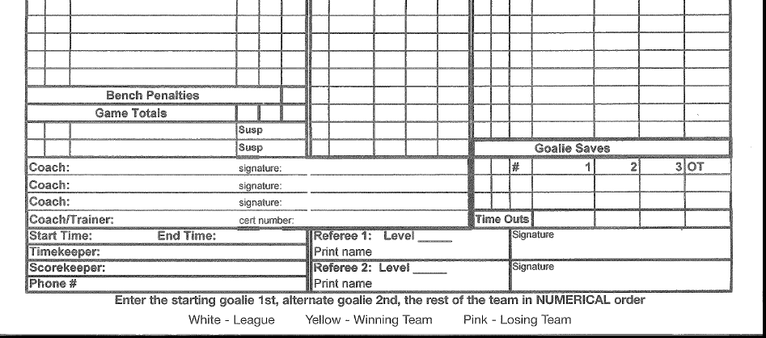
Arena Name
Date Here
Age Group
Game #
Step 1:
Fill out all of the information for the top of the game sheet
Game Number can be found on the master schedule on the standings portion of the website for your division within the age category .
See next slide for screen shots.

Slide 3
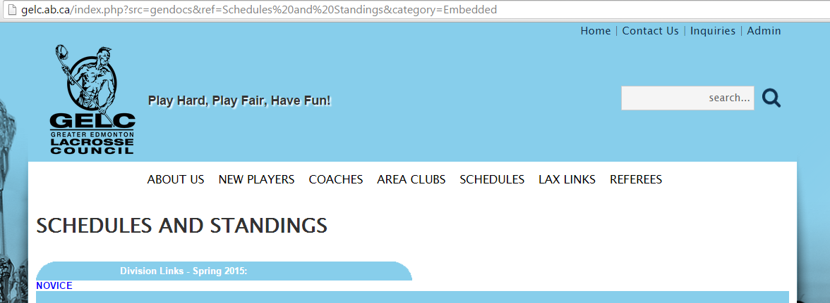

Slide 4
May 3, 2015
Bill Hunter
Bantam “B”
2175729
Team name & Jersey colour
Step 2:
Fill out the team information.
The team name & jersey colour must be filled in
Team name & Jersey colour

Slide 5
May 3, 2015
Bill Hunter
May 3, 2015
Bantam “B”
2175729
Titans / White
Step 3:
As the home team volunteer you are now responsible to get the roster information for your team. This usually comes from the team manager.
Titans / White
Options for completing roster (in order of preference):
NEAT printing
Clear sticker
White sticker that conforms to the lines
*List the starting goalie first followed by the alternate goalie. Then the rest of the team follows in numerical order
Once step 3 is completed give the score sheet to the visiting team to complete.
Warriors / Red&Blk
Check to see roster is completely filled out including coaches names and signatures
------------------------------------------------------

Slide 6
May 3, 2015
Bill Hunter
Bantam “B”
2175729
Titans / White
Step 4:
Check to ensure all of the information including coaches names and signatures is on the game sheet.
Check to see roster is completely filled out including coaches names and signatures
Warriors / Red&Blk

Slide 7
May 3, 2015
Bill Hunter
Bantam “B”
2175729
Titans / White
Goals are written here. The refs will tell you who scored and assisted
During the game fill out the goals and penalties as they occur.
Abbreviations for penalties can be found on the back of the game sheet.
Warriors / Red&Blk
Penalties are written here. The refs will tell you the info you need.

Slide 8
At the end of the game the bottom of the score sheet needs to be completed
Start time
Actual End time
Referee # 1 checks sheet and signs last
Time Keeper’s name
Your name and phone #
Referee # 2 signs off first

Slide 9
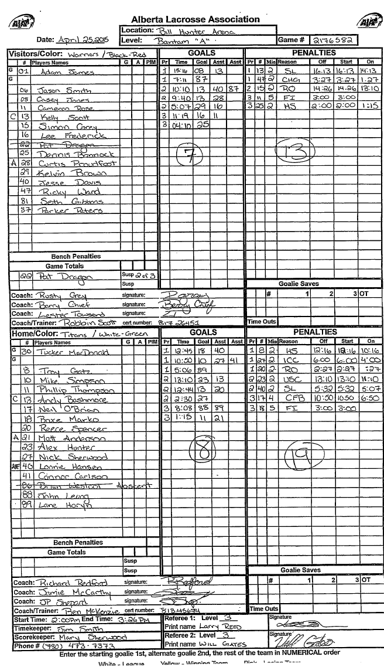

Slide 10
Send Questions, Comments, or
Concerns To:
Edmlax@telus.net

