Slide 2
HiSports - Mobile App Scorekeeping Flow

Slide 3
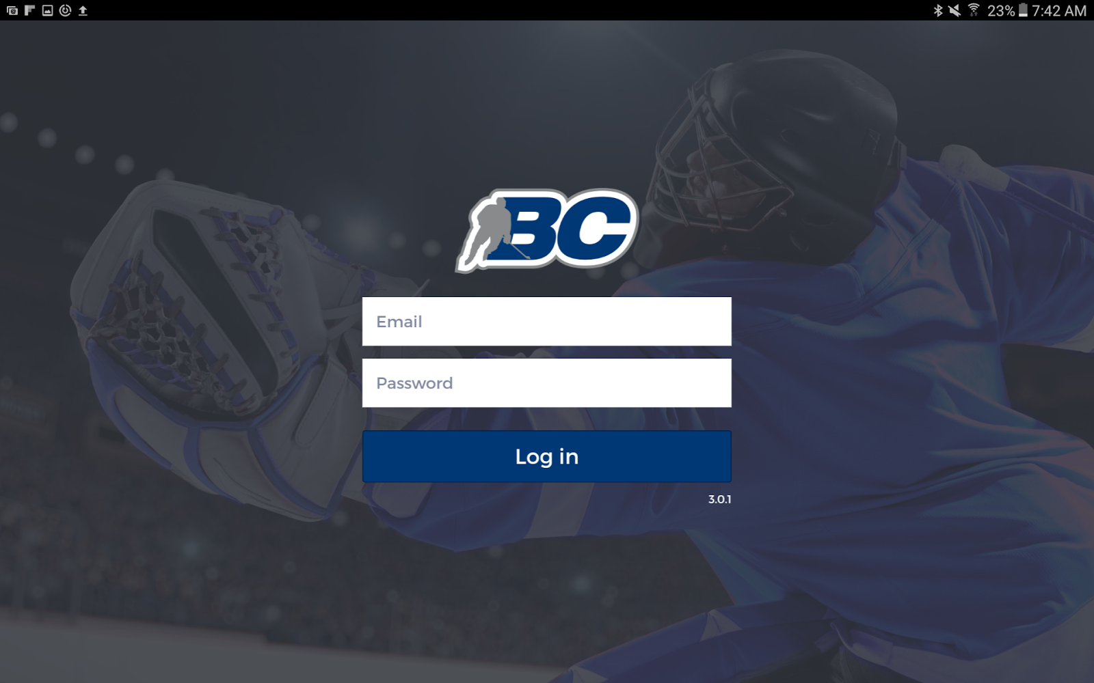
This is where you would log in into the app given your role. As a scorekeeper, you will most likely never be faced with this screen.

Slide 4
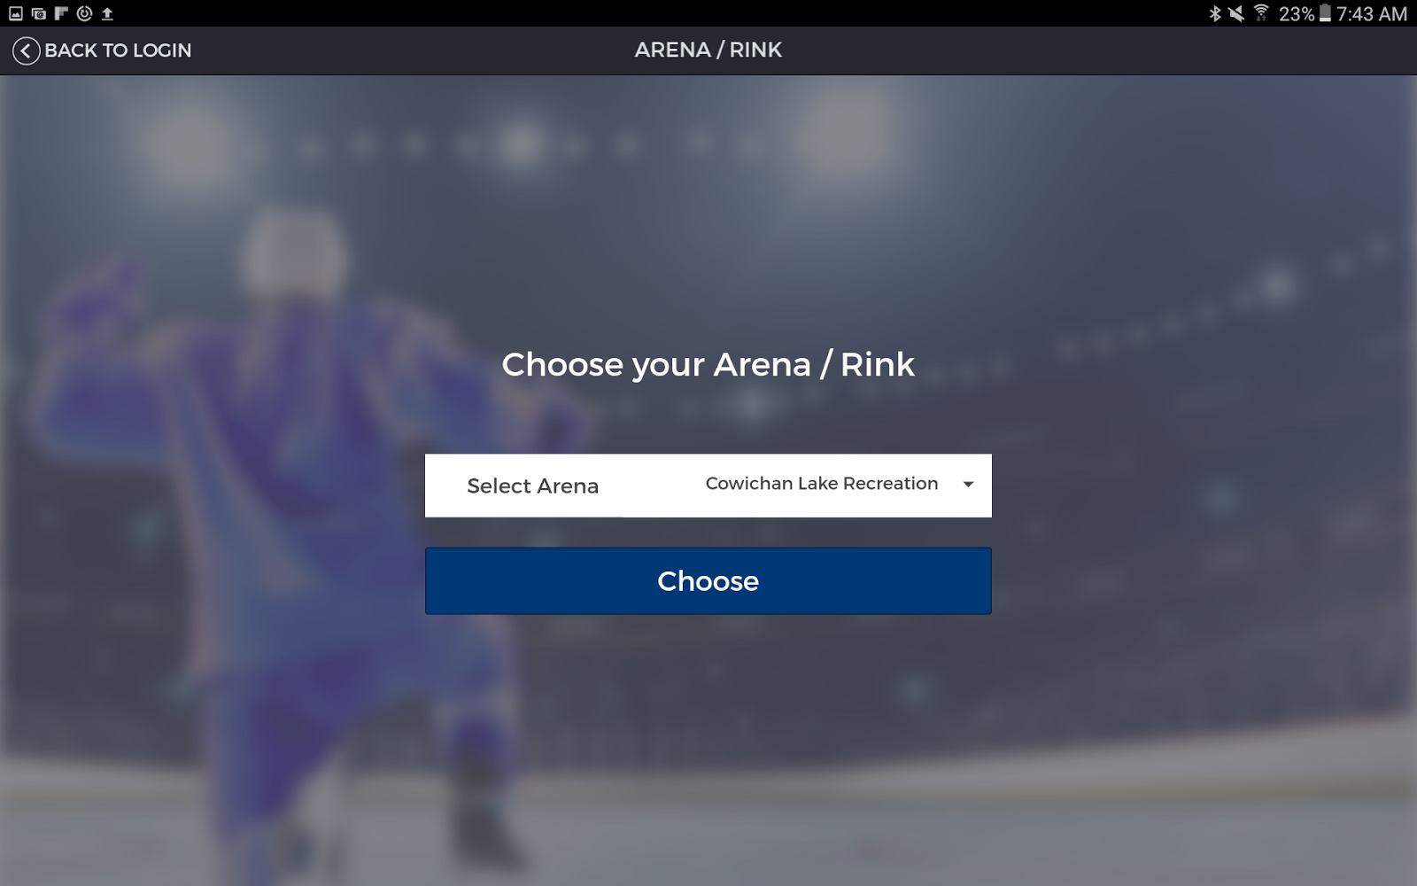
This is where you would select the arena that the tablet is at. Again, the scorekeeper will most likely never be faced with this screen.

Slide 5
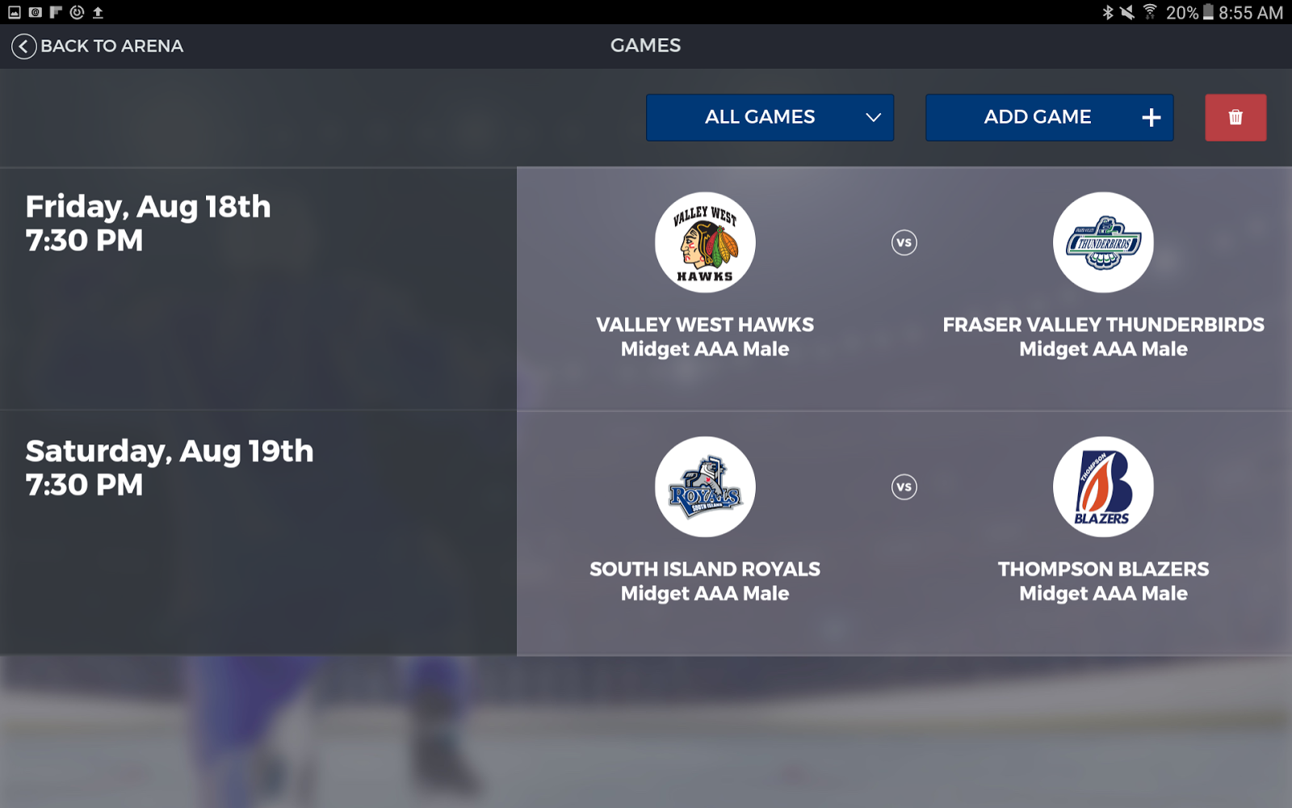
This is where the scorekeeper will see all of the games for the chosen arena.
There is a filter where the “ALL GAMES” button is. It toggles between “ALL GAMES” and “UPCOMING”.
The “ADD GAME” and delete game function will be restricted to certain admin users. The scorekeeper shouldn’t worry about these functions.

Slide 6
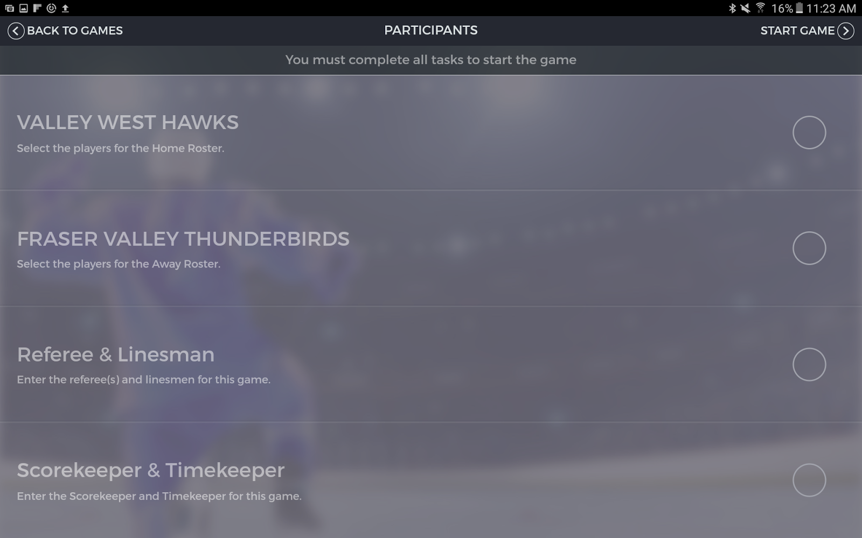
This is the main participant selection screen. From here the away/home team rosters, the referee/linesman roster, and the scorekeeper/timekeeper roster are all selected and entered in order to start the game.

Slide 7
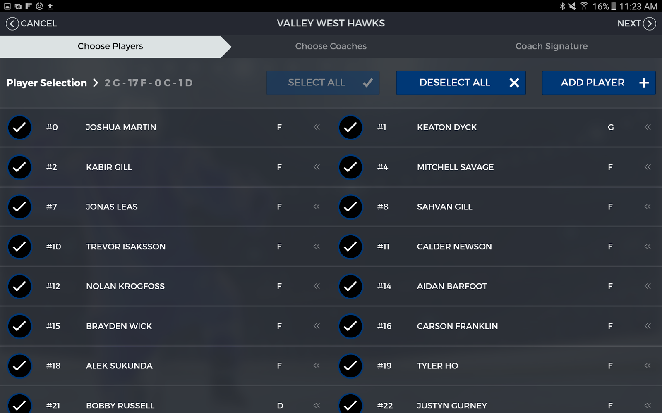
This is the roster selection process for a team. It starts with the selection of the players. If a player is missing, he/she can be added.

Slide 8
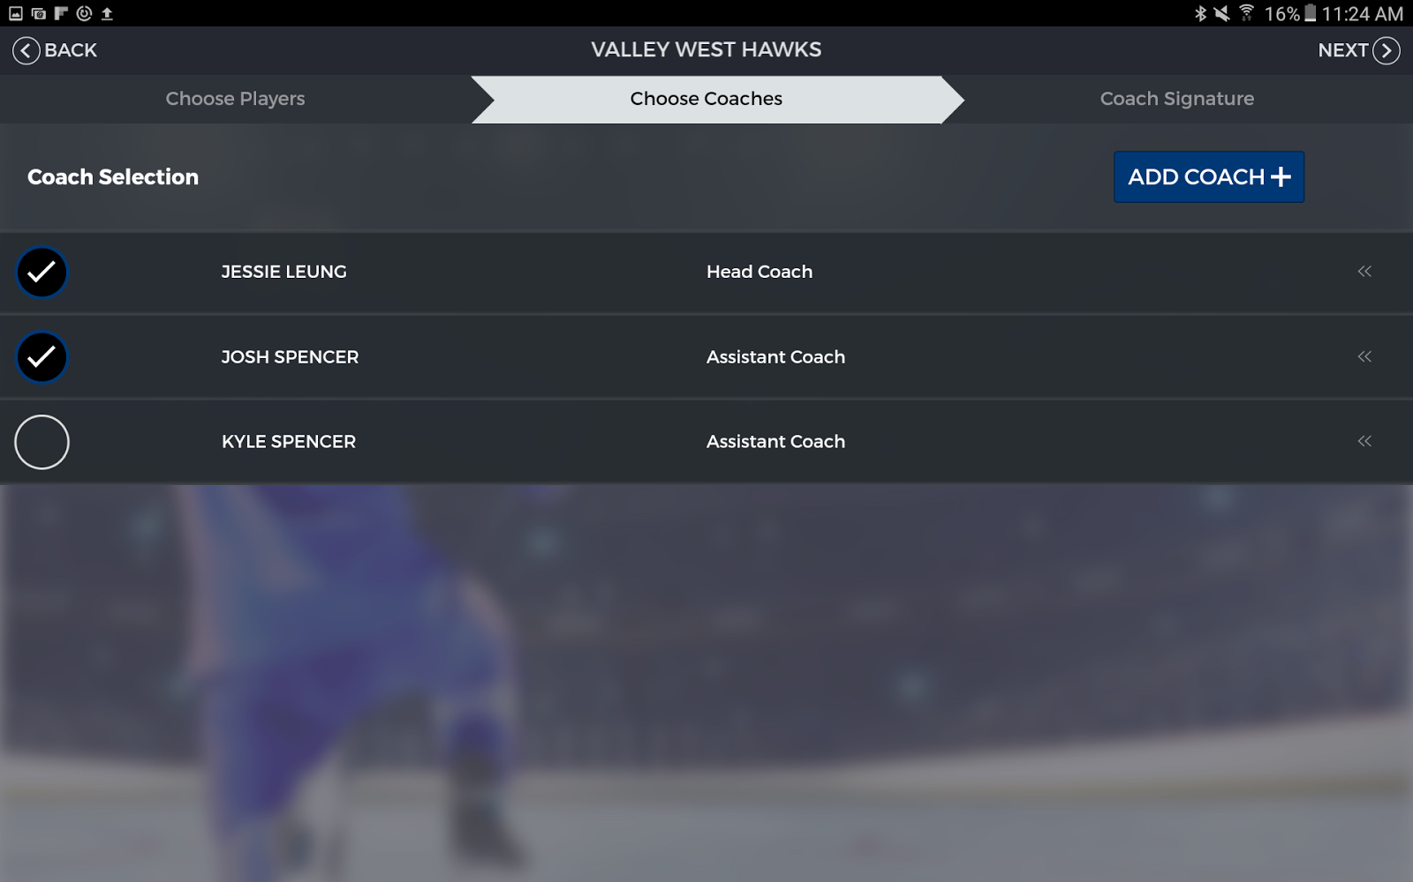
This is where you would select the coaches. Again, if a coach is missing, you can add him.

Slide 9
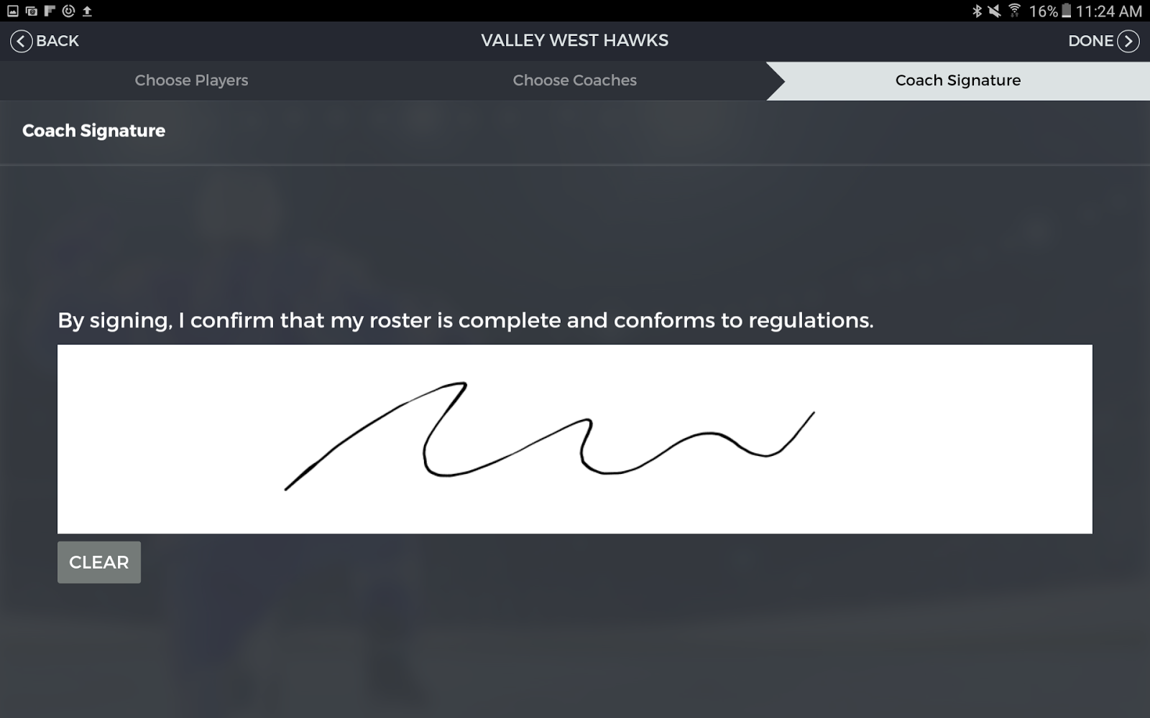
This is the last step to the team roster selection. A coach has to verify and approve the lineup by signing in the box and hitting “done”

Slide 10
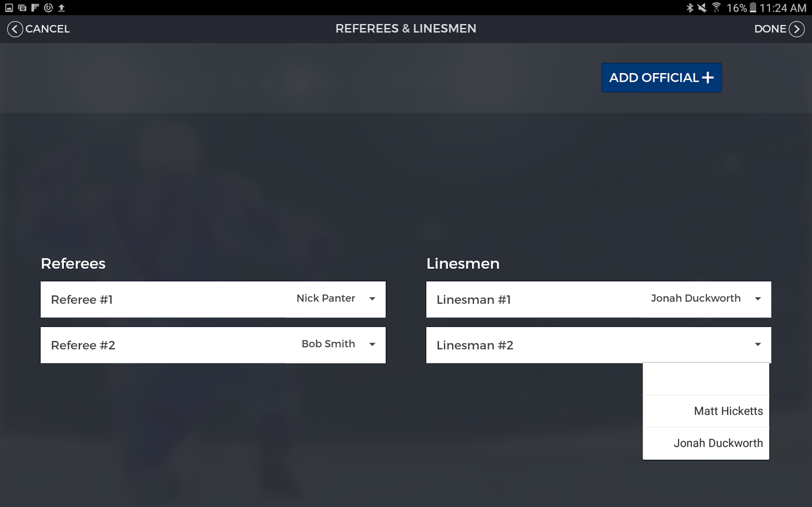
This is the referee and linesmen selection screen. Fill in by using the dropdowns and add official if necessary.

Slide 11
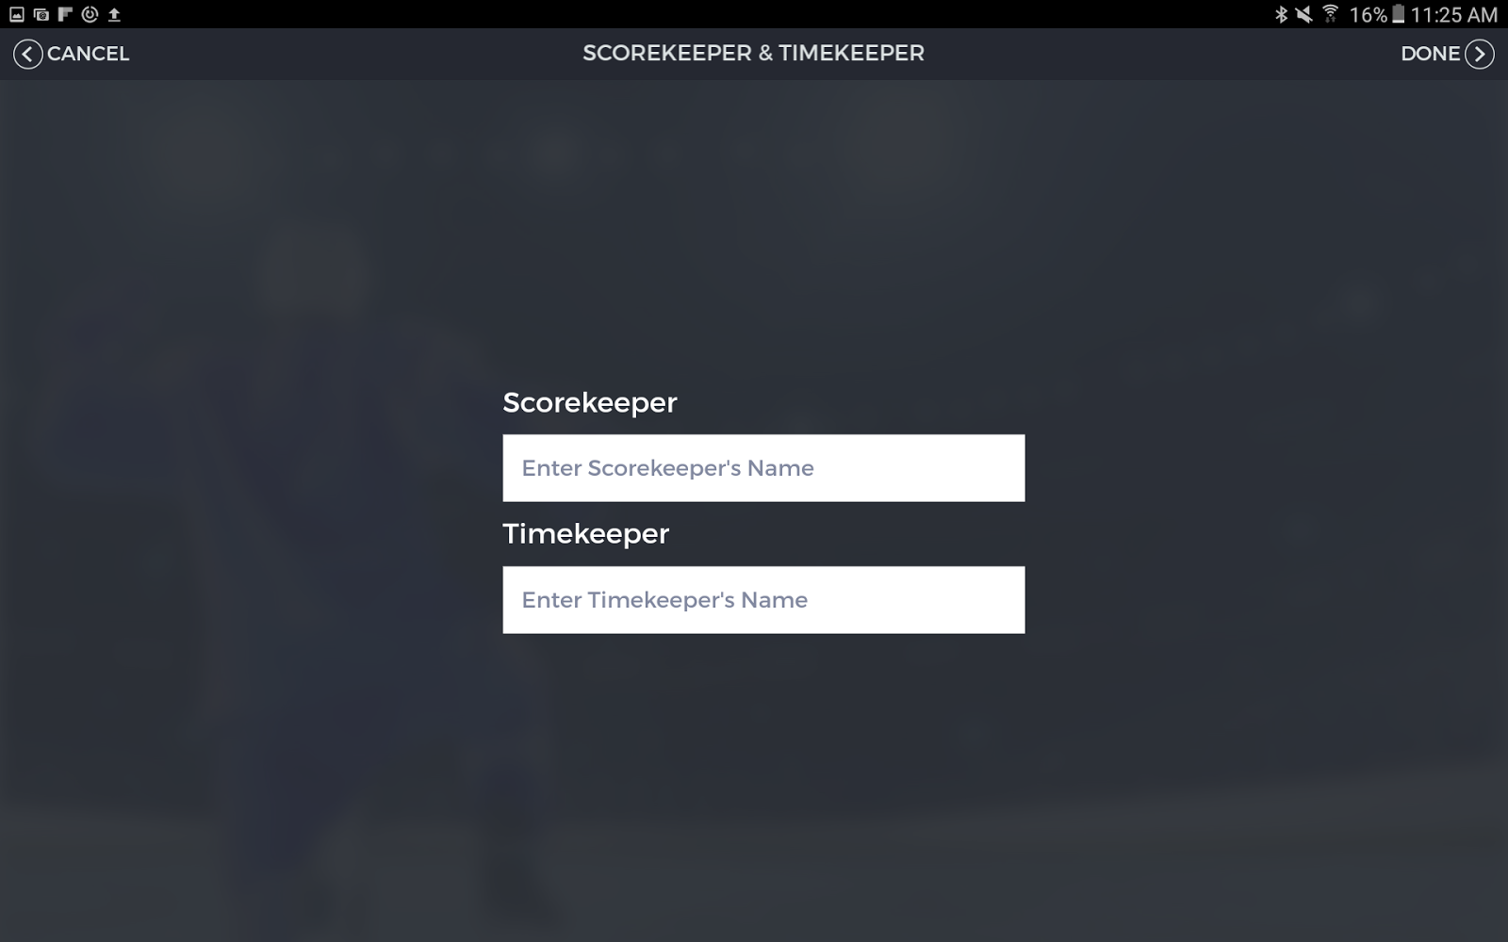
This is the scorekeeper and timekeeper selection screen. Just enter the names and hit “done”.

Slide 12
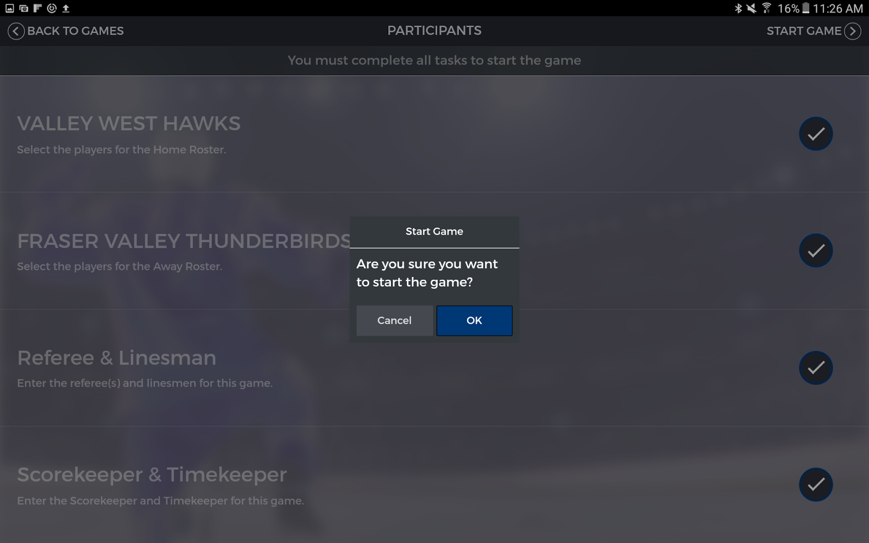
Once all the rosters are filled, you can then start the game. From this point on once you hit “ok”, you will not be able to go back to edit the lineups.

Slide 13
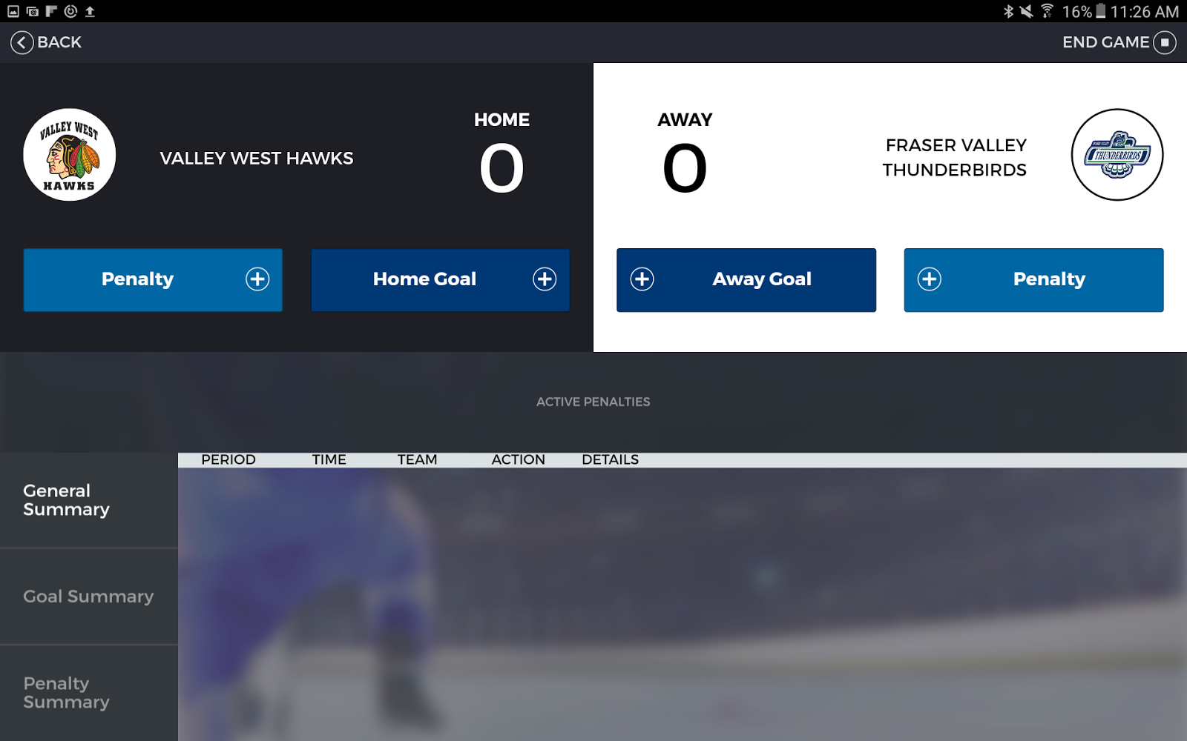
This is the main “in-game” scorekeeping screen.
You can add penalties and goals. All penalties will show in the general summary. You can toggle between general/goal/penalty summary to filter the summary.

Slide 14
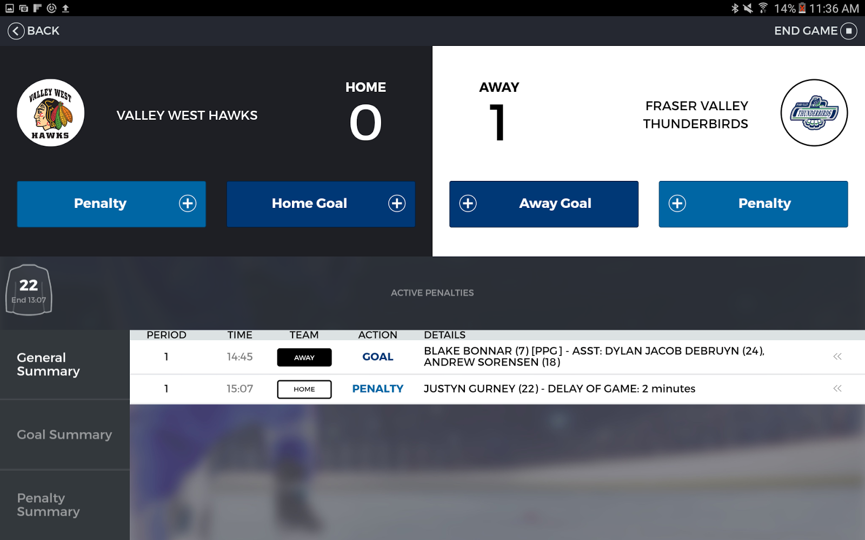
You can also see what penalty is active and can end them by holding the jersey (where the 22 is in the screenshot above).

Slide 15
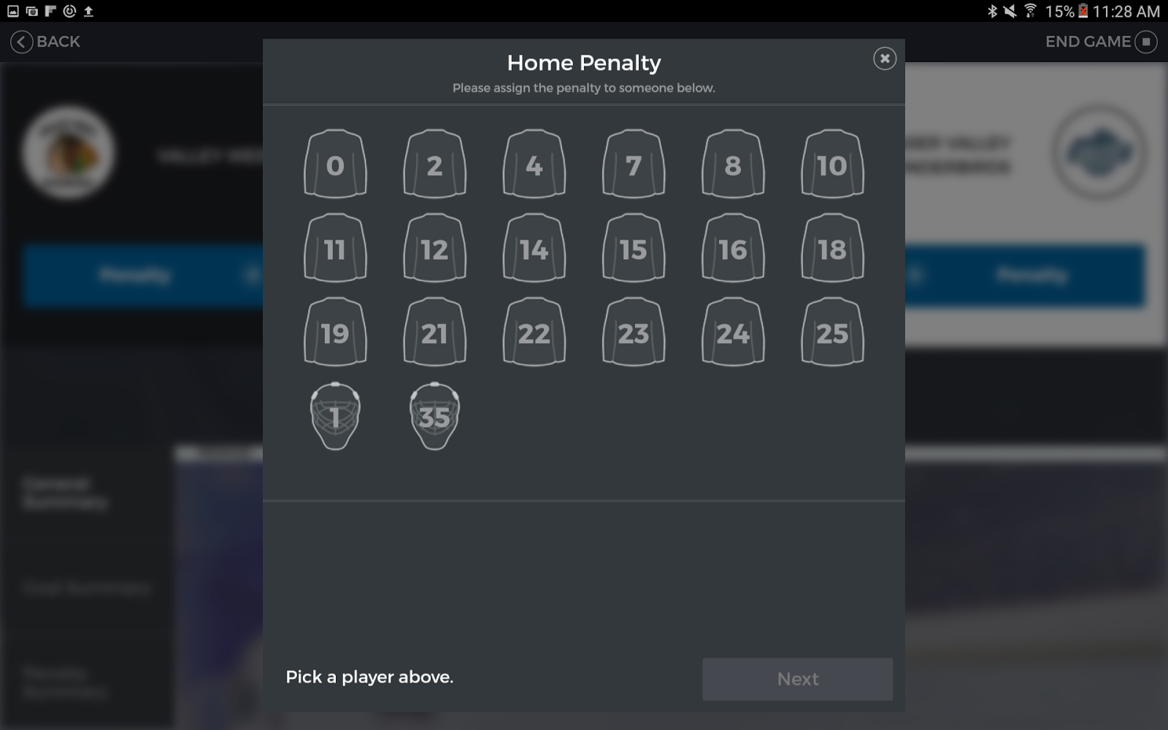
This is the process to add a penalty. First you pick a player.

Slide 16
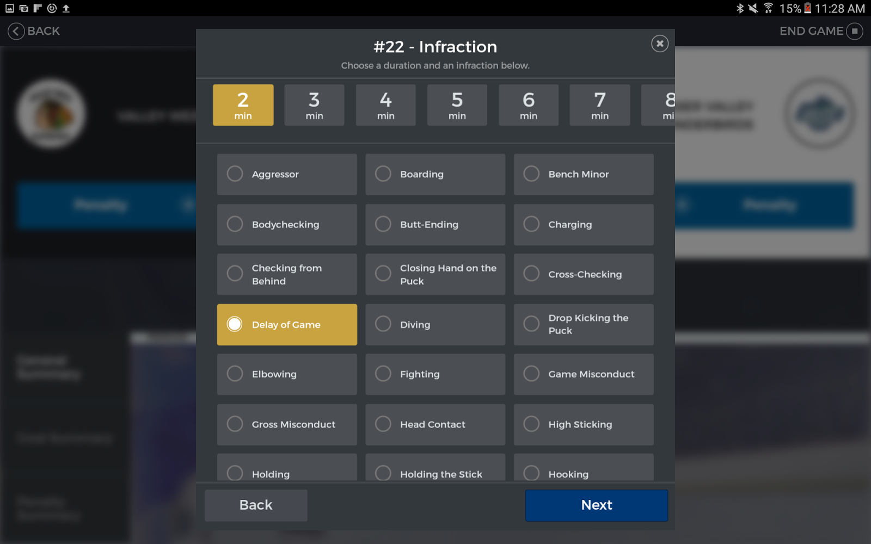
This is where you pick the penalty type and the time.

Slide 17
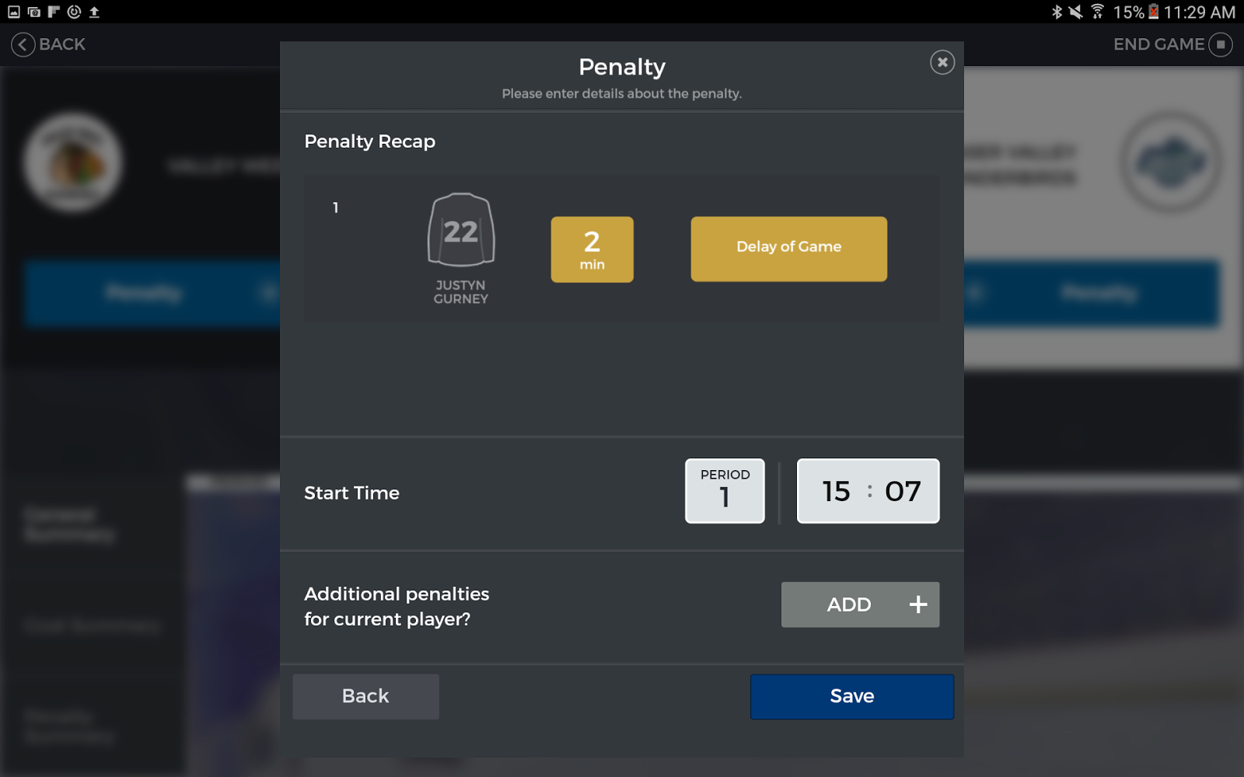
This is the last step to the penalty process. This is where you would enter the period and time and possibly add additional penalties to the player if necessary.

Slide 18
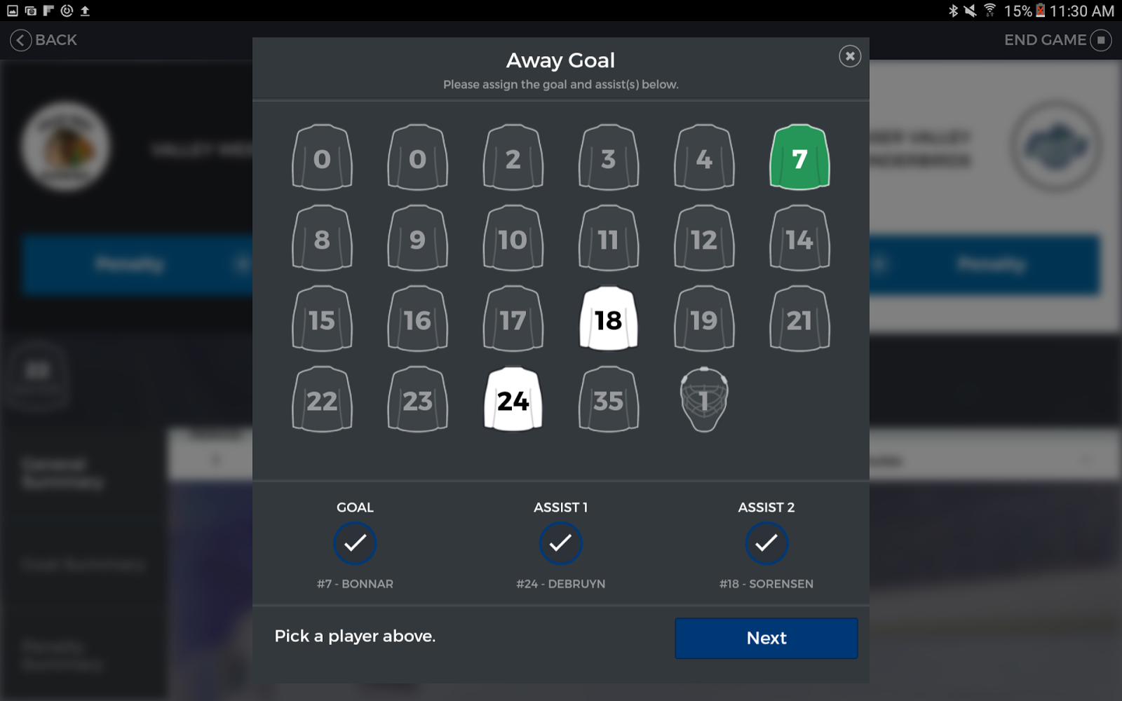
This the add goal process. First you select the goal scorer then select the two assists in the proper order. You can easily toggle around to change the goal scorer / assists.

Slide 19
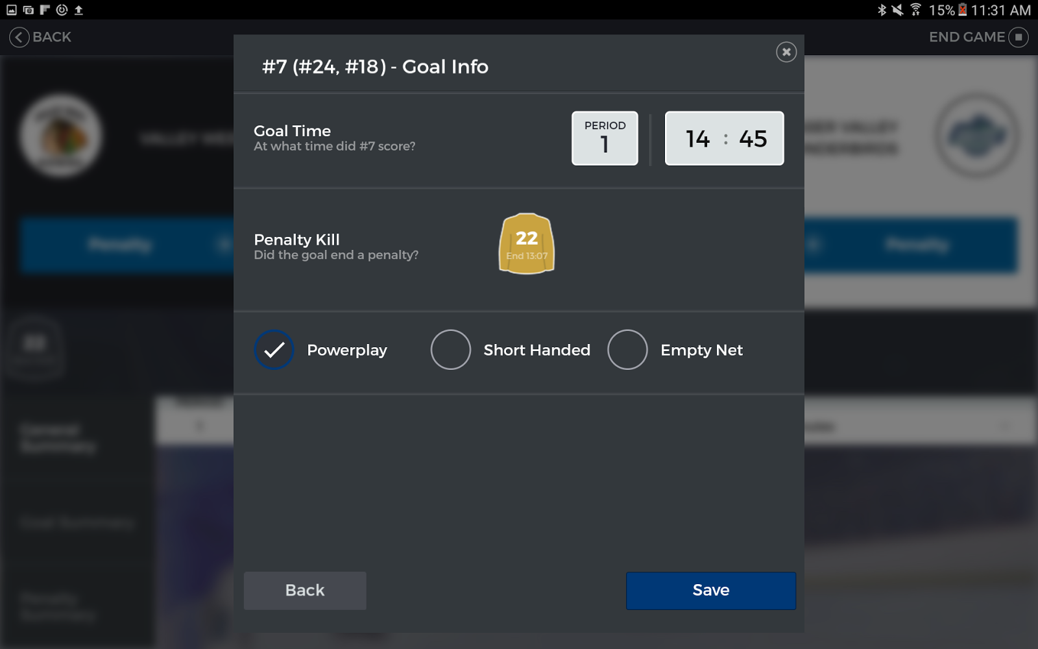
This is part of the add goal process.
This is where you specify the period and time.
You can also end a penalty which will remove it as an active penalty on the main scorekeeping screen.
You can also specify if the goal was powerplay / short handed / empty net.
Note: In the event of a shootout, only the last goal (game winning goal of the shootout) should be recorded. The period would be “SO” (you can select from the dropdown).

Slide 20
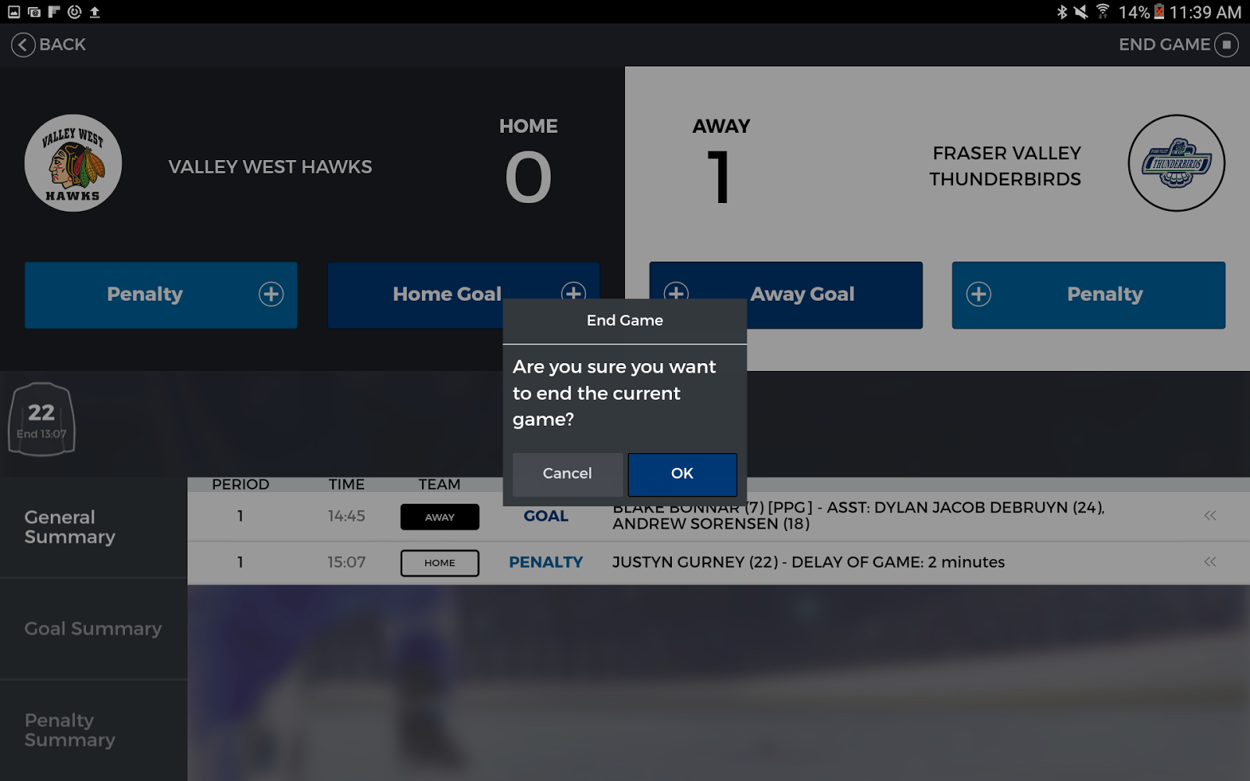
Once all the scorekeeping is done, you can end the game. Remember you can’t go back at this point unless you have the proper role (login).

Slide 21
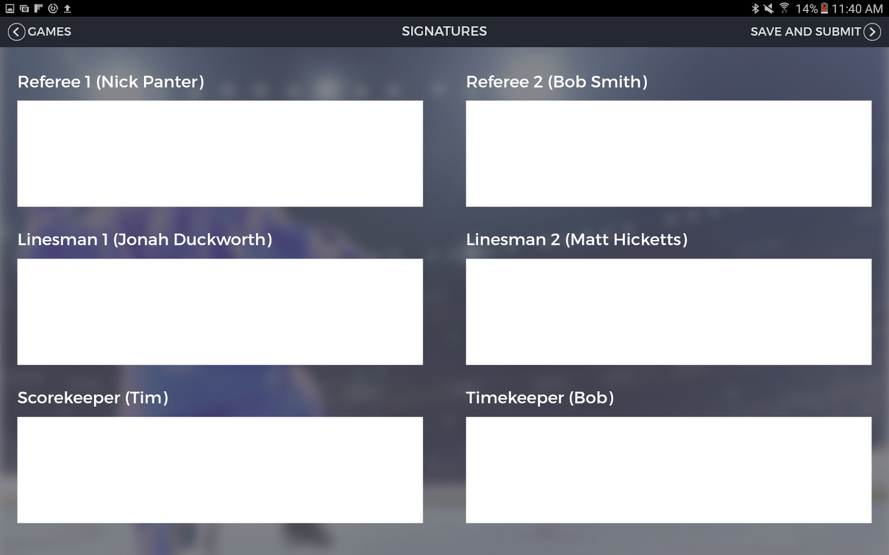
This is the last step to scorekeeping. This is where you would gather around all the signatures to “approve” the game. Then hit “save and submit”.

Slide 22
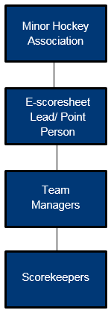
Roles Required?

Slide 23
Minor Hockey Association:
Responsible for the implementation of E-scoresheets within their Association, to provide at least one “point/lead” person to be trained in the operation of the E-scoresheet.

Slide 24
Lead/Point Person:
Responsible for knowing the complete operation of the
E-scoresheets. Would be the “go to” person in local MHA. This person will liase with BC Hockey representative. Training and support will be provided by BC Hockey. District training session followed by regional/area sessions too.

Slide 25
Team Managers :
Will oversee the scorekeepers of their individual teams. This person will liase with MHA lead/point person.

Slide 26
Individual scorekeepers:
Will use the e-scoresheet to record individual games. This person will liase with the Team Manager.

Slide 27
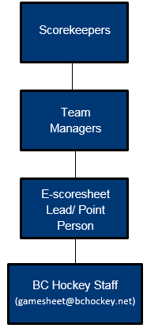
Communication

Slide 28
Communication: Support info: gamesheet@bchockey.net This will generate an automatic reply -Thank you for submitting your game sheet, a response will be provided within 24 hours. In the event that assistance is needed for a current game, please record the game details in a written format until the information can be transferred to the electronic game sheet. This should be done immediately after the game is completed.

Slide 29
Video Tutorial

