Slide 1
OMHA Coach Meeting
Oct 4th 2017

Slide 2
Agenda
Player Health
Return to play
Mentoring Programs
Officials
Fair Play:
Player Affiliations
Driving Policy
Code of Conduct
Coach – Team Responsibility/Accountability ends with you.
Questions

Slide 3
Player Health & Wellness
Bob Dunlop - Summit

Slide 4
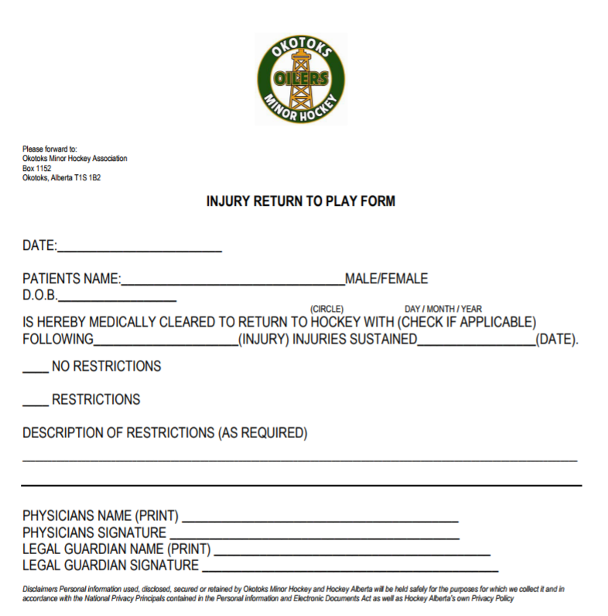
Return to Play
RETURN to PLAY

Slide 5
Coach Mentoring
Novice
Atom
Pee Wee
Bantam
Midget
Jamie Steer
Jay Langager

Slide 6
Officials
Greg Schmidt
Novice
- Blows the whistle
- knows how to drop the puck
- knows the basic positioning on the ice
- understands what an offside is, and what an icing is. Will make the obvious calls
- understands what a penalty is, and the basics around them
In Novice if they understand the above then it is a success. It is more then just making offside calls, and penalties but rather the basics of officiating. If during the game they make 25-50% of what is happening on the ice then we are happy.
Atom, Pewee, Bantam, Midget…we expect more and look for different things, as we expect by pewee, or atom 1 or even Novice 1 that they know how to blow their whistle and know the basics of the craft. When we get into those older divisions with the officials we focus more on penalties, specifics on the offside (inside / outside lines) and other things, and advanced positioning, as well as game management, coach management, player management etc.

Slide 7
Fair Play
We can feel the excitement building in Okotoks as we begin the Hockey season. As we prepare to select Coaches for each division the OMHA Board wanted to thank every coach who has completed an application and in some cases gone through the interview process. The organization is bursting with potential candidates and we thank each of you for your commitment and development to OMHA Hockey.
As we prepare to make coach selections for the season we wanted to send a few reminders as well as some important processes we trust you will find in order.
Fair play basic, non-negotiable rules: SHOW RESPECT; PLAY SAFE; WORK HARD; HAVE FUN
With these in mind, players on every team will receive fair ice time, be exposed to all situations, and be given opportunities to play in and learn from those situations. This means at the minor hockey league level and OMHA guidelines No child will miss a shift out of rotation throughout the season. This is something we will be working very hard at and concerned with. We cannot tolerate misuse. Abuse of the Fair play guidelines and failure to participate my result in suspension or revoking the coach.
EQUAL ICE: Is defined as equal ice-time every game to the best ability of the coach, allowing for the uncertainty in the frequency in stoppages of play.
The OMHA Hockey Development Program operates and encompasses the Coach Mentorship Program and the Player Development Program. The mission of the OMHA is to provide the support and resources necessary to aid in the successful development and continued learning of all of our coaches and players as members of the Okotoks Minor Hockey Association.

Slide 8
Affiliation of Players
Affiliated Players moving up
Affiliated Players to OOAA
Practices & Games be reasonable when requesting.
Bantam/Midget AA Player coming down into T1
Affiliation

Slide 9
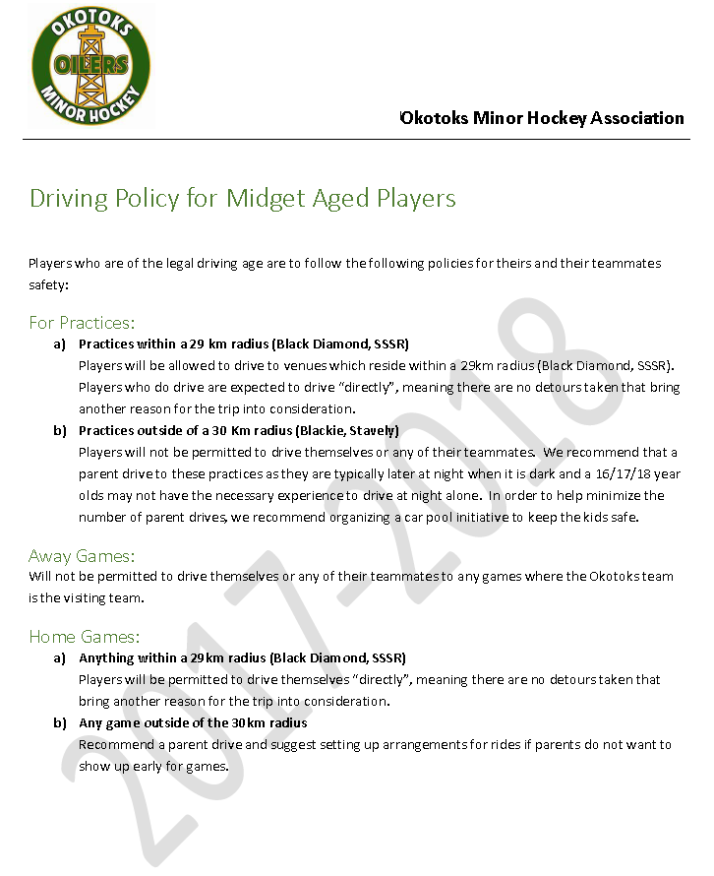
Driving Policy
Driving Policy

Slide 10
Team Code of Conduct
-Code of Conduct signed by all parents/Players
Parent and Player Code of Conduct

Slide 11
Responsibility
Head Coach
Development
Team finances
Player rankings confidential

Slide 12
Questions…

