Slide 1
Richmond Minor Hockey Association
Awards Night and
Annual General Meeting 2016

Slide 2
114 Intro and H1 Players Fueled our Growth

Slide 3
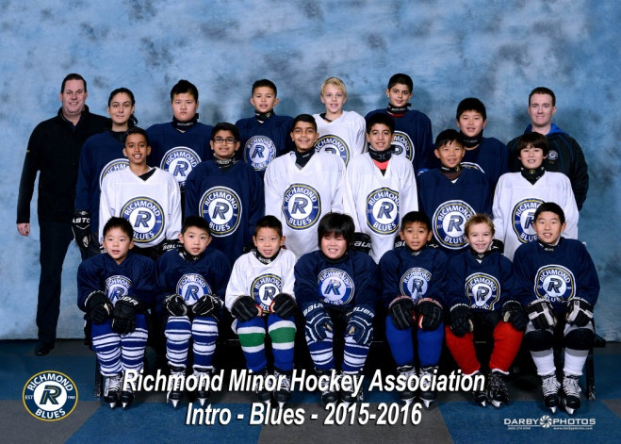
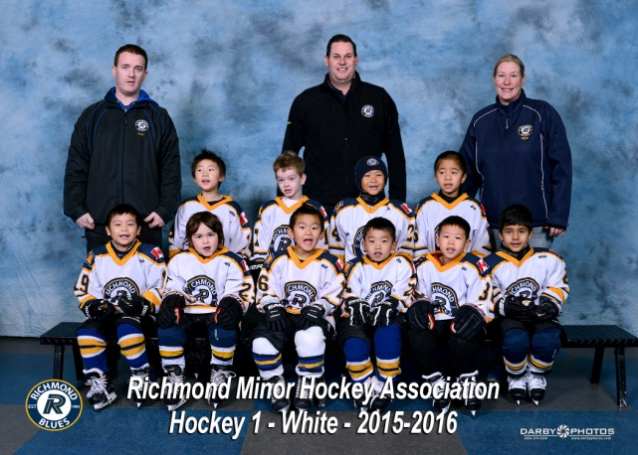
A 10% Increase in Overall Registration
Looking ahead, that’s 4 additional novice teams next season.
Notes:
A Special Thank you to Carolynne Palla, Steveston Insider and Tanya

Slide 4
2015 16 Team Success
In our Rep and C Divisions

Slide 5
Two Trips to the Final Fours – Juvenile A1

Slide 6
and Atom A1

Slide 7
And a Presidents Series Banner for Midget A1

Slide 8
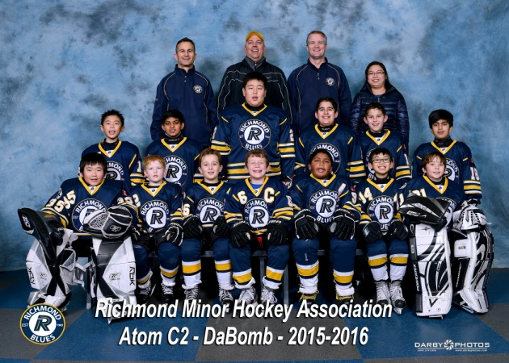
Congratulations to our 6 PCAHA Presidents League Playoff Winning Teams

Slide 9
Outstanding Success in our “C” Divisions
3 Teams Finished Presidents C League Play in 1st Place
7 Teams earned places in PCAHA Championship Playoff games.
6 Teams won their Playoff Championships
Atom C2
PeeWee C1
Midget C2
Atom C1
Atom C2
PeeWee C1
PeeWee C3
Bantam C1
Midget C1
Midget C2

Slide 10
Referee Development
An on-ice clinic with former RMHA referee, now NHL referee, Trevor Hanson.

Slide 11
Fiscal Responsibility

Slide 12
Notes:
After Ice Rental, Player, Coach and Referee Development is our largest expense.
Together, Ice Rental and Development consume 73% of our budget.

Slide 13
Assessments by Other Organizations -
Richmond Arenas Community Association $1,410
Pacific Coast Amateur Hockey Association $14,287
B.C. Hockey $25,481
Approximately $77 per player cost per player $77.00
Notes:
These are usually on a per player basis.
This shows that the first $77 of your registration goes toward assessments.

Slide 14
Keeping Registration Fees as Low as Possible
Running profitable, well-attended tournaments
Applying annually for a BC Gaming Grant
Applying for Sport Hosting Grants
Attracting and retaining Sponsors
Working Cooperatively with others

Slide 15
A Huge Thank You to Our Sponsors

