Slide 1
SOUTHWEST KC MANAGERS’ MEETING October 18, 2018
CANDACE COOK
SOUTHWEST KC MANAGER MENTOR
MENTOR@SOUTHWESTKC.CA

Slide 2
Introductions

Slide 3
Agenda
Managers’ Manuals and Resources
Hockey Edmonton resources
Southwest KC resources
KC West resources
2. Team Administration
Managers’ To Do List
3. Game management
Scoresheets
RAMP
4. Team building activities
5. Fundraising activities
Team level
Club level
5. Questions

Slide 4
Manager’s role
“The Team Manager is a central figure in creating the flow of communication – not only within the team (players, parents and coaches), but between the team and all support systems such as the Minor Hockey Association, Division Managers, League Managers, other teams, referees and officials. By taking on the operational aspects of the team, the manager enables the coach to focus on player development and on-ice instruction to provide the players with rewarding hockey experiences.”
- Hockey Canada Manager’s Manual

Slide 5
Managers’ Manuals and Resources
Hockey Edmonton Managers’ Manual
http://www.hockeyedmonton.ca/content/managers-manual
Includes:
Example Game Sheet
Penalty Abbreviation List
Hockey Edmonton Manager's Meeting Presentation (October 3/9, 2018)
Hockey Edmonton Travel/Event Permit Information

Slide 6
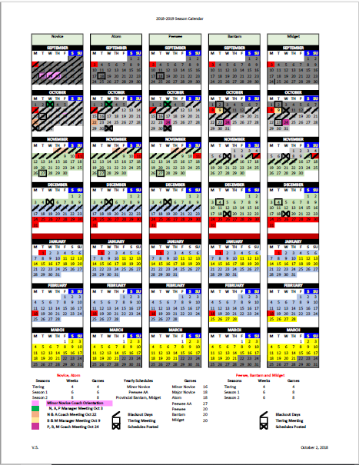
Managers’ Manuals and Resources cont’d…
Hockey Edmonton 2018-2019 Calendar

Slide 7
Managers’ Manuals and Resources cont’d…
Southwest KC Managers Tab http://www.southwestkc.ca/
Includes:
Team Manager Handbook
Team Manager To Do List
Team Opportunities
Sample Volunteer Sign-up Sheet
Tournaments Info
Sample Team Budget
Sample Wallet Card

Slide 8
Managers’ Manuals and Resources cont’d…
KC West Managers Tab http://www.kcwesthockey.com/
Includes:
Team Manager Info - Getting Started
Misc. Manager Forms and Resources
Team Level Fundraising
Tournaments

Slide 9
Team Administration
Manager’s To do list
KCW and SWKC To do lists posted on websites
Team meeting
Volunteers
Team priorities (parties, extra ice, tournaments, etc.)
Team budget
Fundraising

Slide 10
Team Administration cont’d…
Manager’s To do list
2. Admin
Name bars
- order set of 2 name bars for those who need them
United Cycle or Rainbow Sportswear
Cost $12 – $20/set if stitching included

Slide 11
Team Administration cont’d…
Manager’s To do list
2. Admin
Coach jackets (for new coaches ONLY)
SWKC – coach orders through online store by Oct 19, submits receipt for reimbursement to SWKC treasurer
KCW – manager collects sizes for new coaches and email to communications@kcwesthockey.com

Slide 12
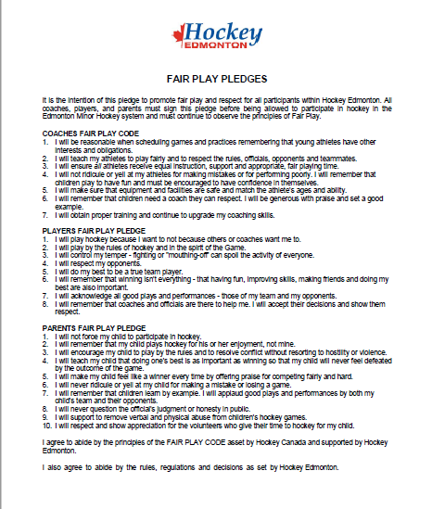
Team Administration cont’d…
Manager’s To do list
2. Admin
Fair Play Pledge, Hockey Edmonton website

Slide 13
Team Administration cont’d…
Manager’s To do list
2. Admin
SWKC Coach Expense Form
KCW Cheque Request Form

Slide 14
Game Management
Game sheets
Recruit volunteer(s) for scorekeeping/timekeeping duties
Prepare game sheet roster stickers
Ensure scorekeeper is assigned to each game
Share Hockey Edmonton instructions for filling out game sheets with volunteers
Enter game sheet results into RAMP if home team,
or verify results in RAMP if away team

Slide 15
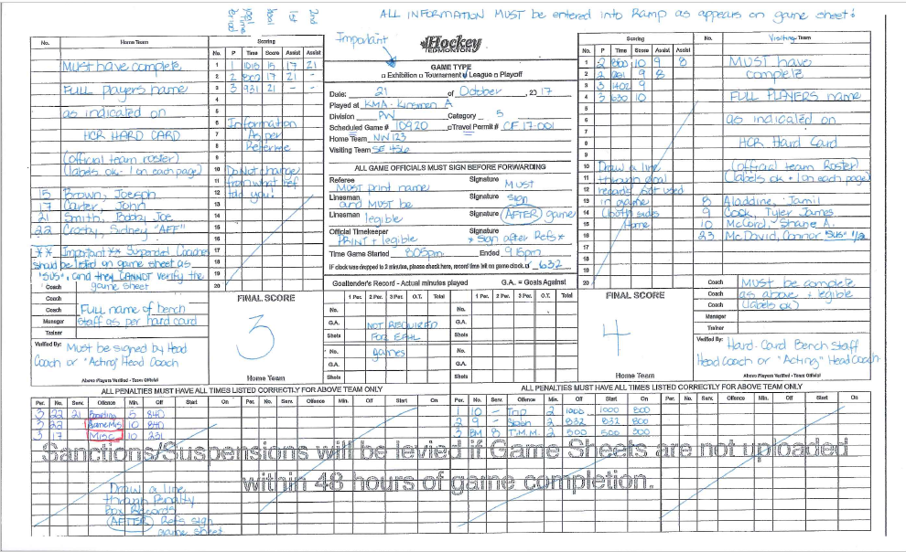
Game Management cont’d…
Game sheets

Slide 16
Game Management cont’d…
2. RAMP
Game sheets must be entered into RAMP within 48 hours of game
If not entered within 48 hours, your coach may be suspended
Hockey Edmonton Managers Meeting Presentation has step-by-step instructions for entering game sheets into RAMP
http://cloud.rampinteractive.com/hockeyedmonton/files/Website%20Information%20Presentation%20v2.pdf

Slide 17
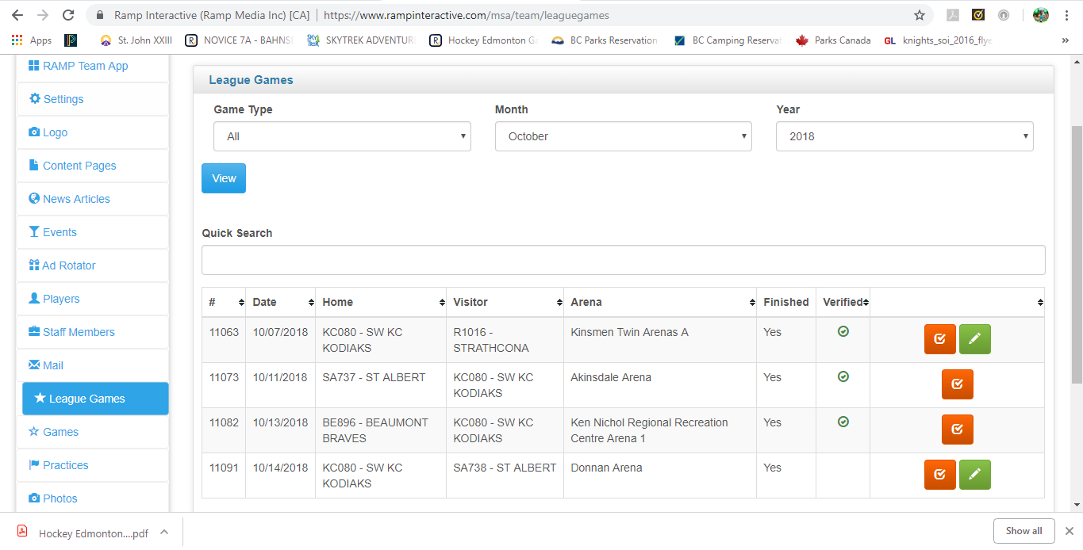
Game Management cont’d…
2. RAMP

Slide 18
Team Building Activities
1. Parties (Kick-off, Christmas, Wrap-up)
2. Community sponsors:
Dodge Caravan Kids (Novice only)
Chevrolet Good Deeds Cup (Peewee only)
Rogers Hometown Hockey Contests
Edmonton Oil Kings
U of A Golden Bears Kids in the Crowd

Slide 19
Fundraising Activities
Team Level
SWKC and KCW both have excellent lists of fundraising opportunities on websites
Recruit volunteers from team to help manage fundraising activities
Review team budget to determine fundraising goals
Setup team bank account to deposit funds

Slide 20
Fundraising Activities
Club Level
Managers of combined KCW/SWKC teams tasked w managing both club level fundraisers
May want to recruit a volunteer from each club to manage their club’s fundraiser at team level
Details of SWKC Silent Auction and KC West Pub night emailed to managers on Oct 16
collection by Oct 27 (SWKC) and Oct 31 (KCW)

Slide 21
Tournaments
Local
Discovery, Junior, and Senior TIMBITS
Fall Festival, December 15, Terwillegar
Winter Jamboree, March 16 – 17, Terwillegar
Minor Novice Winter Jamboree, March 9-10, Terwillegar
Novice Major, Atom, Peewee Quickcard Minor Hockey week, Jan 12 – 21, various rinks
Automatic registration

Slide 22
Tournaments cont’d…
2. Out of town
Inquire early, they fill up fast
Team must pay tournament fees through fundraising or cash call, club will not cover cost
Discuss with coach and team, decide how many tournaments the team will attend and set budget

Slide 23
Tournaments cont’d…
2. Out of town
Search for appropriate tournament by tier and submit application/registration forms
Hockey Alberta list of sanctioned tournaments https://www.hockeyalberta.ca/tournaments/
Hockey Calgary tournaments list https://www.hockeycalgary.ca/tournament/listings

Slide 24
Tournaments cont’d…
2. Out of town
Permits are required for out of town tournaments
Managers can apply for 4 different permits through RAMP (Exhibition Game Permit, Tournament Permit, League Game Reschedule Permit, and Out of Town Practice Permit)
Permit instructions can be found in Hockey Edmonton Managers Meeting Presentation
Out of province tournament permits are managed by Hockey Edmonton Discipline Chair

Slide 25
Final Comments and Questions
Thank you for coming!

