Slide 1
A new parent program introduced by BC Hockey, in partnership with the Vancouver Canucks

Slide 3
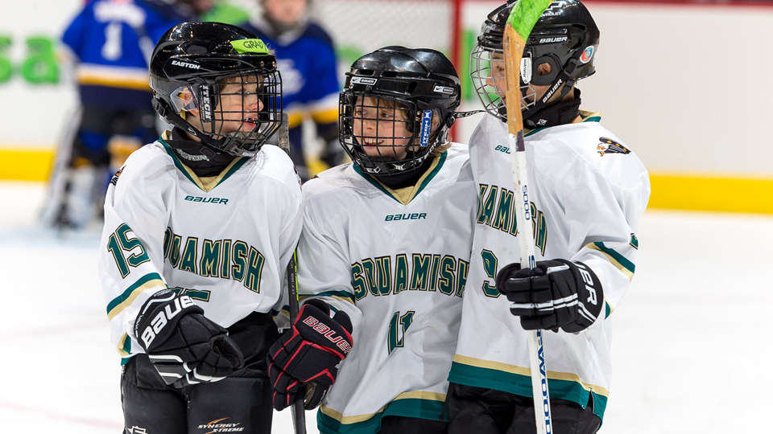
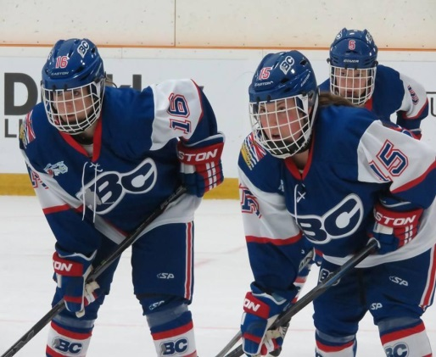
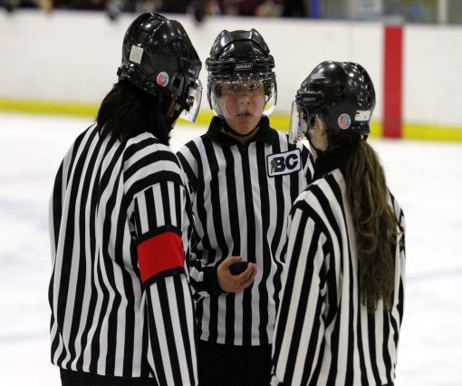
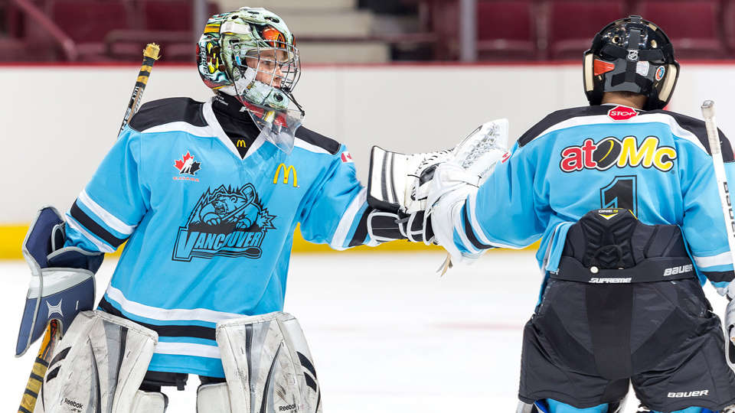
Parents, What Should We Be Looking For From The Game?
A fun, safe, positive environment to play the game
A place to:
Learn to be a team player
Make life-long friends
Learn to be a gracious winner or loser
SPORTSMANSHIP
STARTS IN THE STANDS

Slide 4
Being a Hockey Parent Is No Easy Task
Hockey parents are often called upon to wear many different volunteer hats, some of which result in conflicting roles.
Hockey Canada is committed to helping those parents meet these challenges to ensure they continue to enjoy the game and have as much fun as their kids.
SPORTSMANSHIP
STARTS IN THE STANDS

Slide 5
Player to Parent Relationship
What Are the Motives of a Player?
A positive first hockey experience
Fun
Making friends
Emulating a hero
Playing like mom/dad
Is there a difference between a 16 year old and a 5 year old?
SPORTSMANSHIP
STARTS IN THE STANDS

Slide 6
Player to Parent Relationship
Parent Roles and Responsibilities
Focusing on your child’s enjoyment
Support your child’s endeavors
Model acceptable behaviour to your children
Reaffirming your child’s self confidence during practices and games
Keeping your player focused on participation and fun, not results
Parents need to be positive, understanding, and responsible!
SPORTSMANSHIP
STARTS IN THE STANDS

Slide 7
Notes:
Add explanation to speaking notes

Slide 8
Parent to Coach Relationship
Coaches and Parents
Respect coaches’ duties, goals and responsibilities
Always be positive and respectful when communicating with coaches.
Let the coaches coach
24 hour rule
SPORTSMANSHIP
STARTS IN THE STANDS

Slide 9
Parent to Coach Relationship
Value-Based Coaching
What is value-based coaching?
There are many values that coaches relay to players through words or actions, including responsibility and respect.
Parents need to work in conjunction with coaches to ensure your children take these values to heart.
SPORTSMANSHIP
STARTS IN THE STANDS

Slide 10
Parent to Coach Relationship
Value-Based Coaching
Parents must work with coaches to reinforce learned values
Children constantly look to coaches for instruction and approval
Most coaches are volunteers
Respect must be practiced toward all parties involved, all the time!
SPORTSMANSHIP
STARTS IN THE STANDS

Slide 12
Parent to Parent Relationship
Affecting Change in Parents
The “silent majority” – most people do not express their opinions publically
group dynamics and effective problem solving
Interact respectfully and responsibly with other parents
Let communication and common sense help during difficult times
SPORTSMANSHIP
STARTS IN THE STANDS
Notes:
Need explanation as to what the “silent majority is’
Keeping In Touch:
Communicate season objectives with coaches and other parents
Parents meeting and reps: Let’s all be on the same page
Keep hockey a fun social event for parents
This is the manager or Team parents responsibility not individual parents.

Slide 13
Parent to Parent Relationship
Fostering Parental Respect and Responsibility
In the heat of the moment – respect and responsible behavior first!
Model expected behavior for your player at all times
The onus is on ALL parents to act in preventing unacceptable conduct
SPORTSMANSHIP
STARTS IN THE STANDS
Notes:
How We Help Parents
Communication is key – videos, initiatives, pamphlets, other information
Examples: First Strides, Chevy Safe and Fun, ESSO Fun Days, Team First, Jamborees
These are MHA’s or Districts or BCH responsibilities – not the parents.

Slide 14
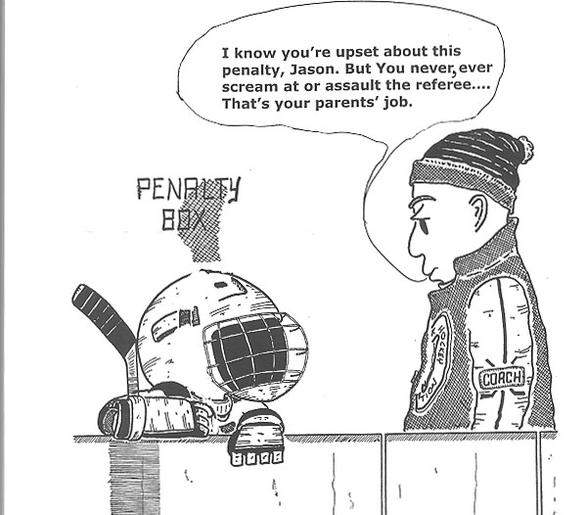

Slide 15
Parent to MHA Relationship
How can you get involved with your MHA?
How to become involved as a volunteer
Attend the AGM
Read the policy manual
Attend meetings and learn how your association operates
The benefits of being a volunteer
Lifetime friendships
Can be a positive role model for your child
Share your love and experiences in sport
SPORTSMANSHIP
STARTS IN THE STANDS

Slide 16
Parent to MHA Relationship
Implementation of Educational Programs
Educational Programs available for coaches, officials and risk managers
Respect in Sport, etc.
Parent education and awareness programs available
The importance of encouraging these programs locally
SPORTSMANSHIP
STARTS IN THE STANDS

Slide 17
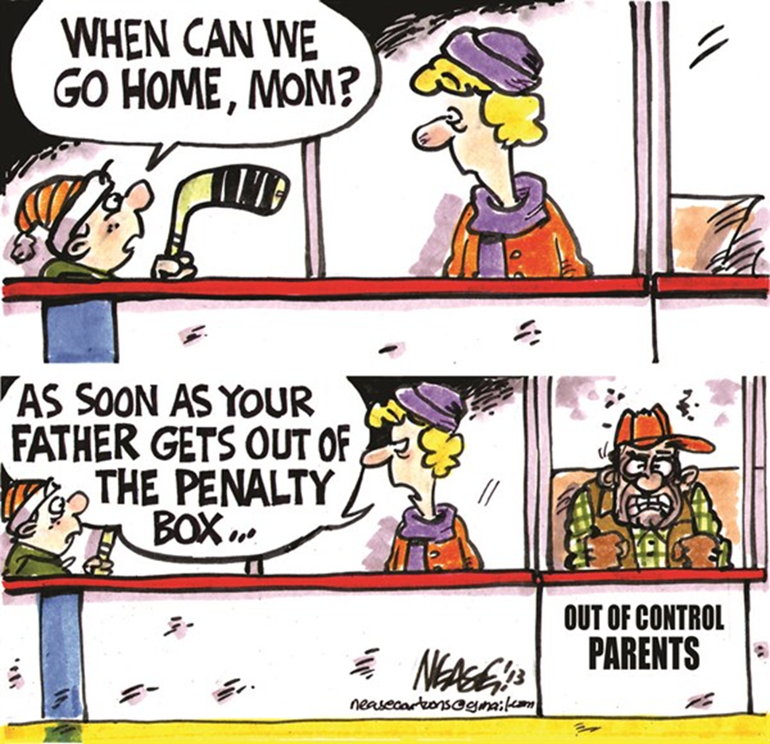

Slide 18
What Does Your MHA, Branch and Hockey Canada Expect From You as a Parent?
To focus on the kids having a fun, positive experience
To hold high but reasonable expectations
To promote the balance between hockey and life
To always model positive, responsible behaviour
To treat all those involved with respect!
SPORTSMANSHIP
STARTS IN THE STANDS

Slide 19
What Does Your MHA, Branch and Hockey Canada Expect From You as a Parent?
Where there is disagreement or conflict, expressing views and opinions in a respectful manner is vital
Emphasize important values such as:
Sportsmanship
Cooperation
Fairness
Respect
Excellence
Teamwork
SPORTSMANSHIP
STARTS IN THE STANDS

Slide 20
MHA Policies
MHA to insert Text
SPORTSMANSHIP
STARTS IN THE STANDS

Slide 21
Complaint Procedure
MHA to insert Text
SPORTSMANSHIP
STARTS IN THE STANDS

Slide 22
A new parent program introduced by BC Hockey, in partnership with the Vancouver Canucks

