Slide 1
Etobicoke Stingers – Season 2023/24

Slide 2
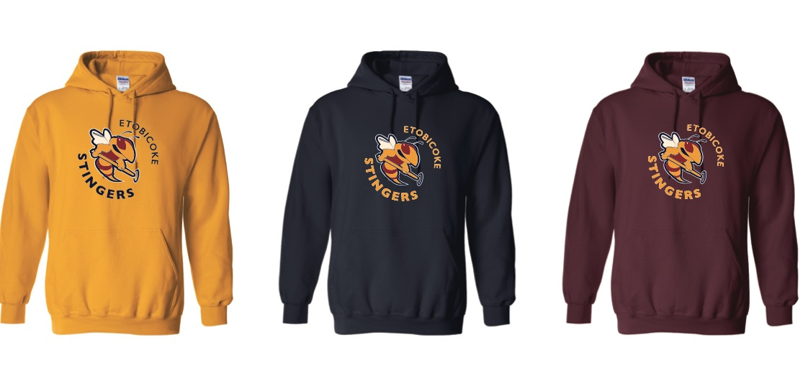
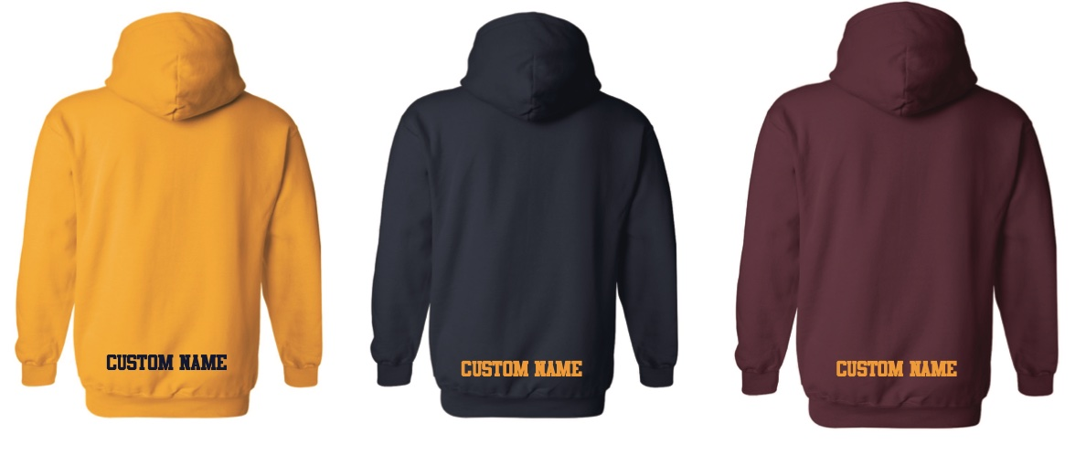
Gildan Fleece Hoodies
50/50% Cotton Poly fleece hoodie
Available in Navy, Gold and Maroon in all sizes
Classic fit
Youth S-XL (no hood string) – $50 each
Adult S–XL - $50 each
2XL-3XL – $55 each
Names only available - additional $10

Slide 3
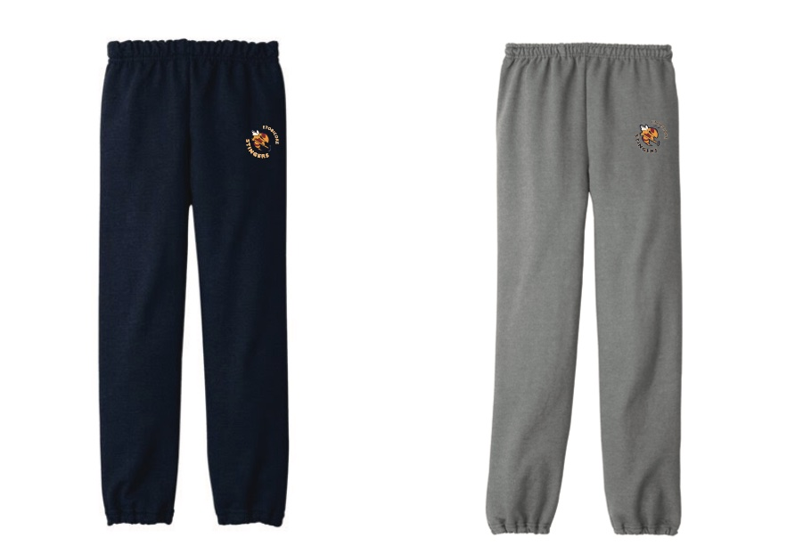
Gildan Grey/Navy Jogger
13.3-oz, 50/50 cotton/polyester fleece
Elastic waistband
Elastic cuffs
Youth S-XL - $40 each
Adult S–2XL - $45 each
No personalisation available

Slide 4
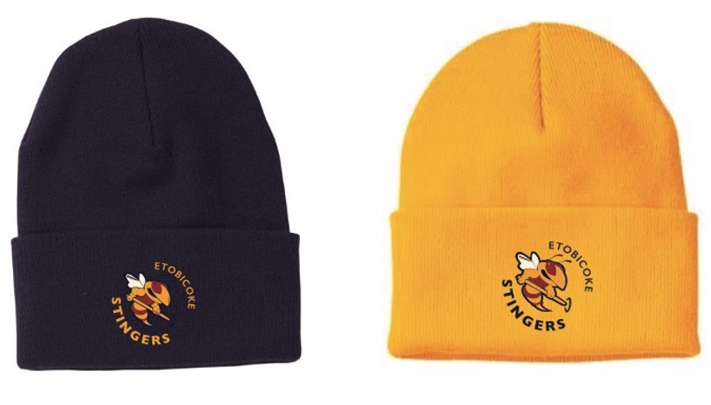
Toques/Hats
Toque
100% Acrylic
Hat
100 %cotton Twill
Adjustable hook /loop closure
One Size– $25 each
No personalisation available

Slide 5
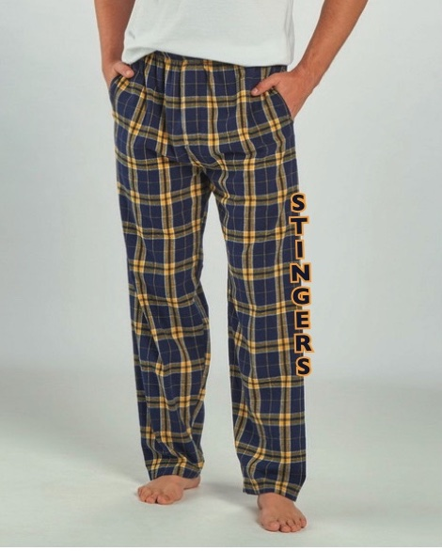
Boxercraft PJ Bottoms
Unisex 100 % cotton flannel PJ bottoms
Sizes – XXS- 3XL
(refer to sizing chart on next page)
Cost - $50 each

Slide 6
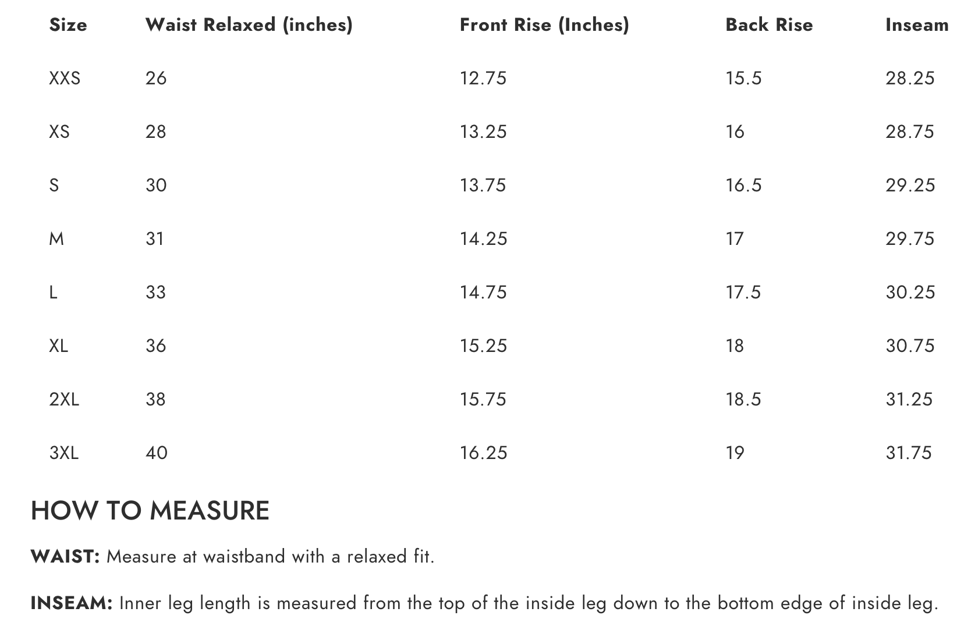
Sizing Chart for Unisex PJ Bottoms

Slide 7
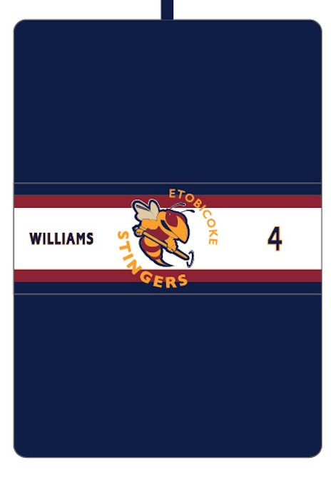
Player Garment Bags
Custom player garment bags
One size
600 Denier polyester
Full zipper on back side
Cost - $50 each
Includes : Name /Number/ or only logo

Slide 8
Terms & Conditions
All pricing includes taxes, set ups and shipping
Substitutions may be applicable on certain items due to backorders/out of stock
Please allow approx. 4 weeks for delivery
Payments are made via credit cards Visa/MC, or etransfer
For additional information please contact - Toni Cooke – toni@blue-hippo.com

