Slide 1

Etobicoke Stingers – Season 2023/24

Slide 2

ATC
Cotton T Shirts
9.1-oz, 100% Cotton
Available in Navy and Gold for all sizes
Classic fit
Youth XS-XL – $27 each
Adult XS–XL - $27 each
Ladies (crew neck) XS-XL - $27 each
2XL -3XL –$33 each

Slide 3
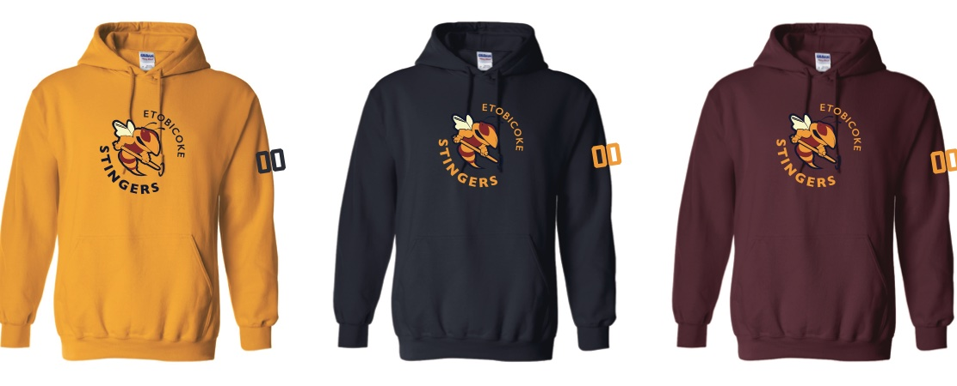
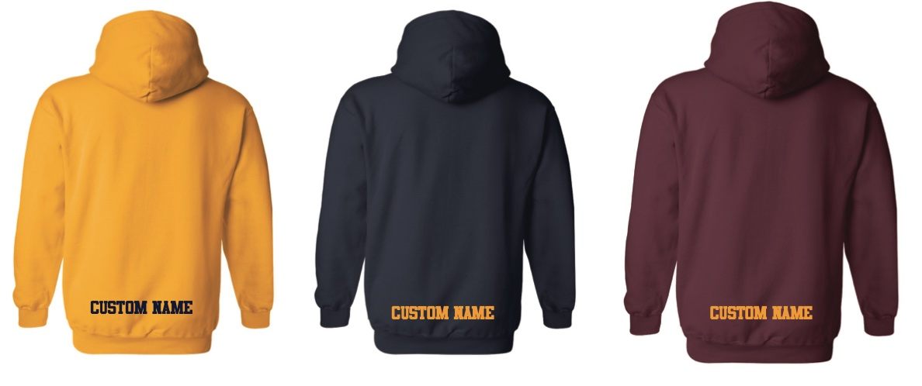
Gildan Fleece
Hoodies
50/50% Cotton Poly fleece hoodie
Available in Navy, Gold and Maroon in all sizes
Classic fit
Youth S-XL (no hood string) – $50 each
Adult S–XL - $50 each
2XL-3XL – $55 each
Add player # or name – additional $10 each

Slide 4

Gildan
Grey/Navy Jogger
13.3-oz, 50/50 cotton/polyester fleece
Elastic waistband
Elastic cuffs
Youth S-XL - $40 each
Adult S–2XL - $45 each
Ladies (grey only) – S-2XL - $45 each
Add player # –additional $10 each

Slide 5


Toques/Hats
Toque
100% Acrylic
Hat
100 %cotton Twill
Adjustable hook /loop closure
One Size– $25 each
Add player # - additional $10 each

Slide 6


Insulated Soft Shell Jacket - Navy
Men’s - S-4XL
Ladies - XS- 2XL
Youth - XS-XL
$120.00 each (left chest logo)
Add name left sleeve- additional $10 each.
Example – “COACH”

Slide 7

Mesh Lined Track/Rink Jacket - Navy
Men’s - S-4XL
Ladies - XS- 2XL
Youth - XS-XL
Jacket - $70.00 each (left chest logo)
Add name left sleeve- additional $10 each.
Example – “COACH”

Slide 8

Sublimated Skate Towel
12 x 18 Microfiber terry towel
Personalization (individual names, numbers) is also included
$12 each

Slide 9



Multi-functional Headband
95% polyester / 5% spandex,
One Size
$20 each

Slide 10
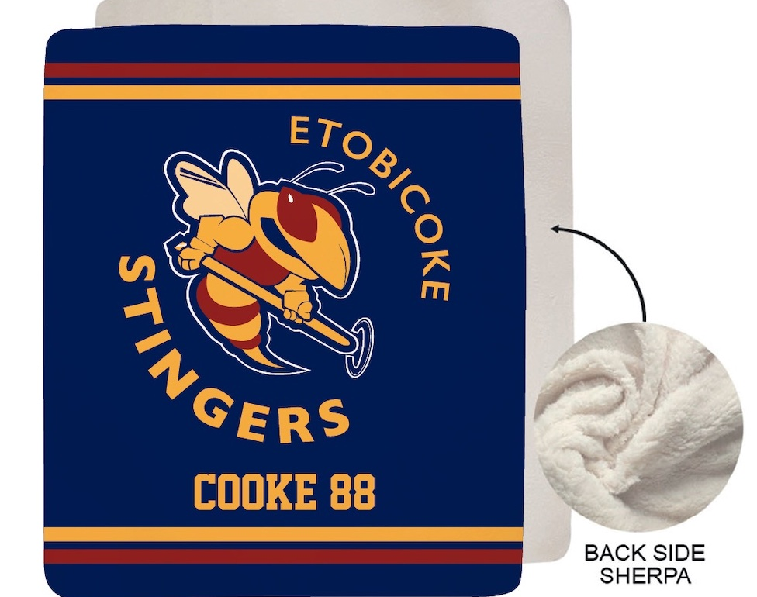
Team Blanket
Team Blanket in Plush Faux Sherpa Lined Micro Mink
50 x 60
Name and Player Number included
$57 each

Slide 11

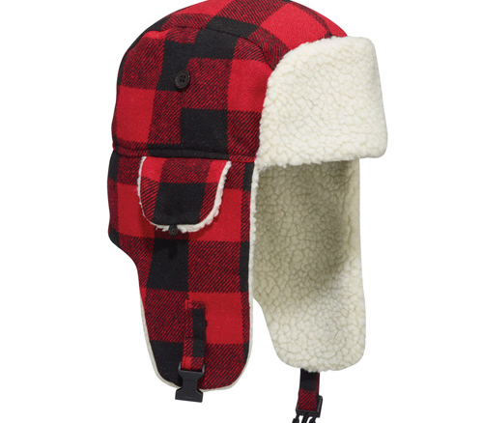
Winter Bomber Hat with Earflaps (Lumberjack)
8 Panel hat
Double lining
2 piece plastic snap buckle closure
$33 each with logo

Slide 12
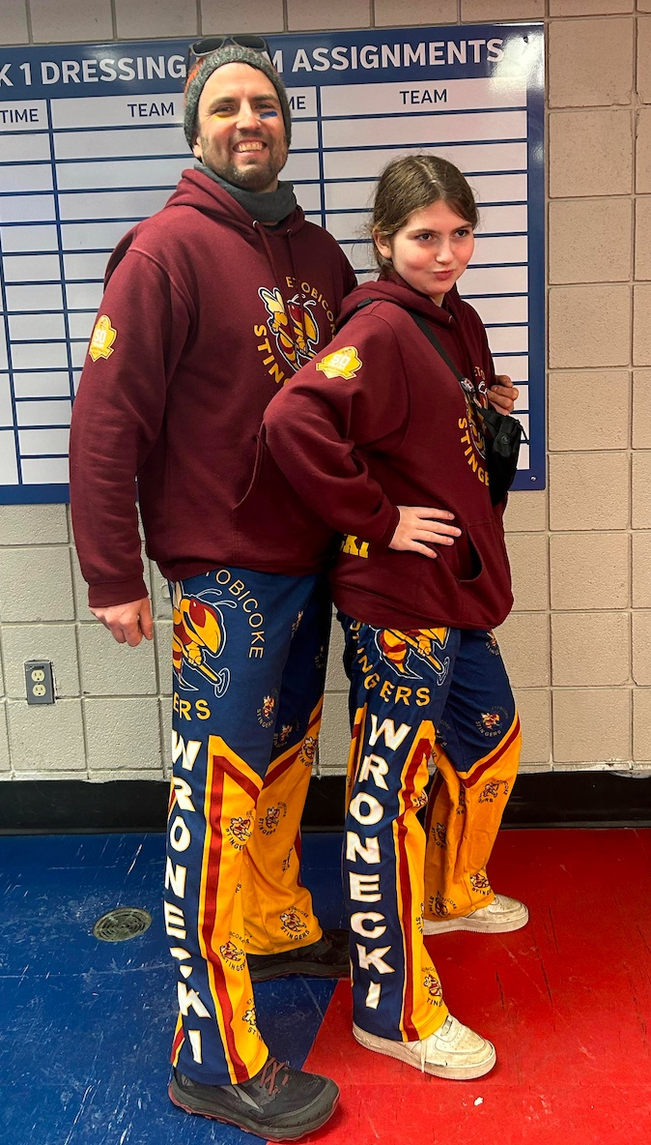
Custom PJ Bottoms
Fleece PJ Bottoms with elastic waist band
Youth 6-16
Adult S-2XL
$59 each
Name and Player Number included

Slide 13
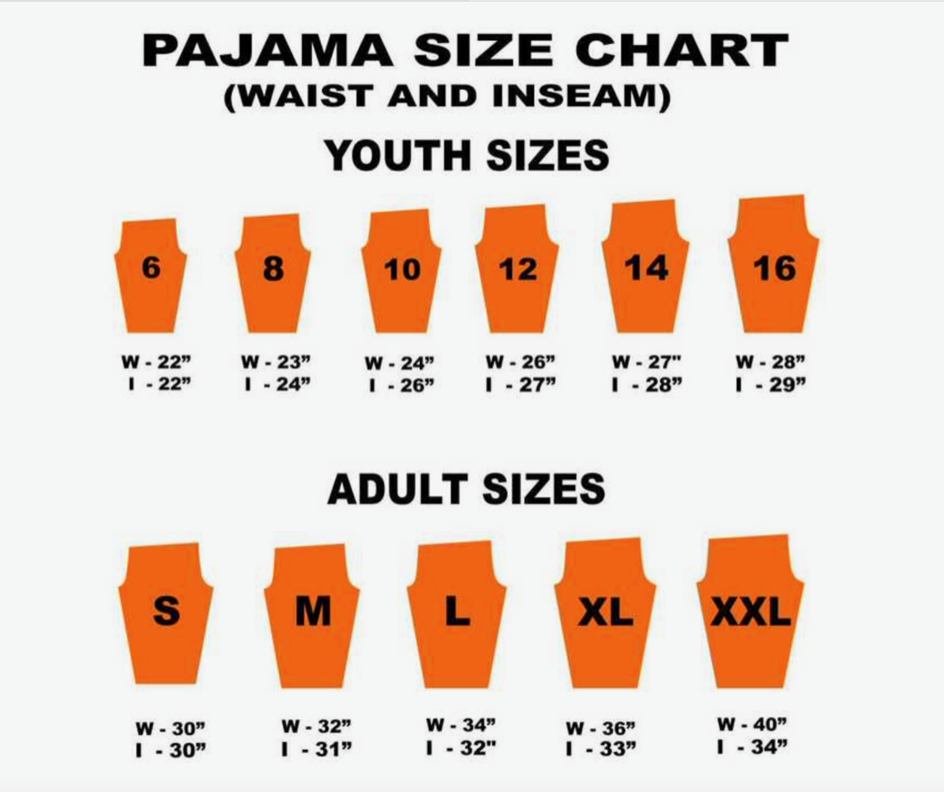
PJ Sizing Chart

Slide 14
Terms & Conditions
All pricing includes taxes, set ups and shipping
Substitutions may be applicable on certain items due to backorders/out of stock
Please allow approx. 4 weeks for delivery
Payments are made via credit cards Visa/MC, or etransfer
For additional information please contact - Toni Cooke – toni@blue-hippo.com

