Slide 1
GCRA A Year in Review AGM – 2022/23 Season
MAY 29TH, 2023

Slide 2
Agenda
Reading and adoption of the minutes of the previous Annual Meeting (motion)
VP Finance report
Registrar’s report
President’s report
Council and Committee Reports
Elections (motion)
New Business?
Adjournment
Notes:
Call to order - confirm quorum
Agenda for AGM is outlined in our bylaws.
Motion to approve the agenda: any new business to be discussed must be approved at onset

Slide 3
2022/23 Councils Councils
Executive Council
President | Vanessa Jones
Secretary | Lindsay Sanford
Executive VP | vacant
VP Finance | Annie Ste-Croix
VP Operations | Nathalie Altherr/ Darlene Pickup
VP Administration | Carissa Morris
VP Development | Josee Sabourin
Director Discipline | Vanessa Jones
Director Finance | Andi Worrell
Ice Scheduler | Dan Bergeron
Director at Large | Nicole Hicks
Past President | Jennifer Kosak
Director Competitive | Celine Leduc/ Dave Mainwood
Director Regional | Ashley Ruelland
Director Novice | vacant
Administrative Council
VP Administration | Carissa Morris
Registrar | Amy Grossett
Equipment | vacant
Director Admin | vacant
Webmaster | vacant
Referee in Chief | Travis Smith
Director of Publicity and Promotions
Tournament Manager | Serge Robichaud/Natalie Altherr
Communications Coordinator | Omar Nalley
Development Council
VP Development | Josee Sabourin
Technical Director Player | Pauline Wong
Technical Director – Coaching | Joel Hazzan
Convenor Bunnies
Summer Camp Manager (s) | Jess Mainwood & Celine Leduc
Notes:
Note: Board has appointed a new Competitive Director effective March 31 (Dave Mainwood).

Slide 4
Adoption of 2022 Minutes
Link to GCRA 2022 AGM presentation & minutes: (May 29, 2022) Minutes
HERE
Secretary
Notes:
Motion to approve the 2019/20 AGM minutes

Slide 5
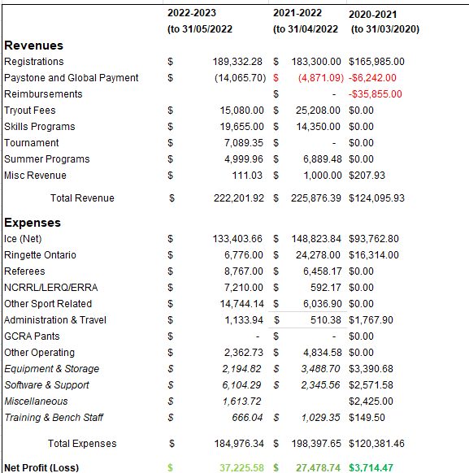
Income
Statement
VP Finance

Slide 6
Financial Highlights 2022-23
The summer programs, try-out revenues, power skating and clinics and competitive 4 on 4 exceed our projected outcomes by close to 50%
Registration stayed the same, ice anticipated budget were within 1%
Less funds on Learn to Skate (Bunny) program, Travel, Scholarship budgets, and only a small portion of the administration, advertising and promotions were used
ERRA fees as well as professional fees have yet to be billed to the association which will add up to close to half the profits from this year.
VP Finance
Notes:
Motion to approve the final income statement

Slide 7
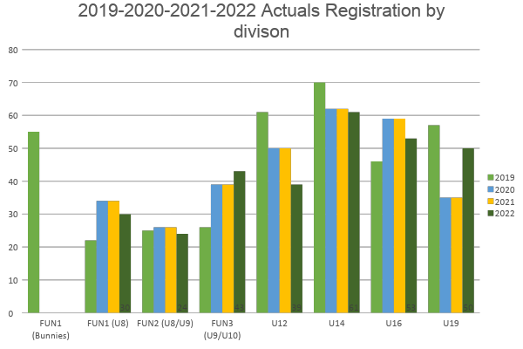
Registrations and Teams
2019: 362
2020: 250
2021: 305
2022: 300
VP Admin / President
Notes:
Essentially the same registration as last year.
Held two CTR this year so hopefully registrations will increase a little.
3 adult teams registered again through GCRA this season
ADD MENTION ABOUT TRANSITION TO RAMP

Slide 8
GCRA President’s 2022-23 Report
Membership numbers slightly decreased this year (by 5) – still need to go to grow our membership base as compared to pre-COVID
2 CTR events, one in the fall and second one in spring.
2022 season was fruitful in terms of player development programs. GCRA will continue to offer similar programs to our athletes in the upcoming season
GCRA Executive welcomed some new faces this year and said goodbye to some seasoned volunteers
Executive is working hard at attracting new volunteers, but it still remains a challenge
Ran a well attend volunteer appreciation in June 2022 and have one scheduled for early June 2023 to thank those who helped out and made GCRA successful
From our PSO RO:
U12 A, B and C only and balanced teams within each competition level – GCRA had 3 U12 teams (A and 2 B)
U19AA - for 2023/2024 season, three teams in NCR as opposed four (no team at this level for Nepean)
President
Notes:
PSO – Provincial Sporting Organization

Slide 9
Council & Committee Reports

Slide 10
Volunteer appreciation
VP Administration,
Notes:
Carissa to speak to volunteer appreciation night from June 2022.
Ashley- Volunteer of the month

Slide 11
Operations – Regional Report
8 teams
U12A,U14B x 2 , U14B x 2, 2 U16B x 2 , U19B
NCRRL Results
U12 B Nasr - Silver
U12 B Dallaire - Silver
U12 A Taylor - SIlver
U14 B Daly - Silver
U16 B Archer - Silver
U19 B Yelle - Gold
Fall sort outs – Dates will be earlier this year (End of Aug start) ]
Challenges - U19 B, Late Start, Out of Association Players @ u12
VP Operations, Director Regional

Slide 12
Operations – Competitive Report
GCRA was represented by U14 AA, A, U16AA, A and U19AA and A
all teams had a varied degree of successes
Our U19AA won bronze at Provincials and went on to Nationals
Our 19A team won gold at Provincials
Individual GCRA athletes successes: 3 athletes participated in the CWG, 7 athletes participated in the OWG (1 gold, 1 silver, 2 bronze)
2 athletes were invited to the Junior Team Canada tryouts
VP Operations, Director Competitive

Slide 13
Development - FUNdamentals
1 FUN team
2 FUN 2 teams
3 FUN 3 teams
Tournament Results
FUN 3 Poirier - Gold in GCRA, Silver in NCRRL
FUN 3 Rheaume - Silver in NCRRL
FUN 3 Grosset - Gold in Ajax
FUN 2 - played intercity weekly games
FUN 1 - participated in jamboree
Challenges
big teams/difficulty adding more players after sortouts.
progressive age - challenging if over-age players/tournaments
VP Development

Slide 14
Development – Player Development
➤ 8 sessions of powerskating by APEX for FUN2/3 & U12 players
➤ 11 sessions for U14A/B players (Combination of power skating and skills)
➤ Partnered with Goalie Central and Offered 7 sessions of goalie training to both regional and competitive teams from U12-U19 (Except U14AA, U16AA and U19B as they have their own goalie trainings)
➤ 5 sessions of Spring 4 on 4 for U14 and 4 sessions for U16 players
➤ 2 conditioning sessions for U19 players prior to Tryout
VP Development
Notes:
-27 Skaters for FUN2/3
-30 Skaters for U12
-40 Skaters for U14A/B
-80 skaters participated for the spring 4 on 4 and 9 goalies participated for Free
-21 skaters for U19 conditioning sessions
** GCRA will continue to offer similar programs this upcoming season to support players in their development

Slide 15
Development – Come Try Ringette
Two events were held
One in Fall 2022 at Bob MacQuarrie with 25 participants and 8 new registrations
One in Spring with 51 participants; however registration is not complete
We continue to try and grow our sport and introduce as many young people to Ringette as we can.
VP Development

Slide 16
Tournament
We are happy to report that after 2 years of not having a tournament due to COVID, we had a successful event this year! We welcomed 63 teams from across the country.
Unfortunately, due to the rescheduled Ontario Winter Games (OWG) which was during the same weekend of our tournament, we had to close the U19AA division. We had many disappointed MB, AB, NB & QC teams!
We would like to thank all of our committee members for their support this past year : Karl Morency, Treasurer, Krista Forrest, Registrar and the new additions : Alison Begley : Medal & banner coordinator and Crystal Chant : Volunteer coordinator.
We would also like to introduce you to the new tournament co-chairs : Martine Francoeur and Melissa Gaudreau! We wish them the best of luck and thank you in advance for your contribution to the association.
It was a honour to chair the GCRA tournament for the past 7 years and we would like to thank everyone for all of their help and support throughout the years. Nat & Serge

Slide 17
Bylaw Updates (N/A) and Elections

Slide 18
Elections
VP Admin

Slide 19
2023/2024 Vacancies (even year)
Role | Council | Year | 2023
Executive Vice President (Elected) | Exec | Odd | vacant
VP Operations (Elected) | Exec | Odd | Darlene Pickup
VP Finance (Appointed) | Exec | Odd | Andi Worrell
VP Administration (Elected) | Exec | Odd | Carissa Morris
Director of Accounting (Elected) | Exec | Even | vacant
Director at Large (Elected) | Exec | Annual | Nikki Hicks
Regional Director (Elected) | Exec | Odd | Ashley Ruelland
Novice Director* FUNdamentals (Elected) | Exec | Even
Scheduler (Appointed) | Exec |  | Sara Dawson
Registrar (Appointed) | Adm | Annual | Amy Grosset
Technical Director - Coaching (Elected) | Dev | Odd | Joel Hazzan
Equipment Manager (Appointed) | Adm | Annual | vacant
Webmaster (Appointed) | Adm |  | Germaine and Erik Fournier
Tournament Manager (Appointed) | Dev |  | Martine Francoeur / Melissa Goudreau
Convenors – Fun, Regional, Competitive (Appointed) | Dev |  | Vacancies! – apply please
Notes:
The vacancies where Role name is bold are CRITICAL for the successful operations of the GCRA, they cannot remain vacant

Slide 20
New Business
Notes:
New business must be motioned at start of meeting

Slide 21
Adjournment
Notes:
Motion to adjourn

Slide 22
About Us: Governance
A brief Education Session – ONTARIO RINGETTE GOVERNANCE
Ringette Canada
BC
Alberta
Saskatchewan
Manitoba
Ringette Ontario
Quebec
New Brunswick
Nova Scotia
PEI
Central
Eastern
(ERRA)
Southern
Western
Northeastern
Arnprior
CORA
GAARA
GCRA
Kingston
Metcalfe
Nepean
UOV
WORA
Exec VP
Notes:
A quick visual on where GCRA sits in the Big Picture.
Teams in within the ERRA umbrella play in 3 leagues (next slide).
Competitive teams must play tournaments in Ontario for provincial rankings

Slide 23
About Us: League Play
Novice & Regional, U12P, U14A: NCRRL (National Capital Regional Ringette League)
All Eastern Region teams in these divisions play regular season games within the NCRRL
NCRRL determines the composition of the various leagues based on player evaluation and team composite scores
Travel as far as Kingston for season games, typically in the Ottawa Area (all associations which fall under ERRA PLUS Gatineau are part of the NCRRL)
U16A, U19A: LRQ (Ligue de Ringuette Québec)
All NCR teams in these divisions play regular season games within the LRQ
Travel as far as the Quebec City for season games (typically Montreal and surrounding areas)
U14AA, U16AA, U19AA: LERQ (Ligue Elite de Ringuette du Québec)
All NCR teams in these divisions play regular season games within the LERQ
Travel as far as Quebec City for season games
Exec VP
Notes:
President/VP Regional attends NCRRL meetings for team seeding, escalate issues and questions through the NCRRL for GCRA
VP Competitive attends each the LERQ and LRQ scheduling meetings on behalf of coaches in association, escalate issues and primary point of contact for league game related questions / incidents/ reporting / penalties
Novice teams are balanced, re-seeding very rare

Slide 24
Tryouts and Sortouts
Level | Teams | Athletes | # Ice Sessions | Time (weeks) | Core (Exec) Volunteers | Other Volunteers | Evaluators Per session
Competitive | 8 | 161* | 40 | 11 | 1 | 4 | 3-12
Regional | 8 | 134 | 20 | 3 | 1 | 10 | 7
Novice | 6 | 108 | 12 | 2 | 1 | 8 | 4
What’s in a session now?
1 ice session in evening: 4 hours
2 sessions in evening: 6 hours
Evaluators
Equipment
Reporting
216 hours for 1 volunteer at 2 sessions per night –
If this were work that would be
30 days of effort @7.5 hrs per day
Feedback
Coach Selection
Emails
Games & Referees
President
Notes:
Am I mi
All Sessions include sessions plus 1 warmup per level.
More athletes attend tryouts then there are spots for – Final athletes assigned to competitive teams in 2018 was 124.

Slide 25
Directors: Competitive, Regional, Novice
These VP’s currently are ultimately responsible for:
All activities surrounding tryouts and sortouts for their area Scheduling / coordination with ERRA & other associations / scheduler Coach selection / interview committees Evaluator management / solicitation of Equipment management Player management On ice management / solicitation of volunteers Communications to players/parents Evaluation result management Final team formations (competitive: with coaches) Underage athlete requests / committees | Season activities: Bench staff approvals League coordination & meetings Soliciting, compiling, communicating bench staff evaluations Primary contact point for teams and escalation person for parents Team Issues management Attend Discipline hearings Scheduling management for teams Work with Director Development to identify / plan development for teams Ensure coach training compliance Much, much more
President

Slide 26
Every Council Member votes at their Council Meetings & at “ALL Council” Meetings
Executive
Operations
Development
Administration
Strategic: Aims & Objectives
Official Communication
Representation externally
Council Alignment and Oversight
Financial
Safety, Discipline & Appeals
Contracts and Facility bookings
Association Wide Policies
Volunteer Compliance
All Day to Day Operational Tasks
Team Formations
All Tryouts and Sortouts including all procedural tasks to accomplish
Player Placement at all levels
Coach Selection
Games oversight
League Meetings
Operational Issues – Game Ice, Practice Ice, Fair Ice, Call ups, etc
Operational Policies
Player Development
Coach Development
Coach Compliance
Mentoring
Learn-to-Skate (Bunnies)
Camps
Coach Compliance
GCRA Registrations
RO Registrations/ TRF
Insurance
Publicity & Promotions
Communications, Website
Equipment
Logo, Team Wear, Advertising
Administrative Policies
Association Compliance
Volunteer Appreciation
GCRA COUNCILS WORK TOGETHER IN SUBJECT AREAS; Representation all Around
Notes:
JK 2020: leave this in as reminder for how the GCRA Executive and Councils operate together

