Slide 1


COMMUNITY DEVELOPMENT
COACH

Slide 2
Land Acknowledgement
From Coast to Coast, we respect and acknowledge the First Nations, Inuit and Metis Peoples as the Keepers of the Territory upon which we will be learning today.
Notes:
LF Instruction: Read Land Acknowledgement slide - Standard NCCP Land Acknowledgment is on the slide;
State where you are & Recite the acknowledgement, add your own Gratitude piece to it if you chose –Conclude with - We encourage you to take a moment to acknowledge the territory where you are located and commit to reconciliation meaningfully throughout the whole year while completing your valuable work.

Slide 3
INTRODUCTIONS
Notes:
Introduce your self & other clinicians.
quick intro of participants - name & where you are attending from; any experience with lacrosse?
Can do a ‘quick name game’ depending on # of participants / Icebreaker
Online – can have them add name & location / club into the chat

Slide 4
A few starters….
BE….
Here – today works better for all when we are all present & engaged
Respectful – we are all here to learn. If you have questions, we will do our best to answer them
In the moment – please put your phone on silent!
Prepared – take notes as you wish, much of what we do today is covered in the Coaching Manual
Notes:
LF guidance – read the slide - guidelines for being “present” during the conference call/zoom or in person
Model the EAP for the location you are at – in the event of emergency - exit and path; where washrooms are

Slide 5

Competition Development Coach
Phases of Athlete Development
Train to Compete
Train to Win
NATIONAL COACHING CERTIFICATION PROGRAM for LACROSSE
Competitive Introduction Coach
Phases of Athlete Development
Train to Train
Community Initiation Coach
Phase of Athlete Development
The FUNdamentals
Community Development Coach
Phase of Athlete Development
Learn to Train
Notes:
LF Instruction: Give a general explanation of the pyramid while emphasizing the Community Development box and the Learn to Train stage of LTAD.
*often CMD clinics will also include LTAD ages of the FUNdamental phase too!
- your job as a Community Stream coach is to encourage “lax for life” – fun, safe, best practices
WE do this within the NCCP …. National Coaching Certification Program

Slide 6
Community Development Course Content
ONLINE / classroom clinic
Introduction
Overview of NCCP
Module 1 – The Game (on floor)
Module 2 – The Coach
Module 3 – The Players
Module 4 – Technical Preparation (On Floor)
Module 5 – Mental Preparation
Module 6 – Physical Preparation (On Floor)
Module 7 – Practice Planning
“What to coach”
ON FIELD PORTION -
The game - rules
FUNdamentals & tactical strategies
Physical Prep - warm up / cool down
Implementing a practice plan
Notes:
Read slide – outline what online concepts are; what will be covered in person clinic
*By doing this clinic - will be able to attend just the “on floor or on field” portion of other sectors if coaching other children
Must attend BOTH portions in order to get credit for the clinic

Slide 7
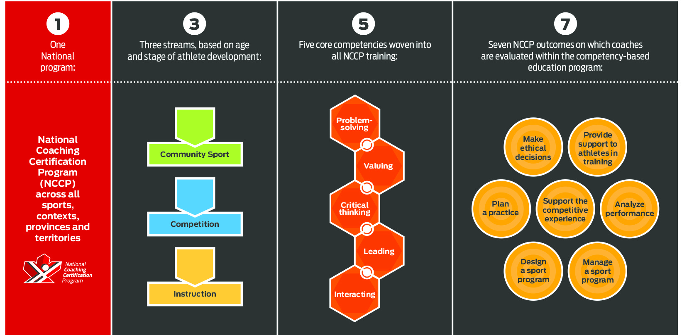
Community Development Coach
Notes:
LF Instruction: Explain each of the 1 – 3 – 5 -7 as these are the foundation of the entire coaching program. At Competition Introduction the 7 NCCP outcomes are what the coach will be evaluated on
1 National Coaching Program
3 streams – you are in: Community Sport (for beginner coaches and those coaching U13 and below) / next is Competitive Introduction (U15 and above) / third is “instructional”(figure skating, equestrian etc)
5 Core Competencies - problem solving, valuing, critical thinking, leading, interacting – these are woven into each module
7 OUTCOMES - for the Community Coach we develop–
a) practice planning (FUN, safe & developing physical literacy/FMS in young athletes);
b) provide support to athletes in training - EAP & concussion protocol
c) MED – coaches at all levels must complete
c) additionally -
Awareness of the Responsible Coaching Movement
And the NCCP encourages us to be a Life Long Learner!
THE LOCKER:
-your MA will enter the clinic; it will show up on your Locker profile
Things to know:
-Self Report - you can enter yourself items such as: coaching a season, attending a conference; doing a workshop; self report button is found on the left side of the screen when you are displaying your ‘certification’ tab
-PD points – Professional Development points; coaches are encouraged to participate in online modules to increase knowledge; once CERTIFIED, must accumulate PD points in the 5 year period

Slide 8
NCCP Competency-Based Education Training
Core Competencies
Valuing
Problem Solving
Interaction
Critical Thinking
Leadership
Recognizes ethical dilemmas, problems and consequences.
Solves coaching problems where the variables may be unknown, uncontrolled or unpredictable.
Intervenes to facilitate progress.
Applies all teaching and learning principles.
Can remain positive when under stress.
Makes decisions based on experience and the larger sport and/or social context.
Has a positive influence on behavior.
Works collaboratively.
Recognizes the efforts of others.
Notes:
LF Instruction: Walk through each Core Competency so that coaches understand that they are woven into the NCCP program & our manuals

Slide 9
The Spirit of Lacrosse
The player who played against me was really working with me.
He caused me to make moves I had never made before.
And any magic that came from the surprise of what I did came because he guarded me so well. The two of us were just working together, creating a new form to get to the same place.
Paul Owens – 1977 Poet
Teaching the Spirit of Lacrosse
The Spirit of Lacrosse is taught by:
Winning through the superior execution of skill.
Gaining advantage through superior fitness.
Playing lacrosse with integrity and respect.
Strong Mind Strong Body Strong Spirit
Notes:
LF Instruction: The spirit of lacrosse as it comes from the creator – embodies the principles of Strong Mind, Strong Body, Strong Spirit.
Virtual - This can be a Q & A in the chat box (or zoom whiteboard)by asking questions such as:
IN person – quick think/pair/share with table partner(s)
1. What can coaches do to ensure players have superior skill? [be technically sound; encourage proper development of skills at appropriate times]
2. How can coaches make lacrosse fun while still increasing fitness? [small area games, tag!, competitions in activities]
3. What does it mean to play the game with respect and integrity? [fair play, stay within the rules of the game; encourage / develop sportsmanship & comradery; appreciate good play by opponents]

Slide 10
Learning – Playing – Coaching
Learning is enhanced when the activity is fun.
Having fun is considered play
Playing is learning
Learning is intrinsic, it happens while involved in an activity where a player is making an attempt to achieve.
Learning is best achieved when the activity has play like qualities.
Resource: Peter B. Vaill Learning as a Way of Being, Jossey-Bass Inc. 1996
Notes:
LF Instruction: Draw the link between Learning is enhanced when it is FUN, fun is considered PLAY and Play is LEARNING.
Explain that learning like motivation at its core is INTRINSIC, that it comes from within
Learning is best achieved when the activity has play like qualities. This means let the athletes play and make mistakes and they will figure it out.
Ref: “Learning as a way of Being”, Peter B. Vail

Slide 11
THE COACH
“Good programs, delivered by good people, in good places”
CAC values for coaches…..
Seek to understand
Cultivate inclusion
Be curious
Act with courage
Lead and serve with gratitude
Notes:
MOTTO of the CAC which all Sport Organizations should be striving for
Review CAC values & MOTTO “good programs, delivered by good people, in good places”
Values for Coaches (expand on the list by stating these items)
Seek to Understand – development of solid practice plans, determining order of progress for your team, being prepared and clearly understanding everything you are presenting to your players
Cultivate inclusion – appropriate language & behaviour exhibited to uphold the NCCP Code of Conduct
Be curious – look for opportunities to expand your knowledge level of lacrosse and coaching methods
Act with courage – decision making is a huge part of coaching, you will never make everyone happy all the time; stick to your guiding principles, have sound rationale for decisions
Lead and serve with gratitude – be appreciative of the opportunity to be involved with the “creator’s game” and lead in a positive manner
*these are in line with the Objectives listed in your Manual for Module 2: The Coach

Slide 12
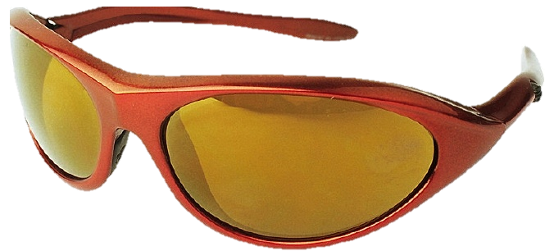
What Influences How You See?
Experiences as a participant
Experiences as a coach
Life experiences
Likes & dislikes
Family
Cultural beliefs
Friends & peer pressure
Religious beliefs
Now add…
The NCCP Code of Ethics
and Coaching Code of Conduct
Education & Training
NB: There can be many other factors that influence how you see a situation, including, but not limited to, politics, economics, and your employment situation if you are a paid coach.
Notes:
LF Instructions: This is a good slide for coaches to see the various things in their lives that influence themselves and others in situations.
Review slide with coaches.
All of these are known as “Bias” –
Sharing – have coaches share an example they have experienced which demonstrates bias
Tie in NCCP Code of Ethics and Code of Conduct – helps to guide us to decrease our level of bias

Slide 13
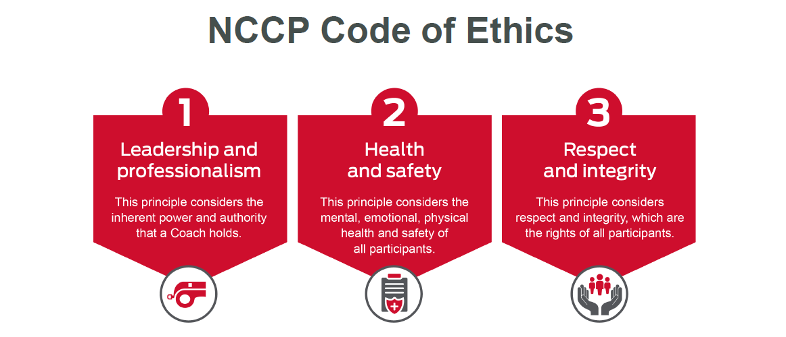
Notes:
LF Instructions:
CRITICAL UNDERSTANDING PIECE for coaches
Read out loud the three badges and explain to coaches the importance of this.
LF reference - use page 2 of code of ethics to expand upon each badge (full code of conduct found on page ___) *PDF to email – MA should email the code of conduct to coaches

Slide 14

Responsible Coaching Movement (RCM)
Notes:
Responsible Coaching Movement (RCM) (youtube.com)
(link in case it won’t play)
Audience participation: before starting the video, ask coaches to be listening for the 3 components of the RCM.
Show video; draw out the 3 components from participants, then ask:
How does this tie into the Code of Ethics?
Audience to Add a response in the chat or share out loud
Review:
SAFE (open/observable/justifiable) – Rule of 2; Respect & Integrity
SMART (Trained coaches) – Safe sport & Ethics training; Leadership & Professionalism
SECURE (background check) – ALL volunteers in your organization have a background check; Health & Safety of all
Prevention of inappropriate situations!
- Consistency across the country

Slide 15
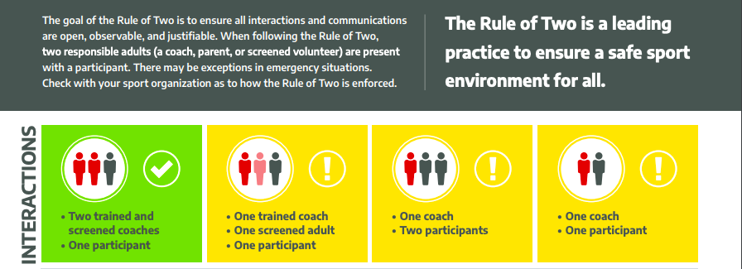
The Rule of 2
Notes:
As seen in the “Initiation to Sport” module;
Coaches should have this completed in advance of attending clinic, if not - strongly recommend completing this online module on the Locker elearning
Read slide – the goal of the rule of 2…..
Ties into Make Ethical Decisions - intended to protect YOU and your athletes
All actions with participants are in OPEN, OBSERVABLE AND JUSTIFIABLE situations
share good practices – ie. No texts to players; correspondence to parents / players – always include your coaching staff/manager
How to implement the Rule of 2 – share with participants through discussion
IN person
Work as a team – A coach should always have another coach or screened adult(parent or volunteer) present when interacting with participants.
Remain open to the public – Have a training environment that ensures all situations are open, observable and justifiable.
Plan transportation – Have 2 adults present when traveling with a participant(s) and refer to your club travel policy.
Be sensible – be considerate of the gender of the participants when selecting coaches or volunteers
Transparent communication – ensure that all communications are sent to a group and/or include parent/guardians without ONE-TO-ONE messaging.
Virtual Settings
Parental awareness – obtain consent for virtual sessions, plus inform parents of activities that will occur.
Record each session – and they should be in a professional setting (not a bedroom!)
Weekly debriefing – encourage regular check-ins with parents, coaches and participants about the virtual training.
www.Coach.ca/responsiblecoaching

Slide 16
Do No Harm Principle
The NCCP considers that, above all,
it is the duty of all coaches to ensure
the decisions they make
and the actions they take
will result in no harm, physical or other,
to the athletes.
Notes:
The Ultimate goal in decision making(MED)….what works LOGICALLY the best for all involved in the situation

Slide 17



Notes:
Player safety is #1 priority - coach can facilitate safety by knowing rules, removing players for dangerous play, keeping players off the floor/field if contact is made to the head
**must complete this online module - Making Headway in Sport (free , about 45 minutes)
In Ontario - Rowan’s Law - MUST have a DESIGNATED PERSON (usually trainer); excellent webinar - You are the Designated Person under Rowan's Law - Now What? - YouTube
Additional info if someone asks a question:
Synopsis of Rowan’s law
Rowan’s Law was named for Rowan Stringer, a high school rugby player from Ottawa, who died in the spring of 2013 from a condition known as second impact syndrome (swelling of the brain caused by a subsequent injury that occurred before a previous injury healed). Rowan is believed to have experienced three concussions over six days while playing rugby. She had a concussion but didn’t know her brain needed time to heal. Neither did her parents, teachers or coaches.
Rowan’s Law and Rowan’s Law Day (last Wednesday in September) were established to honour her memory and bring awareness to concussions and concussion safety.
Explanation of Parachute – Canadian Guideline on Concussion in Sport
This guideline covers pre-season education and the recognition, medical diagnosis, and management of athletes who sustain a suspected concussion during a sport activity. It aims to ensure that athletes with a suspected concussion receive timely and appropriate care, and proper management to allow them to return to their sport. This guideline may not address every possible clinical scenario that can occur but is intended as a general overview that includes critical elements based on the latest evidence and current expert consensus.

Slide 18

Notes:
Emergency Action Plan
*NCCP EAP elearning module – must do! [15 min long]
What are the components of an EAP?
Charge person- stays with the injured player / gives instructions about initiating 911
Call person - calls 911; directs ambulance to site of injury
Specific Instructions to WHERE you are located is critical
Directions to hospital from practice facility - EAP - specific instructions for where the ambulance should come to at the facility and directions to the hospital (we had a team activate an EAP at one of our tournaments and that ambulance went to the wrong field and delayed them by close to 10 minutes).
**Bring a copy of your EAP for your practice facility to the on floor/field session!

Slide 19

Notes:
Jamboard question: or in person discussion: Why do youth play lacrosse?
-gather responses, review;
Example responses -
Have fun
To learn new skills / Improve skills
Stay in shape
Do something I am good at
Excitement of competition
To get exercise
To be a part of a team
Lead into Athlete Centered coaching – which is –
The coach establishes expectations, consistent guidelines for acceptable behaviour so participants feel valued & safe to take risks and grow
Participants are actively engaged, free to discover how to do it, learn from trial & error; become able to make decisions on their own - in game situations
Goal is to have ALL players return
COMPLETE THE TASK - Q1 – what are positive qualities of ‘good coaches’?
Discuss WHY these are positive qualities; responses will vary depending on the group
Coach workbook – task 2-14.positive coach Rank yourself!

Slide 20
Athlete Centered Coaching
You are an Athlete Centered Coach if you . . .
Encourage
Player
Input
Interpret
Listen
Supportive
Organized
Explain
Empathetic
Mentor
Notes:
LF Instructions:
After coaches have ranked themselves(last exercise) review the Jigsaw puzzle.
Walk through this puzzle that outlines the traits of an Athlete Centered Coach. Ask coaches to recognize which traits come most easily to them.
Audience participation – what are your top 3 traits? (think / pair / share at your table)

Slide 21
Coaching Players to Learn
Community Development Focus
FUNdamentals
  Guided Discovery
  Focus on fundamentals
Learning to PLAY
  Players start to think about WHY they play
  Skills improve
Learning to COMPETE
  Players have GOALS
  Commitment and sacrifices are owned by the players
Notes:
We must teach our players to THINK. WE are helping our players to LEARN using a variety of strategies & providing opportunities for them to think!
How?
FUNdamentals (U7) - basics skills; giving opportunity for kids to investigate and explore HOW to do it and think for themselves, using guided discovery / play
What does Guided Discovery look like? How does the player figure it out?
(ie GB/loose ball pick up – just let them try it! through Trial & error they will figure it out…..then we can add specific “tactics” as the coach – “now try it this way”; “here is the rule about GB pickups” – building upon the learning)
U8 to U13 Learning to train/play - focus more on WHY we do certain things in a game
Next phase: Learn to Compete – goals / focus improves

Slide 22
What Parents Expect of Coaches
LEGEND
Make sport enjoyable
Respect children as individuals
Be a knowledgeable leader
Be safety conscious
Act in a mature and adult manner
Be fair
Respect rules and officials
Give equal opportunity for playing time
Plan activities effectively
Be approachable
Strive to win
1 2 3 4 5 6 7 8 9 10 11
Sport Parent Survey. Ministry of Government Services, Sports and Commonwealth Games Division, Government of B.C. (1994)
Notes:
LF Instruction: Important to point out where parents put winning in their child’s sporting experience at the bottom #11.
(note where winning is placed compared to building good people & enjoyment)

Slide 23
What Parents Expect of Sport
LEGEND
To build self-esteem
To have fun
To develop skills
To increase fitness
To make new friends
Other
To have a professional career
To play on a winning team
To win awards
To go to the Olympics
1 2 3 4 5 6 7 8 9 10
Sport Parent Survey. Ministry of Government Services, Sports and Commonwealth Games Division, Government of B.C. (1994)
Notes:
LF Instruction: The top 5 parent expectations are about the DEVELOPMENT OF THEIR CHILD – life skills; need to be developmentally appropriate

Slide 24

Dealing with Parents vs Working with Parents
Notes:
Audience participation; how can we POSITIVELY involve parents? (Whiteboard on zoom; or Jamboard or Brainstorm)
Examples:
Clear communication - Parent Letter / parent meeting
**reference: Parent Letter 2-23(WF) 2-21(box)
Assist with jobs at practice (set up nets; lug water etc)
Socials (lunches at field / drinks / freezies!)
Cheer POSITIVELY for ALL children, not just their own
PARENT MEETING – in person, outline expectations, goals for season
24 hour rule
NOTE: this is important as it is where you get parents on your side

Slide 25
THE PLAYERS
“ Think big, believe big, act big, and the results will be big.” - Anonymous
Notes:
Goal - to have players LOVE the game; come back next year (and bring a friend!)
How to do this? Age appropriate activities - skills/drills, use of language, modifying “the game”

Slide 26
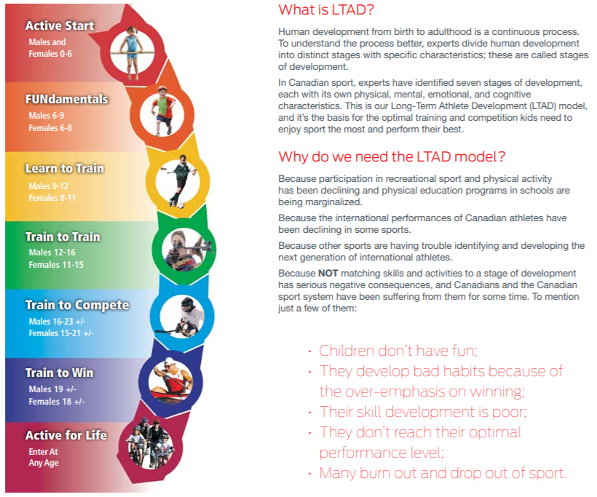
Long Term Athlete Development (LTAD)
Your athletes are here
Notes:
LF Instruction: Emphasize to coaches that Community Development coaches are working with athletes in the “LEARN to TRAIN” Stage of LTAD
LTAD is based on Growth and Development; not ‘chronological age’...but we organize kids by chronological age;
- “developmental age” must be considered - need to be aware of physical, emotional, cognitive, social differences at each age
The Community Development coaching stream is designed for U13 and below. In terms of development this means
Active Start(ages 0 - 6) begin basic play,
building FUNdamentals (ages 7 – 8) more structure but FUN,
Learning to train (8-11 female; 9-12 male) – pre-teen – preparing for structured training.

Slide 27
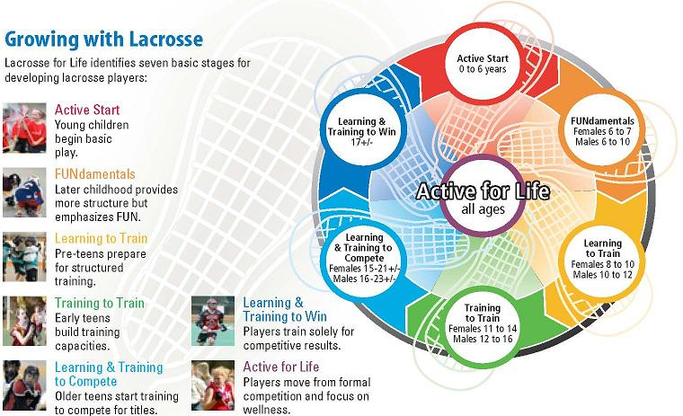
LTAD – Growing with Lacrosse
Your athletes are here
Notes:
LF Instruction: Explain on this graphic that athletes are moving into the third stage of LTAD
Community Development designed to address:
FUNdamentals (U7) & U9/U11/ U13 Learning to train/play
Growth and Development
Players can enter the sport at any age
Meet them “where they are at” (consider the individual’s developmental age)
Goal – everyone comes back next season!

Slide 28
Growth and Development
Review the reference material provided on G & D
For your age group complete the LTAD profile
Break out rooms - share
When we return together - discuss: WHY is it important to recognize & structure activities & practices to appropriate G & D stage?
Notes:
Coach Participation:
Growth and Development exercise [30min activity]
Info: reference material on G & D / recording sheet in Coach Clinic workbook
Review the Task & then send to breakout rooms (or depending on size of the group, give “think time” to work on, then discuss)
Generate summary for your age group
- physical, emotional, cognitive, social differences at each age
1 person to report back to entire group
Discuss all age groups. Have coaches unmute to share their findings, hear from each age group; in person – go around the room and have each age group share
All together - Pose the question – How do you adjust your practices to accommodate the individual differences in your team?
**this will be modeled in the “on floor/field” portion – coaches design AGE appropriate activity

Slide 29
Developing Emotional Intelligence
Emotional Intelligence is developed during
Teachable Moments
Promoting Fair Play & the Spirit of Sport
The effort to satisfy the Psychological Needs
Building confidence and self esteem through sport
Notes:
LF Instructions: Explain the two examples of developing emotional intelligence.
The Meeting of Psychological Needs Builds…
1. Self-Esteem
A feeling of satisfaction that someone has in himself or herself and his or her own abilities.
2. Empathy
Empathy is recognizing the feelings of other and is the primary emotion involved in:
Team Building
Fostering the Spirit of Sport
Developing the Respect that is key to FAIRPLAY
3. Self-efficacy
Self-efficacy is the belief that one can achieve and is the emotion that:
Motivates players to learn and try new things.
Foster hope and keeps players from giving up
Ref: Module 3 of manual

Slide 30
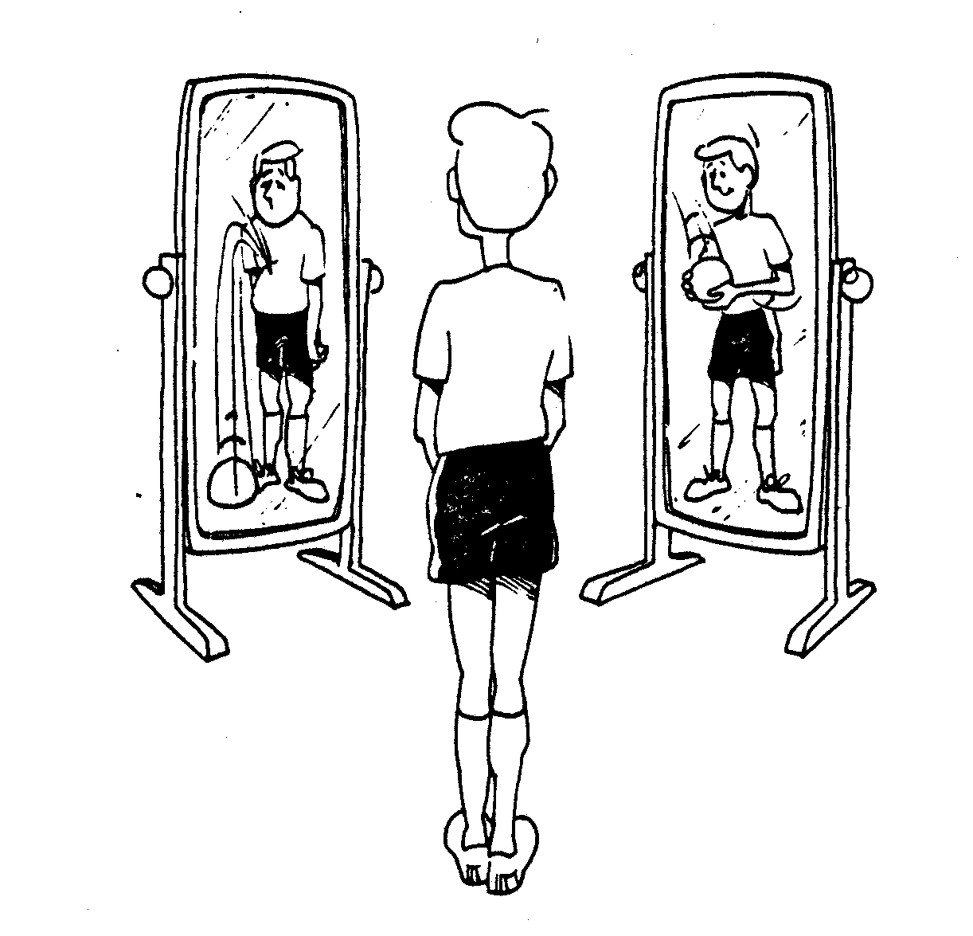
Self Image
Self-image affects
Our Learning
Our Performance
Our Happiness
Our Personal Relationships
Our Motivation
Our Attainment of Personal Goals
Notes:
LF Instructions: Outline some of the things that affect athlete self image and how the coach comes into play with regard to this.
As a coach, what impact on an athlete’s self image do you have?
Audience participation; How can a coach help youth develop their self esteem? As a coach, what impact on an athlete’s self image do you have??
JAMBOARD / brainstorm / “share with a table partner”
Suggested responses: inviting/inclusive atmosphere, speak individually to each player, show respect & confidence in them, positive communication, give them responsibilities in leading, encourage them to ask questions
Further exploration - Coach workbook task 3-4 + reference materials(module 3)

Slide 31
Stages of Learning for Skill Development
Every athlete goes through the following stages or levels of learning when developing skills. Some things to note are:
The following descriptions are useful when assessing players
Athletes will not be at the same level for all skills.
Initiation
Player Traits | Objectives | How to Deliver | Ready to Move on
Completely unaware of the requirements of the skill, even the most basic concepts and motions. | Illustrate a clear picture of what the skill should look like and communicate a basic understanding of the fundamentals. | Create a safe learning environment, free of judgment, where the learner feels safe to engage in physical practice and use a lot of demonstration. | When the performer has established an understanding of basic concepts and at least some level of comfort with the fundamental motions.
Notes:
LF Instructions: These next 4 slides tie into LTAD and how young people learn (and at different rates)
Stages of Learning for Skill Development – there are 4, they are:
Initiation – first introduction to the skill
Acquisition – awkward (possibly uncomfortable) performance of the skill
Consolidation – can perform at game speed
Maintenance – can perform skill (comfortably)under all circumstances
Player assessment chart is found in Module 3 of your coaching manual.
We will walk through each slowly so that you, the coaches, can understand each level. Athletes will progress at different rates.
Coaches will have athletes on their team at various stages and will need to plan and run practices with athletes grouped accordingly based on skill.
Also, coaches need to be able to adapt on the fly at practice as the skill level during drills needs to be pushed to the next level or toned down and back to basics based on execution by athletes - and that is normal and expected as you coach young athletes.
31 - First – Initiation – go through the slide
Next slide 32 - Continue to Acquisition-

Slide 32
Stages of Learning for Skill Development
Acquisition
Player Traits | Objectives | How to Deliver | Ready to Move on
Can perform a rough version of the skill. You will notice that their actions are not well-coordinated or particularly fluid. Outcomes will be very inconsistent from each attempt. | It is important is that the athlete has a clear understanding of what they are being asked to do and are given the opportunity to practice in a safe learning environment. | Athletes in this stage are using significant cognitive effort to control their movements. Specific practice exercises with some positive feedback will support the learning process by engaging an athlete’s problem solving abilities | Through a combination of trial and error and feedback, the player has gained a good understanding for how to produce desirable results. The athlete will not always execute perfectly, but movements are more synchronized and controlled.
Notes:
LF Instructions: Walk through each slowly so that coaches understand that it is imperative that they do NOT move on when the athlete(s) are not ready.
In all likelihood, most Community Development (Learn to Train) athletes will be in this stage the longest.
Explain that mistakes are OK for the athletes to make – this is how they LEARN
“trail & error” stage; make mistakes and learn from them; most Community Development (Learn to Train) athletes will be in this stage the longest. This is where athletes will experience a high level of frustration – good spot to introduce Positive Self Talk (found in Module 5); encourage athletes to be resilient and keep trying to master the skill (getting comfortable performing as more pressure is added)

Slide 33
Stages of Learning for Skill Development
Consolidation
Player Traits | Objectives | How to Deliver | Ready to Move on
Performance has become more fluid and more consistent– but severe degradation occurs whenever instability occurs. | Help the athlete apply their newly developed skill and precision to a variety of conditions that are representative of what they would encounter during play. | Assist the athlete by structuring their practice in a way that reinforces technical correctness while producing functional outcomes from a variety of situations. E.G. An activity where the skills is used in a game like situation. (Not a scrimmage or game) | The athlete develops a better sense of self-awareness and the ability to self-coach at a very high level. The goal is to help the athlete(s) consolidate their actions to the point that they can bridge the gap in performance between stable and unstable environments.
Notes:
LF Instructions: This stage will be for the high achievers at Learn to Train with basic skills such as passing and catching. More technical skills the athlete is likely to still be in acquisition.

Slide 34
Stages of Learning for Skill Development
Maintenance
Player Traits | Objectives | How to Deliver | Ready to Move on
Athletes at the advanced stages of learning can execute with a high degree of precision and consistency in both unstable and stable environments. | Minor technical adjustments may be required from time to time. the advanced athlete is best served by focusing more on how the environment influences performance and execution. This type of training will prepare the athlete with the ability to solve problems during the course of play. | The coach can focus less on technical proficiency and more on problem solving and skill refinement. Providing the opportunity to engage in highly specific and situation-based practice is critical to this process. | This is the final stage of development. Athletes will need to make minor adjustments from time to time to improve their consistency and/or execution.
Notes:
LF Instructions: This stage will be difficult for Learn to Train athletes to achieve as the tasks will need to be done with precision and consistency. Minor adjustments to improve.
This moves them along the LTAD path toward the Train to Train phase.
Summary - athletes learn through trial & error (practice)
Coaches role is to detect errors in technique, provide constructive correction and feedback and have continued interventions to assist in development
Detection
Correction
Feedback
Intervention
Task 3-5 - Discussion: As the coach, what will you do to assist your players through the various levels of learning when they are learning a skill?
Anticipated Responses: introduce Positive self talk / developing of resilience & mindful practice (ie keep trying!)
Keeps all athletes in the their own ‘challenge zone’ as they will develop at different rates

Slide 35
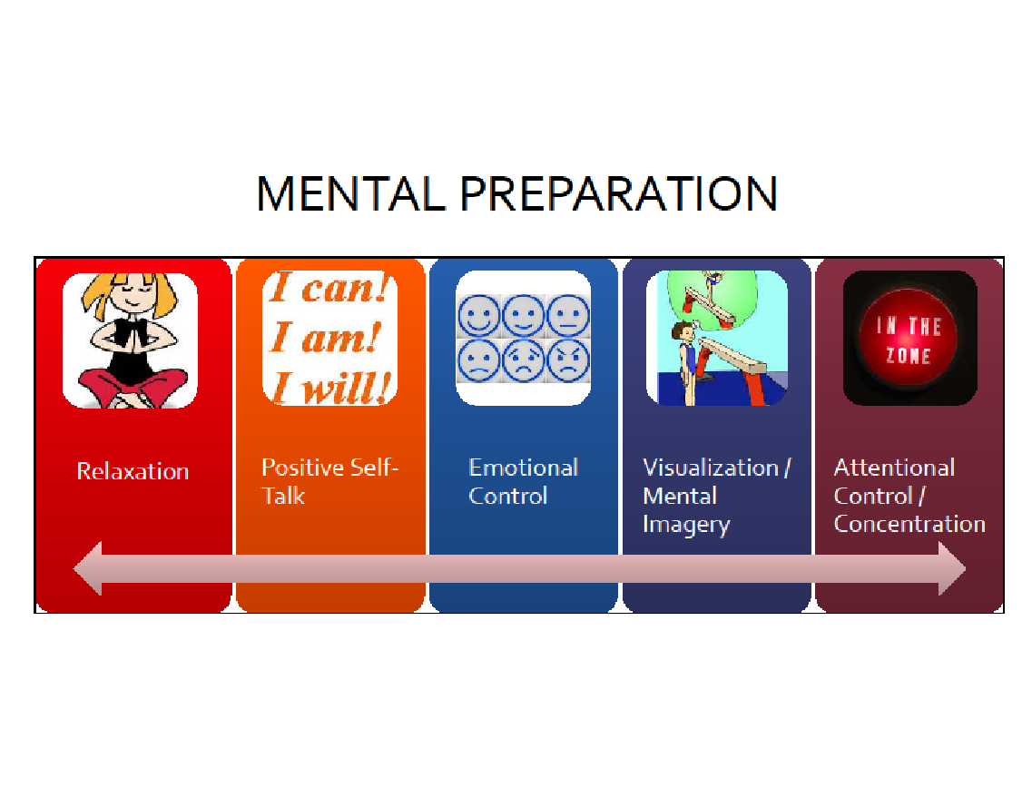
Notes:
Introduce Mental Prep by posing the question: What does Mental Prep mean to you? (quick gathering of examples from participants) Task 5-1 in coach workbook, if you want them to write it down
Share Examples of mental skills with coaches:
Relaxation - team yoga after practice; “soft hands” technique p5-4
Positive self talk - have the player turn negative comments into positive (instead of “I can’t, I’m trying)
Emotional Control - “control what you can control”, let outside influences/forces go - ie. can’t control what the refs call/don’t call, but can control your reaction to it
Visualization/Mental imagery - use of CUE / key words (build into your ‘team language’; bring team together, have them close eyes and focus on your voice – lead them through a guided visualization
Attentional control / concentration - maximize focus - less talking, more doing in practices;
Share - Team & Individual builders -
Positive strategies to use:
Positive sandwich (constructive feedback)
Grow and Glow, 2 stars and a wish….
I like that you… Next time… Keep….
Start / Stop / Continue - provide sample for the COACH to complete in the clinic (part of their growth)
ANXIETY - will be high before competitions, think about teaching basic mental skills before competition (simple breathing exercise here)
Introduce a Breathing exercise and where / how it can be implemented (5-3WF manual)
Refer to Reference Material in Module 5 for more examples

Slide 36


Notes:
Introduce the Mental Health & Sport Resource and Event Hub…..
This new resource can be found on CAC website
Mental Health and Sport Resource Hub introduction (youtube.com)
(link in case it won’t play)
SHOW the 2 minute video, then follow up with:
Coaches aren’t “sport psychologists” but need to be able to assist your athletes – this is an excellent resource
*Good coach & parent resource
*consider adding to your Associations website!
www.Coach.ca , under “coach resources” – Mental Health and Sport Resource and Event Hub
Encourage coaches to go and check out the resource for themselves – other good resources there on “Return to Play” after concussion / injury
Additionally - Another good resource for your athletes: KidsHelpPhone
A National resource – make players aware; encourage them to reach out; If a participant shares information with you, this is an excellent resource for them to access help

Slide 37
Physical Preparation
Fundamentals & Learning to Train Phase of Athlete Development must include:
    → Dynamic Warm up
    → ABC’s (Agility, Balance, Coordination & speed)
    → Energy systems (building into activities)
    → Cool Down
*on floor will encompass some of this!
Notes:
At this phase of development, here are the physical preparation components to be concerned with: Building “training” into practices – this will be modelled in the on floor session
Read slide – A.B.C’s
Additionally - think about energy systems when creating practice plan:
Energy systems Aerobic (long distances - warm up fun games or run); Anaerobic Lactic (10 - 90 sec); Anaerobic Alactic (10 sec or less)
Excellent resource materials / drills in the manual - train energy systems within your practice & drills rather than as a separate entity
Module 6 of coaching manual – excellent resource

Slide 38

PRACTICE PLANNING
Notes:
LF guidance: “If you’re not planning to succeed, then you are planning to fail” (by someone famous!)
Poor planning leads to poor outcomes and retention of athletes.
Poorly planned practices make coaches look disorganized and unprofessional
This is a Core competency/outcome for Community Development coaches so let’s get thinking about designing a practice plan

Slide 39
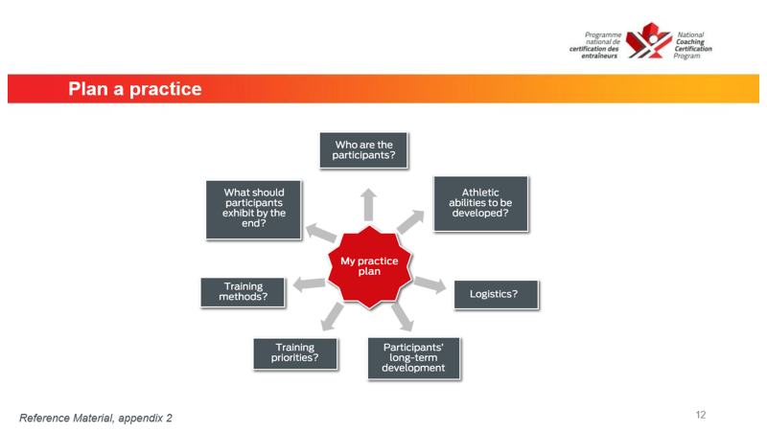
Notes:
Audience participation: Allow time for Participants to Jot down responses to these questions(on slide) to get mindset for practice planning (no need to share, this is specific to them)
Timing: 2-5 minutes
Audience participation; what are the objectives of a practice?
Share in chat or unmute depending on #’s
Fun
Teach skills & strategy of the game
Social interaction
Player development
A specific ‘tactic’ piece you are introducing
Now for the components of a practice (next few slides)
Task 7-3 in Coach Workbook is an outline for a practice plan

Slide 40
Planning a Practice – Warm up
The warm should consist of some short easy activity to get the heart rate up and the body warm.
This will be followed by more dynamic movements such as toe / heel walks, walking lunges, heel kicks, walking or marching A’s
Notes:
LF Instructions: Coaches must understand the warm up is an essential part of the practice. Beside the points above, it is an opportunity to observe the players and what they are bringing to practice that day.
Note: This will also be done physically in the on-floor session of the workshop

Slide 41
Body of the Practice
The main part of practice should be used as an opportunity for skill development.
Each activity/drill should progress or build on the previous activity.
Activities/drills need to keep the attention of the players and be meaningful.
Note:
New activities or skills and high intensity activities should be taught early in the practice before mental or physical fatigue are present.
Notes:
LF Instructions: Review the Body of the Practice – skill development & tactical team components
Skill development and strategy / tactical information
High tempo; keep all participants engaged
“station” approach is useful – utilize all coaches / helpers
New activities or skills and high intensity activities should be taught early in the practice before mental or physical fatigue are present.

Slide 42
Body of the Practice - Teaching a Skill
PLAN EVERY DETAIL!
Plan the explanation & demo - 3-4 teaching points & KEY/cue words
b. Plan how will participants practice the skill?
- PROGRESSIVE STEPS
- lots of reps / maximize activity
c. Formation (for instruction) - whole group, remove distractions; use of voice & body (positive)
d. Teach the Skill - whole, part, whole approach
As kids get active….provide Constructive Feedback
- POSITIVE, immediate, changeable behaviour, check for understanding
Notes:
But before designing the practice, think about HOW we teach a skill / explain a drill
* Go through the slide
* Discuss “Coach Interventions” - Constructive Feedback (POSITIVE, immediate, changeable behaviour, check for understanding) - Learning happens through our quality feedback!
*reference: module 7 & Coach workbook Task 7-1

Slide 43
Planning a Practice - Cool Down
The Cool Down activity should help reduce the heart rate of the athlete.
The Cool Down activity should have a flexibility component.
Notes:
LF Instructions: Explain that a proper cool down helps athletes with recovery. Explain the two points on the slide and ask if the coaches have any questions about the cool down.
Note: This will also be done physically in the on-floor session of the workshop

Slide 44
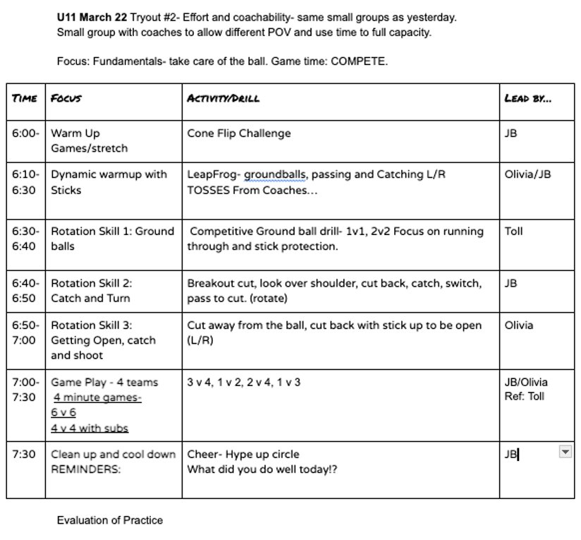
Planning a Practice
Welcome & warm up →
← Use your assistants / screened volunteers
Body of Practice →
Stations
Small groups
Lots of ball contact / opportunity for improvement
Game play – small area games
Cool down & conclusion →
Notes:
LF Instructions: Review this practice plan
Things to point out about the plan
Objective stated; POV (point of view)
Timing on side of plan
DETAIL about the drill
Who’s presenting it
NOTICE - small groups - stations / rotation / challenges
All equates to LOTS of ball contacts for each player;
ENGAGED participants….not standing in lines; having to think
Small area games – “game like” – challenges players to use skills just learned/practiced

Slide 45
Drills/activities don’t equal a quality practice…
PLANNING is the key to a successful practice.
Do things on the move
How do you break it down so everyone gets it? … find the little teachable moments and put it all together…
“Unstructured play” – such as: a tag warm up game, letting them come up with a warm up
Progressions / Regressions / Challenge your Players
Notes:
How to progress / regress drills depending on what individuals need
Progression means – building up from simple to complex
and regression of drills – breaking it down so players understand
… if this is your goal… find the little teachable moments and put it all together…
Encourage “unstructured play” especially in warm ups = FUN
ACTIVE PARTICIPATION: [give 15 minutes of work time; then share ideas, answer questions]
Using the reference material on Practice Planning & the recording sheet in Coach Clinic workbook(task 7-3) – begin to design your next practice

Slide 46
Questions?
Notes:
LF Instruction: Ask if anyone has any final questions.
Inform coaches that the workshop is not over. Must attend on floor session before ‘earning credit’ for the clinic.
Be sure to give them your contact information: Email(s) and cell phone. [CONTINUE TO BE A RESOURCE for coaches]
Moving this onto the floor / field – basic skills to be covered, how to run an effective practice – from warm up to cool down; understanding how the game works, field markings, rules
What to bring? – stick, whistle, clipboard, manual
Convey YOUR SPECIFIC details of the on floor session to the coaches before anyone leaves– WHERE, WHEN, TIME

Slide 47
What’s next for you?
On floor / field session, in person!
Date
Location
Time
Bring – your practice facility EAP, stick, running shoes & positive attitude!
Notes:
Module 4 will be provided via email ; review basic skills – come with your questions
Will be a great afternoon of sharing technical information!

