Slide 1


Competition Introduction
Coach Clinic

Slide 2
Land Acknowledgement
From Coast to Coast, we respect and acknowledge the First Nations, Inuit and Metis Peoples as the Keepers of the Territory upon which we will be learning today.
Notes:
LF Instruction: Read Land Acknowledgement slide - Standard NCCP Land Acknowledgment is on the slide;
State where you are & Recite the acknowledgement, add your own Gratitude piece to it if you chose –Conclude with - We encourage you to take a moment to acknowledge the territory where you are located and commit to reconciliation meaningfully throughout the whole year while completing your valuable work.

Slide 3
INTRODUCTIONS
Notes:
Introduce your self & other clinicians.
quick intro of participants - name & where you are attending from; any experience with lacrosse?
Can do a ‘quick name game’ depending on # of participants / Icebreaker
Online – can have them add name & location / club into the chat

Slide 4
A few starters….
BE….
Here – today works better for all when we are all present & engaged
Respectful – we are all here to learn. If you have questions, we will do our best to answer them
In the moment – please put your phone on silent!
Prepared – take notes as you wish, much of what we do today is covered in the Coaching Manual
Notes:
LF guidance – read the slide - guidelines for being “present” during the conference call/zoom or in person
Model the EAP for the location you are at:
Engagement of Participants: Ask - Is anyone in the group a first responder or has First Aid? (Make one of them your CHARGE person) LF can act as CALL Person should anything occur during the clinic.
– in the event of emergency - exit and path; where washrooms are

Slide 5
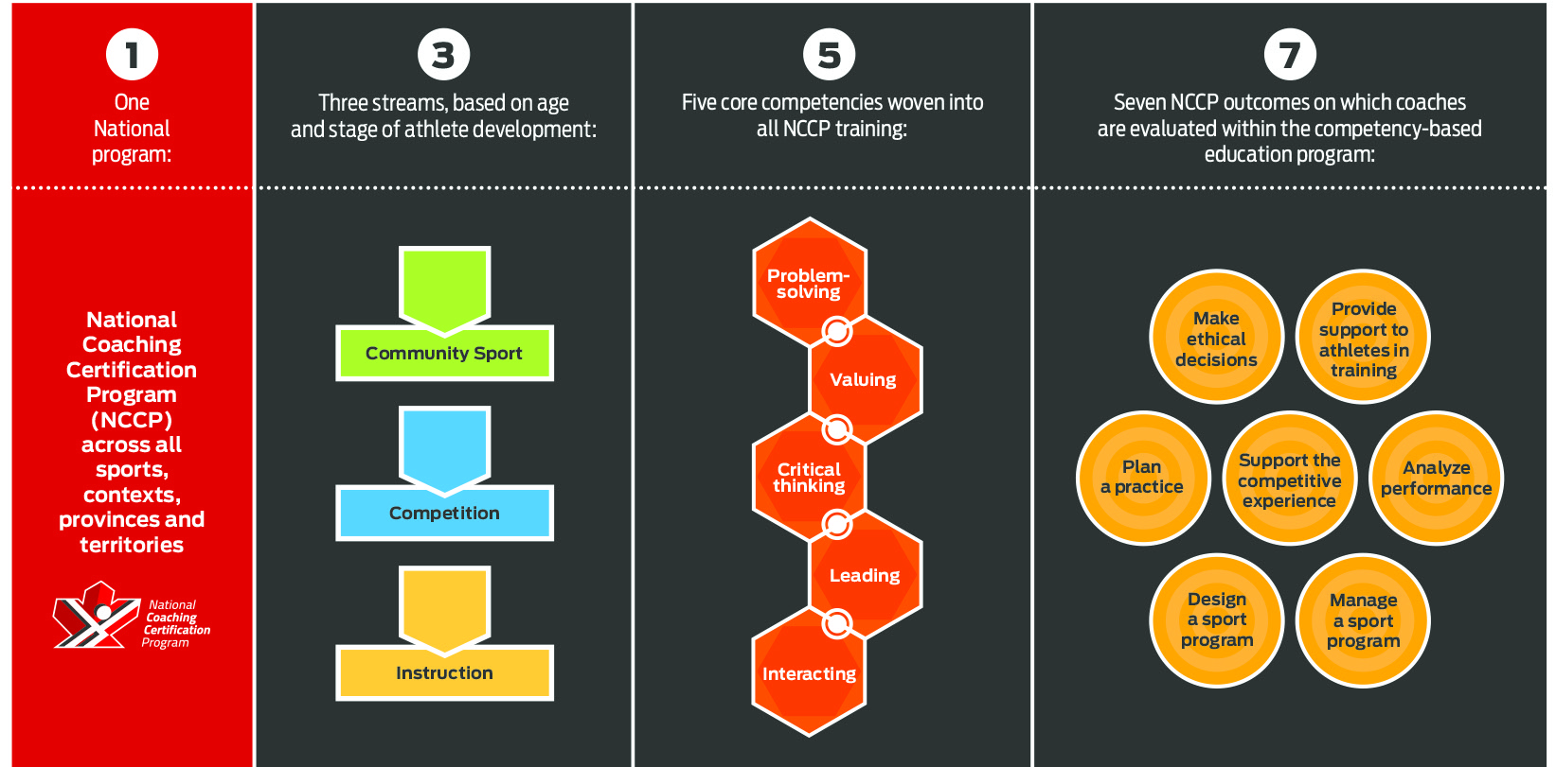
Competition Introduction Coach
Notes:
LF Instruction: Explain each of the 1 – 3 – 5 -7 as these are the foundation of the entire coaching program. At Competition Introduction the 7 NCCP outcomes are what the coach will be evaluated on
1 National Coaching Program
3 streams –Community Sport (for beginner coaches and those coaching U13 and below) / next is Competitive Introduction (U15 and above) – where you are at / third is “instructional”(figure skating, equestrian etc)
5 Core Competencies - Continue to build your Core Competencies as a coach - positive value system, solve problems, interact effectively with players, reflect on consequence of actions, provide positive leadership
7 OUTCOMES - for the Comp Intro Coach we develop–
a) Seasonal Planner & Support the Competitive Process
b) provide support to athletes in training – Mental Health Focus
c) MED – coaches at all levels must complete
d) additionally -
Awareness of the Responsible Coaching Movement
And the NCCP encourages us to be a Life Long Learner!
THE LOCKER:
-your MA will enter the clinic; it will show up on your Locker profile
Things to know:
-Self Report - you can enter yourself items such as: coaching a season, attending a conference; doing a workshop; self report button is found on the left side of the screen when you are displaying your ‘certification’ tab
Spend time emphasizing this:
NO Workbook (was new in 2023) to be considered “trained”; encouraged to move toward “certification” – request in person evaluation – an “Evaluation Portfolio” is part of that process
Growth process, good opportunity for feedback from Coach Evaluator; not a “pass/fail”
-then accumulate PD points – Professional Development points; coaches are encouraged to participate in online modules to increase knowledge; once CERTIFIED, must accumulate PD points in the 5 year period

Slide 6
The Spirit of Lacrosse
The player who played against me was really working with me.
He caused me to make moves I had never made before.
And any magic that came from the surprise of what I did came because he guarded me so well. The two of us were just working together, creating a new form to get to the same place.
Paul Owens – 1977 Poet
Teaching the Spirit of Lacrosse
The Spirit of Lacrosse is taught by:
Winning through the superior execution of skill.
Gaining advantage through superior fitness.
Playing lacrosse with integrity and respect.
Strong Mind Strong Body Strong Spirit
Notes:
LF Instruction: The spirit of lacrosse as it comes from the creator – embodies the principles of Strong Mind, Strong Body, Strong Spirit.
TASK:
Virtual - This can be a Q & A in the chat box (or zoom whiteboard)by asking questions such as:
IN person – quick think/pair/share with table partner(s)
1. What can coaches do to ensure players have superior skill? [be technically sound; encourage proper development of skills at appropriate times]
2. How can coaches make lacrosse fun while still increasing fitness? [small area games, tag!, competitions in activities]
3. What does it mean to play the game with respect and integrity? [fair play, stay within the rules of the game; encourage / develop sportsmanship & comradery; appreciate good play by opponents]

Slide 7
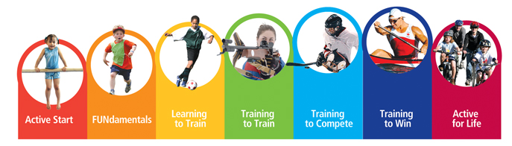
Building from
Community Development to
Competition Introduction
Notes:
Everything we talk about in this clinic, want to frame it as: Moving from Community to Competitive Coach – Learning to Play to Learning to Compete / Training to Train to Training to Compete
Ages 14 - 16 Train to Train
Ages 17+ Train to compete

Slide 8
Module One: THE GAME
COMMUNITY SPORT
Development
COMPETITION
Introduction
Goals of participation | Fun, , fitness | in provincial and national competitions
Proficiency level | Continued participation for fun, acquiring and consolidating | Refining and varying basic skills, acquiring and consolidating and
Level of competition |  | Provincial to National
Stage in athlete development | FUNdamental/Train to Train
Frequency of participation | 1-2 times per week | 3-4 times per week
Age of participants | Youth and adulthood | Youth and young adults
fundamentals
Performance
basic skills
advanced skills
Community
Train to compete

Slide 9
Module One: THE GAME
Task 1:
List the differences in the Game, the Players and Coaches
when players are within these contexts:
Learning to play Learning to compete
Notes:
P. 1-4 (check 2016 manual) – game / players / coaches
ACTIVITY: divide into three groups – one for each - game / players / coaches;
What does Comm Devt look like compared to Comp Intro? ; share responses (draw out theirs and then put up the corresponding slide

Slide 10
Module One: THE GAME
Differences in the Game when players are:
Learning to play | Learning to compete
learning the rules/positions individual play need constant reminders basic skill development lots of repetition overwhelmed by rules sportsmanship | everything at speed team strategy team defense advanced skills players think for themselves team plays – set plays committment performance “pretty”

Slide 11
Module One: THE GAME
Differences in Players when they are:
Learning to play
Learning to compete
focus on having fun
physical differences
learning to work skills into the flow of the game
more individual play
commitment/dedication to team
expectations -> performance
emotionally controlled
conditioned (individual training)
set short & long-term goals
play within the team structure

Slide 12
Module One: THE GAME
Differences in Coaches when players are:
Learning to play
Learning to compete
create a fun environment
bring treats
social
have patience
slow down approach
fair playing time/positions
high degree of individual attention/teaching
act more professionally
set training requirements
establish coach/player relationship
increase player development
  - physical
  - technical
  - mental
working with players to establish goals
work everything into the season plan
higher level of committment

Slide 13
The Coach
“Good programs, delivered by good people, in good places”
CAC values for coaches…..
Seek to understand
Cultivate inclusion
Be curious
Act with courage
Lead and serve with gratitude
Notes:
MOTTO of the CAC which all Sport Organizations should be striving for
Review CAC values & MOTTO “good programs, delivered by good people, in good places”
ACTIVITY: divide group into 5 groups, each group is assigned one of the Values to discuss for meaning & APPLICATION.
Do a quick report back.
Suggested answers found below.
Values for Coaches (expand on the list by stating these items)
Seek to Understand – development of a season plan comprised of solid practice plans, determining order of progress for your team, being prepared and clearly understanding everything you are presenting to your players
Cultivate inclusion – appropriate language & behaviour exhibited to uphold the NCCP Code of Conduct; nurture a united sports family
Be curious – look for opportunities to expand your knowledge level of lacrosse and coaching methods
Act with courage – decision making is a huge part of coaching, you will never make everyone happy all the time; stick to your guiding principles, have sound rationale for decisions; Make Ethical Decisions!; take informed risks to grow as a coach, embrace challenges.
Lead and serve with gratitude – be appreciative of the opportunity to be involved with the “creator’s game” and lead in a positive manner; be inspired by your athletes to shape your coaching
Lead into next slide – with this said, more responsibility on coach to develop people not just lacrosse players, need a foundation for making sound decisions – the Make Ethical Decisions module provides that framework.

Slide 14

MUST do – Make Ethical Decisions
Register through your Provincial Coaching Association
Why important??
Notes:
LF instructions:
-Comp Intro coaches must do this module
Why Important?
-gives coaches a decision making model which allows us to make ethical, unbiased decisions in difficult situations
-encourages one to stick to their values and what’s important to the betterment of the team (and/or individuals)
-aligns with the NCCP Code of Ethics within the CAC
ASK – how many have completed this??
EMPHASIS the importance of doing it to those who haven’t completed the module

Slide 15
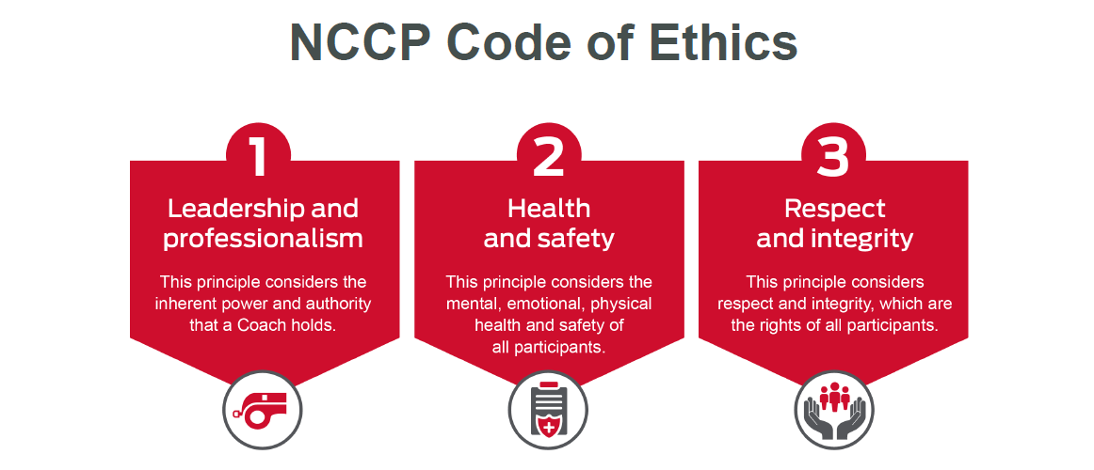
Notes:
Review and tie into the MED module
For each of these core principles, there are associated ethical standards of in-person and on-line behaviour expected of every NCCP coach and NCCP Coach Developer in Canada, whether on or off the field
Leadership and professionalism
This principle considers the inherent power and authority that a coach holds.
Ethical standards of behaviour:
Understand the authority that comes with your position and make decisions that are in the best interest
of all participants
Share your knowledge and experience openly
Maintain the athlete-centered approach to coaching so that every participant’s well being is a priority
Be a positive role model
Maintain confidentiality and privacy of participants’ personal information
Health and safety
This principle considers the mental, emotional, physical health and safety of all participants.
Ethical standards of behaviour:
Recognize and minimize vulnerable situations to ensure the safety of participants
Prioritize a holistic approach when planning and delivering training and competition
Advocate for, and ensure appropriate supervision of participants, including the Rule of Two
Participate in education and training to stay current on practices to ensure the continued safety of your participants
Understand the scope of your role and skills and call upon others with specialized skills when needed to
support your participants
Respect and integrity
This principle considers respect and integrity, which are the rights of all participants.
Ethical standards of behaviour:
Provide equitable opportunity and access for all
Establish a respectful and inclusive sport environment where all participants can raise questions or concerns
Obey the rules and participate honestly and respectfully
Be open, transparent and accountable for your actions
Maintain objectivity when interacting with all participant

Slide 16
Analysis And Decision
-
Making Process For Situations
That Have Moral Implications
1. Establish the facts in the situation
Is this a situation that has legal
implications
- If the situation is not legal, what ethical issues might be involved?
2. From the facts, determine what is at stake
Have all the facts been identified
3. Consider potential options for action or decision, and the consequences of each
What has happened?
Who is involved?
Where and when?
Analysis
How does each option promote a fair decision in relation to the:
4. Assess the pros and cons of each option
- outcomes or results
- means used to achieve results
Decision-Making
5. Select the best option for decision
- Have I thought about factors that might influence me?
- What values must be preserved in the situation?
- Is this a just and reasonable decision?
Implementation
6. Implement the decision and manage the consequences
What is the best course
of action to follow? Who
should be involved?
Notes:
LF instructions: review all of the steps of the model
Manual – 2-18
In STEP 2 - As a coach, if you find yourself in any situation which has legal complications – STOP, refer to appropriate authority.
(optional) Task 2: Work through one of the scenarios provided in the coach manual
If the majority of your participants have completed the module, not necessary to do this task
BUT review the steps of the model –

Slide 17
Legal Situations
Based on the facts, determine if the situation is legal.
It will automatically be so if it relates to one or more of the elements below:
Actions that are criminal or quasi-criminal
Actions that breach a contract
Actions or information indicating there are reasonable grounds to believe that a child may be in need of protection.
Actions that are discriminatory
Actions that constitute harassment
Actions, even those that are not intentional, that could constitute negligence, as legally defined
Notes:
LF Instructions: review this slide thoroughly
As a coach, if you find yourself in any situation which has legal complications – STOP, refer to appropriate authority.
Task 2: Legal situations – practice 2-23 (coaches were asked to print this) – work through the task sheet; good discussion arises from this exercise
Actions that are criminal or quasi-criminal - These are wide-ranging and could include theft, assault, sexual assault, other sexual offenses, possession of narcotics, underage drinking, driving without a license or insurance, forgery, fraud, vandalism, etc.
Actions that breach a contract - These could include someone acting outside the scope of their delegated authority, violating agreed-upon rules relating to the use of a facility or equipments, or failing to meet other contractual obligations.
Actions or information indicating there are reasonable grounds to believe that a child may be in need of protection.
Actions that are discriminatory - Actions of a government, organization or individual that are contrary to the Canadian Charter of Rights and Freedoms, the Canadian Human Rights Act, or any provincial human rights legislation.
Actions that constitute harassment - Harassment is a form of discrimination and is contrary to human rights laws: in its extreme form, harassment may be a criminal offense.
Actions, even those that are not intentional, that could constitute negligence, as legally defined

Slide 18
Do No Harm Principle
The NCCP considers that, above all,
it is the duty of all coaches to ensure
the decisions they make and the actions they take
will result in no harm, physical or other,
to the athletes.

Slide 19
Module 3: The Players
Coaching Players to Learn
Competition Introduction Focus
FUNdamentals
  Guided Discovery
  Focus on fundamentals
Learning to PLAY
  Players start to think about WHY they play
  Skills improve
Learning to COMPETE
  Players have GOALS
  Commitment and sacrifices are owned by the players
Notes:
We must teach our players to THINK. WE are helping our players to LEARN using a variety of strategies & providing opportunities for them to think!
-building COMPETE – spend time building TEAM
-set goals – individual & team
-clear expectations must be set; athletes are apart of this
- This is the “Train to Train” stage of athlete development – more emphasis on WHY they are training and understanding the importance of it

Slide 20
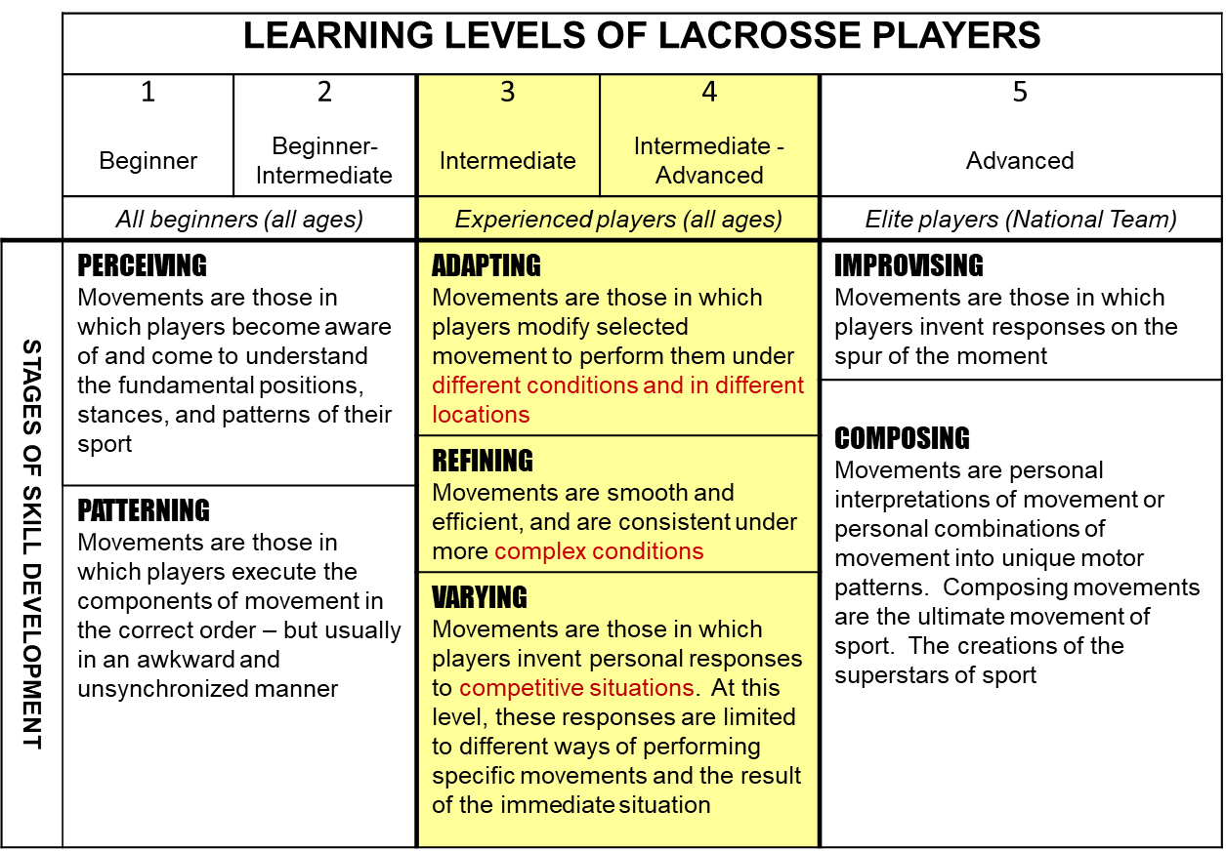
Notes:
LF Instructions – using G & D plus these levels of learning, create a profile of the age group you are coaching.
As athletes mature, gain experience & confidence we see their skill development grow to be able to Adapt, Refine and Vary their movements into the competitive situation.
How do we, as coaches, challenge our players to do this??
Expected responses –
More complex drills, increase the Decision making by the athlete
Practice specific game situations in practice, so they have already been there/done that come game time
Inspire them to get better – stick skills on their own, improving fitness
Others?
TASK:
-Manual – review stages of development
p3-12 learning levels (tied to DEVELOPMENTAL age, not chronological age!)
Must understand their Growth & Development (p3 – 3 through 3 – 8)
Use the “profile” of the age group you have developed from p 3-3
How to get athletes there:
- Refer to(coach can use as they like):
Psycho / emotional development: Goal setting…3-15, 3-16, 3-18(inventory)
Taking your drills / skills to next level 3 - 19

Slide 21

Tryouts – what should they be composed of
Team selection criteria – athletes should know in advance what you’re looking for
How to evaluate players
Notes:
Strength and weaknesses
Areas for growth
Next steps/next level
Why do we evaluate?
How to evaluate?
- many eyes, notes from evaluators
Level of play – are they at or have potential to get to, what you expect
Removing BIAS – ie parents of players as evaluators (and coaches, although this is difficult)
Components of the tryout?? (stickwork / drills involving patterns – can they think? / small game play – need to touch the ball!)
“Deselection” – hardest job that coaches face, can be emotionally challenging to athletes….how to handle? (discussion)
Tryout checklist 7-21 [WF manual]
Early maturers vs late maturers

Slide 22
Developing Emotional Intelligence
Emotional Intelligence is developed during
Teachable Moments
Promoting Fair Play & the Spirit of Sport
The effort to satisfy the Psychological Needs
Building confidence and self esteem through sport
Notes:
LF Instructions: Building confidence in athletes is as important as teaching them strategy!
Explain the two examples of developing emotional intelligence.
Teachable moments –
Stopping practice to learn from something that has just happened in the course of play (playing WITHIN the rules)
Reinforcing positive self talk and support of teammates
The Meeting of Psychological Needs Builds… [developing emotional intelligence]
1. Self-Esteem
A feeling of satisfaction that someone has in himself or herself and his or her own abilities.
2. Empathy
Empathy is recognizing the feelings of other and is the primary emotion involved in:
Team Building
Fostering the Spirit of Sport
Developing the Respect that is key to FAIRPLAY
3. Self-efficacy
Self-efficacy is the belief that one can achieve and is the emotion that:
Motivates players to learn and try new things.
Foster hope and keeps players from giving up
Psychological needs of athletes – Achievement, Affiliation, Self-direction, Sensory
Affiliation – largest need of athlete
How to keep participants involved?
Ref: Module 3 of manual

Slide 23
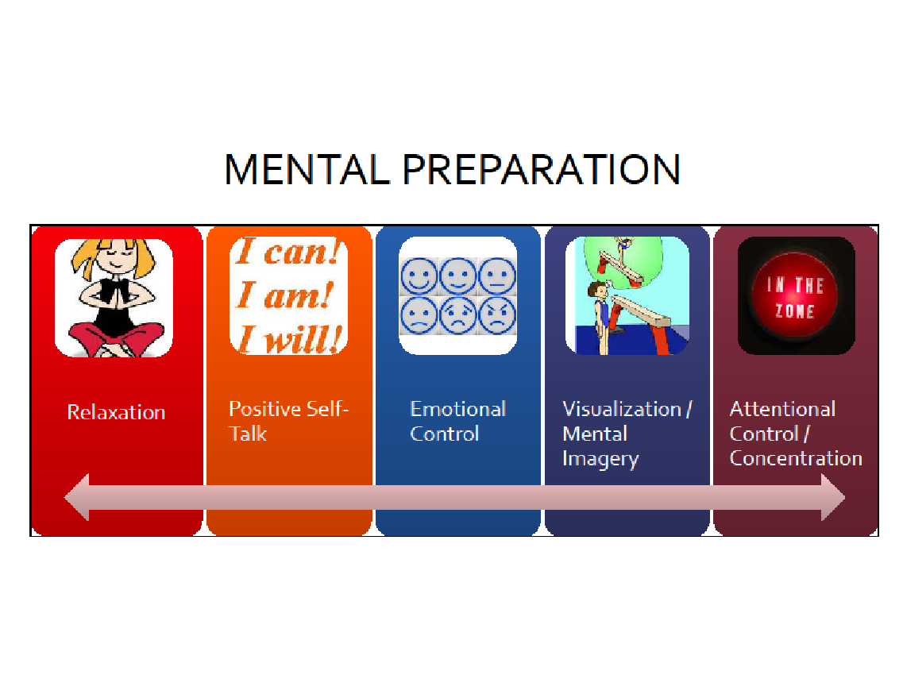
Notes:
LF Instructions:
Introduce Mental Prep by posing the question: What does Mental Prep mean to you? (quick gathering of examples from participants)
Share Examples of mental skills with coaches:
Relaxation - team yoga after practice; “soft hands” technique p5-4
Positive self talk - have the player turn negative comments into positive (instead of “I can’t, I’m trying)
Emotional Control - “control what you can control”, let outside influences/forces go - ie. can’t control what the refs call/don’t call, but can control your reaction to it
Visualization/Mental imagery - use of CUE / key words (build into your ‘team language’; bring team together, have them close eyes and focus on your voice – lead them through a guided visualization
Attentional control / concentration - maximize focus - less talking, more doing in practices;
Share - Team & Individual builders -
Positive strategies to use:
Positive sandwich (constructive feedback)
Grow and Glow, 2 stars and a wish….
I like that you… Next time… Keep….
Start / Stop / Continue - provide sample for the COACH to complete in the clinic (part of their growth)

Slide 24


Notes:
Re-introduce the Mental Health and Sport Resources Hub
Ask how many coaches have actually visited it??
Show the 2 minute video
Valuable resource for coaches & parents

Slide 25

What were your key takeaways from this elearning module?
Notes:
Definitions: Mental health is a state of psychological, emotional and social well-being in which individuals are able to feel, think and act in ways that allow them to enjoy life, realize their potential, cope with the normal stresses of life, work productively and contribute to their community.
Some signs of good mental health include self-acceptance, positive relations with others, independence, personal growth, satisfaction with life and integration into our communities.
Mental illness is a health condition that makes it difficult to function effectively (Keyes, 2003). It involves experiencing prolonged changes in thoughts, behaviours and feelings that cause distress and can make it difficult for a person to experience positive emotions, function day-to-day, maintain positive relationships with others and contribute meaningfully to their community (Public Health Agency of Canada, 2006).
Possible responses:
How to recognize, listen and respond
2. Duty of Care
The minimum care a coach owes to participants is to:
provide a healthy environment
recognize distress
refer when necessary
3. Valuable resources – Mental Health Action Plan; usable PDF files (which you can go back and access)
4. When you observe changes in behaviour for a period of two weeks or more, it may be time to assist the participant in accessing additional support. Use your judgment and don’t hesitate to seek support if you are unsure.

Slide 26
Mental health is a state of psychological, emotional and social well-being in which individuals are able to feel, think and act in ways that allow them to enjoy life, realize their potential, cope with the normal stresses of life, work productively and contribute to their community.
Mental illness is a health condition that makes it difficult to function effectively (Keyes, 2003). It involves experiencing prolonged changes in thoughts, behaviours and feelings that cause distress and can make it difficult for a person to experience positive emotions, function day-to-day, maintain positive relationships with others and contribute meaningfully to their community (Public Health Agency of Canada, 2006).
Notes:
Discussion point: How can this affect Mental Performance of your athletes?

Slide 27

Notes:
This Graphic - Thinking of our participants / athletes as a whole. (borrowed from elearning module: Mental Health in Sport)
The elements described here are not exhaustive, but they can help us to think about participants as whole people.
Knowing the participants you’re coaching helps you more easily recognize changes in a participant’s behaviour, appearance or interactions with others.

Slide 28
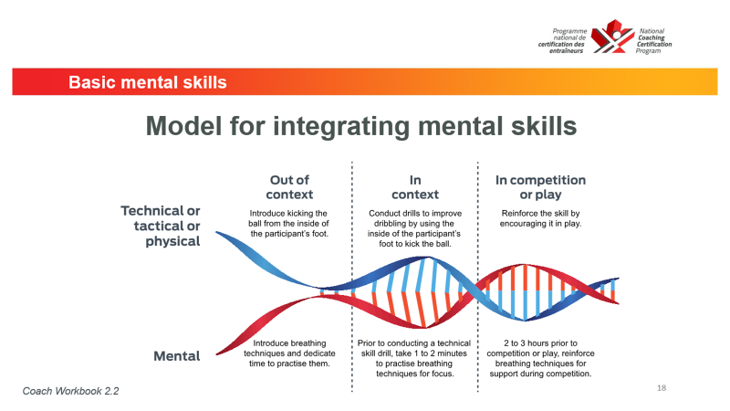
How to apply a useful technique:
Notes:
ANXIETY - will be high before competitions, think about teaching basic mental skills before competition (simple breathing exercise here)
Introduce Breathing exercise and where / how it can be implemented
Non lacrosse example – moving from out of context, in context, in competition (read through slide)
Task: Can take coaches through a simple breathing exercise – box breathing – in for 4, hold for 4, out for 4
Think about:
Building into Seasonal Planner – when to introduce?
Again GOAL SETTING can help to manage competition anxiety – must build in!
Break before starting Seasonal Planning

Slide 29

Seasonal Planning
Notes:
One of the NCCP OUTCOMES for competition introduction coaches is the ability to PLAN A COMPLETE season; your practice plans are only a piece of this
What is the seasonal plan ?
Allows the coach to “map out” the season – all components
To get started – p7-5 in module 7 (context of program)
P7-6 Orientations of your program/objectives
Now need a calendar – read p7-7
Time for the seasonal planner [hand out extra copy to each participant]

Slide 30
2018
PRE-SEASON (Preparatory)
IN-SEASON (Competitive)
POST-SEASON (Transition)
Mar
APR MAY JUN JUL AUG SEP
27 7 14 21 28 5 12 19 26 2 9 16 23 30 7 14 21 28 4 11 18 25 1
1
1
2
2
3
3
2
2
2
2
2
1
2
2
2
2
2
2
3
2
39
2
2
2
2
2
2
2
2
16
5
6
11
1
1
1
1
1
1
3
1
1
3
14
T P
SL
M
M
T P
R2
M
RF
PL
PA
PL
F
PA
F
SO
SO
SO
14 Competition Days
% of days devoted to competition
= 26%
14 Competition Days + 39 Training Days
39 Training Days
% of days devoted to training
= 74%
14 Competition Days + 39 Training Days
Notes:
Setting up the Seasonal Planner – this slide has “MANY CLICKS” !!
Will allow participants to go through STEP BY STEP how to set up their planner
Required for this TASK – copy of seasonal planner; a calendar (for dates); an idea of their practice & playing schedule for season(estimations are fine for this exercise)
Step 1 – setting up the calendar (MONDAY of each week is the DATE you put in)
Step 2 – planning out your “admin duties” – these include duties perhaps completed by a manager or trainer; create short forms that make sense to you
Step 3 – think about “evaluations”
Step 4 – complete the “team” training/competition schedule
Step 5 – establish the PHASES of your season – draw a vertical line down the page; label at top [pre season(preparatory) / in season(competitive) / post season(transition)] p7-9
**go through manual to match page numbers with exercise……
Step 6 – Competition days vs Training days (importance…… ALL the learning happens in practice! Need reps to grasp all concepts) p7-10
Analysis (7-11)

Slide 31
Module 6: Physical Preparation
Learning to Compete Phase of Athlete Development must include training to increase:
- speed
- intensity & endurance

Slide 32
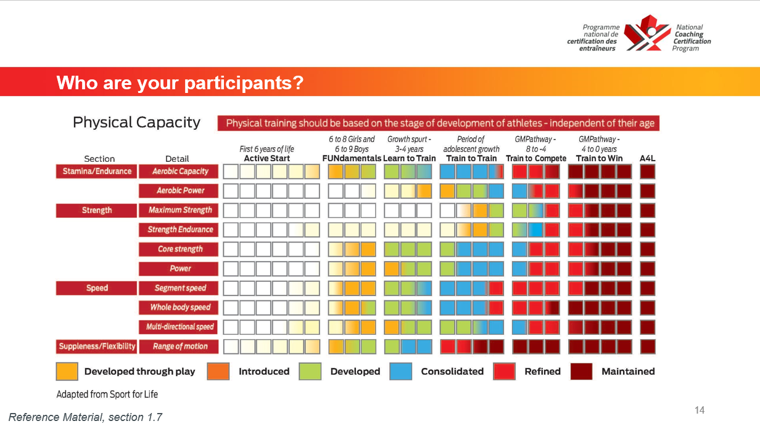
Notes:
Be aware of the actual capabilities of your participants
Adolescent growth vs Mature body
What components are necessary for WF?? Look where optimal training time is….
COMPLETE p7-14 [athletic abilities

Slide 33
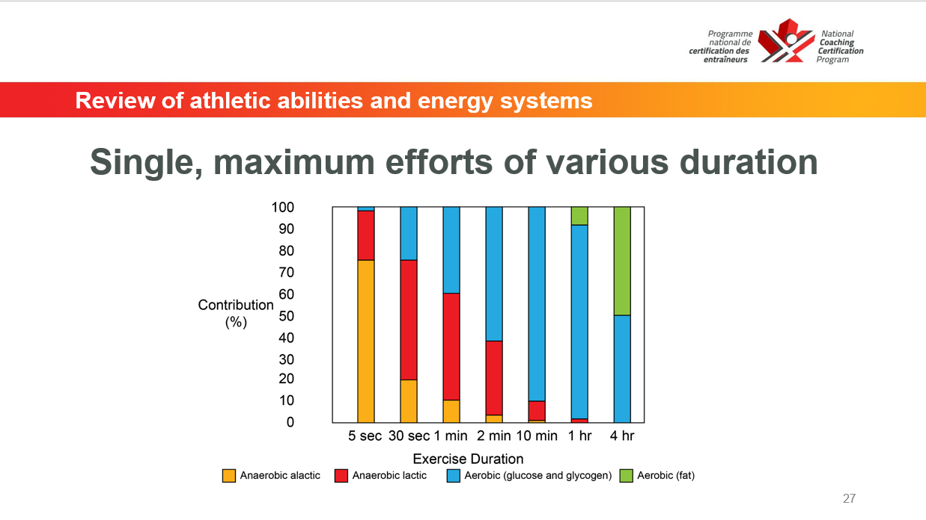
Notes:
Energy systems in Lacrosse –
HIGH – anaerobic alactic & anaerobic lactic (short bursts of maximum effort; followed by active recovery)
Need ‘aerobic’ endurance for recovery
Good examples of drills in manual for building these capacities (module 6)
Don’t need to “just run” in practices – build in the energy systems

Slide 34
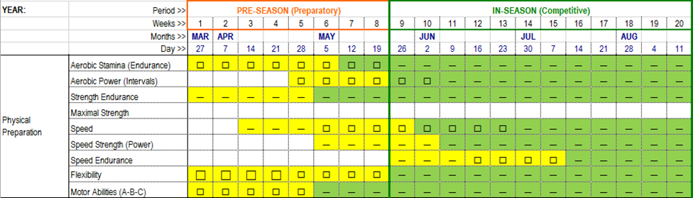
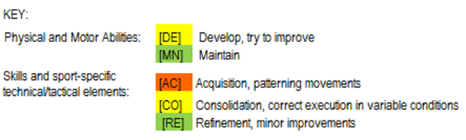
CODES for the objectives:
Use shapes to indicate the importance of the skill or ability:
High
🗆 Medium
- Low
Notes:
Adding Physical Preparation to the seasonal planner – coding info!
Technique: initiation, acquisition, consolidation, refinement
Tactics: acquisition, consolidation, decision-making (more intense competition requires MORE and FASTER decision making by the athlete)
Physical skills – development, maintenance
Reminder…..
Stages of Learning for Skill Development – there are 4, they are:
Initiation – first introduction to the skill
Acquisition – awkward (possibly uncomfortable) performance of the skill
Consolidation – can perform at game speed
Maintenance(refinement) – can perform skill (comfortably)under all circumstances

Slide 35
What’s next for you?
If not already done – elearning modules (Safe Sport, Mental health in sport)
Make Ethical Decisions module
Develop your seasonal planner and make it useful for you!
Moving toward “certification” – in person evaluation & completion of evaluation portfolio [recommend within the next several years]
Notes:
ADD TO TECHNICAL SLIDEDECK

Slide 36
Lunch break – then technical package
Come back by…..
Ready to discuss all things game related!

Slide 37
Lunch break – then technical package
Come back by…..
Ready to discuss all things game related!

