Slide 1
Annual General Meeting May 9, 2023

Slide 2
2023 AGM Agenda
2023 AGM Agenda
Call Meeting to Order
Quorum is declared
Adoption of Minutes from 2022 AGM
Introduction of Current:
AMHA Executive
Board of Directors
Operations Committee
League Reps
Acknowledgements
Committee Updates
Survey Results
Registration Update and what's new next season
Financial Review
Motion to adopt Financials
Proposed Bylaw changes - Vote
Membership Questions
Presidents Report
Invitation to All stay on the call for Elections
Motion to adjourn

Slide 3
Current Executive Committee
President – Christie Cameron
VP 1 Administration – Graeme Rowe
VP 2 High Performance – Jeff Chase
VP 3 Competitive – Brad Kempin
VP 4 City – Kelsey Brockway

Slide 4
Current Board of Directors
High Performance – Chad Barton
Competitive – Kiel Camponi
City – Erin Huta
Female – Jenna Wood

Slide 5
Current Operations Committee
Division Coordinators:
High Performance:
U18 AA – Byron Eddy
U18 AA Female – Mike Harper
U15 AA – Troy Skidmore
U13 AA – Jim Gamlin
Competitive:
U18 – Johnny Abboud
U15 – Rhyan Stefura
U15/U18 Female – Chelsea Oberten
U13 – Patrick Stachniak
U11 – Scott Brockway
U11/U13 Female – Scott Brockway
RHL/City:
U18 – Jodi Clark
U15 – Brent Emo
U13 – Clayton Weir
U11 – Ashley Schuler
Recreation – Darren Dreger
U9 – Megan Condie
U7 – Mumtaz Robson

Slide 6
Current Operations Committee
Operational Coordinators:
Coach Coordinator HP/Comp – Paul Brophy
Coach Coordinator RHL/City - Mike Lawson
Player Development HP/Comp - Cale Larson
Player Development RHL/City - Darryl Fraser
Player Development Female - Mumtaz Robson
Team Manager – Robyn Sikorski
Evaluations – Nicole Gidluck
Tournament – Michelle Anhorn
Equipment – Michelle Anhorn
Risk Management – Curtis Slabosz
Goalie Development – Eric Campbell
Referee Liaison – Trevor Dziaduck

Slide 7
League Representatives
AEHL (AAA Teams) - Bob McLean
SCAHL (AA Teams)- Dave Skrenek
CAHL (Competitive Teams) - Carrie Nedeau
RHL (City Teams) - Erin Huta
AFHL (AA Female Elite) - Mike Harper
RMFHL (Female) - Jenna Wood

Slide 9
Committees
COMMITTEES of AMHA
AEHC - Airdrie Elite Hockey Committee
Chair - Bob McLean
Goalie Development
Chair - Eric Campbell
Player Development
Chair - Vacant
Tournament
Chair - Michelle Anhorn
Evaluations
Chair - Nicole Gidluck
Female
Chair - Jenna Wood
Evaluations Food Committee
Chair - Shannon Stiefel
NEW COMMITTEES
Coach Committee
Social Media Committee

Slide 10
Committee Update
ACAA Committee
The Committee has worked hard this season and we do have some new changes to our AAA Committee and Teams.
This committee will now be called the AEHC, Airdrie Elite Hockey Committee.
The AMHA Executive will be revising the committees Terms of Reference soon.
A decision was made by the AMHA Executive to move the Avalanche practices and games to Airdrie.
AMHA plans to also have some AAA team games in a few of our draw zone arenas, this season.
Cochrane Minor Hockey informed us that they have no ice for the Havoc so the U16 AA team will also be practicing 100% in Airdrie this year too.

Slide 11
Committee Update
Goalie Committee
This committee is responsible for looking after everything related to goaltenders in AMHA.
DMSG will be running our Prep Camps and Evaluations again in the fall.
During the season, we will be continuing with our weekly goalie development at Explosive Edge for U9 to U18.

Slide 12
Committee Update
Player/Coach
Development Committee
AMHA will continue to use Ross MacLean Hockey and Airdrie Skate Club for our Player Development again this season.
We will be adding some off ice Coach Sessions with the Ross MacLean group to create a more cohesive coaching culture.
Recreation teams, AAA, AA and U18 teams will not participate in the Ross MacLean Hockey Player Development.
U9 will continue to have Ross Maclean Hockey and Power Skating sessions by the Airdrie Skate Club team.

Slide 13
Committee Update
Tournament Committee
Each season AMHA hosts tournaments that rotate by division every second year.
This year AMHA will be hosting the U11 and U13 tournaments as well as the U7/U9 jamboree at the end of the season. We will offer to host AA tournaments as well during the Christmas break.
This past season we hosted the First Annual Ryan Couling U18 AA tournament during the Christmas Break and it was a great success. It will run again this season.

Slide 14
Committee Update
Evaluations Committee
The Evaluations committee works with the staff and coaches to set up dates and plan out the evaluation sessions for all divisions each season.
The committee ensures that our tryouts and evaluations are run smoothly.

Slide 15
Committee Update
Female Committee
This past season, the female committee has made huge strides to increase the awareness and female programs within AMHA.
AMHA was given the opportunity to bid for the new U13 AA team and we were awarded the team as well as given the U15 AA team.
AMHA is excited to be the host association to the full AA Female program for our zone.

Slide 16
Committee Update
Evaluations Food Committee
This past season, instead of purchasing meals for volunteer evaluators, the Evaluations Food Committee coordinated volunteers to bring in food
Meals were well received by volunteers
Looking for more volunteers to help with supplying meals during evaluators.

Slide 17
Committee Update
New Committees:
Coach Committee
AMHA is working on creating a coach committee and the first meeting was very successful.
Social Media Committee
AMHA is hoping to create a social media committee for the 2023-2024 hockey season. The committee will work on increasing our social media presence. If you are a parent or a player and have experience with social media and would like to join our committee stay tuned for information from AMHA soon.

Slide 18
Year End Survey Results
Survey Results:
466 responses out of a possible 1197 (39%) from the U7 to U18 divisions representing AA, CAHL and RHL.
For all the questions about Head Coaches, practices and games the majority of results were in the Strongly Agree category.
Overall the majority of respondents were happy with their Head Coach, Assistant Coaches and Team Managers this past season.
In regards to our Player Development the results were a bit more neutral with 73% of people in the middle Agree category.
We will be breaking the data down by team and sharing it with the Division Coordinators to have available for any coaches that want to learn more.

Slide 19
2023-2024 Season Update
Registration Update
Registration will open by the end of May and will be done through Ramp again this year.
All Members will be charged any conditioning/ prep camps and/or tryout fees at the time of registration, as well as the base fee for the division of hockey they are registering for.
Once their player makes a specific team then a payment plan will start for the balance owing based on the schedule set out per team/division.
If you register your player for a AAA, AA, or Travel team, and your player does not make one of these teams, the pending payments for October and/or November will be cancelled.
Please refer to the fees chart when registration opens.

Slide 20
2023-2024 Season Update
New Registration Costs
The City of Airdrie Ice Rate has increased from $227.85 to $229.95.
Hockey Alberta Player and Coach Fees have also increased approximately $12 person.
Increase in fees for AMHA photos from $10 per player to $20-$30 per player
AMHA has also added some additional items to our overall budget.
PD Day Ice Sessions - we will have some ice on Professional Development days for all AMHA streams. The ice is limited and will be on a first come first serve basis for registration.
New Arena Fund - the city informed us that if we want any kind of extra’s (special dressing rooms, offices etc.) that we would need to contribute to costs.
Scholarships for U18 graduating players

Slide 21
2023-2024 Season Update
Jersey Deposit Update
We will no longer have the Jersey deposit fee added to our registration.
We have a new policy.
We will expect all jerseys (exception U11 - one set)to be returned at the end of the season in reasonable condition.
Families who do not return their jersey(s) will have a $200 fee added to their RAMP account and a note will be added to their Hockey Canada Profile to indicate the player is not a member in good standing.
Once the fee is paid this note will be removed.

Slide 22
2023-2024 Season Update
Volunteer Deposit Update
Our volunteer policy will be changing.
All families will be expected to volunteer for 10 hours per team.
We hope this change will help our teams run more effectively with volunteer participation from all families.
Our managers will have reporting dates throughout the season to let us know if all families are completing their volunteer roles.
If not, AMHA will add a $300 fee to the RAMP account to be paid within 15 days or the player will be suspended.
If not paid a note will be added to the players Hockey Canada profile to indicate the player is not a member in good standing.
Once the fee is paid the note will be removed.
Any fees collected will go back to the team.
The intention of our volunteer policy has always been to have our members share the volunteer responsibilities on their teams and within our association not to collect money.

Slide 23
2023-2024 Season Update
Registration Cap
AMHA is projecting over 80 full teams this season
Important to register as early to secure a spot for your player(s).
We will close registration when we reach our cap.
For those members who use funding options such as Kidsport, Jumpstart, Hockey Assist or Kalix Langenau fund, or those who may need different payment options, please call the office prior to registration opening to make arrangements.

Slide 24
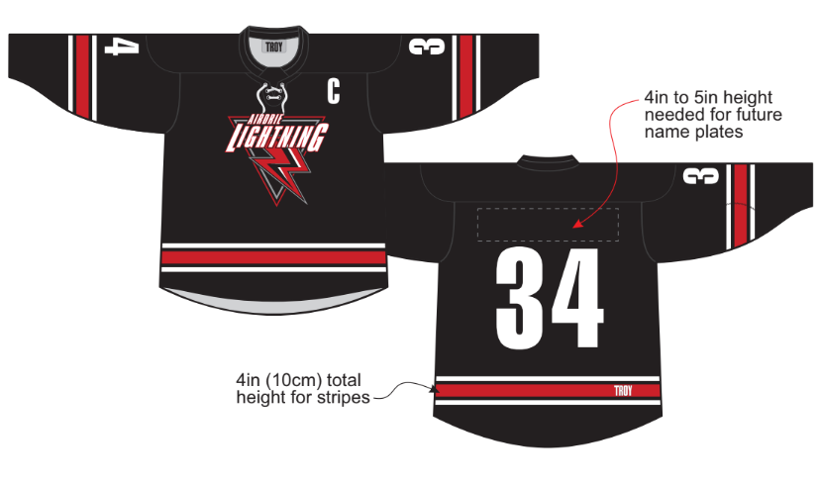
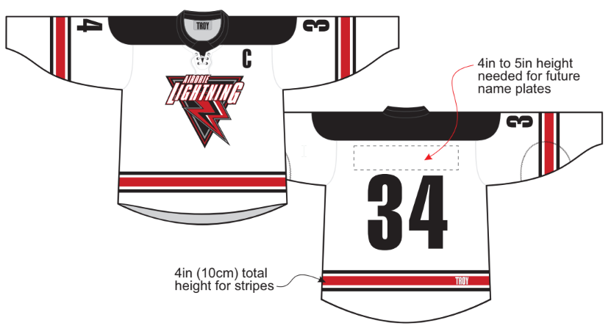
2023-2024 Season Update
Jersey Update
AMHA has a plan to replace our jerseys every three to four years, and it is now time to replace them, so we will have new jerseys this fall.
Our Jerseys will align with our AAA teams and be black with red and white with red, they will have a lace neck and a scoop bottom.
We have removed the hockey stick logo and are going forward with the Airdrie Lightning logo for all teams except AAA.
Teams will be able to have sewn on name bars.
We are excited to roll out our new look!

Slide 25
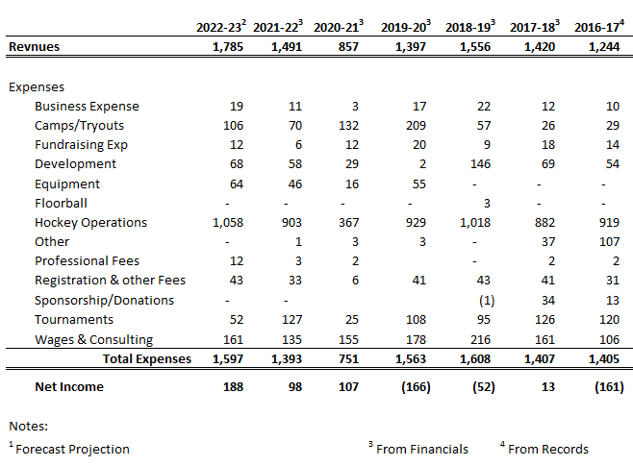
Financial Review
Profit and Loss

Slide 26
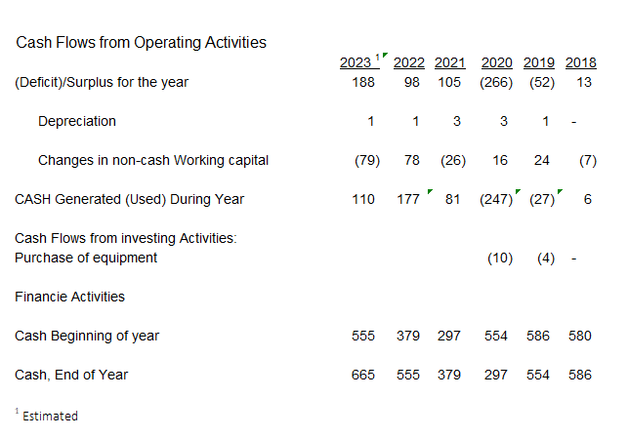
Financial Review
Cash Flow

Slide 27
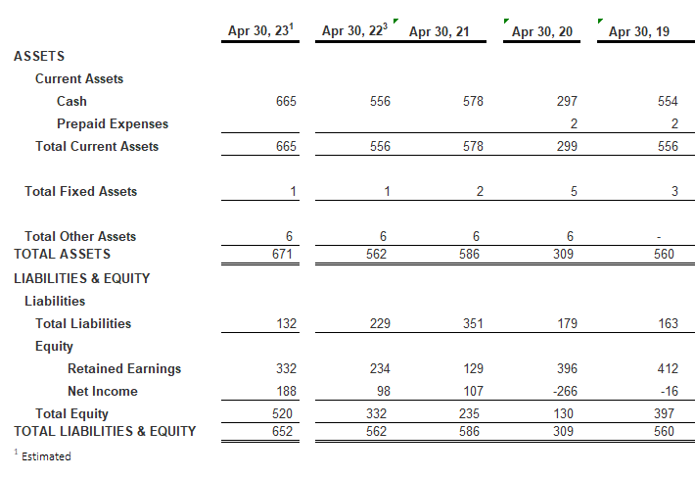
Financial Review
Balance Sheet

Slide 28
Proposed Bylaw Changes
Repeal and replace our 2022 Bylaws with the new proposed 2023 Bylaws
Summary of Changes:
Add a Vice President 5 - Female to the Executive Committee
Add a High Performance - Female Director
Remove Female U18 AA Elite team responsibilities from VP 2 and VP 3
Add the VP 5 Responsibilities
Quorum for EC will now be 4
Amended the voting structure for the EC. In the event of a tie the President will get a second vote.
#14 Minutes of meeting - remove the line where the minutes are signed by the President as they are maintained online.

Slide 29
Member Questions
Question 1 - Submitted by Eric Campbell
When it comes to team creation, majority of the coaches have coached the "bubble" kids in the past. With the current procedure the player has to be within a certain range in order for a coach to be able to select that player to be on their team. To make our teams as competitive as possible, I feel the coach/coaching staff should have more of a say to whom they'd like to select and not be restricted to algorithm information results that was provided by evaluators that some have very little experience doing so. By the time the 2nd game skates are completed, there's a good idea as to where the majority of the coaches kids will land, the coaches should then be selected and those coaches should be involved with the evaluations of the remaining skates and team creation.
AMHA Answer read by Jeff Chase:
AMHA members expect that our evaluation process is unbiased. If we allow coaches to choose even more players than we do now, even if our coaches are not choosing players for the wrong reason, the perception could be that they choose certain players because they are friends, family, etc. AMHA wants our prospective coaches to all participate in evaluations, however the process is very different for an evaluation vs a tryout where the coach picks the whole team. If the coaches attend the final skates of the potential team they will be coaching they will have a better idea of who to select when it comes time to pick out of the “bubble kids”.

Slide 30
Member Questions
Question 2 - Submitted by Eric Campbell
I feel if you have signed up for a coach/asst coach position, you have to participate in the evaluation process.
AMHA Answer read by Brad Kempin:
AMHA does encourage our coaches to sign up for the evaluation process. Unfortunately our coaches are volunteers and some just may not be able to attend our evaluations. Sometimes we are looking for coaches for some of our teams after evaluations have completed.

Slide 31
Member Questions
Question 3 - Submitted by Eric Campbell
I realize we rely on the expertise of our 3rd party goaltending evaluators to place our goalies in their appropriate spot to enable them to succeed. I do feel the coaching staff should have more input in the selection of their 2nd goaltender (with proposed restrictions in place)
AMHA Answer read by Graeme Rowe:
As the goalie coordinator, you could propose a change to the evaluations process for goalies and the Executive could consider the coach pick part of the process to be extended to the goalies? Currently with only 2 goalie’s per team that is giving the coach a lot of power and they would probably still have to only be able to pick from 1 goalie up or down in the ranking to keep it fair.

Slide 32
Member Questions
Question 4 - Submitted by Helena Killinger
Why aren’t evaluation scores made public or accessible to the parents after each skate or at all? We parents are paying to have our children participate in this sport and it makes no sense that these scores aren’t accessible to us. We should be allowed to see and have access to that information. I would like to see that change.
AMHA Answer read by Kelsey Brockway:
The AMHA evaluations are technically not an evaluation of each player. The volunteer evaluators are tasked to rank the players on each separate ice session from top to bottom in order to place each player on the team that is appropriate for his/her skill level. We would never publicize these rankings as that could be devastating for a child who is ranked lower. We do have an evaluations policy which states that parents can ask for their child's evaluation ranking. These results would just be the players ranking among all the players in that division. The parent would only be given their own child's ranking.

Slide 33
Member Questions
Question 5 - Submitted by Helena Killinger
Why aren’t we hiring outside evaluators at all levels? Just because an evaluator doesn’t have a player in the age group that they’re evaluating in, doesn’t mean they don’t know the families or kids they’re evaluating.
AMHA Answer read by Jeff Chase:
AMHA has hired outside evaluators in past years, and felt that we had an equal amount of parent complaints. Outside evaluators could raise player registration fees by $100 to $150 each. AMHA feels like our current evaluation process is set up to be unbiased, cost effective and works efficiently.

Slide 34
Member Questions
Question 6 - Submitted by Norm Stevens
Is there any reason why AMHA isn’t using outside evaluators for the evaluation process. This would provide unbiased process and a more accurate assessment of every child’s level of play.
AMHA Answer read by Brad Kempin:
Previously Answered in the last question.

Slide 35
Member Questions
Question 7 - Submitted by Norm Stevens
Is there any thoughts of allowing player movement after the tiering round to ensure the teams are going into the season with like skilled players on every team. This would also players are placed in an environment to succeed and thus creating a higher level of confidence.
AMHA Answer read by Graeme Rowe:
Often players who are in the “bubble”, meaning the last five players of the higher team and the top five players of the lower team are interchangeable and are evaluated to the best of our abilities given what the players show during the evaluation skates. We do have the coach pick, which can serve to help alleviate any possible misses. Due to the quick timelines that we have to adhere to for league starts dates after our evaluations are complete, it is not conducive to re-tier players. It is also not mentally fair to players who make a team to then tell them that they must move to a lower team after a few weeks of being on a team.

Slide 36
Member Questions
Question 8 - Submitted by Helena Killinger
Will AMHA be hiring a new photographer for team photos this year? Will the venue be the same as well?
AMHA Answer read by Kelsey Brockway:
AMHA is looking at getting a new photographer for next season. We currently do not have information on the venue. If any of our members know of a great reasonably priced photographer or venue they can email that information to the AMHA office admin team for consideration.

Slide 37
Member Questions
Question 9 - Submitted by Lacey Short
Why are we still using GameFace Photography when year after year there is so many issues?
AMHA Answer read by Jeff Chase:
AMHA was in a 3 year contract with GameFace and is looking at getting a new photographer for next season. As mentioned earlier, if any of our members know of a great reasonably priced photographer and/or venue they can email that information to the AMHA office admin team for consideration.

Slide 38
Member Questions
Question 10 - Submitted by Raymond Pollock
I suggest AMHA ADDS an ice time each week for the Rec hockey teams. There are currently 2 ice times and they average ~40 kids (20 kids per team). It would be great to reduce the number of kids per time to maximize the ice time each kid gets. Overall the rec hockey program is well run and meets my expectations.
AMHA Answer read by Brad Kempin:
AMHA feels that we have a well balanced assortment of programming in our association. The recreation program is set up to offer a low cost, low commitment program for families with those wants in mind. All families have the option to join our Rockies Hockey League (RHL) if they would like to have a program that offers more ice time.

Slide 39
Member Questions
Question 11 - Submitted by Darcy Campbell
Full ice practice for U11. It’s important more so for U11s moving into full ice games to get full ice exposure in practice. During COVID tiered teams were doing the max ice concept giving them opportunity to practice full ice for half of their practices. Why did this change and is it an option moving forward?
AMHA Answer read by Graeme Rowe:
We have been using the shared one hour practice for a few years now and we find that our teams are doing well in their leagues. This coming season, we hope to have more engagement with our coaches in order to provide them with options to best utilize and get the most out of each one hour practice. As well the 2 head coaches can sometimes work together to run full ice drills during the shared practices.

Slide 40
Member Questions
Question 12 - Submitted by Kevin Visser
How can the ACAA decide to move the AC Avalanche out of Cochrane without even consulting with the AMHA and CMHA parents and players who were members of the Avalanche? Or even the rest of the members of the ACAA?
AMHA Answer read by Kelsey Brockway:
The ACAA Committee did not make the decision to move the Avalanche practices and games. The decision was made by the AMHA Executive Committee and we are confident in this decision. This move has been a decision that has been being considered for years since Hockey Alberta split the zone. Airdrie is the host association for the draw zone, not Cochrane. We did research and found that we were the only host team in Alberta that did not host all of our AAA teams games in their hometown. The below excerpt from the Hockey Alberta Elite Male document also encouraged us to move the practices and games to Airdrie. While the Avalanche team was in Cochrane there was a perception that Cochrane was the host team and therefore responsible for the operation of the team. AMHA felt that this perception needed to be corrected and clarified. Our Executive also feels that in order for us to have a strong AAA program, our three AAA teams need to be aligned and have consistency in programming.
Each EDZ has a Host Minor Hockey Association identified within it and this Host MHA is responsible for operating the “AAA” Team(s) as identified for the area, in accordance with this Elite Male Hockey Model and the EDZ Operating Model document;

Slide 41
Member Questions
Question 13 - Submitted by Kevin Visser
Where will the extra ice times for the Avalanche AAA team come from? They practice 2x per week like the rest of the ACAA teams?
AMHA Answer read by Jeff Chase:
The AMHA Administrative team and the AMHA Executive have worked out a schedule for the upcoming season that will fulfill the needs of all of our teams including the addition of two new female AA teams and the U17 AAA Avalanche and the U16 AA Havoc, as Cochrane Minor Hockey has informed us that they no longer have ice available for the U16 AA Havoc practices or games.

Slide 42
Member Questions
Question 14 - Submitted by Chelsea Oberten
With the addition of two more AA teams and moving the U17AAA team to Airdrie how will that be affect the already existing ice shortage?
AMHA Answer read by Brad Kempin:
Previously Answered.

Slide 43
Member Questions
Question 15 - Submitted by Jessica Lacey
I noticed the U15 AA head coach posting was worded differently, after hiring a parent for the U13 head coach position I’m wondering if your intentions are the same for this position?
AMHA Answer read by Graeme Rowe:
AMHA always strives to choose non-parent coaches for our AA teams. We often receive resumes for the older age categories and very few or none for the U13 age. Our AA stream looks to hire the best possible non-parent coach but can choose a parent coach if that parent coach is the best option or a parent coach is the only option. If we choose a parent coach, and their player has not already been on the AA team in the previous season, then a team of evaluators are hired to evaluate the tryout group to determine if the prospective coaches player is in the top 10 to make the team, until the tournament portion of the tryout process.

Slide 44
Member Questions
Question 16 - Submitted by Chelsea Oberten
How is AMHA going to monitor the upcoming seasons U18 goalie registration to ensure there will be enough positions for all the goaltenders registered?
AMHA Answer read by Kelsey Brockway:
We hope to offer spots for all of our players who played with us this season, but it will be extremely important to register early as we are expecting to be full in most divisions and we will be capping registration. For families with goalies it will be even more important to register early.

Slide 45
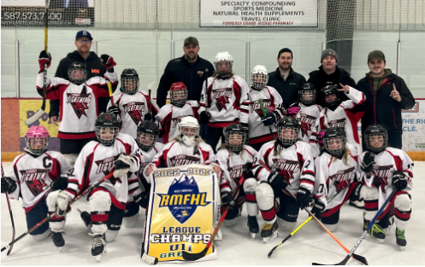
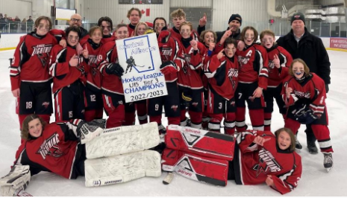
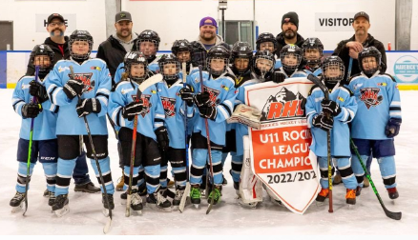
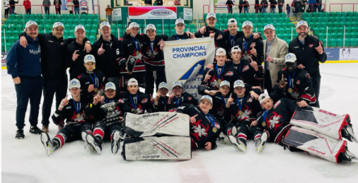
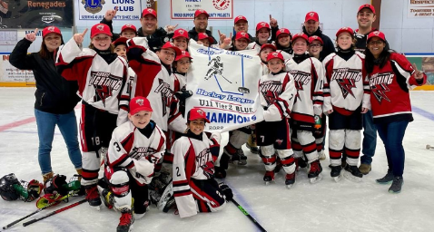
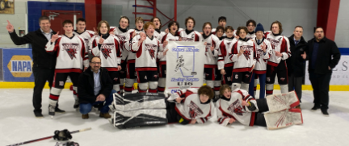
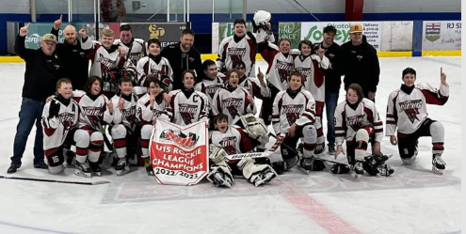
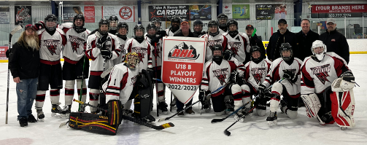
Presidents Report
2022-2023 Highlights:

Slide 46
Thanks for attending
AGM Adjourned
Everyone is invited to stay on call for Elections.

Slide 47
AMHA
Elections 2023-2024

Slide 48
Elections for Executive Committee
Executive Committee
President: Christie Cameron
Vice President 1 - Admin: Vote
Graeme Rowe
Nicole Gidluck
Vice President 2 - High Performance: Jeff Chase
Vice President 3 - Competitive: Brad Kempin
Vice President 4 - City: Kelsey Brockway
Vice President 5 - Female : Vote
Mumtaz Robson
Jenna Wood

Slide 49
Election of Board of Directors
Directors
High Performance: Vote
Chad Barton
Pat Stachniak
Competitive: Kiel Camponi
City: Erin Huta
Female HP: Brendan Clavelle
Female RMFHL: Vacant

Slide 50
AA Division Coordinators
Division Coordinators
AA:
U18 AA : Vacant
U18 AA Female: Mike Harper
U15 AA: Vacant
U15 AA Female: Dacia Caron
U13 AA: Glenn Odishaw
U13 AA Female: Kendra Bigoraj

Slide 51
Competitive Division
Coordinators
Division Coordinators
Competitive:
U18: Johnny Abboud
U15: Clayton Weir
U13: Korin Lemay
U11: Vote
Oscar Alvarez
Scott Brockway

Slide 52
Female Division Coordinators
Division Coordinators
Female:
U15/U18: Chelsea Oberten
U11/U13: Megan Condie

Slide 53
RHL/City Division Coordinators
Division Coordinators
City:
U18: Jodi Clarke
U15 : Brent Emo
U13 : Nicole Grochowich
U11: Vacant
U9 : Aliceyn Egan
U7 : Brian Eagle
Recreation: Darren Dreger
Jr C : Vacant

Slide 54
Operations Committee
Operational Coordinators:
Team Manager: Vacant
Tournament: Michelle Anhorn
Equipment: Michelle Anhorn
Appointed positions after AGM:
Evaluations
Risk Management
HP/Competitive Coach
RHL/City Coach
HP/Competitive Player Development
RHL/City Player Development
Female Player Development
Goalie Development
Referee In Chief Liaison - Trevor Dziaduck

Slide 55
Adjourn
Motion to Adjourn the
Election meeting

Slide 56
Thank you all for attending.

