Slide 1
Annual General Meeting May 14, 2025
Notes:
📣 The current slide has created polls by Live Polls, please do not delete the poll icon
✅ Click on "Click to Present" icon and the poll will launch automatically

Slide 2
2025 AGM Agenda
2025 AGM Agenda
Call Meeting to Order
Quorum is declared
Adoption of the 2024 AGM Minutes
Introduction of Current:
AMHA Executive
Board of Directors
Operations Committee
League Reps
Acknowledgements
Committee Updates
Survey Results
Registration Update and what's new next season
Financial Review
Motion to adopt Financials
Membership Questions
Presidents Report
Invitation to stay for Elections
Motion to adjourn
Notes:
Slide 2 - Nicole
I will call the meeting to order at ____pm.
As per by-law 9.1(L), more than 20 is a quorum. Since we are well over that tonight, we have a quorum, thank you.
Our 2024 AGM Minutes have been on our website since just after our AGM 2024, but if you would like to read them, you can find them under our AGM Tab. Can I get a motion to adopt the 2024 AGM Meeting Minutes.
_____________, Seconded ______________
Approved.
As you can see we have a full agenda this evening. We would like to start with introducing all of the AMHA Board.

Slide 3
Current Executive Committee
President – Pat Stachniak (Interim)
VP 1 Administration – Nicole Gidluck
VP 2 High Performance – Pat Stachniak
VP 3 Competitive – Glenn Odishaw
VP 4 City – Brent Emo
VP 5 Female - Mumtaz Robson
Notes:
Slide 3 - Pat
Sincere thank you to our Executive Committee.
- VP Administration Nicole Gidluck
- VP High Performance Pat Stachniak
- VP Competitive Glenn Odishaw
- VP City Brent Emo
and VP Female Mumtaz Robson.

Slide 4
Current Board of Directors
High Performance – Darcy Campbell
Competitive – Korin Lemay
City – Jayelle Peters
Female HP – Brendan Clavelle
Female RMFHL – Chelsea Oberten
Notes:
Slide 4 - Glenn
Next we have the Board of Directors:
- High Performance Darcy Campbell
- Competitive Korin Lemay
- City Jayelle Peters
- Female High Performance Brendan Clavelle
- Female Chelsea Oberten.

Slide 5
Current Division Coordinators
Division Coordinators:
High Performance:
U18 AA – Jevon Sikorski
U18 AA Female – Kelly Arsenault
U16 AA – Shawn Brade
U15 AA – Ian Johnstone
U15 AA Female - Dacia Caron
U13 AA & U11 AA – Jonathan Wiest
U13 AA Female - Jenn Ross
Competitive:
U16 & U18 – Johnny Abboud
U15 – Heather Campbell
U15/U18 Female – Heather Bell
U13 – Julie Williams
U11 – Oscar Alvarez
U11/U13 Female – Megan Condie
RHL/City:
U18 – Jodi Clark
U13 & U15 – Nicole Grochowich
U11 – Jennifer Latreille
Recreation – Elizabeth MacGillivary
U9 – Aliceyn Egan
U7 – Derek Habberfield
Notes:
Slide 5 - Brent (or Nicole)
Here is a list of our great division coordinators.
U18 AA – Jevon Sikorski
U18 AA Female – Kelly Arsenault
U16 AA - Shawn Brade
U15 AA – Ian Johnstone
U15 AA Female - Dacia Caron
U13 AA & U11 AA - Jon Wiest
U13 AA Female - Jenn Ross
U18 – Johnny Abboud
U15 – Heather Cambpell
U15/U18 Female – Heather Bell
U13 – Julie Williams
U11 – Oscar Alvarez
U11/U13 Female – Megan Condie
U18 – Jodi Clark
U15 & U13 – Nicole Grochowich
U13 – Nicole Grochowich
U11 – Jennifer Latreille
Recreation – Elizabeth MacGillivary
U9 – Aliceyn Egan
U7 – Derek Habberfield

Slide 6
Current Operations Committee
Operational Coordinators:
Development Coordinator – Mike Mullenix
Coach Coordinator - Robyn Buchart
Player Development Female - Damara Allen
Team Manager – Megan Banks
Evaluations – Lindsey Goddard
Tournament – Michelle Anhorn
Equipment – Michelle Anhorn
Discipline / Risk Management – Curtis Slabosz
Safety Coordinator – Will Stewart
Goalie Development – Vacant
Referee Liaison – Leif Hanson
Notes:
Slide 6 - Nicole
And a list of our wonderful Operational Coordinators.
Development Coordinator – Mike Mullenix
Coach Coordinator - Robyn Buchart
Player Development Female - Damara Allen
Team Manager – Megan Banks
Evaluations – Lindsey Goddard
Tournament – Michelle Anhorn
Equipment – Michelle Anhorn
Risk Management – Curtis Slabosz
Safety - Will Stewart
Referee Liaison – Leif Hanson
Again, thank you so much for your time and dedication, it is greatly appreciated.

Slide 7
League Representatives
AEHL (AAA & AA Teams) - Jack Lumley
CAHL (Competitive Teams) - Korin Lemay
RHL (City Teams) - Jayelle Peters
AFHL (AA Female Elite) - Brendan Clavelle
RMFHL (Female) - Chelsea Oberten
Notes:
Slide 7 - Mumtaz (or Pat)
And lastly, our 6 league representatives.
AEHL (AAA Teams) - Jack Lumley
CAHL (Competitive Teams) - Korin Lemay
RHL (City Teams) - Jayelle Peters
AFHL (AA Female Elite) - Brendan Clavelle
RMFHL (Female) - Chelsea Oberten

Slide 8
Notes:
Slide 8 - Pat
At this time I want to acknowledge all of the wonderful people that help to make our organization run so smooth and successfully.
Thanks to all of our:
Board and committee members that we just mentioned
Coaches
Managers
Scorekeepers
Fundraisers
Team Building planners
Tournament Volunteers
Evaluations Volunteers
Jersey Parents
Safety Personnel
and all the other volunteers that keep our organization running day to day for our kids.
Thank you, thank you, thank you.

Slide 9
Committees
COMMITTEES of AMHA
AEHC - Airdrie Elite Hockey Committee
Chair - Jack Lumley
Goalie Development
Chair - Vacant
Tournament
Chair - Michelle Anhorn
Coach Committee
Chair - Robyn Buchart
Evaluations
Chair - Lindsey Goddard
Female
Chair - Mumtaz Robson
Evaluations Food Committee
Chair - Shannon Stiefel
Notes:
Slide 9 - Nicole
Now, we want to let everyone know about the committees we have within AMHA.
AEHC - Airdrie Elite Hockey Committee Chair
Goalie Development
Tournament
Coach Committee
Evaluations
Female
Evaluations Food Committee
If you have any ideas of other committees that we should start in the fall please bring your ideas forward. The Org Structure Review Committee will be beginning the arduous task of addressing the association structure this spring.

Slide 11
AIRDRIE ELITE HOCKEY COMMITTEE – THE YEAR OF CHANGE!
Change is the Only Constant
3 AAA Teams to 4
Added 3 Female AA Teams
Added 5 Mixed AA Teams
Spring Tryouts
Committing Elite Players Earlier Provides More Certainty to Families
The Airdrie Way
A consistent methodology for all teams within the Elite stream to operate

Slide 12
OUR COMPETITION STRATEGY:
In Comparison – 15% of our teams are Elite - over 17% of Calgary’s
Advocating for New Ice Surfaces = More Practice / Skills Time For Our Players
Need to make this an election issue
Working with the City and Private Builders
Airdrie Citizens pay for the surfaces, there should be a high % of Airdronians using the ice
The Best Coaches
Most important elements within our organization next to the players!
9 Box Methodology
Stack Ranking with a succession plan for each level
Spring Tryouts
Many thanks to our Partner Village Sports for making this work.
12 teams / 0ver 700 players / 100 ice times / 14 days / +1200 volunteer hours

Slide 13
NEW WEBSITE WWW.AIRDRIEELITEHOCKEY.COM

Slide 14
Committee Update
Goalie Development Committee
This committee is responsible for looking after everything related to goaltenders in AMHA.
A new Goalie Coordinator is electable at this AGM, to provide an interface between the committee and the board
Service Providers for Prep Camps and Evaluations still to be determined
Goalie development at Explosive Edge for U9 to U15 will continue
Notes:
Slide 12 - Nicole
The Goalie Development committee is chaired by the Goalie Coordinator, which is currently vacant.
The committee looks after the goalie evaluation process as well as coordinates with any goalie development opportunities throughout the season.
This committee has been in place for a few years now and has good membership, but needs a leader.
During the season, we will be continuing with goalie development at Explosive Edge for U9 to U15.
Last year the Goalie Development at Explosive Edge was over utilized and due to limited hours, we will be providing goalie development to all U11 & U13 teams, and some U15 teams .
92 goalies were rostered in 24-25; compared to 82 in 22-23; and 64 in 21-22.
Greatest demand was in U11 and U13, where available goalie registration spaces filled up within hours of opening registration
The Committees focus is on placement and development

Slide 15
Committee Update
Player/Coach
Development Committee
U9 Power Skating with Coach Chalsie was a success and will be continuing
AA/AAA Development will continue with Village Sports
CAHL/RHL & City leagues have no development built into registration costs. Each team is able to direct fundraising/sponsorship money for any desired development. There isn’t a one-size-fits all approach.
IHS (Ice Hockey Systems) software for Coaches was a hit and will be continuing
Current Coaches with expiring credentials have received notifications
Notes:
Slide 13 - Nicole
Team development was at each team’s discretion this year, as a one-size-fits-all approach wasn’t successful. That being said, the amount of development had to decided on and paid for out of team funds
Village Sports and the AAA Coaches helped to create a more cohesive coaching culture with AA.
U9 will continue to have Power Skating sessions by the Airdrie Skate Club team.
In an effort to have coaches certified before the season begins, all current coaches have been notified of expiring credentials.

Slide 16
Committee Update
Tournament Committee
Each season AMHA hosts tournaments that rotate by division every second year.
This year, Michelle Anhorn and her core group members (Erin Huta & Susan Englot) celebrated the organization of their 50th tournament for AMHA
2025 - 2026 Tournaments
U11 and U13 for all CAHL/RMFHL/RHL teams
U7/U9 jamboree
Notes:
Slide 14 - Nicole
The Tournament Committee is chaired by the Tournament Coordinator Michelle Anhorn. This committee has been in place for many years and reached the amazing milestone of it’s 50th tournament this year, planning, organizing and hosting AMHA’s tournaments.
Each season AMHA hosts tournaments that rotate by division every second year.
For 2024/25, AMHA hosted the U15 and U18 tournaments as well as the U7/U9 jamboree. Some AMHA AA teams host tournaments during the Christmas break.
For 2025/26, AMHA is hosting the U11 and U13 tournaments, as well as the U7/U9 jamboree…provided REA is open in the fall.
The availability of hosting a provincial tournament returns for March 2026, depending on volunteer commitment

Slide 17
Committee Update
Evaluations Committee
ensures that our tryouts and evaluations are run smoothly
For 2024 AMHA hired Fuel Performance Services for Travel teams and feedback was highly positive.
Paid 3rd party evaluators will be utilized again for the travel teams in 2025
Not cost effective to use paid evaluators for parity teams that are coach picked
Notes:
Slide 15 - Nicole
The Evaluations Committee is chaired by the Evaluations Coordinator Lindsey Goddard. This committee is responsible for ensuring that our evaluation process is current, clear and communicated to our members. Their meetings result in updates to the applicable evaluation policies.
The Evaluations committee works with the staff and coaches to set up dates and plan out the evaluation sessions for all divisions each season.
The committee ensures that our tryouts and evaluations are run smoothly. This year, with the REA closure for all of evals, things may look a bit different. Please be patient and accommodating.
AMHA will use Fuel as paid evaluators for our 2025 Travel Team Evaluations.

Slide 18
Committee Update
Safety Committee
ensures every team has education and documentation for Safety concerns, including injury & concussions
answers questions regarding protocols throughout the season
documents reported injuries
majority of documented injuries this season involved collisions and U15 made up over ⅓ of all reported injuries in 2024-25 season
concussions (either suspected or confirmed) represented ⅓ of all reported injuries
this committee would welcome some additional assistance from Safety oriented/concerned members safetycoordinator@airdriehockey.com
Notes:
Slide 15 - Nicole
The Safety Committee is dedicated to ensuring safe practices and providing education around injury processes. Will would welcome some additional assistance, especially early in the season.
ensures access to education materials including procedures in the event of injury and emergency plans
answers questions
document reported injuries

Slide 19
Committee Update
Female Committee
increase the awareness of female programs
Female Athletes numbers have stabilized with the addition of Female AA teams to AMHA, but increasing at younger ages
# of Teams currently stable
Notes:
Slide 16 - Mumtaz
Female Athletes rostered to female teams was 101 for the 2024-25 season with an additional 118 playing on mixed teams, representing a decrease of 18% compared to the previous year..
We had 9 dedicated female teams , compared with 11 the year before

Slide 20
Committee Update
Evaluations Food Committee
Volunteers supply food for RHL evaluators
Meals were well received
Always looking for volunteers to help and recipes to try!
Notes:
Slide 17 - Nicole
For the past two seasons, instead of purchasing meals for volunteer evaluators, the Evaluations Food Committee coordinated volunteers to bring in food.
Meals were well received by volunteers.
Always looking for some volunteers to help with supplying meals during the RHL evaluations.

Slide 21
Year End Coach Survey Results
Survey Results:
612 responses out of a possible 1254 (49%)
71% of Head Coaches were rated above 3.5 Stars out of 5
21 coaches recognized as Outstanding
U7 division yielded the highest percentage of 5 Star coaches (Congrats!)
Head Coaches End of Year Coach Meetings are underway
Full report will be posted online soon
Notes:
Slide 19 - Nicole
612 responses out of a possible 1254 (49%) from the U7 to U18 divisions representing AA, CAHL, RMFHL, RHL and City teams.
Only 1 team had no responses to the survey, while 3 others had too few responses to make conclusions.
This year 71% of Head Coaches were rated above 3.5 Stars out of 5, with 21 Head Coaches receiving perfect scores and being recognized as Outstanding by his/her team. Last year, 85% of Head Coaches were rated above 3.5 Stars, but only 8 received perfect scores. While this years results represent a decrease in the overall number of Head Coaches receiving top end rating, it also puts a significantly higher proportion of coaches at the Extreme side.
The U7 division yielded the highest percentage of 5 Star coaches (Congrats!)
This year we added ratings and comments specific to Assistant Coaches. This seemed to be appreciated and utlized.
Head Coaches will be able to see their specific results during our End of Year Coach Meetings, and were extremely appreciative of the comments yielded by their teams.
The full report will be posted online soon.

Slide 22
Ron Ebbesen Arena Renovation Update
Projected Completion & Ready to Skate by Oct 17, 2025
Major renovation involving new ice pads for both Blue & Gold side, as well as a lobby facelift and new washrooms
Also a new AMHA office! (same location)
Current AMHA office is in the lobby of Genesis
Due to ice limitations prior to REA reopening, schedules may look a bit different this October, including the possibility of morning practices
In the event of delays, registration dollars allocated to missed icetimes will be redirected to the TEAM
Notes:
Slide 20 - Glenn
The closure of Ron Ebbesen Arena has presented some challenges around the end of season and High Performance tryouts. We appreciate everyone’s efforts in making the best of the situation, including our scheduler, Mandy. The timeline from the City gives us surface usage on Oct 17, if progress is on-time.
Current AMHA office is in the Genesis lobby
When REA reopens, the AMHA office will transition back to REA
Until Ron Ebbesen arena reopens, practice schedules may look different. After the start of regular league play, morning practices may be required if REA is not open for standard practice schedule. Without REA, AMHA has only 34 practice slots in a Mon-Fri after school schedule, for 78 teams.

Slide 23
2025-2026 Season Update
Registration Update
Projected to open June 2
Similar to last years
Only invited players may sign up for AA camps/tryouts. If you have no invitation but sign up anyway, you will be removed and given a credit
Please refer to the fees chart when registration opens.
Notes:
Slide 20 - Mumtaz
Registration will open June 2nd.
All Members will be charged any conditioning/ prep camps and/or tryout fees at the time of registration, as well as the base fee for the division of hockey they are registering for.
In the Fall, once their player makes a specific team then a final payment will be added to the balance owing, due on November 1st based on the schedule set out per team/division.
If you register your player for a AAA, AA, or Travel team, and your player does not make one of these teams, the pending payments for November will be canceled.
Please refer to the fees chart when registration opens.

Slide 24
2025-2026 Season Update
Registration Cap
Projecting over 80 full teams
Register as early as possible
Registration will close once we reach cap value or, if position dependent, players will be notified of waitlist
Players outside of AMHA boundaries who wish to register here will not receive confirmation of acceptance until August 1, 2025
Funding Assistance is available; apply now!
Notes:
Slide 21- Brent
AMHA is projecting over 80 full teams again this season. Hockey Canada allows a maximum of 20 per team, 18 Players and 2 Goalies, so based on our registration numbers and to get as many players as possible to play hockey AMHA may be taking teams to the maximum roster size where required.
Important to register as early as possible to secure a spot for your player(s).
We will close registration when we reach our cap. Last year we filled all available goalie positions at U11 in the first day.
For those members who use funding options such as Kidsport, Jumpstart, Hockey Assist or Kalix Langenau fund, or those who may need different payment options, please call the office prior to registration opening to make arrangements. Members using funding should look to apply to the funding organizations now, so they are ready to register on the first day of registration.

Slide 25
Financial Report
2023-2024
Audited Financial Report 2023-24
Completed by NUMIS Chartered Accountants in Fall 2024
Available on the Website, under AGM here
Shows increase of $134K in revenues
Notes:
Slide 22 - Nicole
motion to adopt 2023-24 financials as documented

Slide 26
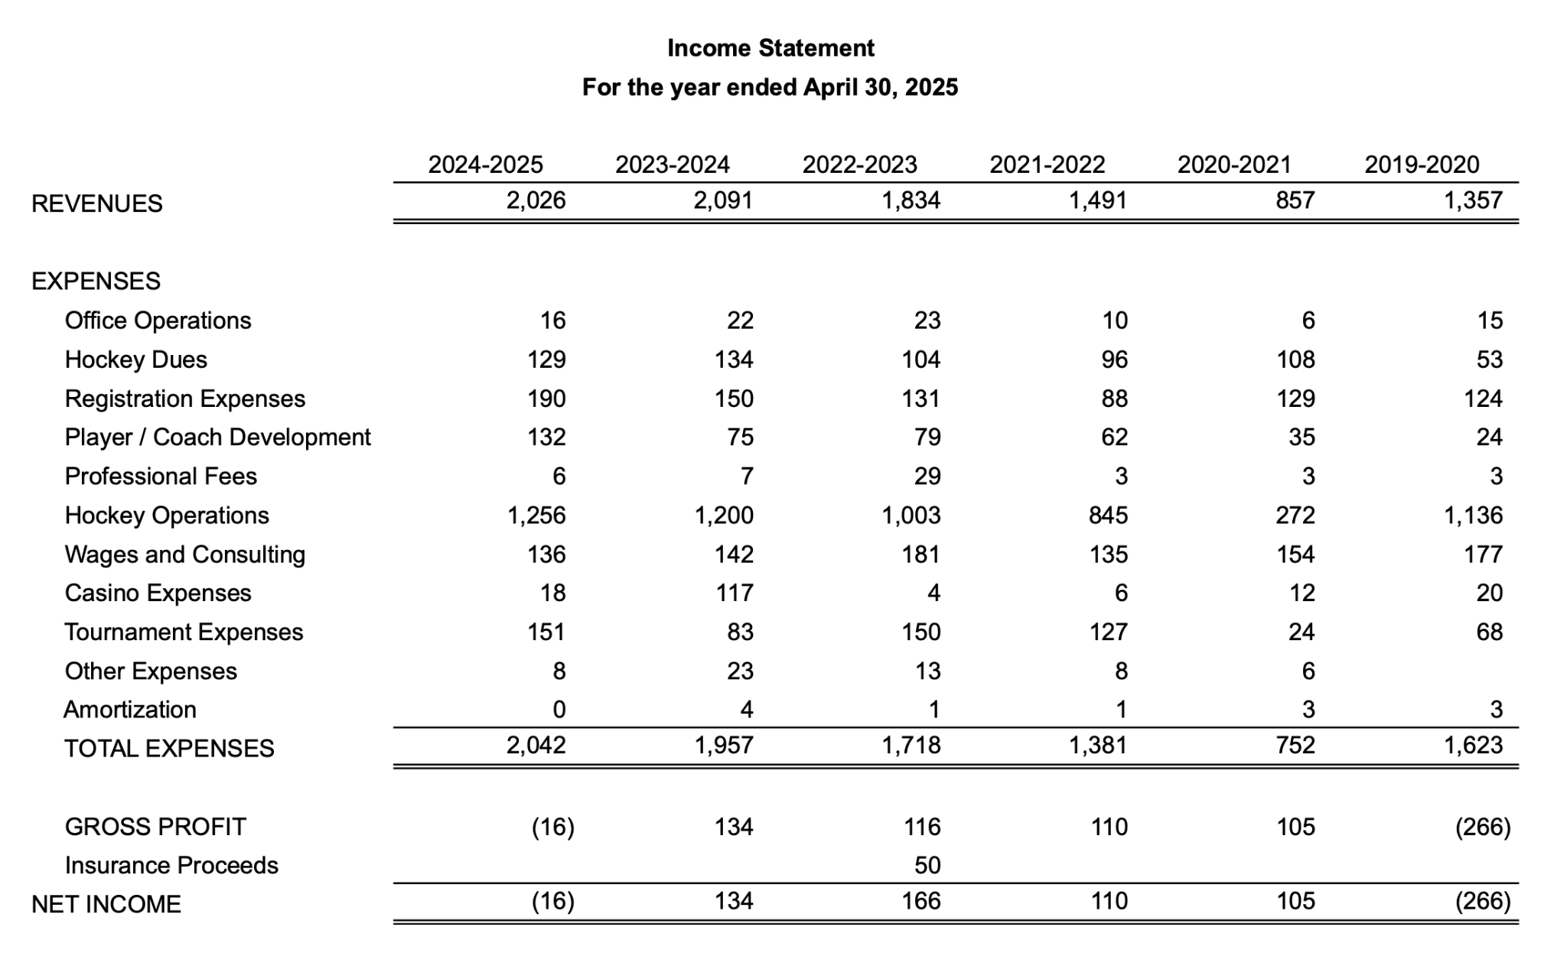
Financial Review
Profit and Loss
Notes:
Slide 22 - Nicole

Slide 27
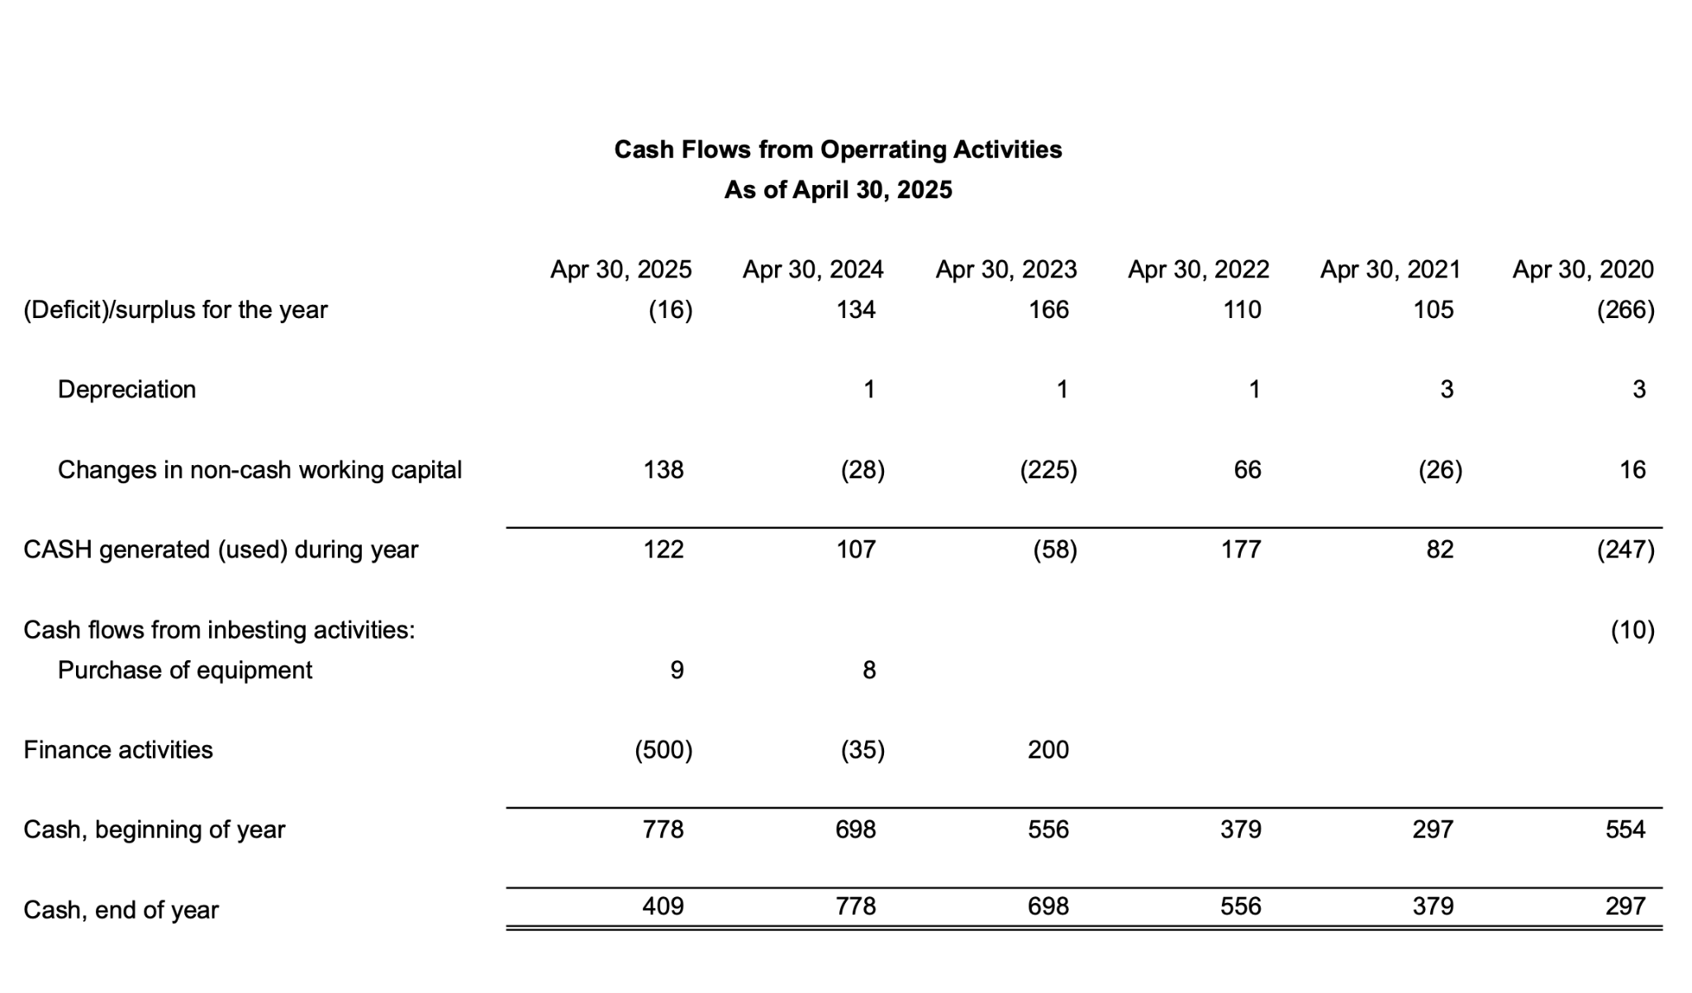
Financial Review
Cash Flow
Notes:
Slide 23 - Nicole

Slide 28
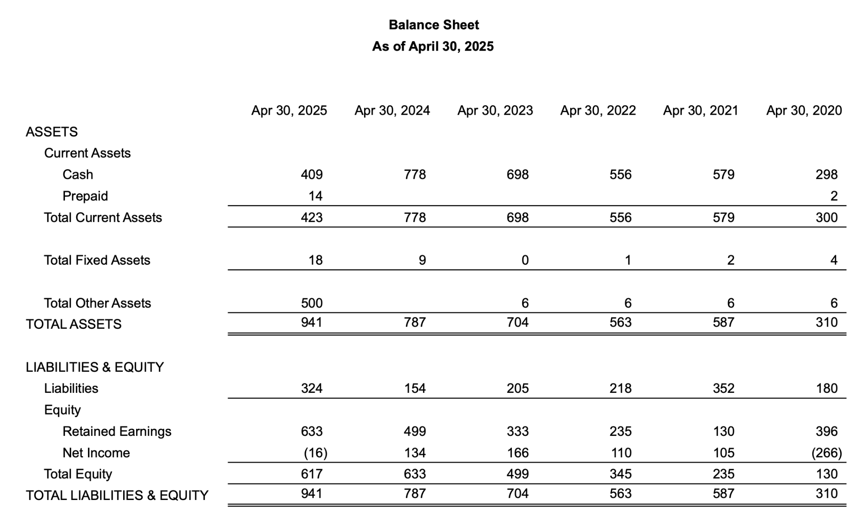
Financial Review
Balance Sheet
Notes:
Slide 24 - Nicole

Slide 29
2025-2026 Photo update
AMHA Photos
No significant complaints around photo quality; intend to stay with Mojo
Date set for Dec 5th to 7th, 2025
Notes:
Slide 25 - Glenn
AMHA had no significant complaints last year so we will be using Mojo Photography again for the upcoming season.
Photos will be happening on Dec 5-7th so they won’t be available for Christmas but more teams will know their schedules and be able to book times easier.

Slide 30
2024-2025
Q & A
Member Questions
All Questions sent in before May 6th have been answered and posted on the website here:
AMHA Questions 2025
Notes:
Slide 26- Pat
In order to be transparent and shorten the length of our AGM, AMHA posted member questions to our website
The members were sent the link to the questions that appeared on our website in the news reel.
If you have not already viewed the member questions and answers, you can find them on our website.

Slide 31
Year In Review
2025-2026
Year in Review
Click for Video
Notes:
Slide 27 - Pat

Slide 32
Thanks for attending
AGM Adjourned
Everyone is invited to stay for Elections.
Notes:
Slide 28 - Pat
And that concludes our regular AGM meeting. I am making a motion to adjourn the meeting at ____, ____ seconds the motion. A copy of this slideshow and minutes of the meeting will be posted to our website, under the AGM tab, as soon as they can be documented.
Please stay for the AMHA Board Member Elections.

Slide 33
AMHA
Elections 2025-2026
Notes:
Slide 29 - Pat
Welcome to the 2025 AMHA Board Elections.
We will now get started and I will hand over the meeting to Lindsey Goddard & Robyn Buchart.

Slide 34
Eligibility Priority
each position has defined criteria for eligibility
 | Primary Eligible | Secondary Eligible
President | one full term as a member of the Executive Committee in the previous year | any member of the Board of Directors
Vice President | one full term as a member of the Board of Directors or two years on the Operations Committee | any member
Director | a full term as a member of the Operations Committee for the previous year | any member
Coordinator (elected, not appointed) | any member | n/a
Notes:
Slide 30 - Lindsey
Introduce yourselves - I’m Lindsey Goddard and this is Robyn Buchart. We’ve both been members of the Operations Team for a number of years and our positions are not up for election. Consequently, as uninvolved board members, we’ll be chairing the election portion of the meeting.
We have had a lot of interest this year for people wanting to join the board which is great. Therefore however we are going to have a number of votes tonight. How the voting will work is:
we will announce who has been nominated along with his/her eligibility
About eligibility: For a Secondary Eligible candidate, your name will stand for the AGM election; however, in the event that at least one primary eligible candidate accepts the nomination, no secondary eligible candidate will be included in the election process. If no primary eligible candidate is able to accept a nomination, then all secondary eligible candidates would remain on the ballot.
We will ask the primary candidate(s) if they want to let their name stand
if “Yes” then we will give them 1 - 2 minutes to give a little speech about themselves and what they would like to do in the position
The order of candidate speeches will be alphabetically by last name first unless there is an incumbent and they will get to go last.
then we will vote.
The voting will take place through email?. As soon as everyone has voted we will close the poll and present the results to you.
Ok so let's get started.

Slide 35
Elections for Executive Committee
Executive Committee
President: Vote
Glenn Odishaw
Pat Stachniak
Vice President 1 - Admin: Vote
Nicole Gidluck - Incumbent
Jayelle Peters
Vice President 2 - High Performance: Vote
Mike Mullenix
Glenn Odishaw
Vice President 3 - Travel: Vote
Glenn Odishaw - Incumbent
Korin Lemay
Vice President 4 - RHL/City/Recreation:
Brent Emo - Incumbent (acclaimed)
Vice President 5 - Female : Vote
Christie Cameron
Eric Campbell
Glenn Odishaw
Mumtaz Robson - Incumbent
Chelsea Frayling
Heather Bell
Notes:
Slide 30 - Executive Committee - Robyn
We have 2 Primary Eligible nominees for President:
Glenn Odishaw - do you accept this nomination ____
Pat Stachniak - do you accept this nomination ____
(Assuming Yes)...We will now hear a speech from each of the candidates for President.
Vote
With % of the vote, _________________ will be our 2025-2026 AMHA President. Congratulations.
____________________________________________________________________________
Lindsey
For Vice President 1 Administration the only Primary Eligible nominee is the Incumbent Nicole Gidluck, do you accept this nomination?
If yes…Nicole Gidluck will be our 2025-2026 AMHA Season Vice President 1
If no…Jayelle Peters, do you accept the nomination? If yes, Jayelle Peters will be our 2025-2026 AMHA Vice President 1
____________________________________________________________________________
Robyn
For Vice President 2 High Performance we have 2 Primary Eligible nominations.
Mike Mullenix, do you accept this nomination? ____
Glenn Odishaw, do you accept this nomination? _____
(Assuming yes)...We will now hear a speech from each of the nominees.
Vote
With % of the vote, ____________________ will be our new 2025 -2026 AMHA Vice President 2
____________________________________________________________________________
Lindsey
**If Glenn doesn’t win VP2**
For Vice President 3 Travel, the only Primary Eligible nominee is the Incumbent Glenn Odishaw, do you accept this nomination?
If yes…Glenn Odishaw will be our 2025-2026 AMHA Season Vice President 3
If no…Korin Lemay, do you accept the nomination? If yes, Korin Lemay will be our 2025-2026 AMHA Vice President 3
**If Glenn does win VP2**
For Vice President 3 Travel, the only remaining candidate is Korin Lemay. Korin, do you accept the nomination?
If yes, Korin Lemay will be our 2025-2026 AMHA Vice President 3
____________________________________________________________________________
For Vice President 4 City, the incumbent Brent Emo is acclaimed as 2025-2026 AMHA Vice President 4.
Robyn
____________________________________________________________________________
For Vice President 5 Female there are 3 (or 4, depending on Glenn’s situation) Primary Eligible candidates
Christie Cameron, do you accept the nomination? .
Eric Campbell, do you accept the nomination? .
Glenn Odishaw, do you accept the nomination? .
Mumtaz Robson, do you accept the nomination? .
(Assuming Yes)...We will now hear a speech from each of the candidates for Vice President Female
Vote
_________________ will be our 2025-2026 AMHA Vice President 5.

Slide 36
Election of Board of Directors
Directors
High Performance: Vote
Darcy Campbell - Incumbent
Leif Hanson
High Performance Female: Jon Weist
Travel: Vote
Jayelle Peters
Julie Williams
Female RMFHL: Damara Allan
City League (City (RHL), U7, U9 & Recreation): Vote
Jennifer Latreille
Jayelle Peters - Incumbent
Notes:
Slide 31 - Lindsey
2 of the Director roles have only a single individual who has put his/her name forward for the role. He/she will be acclaimed, pending acceptance of the nomination.
For High Performance Director, Darcy Campbell is the only Primary eligible candidate. Darcy, do you accept the nomination? <leave time for a response> Darcy Campbell will be continuing in this roles for the 2025-26 season.
Jon Weist, do you accept the nomination for High Performance Female Director? <leave time for a response> Congratulations, Jon Weist will be the new High Performance Female Director for the 2025-26 season
For Travel Director, there are 2 eligible nominees
Jayelle Peters, do you accept the nomination? .
Julie Williams, do you accept the nomination? .
We will now hear a short speech from each of the nominees.
Vote
With % of the vote _____________________will be our 2025-2026 AMHA Travel Director. Congratulations.
____________________________________________________________________________
For Female Director, the only nominee is Damara Allan, do you accept this nomination? < leave time for a response> Damara Allan will be our 2025-2036 Female Director
____________________________________________________________________________
For RHL/City/Recreation Director, we have 2 nominations.
Jennifer Latreille, do you accept this nomination? ____
Jayelle Peters, do you accept this nomination? ____
We will now hear a speech from each of the nominees.
Vote
With % of the vote _____________________will be our 2025-2026 AMHA Season RHL/City/Recreation Director.

Slide 37
Travel and Female Division
Coordinators
Travel Division Coordinators
Mixed
U16/U18: Leif Hanson
U15: Julie Williams
Elizabeth MacGillivary
U13: Still vacant
U11: Jeremy Maher
Female
U15/U18: Heather Bell - Incumbent
U11/U13: Megan Condie - Incumbent
Notes:
Slide 33 - Robyn
For U16/U18 Travel Coordinator, the only nominee is Leif Harrison, do you accept this nomination?
Leif Harrison will be our 2025-2026 Season U16/U18 Coordinator
____________________________________________________________________________
For U15 Travel Coordinator, the only remaining nominee is Elizabeth MacGillivary. Elizabeth, do you accept this nomination?
Elizabeth MacGillivary will be the new 2025-2026 U15 Travel Coordinator
__________________________________________________________________________
For the U13 Travel Coordinator has no candidates and remains vacant
____________________________________________________________________________
For U11 Coordinator, the only nominee is Jeremy Maher. Jeremy, do you accept this nomination?
Jeremy Maher will be our 2025-2026 U11 Travel Coordinator
____________________________________________________________________________
For the U15/U18 Female Coordinator the only nominee is the incumbent, Heather Bell. Do you accept this nomination?
Heather Bell will be our 2025-2026 U15/U18 Female Coordinator
____________________________________________________________________________
For the U11/U13 Female Coordinator Megan Condie, the incumbent, was nominated. Do you accept this nomination Megan?
Megan Condie will be our 2025-2026 U11/U13 Female Coordinator

Slide 38
City League (City (RHL), U7, U9 & Recreation) Division Coordinators
RHL/City Division Coordinators
RHL
U18: Jodi Clarke
U15 : Still vacant
U13 : Still vacant
U11: Aliceyn Egan
City
U9 : Andrew Taylor
U7 : Still vacant
Recreation: Still vacant
Jr C : Kirstin Staples - Incumbent
Notes:
Slide 34 - Lindsey
For the U18 RHL Coordinator the only nominee is Jodi Clarke. Jodi, do you accept this nomination?
Jodi Clarke will be our 2025-2026 U18 RHL Coordinator
____________________________________________________________________________
The U15 RHL and U13 RHL Coordinator positions have no nominees and remains vacant.
____________________________________________________________________________
For the U11 RHL Coordinator, the only nominee is Aliceyn Egan, do you accept this nomination?
Aliceyn Egan will be our 2025-2026 U11 RHL Coordinator
____________________________________________________________________________
For the U9 City Coordinator the only nominee is Andrew Taylor. Andrew, do you accept this nomination?
Andrew Taylor will be our new 2025-2026 U9 Coordinator
____________________________________________________________________________
The U7 City position and Rec Coordinator position have no nominees so are still vacant
____________________________________________________________________________
The U21 Junior C Coordinator position is being filled by the incumbent, Kirstin Staples.

Slide 39
Operations Committee
Operational Coordinators:
Goalie Development: Still vacant
Team Manager: Jeanine Schill
Tournament: Michelle Anhorn - Incumbent
Equipment: Still vacant
Safety: Will Stewart - Incumbent
Appointed positions after AGM:
Evaluations: Lindsey Goddard - Incumbent
Discipline/Risk Management:
Curtis Slabosz - Incumbent
Leif Hanson
Coach Coordinator: Robyn Buchart - Incumbent
Development Coordinator(s): Oscar Alvarez
Chelsea Frayling
Female Player Development: Chelsea Frayling
Referee In Chief Liaison: Leif Hanson
Notes:
Slide 35 Operations - Robyn
The Goalie Development and Equipment Coordinator positions remain vacant and will be appointed by the Executive.
For the Team Manager Coordinator the only nominee is Jeanine Schill. Jeanine, do you accept this nomination?
Jeanine Schill will be our 2025-2026 Season Team Manager Coordinator
____________________________________________________________________________
For the Tournament Coordinator the only nominee is Michelle Anhorn. Michelle, do you accept this nomination?
Michelle Anhorn will be our 2025-2026 Season Tournament Coordinator
____________________________________________________________________________
For the Safety Coordinator the only nominee is Will Stewart. Will, do you accept this nomination?
Will Stewart will be our 2025-2026 Season Safety Coordinator.
____________________________________________________________________________
The following positions will be appointed by the Executive in the next few weeks
Evaluations Coordinator
Discipline/Risk Management Coordinator
Coach Coordinator
Development Coordinator
Female Player Development Coordinator
We have a volunteer Referee in Chief who is currently Leif Harison. As Leif has another role on the board, this position will need to be filled by another.

Slide 40
Adjourn
Motion to Adjourn the
Election meeting
Notes:
Slide 37 - Motion to Adjourn - Pat
Ok so that is the last position.
I would like to now make a motion to adjourn the meeting at ________.
Seconded by ___________

Slide 41
Thank you all for attending.
Notes:
Slide 38 - Thanks - Pat
Thank you for attending!
We are very happy to see so many of our members get engaged for the AGM.
As you noticed there are still a few vacant board positions and lots of room on some of the AMHA committees so if you want to get involved don’t wait till next AGM get in touch with one of the board members or the AMHA staff and let us know what you are interested in helping out with.
Have a good rest of your night.

