Slide 1

Freeborn Global Baseball
Softball Recruiting Service

Slide 2
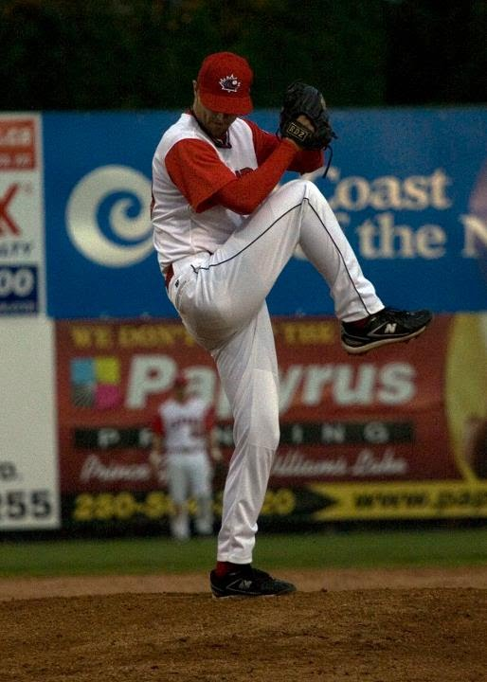
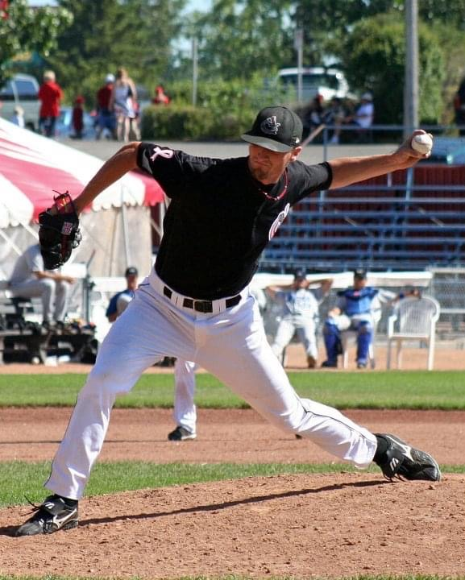
My name is Geoff Freeborn, I'm a former pro pitcher from Calgary, Canada. I was fortunate to travel the world thru baseball. I played pro baseball for 5 seasons, played on two National teams, and played on 6 continents. I studied at North Idaho Junior College and at Northern Kentucky University. After my playing days, transitioned into coaching. I was the head coach at the University of Calgary for 3 seasons. Developed the pitching web site - Sidearmnation.com

Slide 3


With my unique baseball background I have become very familiar with the baseball/softball landscapes in both Canada and the United States.
What my services offer :

Slide 4





Facilitate the college recruiting process for players/families:
It can be a complicated process. Not everyone is going to play NCAA Div 1, but I can help with that. Not just with the recruiting side, but also with any questions thru the process.
- United States: NCAA Div. 1, 2, 3 - NAIA - USCAA - JUCO
- Canada: CCBC - Western Canada - OUA, OCAA Atlantic, QUB - Eastern Canada
Western Collegiate Softball Association
- Programs in Canada that compete in the States - UBC (NAIA), Douglas College (NWAAC), Simon Fraser (NCAA Div 2)

Slide 5
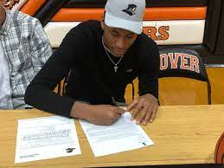
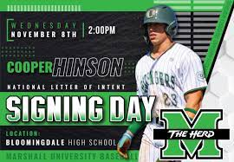
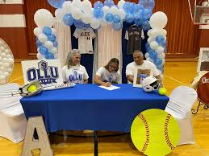
How this would work:
-Phone/zoom meeting with individual players/parents to talk about goals, what college looks like in US/Canada, answer any questions
-Help with what college coaches are looking for in their emails
-How to talk with college coaches
-Help put together a list of schools with contacts that would be a good fit. I'll follow up myself too with schools (if needed)
-Help set up any potential visits to schools

Slide 6
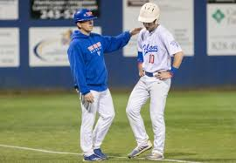


Players can contact me as a resource both on and off the field:
Not just with the recruiting side but any questions on/off the field
Any baseball related questions, will be a resource for players
Help with the mental part of the game
Personal support system, the game can be hard enough - sometimes good to chat with someone neutral other than parents, coach or teammates

Slide 7
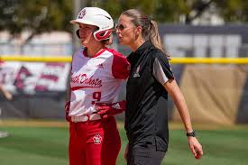
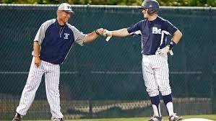
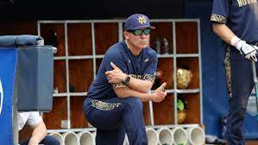
Part of my role is to be constantly connecting with college baseball/softball coaches in both Canada and the United States to enable me to create a network and database for your athletes.
-There are many recruiting platforms available, and unfortunately many of them end up spamming coaches. College coaches enjoy hearing from a player or a contact/coach that knows the player

Slide 8


Look forward to working with you and helping you move on to the next level of baseball/softball and being a great human on and off the field!
Thank you for your time!

Slide 9

Cost - 2 different plans
1. College plan - $1000 - HS player looking for a school or Juco player looking for a 4 year school – one time fee - split up $500 before then $500 after signing
2. Career plan - $2000 - Be with your player all the way in their baseball/softball career
-if a Juco player/Canadian school will help in transferring to a 4 year
-after college will help with what pro baseball/softball world looks like (Indy ball, Overseas)

