Slide 1
2025 SEASON HOUSE LEAGUE PARENT NIGHT

Slide 2
Agenda
President Address
Who we are Information
Challenger Baseball
Team Selection
BOMBA Teams
Training Resources
House League Select
Baseball Succession
Pink In The Park
Gift of Giving Back
11. Important Dates
12. Baseball Is Back!
13. Where to get gear
14. Umpires
15. The Yard & Strike Zone
Training
16. Batter’s Box
17. Thank you to sponsors
18. Draw
19. Closing

Slide 3
Who We Are: Board of Directors
President | Paolo Mari
Vice President | John Turner
Past President | Dave Margetts
Treasurer | Greg Huckle
Secretary and Administrator | Brenda Macdonald
Umpire-In-Chief | David Phillips
House League Baseball | Tania Gibson
House League Development | Nic Brissette
Junior House League Baseball | Tania LaRoche
Senior House League Baseball | Bill Brooker
REP Baseball | Tyler McNaughton
Junior REP Baseball | Jonathan Aycan
Senior REP Baseball | Sean Pinney
Tournaments | Frank Cardamone
REP Development, Coach Selection & Tryouts | Linda Laugesen
Special Events | Angela Mallard
Concessions | Tara O’Neill
Purchasing | Doug McCoy
Sponsorships | Rachel Cleland
Marketing & Social Media | Rachel Cleland
City Liaison | Adam Parisi
Director at Large | Andrew Frank
Webmaster | Dave Dusseldorp
Scheduler | Monica Flor
Equipment | Todd Fleming

Slide 4
Who We Are: Convenors
Jr and Sr TBall | Tania LaRoche
Jr Coach Pitch | Lisa Rumble
7UHL | Andrea Atkinson and Leni Strineka
8UHL | Ahmet Ahmet
9UHL | Alyssa VanKleek
11UHL | Dan Noonan
13UHL | Lily LaRoche
15UHL | Jacob Fleming
18UHL | Bill Brooker
Challenger Baseball | Meghan Kennedy & Zack Shaban

Slide 5
Challenger Baseball
An adaptive baseball program, run in partnership with Little League Canada and Baseball Canada, where kids living with physical and/or cognitive disabilities find a place on a team where they belong. The program teaches athletes the core life skills inherent to baseball, including:
teamwork
communication
determination
resiliency
inclusion
support
courage
Challenger Baseball ensures athletes of all abilities have the opportunity to play in a fun and safe environment where they learn to become more independent, build confidence, and create lasting friendships with their peers.

Slide 6
Challenger Baseball

Slide 7
Team Selection
Teams have been selected using the previous season’s coaches evaluation (if available), as well as the information filled out by you, the parents, during registration
The HL Committee also took into consideration if the players are on a HL Select team and distributed those players evenly throughout the divisions
All HL Committee members were involved in the creation of teams. They were reviewed by all Convenors and Directors for fairness and even distribution of talent

Slide 8
2025 Teams
Division | Number of Teams
Junior T-Ball | 8
Senior T-Ball | 10
Junior Coach Pitch | 10
7UHL | 10
8UHL | 8
9UHL | 8
11UHL | 10
13UHL | 9
15UHL | 5
18UHL | 4
If you are interested in helping coach your child’s team, please reach out to your Convenor!
Your team will thank you!

Slide 9
Resources for Coaches
The Ontario Baseball Association has incredible resources on their website and on their app ‘On Deck’.
All coaches have the opportunity to use the practice plans and drills on the website or app.
This is a useful tool to help even the most experienced coach or the new-to-coaching volunteer.
It will also give you information on NCCP clinics, these are not required by BOMBA for House League, however are very helpful.
We recommend the Coaches Initiation clinics which are mostly held online.

Slide 10
House League Select
The HL Select program is an extension of BOMBA’s House League and offers skilled House League players the opportunity to participate in a more competitive experience
2025 will be our 4th year offering this program since it’s return
5 teams (9U, 11U, 13U, 15U and 18U)
Tryouts for the 2026 program will be in November and run by Strike Zone training professionals.
In order to play on a HL Select team, you must be registered and play on a House League team as well
HL Select is a tournament team only

Slide 11
Baseball Succession
EBLO
REP
HOUSE SELECT
HOUSE LEAGUE

Slide 12
Pink In The Park: Strike Out Cancer
BOMBA is excited to share a new and meaningful initiative for this season. In June, two of our Bulls teams will participate in the Pink in the Park: Strike Out Cancer tournament in Peterborough. We are looking to bring the spirit of this event to our entire membership and launch a fundraiser featuring limited-edition pink hats!
Team Participation: Entire teams are encouraged to get involved. Additional hats for family members and siblings can also be purchased.
Hats can be purchased for $20 with 100% of profit going to the Canadian Cancer Society.

Slide 13
Pink In The Park: Strike Out Cancer
Wear your hats during the last two weeks of May and the first two weeks of June to honour this incredible cause (can also be worn after this time period).
Teams can share their spirit by sending pictures to marketing@baseballburlington.com and tagging BOMBA social media with #BurlPinkInThePark
Follow us
@bombabaseball
BOMBAbaseball

Slide 14
Gift of Giving Back | Batting Out Hunger
Burlington has MANY families that rely on the Salvation Army food bank each week and they provide a wonderful service for those less fortunate. The summer months see their shelves run quite empty and they have a huge need for donations, this is where BOMBA is going to help!
The Salvation Army and Food Bank will have a truck on Picture Day collecting Food Donations throughout the day. – JUNE 7th & 8th.
Last Year we raised 35,000 lbs for our community!
Please give what you can. BIG or SMALL, all donations are welcomed.

Slide 15
Important Dates
Activity|Event | Key Dates | Timing|Notes
Uniform & Team Equipment | TBD in the next 2 weeks (coaches meeting | May 3rd)
Start of Season | May 12th | Exhibition games will take place 1st week
Start of Season for entry Levels | May 20th | Get ready for some FUN!
Photo Days & Food Drive | June 7th & 8th | Schedules for team slots will be released prior to photo days
All Star Day | July 19th | 7UHL & older
Fun Day & End of Season | July 26th | Challenger, Jr. TBall, Sr. TBall & Jr. Coach Pitch
Championship Day | August 9th | Details TBC
End of Year Awards Banquet | September 7th | Details TBC
Notes:
In the next 2 weeks communication will go about about picture day to all teams.

Slide 16
Join us at The Yard on Saturday May 19th from 9AM - 4PM for a full day of fun, games, and community spirit!
BBQ 12PM–2PM
Drills & Games by Strike Zone Training
Raffles & Giveaways
Ice Cream Truck on site
Gear help from Corbett’s Source for Sports
Free flower to give to your biggest cheerleader for Mother's Day
No registration required, all Burlington Baseball players are invited to attend!
BBQ 12PM–2PM
Drills & Games by Strike Zone Training
Raffles & Giveaways
Ice Cream Truck on site
Gear help from Corbett’s Source for Sports
Free flower to give to your biggest cheerleader for Mother's Day (limited supply)
No registration required, all Burlington Baseball players are invited to attend!
Notes:
In the next 2 weeks communication will go about about picture day to all teams.

Slide 17
Additional Information
7UHL and above also includes
Pants
Socks
15UHL and above also includes
Belt
Player Requirements
Glove
Protective Equipment (jock or jill)
Running Shoes or Cleats
Helmet with chin strap (mandatory)
Optional - Bat
Team Bag Includes
Team Bats
Catcher’s Equipment
Equipment Box Includes
Bases
Pitching Rubber
Pitching Machine and Generator
Registration Covers
Jersey
Hat

Slide 18
Where To Get Gear
• BAT FITTINGS / EQUIPMENT
• TRAINING EQUIPMENT
• EXPERT ADVICE
• OAKVILLE LOCATION
sourceforsports.com
450 S Service Rd West |Oakville ON | L6K 2H4

Slide 19
Umpires
Respect the umpires – they are often kids who are still learning and are doing their job so the game can be played safely and fairly.
“I think he found it a bit stressful last year. He got through it and you were very supportive but coaches in particular were very challenging. Not something we expected for house league children’s games. It’s really unfortunate. Thank you for all of your training and support.”

Slide 20
Umpires
We will do our best to ensure umpires are assigned to all HL games – umpire numbers are up for first time in years!!
We always need more umpires – please have anyone interested contact Dave Phillips at umpireinchief@baseballburlington.com.
BOMBA Website (Umpires Tab) has rules, interpretations and information for umpires, coaches and spectators.

Slide 21
Umpires - 2025 Initiatives
Mentorship Committee in place to observe, mentor and guide new umpires. The committee will be active and on-field between innings.
Equipment Rental Program continuing to providing Level 1 & 2 Umpires with equipment.
Game Report Tracking to monitor concerns, issues and successes.
Umpire Manual and Uniform Guidelines now posted.
Umpire equipment now for sale at The Batter’s Box.

Slide 22
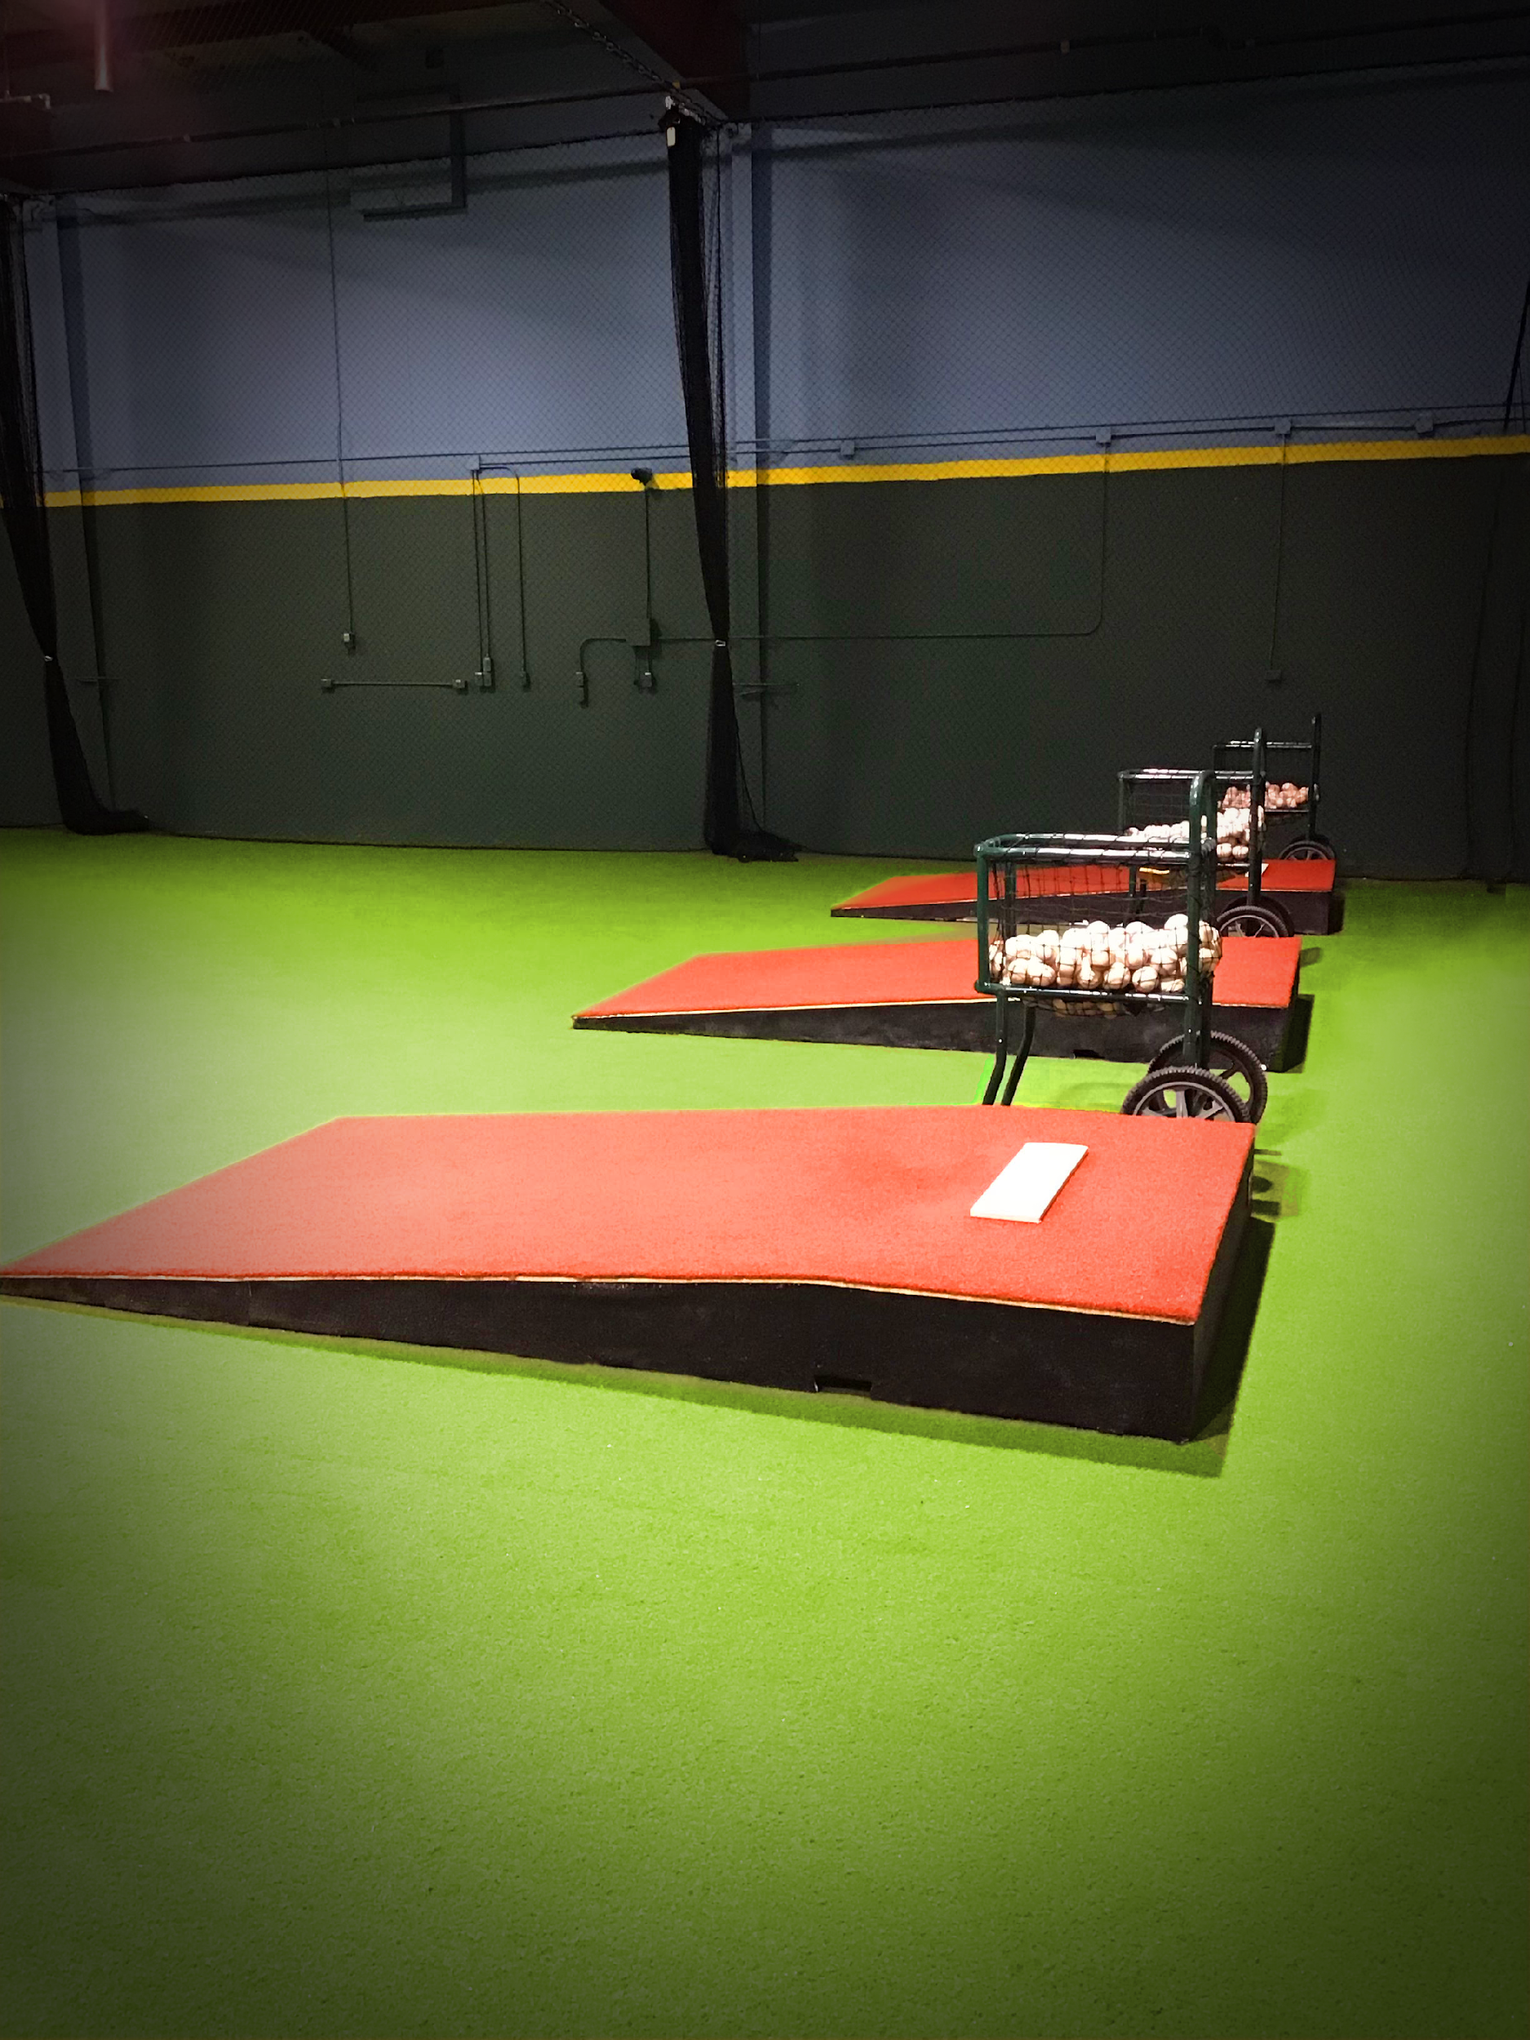
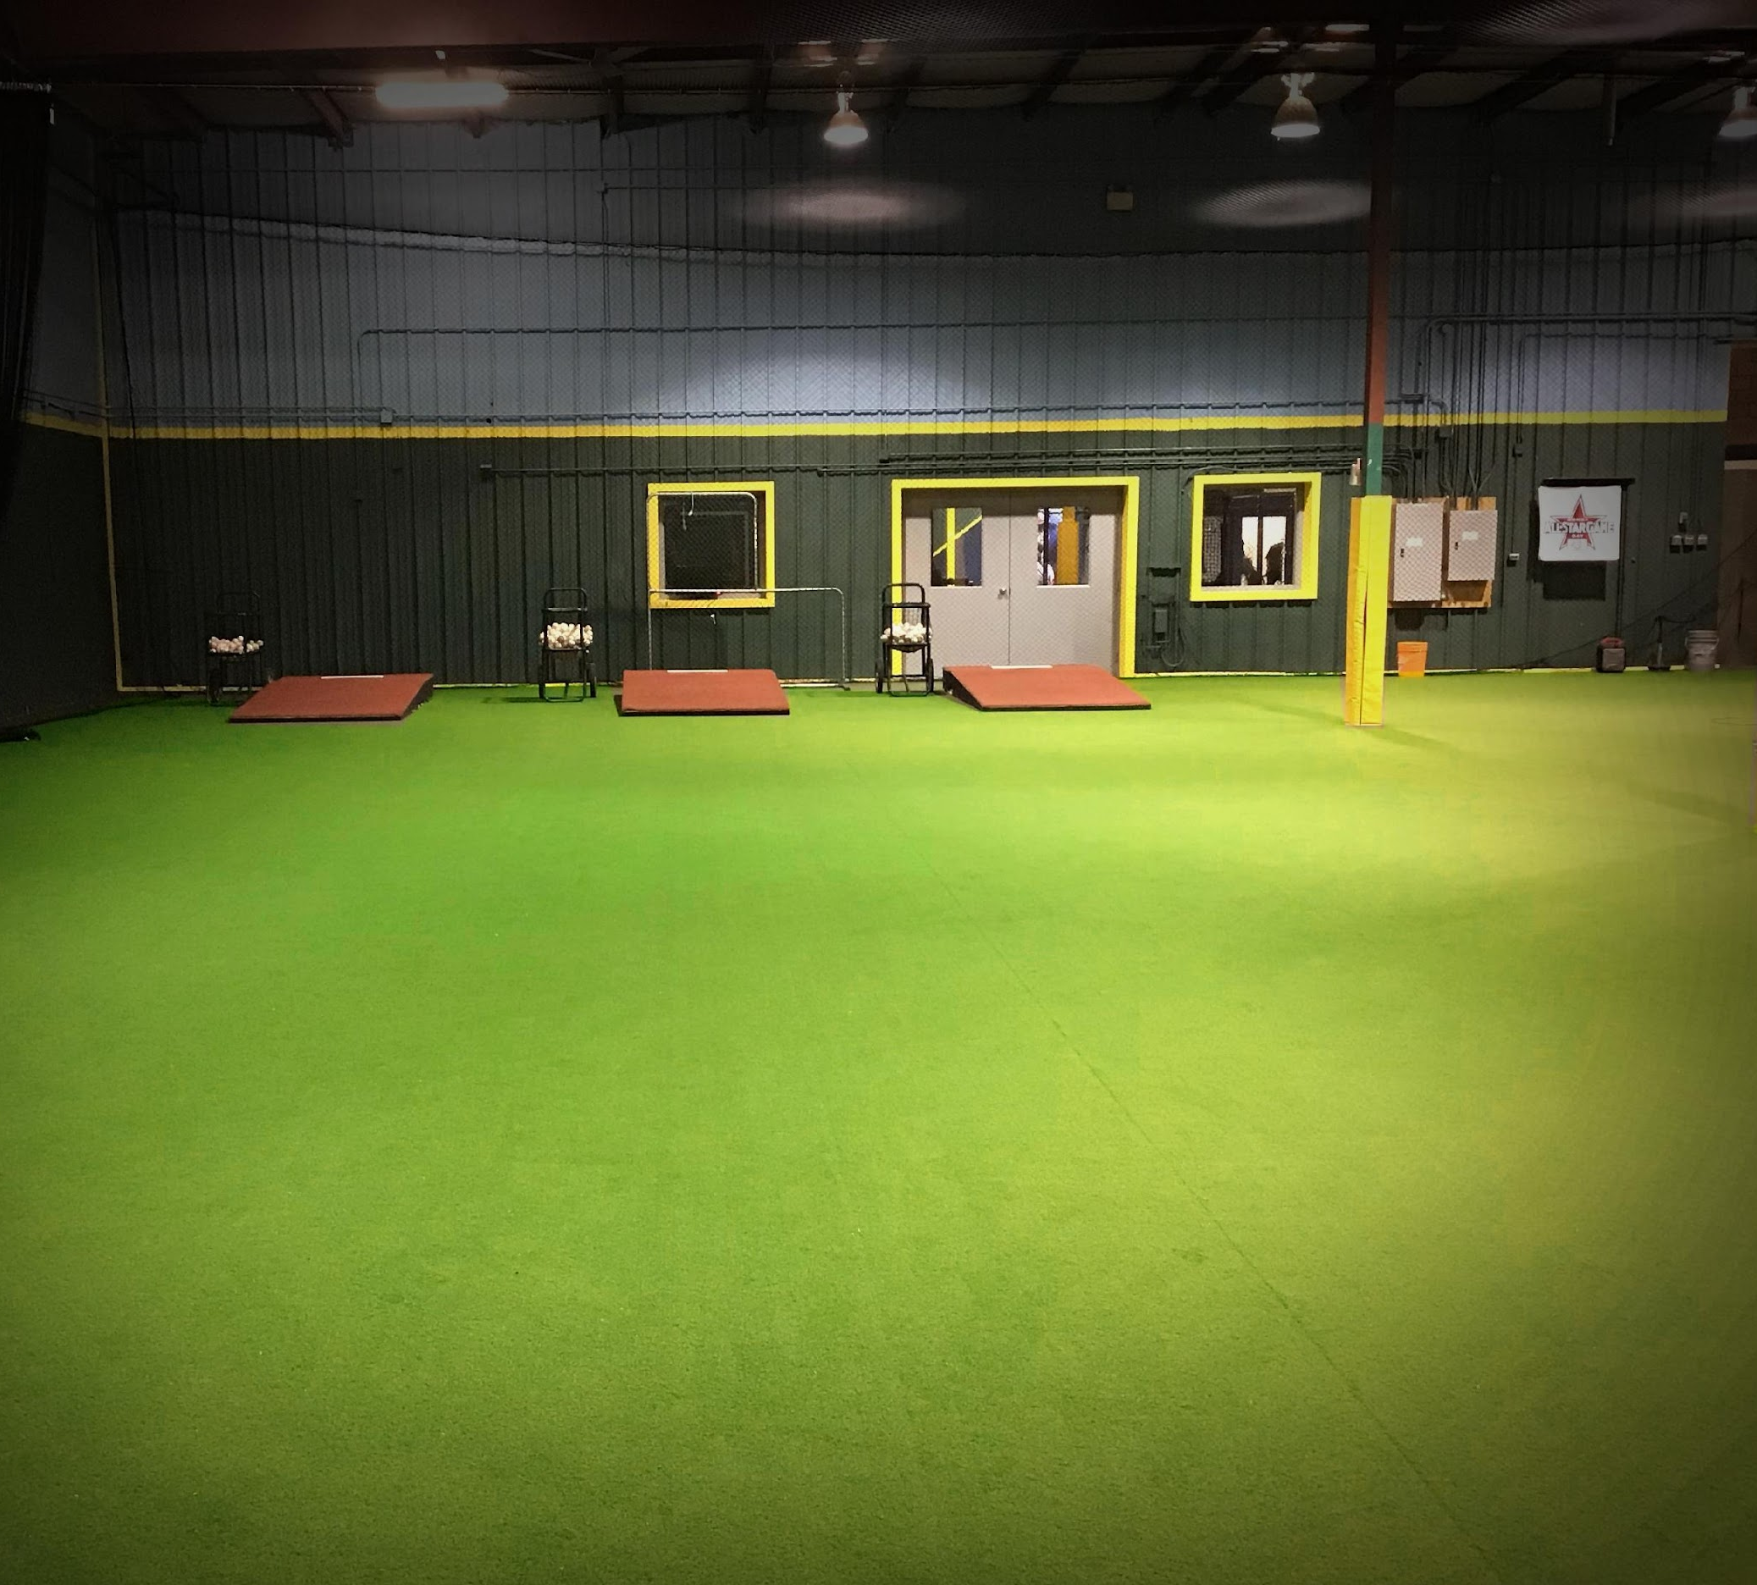
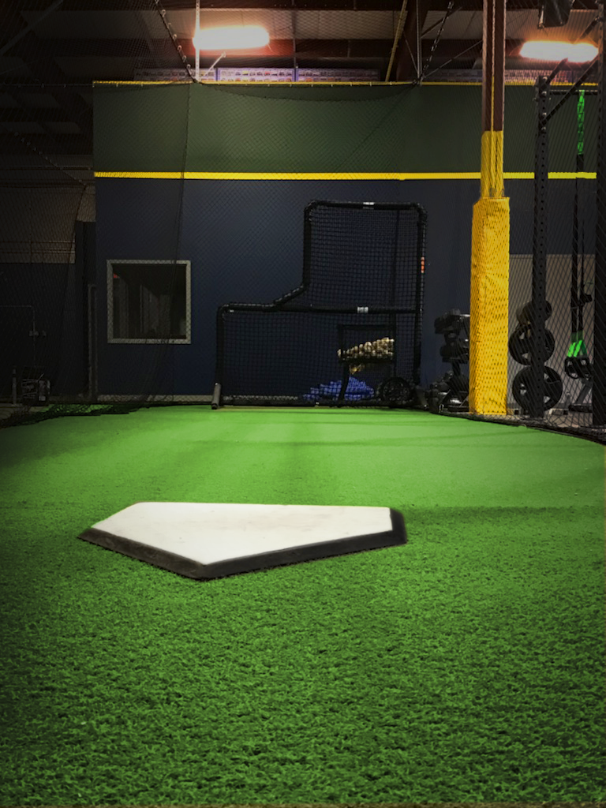
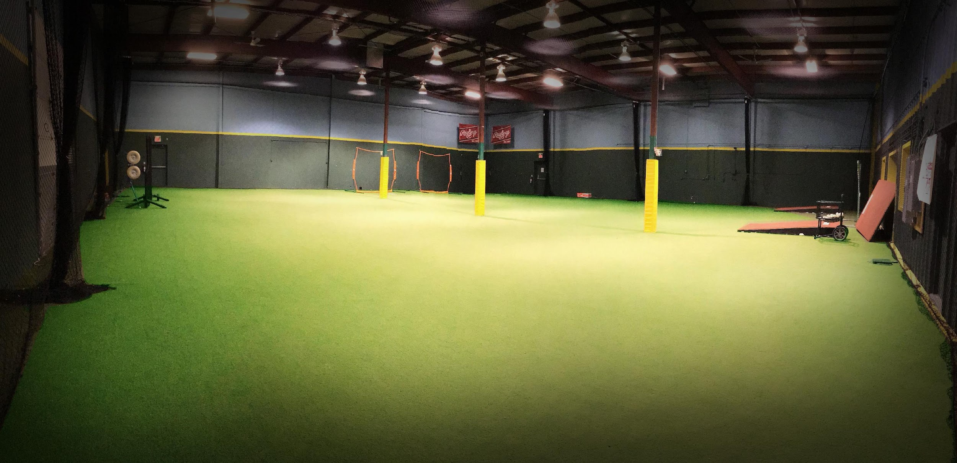
The Yard | Baseball Development Facility
• 18,000 sq ft. facility
• Modular training facility
• Multiple cages with pitching machines
• Lunchroom
• Change room
• HitTrax

Slide 23
Strike Zone | Training | Camps | Clinics
Variety of options to help players continue their development both on and off the field: camps, clinics, private and group training.
Upcoming Camps/Clinics
One-Day Outdoor (Cityview Park) Clinic May 3rd 10am - 12pm
Outdoor Summer Camp: Jul 7-11 & Aug 11-15 (Nelson Park)
Baseball Specific ½ Day Camp: Jul 14 - 18; Jul 21 - 25; Aug 5 - 8 and Aug 18 - 22 indoors (The Yard)
PA Day Camp: Jun 6
Yard Drop In Sessions - 3 days a week
Additional program details strikezonetraining.ca

Slide 24
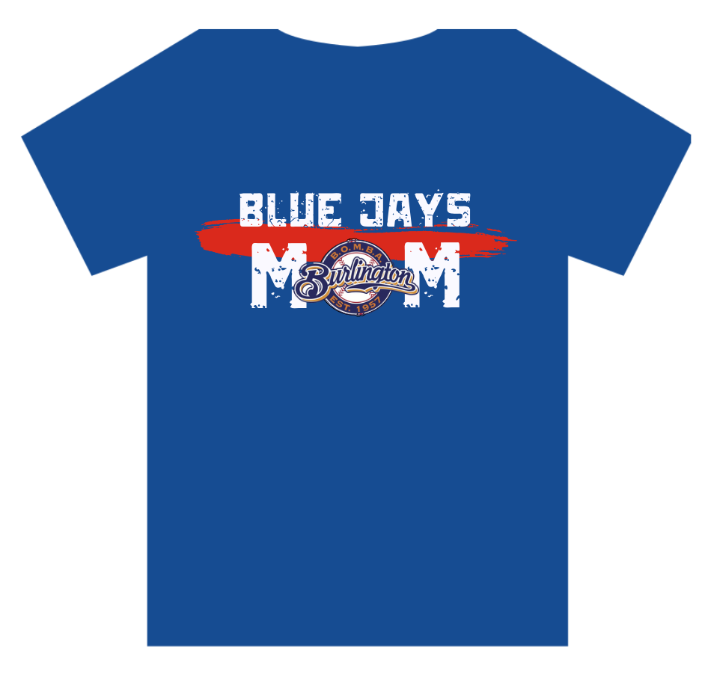
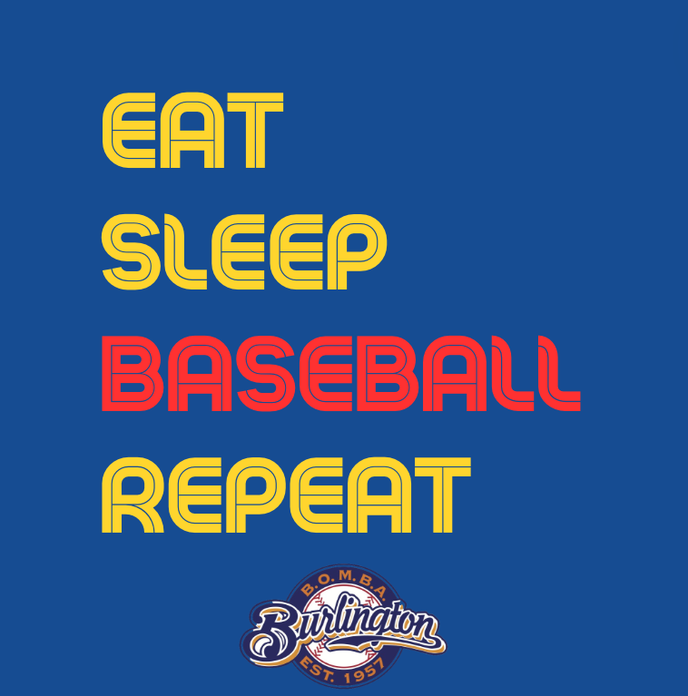
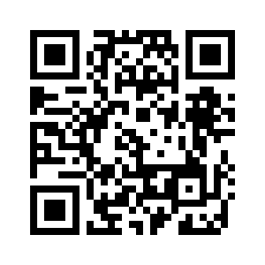
The Batter’s Box
We are thrilled to continue The Batter’s Box as an online store, allowing you to purchase House League, Bulls and Bears merchandise directly from BOMBA! Visit battersboxburlington.myshopify.com to see what we have in store!

Slide 25
Thank you to our Premium Sponsors!!!
Multi-Team Sponsor (10 or more teams)
All Star Day Sponsor
Multi Team Sponsor(10 or more teams)
15% discount on cleats
Player of the Game Pennant Sponsor
Coach Gift Card Sponsor
Player of the Game Booster Juice Reward Sponsor

Slide 26
Thank you to our House League Team Sponsors!!!
Access Storage
Factory Shoe Outlet
QB Sports Bar Grill Games
Booster Juice Brant St.
Beacon Hill Dental Centre
Bozek Milligan Orthodontics
Corbetts Source for Sports
Global Citrus Group
Hurd Tomson Orthodontics
Absolute Business Supply
Access Abilities
Alto Consultants Inc.
Aqua-Tots Burlington
Brechin & Huffman Lawyers
Bulk Food Warehouse
Burlington Hyundai
Custom Promo Marketing
Excalibur Insurance
Flynn Fitness
GOSAVI Meeting Solutions
Halton Naval Veterans Association
Please support the sponsors who support us!
Irpinia Kitchens
Lakewood Outdoor
Marcon Construction Ltd.
McArthur Mortgages
Morgan Wasley Group
Oakstone Wealth
Patrick Buscar Wealth Management
POSRG CANADA
Strike Zone Training Inc.
Trinity Trotters Equine

Slide 27
Draw for a Free House League Registration
And the Winning Ticket is…………………….!

Slide 28
Thank you for joining us this evening!
Follow us
@bombabaseball
BOMBAbaseball

