Slide 1
2025 NEW UMPIRE & PARENT INFORMATION MEETING
Sunday April 27, 2025
Google Meet Platform
7:00 pm – 9:00 pm
Posted on BOMBA Website After Presentation for Reference
THIS MEETING IS NOT RECORDED

Slide 2
NOTICE
This is the power point of the slide show which was presented by the Umpire In Chief. There is no audio attached to this presentation.
For more information, see the BOMBA Website under “Umpires” or contact the Umpire in Chief.

Slide 3
Welcome & Agenda
Welcome & Introductions
Resources, Website & Contact Info
BOMBA Programs
Umpire Requirements & Expectations
Rules
Scheduling System (Ramp Assigning)
Other Items/Updates
Question & Answer Session

Slide 4
Welcome & Agenda
Umpire Mentorship Committee
David Phillips
David Margetts
Lisa Turbitt
Jonathon Chapman
Alyn Warrington
Adam Sims
Eric Laugesen
Sam Turnock
Kevin Smith
Darcy Wicks
Shawn Schaefer
Chris Walters
Umpire In Chief – David Phillips
Mobile: 519.635.2575
umpireinchief@baseballburlington.com
Umpire Scheduler – Monica Flor
scheduler@baseballburlington.com
Office Manager Brenda MacDonald
administrator@baseballburlington.com
Notes:
Umpire In Chief - Overall Management of Umpire Program
- Resolve Issues Arise during Season
- Liaison with Convenors, Teams, Coaches, BOD
- Rules Reference for all
- Supervise Scheduling of Umpires
Scheduler - Dual Role of Parks & Umpires
- Assigns using RAMP
- Based on Availability & Credentials
- First Point of contact for games/issues/scheduling
- Possible to never speak to Monica, only online
Office Manager - Office Wednesday & Saturdays
- Pick Up Cheques
- Possibly Jacob as well
UDC - More info on this to come later in presentation
- Group working with umpires to help improve
- Be extra set of eyes
- Listed in Ramp Assigning as Mentors

Slide 5
Resources, Website & Contact Info
BOMBA Office
Hours: Wednesday 6:30-8:30, Saturday 9-12
1370 Artisans Court, Burlington
Closed Holidays
BOMBA Website
www.Baseballburlington.com
ONDeck App
Baseball Ontario Application
Rules, Interpretations, Explanations
Clinic Sign Up for Future Years

Slide 6
Resources, Website & Contact Info
Baseball Ontario Website
www.playoba.ca
Batters Box
Link on BOMBA Website
Ball Bags, Brushes, Indicators
Equipment Sets
Umpire Hats & Shirts (2025)

Slide 7
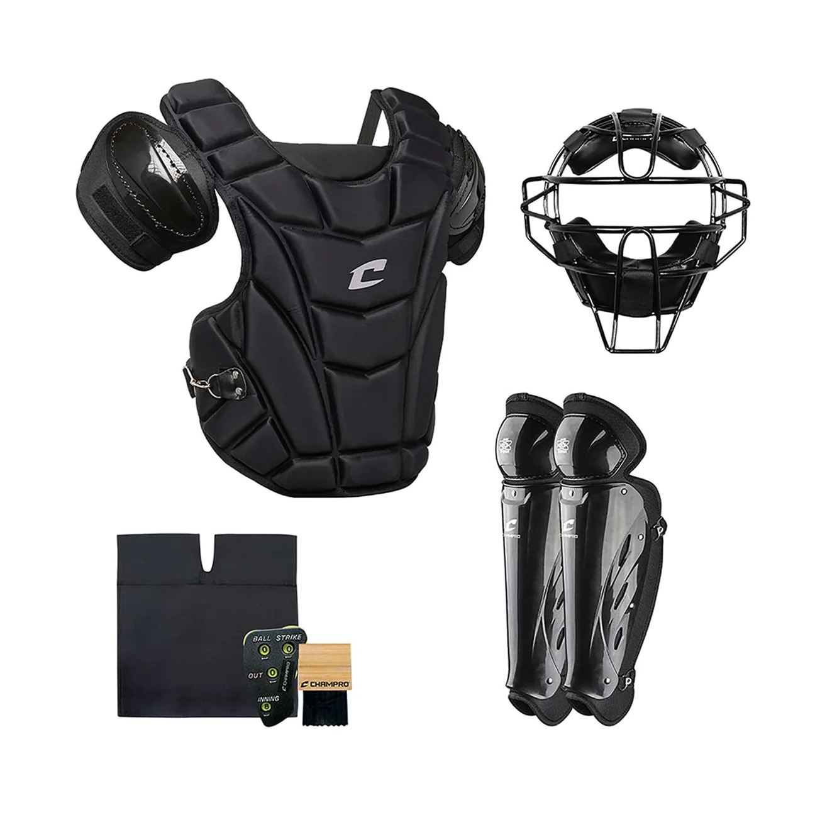
BOMBA Programs

Slide 8
BOMBA Programs
Indoor Training
Monthly session held in February, March & April
Boot Camps added for Level 1 Umpires (April 23 & 30)
Looking to continue in Winter 2026
Umpire Certification & Game Tracking
All umpires levels are being cross referenced to ensure completion
Game reports will be reviewed monthly for assignment counts & fair distribution
Respectful Focus from Spectators & Coaches
Ongoing effort to improve the treatment of officials within BOMBA
Notes:
Indoor Training – Can be January in the past
- Communicated through RAMP
- Last Boot Camp this Thursday 6:00-8:00
Certification
- Last camp completed on Saturday
- Others still running around province
- Assigned based on level
- Game counts based on multiple factors: # Games available, system availability, OBA Level
Continued Focus for Spectator and Coach respect towards Officials

Slide 9
BOMBA Programs
Umpire Mentorship Committee
10 Umpires (3-Level 5, 1-Level 4, 6-Level 3)
Level 1, 2, 3 Umpires will be paired with a Mentor
Objective is to see 2 games for each Umpire by Mentor
Mentors have access to schedule to Coordinate visits
Game Reports
Reports to be filed by both umpires after each game
QR Code on Equipment Bag if renting, or BOMBA Site if Not.
Separate ejection report required if an ejection occurs in a game
Notes:
Very Fortunate for the Committee Members
Very busy with their own schedules
Game Reports New from Last year
Must be completed by Umpires
Poorly noted incidents during games last season.

Slide 10
BOMBA Programs
Equipment Program
Posted on website
Rental program for Level 1 & 2 Umpires. (Year #2)
Uniform Policy
Revised and updated for 2025
Rules, Website Information
Notes:
Equipment Program Details Listed on website.
- Chest protector, mask, shin guards and carry bag ($50+50)
- Optional but require plate gear somehow
- Coming up in next section on specifics.
Uniform Policy update for 2025
All details posted on the BOMBA Website and more explained coming up.

Slide 11
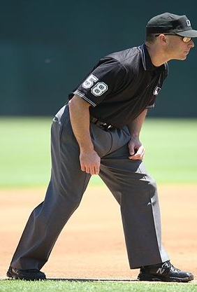
Umpire Requirements
Notes:
Uniform and Equipment

Slide 12
Uniform & Equipment
New for 2025
Bomba Website, Umpires, Uniform
9 Page Document
Explains all things uniform and equipment
Synopsis chart (1 Page)
Issues need to be address to UIC
Notes:
Cost to Purchase own Equipment all new $1,000
Tried to put in a year by year process to avoid significant costs.
Some centers require full uniforms from the start.
Website has detailed explanation of parts of uniforms and specifics similar to next slides.

Slide 13
Uniform & Equipment
Required Uniform
Jock/Jill (Base & Plate)
Grey Pants (Heather or Charcoal)
Black Belt
Black Socks
Dark Colour Shoes
Notes:
Cup Any Game
Pants Any grey pants
Unlikely for Shin Guards to fit under
Expected at higher levels
Other Belt, Socks
Shoes No buying new shoes

Slide 14
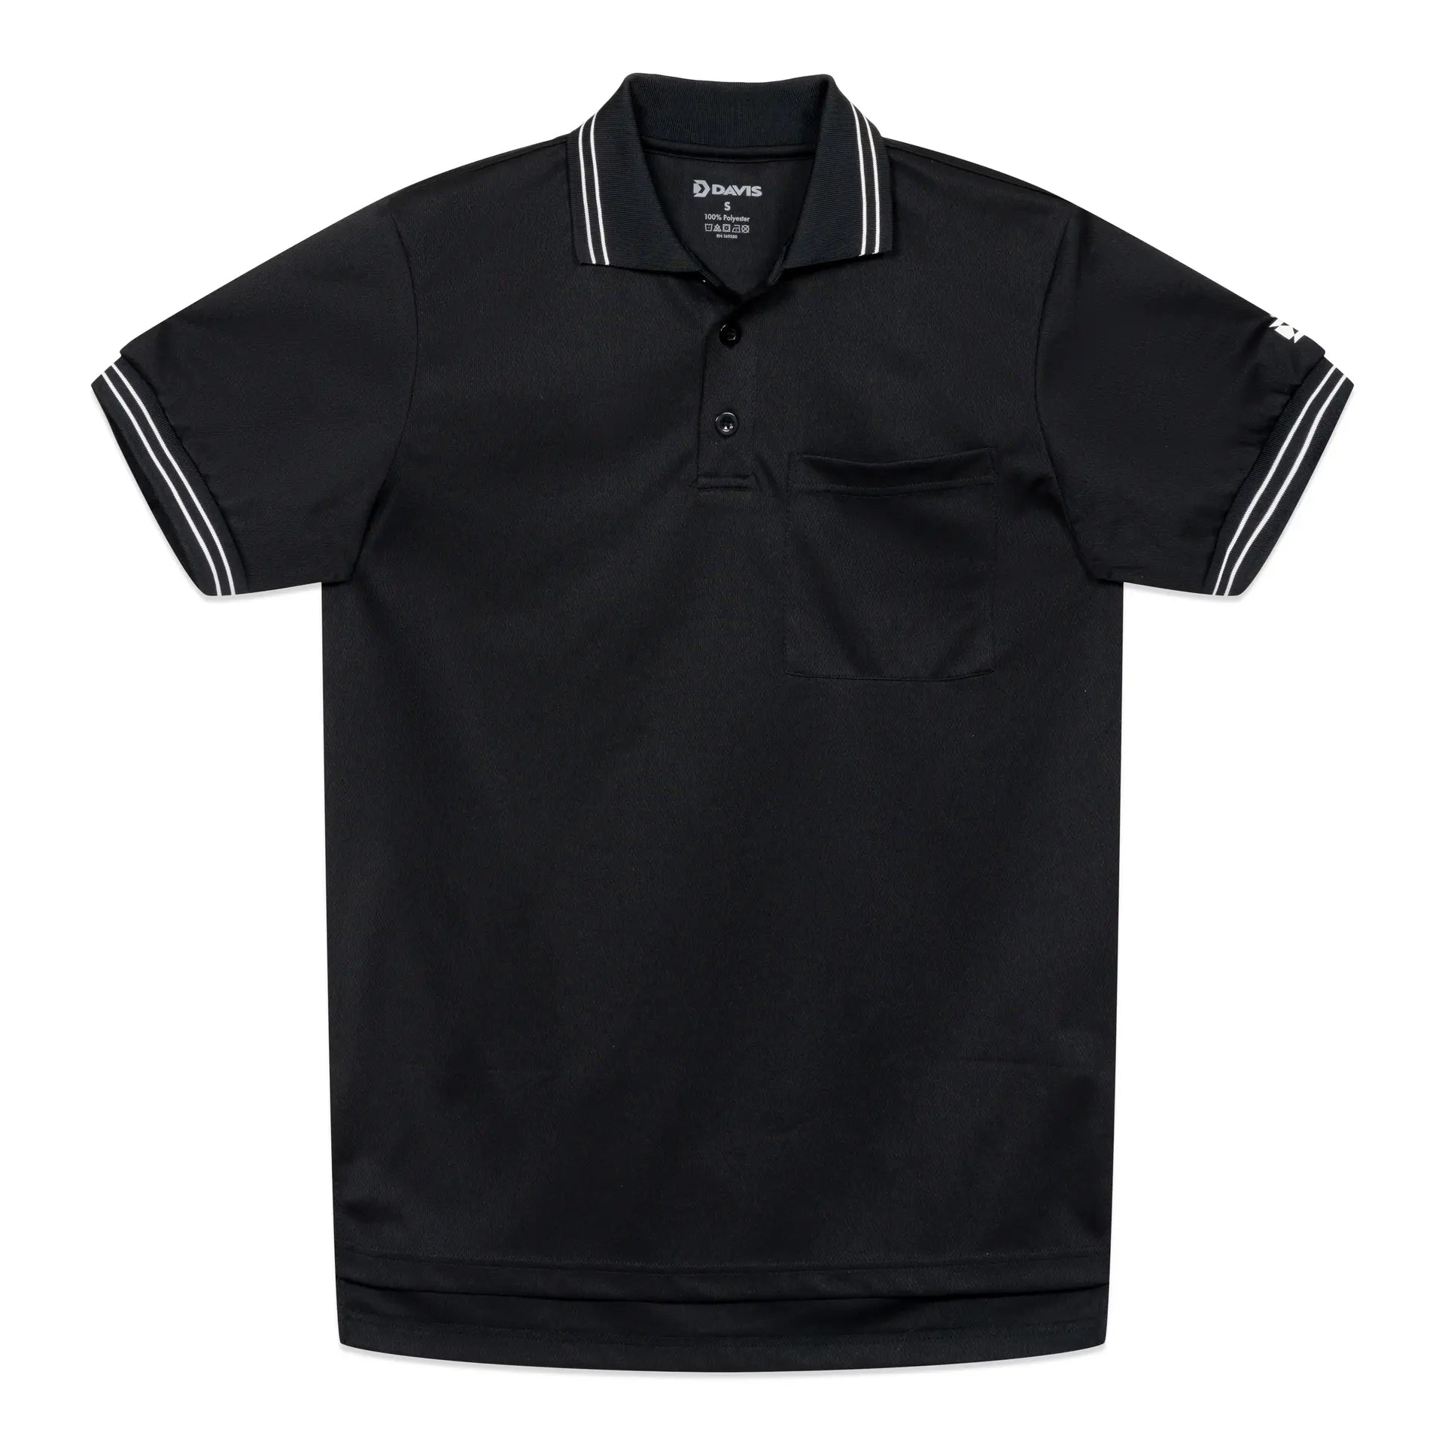
Uniform & Equipment
Required Uniform
Black Black Hat
(Must be Umpire Hat – OBA or Plain)
Fits under the Umpire Mask due to shorter brim
Only exception is if using a goalie style mask
Black Collared Shirt (No major markings)
Option for Level 1.1 to wear any plain black shirt with a collar.
Level 1.2 require proper umpire shirt – plain or OBA
Notes:
Hat Do not want Burlington Logo on Hats, Especially Rep
Shirt Any black collored shirt for 1.1
Ideally Work Over Chest Protector (+2-3 Sizes) (Required for 2.1 and up)

Slide 15
Uniform & Equipment
Required Uniform
OBA hats and shirts available through Batter’s Box
Multiple sizes available for trying on.
Orders placed online and will be special ordered from the supplier.
First order being placed May 1
Last try on date is Wednesday May 30
Next order window closes May 10.

Slide 16
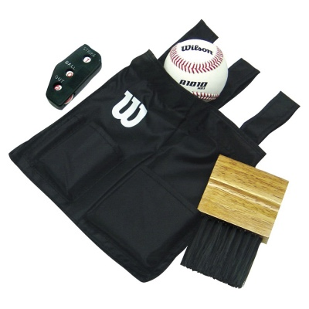
Uniform & Equipment
Plate Umpires
Shin Guards
Chest Protector
Mask
Optional (Skull Cap) Helmet
Black Ball Bag
Indicator
Plate Brush
Ball Bag, Plate Brush, Indicator Sets available at BOMBA $20
Notes:
Batter’s box for Ball Bag sets or during equipment pick up.
Replacement indicators and brushes available as well.
Must bring equipment with them EVERY game, whether on plate or not.

Slide 17
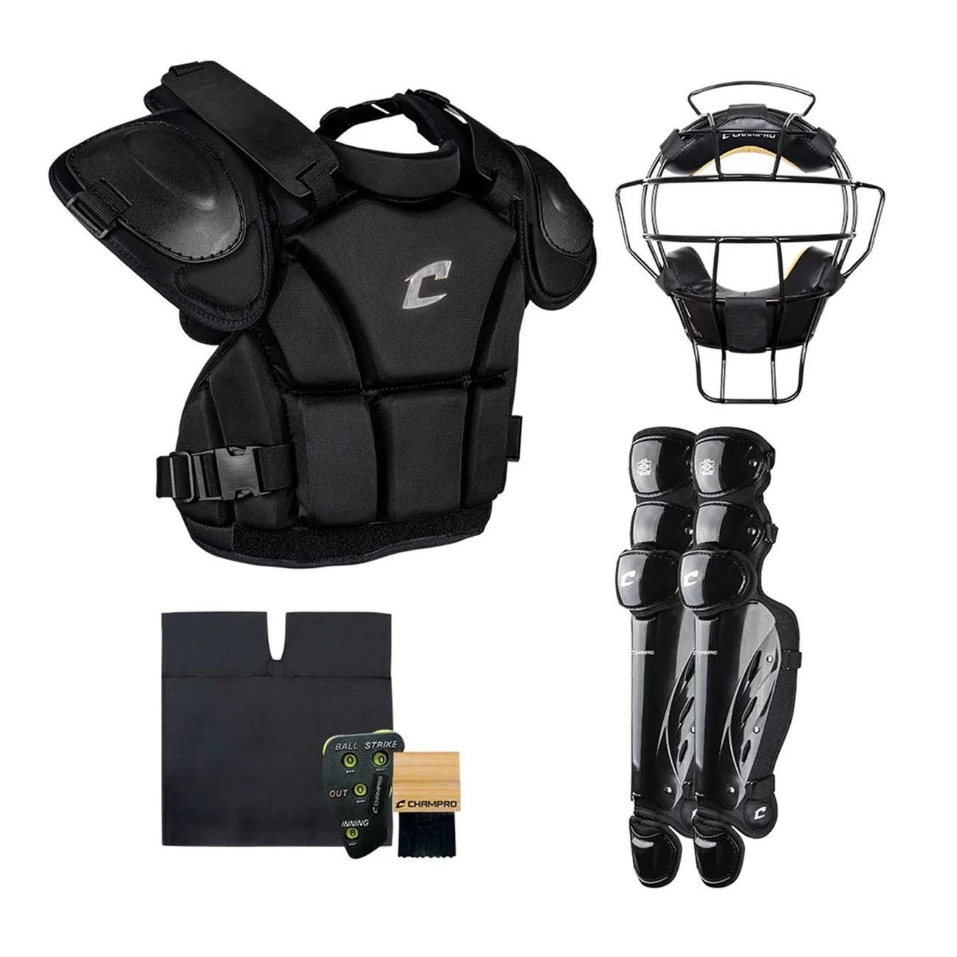
Uniform & Equipment
Equipment Program
New 2024
Rental Program for Umpires
Chest Protector, Shin Guards, Mask, Bag
Fitting by Mentorship Committee
Cost for Season $50
Deposit Held $50
Value of $350+
Exchange equipment if issues/damages
No equipment left at Fields
Option to use own gear (Catcher)
Notes:
Cost to Purchase own Equipment all new $400 - $1,000

Slide 18
Expectations
Arrival / Departure
At Field 15 minutes prior
On Diamond 5 Minutes prior
Leave area after game
Meet partner near back of fence
Bring equipment
Post Game
Chat with partner or mentor
Complete game report (QR Code)
Take equipment!
Notes:
Games scheduled start 6:15 pm
Need to ensure they have time to walk to field
Must be dressed and ready to start on time. (Even if team is not)
Expect to chat with partner/mentor before and after about game.

Slide 19
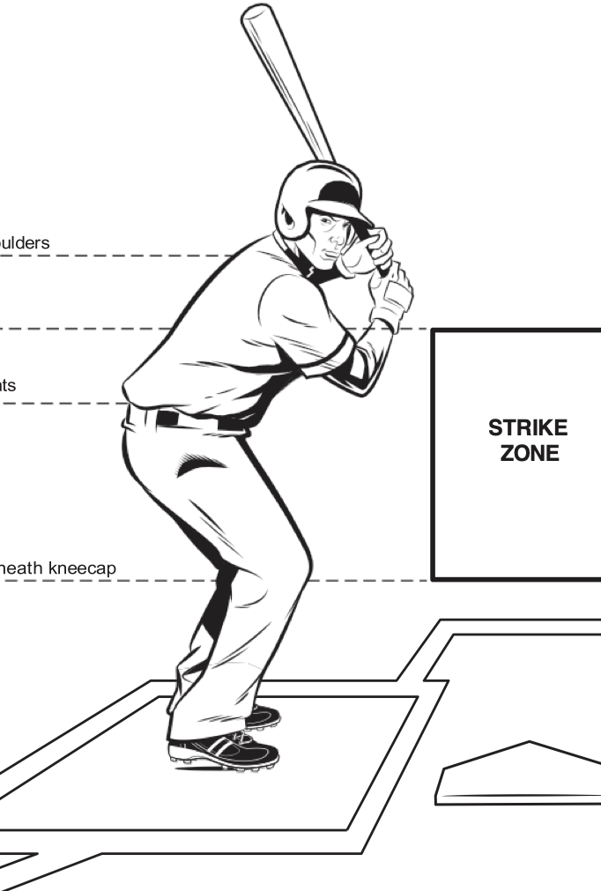
Rules
Notes:
Uniform and Equipment

Slide 20
Rules 1/5
All listed on BOMBA Website & Recently Update
House League Rules
Curfews & Time Limits
Need to review rules for each division before going to game
Curfew
Parks without Lights
Same for Rep & House League
Games start at 6:15pm
No New Inning 2 Hours (8:15pm)
Drop Dead 2:15 (8:30pm)
Umpires needs to carry a watch (not allowed to be on a cell phone)

Slide 21
Rules 2/5
Weather
Home coach is in charge of field until the plate meeting
Umpires call after that
Need to work with coaches in poor weather
Thunder Rule:
When thunder roars, go indoors
Cue is THUNDER
There is no Lightning rule
30 Min delay after each Thunder crack
Notes:
Stop when both teams decide to go home or when curfew ends the permit time.

Slide 22
Rules 3/5
Other Rules of Note
No Cell Phone on field by anyone at anytime
Umpires keep time on their watch, not the coaches
Curfews start from scheduled start time
Catchers must be behind Home Plate (Not off to side)
Anyone warming up a pitcher must wear a mask (standing or squatting)
Umpires must keep baseballs in ball bag in all divisions

Slide 23
Rules 4/5
Other Rules of Note
Rookie Ball Machines require an 8’ circle drawn around it
Only coach is allowed inside
Dead ball if anyone steps in circle, or ball hits people/equipment inside
Safety Bases
White is for Defense to touch/make a play
Orange is for runner
Only applies on a play at first base
All other normal rules apply
Calling Time
Time is requested by players, Called by the umpire
All actions must have stopped
Runners do not advance. There is no ‘half way rule’.

Slide 24
Rules 5/5
Other Rules of Note
7U Coach Pitch (Only HL Level)
Uses a soft baseball
Same rules – umpire holds spare baseballs
New rule printed this year – Wild Throw
Runners can not advance when a fielder makes a wild throw to a base.
Ball must be thrown to retire a runner
If ball is caught by fielder, this rule doesn’t apply
Purpose is to stop runners advancing when few can catch/throw
This will be updated on website in HL Rules as well as on a rule change section.

Slide 25
Scheduling & Pay
Notes:
Uniform and Equipment

Slide 26
Pay Information
Pay is done by level of baseball
Pay is via cheque on monthly basis
Pay period listed in ramp
May, June, July, August, September
Email sent when cheques are ready
Do not go in looking for cheques ahead of emails
Pays attempted for 10-15 days after end of month
Adjustments for games done alone, rain outs, no game
Email Scheduler & UIC
Issues on Pay → Notify UIC

Slide 27
Pay Information
Cash Games
Exhibition Games scheduled by Coaches
In Ramp Assigning, Noted as “Cash Game”
Payment Required by Coach at Plate Meeting
Pay Conditions
Game cancelled by us (Approximately 1 Hour Prior) = No Pay
Attend game location, not played = ½ Pay by Adjustment
Start game (Plate Meeting) = Full Pay
Miss the cancellation notice = No Pay
Work game alone = 1.5x Game rate (Extra paid by Adjustment)

Slide 28
Pay Information - 2025
DIVISION
7U
8U & 9U
10U & 11U
12U & 13U
14U & 15U
16U & 18U
22U
House League
$30
$35
$40
$40
$50
$55
N/A
REP
N/A
$35
$40
$40
$55
$65 (7 Innings)
$75 (9 Innings)
N/A
HP/EBLO
N/A
N/A
N/A
$60
$65
$80 (7 Innings)
$80 (9 Innings)
N/A

Slide 29
Scheduling System (Ramp Assigning)
BOMBA.RAMPASSIGNING.COM
Terms to Know
Dark Days
Available Days
Assigned Games
Accepted Games
Declined Games
Up For Grabs Games
Open Games
Not Available
Available to be scheduled
Games Given, Not Accepted
Assigned Games Accepted
Assignments Declined
Accepted Games open for taking
Open Games for taking

Slide 30
Scheduling System (Ramp Assigning)
Key Take Aways from Terms:
All your days are available now by default (Change from last year)
You must select days which you are not available work.
48 Hours to accept games then they are withdrawn
Once a game is accepted, it is yours
Decline too many games and you stop getting games
Up For Grabs Games belong to the person offering it until someone takes it
Open Games are rare in the system but are usually used for last minute changes

Slide 31
Scheduling System (Ramp Assigning)
How it works:
Umpire puts in their black out dates
Assigner matches games with umpires
Umpire gets a notification of a game
Umpire accepts/rejects assignment
Games are assigned based on Levels subject to your availability
If you say your unavailable, scheduler does not see you

Slide 32
Scheduling System (Ramp Assigning)

Slide 33
Scheduling System (Ramp Assigning)

Slide 34
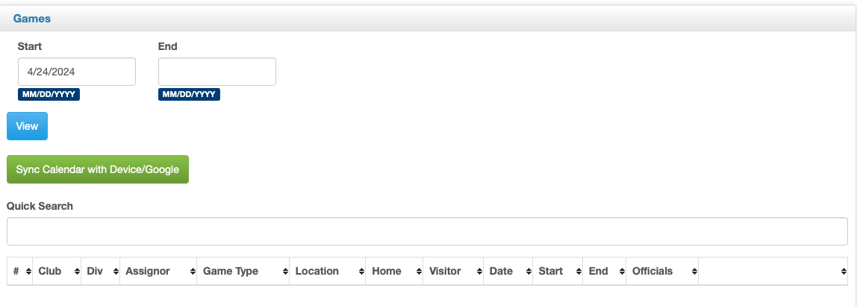
Scheduling System (Ramp Assigning)

Slide 35
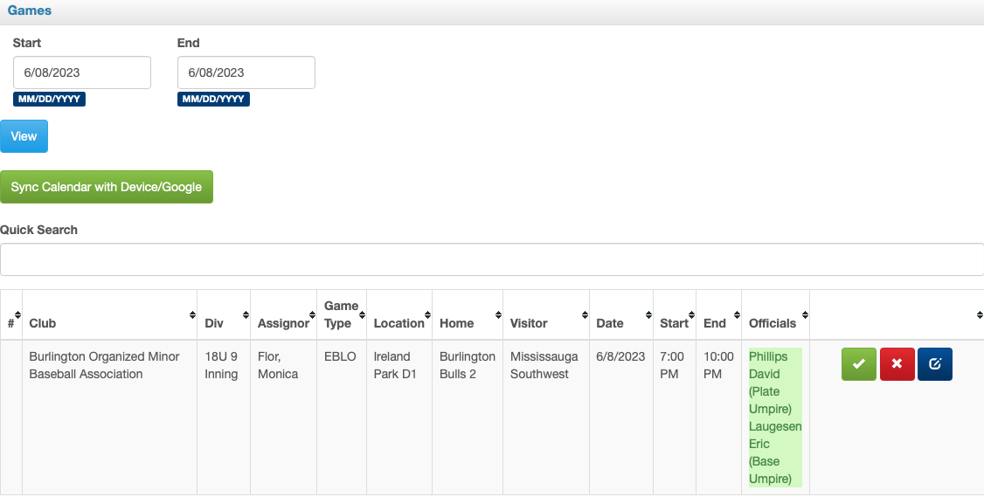
Scheduling System (Ramp Assigning)

Slide 36
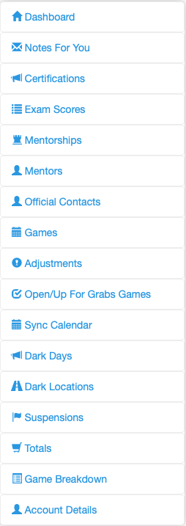
Scheduling System (Ramp Assigning)

Slide 37
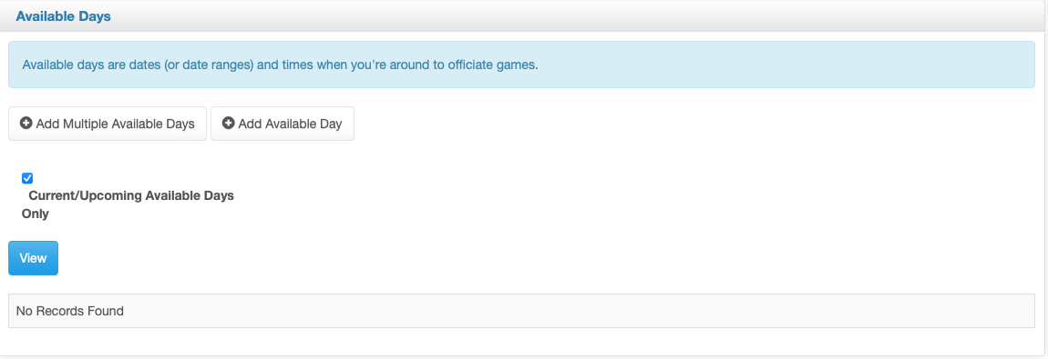
Scheduling System (Ramp Assigning)

Slide 38
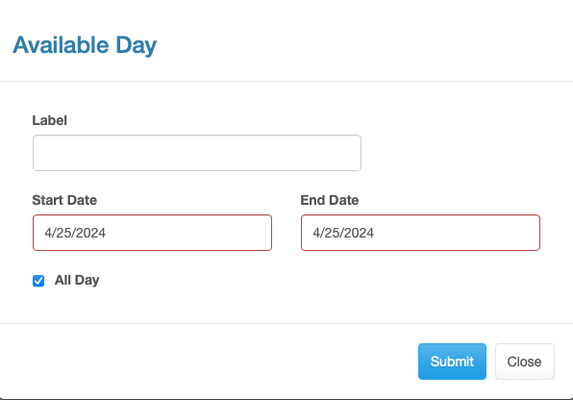
Scheduling System (Ramp Assigning)

Slide 39
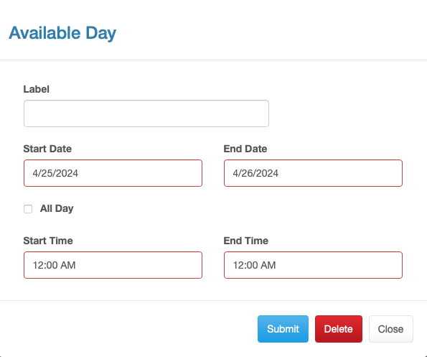
Scheduling System (Ramp Assigning)

Slide 40
Scheduling System (Ramp Assigning)

Slide 41
Scheduling System (Ramp Assigning)

Slide 42
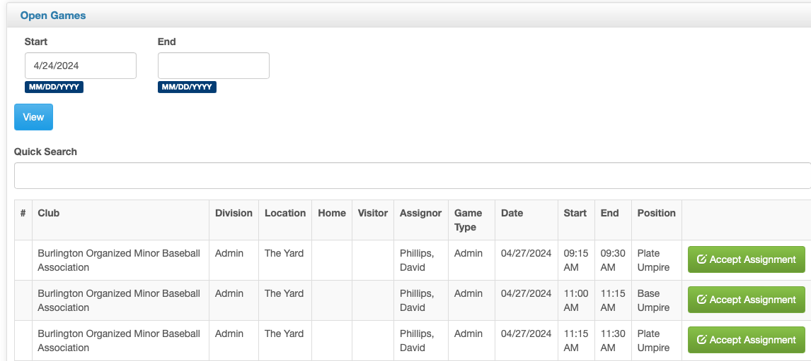
Scheduling System (Ramp Assigning)

Slide 43
Scheduling System (Ramp Assigning)

Slide 44
Note on 2025 Season & Schedules
Issues, questions on scheduling go to Scheduler first.
Additional concerns go to UIC next.
Availability and limited restrictions are key to more games.
Consistent Turn backs are not good
Working with friend/parent/sibling is not a guarantee
Largest number of new umpires in any recent history in BOMBA

Slide 45
Other Items & Updates
Notes:
Uniform and Equipment

Slide 46
Conduct & Discipline
Code of Conduct Policy in place signed by all coaches and parents during registration
Visitors subject to same policy
Zero Tolerance Policy in place
Violation subject to Discipline up to and including removal from BOMBA
Need to report problems, concerns to UIC
Reasonable questions deserve reasonable answers
Coaches expect umpires to not have all answers

Slide 47
Conduct & Discipline
“I think he found it a bit stressful last year. He got through it and you were very supportive but coaches in particular were very challenging. Not something we expected for house league children’s games. It’s really unfortunate. Thank you for all of your training and support.”
Quote from parent of 15-year-old umpire who did not return.
Failure of multiple parts for this happening
Can easily change House League to Rep to describe other umpires
It is imperative that issues are reported promptly!
Need to do better job on game reports!

Slide 48
Conduct & Discipline
Inappropriate Behaviour Examples include:
Physical Contact
Intimidation
Derogatory Comments
Screaming
Ganging Up
Post Game Comments
Passive Aggressive Comments
Repeated Remarks
Failure to Take Proactive Control of Team and Spectators

Slide 49
Expectations of Umpires
Arrive on Time – 15 Minutes Minimum, 5 Min on Field
Be professional
Be loud and Decisive
Know the Rules
Do not accept inappropriate behaviour
Answer reasonable questions
Work as a Team with your Partner
Do your best, Ask questions
Get the Call Right

Slide 50
Q & A Session
This session is not recorded

Slide 51
Thank you!
Officiating is a vital part to any game. Thank you for your commitment to making the game happen!

