Slide 1
WELCOME UMPIRES!
April 16th and May 06th , 2023
BOMBA Level 1 and 2 Umpire Clinics

Slide 2
INTRODUCTIONS
Umpire In Chief
Dave Phillips
Email: umpireinchief@baseballburlington.com
Phone: 519-635-2575
Umpire Scheduler
Monica Flor
Email: scheduler@baseballburlington.com
Phone: 647-205-4688
President
David Margetts
Email: president@baseballburlington.com

Slide 3
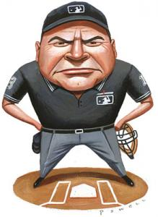
Resources
BOMBA
www.baseballburlington.com
BASEBALL ONTARIO
www.playoba.ca
ON-DECK App
EMAIL
umpireinchief@baseballburlington.com

Slide 4
2023 PAY RATES FOR UMPIRES
DIVISION | HL (Card) | Rep (Cash)
Sr. Coach Pitch 7U | $30 | N/A
Rookie Ball 9U | $35 | $35
Mosquito 11U | $40 | $40
Pee Wee 13U | $40 | $40
Bantam15U | $50 | $55
Midget 18U | $55 | $65 (7 innings) $75 (9 innings)
Junior 22U | N/A | $70 (7 innings) $80 (9 innings)
All league games will be paid by cheque monthly.
There is no money exchanged at the park.
If the game is a rainout (prior to first pitch), the Umpires will notify the schedulers and they will make the payment through RAMP.
Cheques can be picked up at the BOMBA office
1370 Artisans Court, L7L5Y2

Slide 5
Curfews
Houseleague
Rep
Parks without lights
Games start at 6:15 pm
No new inning after 8:15 pm
Dead ball at 08:30
Parks with Lights
Games start at 6:15 pm
No new inning after 8:15 pm
Dead ball at 8:25 pm
If inning is not completed the score reverts back to the previous inning played.
For Games that start at 8:30 pm
No new inning after 10:30 pm
Dead ball at 10:45 pm
Parks without Lights
Games start at 6:15 pm
No new inning after 8:15 pm
No pitch after 8:30 pm
Parks with Lights
Games start at 6:15 pm
No new inning after 8:15 pm
Dead ball at 8:30 pm
For Games that start at 8:30 pm
No new inning after 10:30 pm
Dead ball at 10:45 pm

Slide 6
Thunder rule
If you hear Thunder, suspend the game, then wait at least 30 minutes, before resuming the game
Every time you hear Thunder, the 30 minute clock restarts.
If the Thunder persists and does not appear to get better, the umpires will make the decision to call off the game. (Alert the schedulers if this happens)

Slide 7
Uniform
Required uniform:
Black hat (Preferably with no bright markings)
Black collared shirt (with no major markings)
Jock/Jill (Required for any game)
Grey pants with black belt
Darker coloured shoes
Where can I buy these articles?
Winners, Walmart, Old Navy, or check the closet for hand-me-downs!

Slide 8
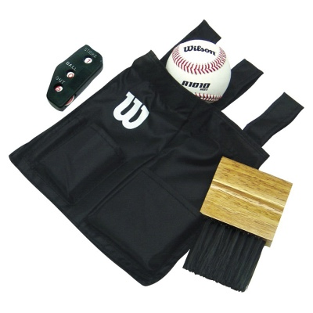
Equipment
Plate Umpire Uniform pieces
Ball bag
Indicator
Plate brush
These pieces can be found at Home Run Sports, online and other sporting stores!

Slide 9
Equipment
Plate umpire position ONLY!!
If you are assigned as a Plate Umpire for a game and do not have a chest protector/shield, mask, and shin guards do not panic. All fields used by BOMBA have an equipment box at the diamond that will have one chest shield, one mask, and one set of shin guards.
No need to purchase a chest shield, mask, or shin guards as this equipment is at every field.

Slide 10
UMPIRE EXPECTATIONS
Arrive On Time -15 Min Minimum, 5 Min On Field
Be Professional
Be Loud
Be Decisive
Know the Rules
Do Not Accept Inappropriate Behaviour
Answer Reasonable Questions
Work As a Team with Your Partner
Do Your Best, Ask Questions
Get the Call Right

Slide 11
GAME ISSUES
Umpire In Chief
Dave Phillips
Email: umpireinchief@baseballburlington.com
Phone: 519-635-2575
MAKE NOTES
COACH/PLAYER, TEAM NAME, INNING
# OUT, RUNNERS, BATTER, PLAY DETAILS
COMPLETE REPORT (ONLINE)
SEND EMAIL TO UIC
CALL UIC

Slide 12
ZERO TOLERANCE
ABUSE
PHYSICAL CONTACT
INTIMIDATION
DEROGATORY COMMENTS
SCREAMING
DISRESPECT
GANGING UP
POST GAME

Slide 13
Scheduling
What is RAMP?
Ramp is the website used by all BOMBA umpires to receive games scheduled.
This is also the website you will use to block time/days that you can not work
You will also be able to see how much money you will be paid at the end of the month for the games you worked
After this clinic you will need to sign up for RAMP. An email will be sent out to remind you of this.

Slide 14
MANDATORY RAMP RULES
YOU MUST FOLLOW THESE RULES IN ORDER TO RECEIVE GAMES!!!
Must provide a valid, working phone number in the RAMP website
Make sure days you CAN NOT work are blocked well in advance on the RAMP schedule (i.e. School events, family events, trips, appointments, sporting games, any other events that will render you not available for a game.)
Note: You do not have to wait for that month to block the event off you can block days in future months. Update your availability as often as possible to avoid conflict. (i.e. same day availability)
Make sure if you receive an email from RAMP about a game that you log on to the website and confirm the game details. You CAN NOT decline a game. If you can not take the game it is your responsibility to find a replacement. (Relates back to rule #2)

Slide 15
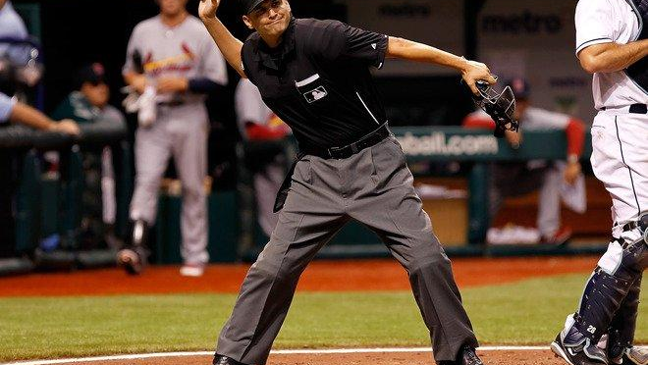
DO NOT SEND OUT MASS EMAILS LOOKING FOR COVERAGE!!!!

Slide 16
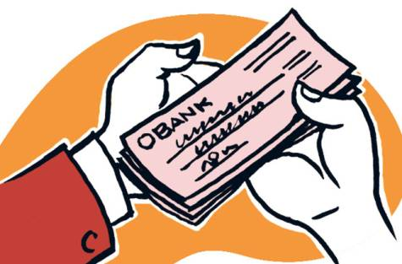
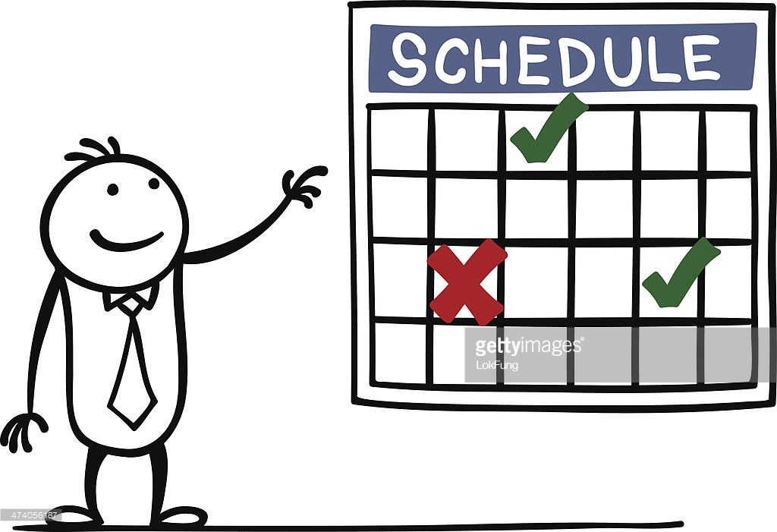
FAQ
Q: How many games should I expect to receive?
A: There is no guarantee, as long as your blocks are done we will be able to assign you games. Keep in mind, if you are only available 4 days a month it will be harder to schedule you.
Q: When will I get paid?
A: All rep and house league games worked will be added up and paid by cheque at the end of each month. You will receive an email from RAMP when cheques are ready to be picked up at the BOMBA office.1370 Artisans CT, Burlington,L7L5Y2

Slide 17
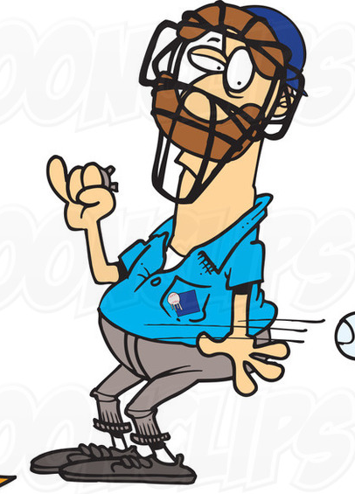
FAQ
Q: What if I am sick or have another pop up event on the day of a scheduled game?
A: YOU are responsible for finding a proper replacement and notifying the schedulers of your switch and replacement. If you switch games last minute more than once your name will be put at the bottom of our list for scheduling. If you no-show a game without notification your name will instantly fall to the bottom of our list.
Q: I want to umpire with my friend/sibling, is that possible?
A: We do our best to accommodate but we can not guarantee.

Slide 18
2023 Initiatives
On-Going
Respect and conduct with umpires, coaches, players and spectators
Focus Points
Clear Communication
Fair & Effective Scheduling
Attention to Concerns/Issues
Web Site Enhancement (New)
Training (New)
Indoor Sessions at Bulls Pen
Times/Dates TBD
Issue Reporting (New)
Online Form Submissions
COBA UIC Committee
Future
Mentoring Program
Evaluations
New Scheduling Software (2024)

Slide 19
Questions & Answers

Slide 20
GOOD LUCK TO EVERYONE AND WE HOPE TO SEE YOU ON THE DIAMONDS!

