Slide 1
PRESIDENT’S REPORT FOR 2024
Annual General Meeting
January 21, 2025

Slide 2
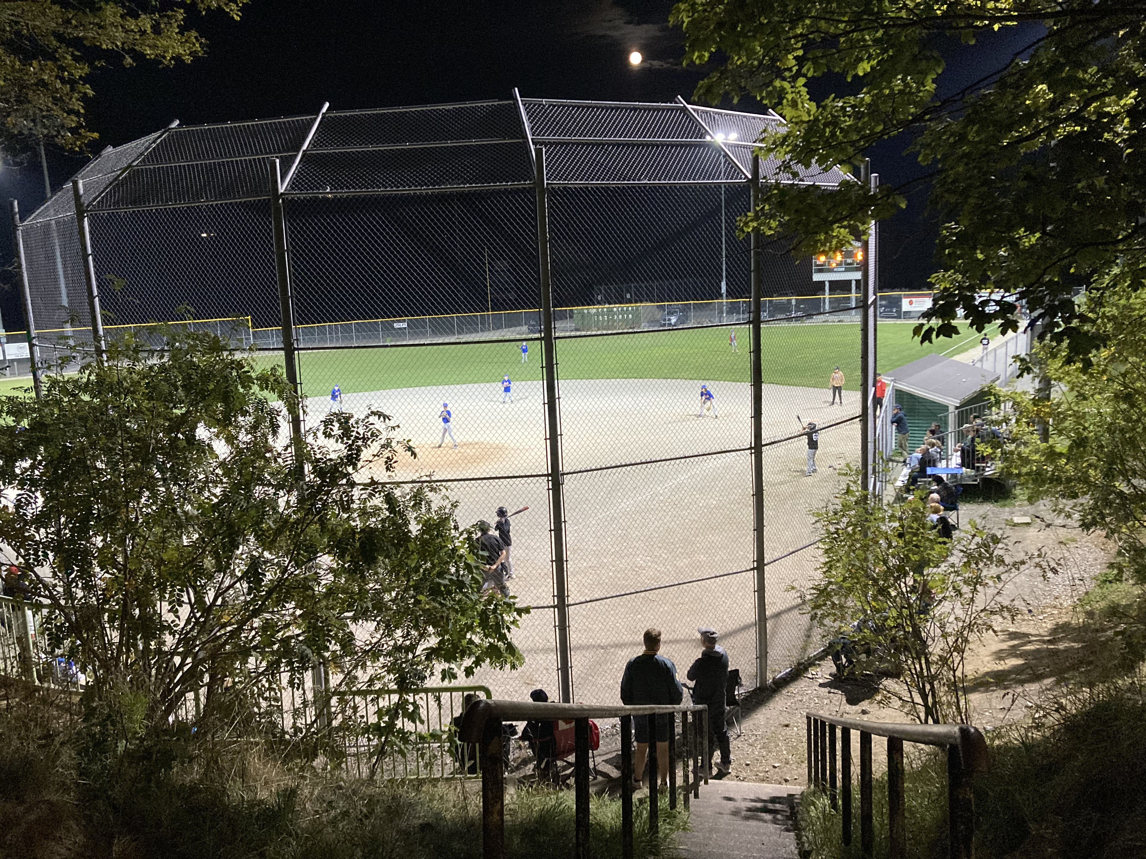
2024 YEAR IN REVIEW
Hired a new Executive Director, Dave Lahey
Registration totaled 1,010, approximately 17% females
Registration steady at just over 1,000 for last three years

Slide 3
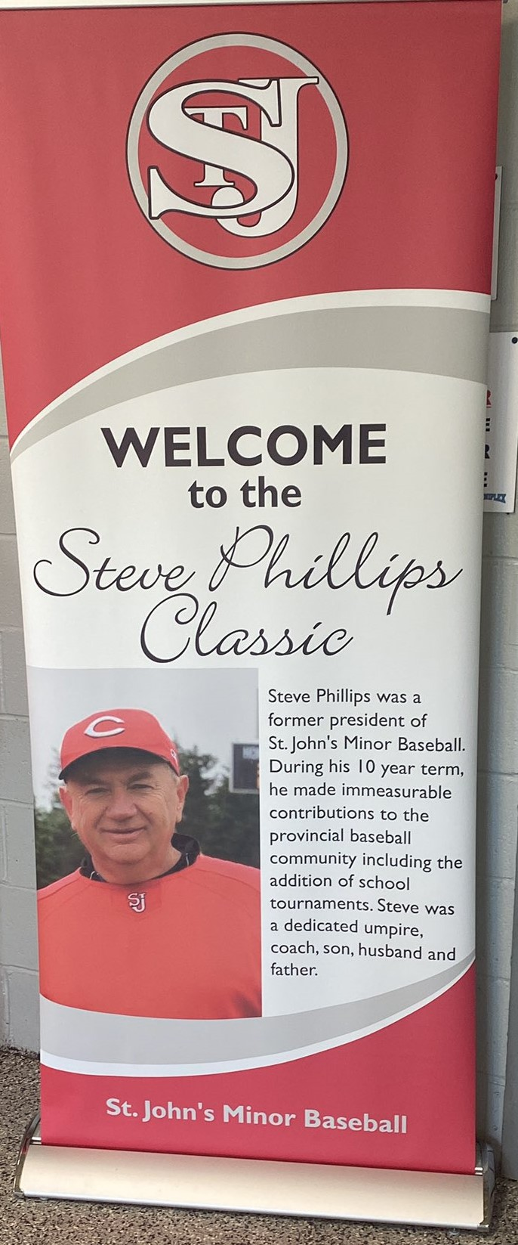
2024 YEAR IN REVIEW
Hosted school tournaments including the Steve Philips Classic, Geoff Walsh Memorial, Junior High and Senior High Girls
School tournaments included
76 schools
105 teams
210 games

Slide 4
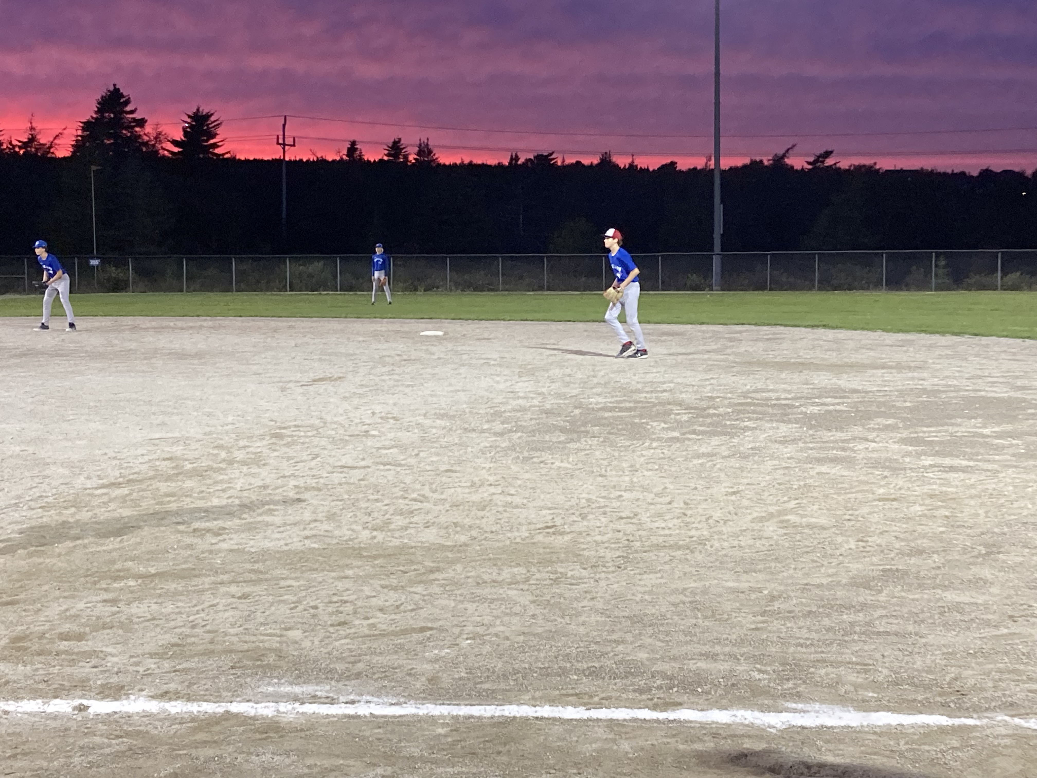
2024 YEAR IN REVIEW
House league registration totaled 772 (76%) across 7 divisions
Rally Cap - 98 9U Minor - 122
9U Major - 112 11U - 160
13U - 163 15U - 70
18U - 47
354 games; 70 practices

Slide 5
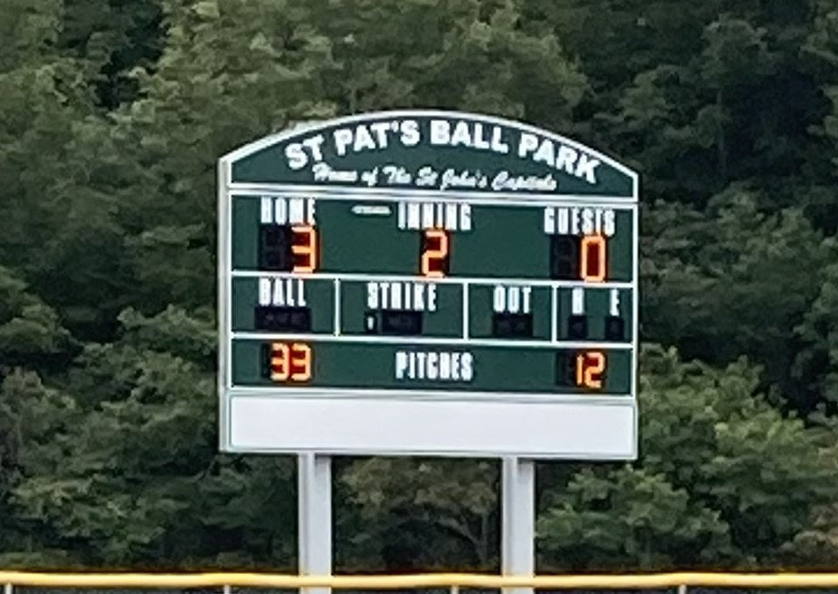
2024 YEAR IN REVIEW
Hosted the 5th Annual Mike Buist Classic
55 teams
117 games
Hosted 13U A and 15UA provincials
Installed a scoreboard at Edgar Hartery field

Slide 6
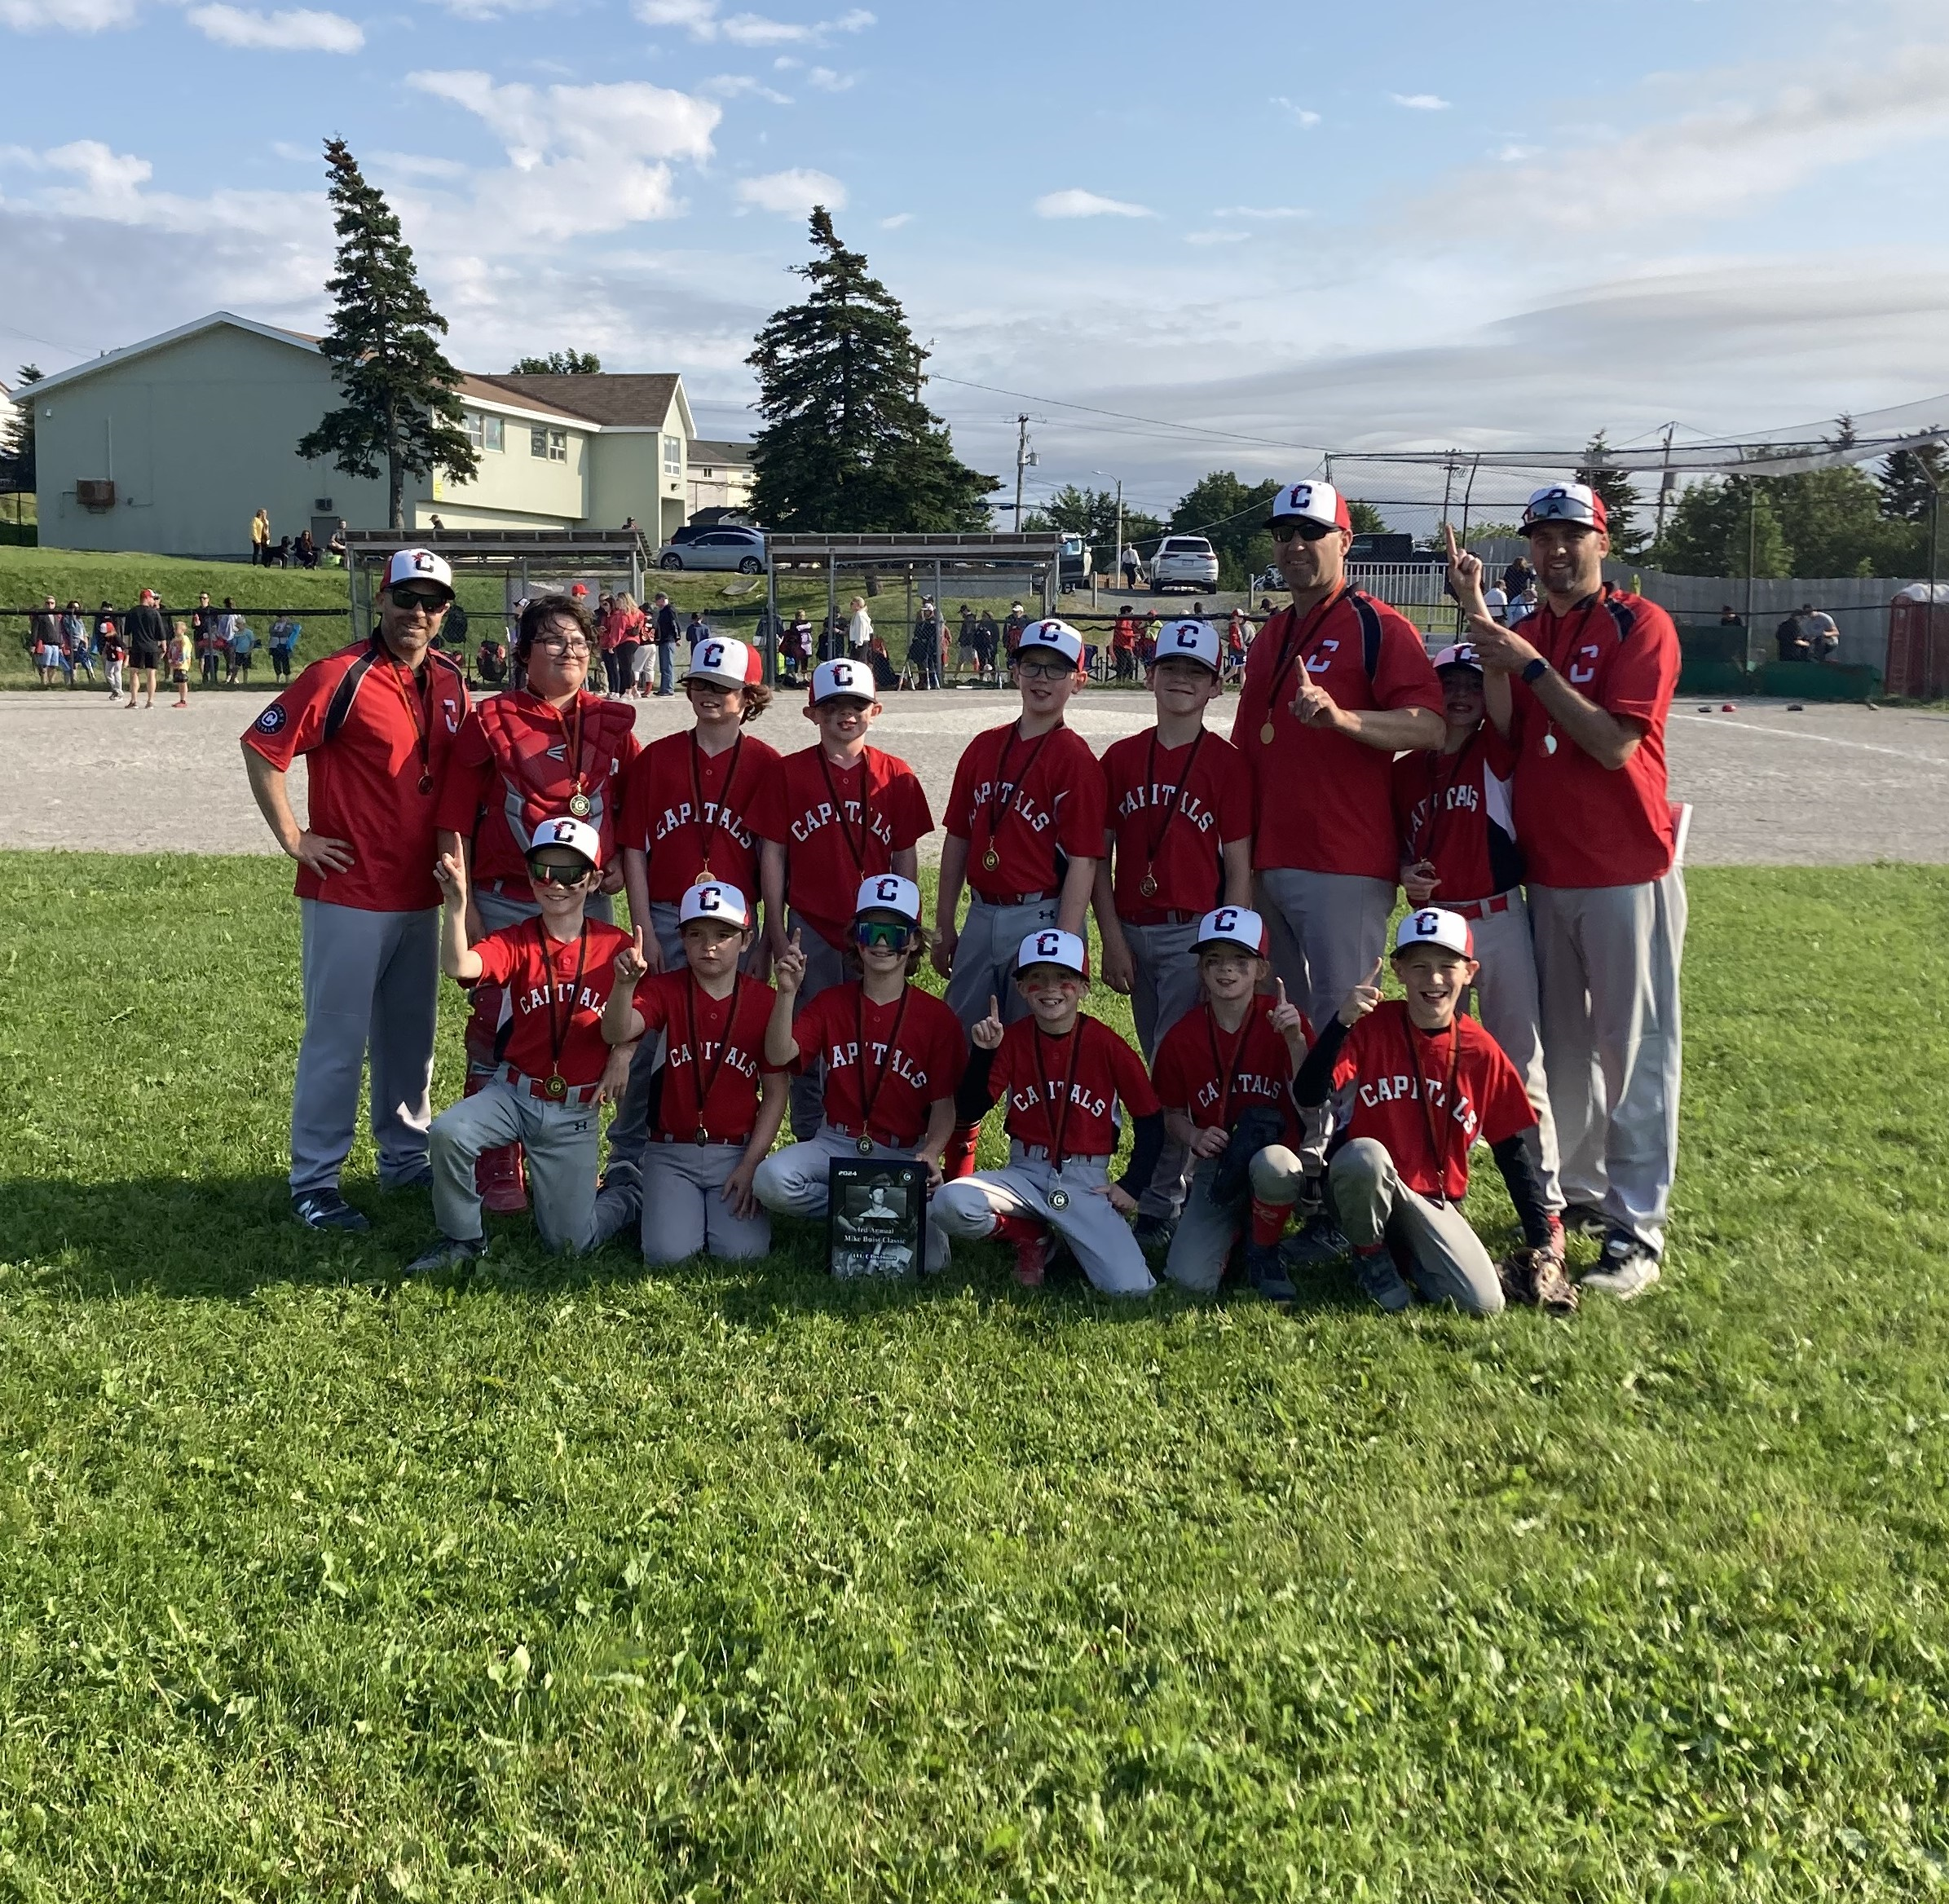
2024 YEAR IN REVIEW
Installed portable washrooms at four fields
Revamped the All Star High Performance Program
Successfully completed All Star team selections

Slide 7
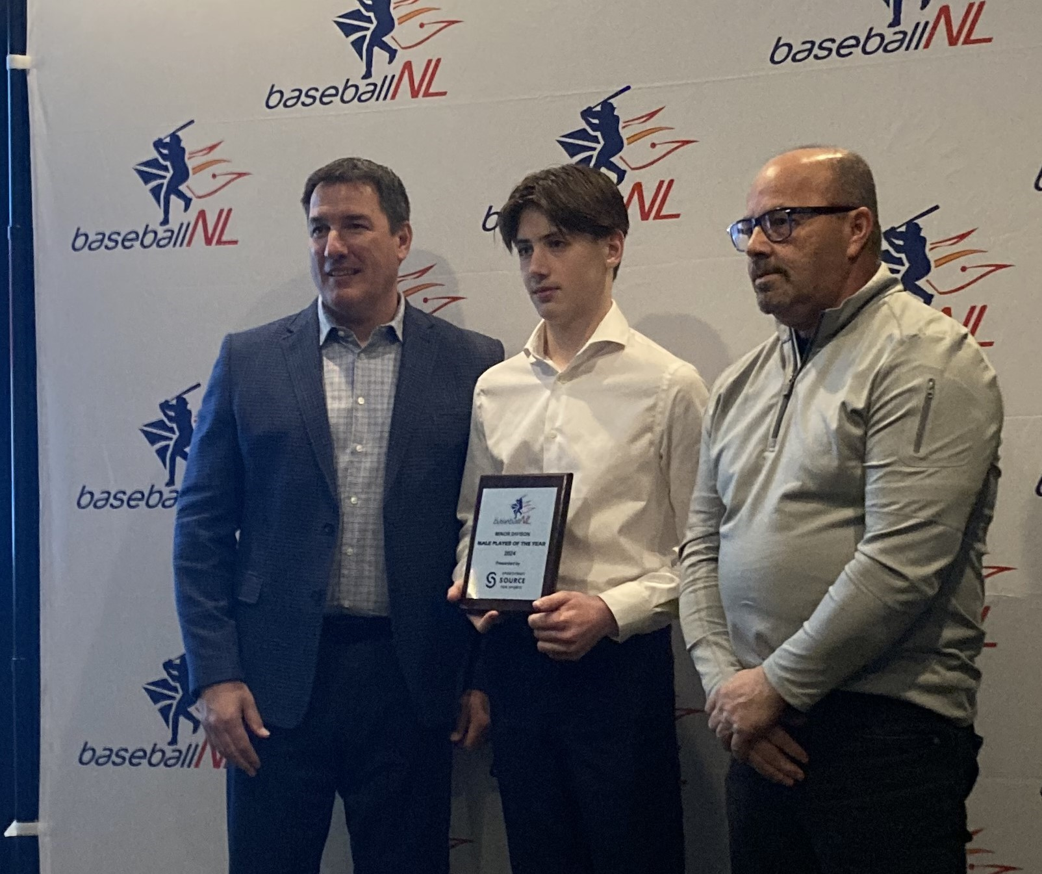
2024 YEAR IN REVIEW
Won BNL Awards in the following categories:
Minor Male Player of the Year – Kellan Sullivan
Female Coach of the Year – Nikki Mousseau
Minor Umpire of the Year – Maggie Byers

Slide 8
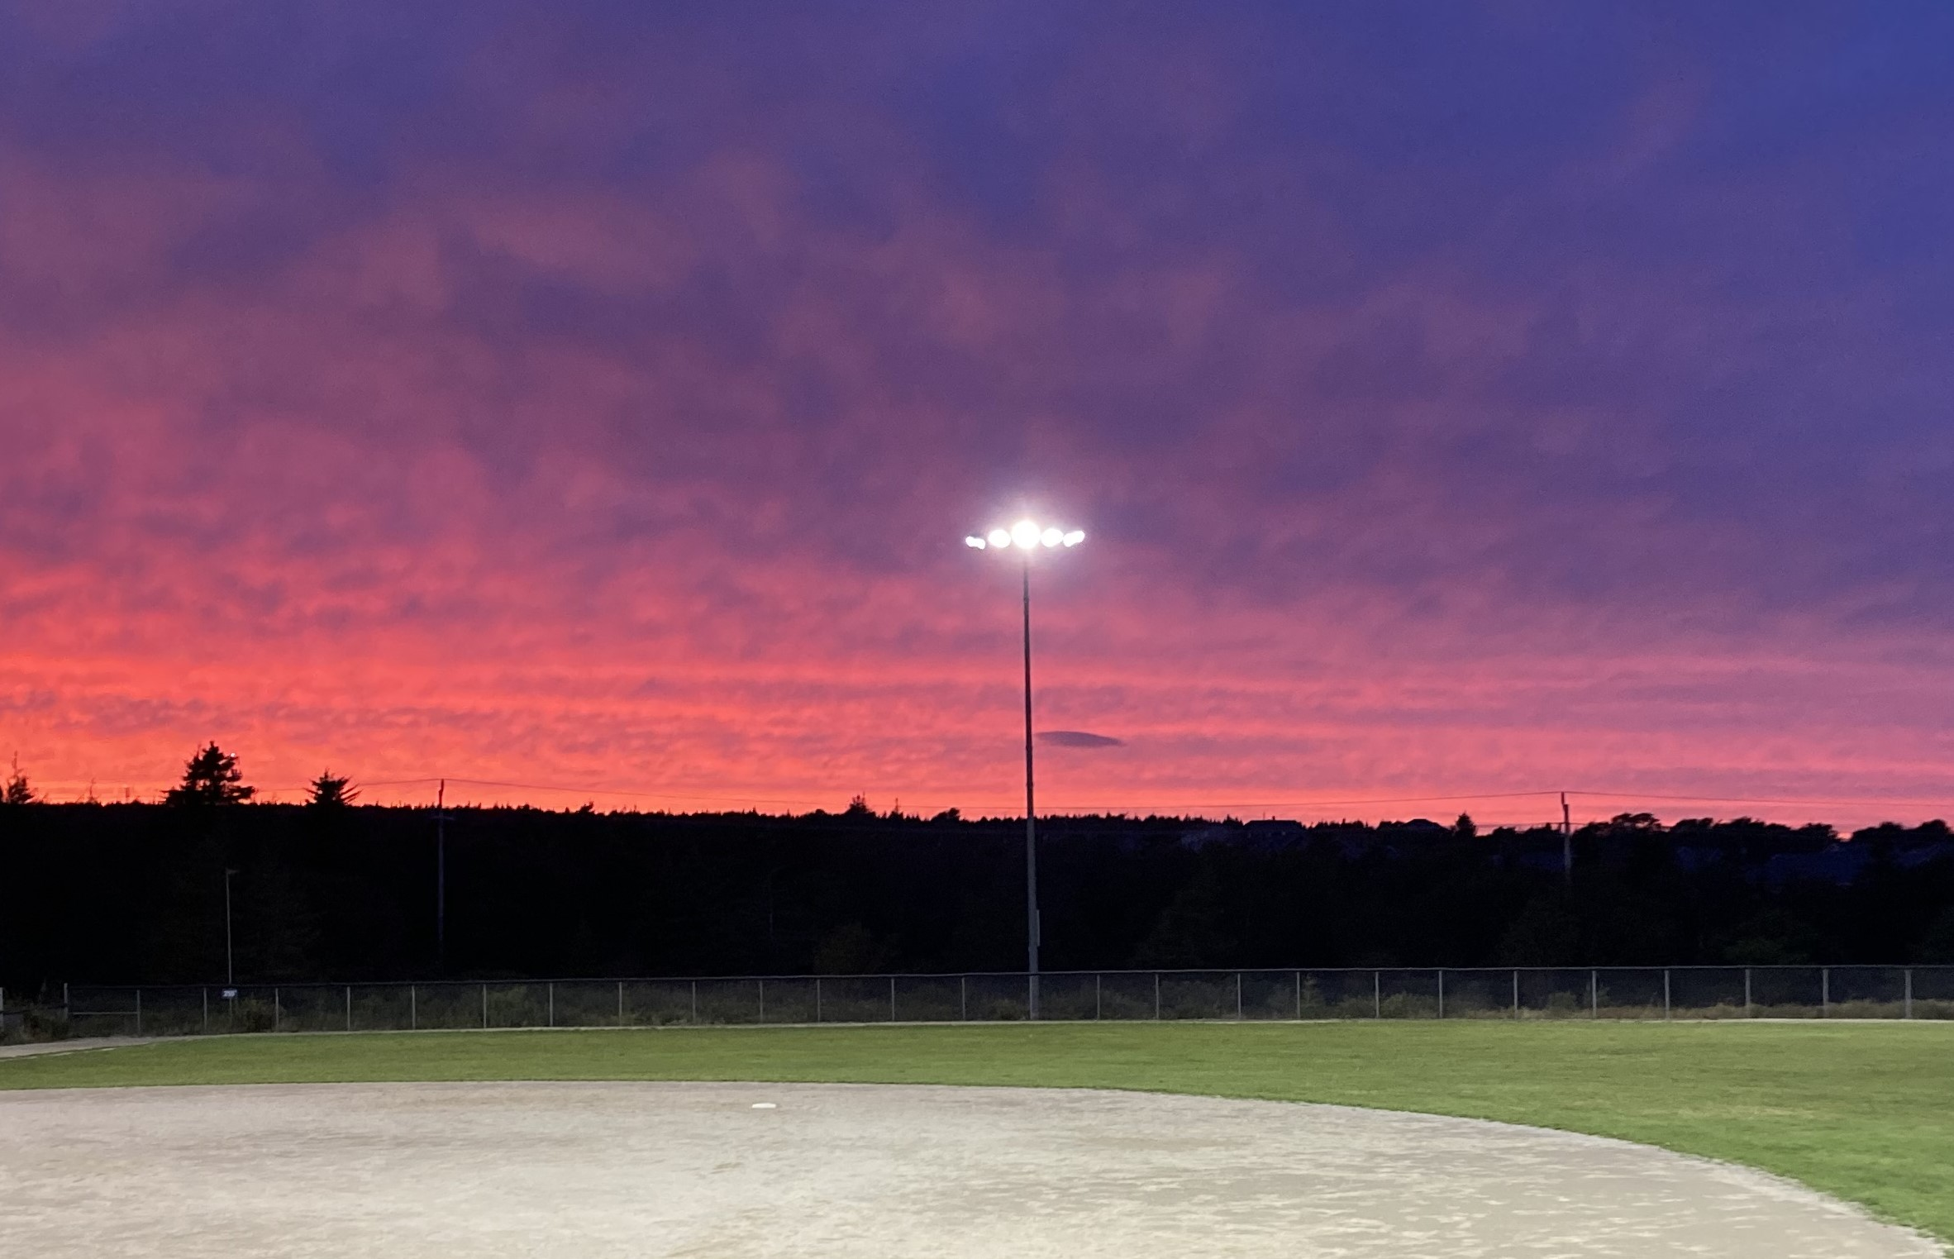
2024 CHALLENGES
Transitioning to a new Executive Director
Delivering programming, ensuring a quality experience, and meeting expectations
Sustaining A League of Their Own while supporting AS teams/players

Slide 9
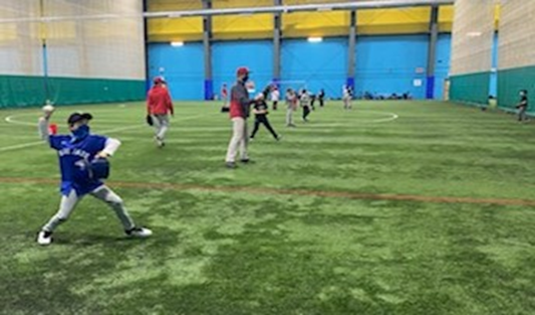
2024 CHALLENGES
Offering School Tournaments without impacting other programs
Ensuring adequate staffing at the right place at the right time
HL Game defaults

Slide 10
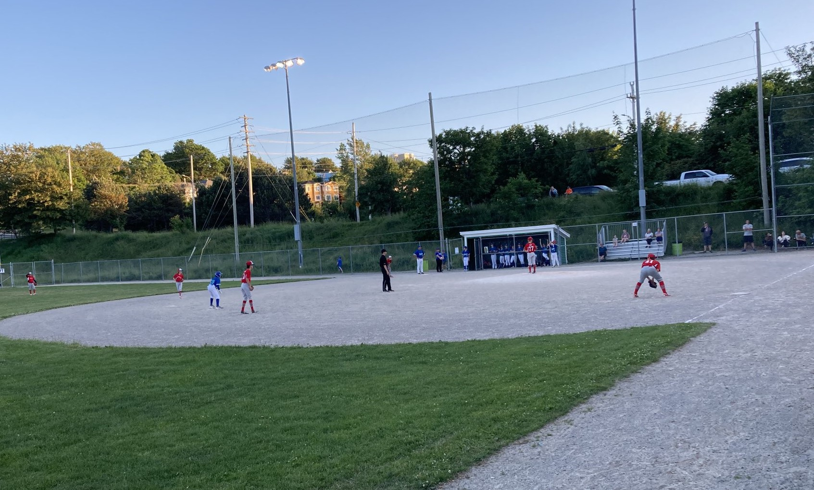
2024 CHALLENGES
Delays in rolling out Skills and Drills Sessions
No HL mid season tournaments or alternative events
AS metro league coordination and communications

Slide 11
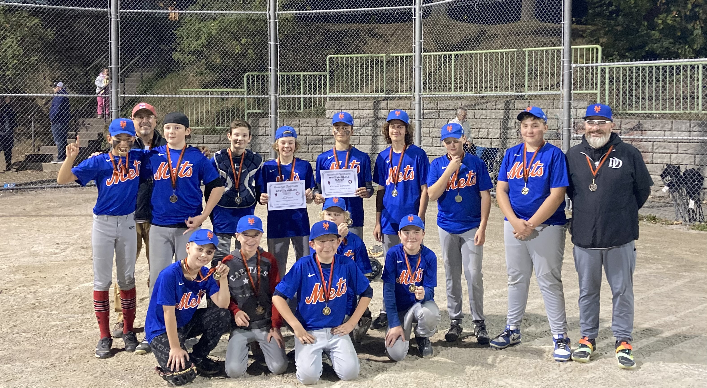
POST SEASON SURVEYS
To get feedback on the HL experience this year in light of known challenges a parent’s survey was distributed
* Surveys were also sent to HL and All Star coaches

Slide 12
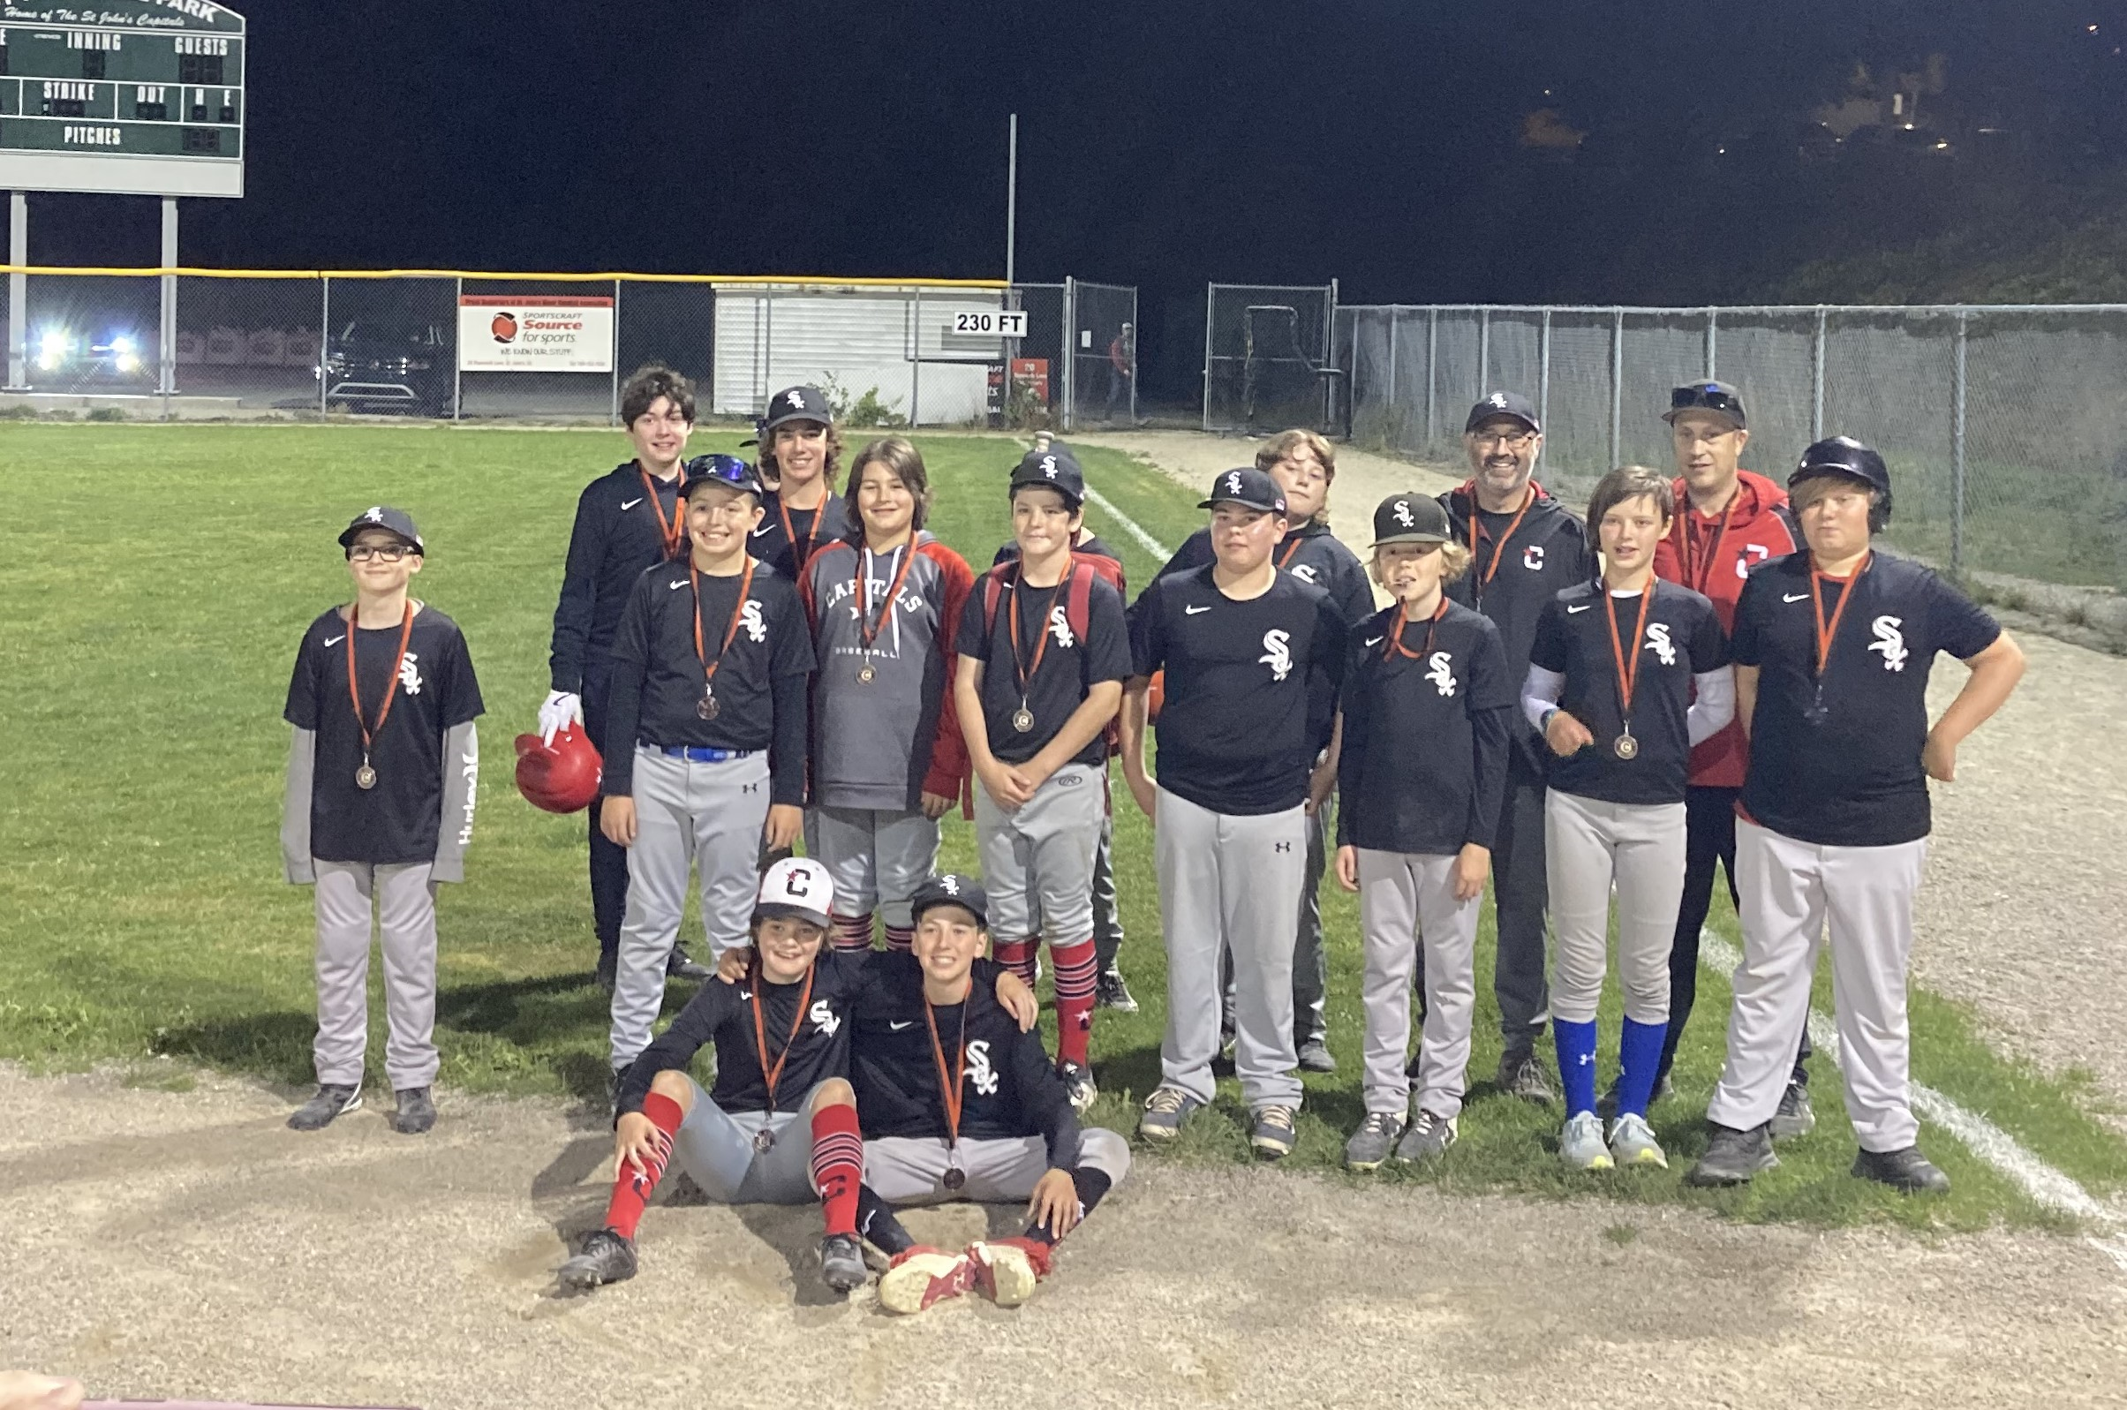
POST SEASON HL SURVEY
HL Survey – 167 responses
A lot of positive feedback
Compliments for individual staff
Appreciation for ability to provide feedback
Kids enjoy baseball with SJMBA
A good program and experience

Slide 13
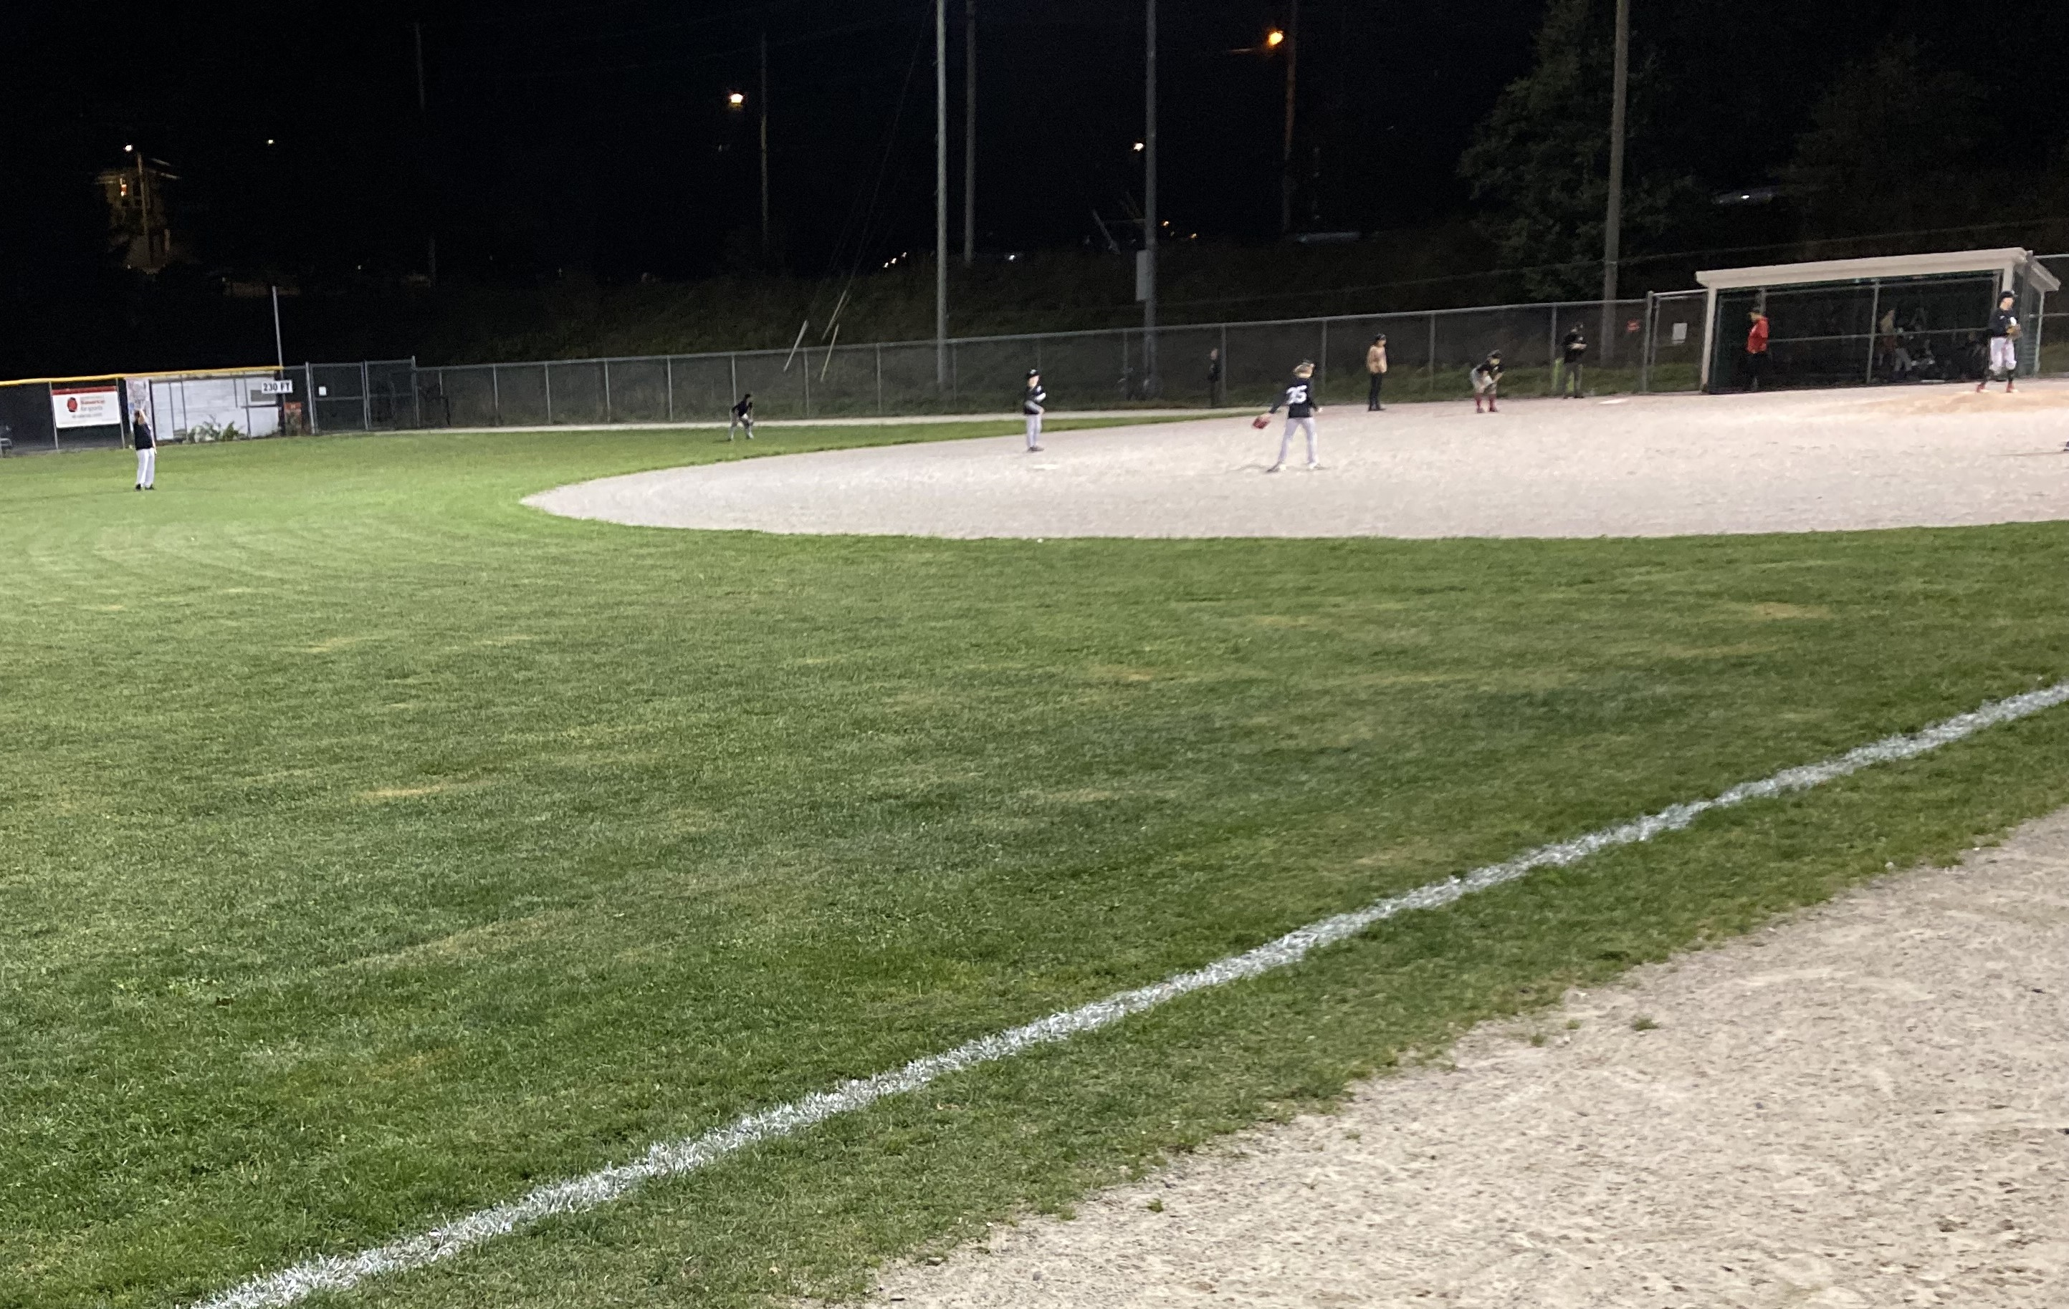
POST SEASON HL SURVEY
Planning to return next year
Yes 64%
Will depend (child, activities, schedule) 20%
Unsure 14%
No 2%

Slide 14
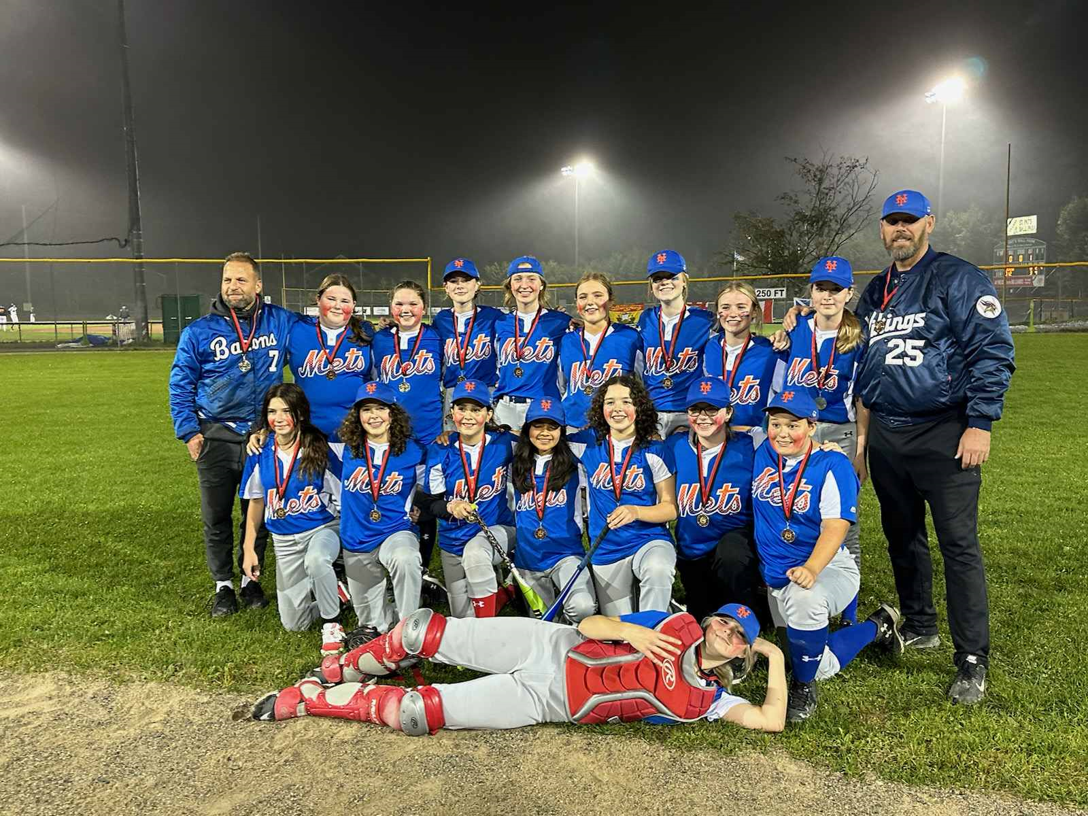
POST SEASON HL SURVEY
Key areas for improvement
HL is an afterthought; focus is on AS
Season starts too late
Too many defaults
Too many games with 1 umpire
Earlier & better communication of schedules including year end tournaments
More practice time early is season

Slide 15
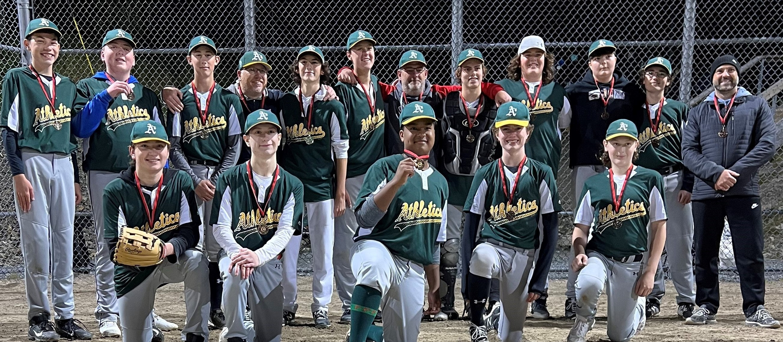
POST SEASON HL SURVEY
Key areas for improvement
Better catchers gear, 2 sets, right sizes
Umpires calling games too early
Number of players per team
Rally Cap still periods of inactivity
“A” players in house league, mixed reviews
Better definition of 9U major & minor
An all girls team in 9U

Slide 16
POST SEASON HL SURVEY
Key areas for improvement
Need to update registration materials to better reflect current programming
Roughly 50/50 split on ability/desire regarding weekend activity
Some feedback on mid season events
15U had the most negative feedback and needs improvement

Slide 17
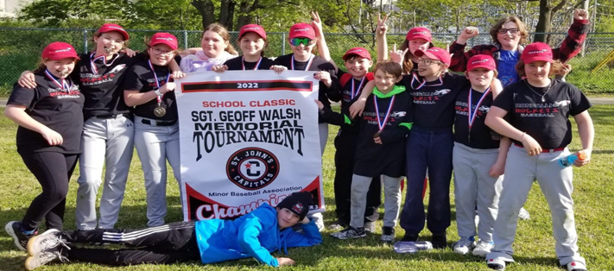
2025 KEY AREAS OF FOCUS
Reviewing staffing complement and adding operational support
Assessing impact of 2025 Canada Games
School tournaments in 2025 and Beyond

Slide 18
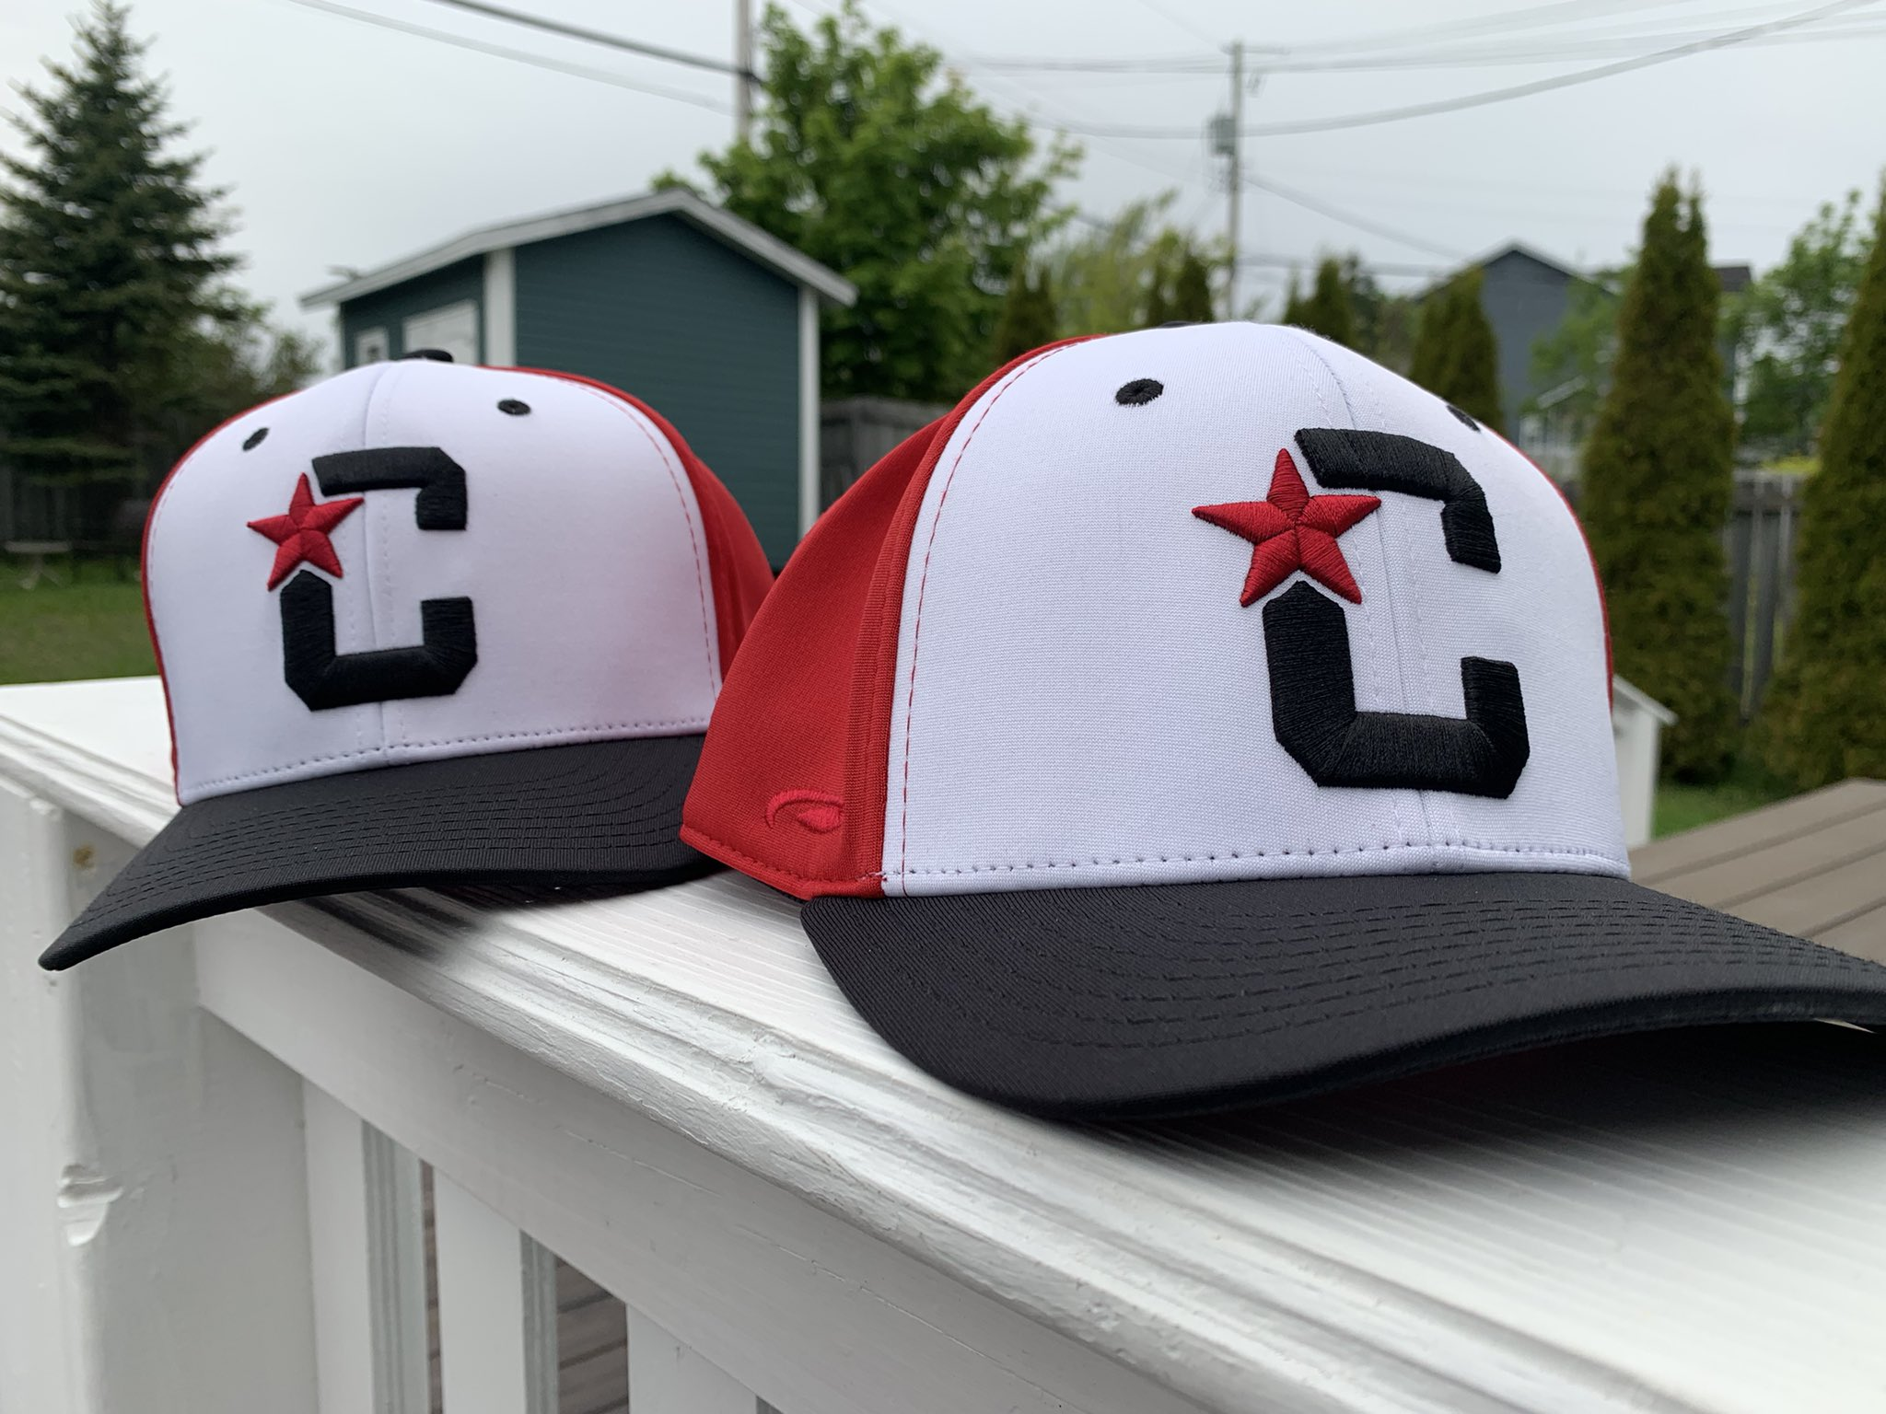
2025 KEY AREAS OF FOCUS
Addressing HL Survey feedback
Reviewing fee structure
Further refinements to High Performance Program

Slide 19
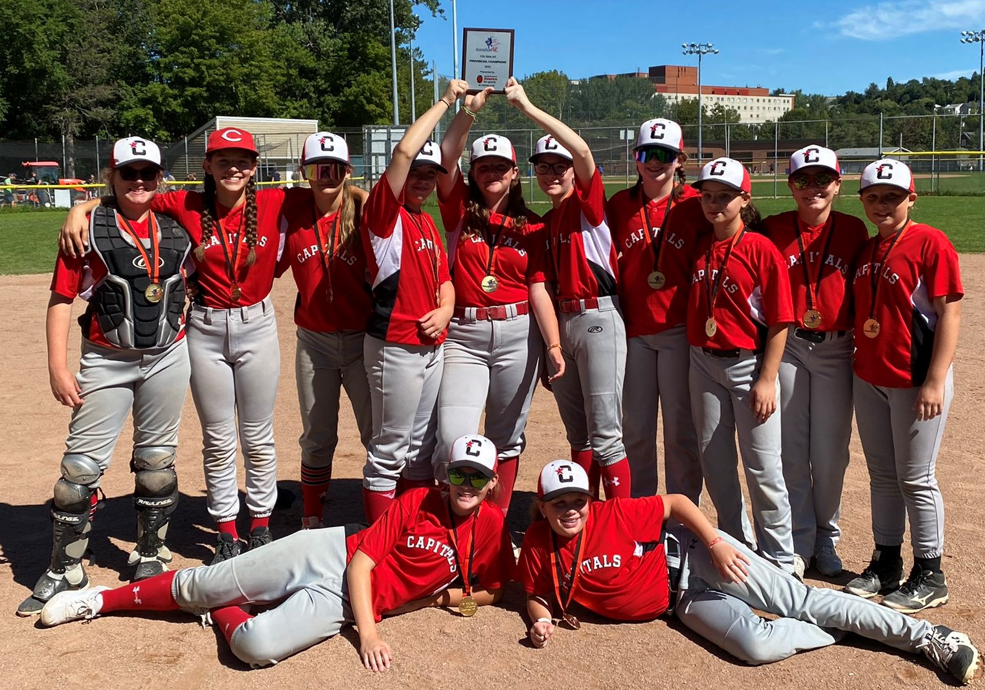
2025 KEY AREAS OF FOCUS
Better coordination with metro associations regarding AS
Consider changes to AS program
Review feedback from AS coaches
Continue transition to new Executive Director

Slide 20
2025 KEY AREAS OF FOCUS
Maintaining and supporting A League of Their Own
Bring administration back under SJMBA
Supporting female all star players

Slide 21
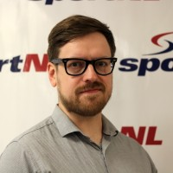
THANK YOU
Dave Lahey
Executive – Nikki Mousseau & Danny Penton
Cole McIsaac, Krista Rice, Michelle Healy, Mark Healy
Board members
Volunteers
Parents and Players

Slide 22
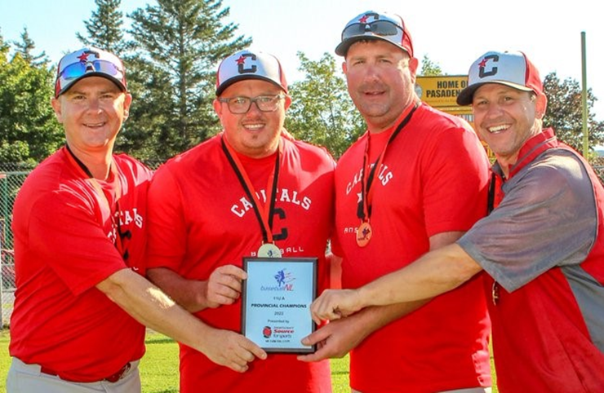
THANK YOU
Parents and Players
Program Coordinators – HPP, Office, Rally Cap, 9U
Umpires
City of St. John’s and city staff
SJABA
Grounds Crew at St. Pat’s

Slide 23
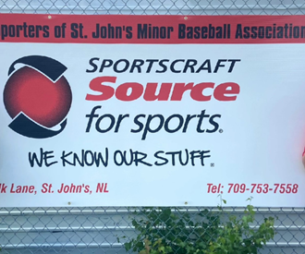
THANK YOU
Members of Parliament and MHAs
Department of Immigration, Population
Growth & Skills
Sponsors – Sportscraft, Scotia McLeod, DSS Protection
Baseball NL

