Slide 1
Long-Term Player Development Program
BCSA-PRE-004

Slide 2
Big Country Soccer Association 4-Corner Model
The 4-corner model is a means of addressing the multifaceted needs of the player throughout their development.
Model first appeared in the early 2000’s when it was identified that a specific framework was needed to adequately develop a player’s all-round abilities.
Model starts as early as the U5 age group and goes up to players in the U18 age group.

Slide 3
4-Corner Model Consists of:
Technical/ Tactical Corner
Physical Corner
Psychological/ Mental Corner
Social/ Emotional Corner

Slide 4
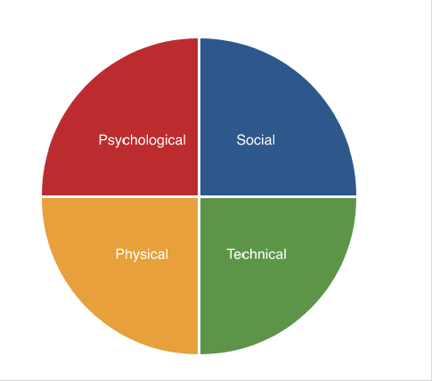
4-Corner Model

Slide 5
Purpose of the 4-Corner Model
All 4 of the corners are necessary to complete the player’s development.
An interlinked model allows coaches to ensure that all 4-corners are included in all training sessions.
Gets away from the traditional idea of coaching each element in isolation.
Each player requires support in all areas but some in one area more.
Allows for adjustment of the changing needs of the player as the player ages without losing site of ensuring all 4-corners are continuing to be supported.

Slide 6
Coaching Guidelines

Slide 7
Coaching Program Curriculums
Big Country Soccer Association has developed curriculums for the following age groups:
Under 5 (Active Start), Under 7 (Fundamental), Under 9 (Learn to Train), Under 11 (Learn to Train), and Under 13+ (Training to Train)
These curriculums are available to coaches to support the priority and focus on player development for each age group. These curriculums are a requirement to be followed in support of the Long-Term Player Development program.
The following details are a summary. For more specific information, coaches are to consult the specific curriculum for the age group they are coaching.

Slide 8
Technical/ Tactical Corner
This corner covers the kind of skills, such as passing, finishing and tactical awareness that most people think of when asked what a soccer player needs to be good at. They are an important part of the game, but as the model makes clear, they’re linked to the other corners and are only one element of what makes for a good player.

Slide 9
Technical/ Tactical Corner Points
Appropriate technical challenges for the developing player specific to the age of the player. This is to avoid introducing complex instructions too young.
Coaches need to develop/ use practice sessions that are interesting to prevent boredom and encourage player development.
Tactical is not introduced until the later years in development in order to be more focused on player skill development.

Slide 10
Physical Corner
Soccer players have never been so physically fit. The physical corner is made up of 12 areas, including speed, balance, strength and endurance. Without these abilities, a player will struggle to carry out technical skills such as dribbling and turning and will be hindered in their tactical movement both on and off the ball.
There is also more focus on injury prevention through an established warm-up program. Big Country Soccer Association supports the FIFA 11+ Program for proper player warm-up and injury prevention.

Slide 11
Physical Corner Points
Coaches should use the ABC’s Agility, Balance, Coordination and Speed to improve the physical literacy of players.
Coaches will work on these physical components in a fun, interesting, and challenging way through developed practice plans.
Focus during practices is for players to be with the ball as much as possible as part of their technical and physical development. This is to avoid prolonged downtime during practices where the players are not in motion.

Slide 12
Psychological/ Mental Corner
Strong emotions and pressure situations are a big part of soccer. It’s essential that players are confident, resilient and focused. This corner reminds coaches that as well as developing the players as athletes, they need to help them develop as people who are able to cope with the demands of the game.
The demands in the sport is progressive and in relative to the age to ensure proper and safe development of the mental aspect of the sport and dealing with teammates, Match Officials (in the older age groups), etc.

Slide 13
Psychological/ Mental Corner Points
Coaches should create an environment where players are encouraged to develop their problem-solving skills, and creativity.
Big Country Soccer Association does not endorse an environment where players should be afraid to be creative in their play and of failing. This is all part of the player development path.
Coaching will be using a variety of styles to address the many different learning styles of their players. Demonstration being one of the primary methods so players can easily visualize.

Slide 14
Psychological/ Mental Corner Points
The game is a great teacher for players.
Coaches will foster cooperation, teamwork, communication, friendship, discipline, and dedication.
Positive and meaningful praise is essential along with understanding how to provide information to players to correct them that is not causing the player to stress or be fearful.
Big Country Soccer Association coaches are positive role models for player development and includes their dress, language they use, behaviors, standards, and fairness.

Slide 15
Social/ Emotional Corner
Soccer is a team game. This corner aims to cultivate relationships in the team, improving areas such as teamwork, communication, and the emergence of leadership traits. These qualities help to make a player a better member of the team, able to work well with their fellow players even during tough periods.
Because Big Country Soccer Association fields mixed teams, providing a safe and inclusive environment is important for supporting social and emotional development, starting at the U5 age group where the focus is on play.

Slide 16
Summary

Slide 17
The 4-Corner model is a comprehensive means of addressing the needs of the player.
All components are critical, and each takes on a different significance as the player develops.
It’s not a rigid model or a set of instructions that a coach should follow to the letter. Instead, it’s a framework to help coaches plan their sessions and make sure that there is some focus on developing each corner.

Slide 18
Part of its value is the way that it develops each player as a whole person, not just as an athlete. The majority of youngsters who play in Canada won’t make it as professional soccer players. Many will end up playing at an organized recreational level, or college level through scholarships, and others will leave football altogether.
By making sure that psychological and social skills are developed, players will at least have gained confidence, self-esteem and the ability to work well in a team, regardless if it is through sport or their chosen career path.

Slide 19
On behalf of Big Country Soccer Association, we thank you for taking a moment to go through this presentation in order to better familiarize on the 4-Corner model that Big Country Soccer Association supports for Long-Term Player Development.
If you have any questions and/ or comments, please send them to the Big Country Soccer Association Board.

