Slide 1
Capital District
Minor Football Association
CDMFA Board Meeting February 7, 2023
7PM @ St. Albert Rugby Club

Slide 2
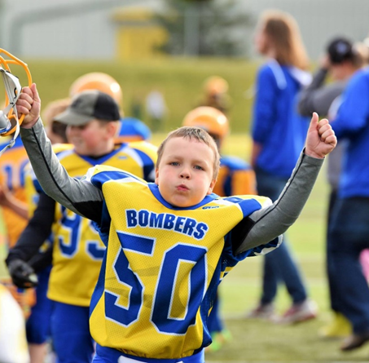
AGENDA
Welcome and Roll Call
Approval of Minutes from December Board Meeting
2023 Meeting Structure
2023 CDMFA Structure
Our Member Clubs
VP/Committee Update
Policy Updates
President Update
BRAND NEW FLAG PARTNERSHIP ANNOUNCEMENT
2023 CDMFA Re-Brand
Notes:
2023 Board Meetings will be information sharing or presentation of new ideas/plans
In depth discussions, debates and brainstorming will be saved for Committee planning meetings

Slide 3
2023 CDMFA STRUCTURE

Slide 4
CDMFA Organizational Chart 2023
President
(Tracy Kociuba)
Senior Program Manager
(Ryan Schulha)
VP Coaching
(Chris Malo)
VP Programs
(Ali Arafat)
VP Finance
(Nick Schmidt)
VP Communications
(Courtney Sakaluk)
Secretary
(Rita Murphy)
VP
Non-Contact
(Vacant)
Midget
Spring Flag
Bylaw/RPP Committee
Fundraising Committee
Communications Committee
Coach
Council
Boundaries Review Project
Governance Review
Coach Working Committee
Coach Social Committee
Female
Fall Flag
Casino
Raffle
Grants
Youth Council
Fall Tackle
Special Events Team
Rules Review Project
Junior Coaches
Discipline Committee
Safety Personnel
LTAD
Admin Committee
Sustainability Committee
Officials Committee
Inclusivity Committee
Registrar
Manager
Board of Directors
elected
appointed
staff
Notes:
Vacant VP of Non-Contact - will want to replace ASAP (opportunity to get Football Exposure through Team Alberta Flag GM)
Mary-Anne Vollman - Registrar/Managers Committee Chair and Support with RAMP

Slide 5
Who are our 2023 CDMFA Member Clubs?

Slide 6
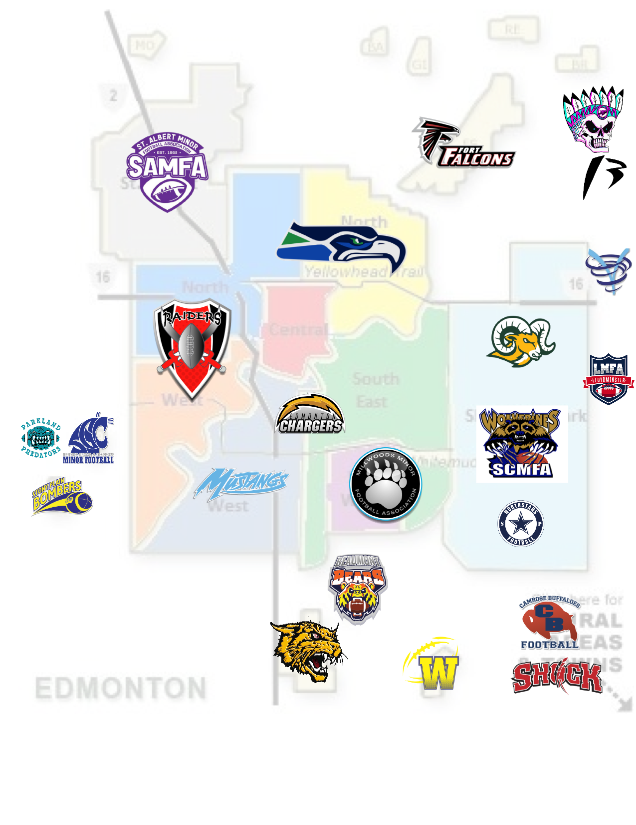
Notes:
22 Member clubs (some only spring and others spring & fall)

Slide 7
VP & COMMITTEE UPDATES

Slide 8
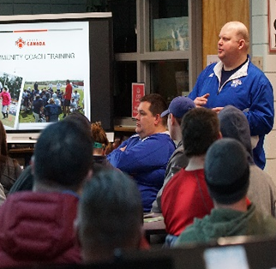
VP Coaching Update
February Committee Meeting date TBD
Coaches Roundtable for LTAD Implementation
Flag & Midget House Rules review and finalized by early March
Coaches Clinic in planning for end of March
Line (Skills Camps) in planning
Spring Coaching Requirements
NCCP Clinics
Notes:
Coaches clinic date tentative March 24-26, 2023

Slide 9
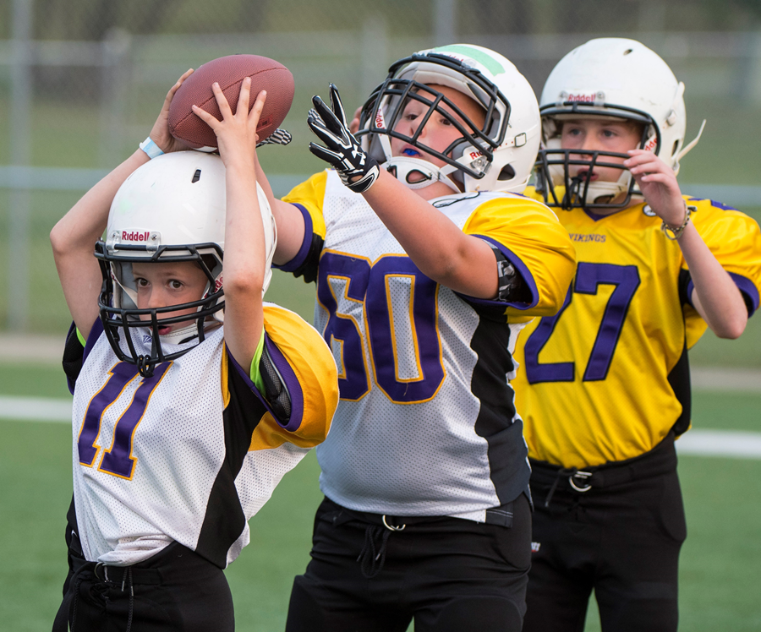
VP Programming Update
Girls Camp Registrations - 40
U18 Female Registrations - 31
U16 Female Registrations - 23
Midget Registrations - 161
LTAD (Spring & Fall Updates)
Flag Registrations - 160
Football Alberta Dates and Opportunities
2023 Alberta Summer Games
Coaching Staff Opportunities

Slide 10
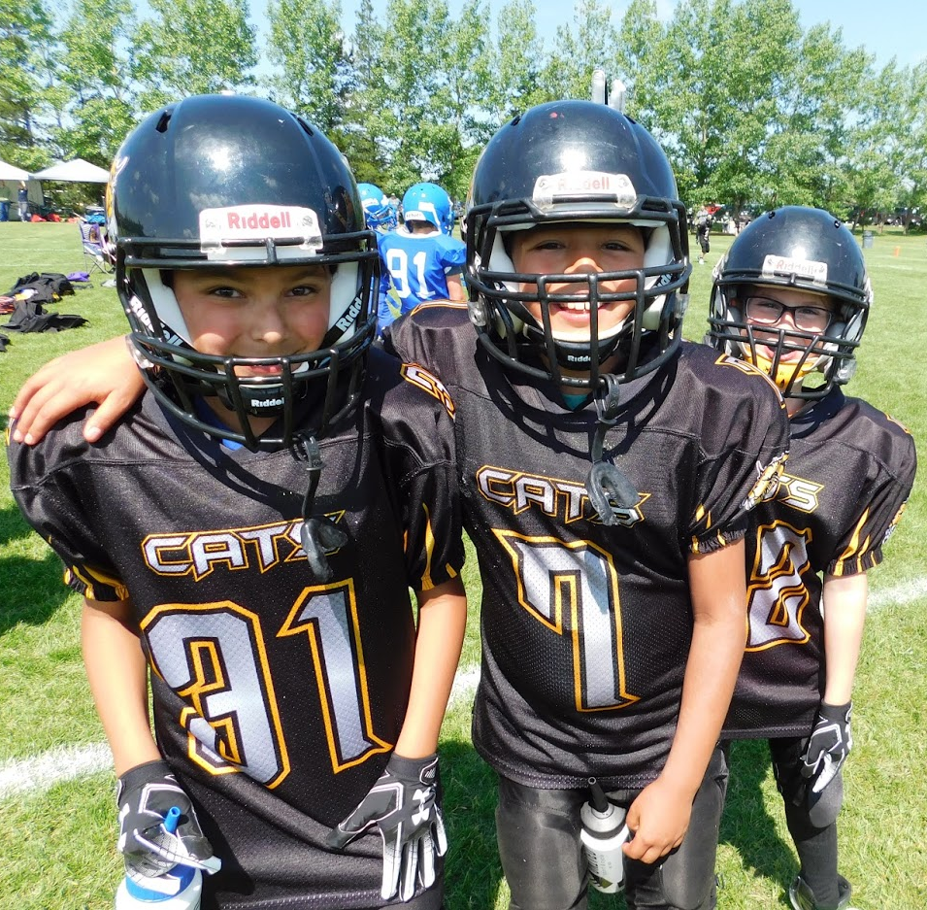
VP FINANCE
2022 year end financials being completed with audit to follow soon
2022 Raffle winners have all been paid out
HUDL - league proposal/discount
Casino Announcement - July 26-27, 2023
2023 raffle details coming soon
New signing authority on bank account
2023 Fee structure approved
Notes:
HUDL - Look for your thoughts here. Hudl has offered two options for a league-wide purchase:
League mandates ALL midget, bantam, peewee clubs use Hudl – everyone gets 50% off. Would be $200/USD per TEAM (not per club) each year, not including their play tools feature which allows for building playbooks.
League leaves it optional for all clubs to use Hudl. Would still need a majority. For those that want to, a 25% discount would be applied.
Casino - notice will be coming out and all clubs will be required to participate as per our League Fundraising Policy & Requirements - club ‘opt out’ is available but penalty as per policy will be implemented for clubs that do not fulfill their obligations
Raffle - ticket quote is done, AGLC process started, confirming draw dates and locations
2023 fee structure approved by electronic vote 13 clubs responded and all 13 clubs in favour of the new 2023 fee structure so motion passed

Slide 11
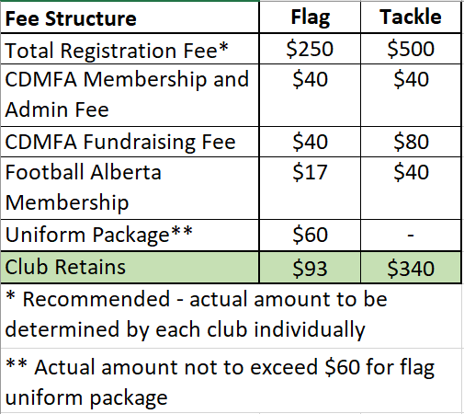

Slide 12
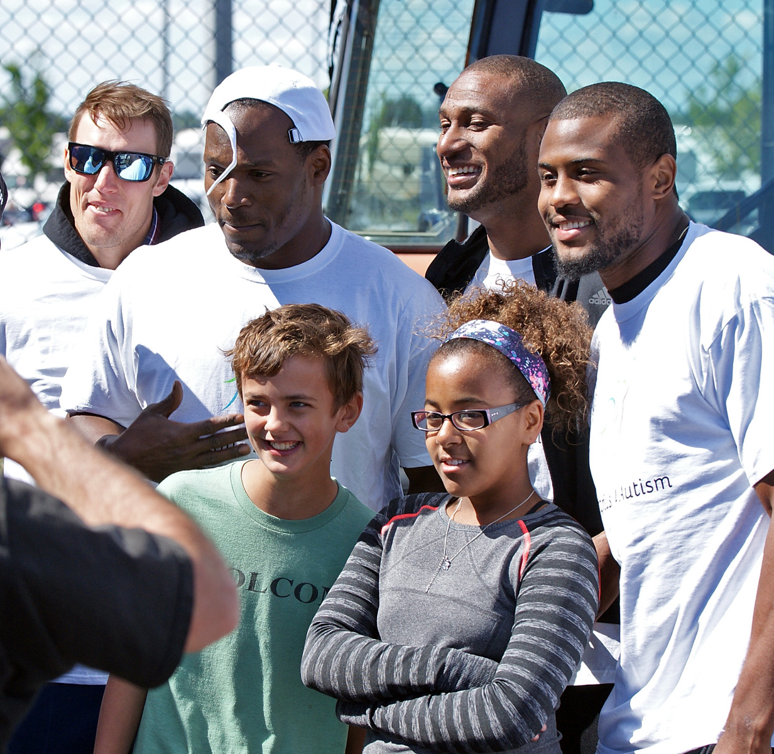
VP COMMUNICATIONS
Looking to establish a contact with each club who can provide updates for game days/events, etc.

Slide 13
POLICY UPDATES
The following policies have been updated or created
CDMFA Awards
Coaching Standars
Communications
Conflict of Interest
Discipline Process
Eligibility, Recruitment Zones & Boundaries
Equipment & Fields - Flag
Equipment & Fields - Tackle
Fair Play
Finance Procedures
Governance
League Fundraising
Police & Vulnerable Sector Checks
Registrations
Releases
Rules & Standards - Flag
Rules & Standards - Tackle
Safety Personnel
Team Travel
Notes:
The following are some of the policies that have been updated and/or created in the last six months. Most of these have either been submitted by, or reviewed by, the various committees. According to our Bylaws (9.2), policies can be updated by the Board of Directors at any regular meeting. As there are so many of them, we will be sending them out to you to review on your own time, ask questions if necessary, and then approve/disprove on an electronic vote. We will then read them into the minutes at the meeting in March. Please contact Tracy Kociuba if you have any questions

Slide 14
Presidents Message
Welcome to 2023
Club contacts - will send out communication to update
Long Term Athletic Development (Atletics Canada)
Football Canada
Football Alberta
CDMFA

Slide 15
EXCITING NEW PARTNERSHIP FOR 2023

Slide 17
CDMFA Flag Football Powered by the…
Growing from 7 clubs last year to 10 clubs for spring this year
We will also be responsible for the Elks fall Flag program
Collaboration with all aspects of Elks for:
Co-promotion (branding and media support)
Tickets
Experiences
Show casing all 9 of our programs
Kick Off date of April 15, 2023 - Commonwealth Stadium?
Wrap Up Jamboree May 28, 2023 - Fuhr Field Spruce Grove

Slide 19
All of this while maintaining what we feel is the most important brand we have…….
OUR CLUBS

Slide 20
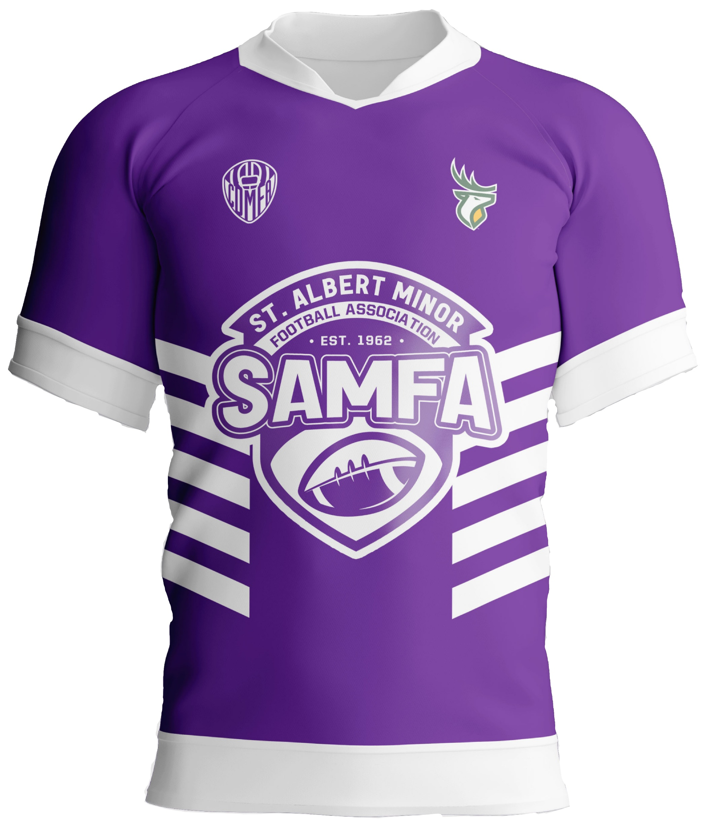
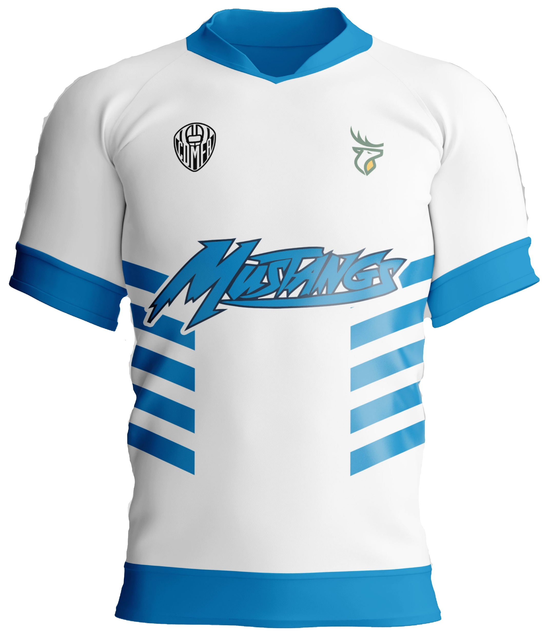
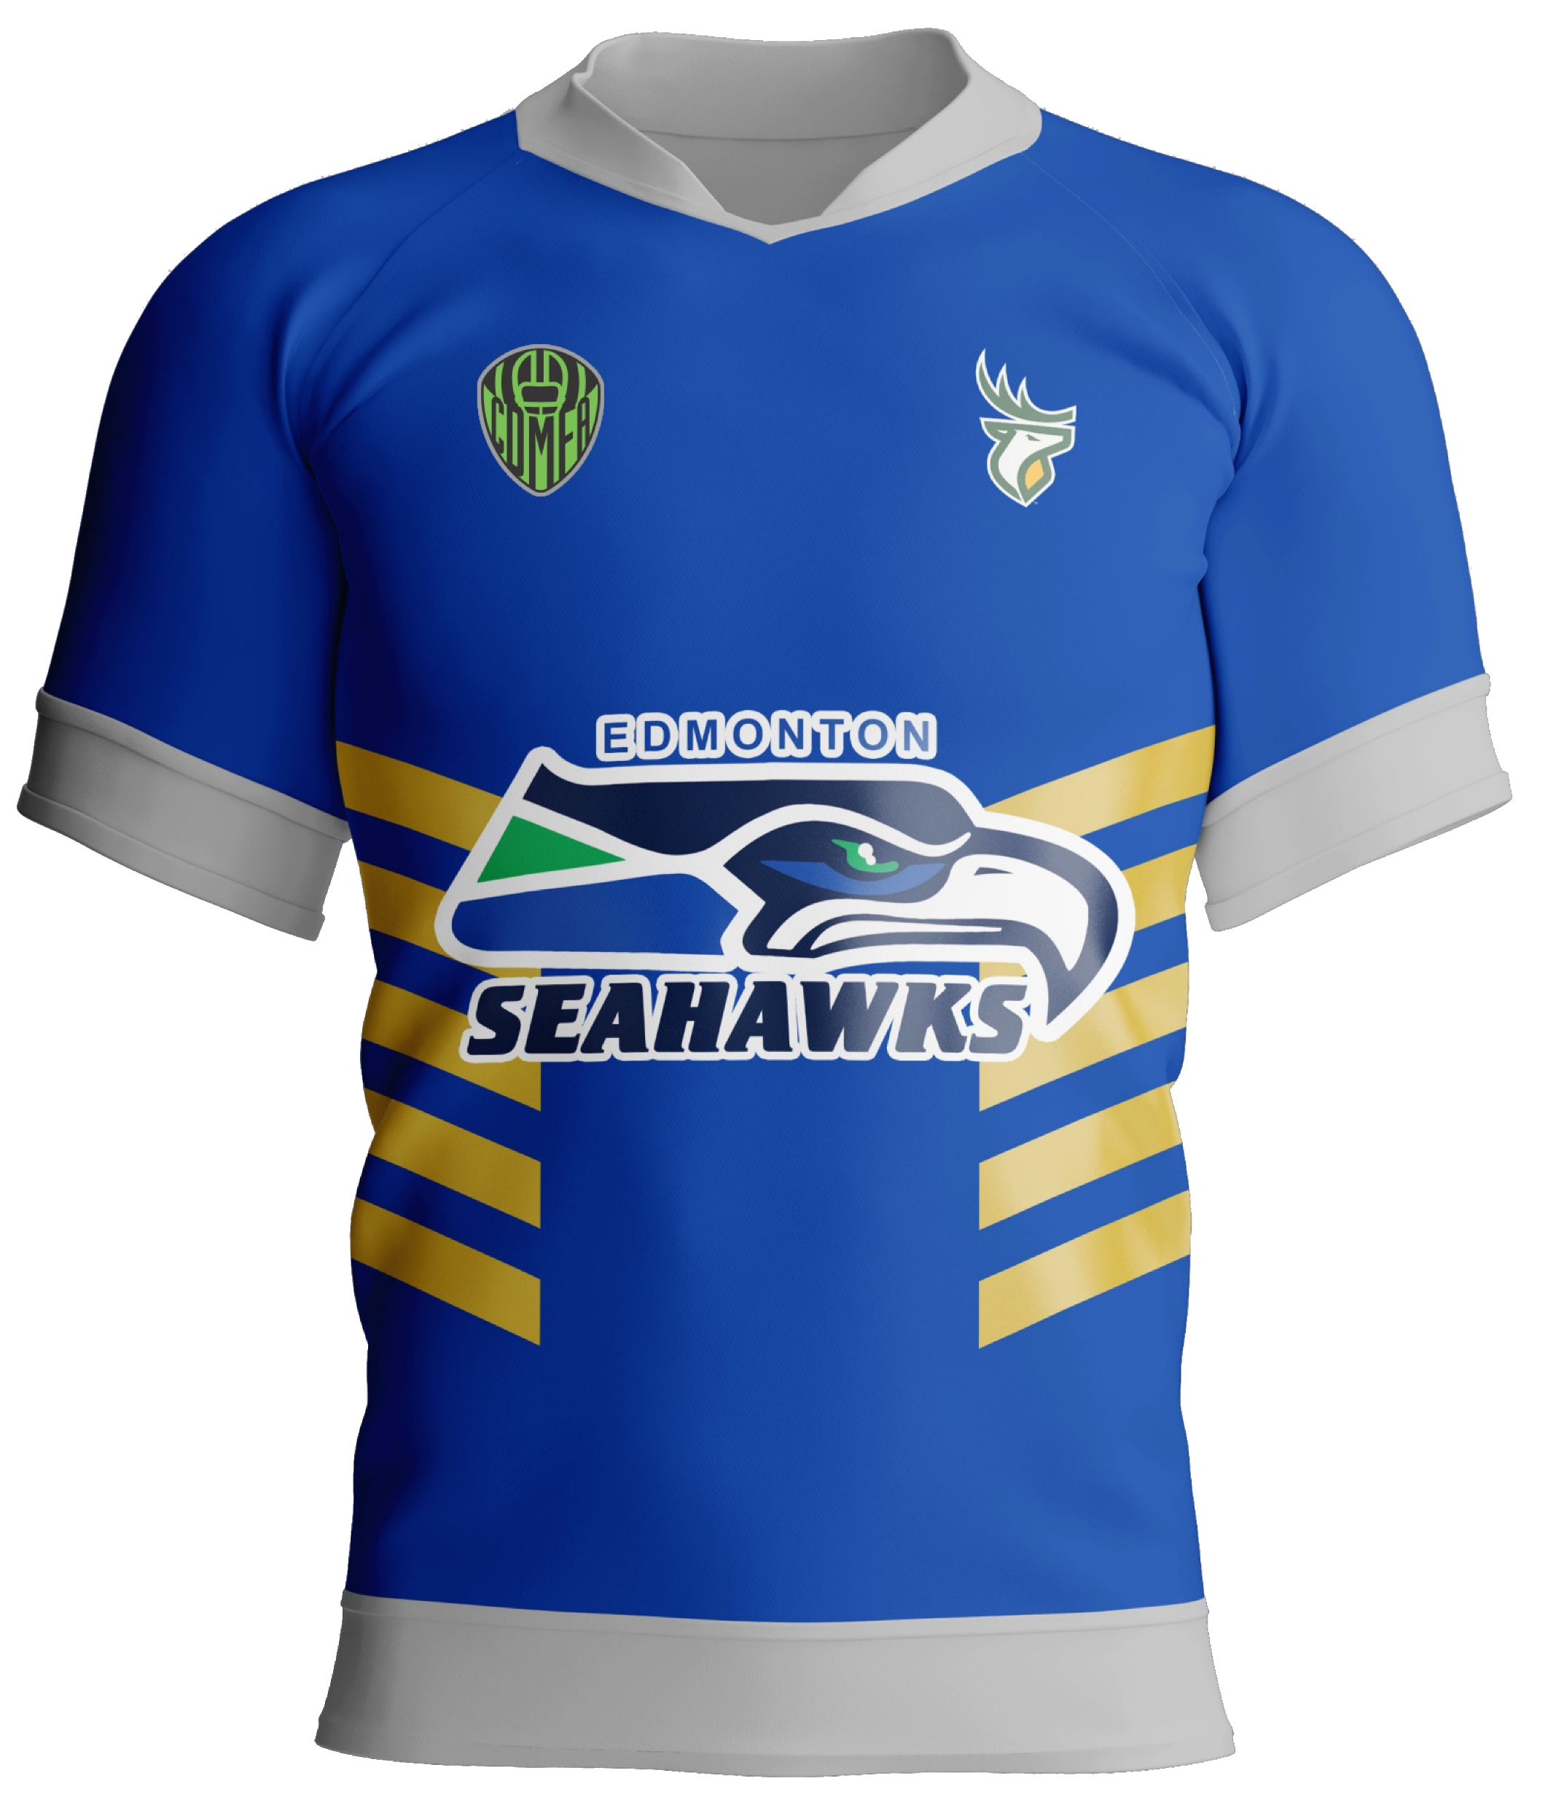
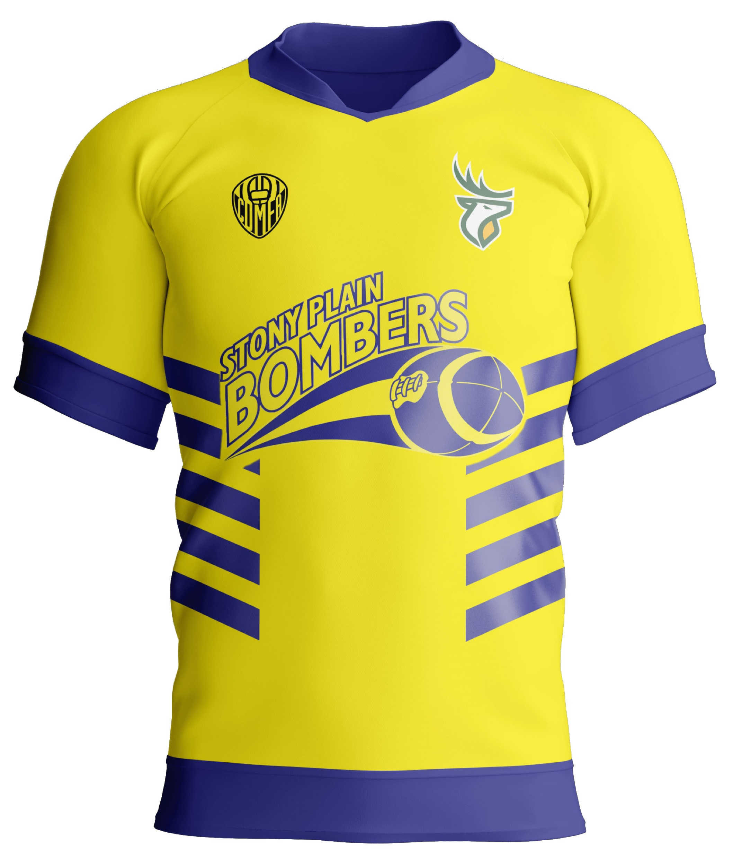
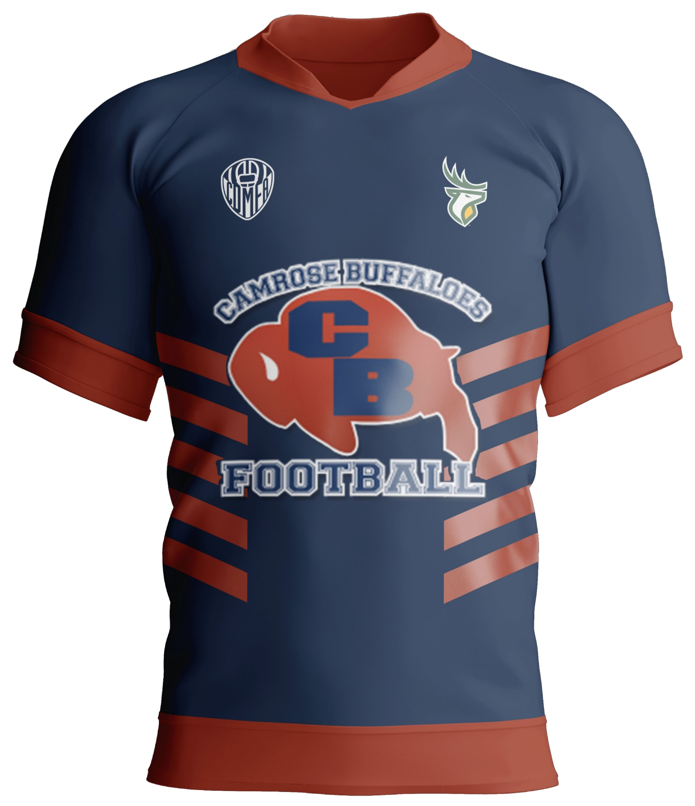
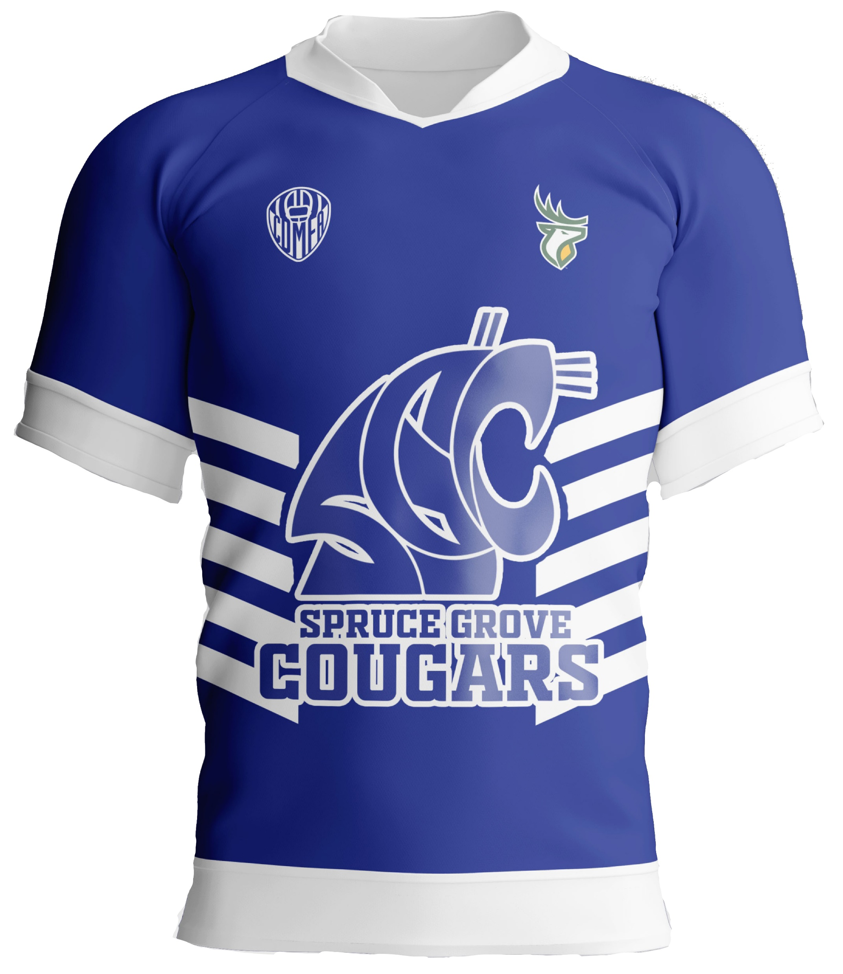
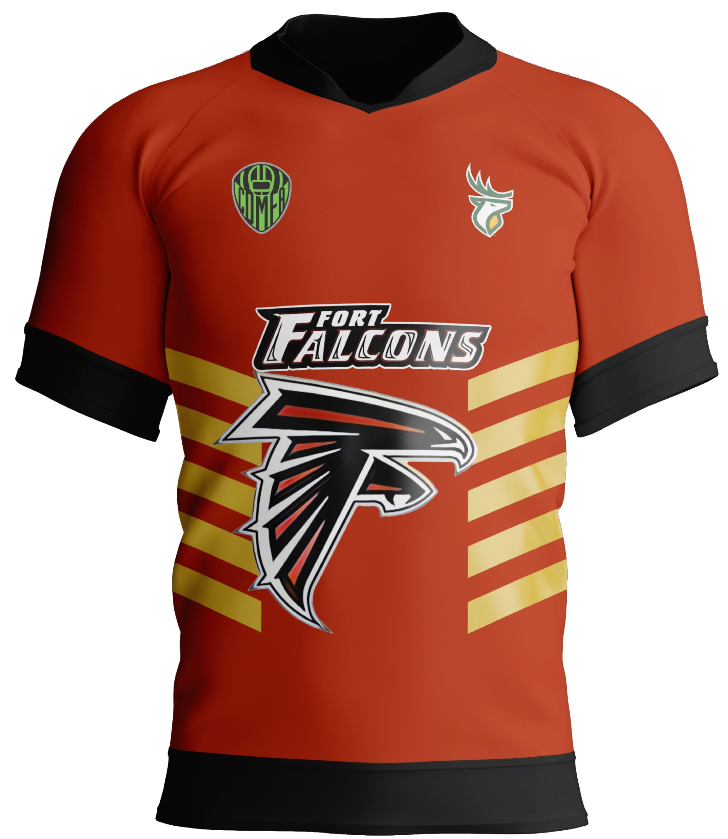
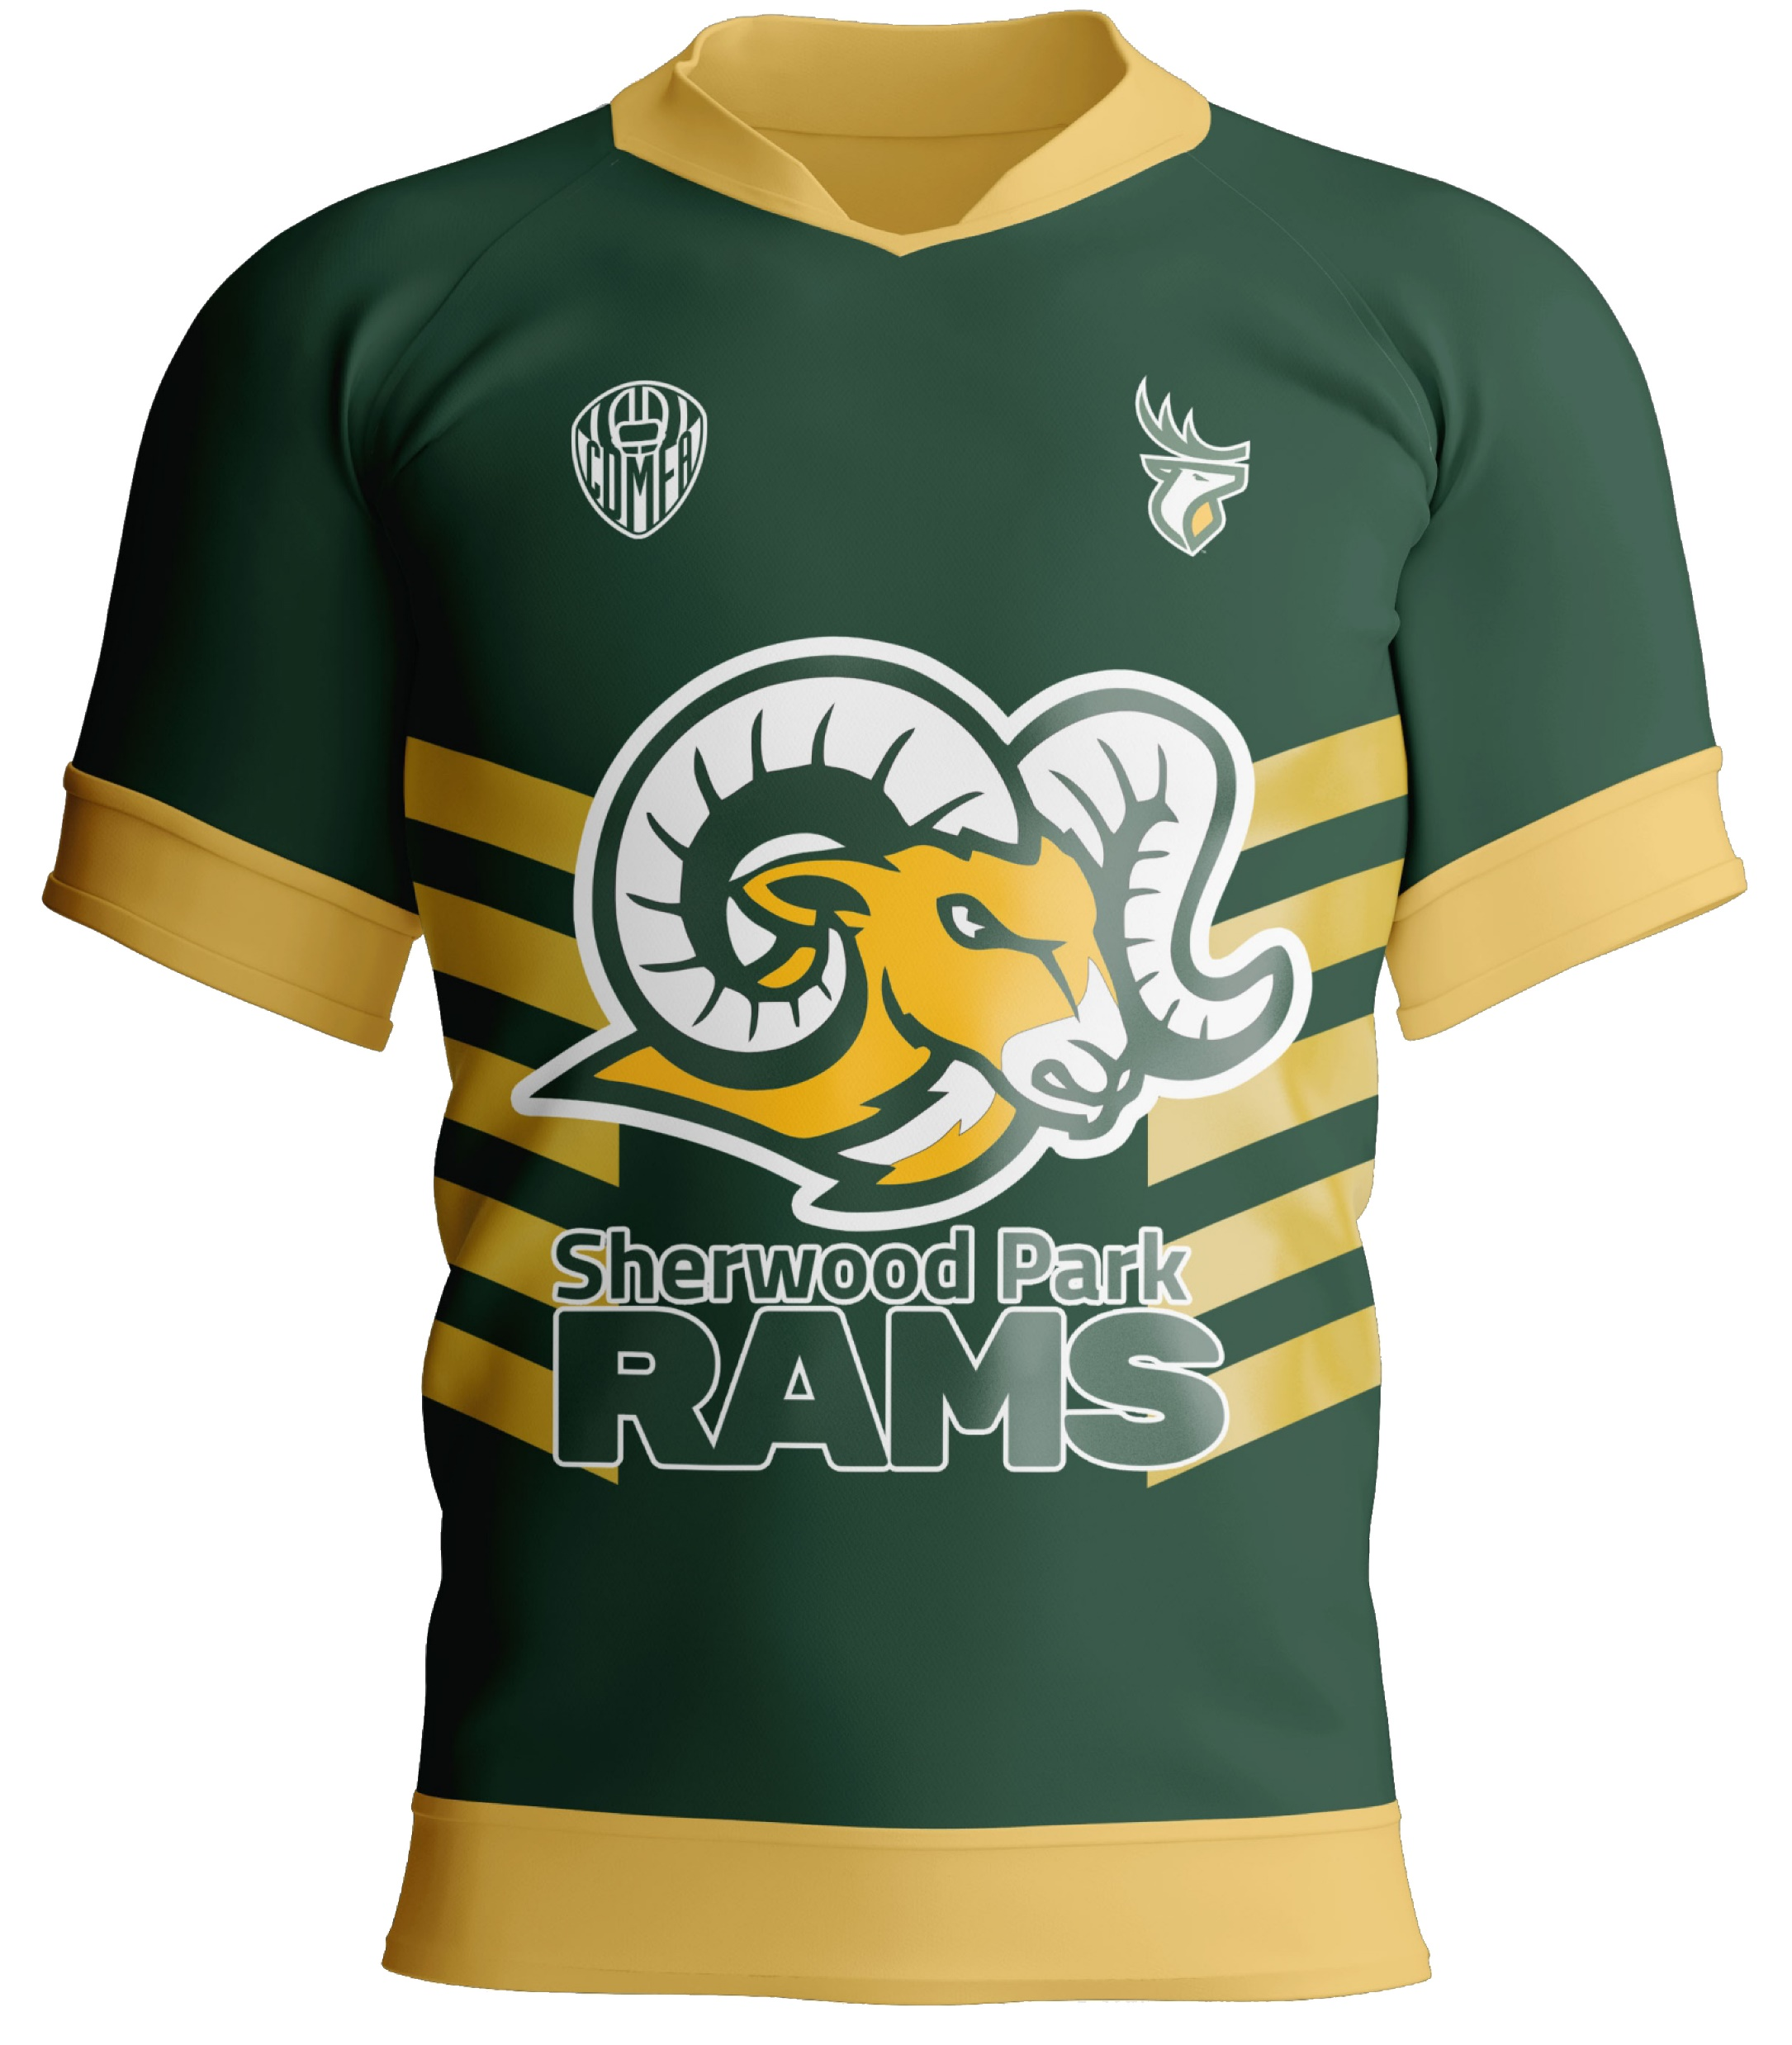
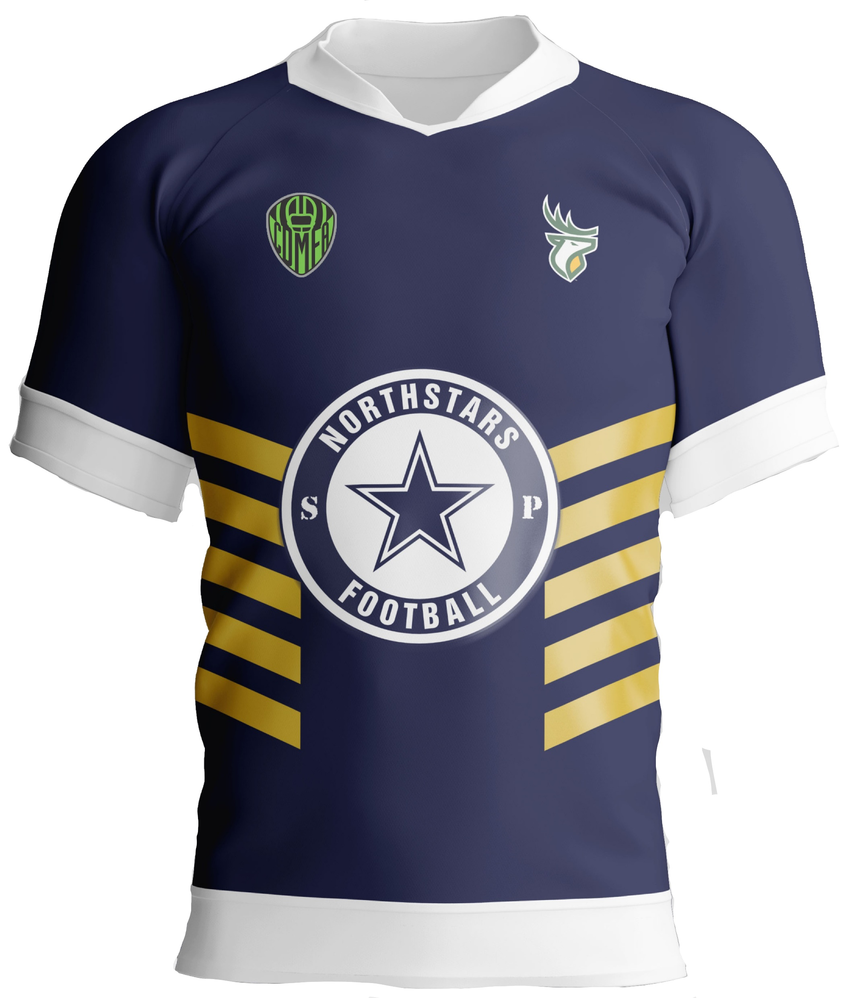
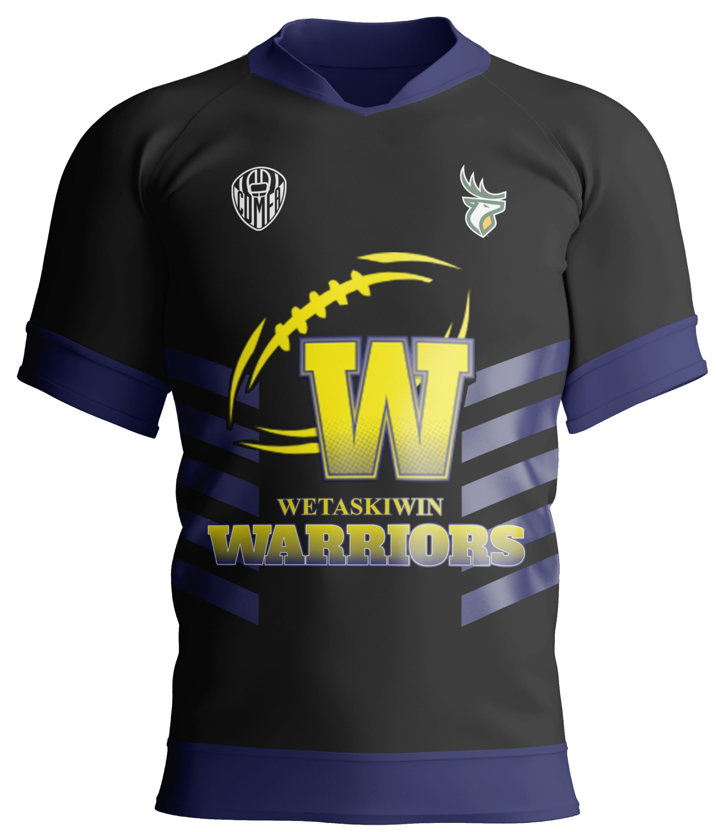
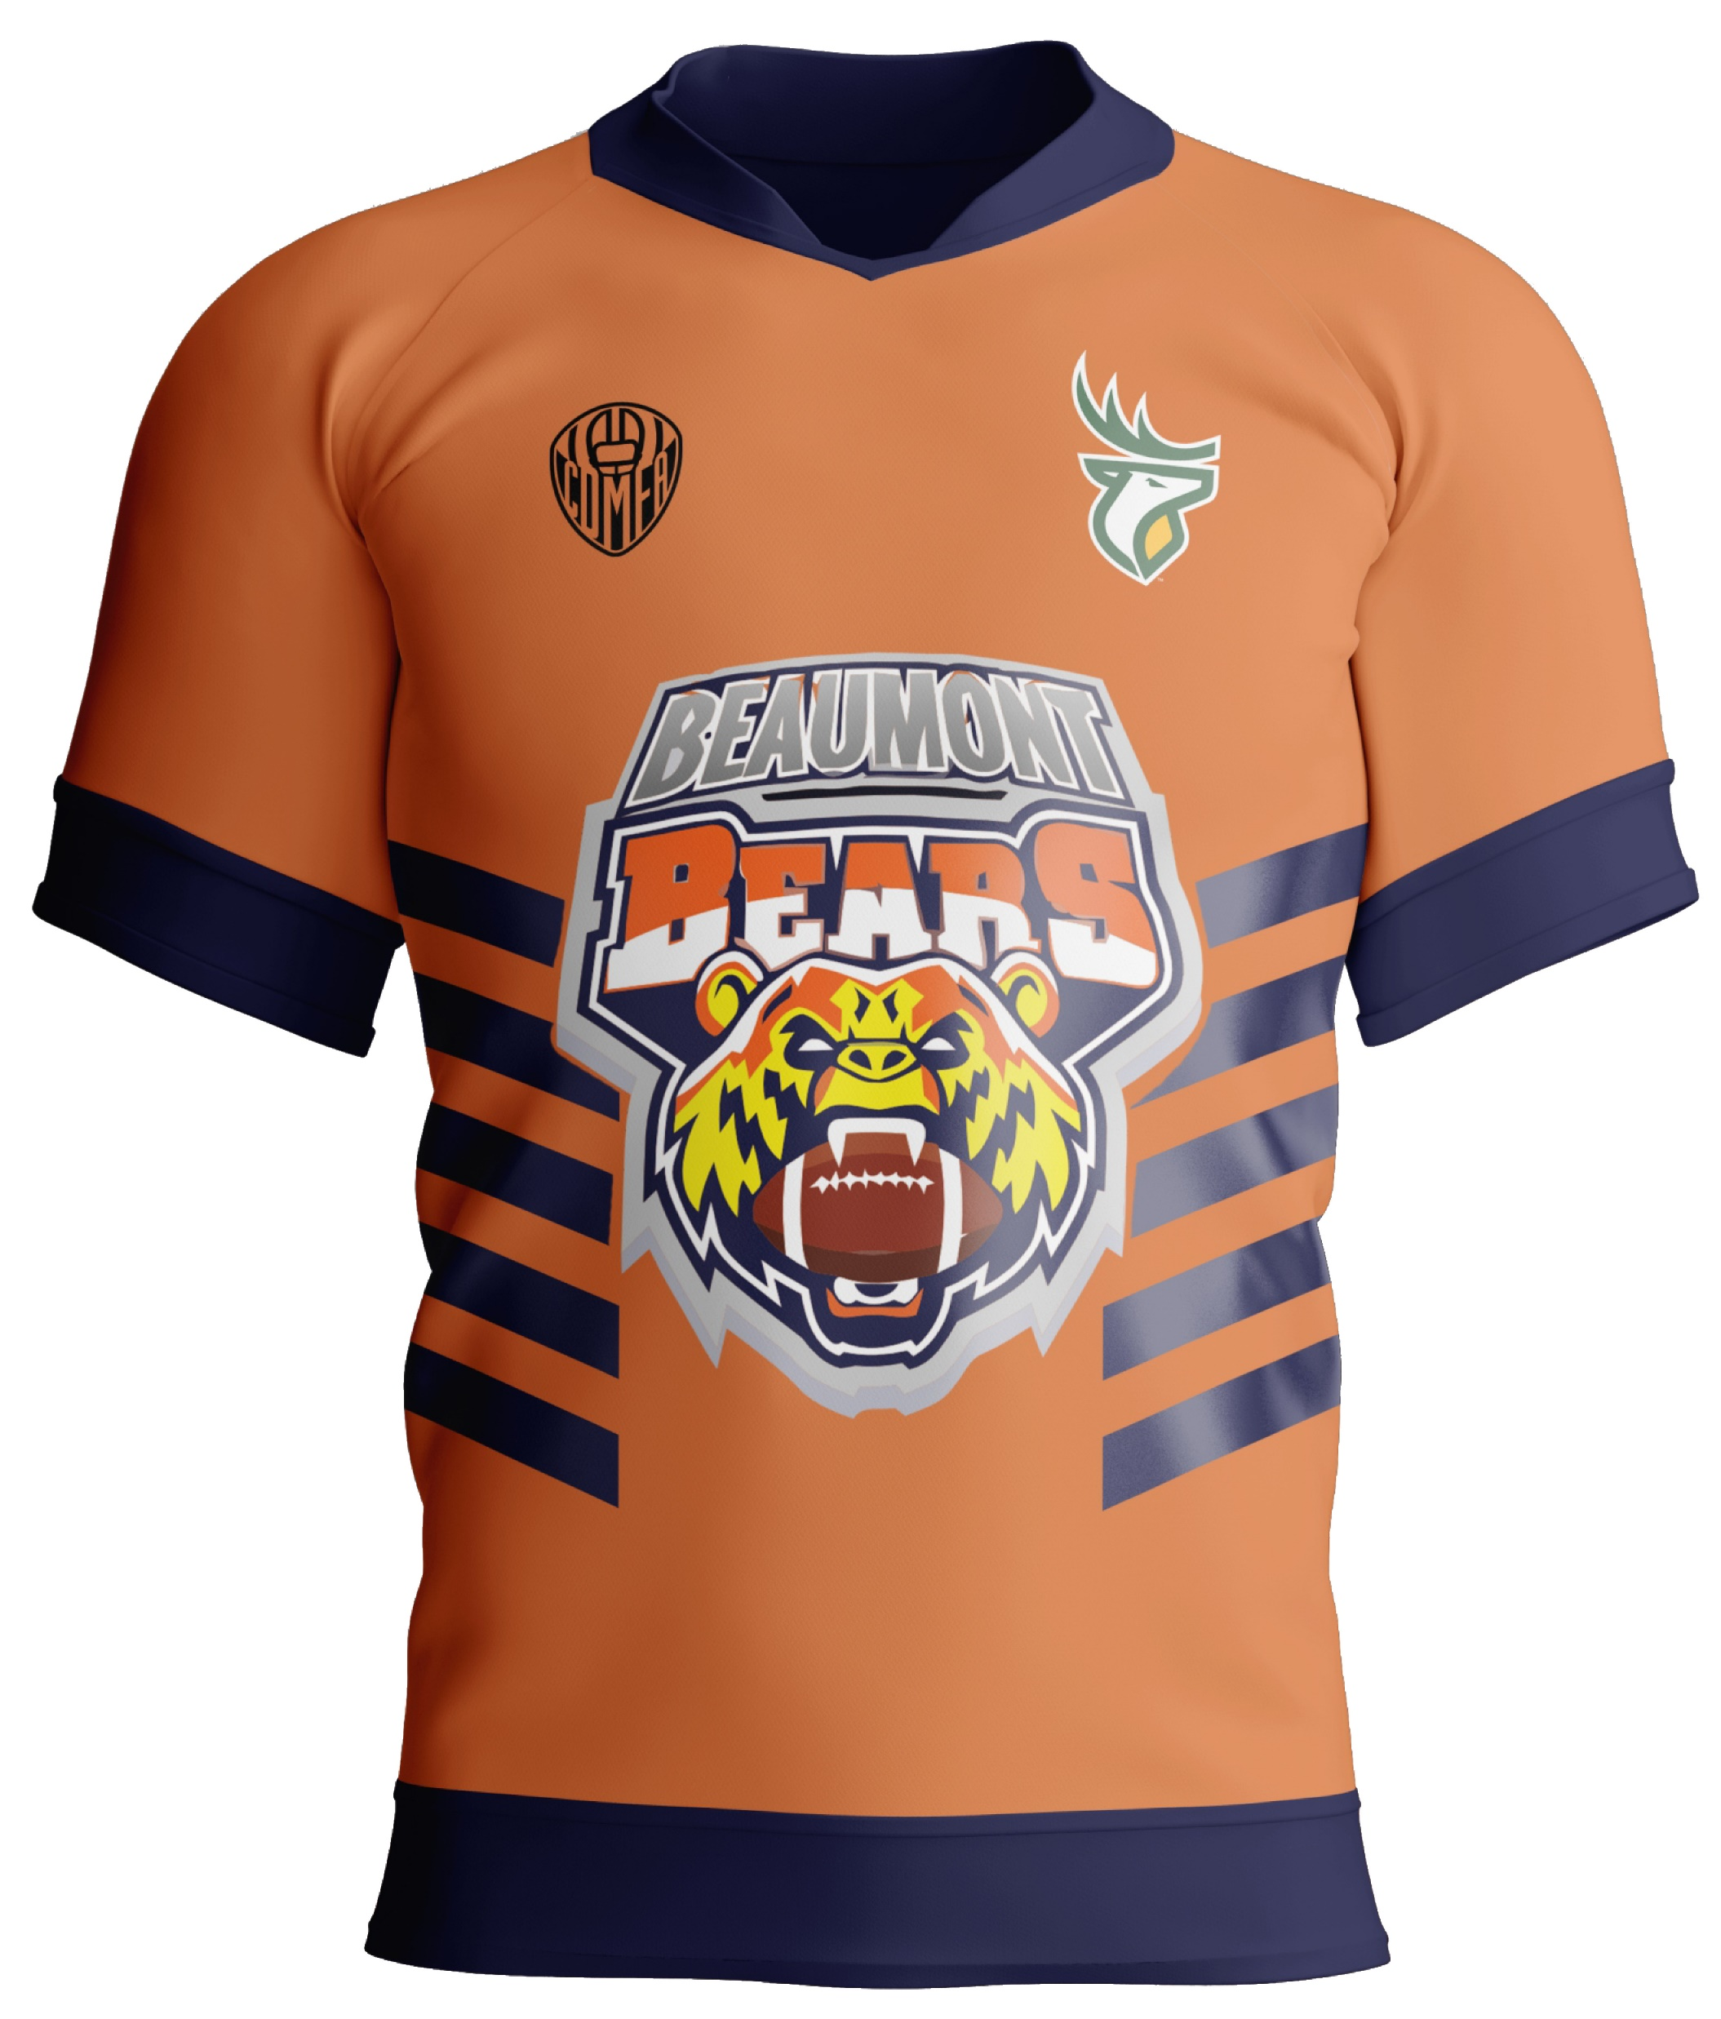
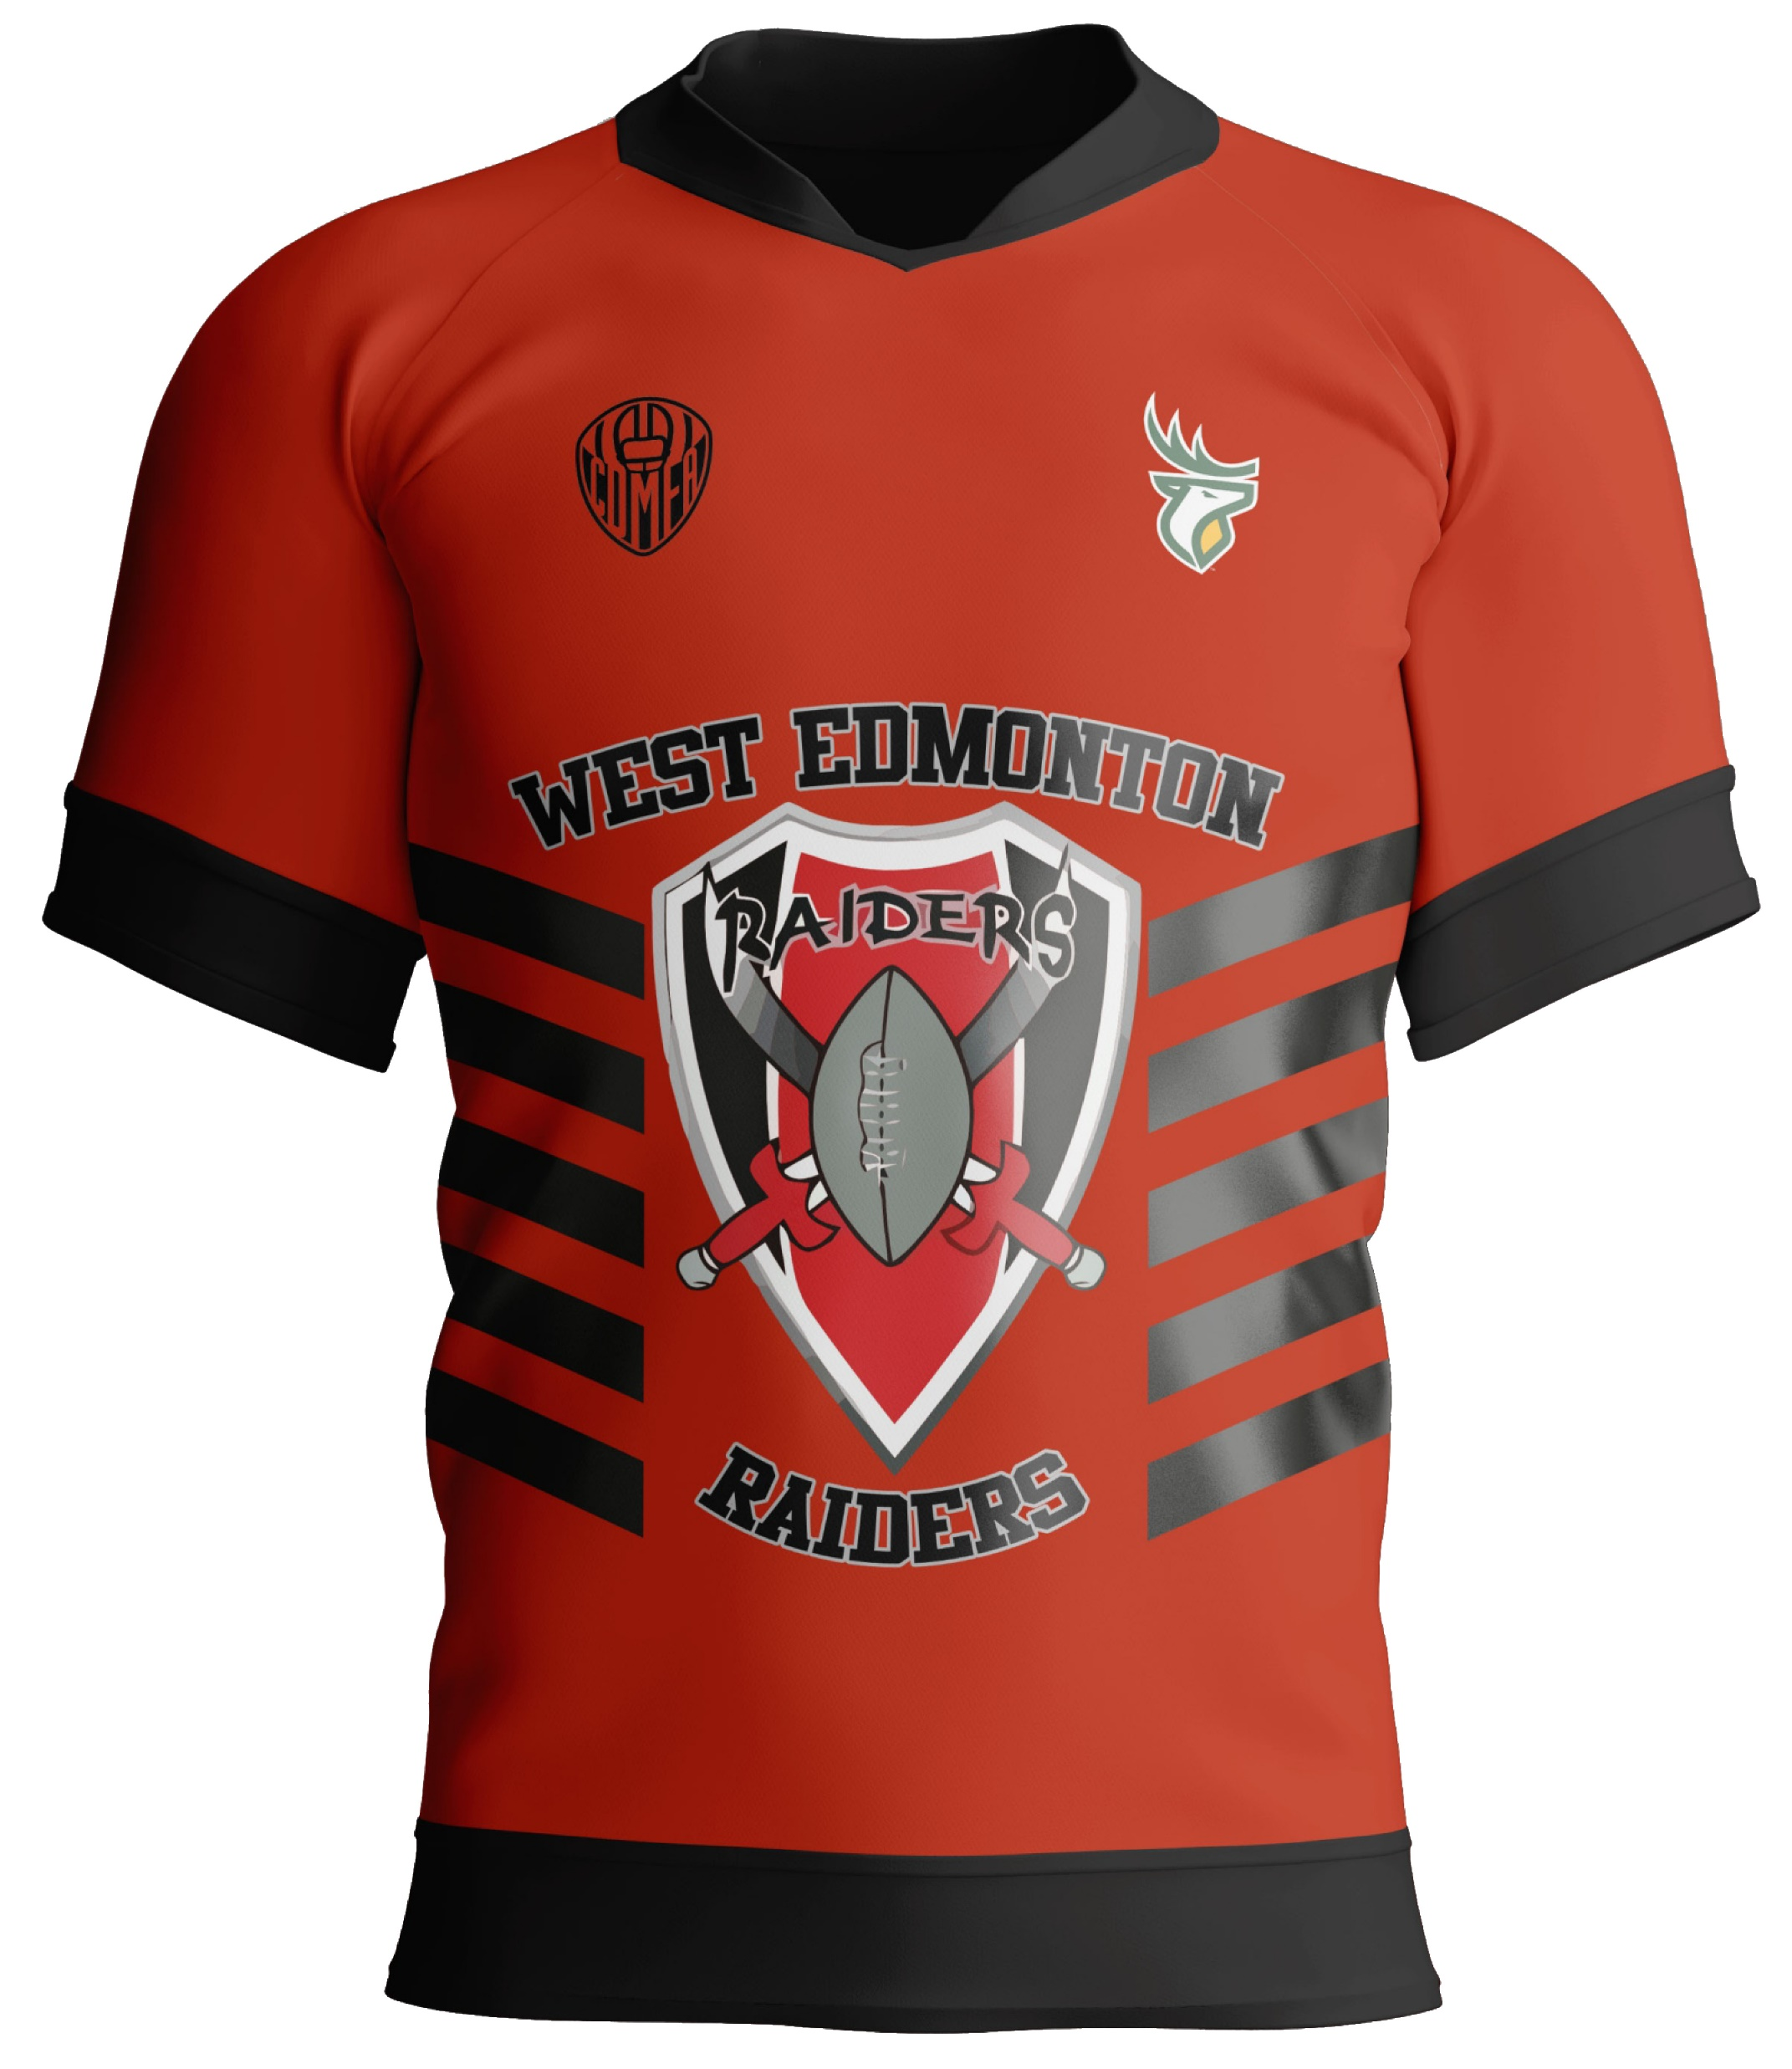
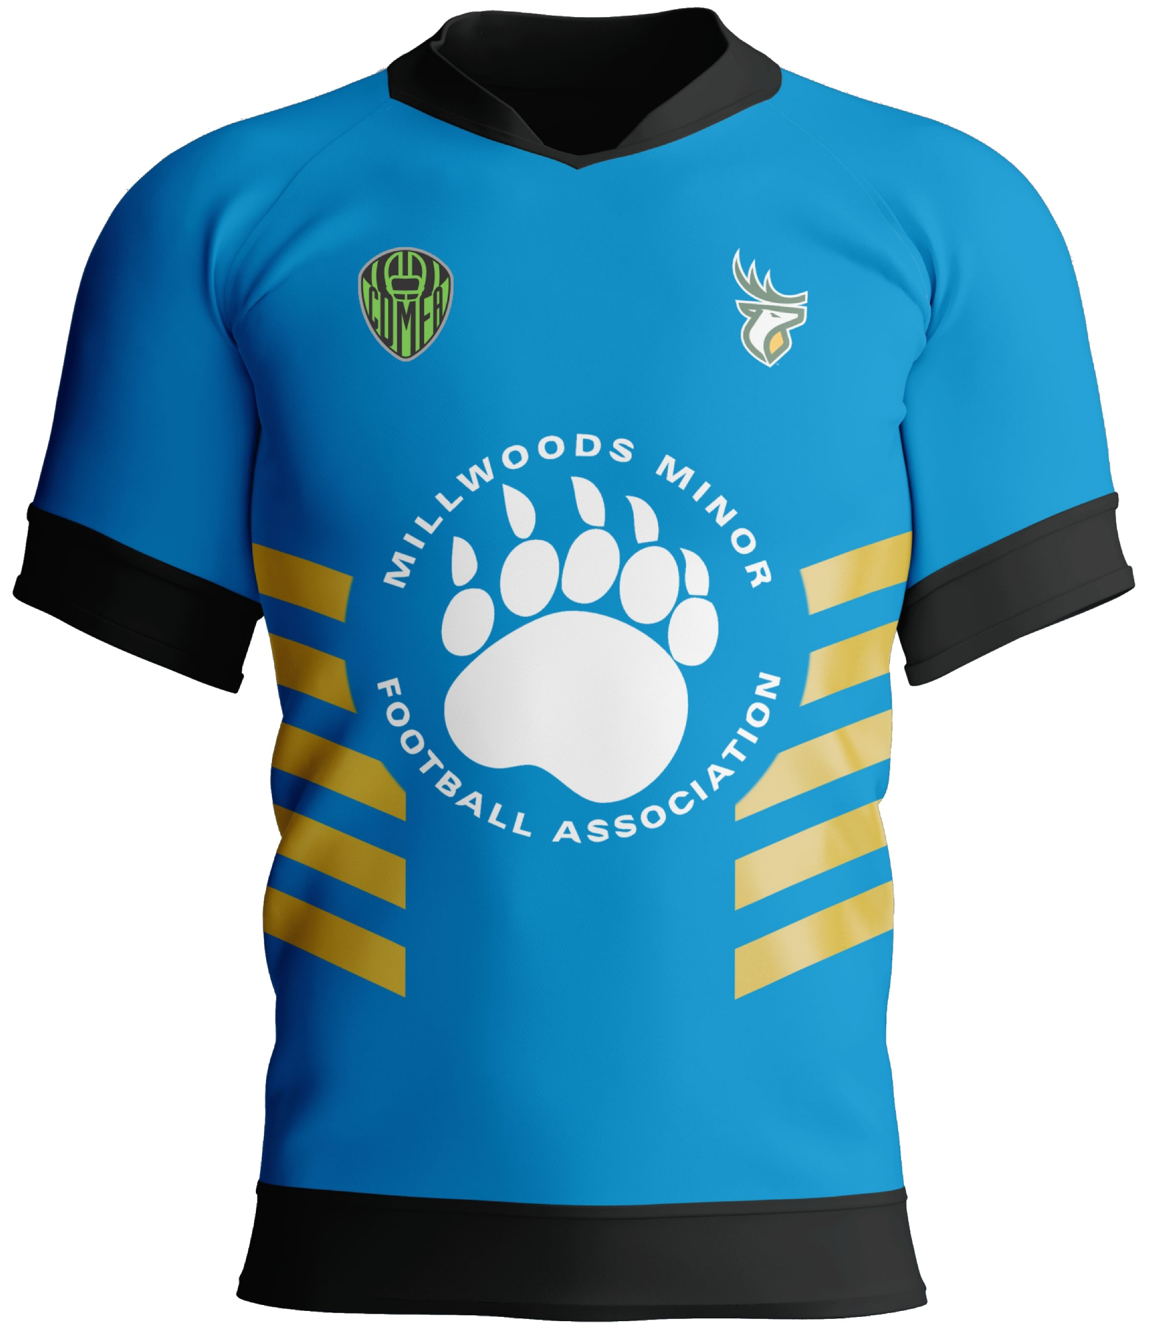
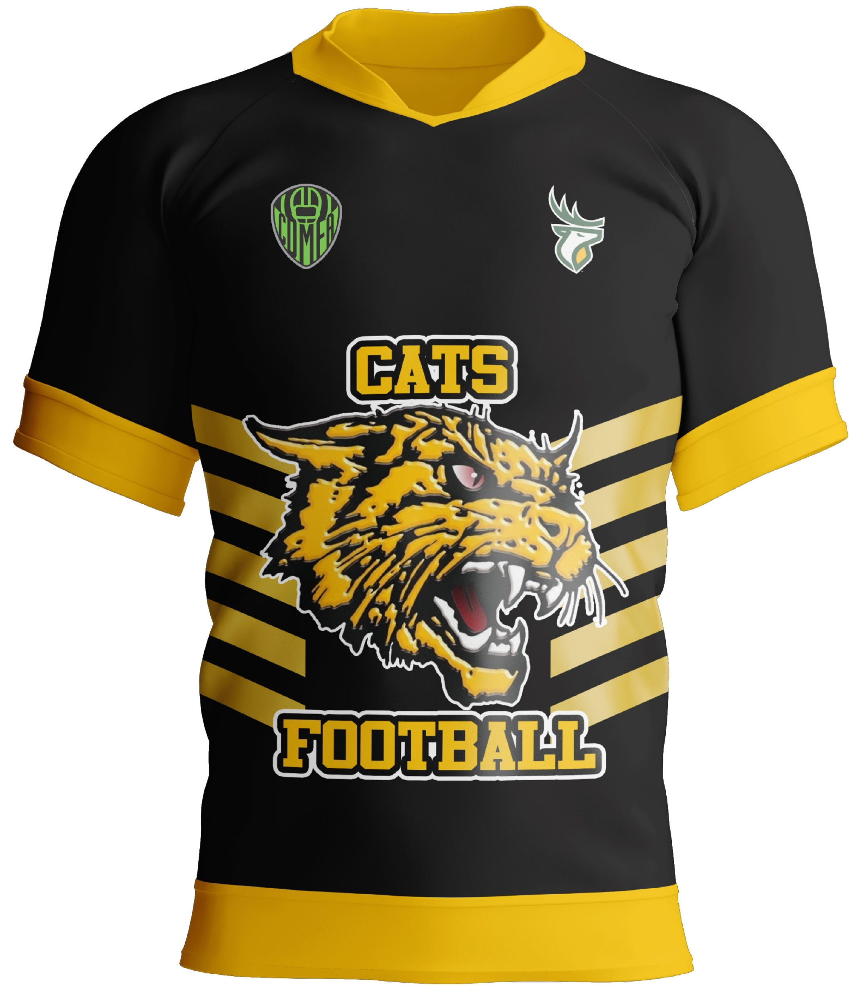
Our Clubs, Our Game
Notes:
In 2022, we launched our CDMFA flag program as its own league: 7 clubs = 504 kids
Now 2023 Spring Flag ….
Registration hasn’t even opened … we have 10 clubs declared … expecting approx. 700 kids …. We haven’t even started promotions or any reach to new markets.
Potential for 2 more clubs to join … only limited by availability of coaches and field/practice spaces …. They may commit once they see the final package that we have ready to deliver.

Slide 21
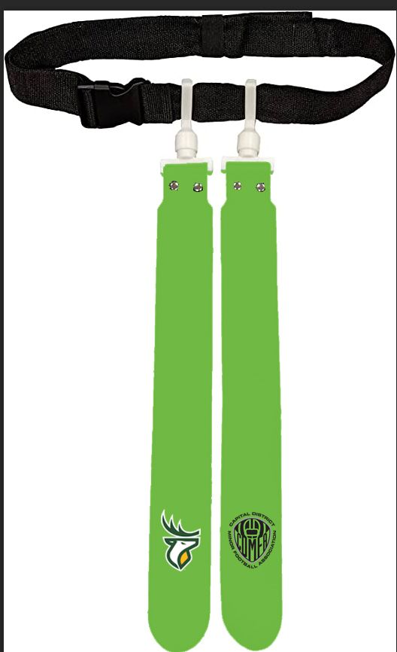
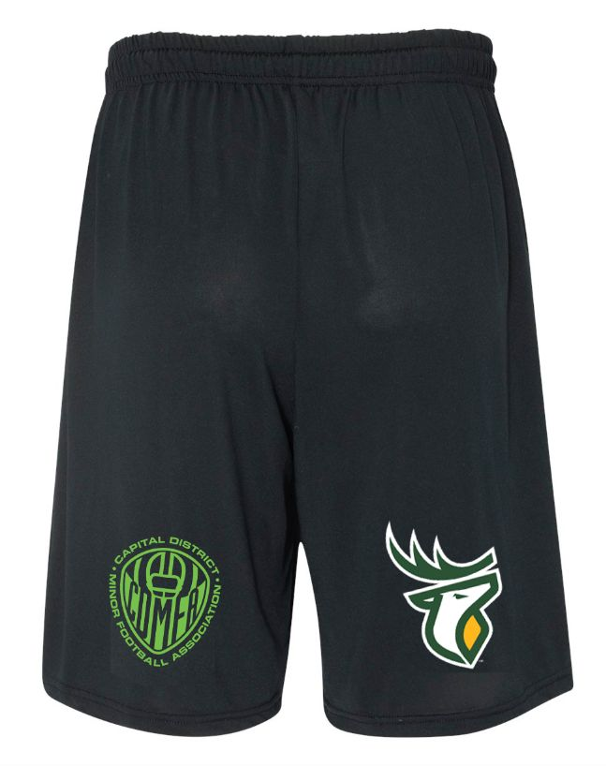

Slide 22
2023 CDMFA RE BRANDING

Slide 24
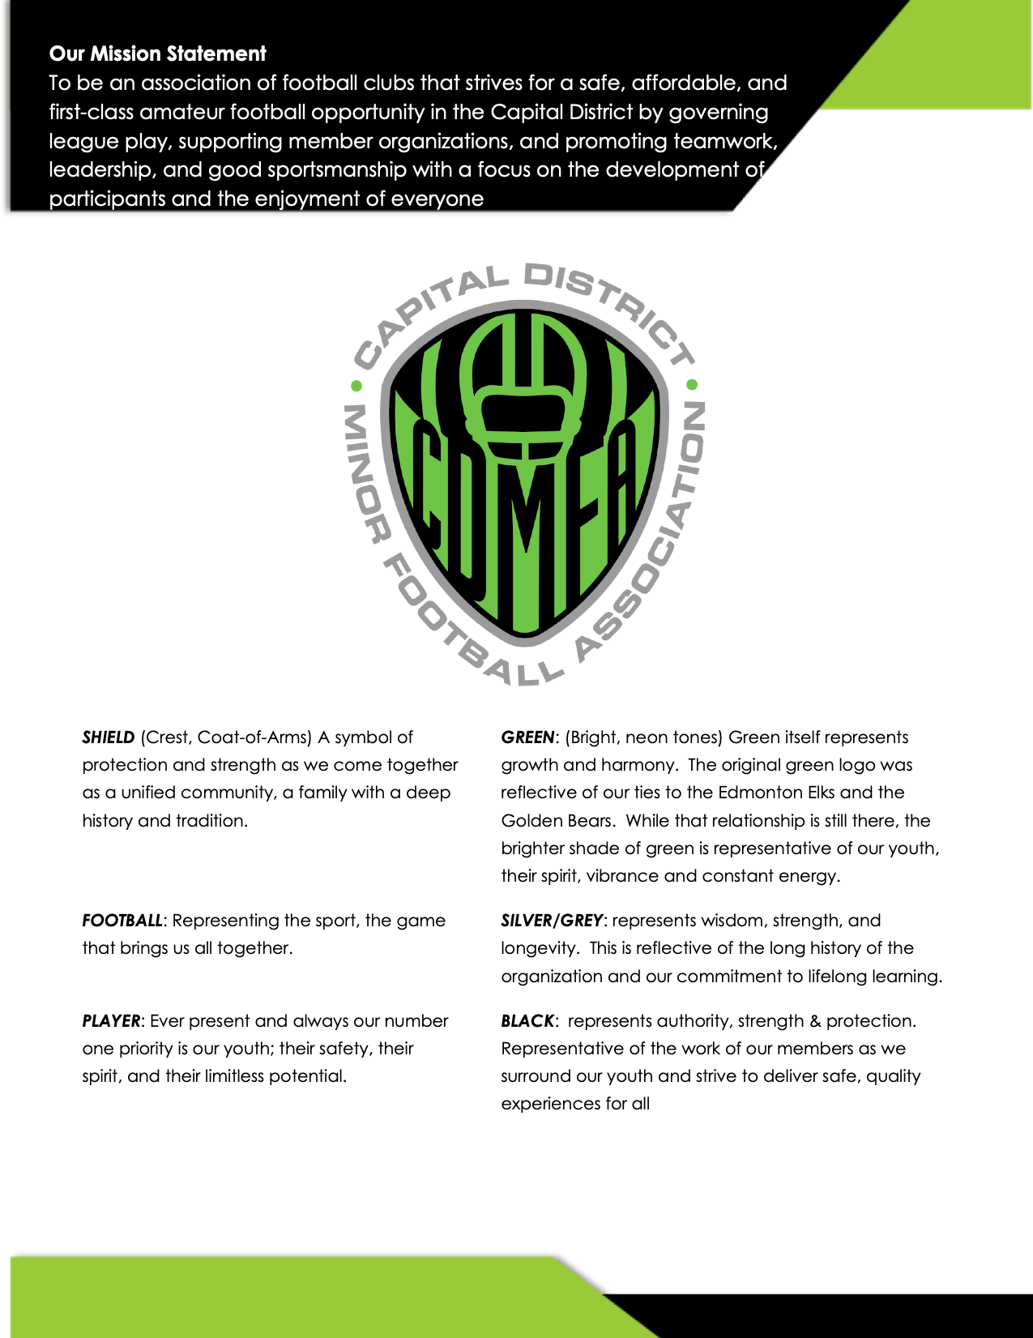

Slide 25
AGM WILL BE MARCH 28, 2023

