Slide 1
Cochrane Minor Hockey 2022-2023 Highlights

Slide 2
U15T2 was a diverse team made up of an even number of first and second years with many players not having played together prior to this season. The team formed well and supported each other throughout the season which ended up being very successful. Winning gold at our tournament in Invermere kicked off the comradery needed to win the banner for our CAHL U15T2 Red division. There were a number of fun events the team did throughout the year which included dryland training at F45 and the mother son Christmas dinner hosted by the captains and assistants. Thanks for a great season team and good luck next year!

Slide 3
U7 JETS The U7 Jets had a great, fun season. We played on a couple tournaments and had a few exhibition games that the kids really enjoyed. We had a lot of first years and there was so much growth through the whole team! It was a great year as a first-year manager, and I couldn't have asked for a better team or coaches or parents!

Slide 4
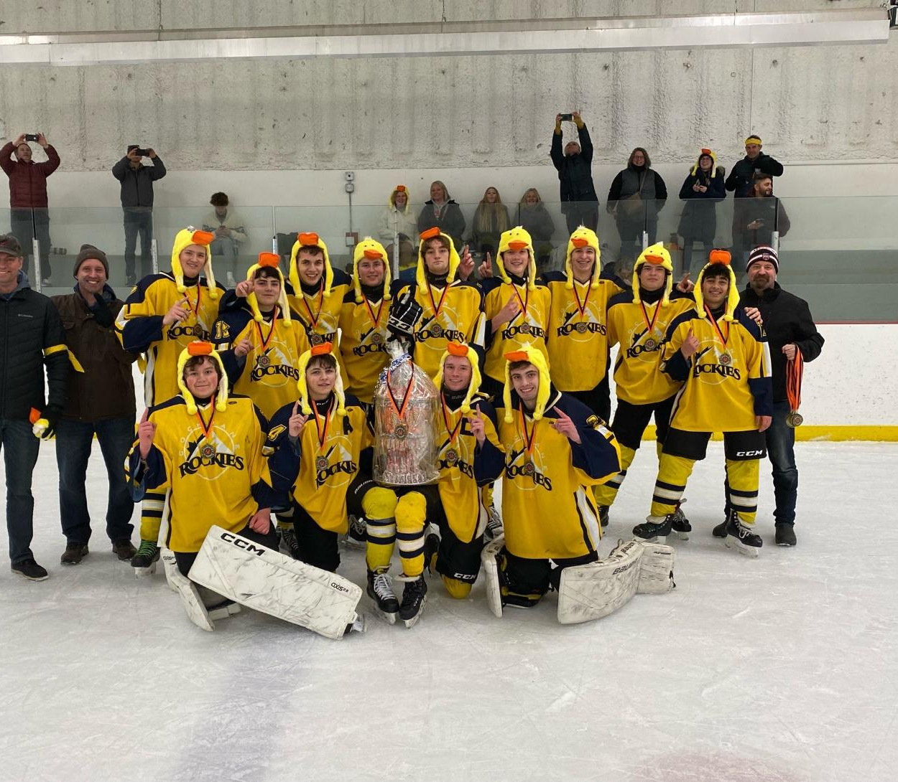
The U18 Ducks had a great year. We played in two out of town tournaments, Devon and Medicine Hat. We won both tournaments and we all had a lot of fun while we were there. We kept everyone in the stands on the edge of their seats when we came back from being down 5-1 in the third period of the Yelnats final to tie it up and go to a shootout. We may not have won the shootout, but it was an exciting end to our season. A huge thank you to our amazing coach, Coach Shane, and our awesome assistant coaches, Andrew, Scott, Ian and Jarvis. It was a great group of kids and parents, and we wish our graduating players well and hope to see all our returning players back again next year!

Slide 5
RHL-13B Cochrane Predators With excellent coaching staff and great kids these players continued to have huge growth bringing them two tournament gold medals, finishing 1st in league play with only one loss all season and battling to the end of playoffs coming one goal short of their banner. Their team connection was noted time and time again by other teams not only in the plays and passing but in their sportsmanship and respect for one another. We are very proud of this entire team !!!

Slide 6
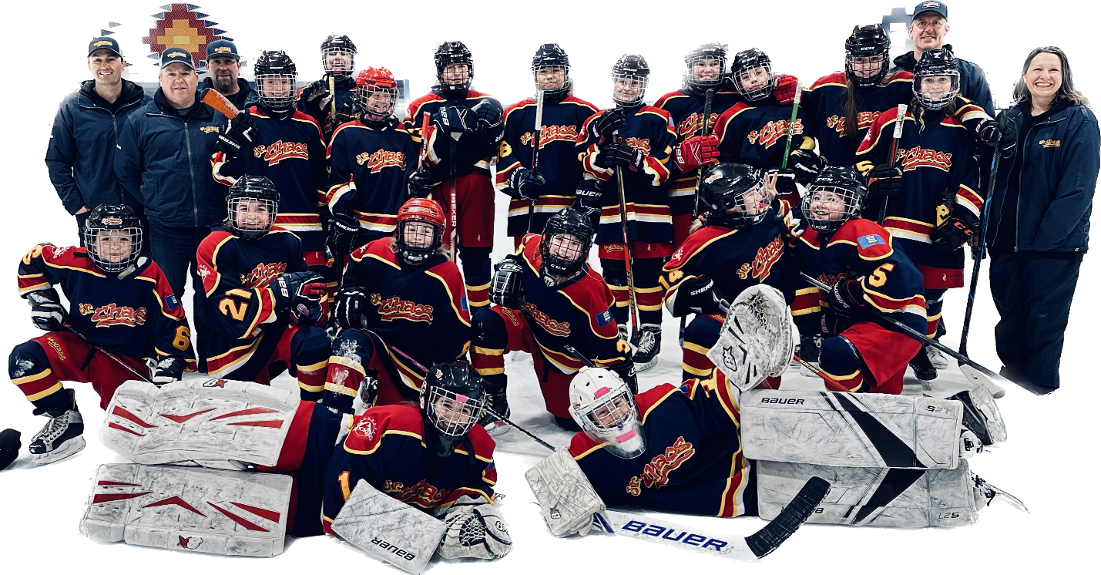
U13B had a fantastic season! They won 2 Bronze Medals and made it to the U13B Green Championship round of playoffs.
U13 B JR CHAOS

Slide 7
U9B4 – Mini Chaos The Mini Chaos are an elite team of female U9 hockey players. This team quickly came together and became a tight knit group. They dominated the opposition with speed, skill and toughness all season long. This was the inaugural year of the “Mini Chaos” name for the top girl's team in U9, connecting this group with the “Chaos” family in Cochrane. Our girls played in Wickfest Calgary 2022 where they competed against some of Calgary’s best U9 female players.

Slide 8
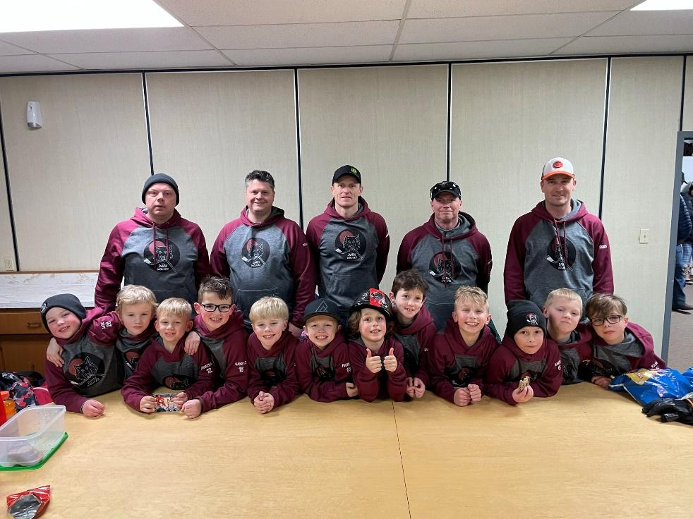
U9-A1 Dark Wolves
Thanks to the coaches this team did exactly what they set out to do, have a fun year with growth and to fall in love with hockey just a little more! New friendships were made and lots of hockey played. Great work Dark Wolves

Slide 9
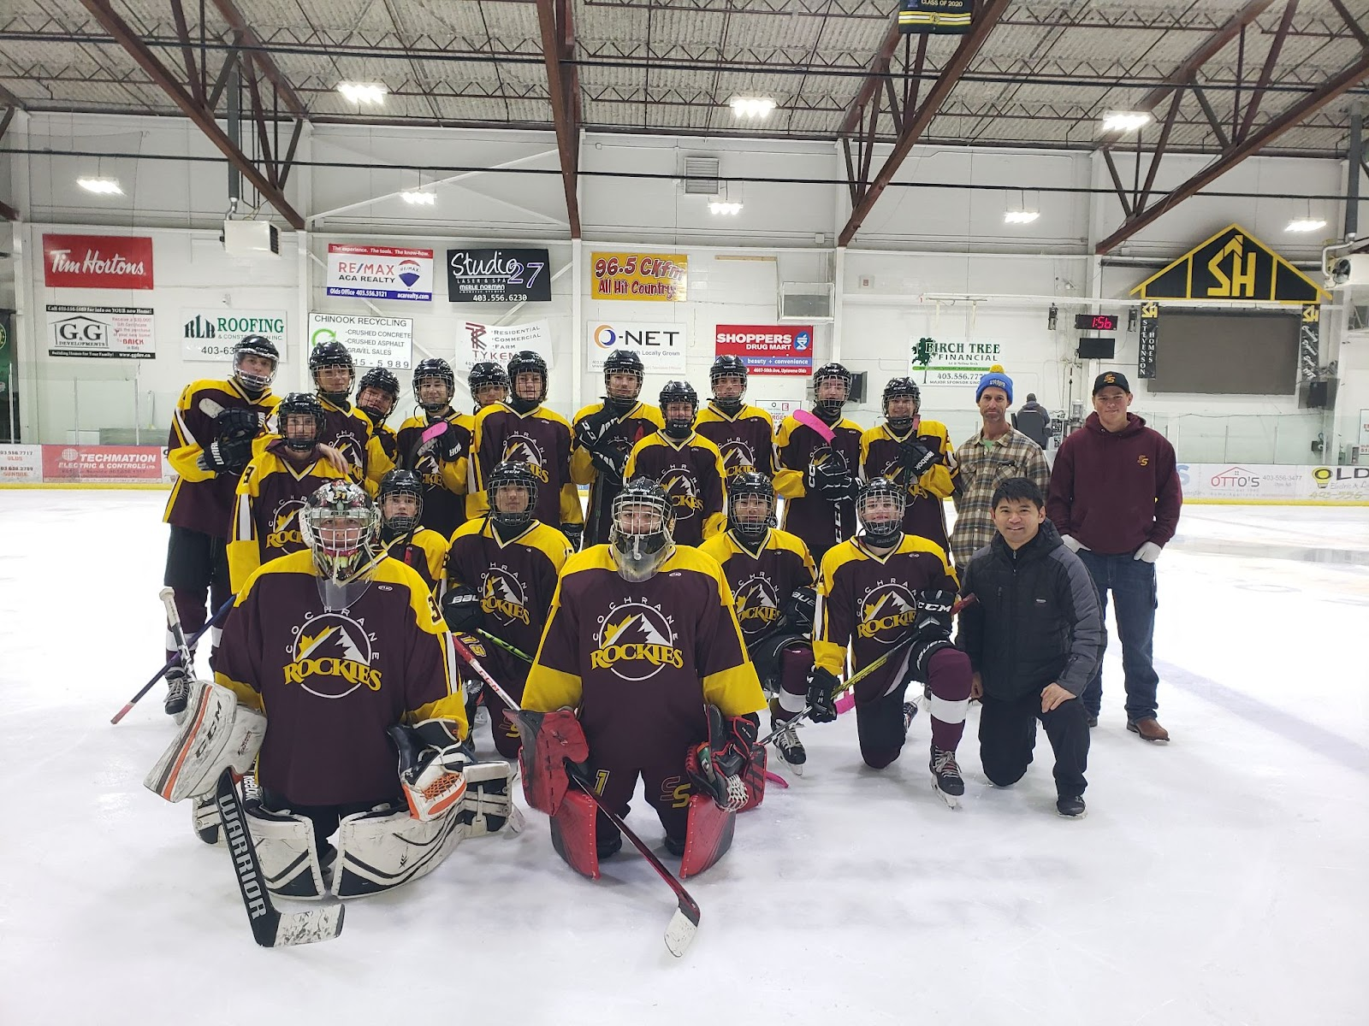
The U18 Sellwood Selects enjoyed a great season with all of the players being dedicated and contributing in many different ways. This group of individuals was made a team by playing to each individual's strength for the betterment of the group, amazing young men both on and off the ice. It was rare we were missing players for games, practices or extra curricular events. The team impressed the Cochrane Rodeo Queen with their gourmet barbecuing skills at the Cochrane light up, taking the award for the best hotdog in Cochrane. The team also contributed to the Coldest Night in Cochrane fundraiser, and provided over 1000 pounds of food for the community of Morley food bank all the while taking part in numerous hockey sponsored events. Mentorship of teammates and friendships were forged where celebrating teammates victories was held in higher regard than acknowledging their own. The group embodied the essence of hockey by playing the game as a team, experiencing their wins and overcoming their losses together. They boys made a point to always invite and include each other in their on ice or extra curricular activity strengthening their friendships and comradery. While this season ended much too soon, this is a group of boys that will be scrimmaging together throughout their lives. Thank you for reminding us what hockey is all about!

Slide 10
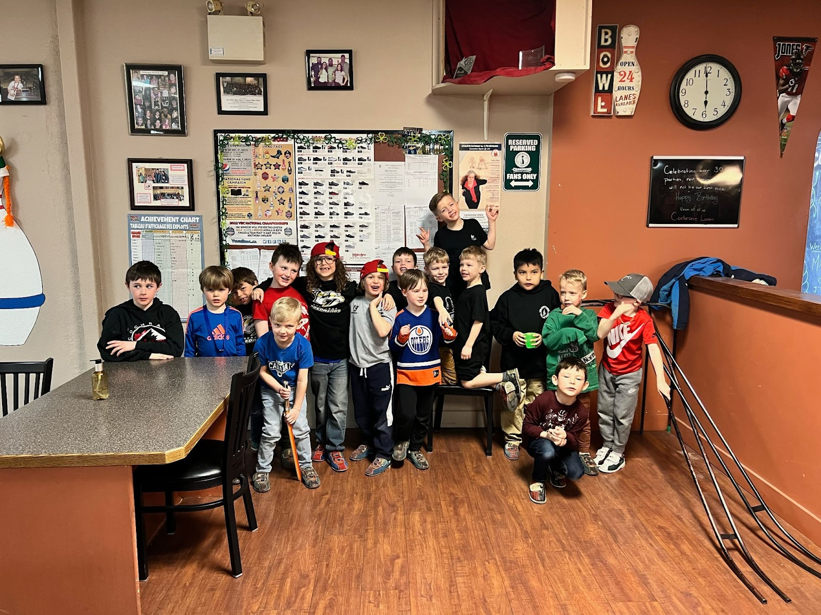
Congratulations Predators on an awesome year! You all played with heart, worked hard and had so much fun!

Slide 11
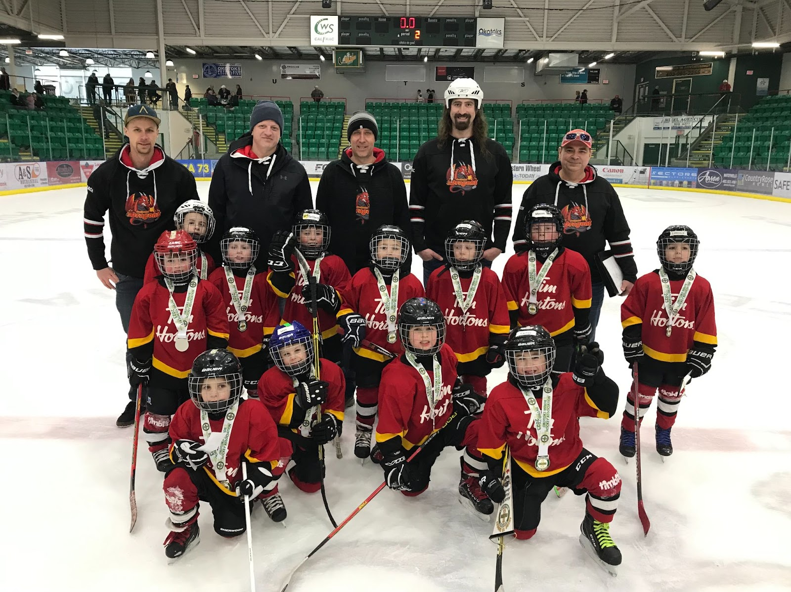
U7 - A - Cochrane Dragons The Cochrane Dragons know how to light things up on the ice! Our boys have big smiles, shoot big shots, and know how to work a crowd! This 2022/2023 season we toured the boys into Calgary for an exhibition game, and to Didsbury and Okotoks for tournaments. We also attended our Home tournament where we nearly pulled off a weekend sweep! Each player scored a goal during a game this season which speaks to our biggest accomplishment as a team! We had an amazing group of parents who helped carry the load by filling volunteer positions and jumped to grab odd jobs! We saw strides of improvement in our players, thanks to our Coaches and their commitment to development and fun of the game!

Slide 12
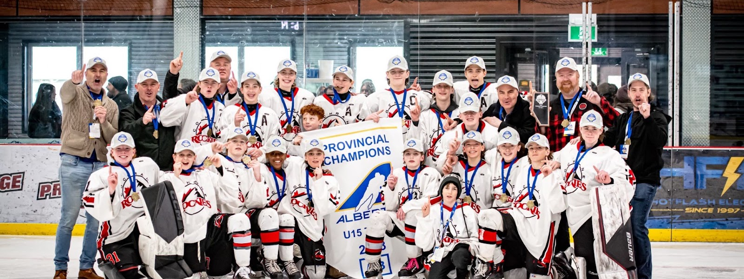
U15T1 – COCHRANE ROCKIES
The U15T1 Cochrane Rockies had an amazing year. The team quickly united and there was no stopping them. They took part in two tournaments in which they brought home gold in both. The big tournament was the Vegas JR. Golden Knights MLK in Las Vegas where the team played against American AA teams. The Rockies were undefeated in the playoffs where they advanced to Provincials in La Crete. Once in La Crete they were also undefeated and brought home the Provincial banner.

Slide 13
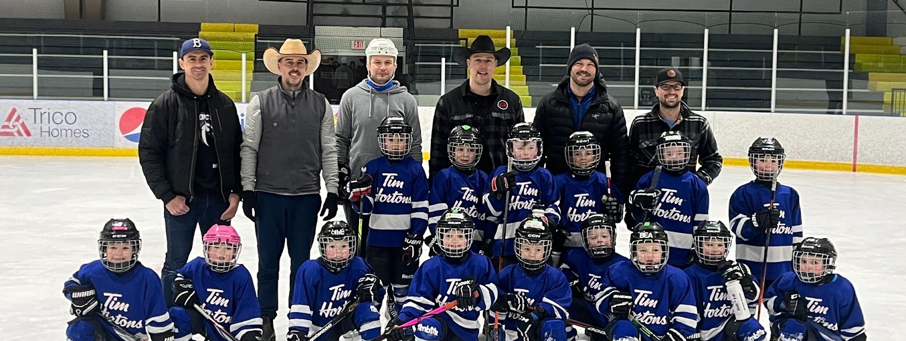
The Broncos had a great season! Lots of learning on the ice & fun off the ice. With some of the most dedicated coaches, players & parents, we ran with a full crew almost every weekend (even during our 6:45am ice times). Thank you to everyone involved for making it such a successful year of hockey!!
U7 BRONCOS

Slide 14
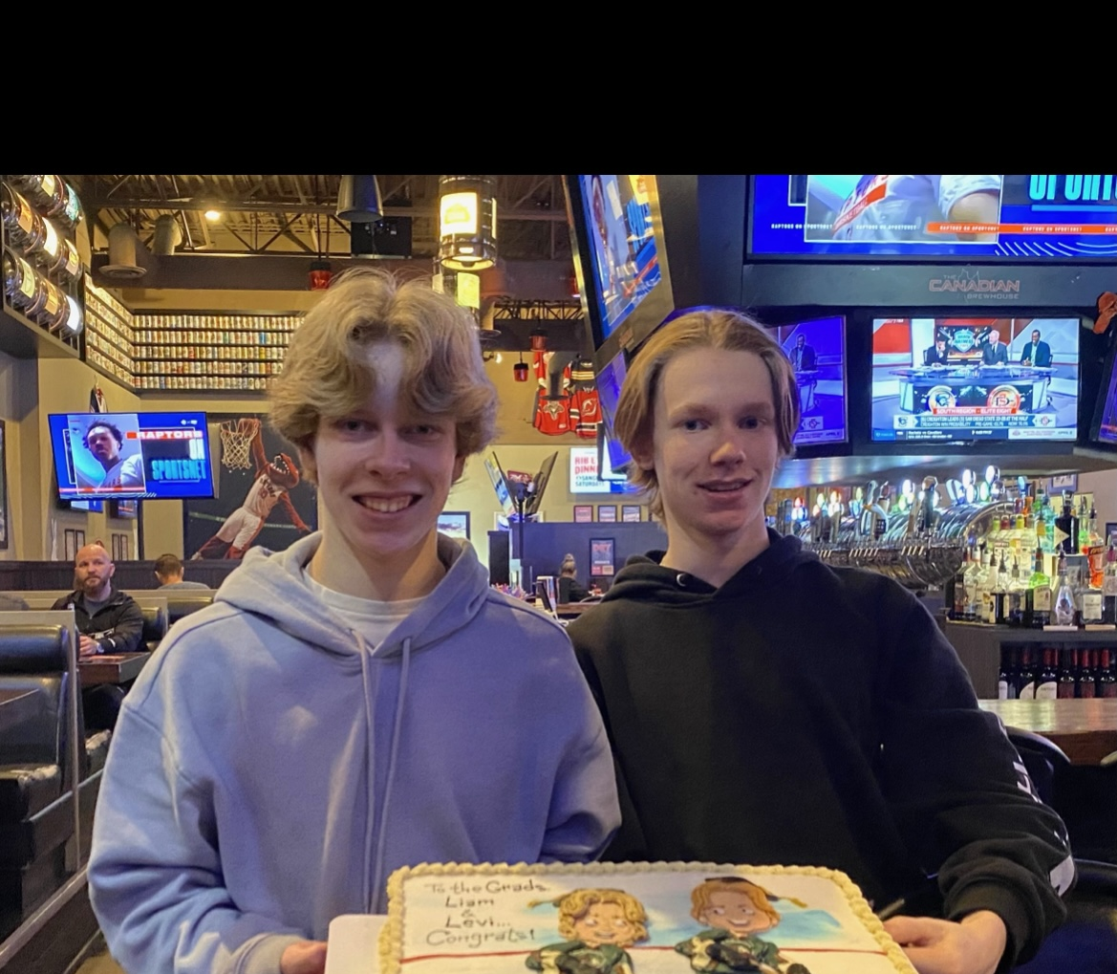
U18 GREEN GOBLINS
"Another great year of Cochrane Hockey for the boys and girls of Team D, the Green Goblins. All were really proud of the run in the league and the Yelnats Tournament. Particularly the epic win over the League Champs day 1 of Yelnats!! Sadly we are saying good bye to Liam and Levi who are graduating and moving onto bigger and exciting things. The team is sad to see them go but excited about how many are returning next year. What out everyone :) Enjoy the summer."

