Slide 1
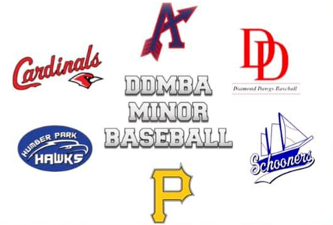
2026 DDMBA Coaches Meeting
May 31,2026

Slide 2
Agenda
CRC Checks
NCCP Training and Clinics
Respect in Sport Training
Participant Discipline
Player and Coach Safety
Fair Play/Equal Play
Pitch Counts
Field Closures
Links
Finish Q&A

Slide 3

CRC Checks
Must be done by June 30
mybackcheck.com ($50) or VIPCoaching.ca (Free)
Home Association will reimburse
Good for 3 years
Must submit to iplayball.ca
  Click
  Choose Age Level and Role – Head or Asst Coach, Manager, Buddy
  Submit Vulnerable Sector Screening or CRC

Slide 4
NCCP Training
Register for NCCP # at nccp.baseball.ca
Community Coach (Rec League) Requirements
  Online Modules and NCCP In person clinics (Initiation and Absolutes)
  Online modules up to age specific level
  Do not require Core Evaluations
Competitive Coach Requirements
  Community Coach Requirements
  Age Specific Requirements

Slide 5

Respect in Sport

Slide 6
Participant Discipline
Applies to Coaches, Staff, Players and Fans
BNS Umpire – Green Arm Band
Complaints filed by BNS Umpires and reviewed with recommendation by BNS
Forwarded to DDMBA Discipline Committee
Penalties implemented – as per BNS Discipline Grid
Coaches must set expectations with Parents, Players and Staff at the start of season
Complaints not filed by BNS Umpire may be sent to DDMBA President for review

Slide 7
Player and Coach Safety
Players must wear protective equipment at all times
Players - Batting Helmets, Catchers Gear(Game and Bullpen, Jock or Jill Cups)
Coaches – Mask when warming up Pitchers (Game or Bullpen Practice), Cup?
Coaches must set expectations of safety for team
  Safe throwing pattern
  Bat Safety
  Safe Defensive Positioning – Practice where to be to avoid collisions

Slide 8
Fair Play/Equal Play
Rec - Players must play minimum 2 innings unless there’s a discipline reason
Coaches need to consider player ability before putting players at 1st, 3^{rd or} SS or Pitcher. Player must have the ability to defend themselves from line drive, bouncing ball or throws
Improve quality of gameplay by using experienced pitchers when possible but follow Pitch Count requirements by age

Slide 9
Pitch Counts
Maximum Pitches per week
  Rec - U11 25/game – 50/week
  A pitcher cannot pitch in 3 consecutive days UNLESS a pitcher’s first 2 days combined does not exceed:
    • 11U – 25 pitches
    • 13U – 30 pitches
    • 15U – 35 pitches
    • 18U – 40 pitches
    • 22U – 45 pitches
Combined 3 day counts
  • 11U/12U Girls - 105 pitches
  • 13U Boys/14U Girls - 120 pitches
  • 15U/17U Girls - 135 pitches
  • 18U - 150 pitches

Slide 10
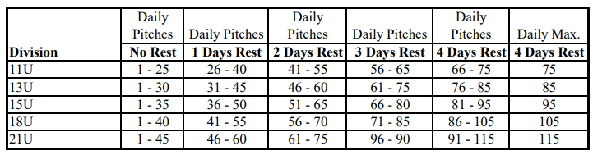
Pitch counts monitored by both teams and not exceeded
Overages must be reported to umpire by away team
Last batter called before hitting threshold, can finish batter and threshold max counted, not total pitches

Slide 11
Last Inning
Last inning is called when time threshold reached and is the first full inning
  – game in top of inning at 7:40pm, new inning starts and is completed, next inning last and open
  – inning completed after time threshold (bottom of 4th ends at 7:46 , next inning open and last

Slide 12
Field Closures
Field Conditions | Sport Fields | Halifax
If you arrive and the field is playable, please contact you association president or field coordinator to contact the HRM to advise play is happening
Field must be safe to play. Dry, no standing water

Slide 13
Links
DDMBA Rec League Rules
BNS Handbook
BNS Safe Sport Policy
Beazley Cage Booking
HRM Field Conditions
NCCP
MyBackCheck
VIP Coaching

Slide 14
Q&A
ddmbapresident@gmail.com

