Slide 1
Edmonton Ladies Softball Association
Spring meeting
April 30/2024
7pm

Slide 2
Agenda
ELSA Season
John Fry Diamond Allocation
New/Changed ELSA Rules
Intro w/ EDSUA Umpires
Ice Breaker & Volunteer Sign Up
Fall AGM
Questions

Slide 3
2024 Season at a Glance
Season runs May 13 – July 25 –> No Playoffs
# of Teams Registered
Expenses for 2024
Program Coordinator
Future plans

Slide 4
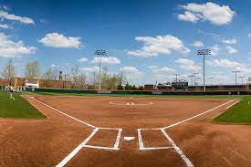
Diamond Allocation
City of Edmonton: Rollovers – trying to keep as many diamonds as possible.
Dropped a significant amount of diamonds that we will likely never get back due to low registrations this year ☹
Diane now a member of the city of Edmonton Field user committee (no Fastball rep was in place)

Slide 5
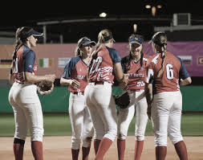
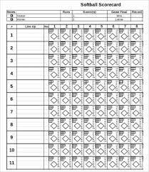
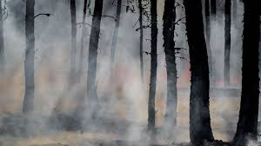
New/Changed ELSA Rules for 2024
RULE #9: WEATHER CONDITIONS
Air Quality added **Wildfires likely to be an issue ☹
Softball AB guidelines: AQHI > 7, games will be cancelled (noted as “rainout”)
Decision to be made no later than 5pm
Teams can choose to cancel games if below 7, but all forfeiture rules/fines will be applied against their bond

Slide 6
New/Changed ELSA Rules for 2024
RULE #10: SCORESHEETS
Adding: First and last names must be included cards and score sheets in a legible fashion.
Press Hard on carbon copies please
RULE # 13 – PLAYER ELIGIBILITY:
Roster must be completed and submitted in EXCEL format via email.
Change/clarification: a Substitute player may only be fielded to make a maximum of 10 players for any given game.
ELSA is no longer enforcing a deadline for additions to rosters (used to be June 30)
If attending Provincials – No roster additions will be recognized after June 30 by Softball AB (players can be registered with any ELSA team – see Softball AB Website for more information)

Slide 7
New/Changed ELSA Rules for 2024
RULE #17: TEAMS FOLDING
Teams folding or withdrawing from the league on their own volition
Prior to the registration deadline = refunded their registration fee and cash bonds in full
After the registration deadline = no refunds issued

Slide 8
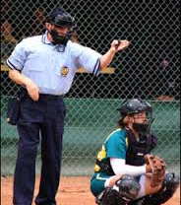
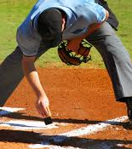
EDSUA UMPIRES

Slide 9
ICE BREAKER TOURNAMENT + ELSA VOLUNTEERS
Takes place May 10 – 12, 2024 @ Lede Park, Leduc
Last years tournament broke even (we have lost money previously as a league opener).
We have 24 teams registered this year with a wait list. (11 last year)
Entry was not mandatory for ELSA teams, BUT all teams must supply 2 volunteer workers regardless if they’ve entered the tournament or not.
Volunteer Sign Up Sheet at head table – First come, First serve

Slide 10
POPCORN FUNDRAISER
League fundraising = Mandatory
Kick back to teams

Slide 11
2024 AGM
Fall 2024 – usually early October
Recap of 2024 season
Elections
Motions for changes/updates
Distribution of bond/rainout refund cheques (must be in attendance to receive)
Plans for 2025
More details will follow upon conclusion of season

Slide 12
Questions ??

