Slide 1
Edmonton Ladies Softball Association
Spring meeting
May 2. 2023
7pm

Slide 2
Agenda
ELSA Season
John Fry Diamond Allocation
New/Changed ELSA Rules
Intro w/ EDSUA Umpires
Open Executive Positions
Ice Breaker & Volunteer Sign Up
Fall AGM
Questions

Slide 3
2023 Season at a Glance
Season runs May 15 – July 27 –> No Playoffs
# of Teams Registered
Expenses for 2023
Program Coordinator
Goal for 2024 – Plan for continuing to rebuild

Slide 4
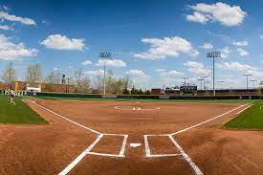
Diamond Allocation
Continued saga in securing diamonds with City of Edmonton
City of Edmonton Rollover Pilot project
Game slots 2023 vs 2022

Slide 5
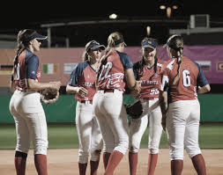
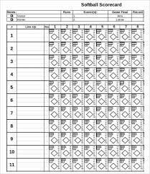
New/Changed ELSA Rules for 2023
1) A team may play a game with eight (8) players
The 9th player on line-up card will be considered a “ghost” player & will receive an auto-out in their place in the batting lineup.
This player must be distinguished & tracked on the scoresheet and announced to umpire & opposing team each time as to be tracked accordingly.
A player arriving late may be added to the lineup card at any point; Announce as a sub for the “ghost” player. Inning of arrival to be noted on scoresheet.

Slide 6
New/Changed ELSA Rules for 2023
Reminder: rainout line/ Website is updated @ 4pm. If diamonds listed as open – you must show up to diamond
2) RAINOUTS/WEATHER:
Games called by umpire @ Diamond:
Both Teams + Umpire must confer
Scoresheet to be signed by umpire with notation of Rainout
Home team submits signed gamesheet to ELSA
3) SCORESHEET SUBMISSION:
Scoresheets must be submitted via EMAIL only by Winning team

Slide 7
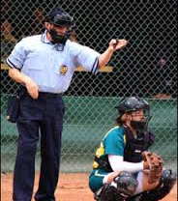
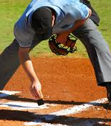
EDSUA UMPIRES

Slide 8
OPEN EXECUTIVE POSITIONS
All Executive positions are 2-year terms
Vice President
Successional position to President
Events & Fundraising Coordinator

Slide 9
ICE BREAKER TOURNAMENT + ELSA VOLUNTEERS
Takes place May 12 – 14, 2023 @ Lede Park, Leduc
Running as a stand-alone tournament this year, not league opener, as an association fundraiser.
Entry was not mandatory for ELSA teams, BUT all teams must supply 2 volunteer workers regardless if they’ve entered the tournament or not.
Volunteer Sign Up Sheet at head table – First come, First serve

Slide 10
2023 AGM
Fall 2023 – usually early October
Recap of 2023 season
Elections
Motions for changes/updates
Distribution of bond/rainout refund cheques (must be in attendance to receive)
Plans for 2024
More details will follow upon conclusion of season

Slide 11
Questions ??

