Slide 1
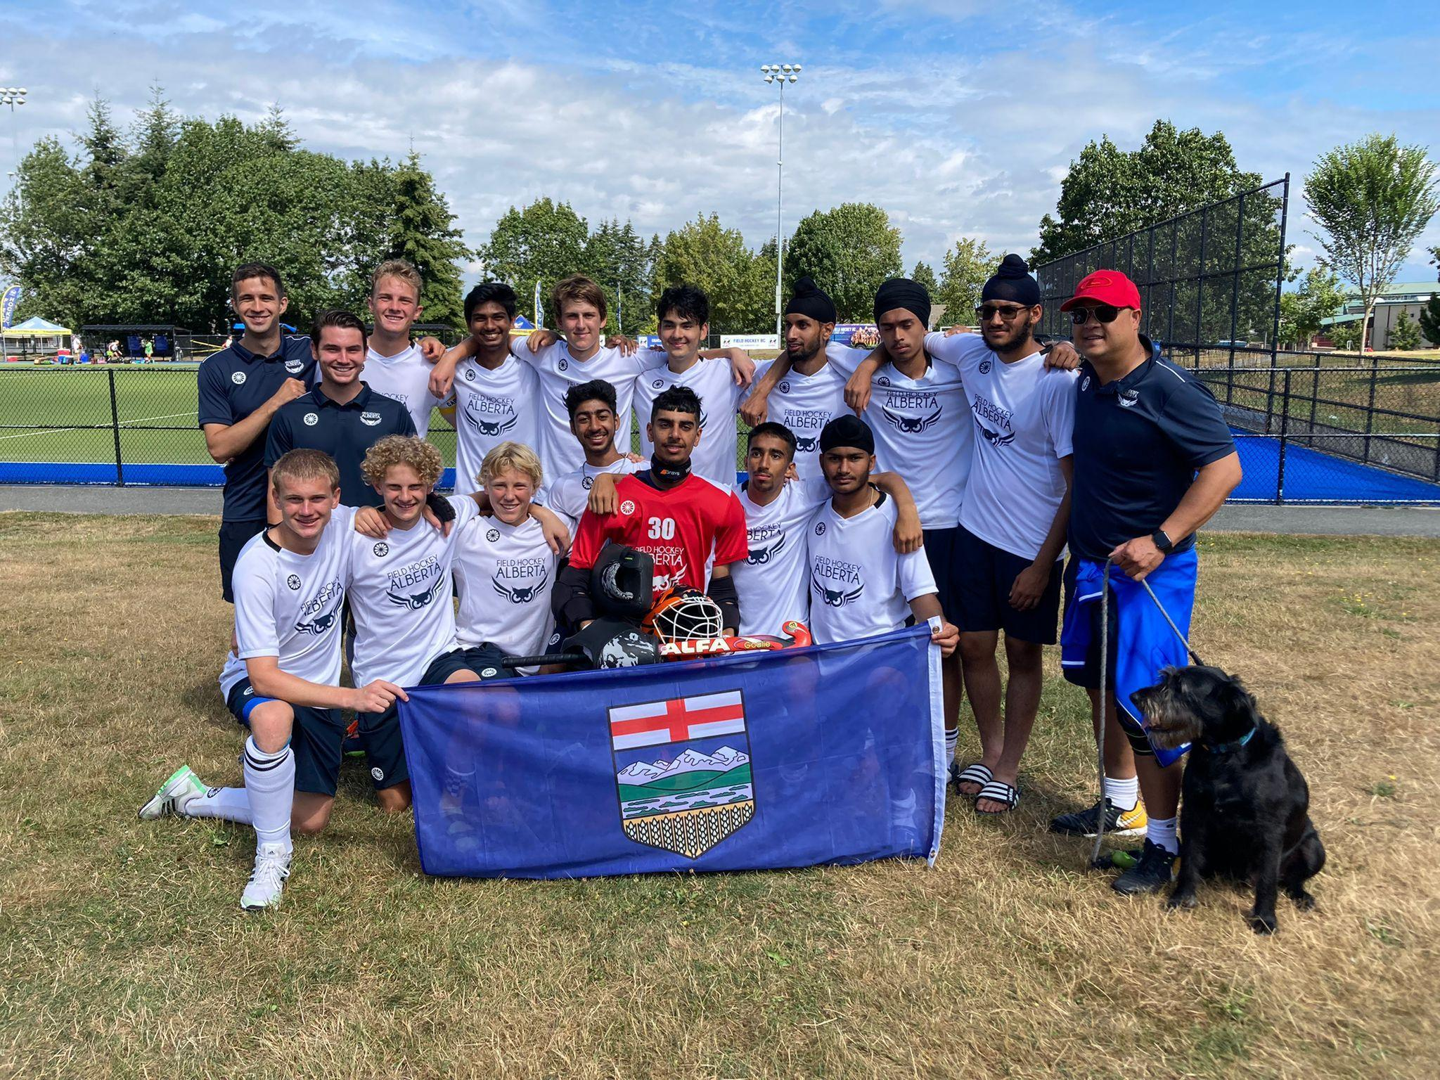
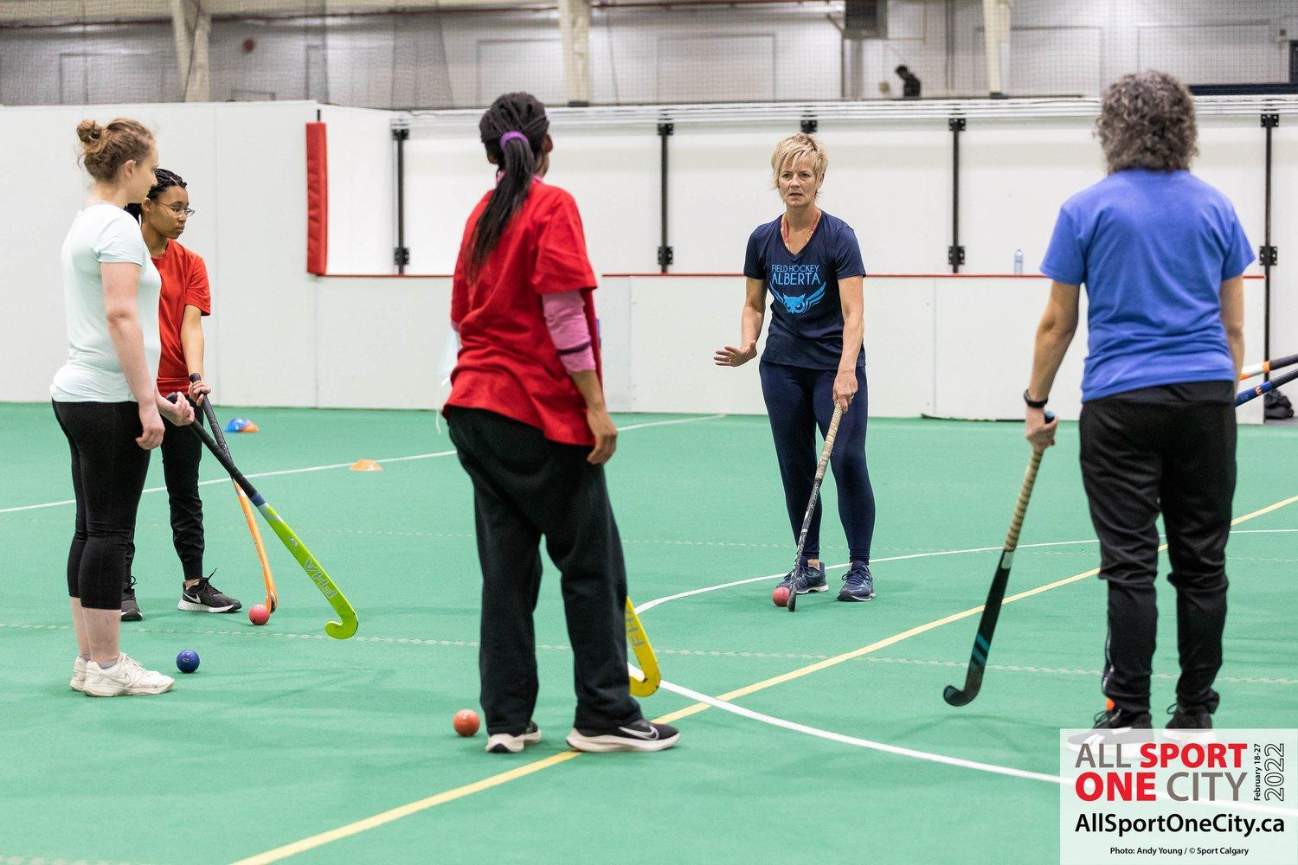
Alberta Field Hockey Association
2022 AGM Report

Slide 2
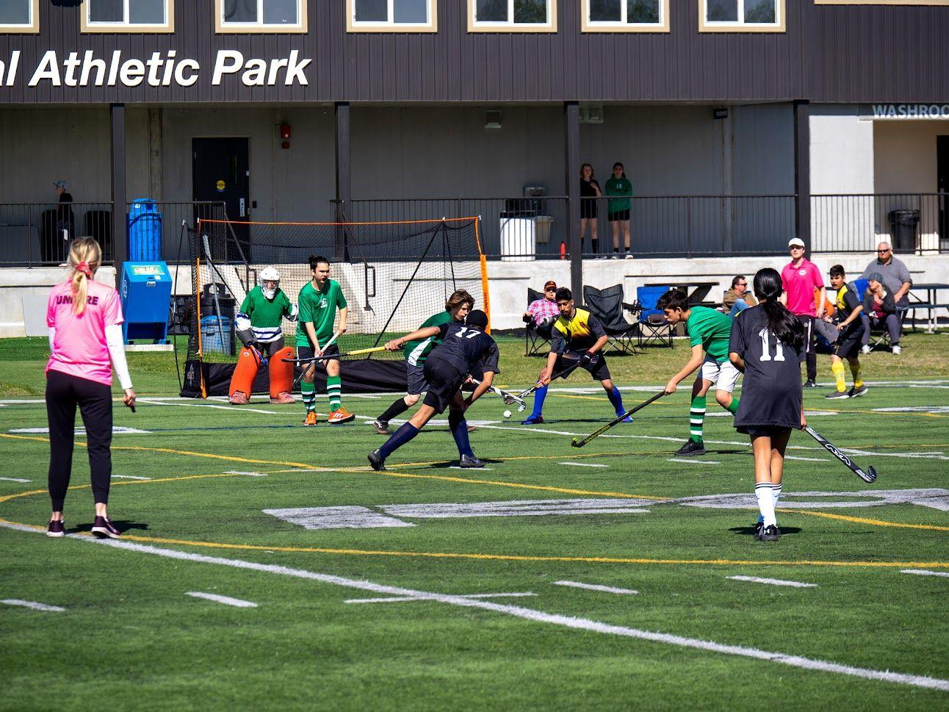
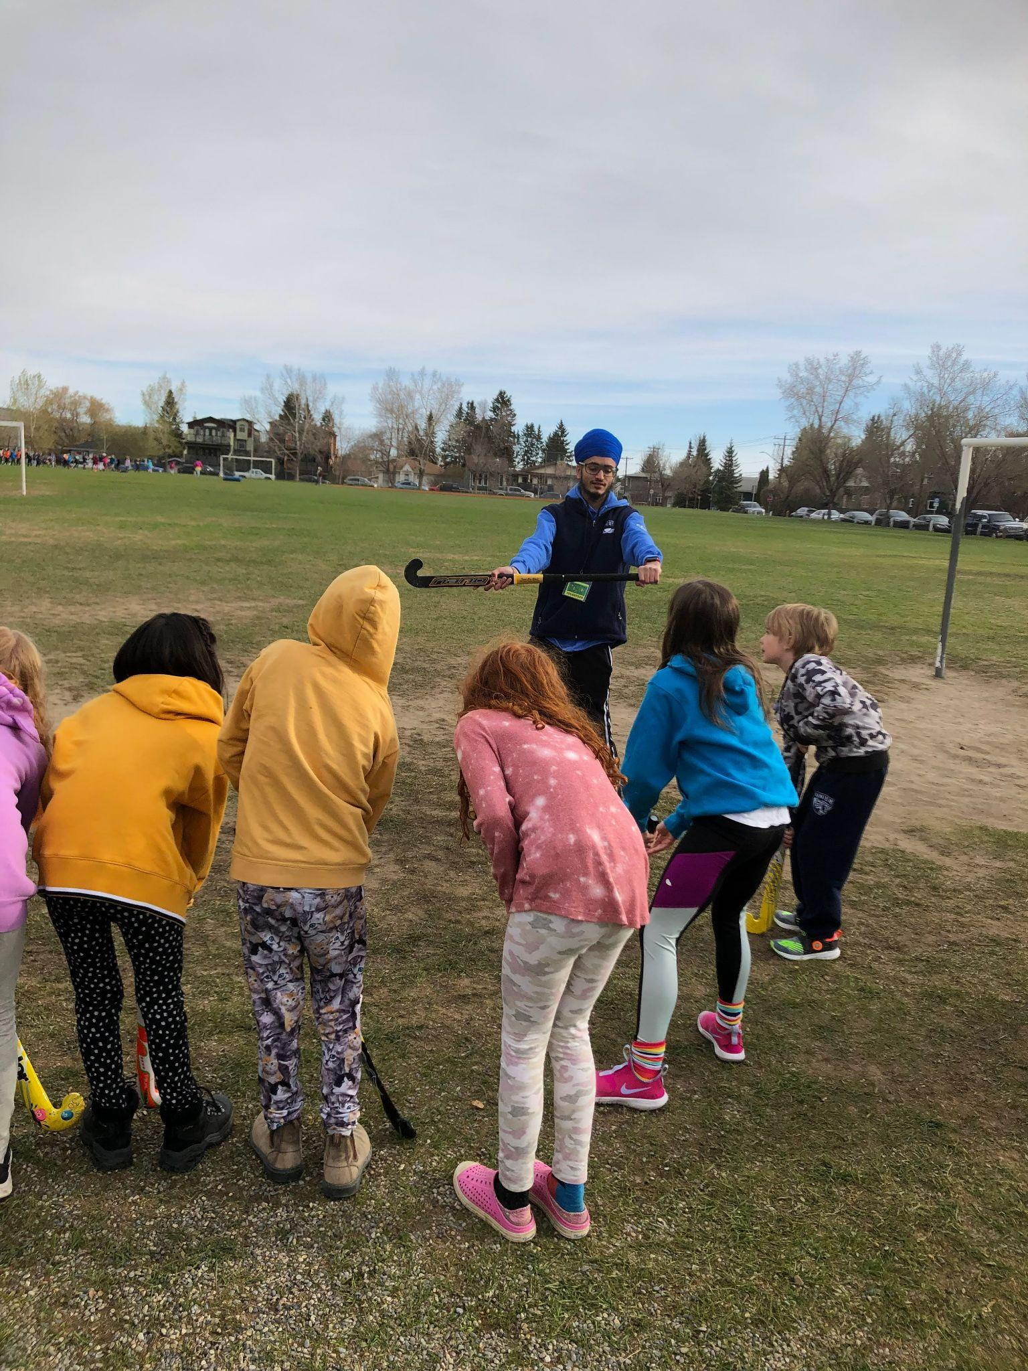
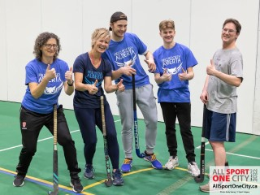
2022 Highlights
Regional Development
Calgary Junior
Red Deer Camps
Edmonton Camps
Grande Prairie - Try it free
Lethbridge
Nationals
Schools
5 Calgary School Programs
3 Edmonton School Programs
Coaching
Hosted 2 NCCP Training
Hosted Coaches Corners
Hired Coach Educator
Events
3 Junior Festivals
Masters Festival
6 Try it Frees
2

Slide 3
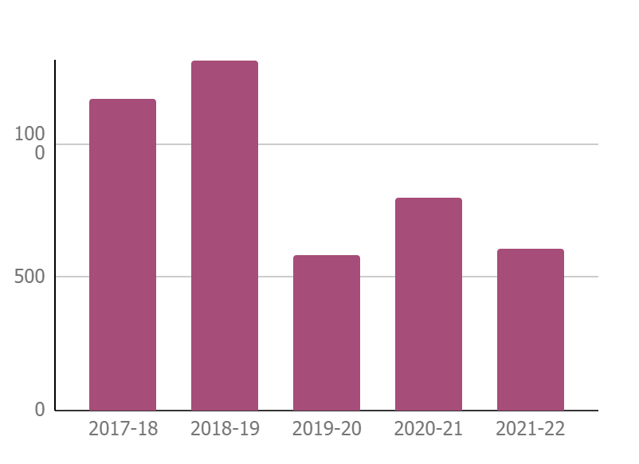
Membership 2021-22
FHA Membership Numbers
 | Year | Total Members
 | 2017-18 | 1169
 | 2018-19 | 1315
 | 2019-20 | 585
 | 2020-21 | 798
 | 2021-22 | 608
2021/22 Membership was lower this year due to several factors:
No Edmonton players (no memberships bought)
Extensions on memberships due to Covid
3

Slide 4
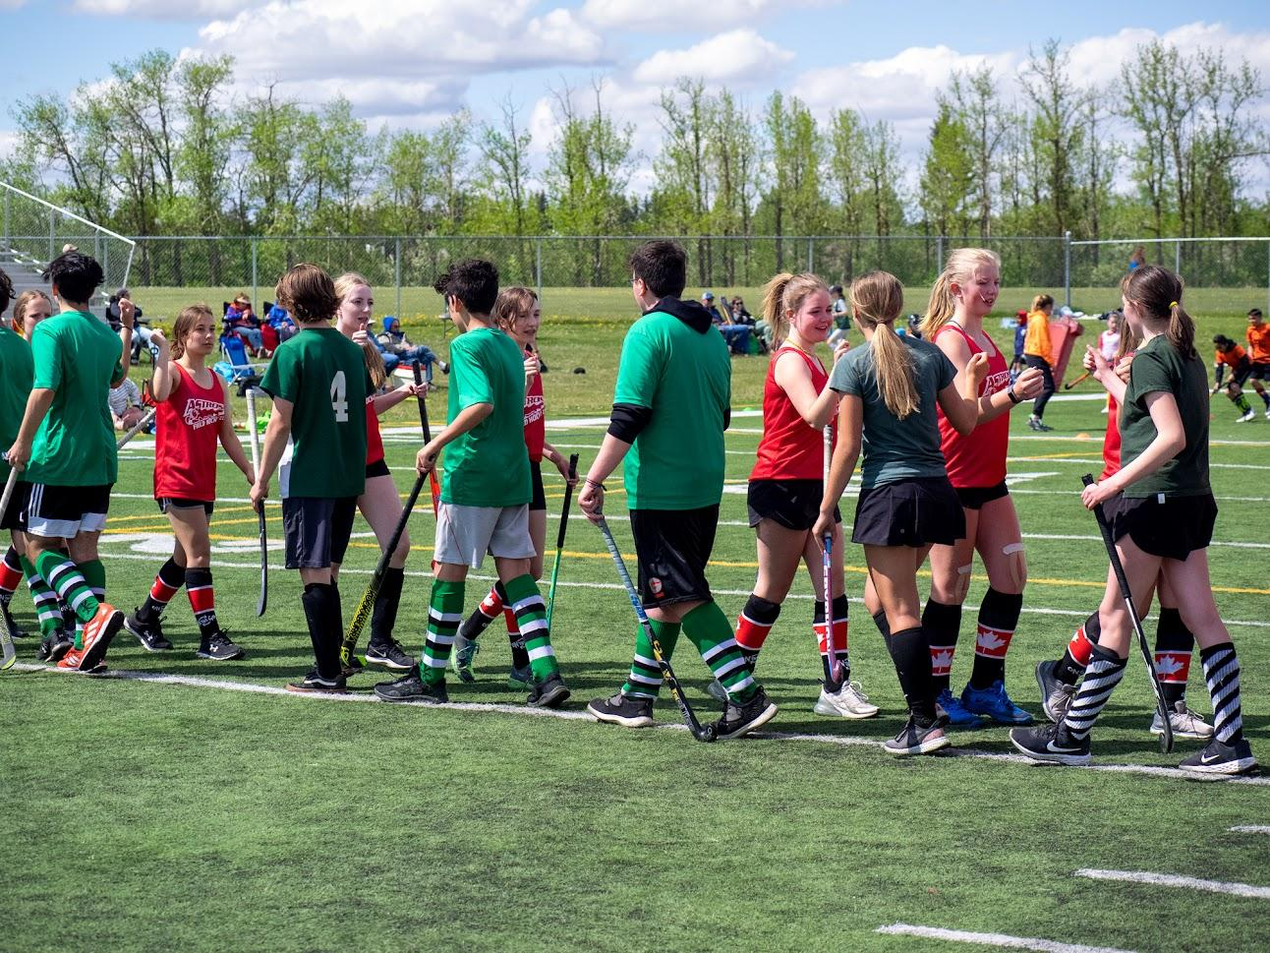
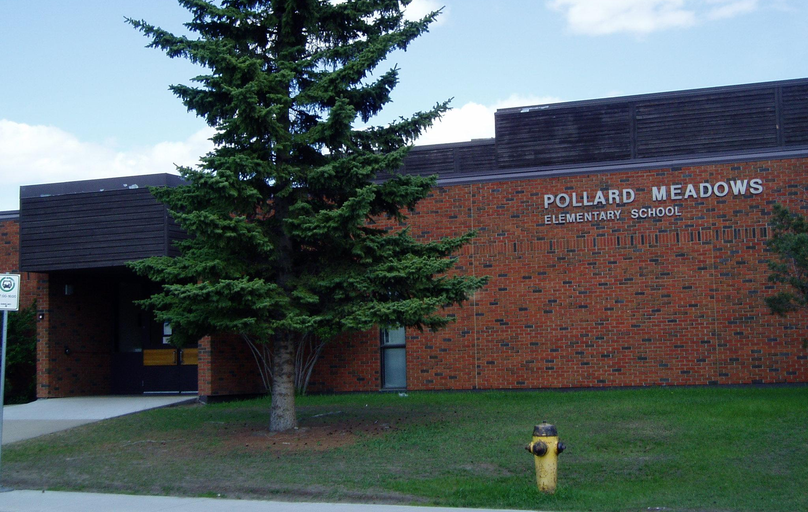
Regional Development
Calgary Junior Programs
Red Deer Summer Camps
Edmonton Schools/Summer Camps

Slide 5
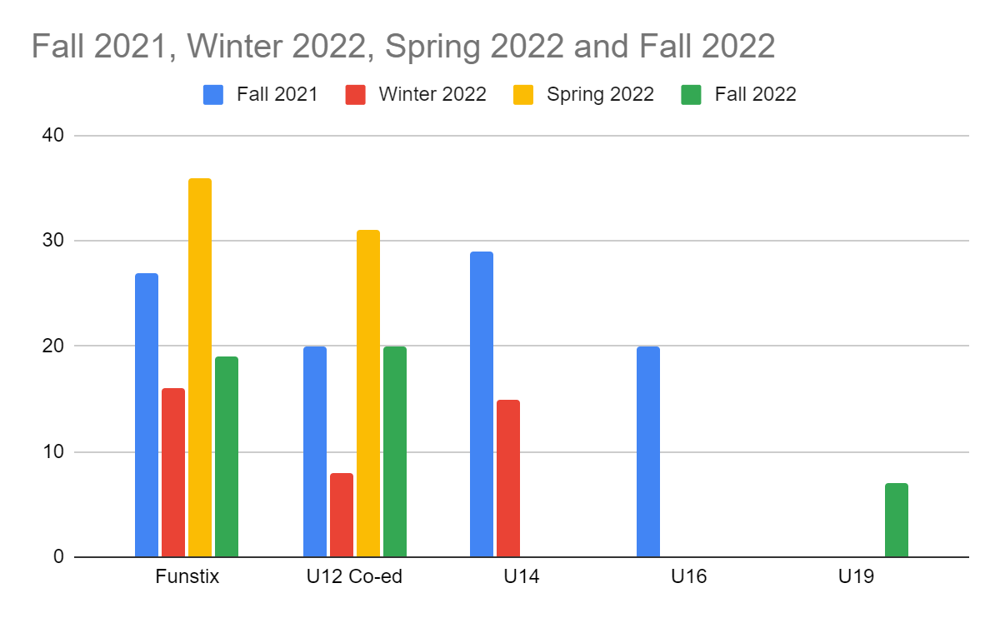
Calgary Junior Field Hockey 2021 - 2022
Fall 2021
Age Group
Funstix | 27
U12 Co-ed | 20
U14 | 29
U16 | 20
Total | 76
Spring 2022
Age Group
Funstix | 36
U12 Co-ed | 31
Total | 67
Winter 2022
Age Group
Funstix | 16
U12 Co-ed | 8
U14 | 15
Total | 39
Fall 2022
Age Group
Funstix | 19
U12 Co-ed | 20
U19 | 7
Total | 46
Thanks to all the hard work from Shelley V, Jenn Swagar, the Junior Committee & the FHA Admin team
6

Slide 6
Red Deer 2022
Hired a Red Deer Summer student Ryan Mcconkey, highlights:
Ran a successful festival in Lacombe (head contact on site)
Made contact with several camps (including the National Ringette School)
Attended Sport Speaker series on our behalf
Had a booth at the Red Deer Public Market through the Spring
Had Storm players at every festival & coached the teams
Was a great help for our last festival in July when several summer students got Covid!
Developed our Master Program!
Tried to start a drop in Adult program.
Is doing a fundraiser on Sat March 18th with Rebels
Red Deer Camps | Date | Ages | # of kids(under 18)
Ringette Camp | May 29th | 6-15 | 50
Female sport camp | July 29th | 8-12 | 40
Blackfalds - Camp Curious | July 25th | 5-9 | 20
City of Red Deer Camps | Aug 2-5 | 6-15 | 200
Coached by Ryan | Total |  | 310
Red Deer Programs
Spring
U8 | 0
U12 | 6
U18 | 5
Total | 11
6

Slide 7
Edmonton/Grande Prairie/Lethbridge 2022
Edmonton Summer Camps
Date | # of kids(under 18) | Age of kids
July 26-28 | 100 | 8-15
Coached by Sajan
Grand Prairie Sportsday
Date | # of kids(under 18) | Age of kids
Feb 26 | 9 | 6-12
Coached by Vanessa
*Then Vanessa quit said she was too busy
Lethbridge Try it Frees
Date | # of kids(under 18) | Age of kids
May | 0 | 6-12
June 22nd | 0 | 6-13
Coached by Abby
No one attended (although one media person showed up)
We let Abby go as a summer student since we could not get anyone to show up
6

Slide 8
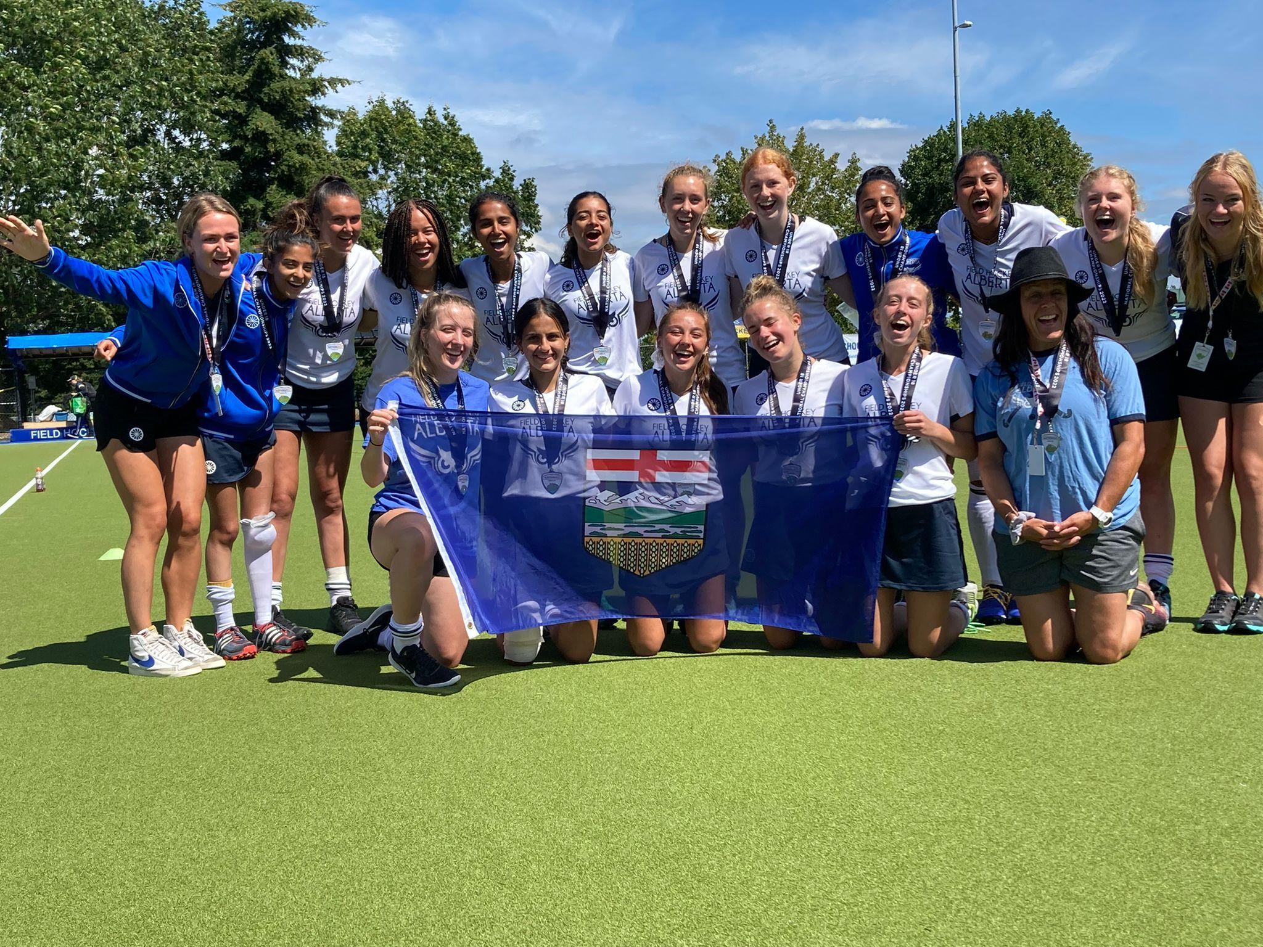
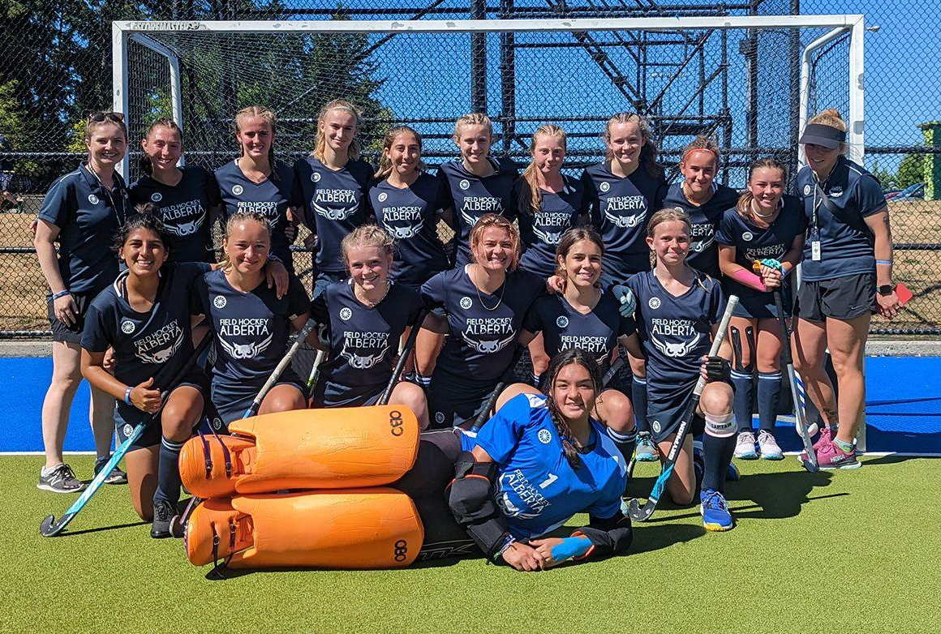
Alberta Provincial Teams -
Nationals 2022 - Vancouver BC
U18 Boys - 3rd Place (Bronze)
U18 Females - 2nd Place(Silver) Tier 2
U16 Females - 4th
Thank you to Coaches
Said/Peter (U18 Boys),
Laura/Swagar (U18 Females),
Wishart/Janelle (U16 Females)
and Roel who left us in April
Also a HUGE thank you to Chan Campbell, who booked all the teams flights, accommodations, transportation & everything else that came up!

Slide 9
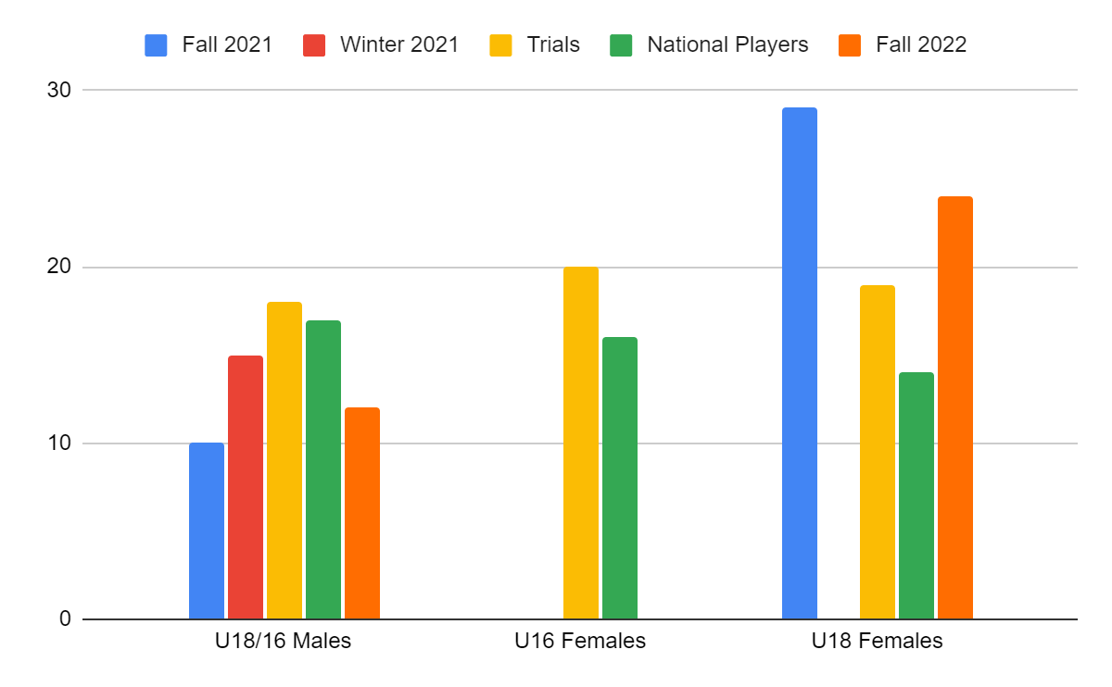
Provincial Programs 2022
Provincial/High Performance Players
Age Group | Fall 2021 | Winter 2021 | Next Gen trip | Trials | National Players | Fall 2022
U18/16 Males | 10 | 15 | 10 | 18 | 17 | 12
U16 Females | See U18 |  | N/A | 20 | 16 | see U18
U18 Females | 29 | 2 (Cancelled) | N/A | 19 | 14 | 24
Total | 39 | 15 | 10 | 57 | 47 | 36
8

Slide 10
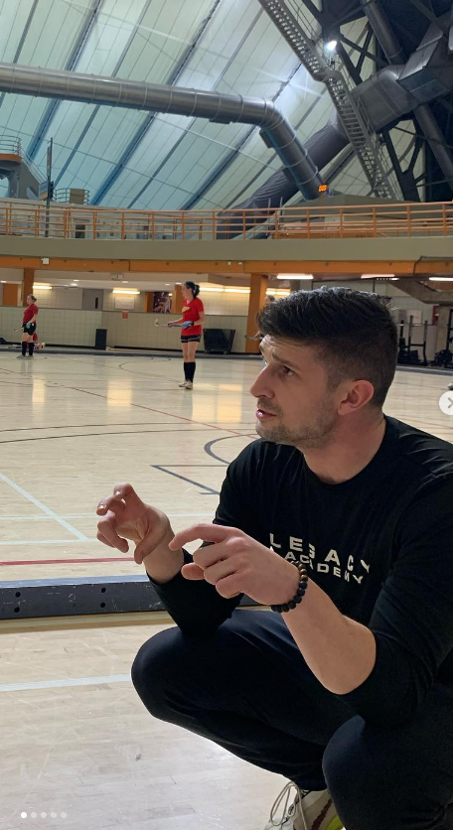
Next Gen/TAP Athletes
Spring: 10 identified NextGen boys went on tour to Vancouver in April with Roel. This was a hockey filled weekend with two matches and a training session with the current Men's NextGen squad. All the players left Vancouver inspired and eager to work hard.
Summer: Following the National tournaments in Vancouver, many Alberta athletes were invited to the U16 and U18 girls identification camp as well as the U21 boys identification camp.
Fall: A West Identification camp for U21/U18/U16 boys will take place on Thanksgiving weekend.
Winter: FHC will begin a National Training Centre hub in Calgary and run a NextGen/TAP program for Alberta athletes, starting October 21, 2022
Women's Next Gen program has 10 Identified athletes and 21 identified TAP athletes.
Men's NextGen program will be announced following the West Camp.
Coach: Nick Higell is our head coach for NTC in Calgary, working closely with FHC & Jenn Began & Chan Campbell to make it a success!

Slide 11
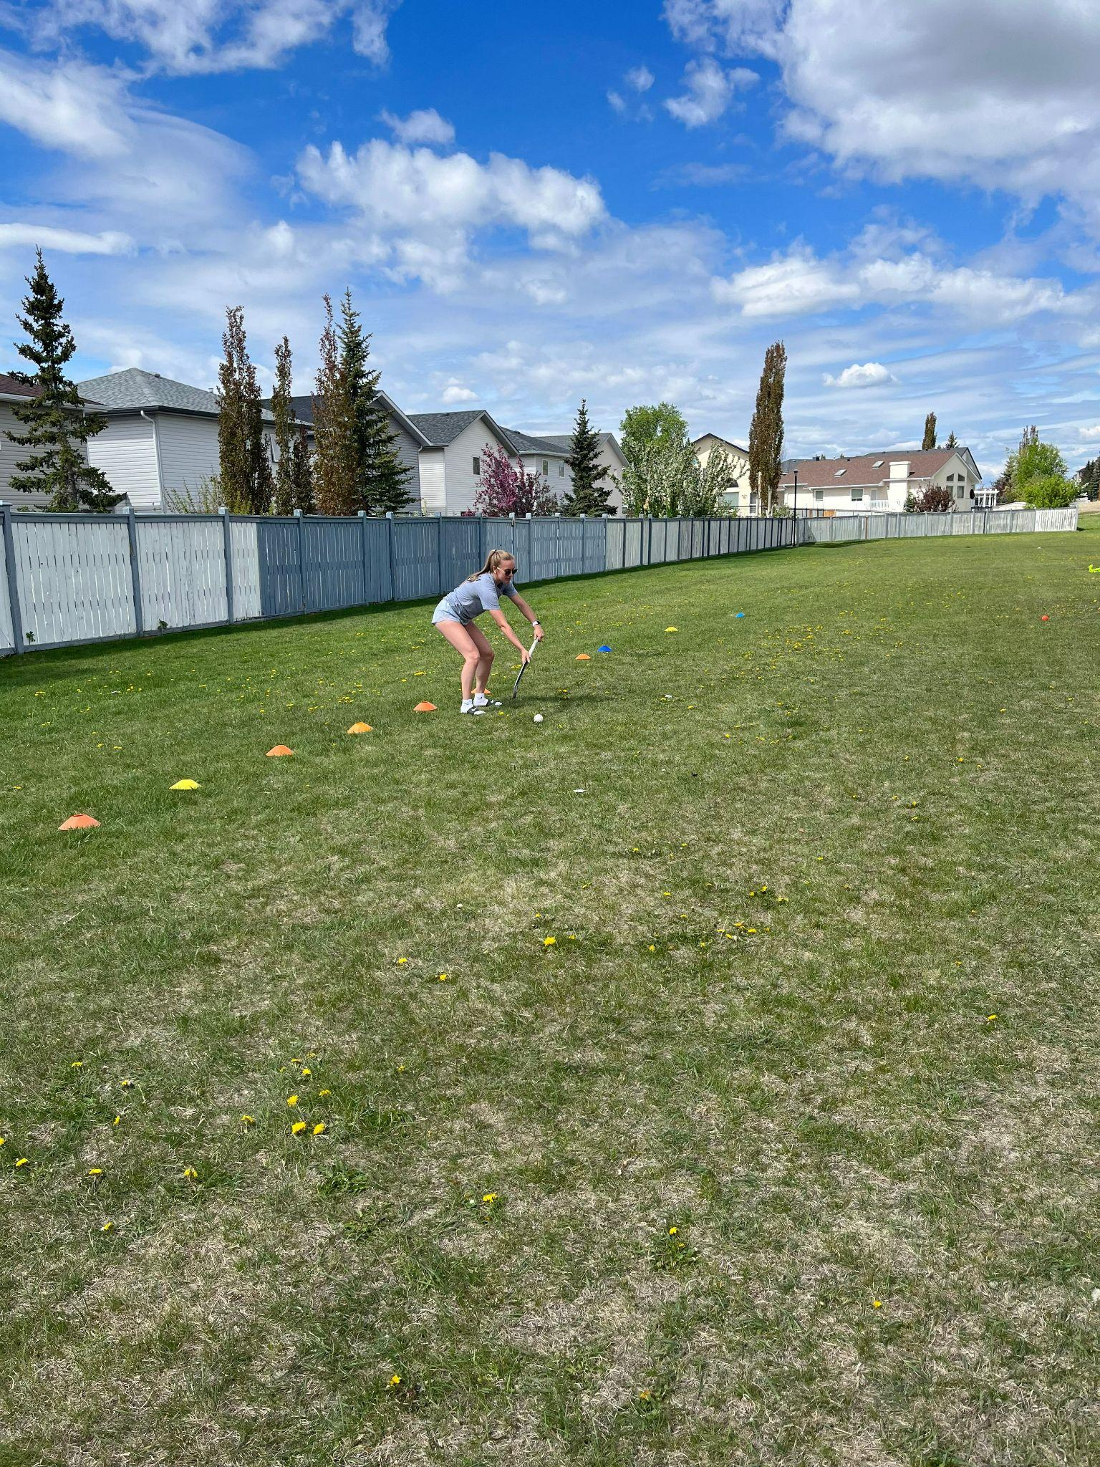
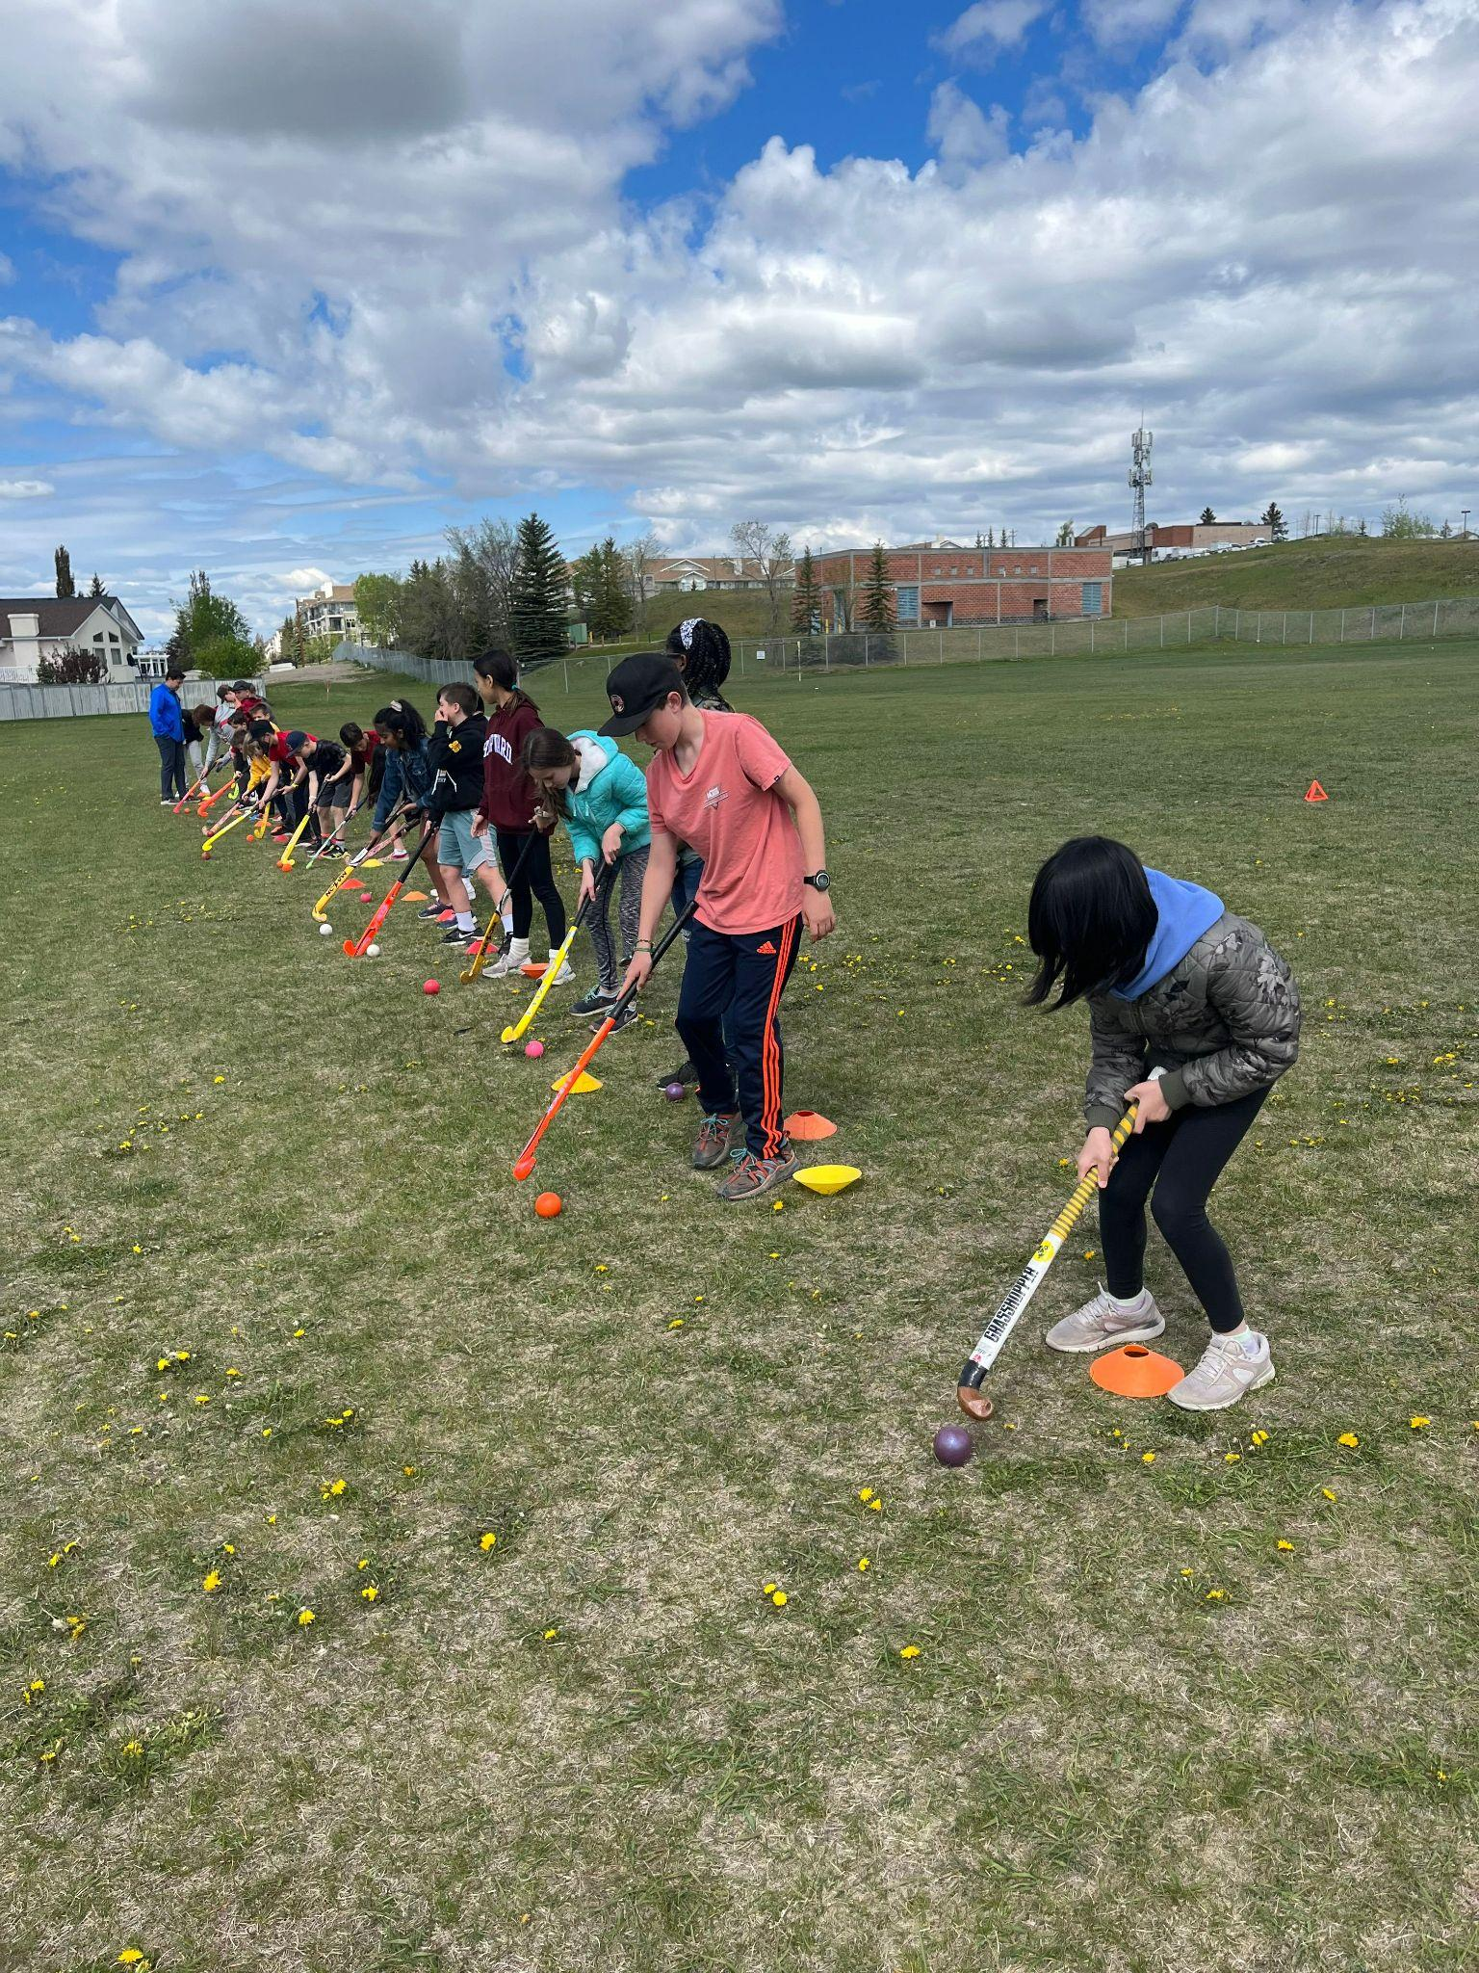
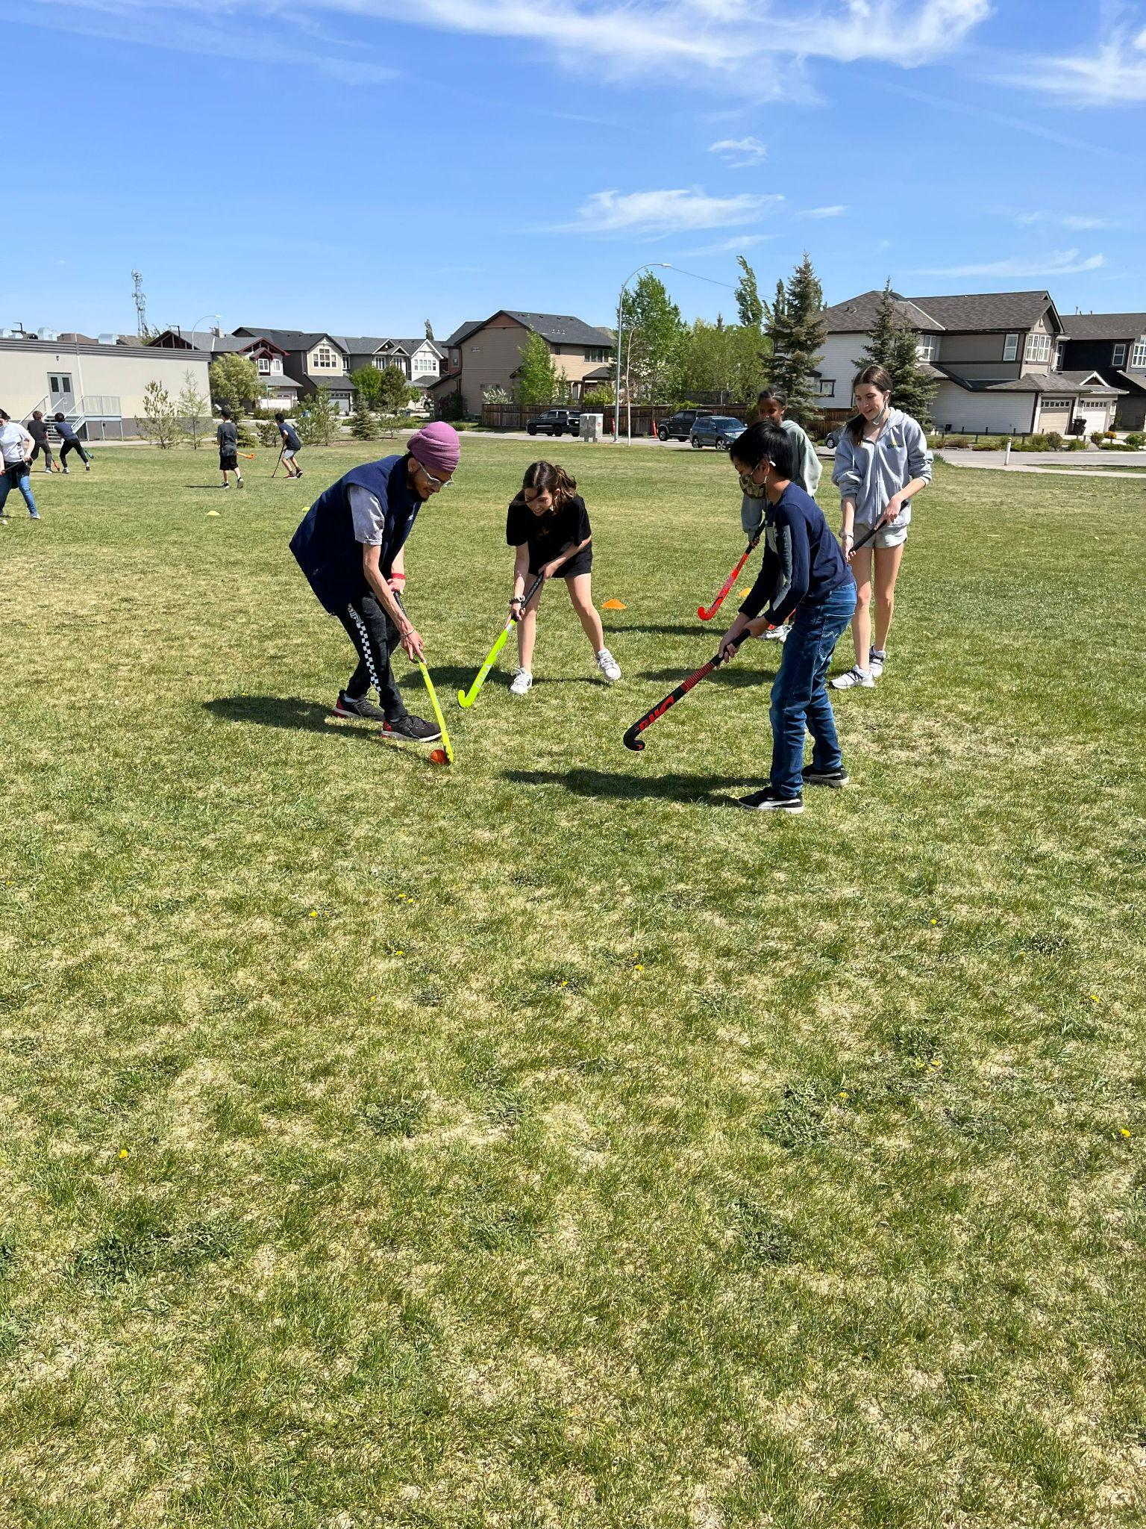
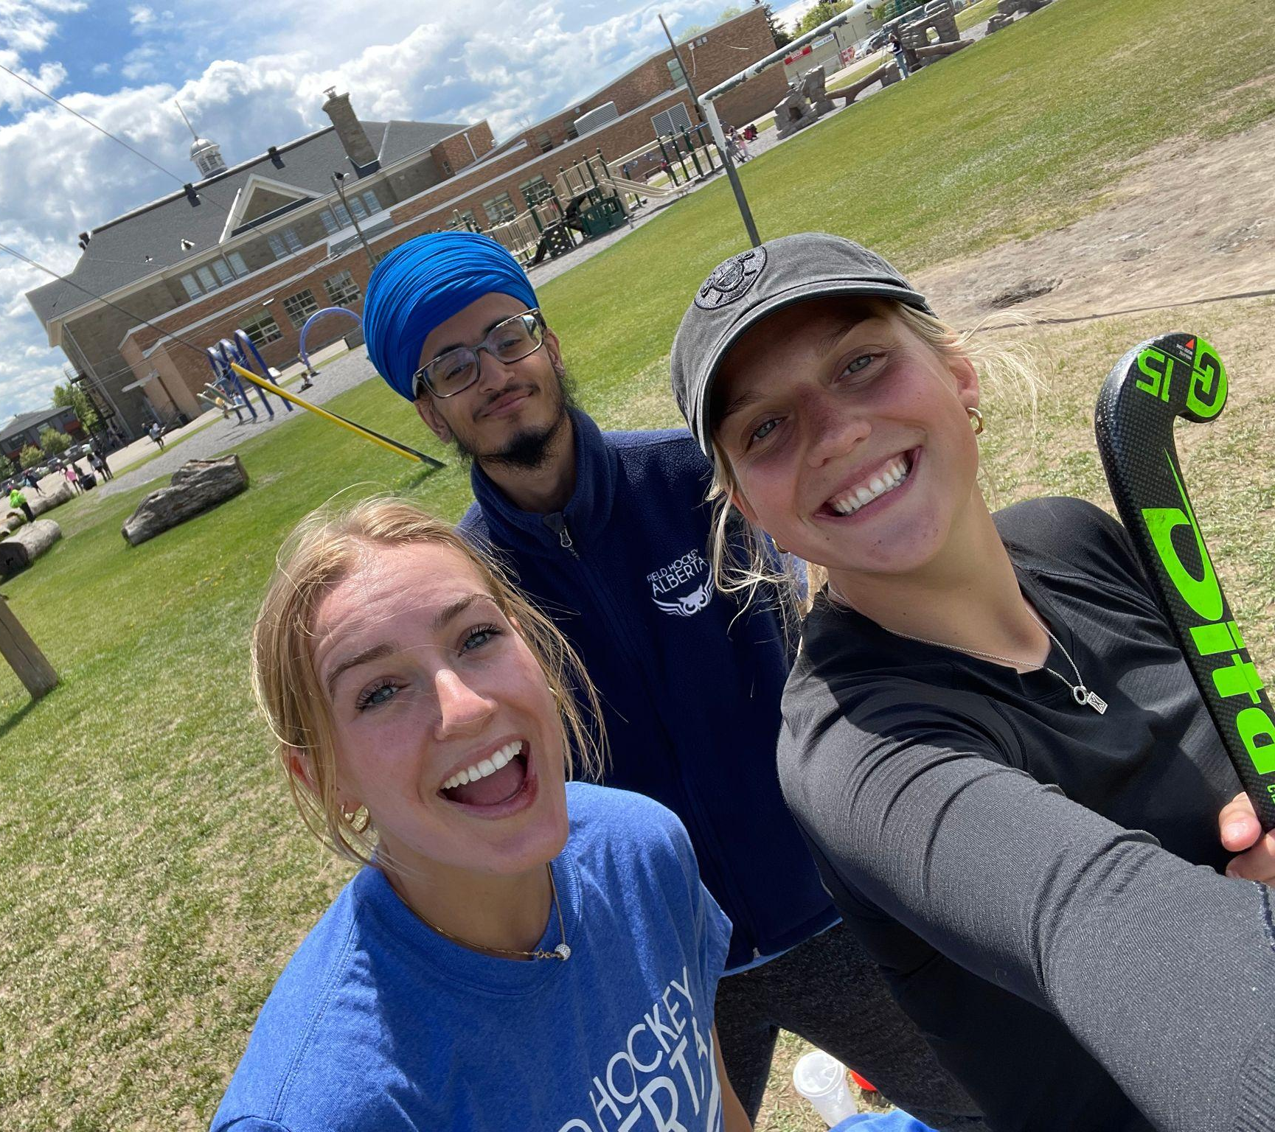
Schools 2022
8

Slide 12
Schools
Calgary Schools
School | Ages | Students | Coach/s
William Aberhart | Grade 10s | 180 | Roel
King George (Wellness Day/Program) | Grade 3-5 | 300 | Aidan/Gurminder
St Ambrose | Grades 4-9 | 330 | Aidan/Gurminder
St Gianna's | Grades 2-6 | 450 | Gurminder
Valley Creek School | Grades 4-7 | 525 | Aidan/Gurminder
 | Total | 1785 | Students
Edmonton Schools
 | Ages | Students
Pollard Meadow School | Grade 1-6 | 745
Menisa School | Grade 4-6 | 180
Ecole Frere | Grade 1-6 | 300
Coached by Sajan | Total | 1225
Happy that we got several schools onboard for spring programs, sent out survey and all schools were very impressed with our amazing coaches. Several schools are looking to rebook for spring and 3 schools have already reached out for Fall programming.

Slide 13
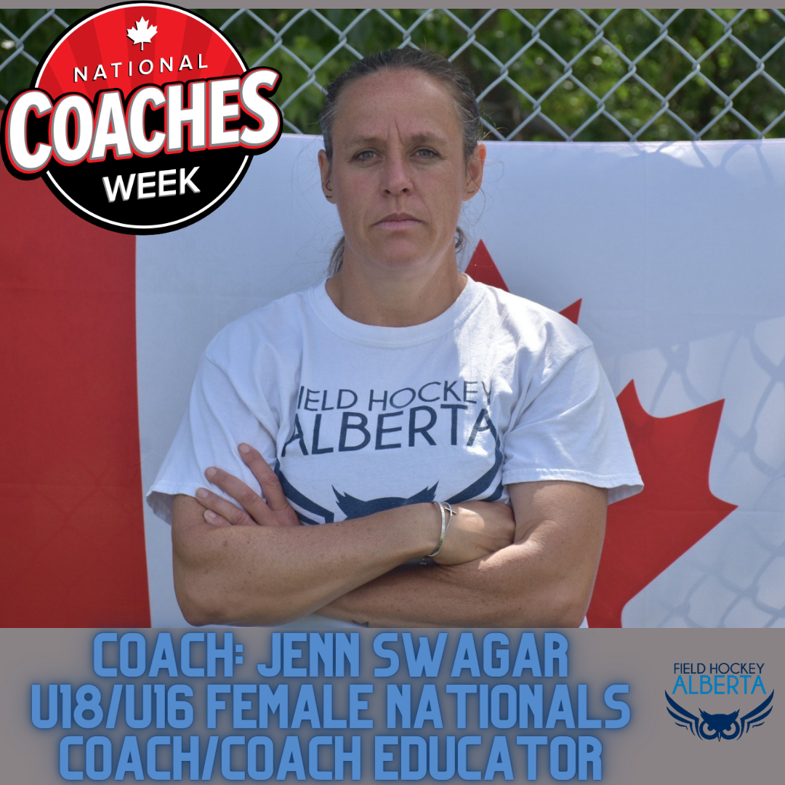
Coaching
Hosted 8 Coaches Corner from March to June
Hosted 2 (2 weekend) NCCP Coaching Certifications
Hired a Coach Educator

Slide 14
Events

Slide 15
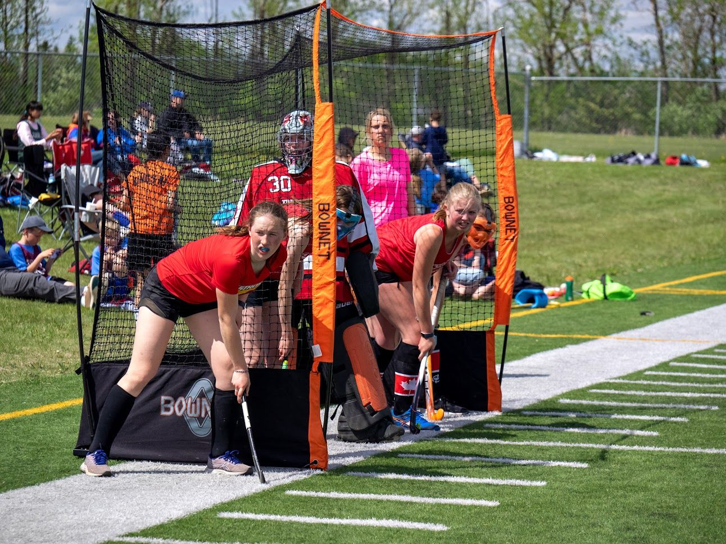
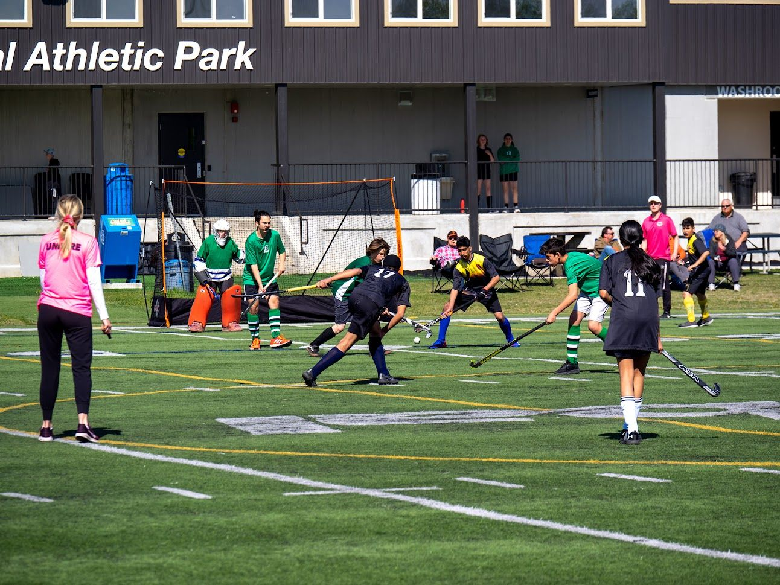
CJFH - 3 Festivals – Lacombe & Father's Day
Lacombe Festival - May 29th
Teams: Over 175 Athletes
Host: Ryan Mcconkey (Red Deer summer student)
Highlights:
Food truck popular,
Hired a face painter that was enjoyed by funstix athletes
Introduced the lolly pull. very popular.
athletes from calgary and red deer
Great facility as always
Father's Day Festival - June 18th
Teams: Almost 200 participants from Calgary
Host: Aidan Patterson (Calgary Summer student)
Highlights:
A handful of athletes from Red Deer joined the Astros & Saracens teams. We even had a Red Deer Umpire participate!
U o f C turf and end zone were in full swing the whole day.
Lightning stopped us in middle of day for an hour but that didn’t stop the funstix who returned and had a massive water balloon fight!
We awarded most sportsmanlike teams as selected by umpires.
Father’s day bbq included hotdogs, snacks and drinks. Lolly pull was back!

Slide 16
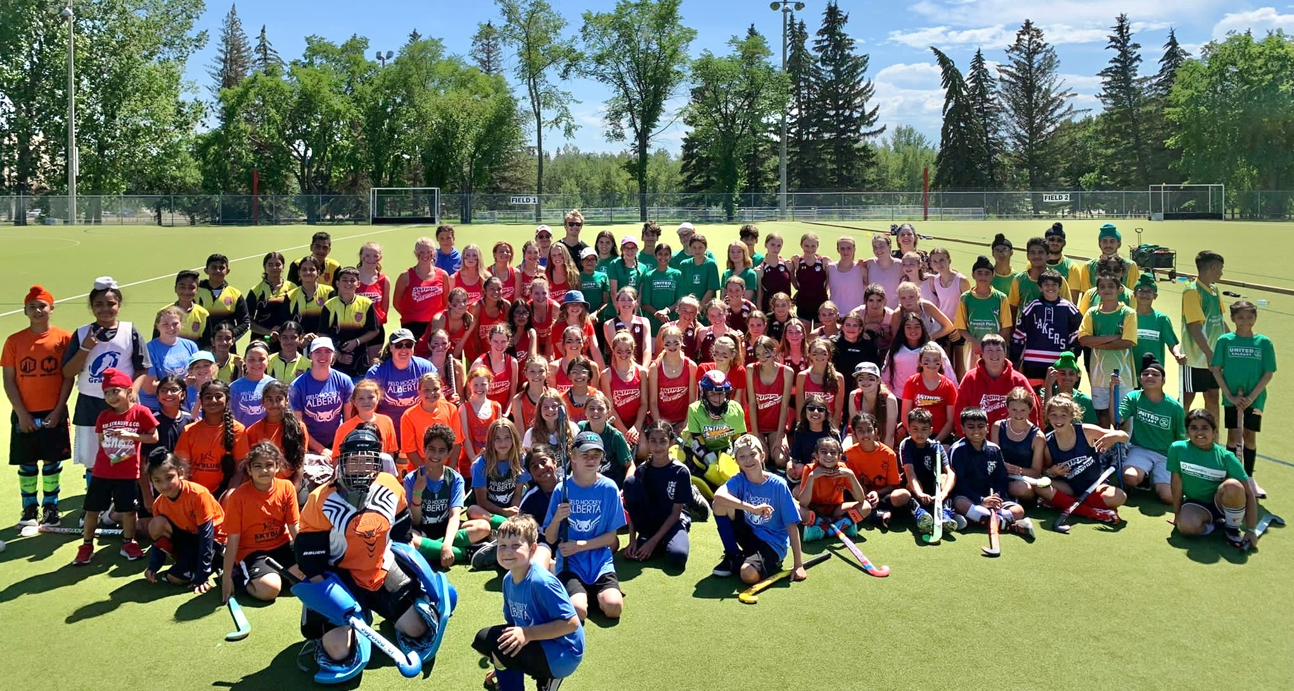
Calgary Year End Festival
Calgary Festival - July 23rd
Teams: over 125 athletes in attendance
Host: Gurminder Dhillon
Highlights:
Brought in a bouncer which was very popular
We held a shootout for u12-u16. with stick prizes donated by aa sports and fha. very exciting
Tooney stick, lolly pull and door prizes including Indian maharaja basket donation.
We again awarded most sportsmanlike team
Food truck invited.
secured water donations from alberta springs.
Used turf and rugby field
A HUGE thanks to Shelley Anderson, Leagues Coordinator, who supported all our summer students with their hosting responsibilities!

Slide 17
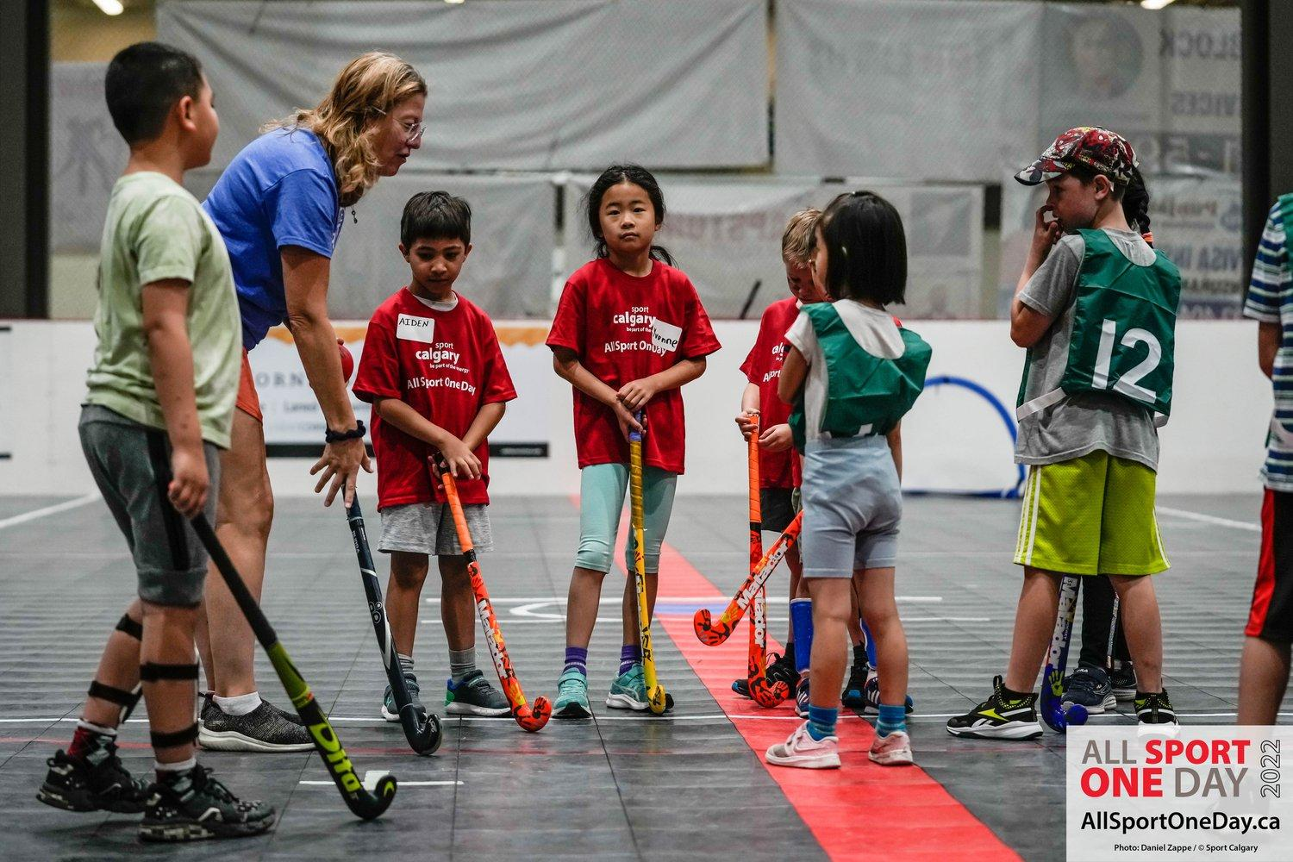
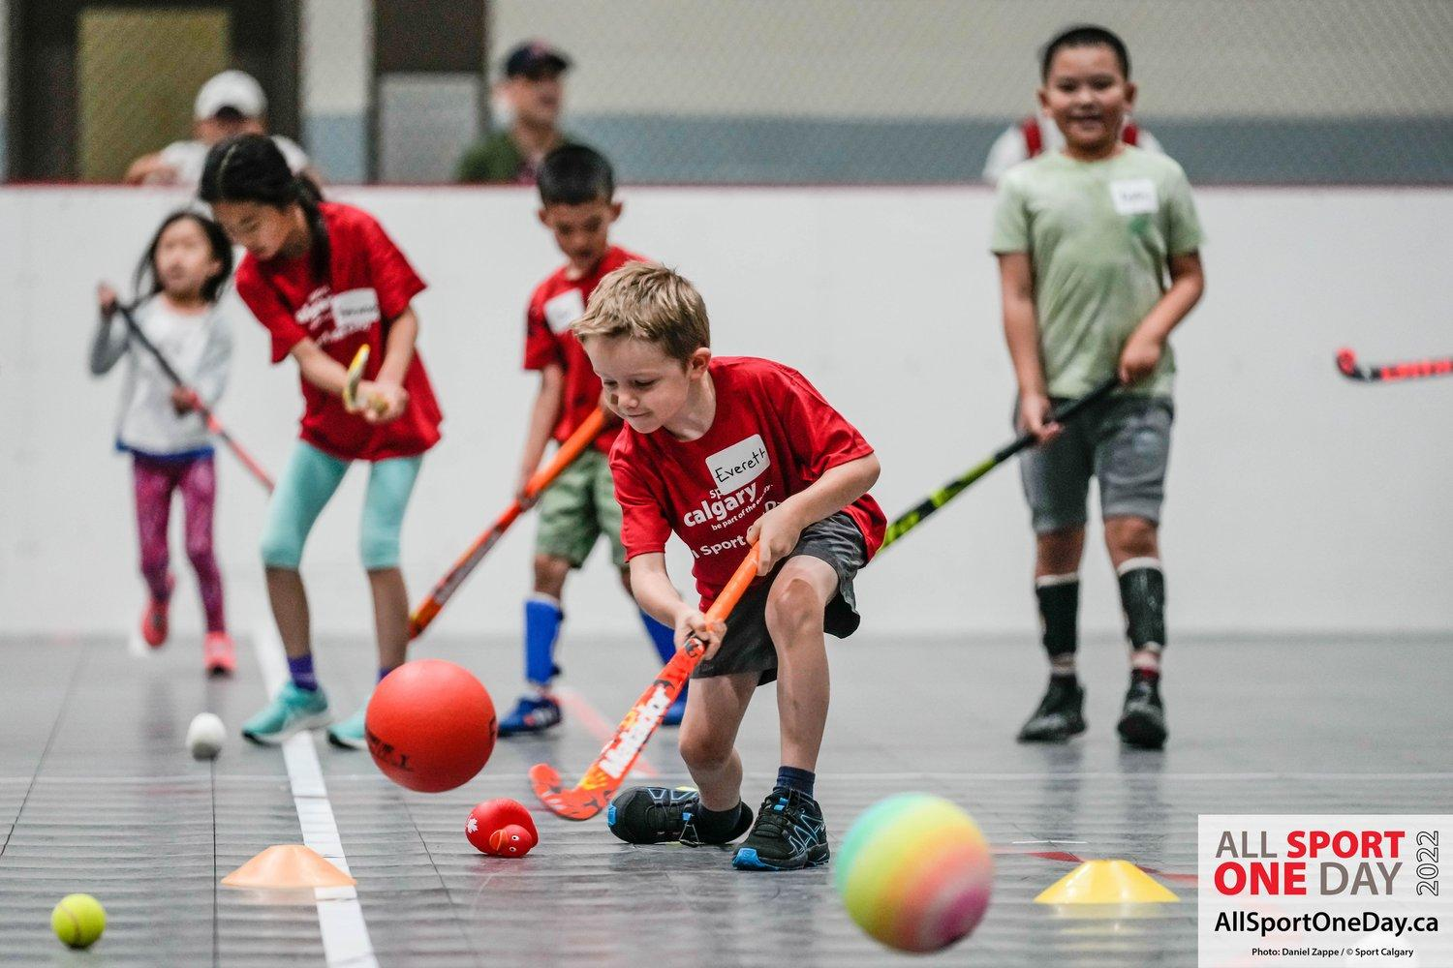
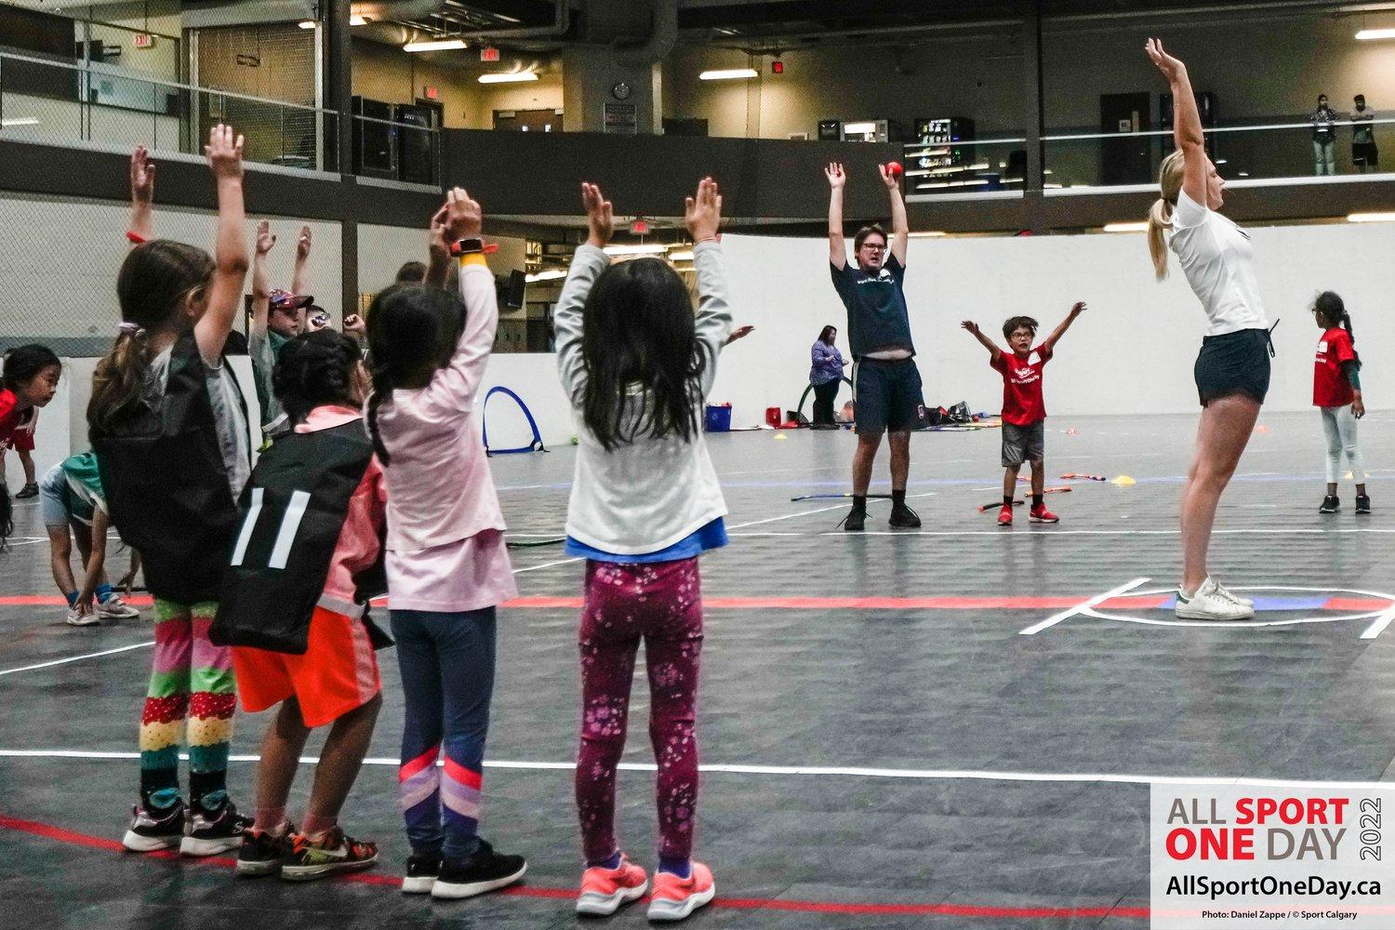
Try it Frees
Date | Numbers | Age of kids
Feb 26th | 33 | 8-15
 | 18 | 16+
April 23rd | 13 | 6-16
 | 3 | Adults
Jun 19th | 19 | 6-15
Aug 21st | 28 | 6-9
 | 16 | 10-15
Total | 130 | Participants

Slide 18
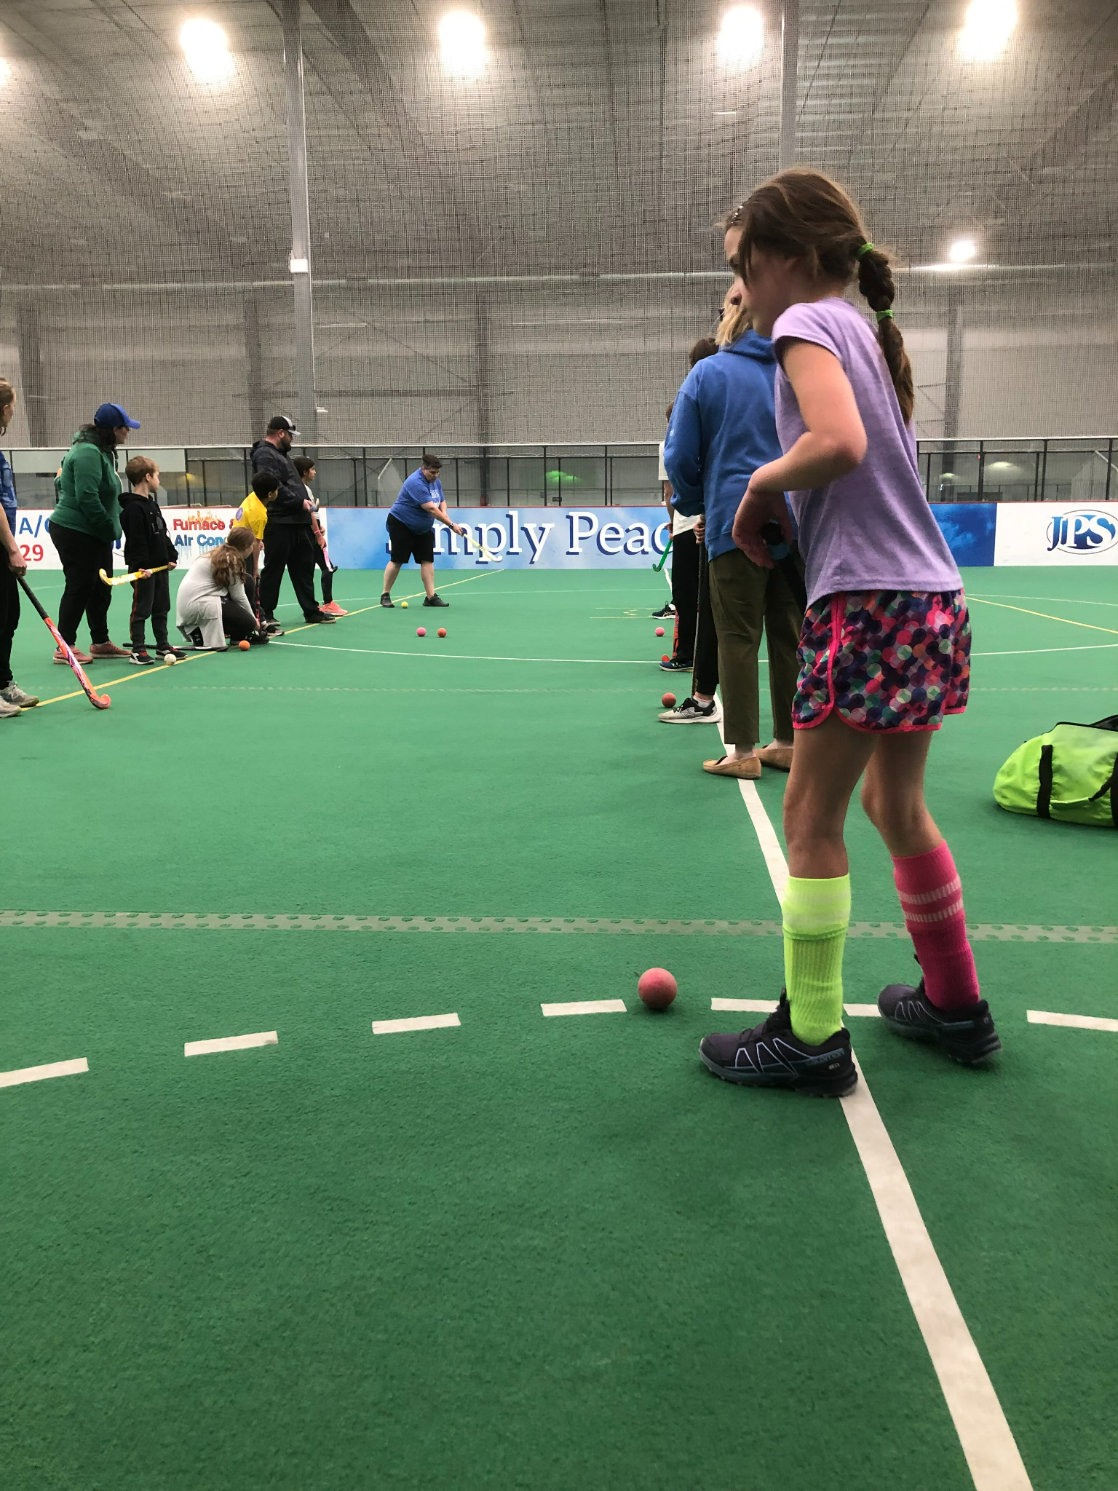
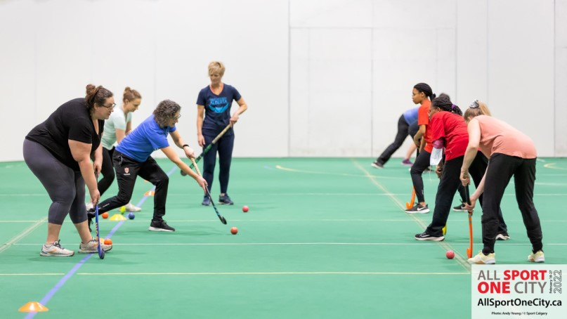
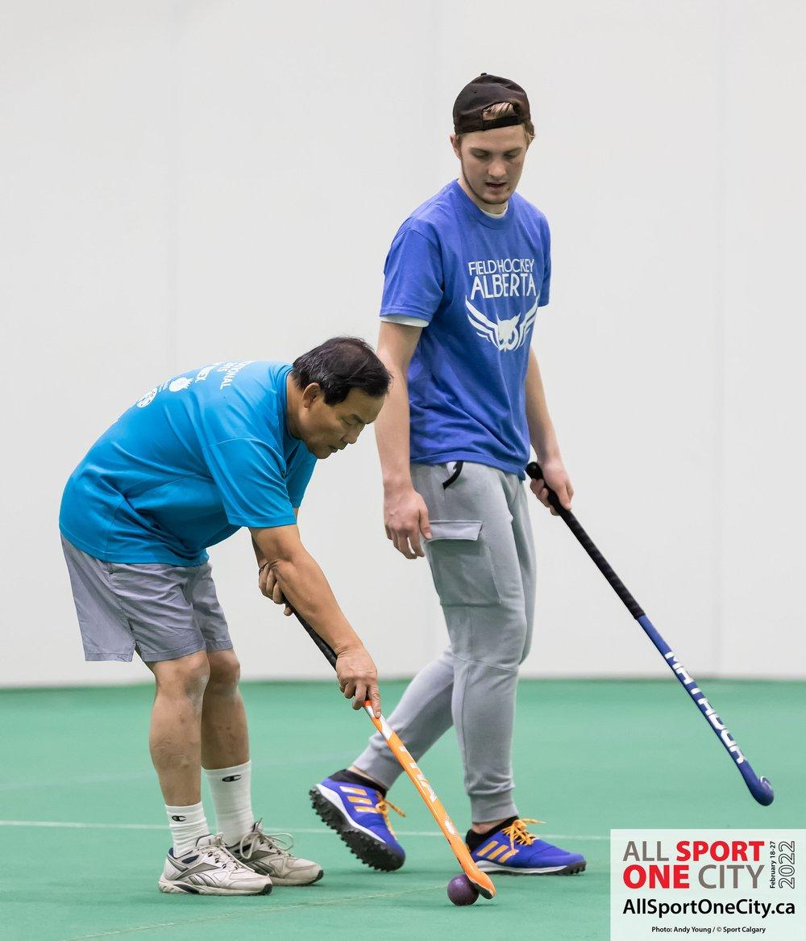
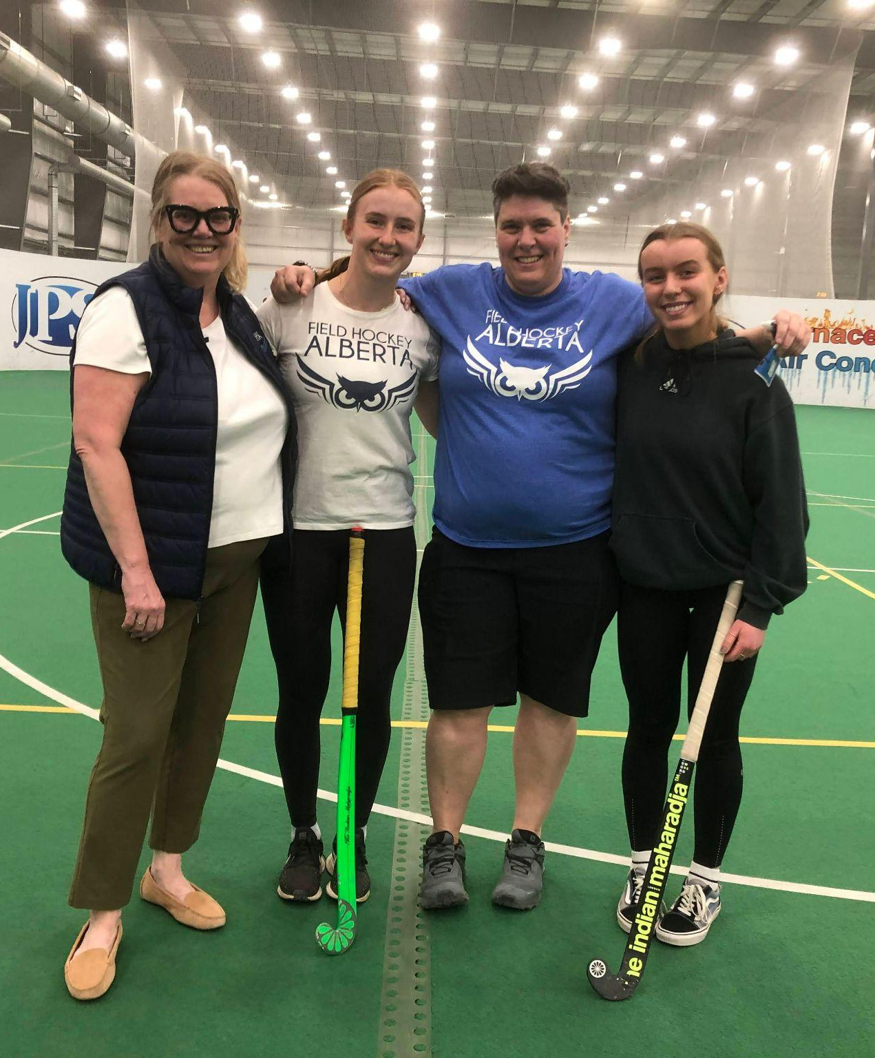
Try it Frees

Slide 19
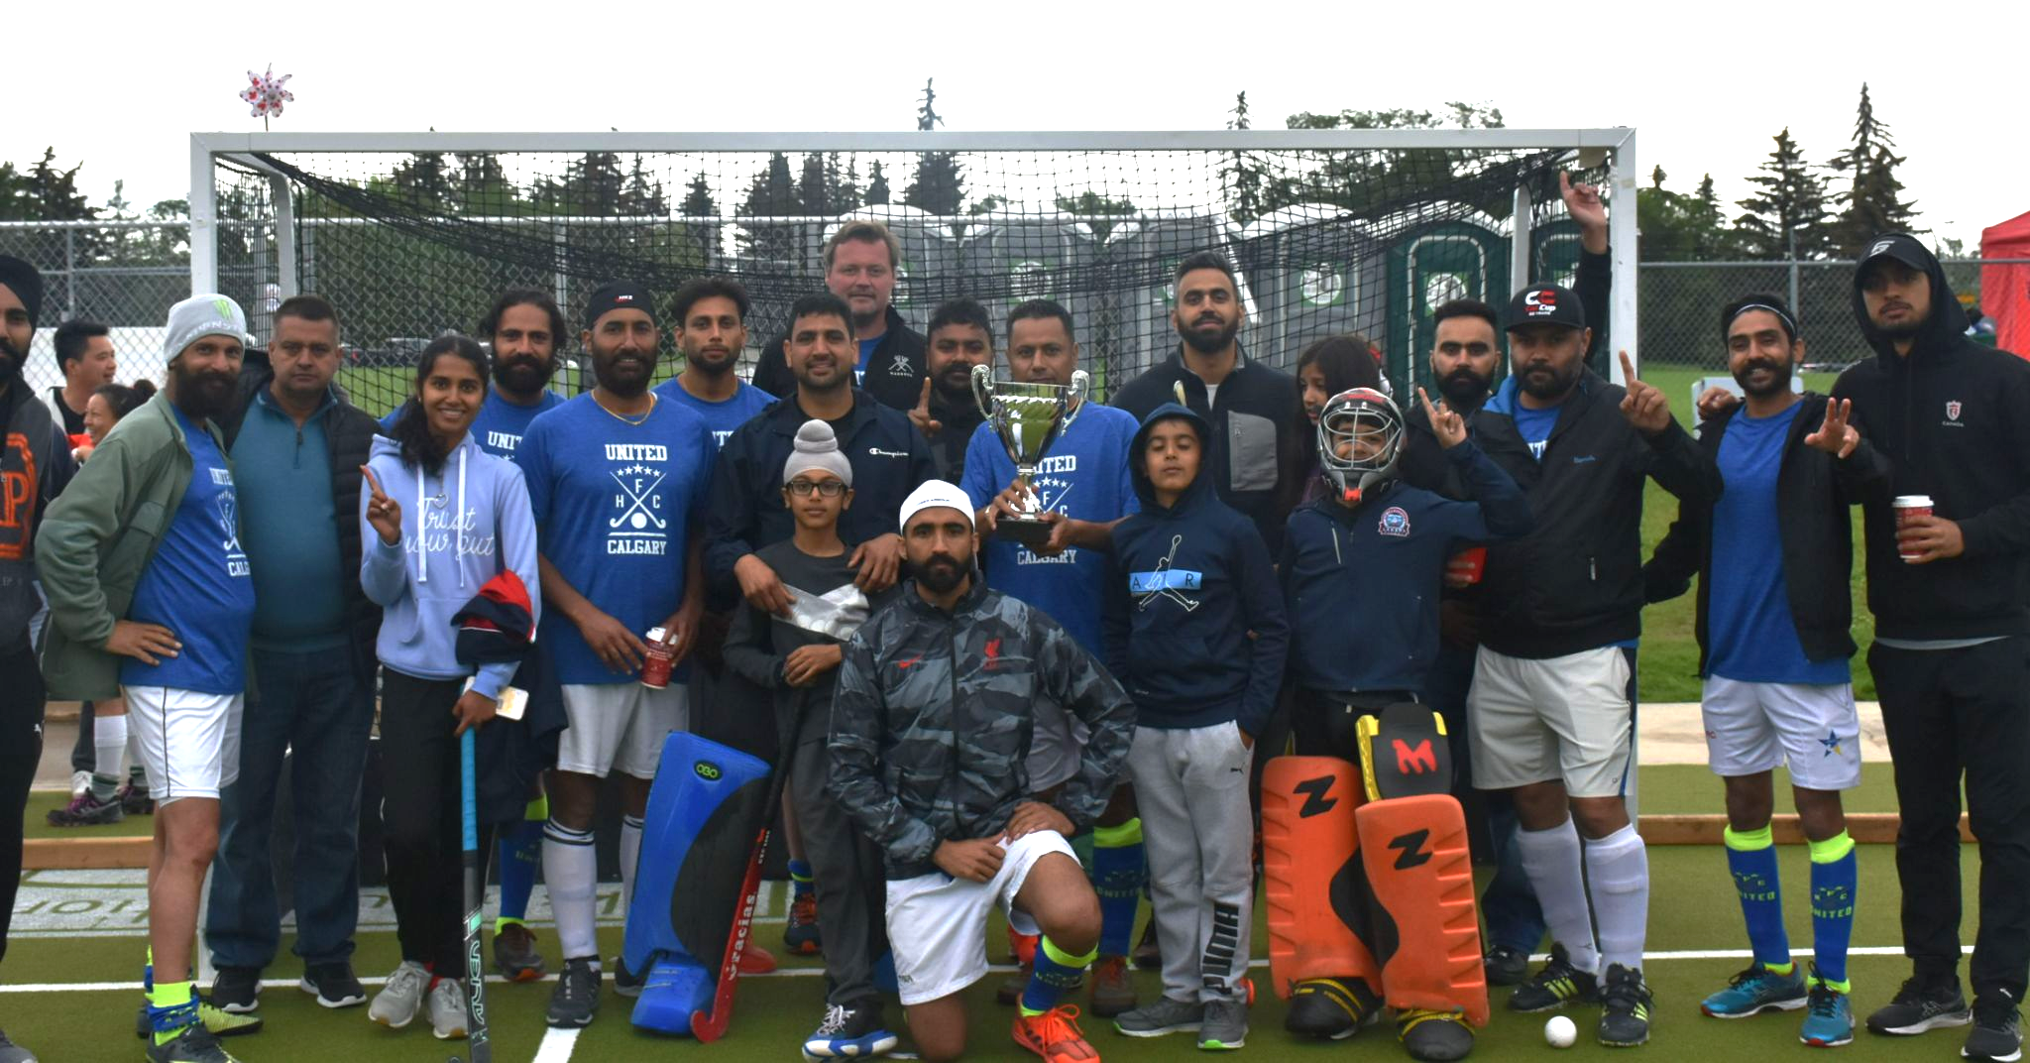
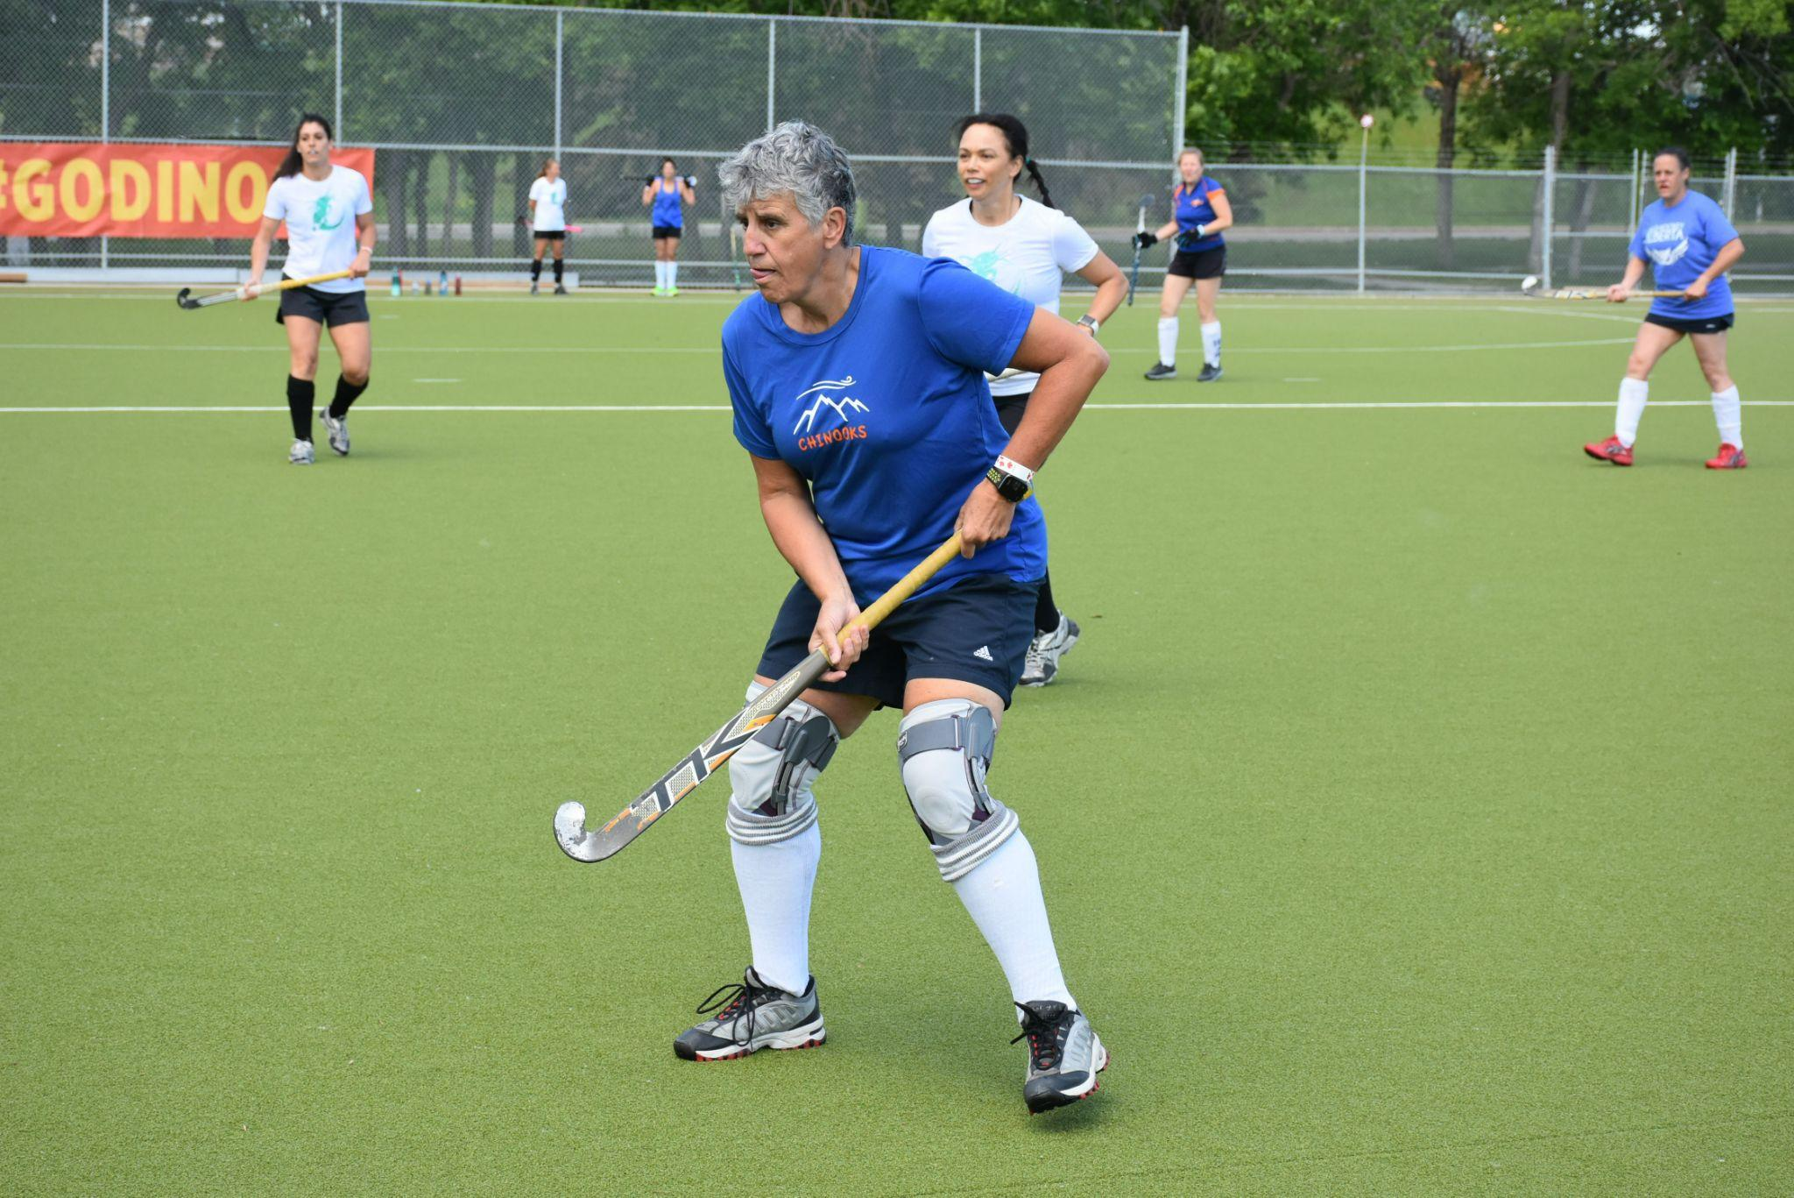
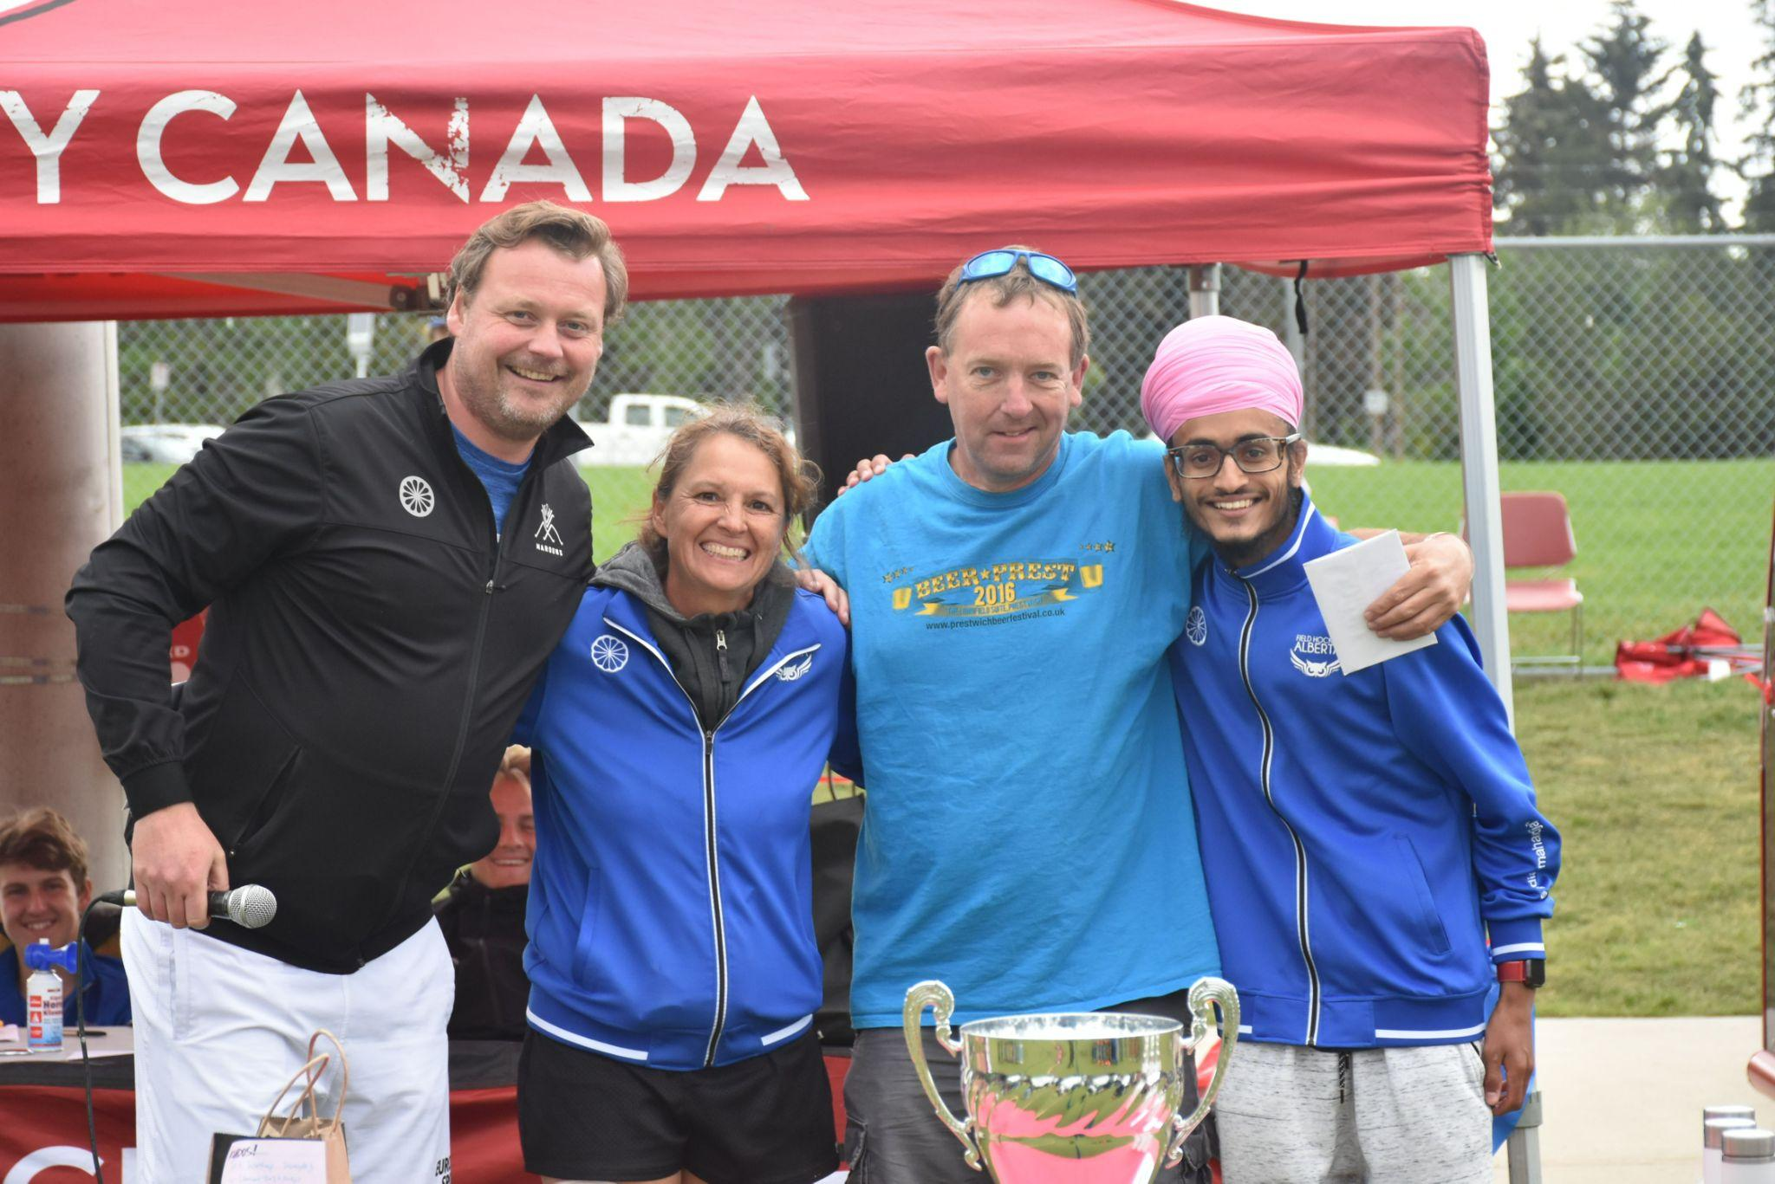
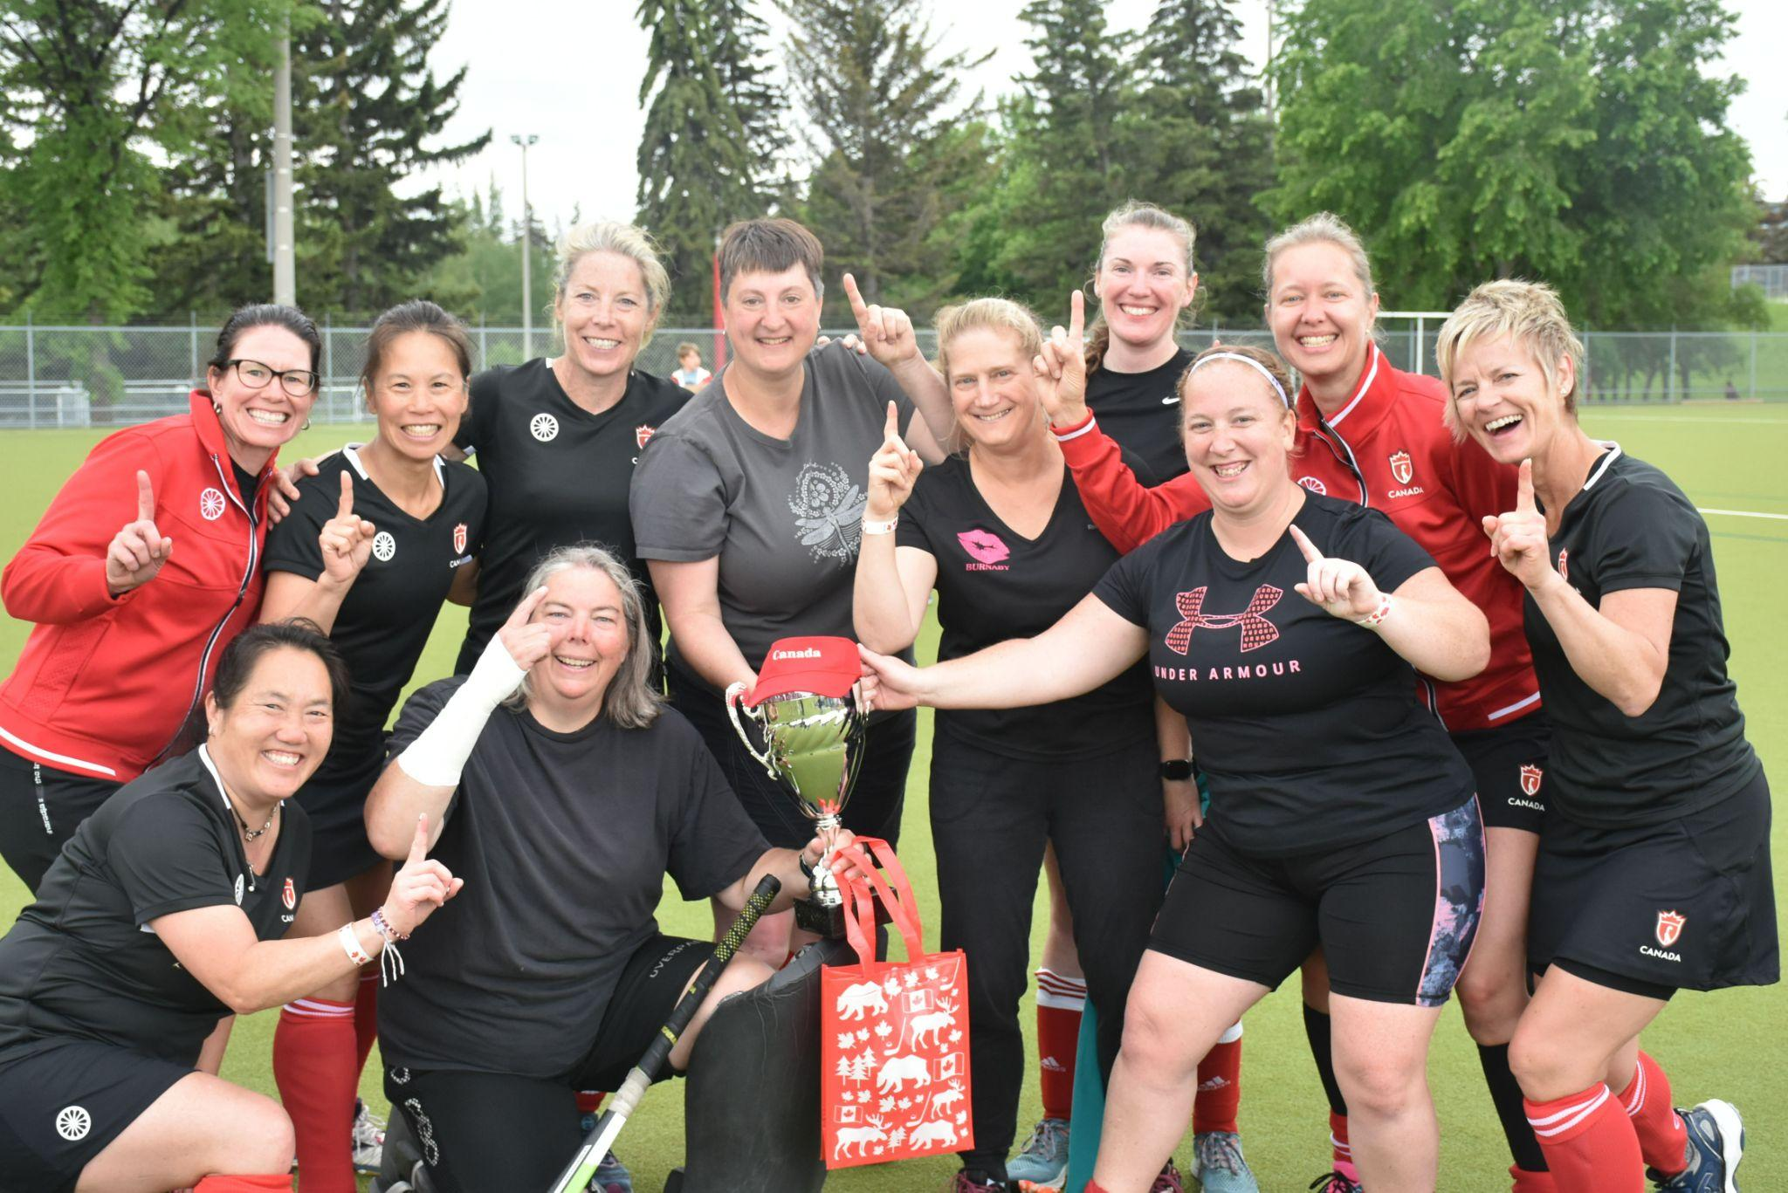
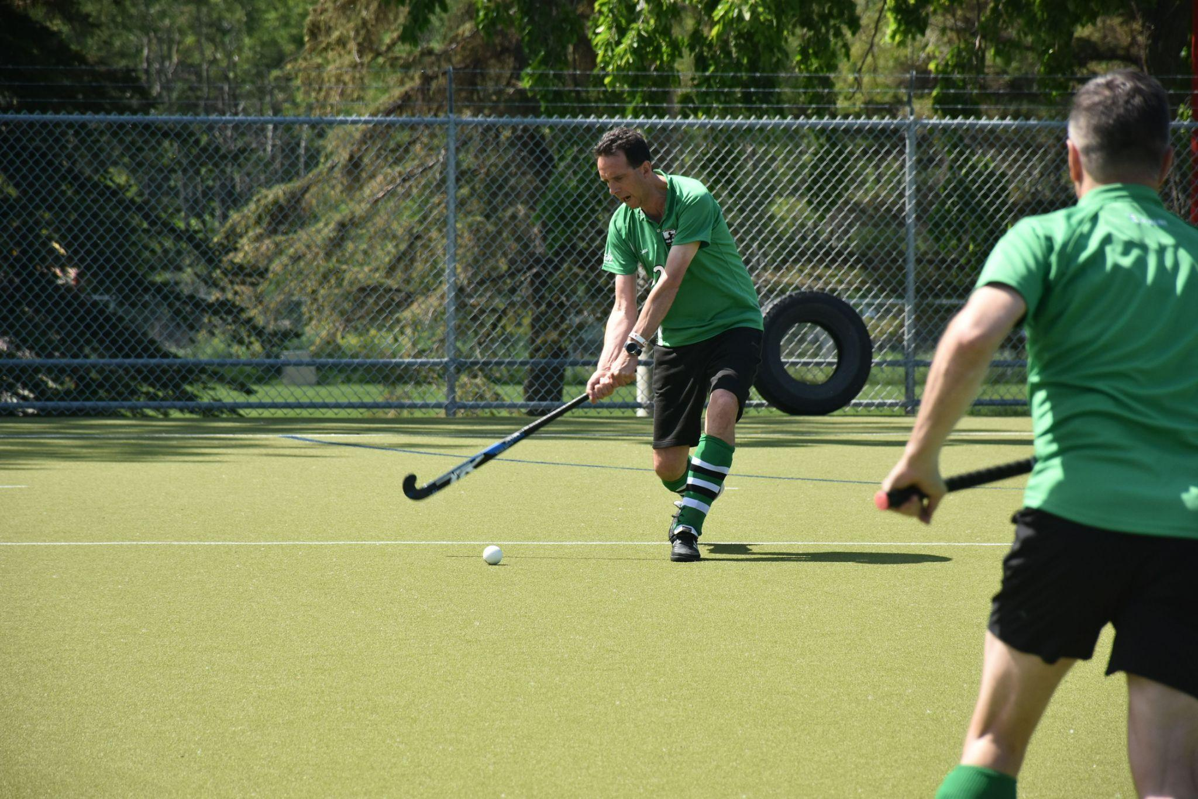
Canada Day Masters Festival - July 1st - 3rd
Male Division - #1 United
95 Players attended
$4,000 in Sponsorship
2 Social events
A DJ & Athletic therapist
Women Division - #1 Masters of Disasters
Huge THANK YOU to
Lori Gaffney (the organizer)
Paul Jacobs (the beer/food supplier)
And all the volunteers who supported this 3 day tournament

Slide 20
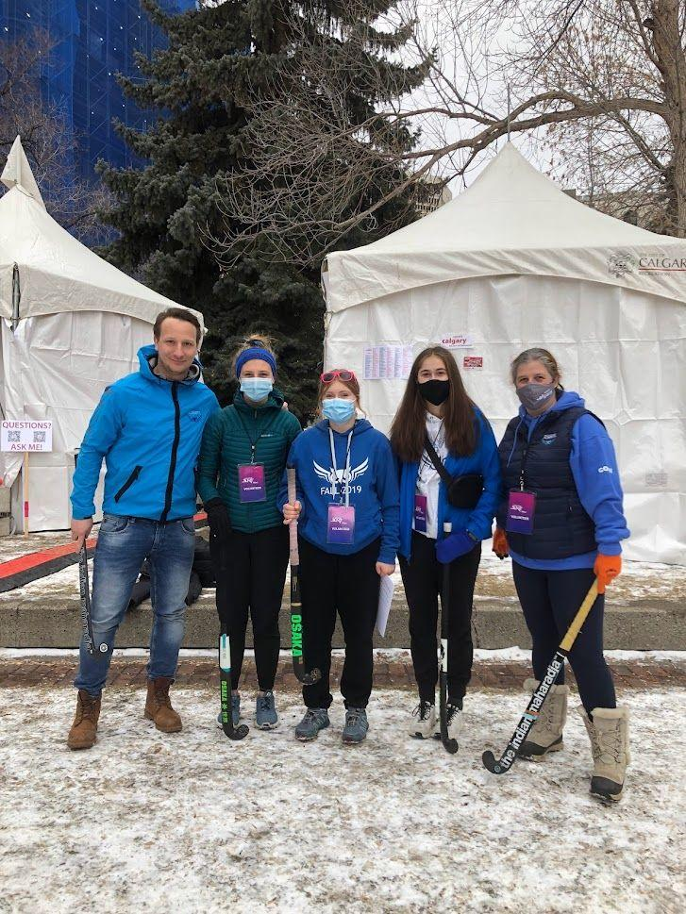
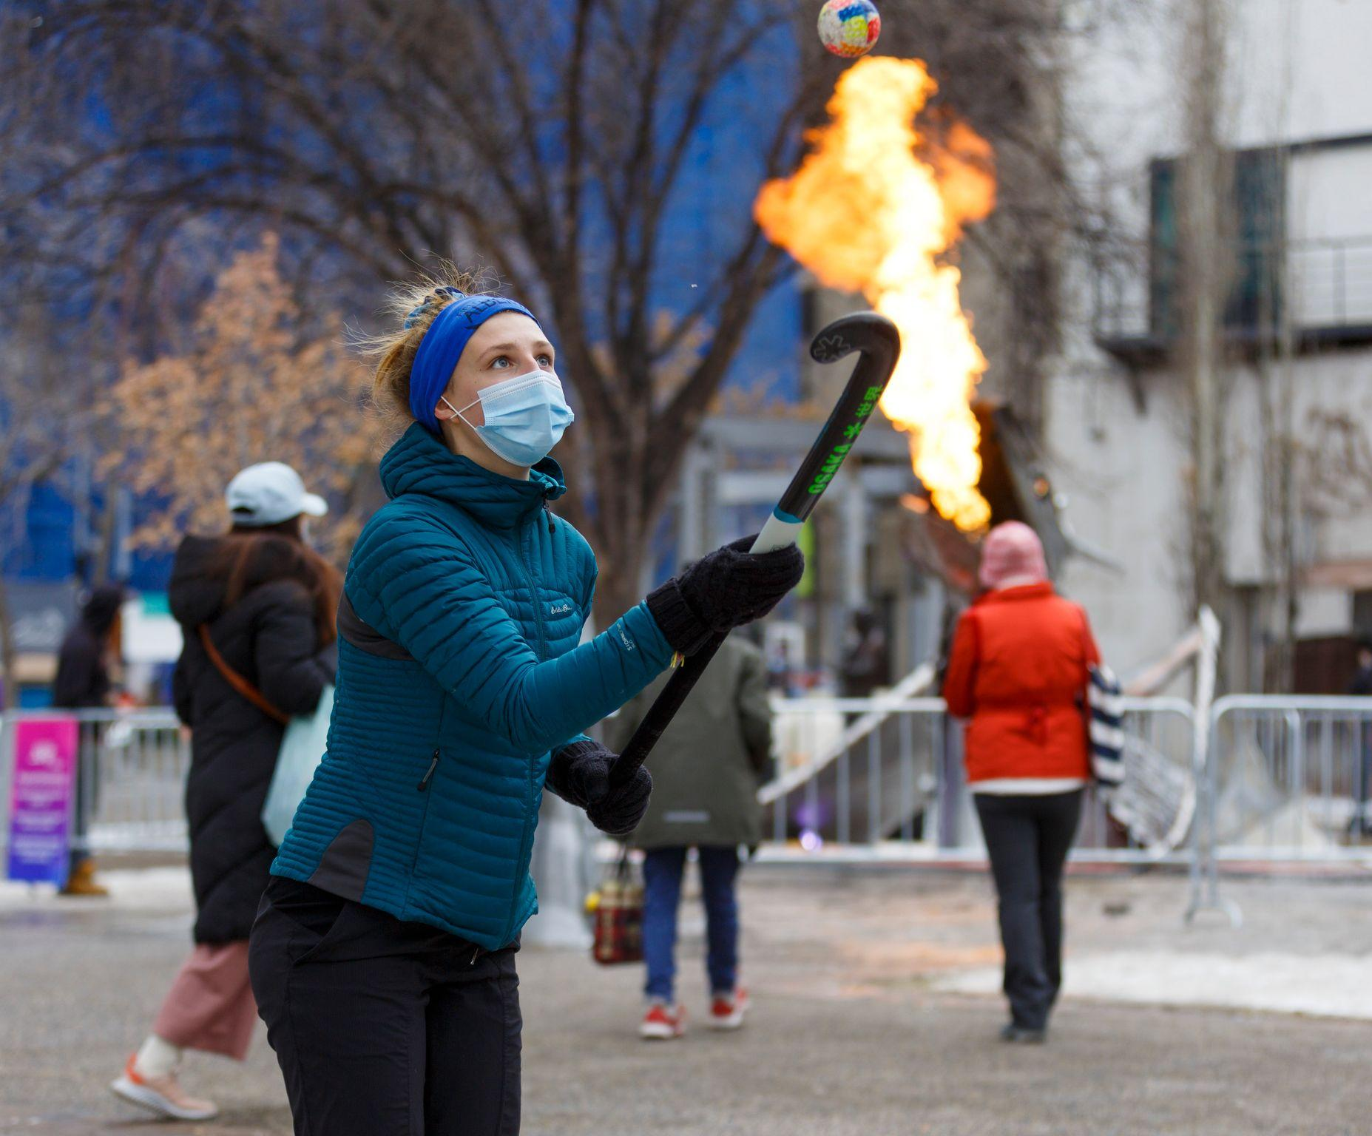
Chinook Blast

Slide 21
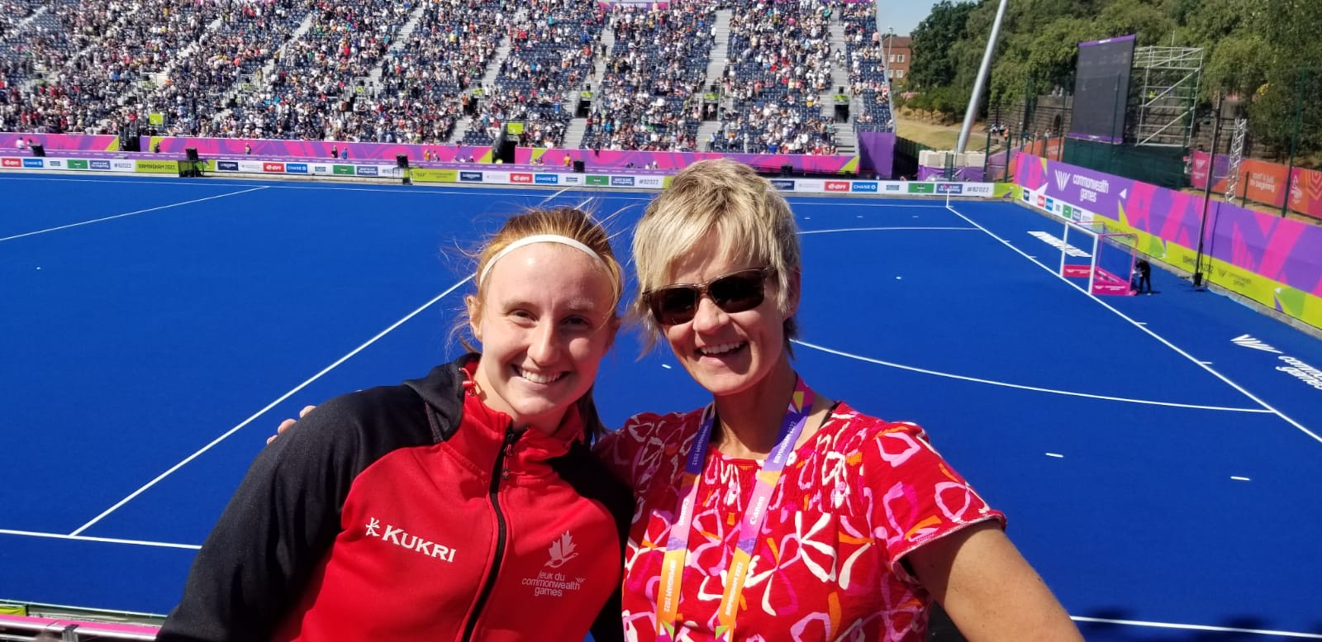
Alberta Athlete’s Abroad
FIH Women's Junor World Cup
Mel Scholz & Tayler Guy
South Africa
April 2022
Commonwealth Game 2022
July 28th – Aug 8th
Mel Scholz – Women's National Team
Wendy Stewart – Umpiring!
Cam AM Indoor Hockey
Grant Simpson
March 19th & 20th
Pennsylvania

Slide 22
2022 - 2023
FHA Future
#1 Priority: Membership, Membership, Memberships (Grow our Numbers) – We need the numbers back up to support everything we do!
#2 Priority: Regional Development: Get Red Deer's numbers back up, Get Edmonton back on board, Start programs in Lethbridge and Zone 5 find a coach & start running programs
#3 Priority: Coaching/Umpiring Development – We made some great steps with coaching, but still need to focus on development. Umpiring we need to it back up (having no rep on the board has been very detrimental).

Slide 23
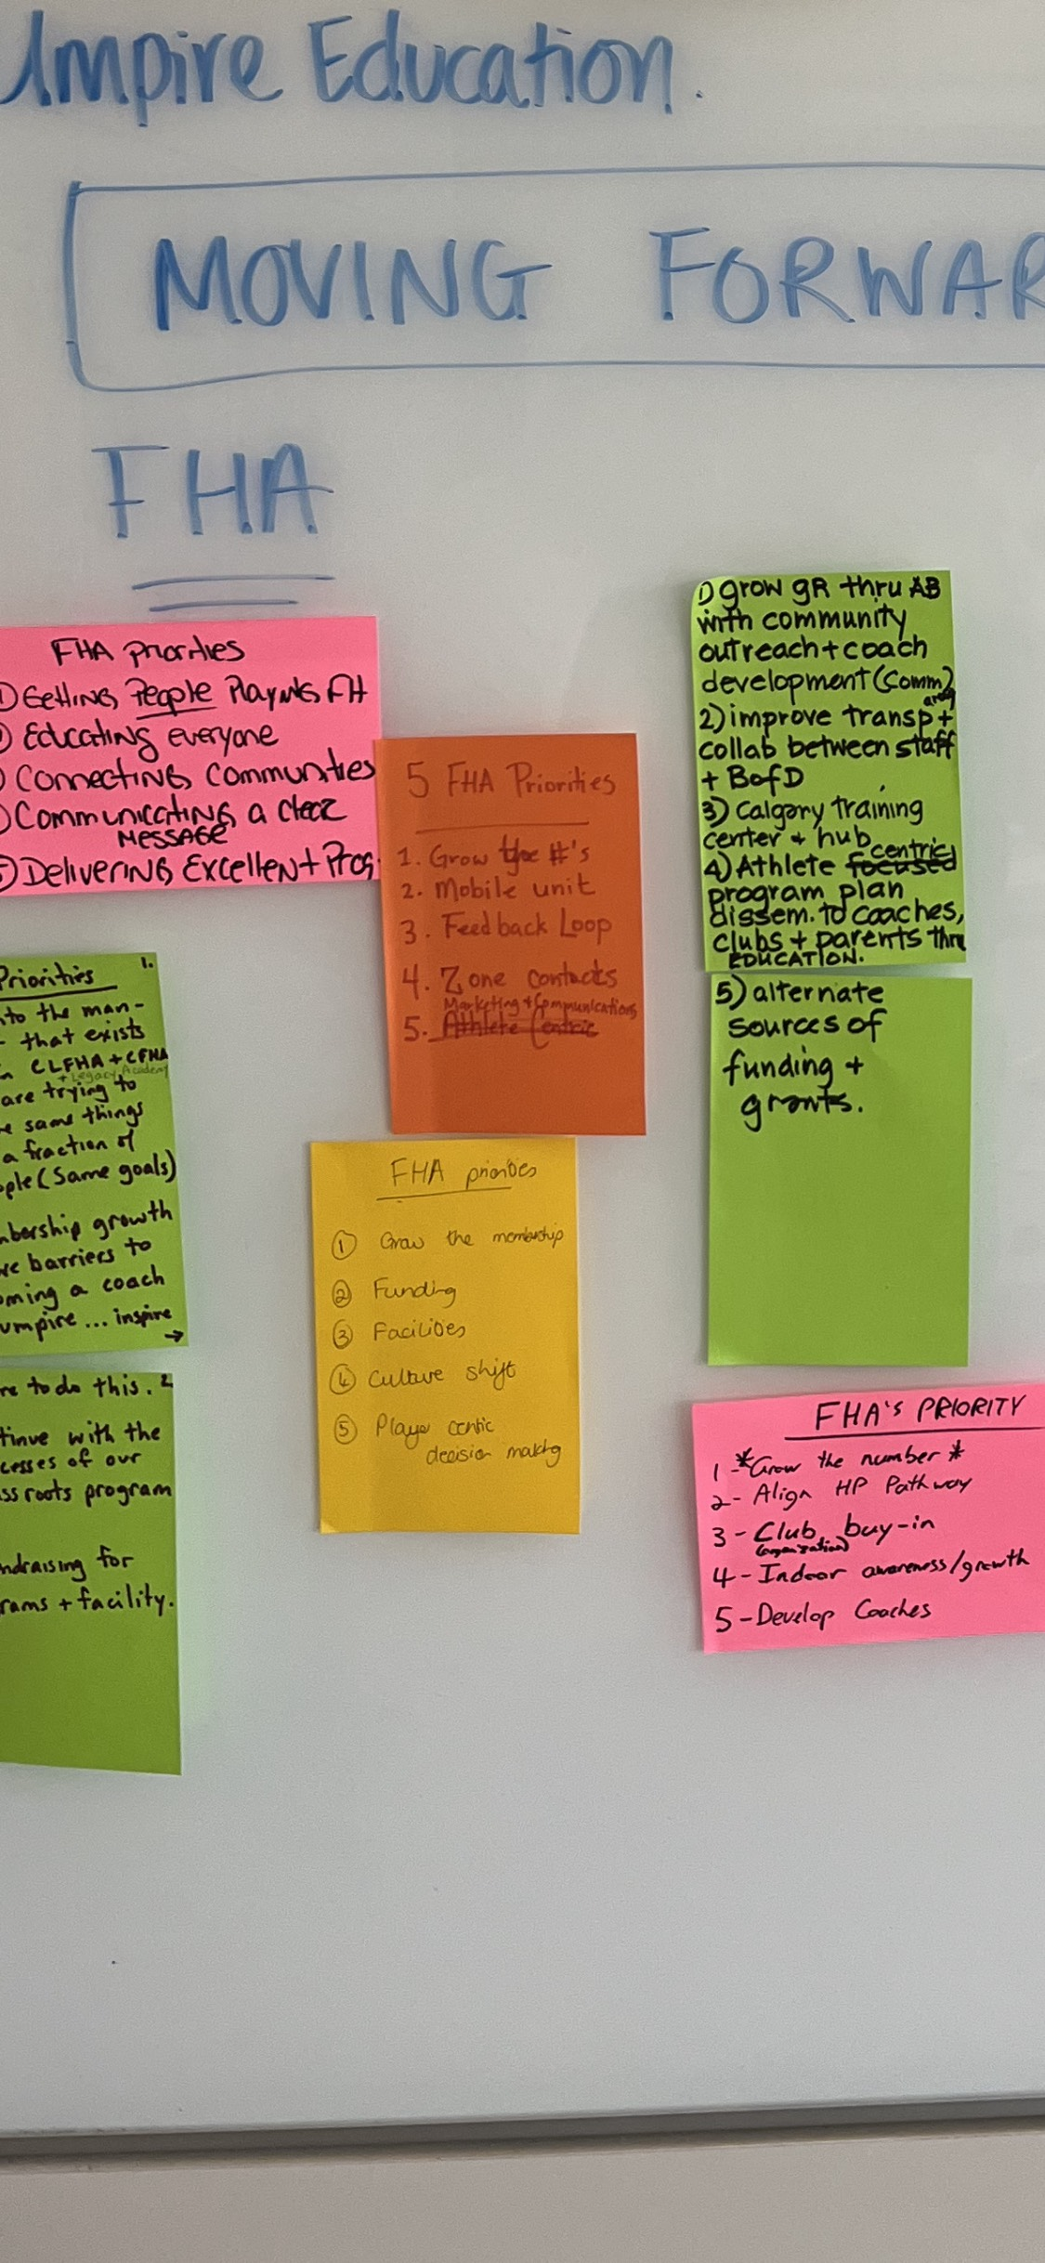
2022 - 2023
FHA Future
Had a great session on June 9th, 2022 with Jennie Gilbert to start taking about where FHA needs to go!
All staff attended and out of it we thought our top priorities were these:
* Grow the numbers (membership)
* Funding
* Facilities
* Culture shifts
* Player centric decision making
Hoping once we realign our staff again to have another one!

