Slide 1
AGM - June 18th, 2024 Forest Legion

Slide 2
2024 AGM Agenda

Slide 3
Last Years AGM Minutes

Slide 4
Mission Statement
The purpose of the association is to provide wholesome recreation through participation in the ringette program.
Our main interest shall always be in the player and not his/her ability.
Sportsmanship, fair play, citizenship, friendly competition, enjoyment and full participation for all team members will be our guideposts.
All decisions of the association shall be tempered with reason and will always consider the feelings of an individual.
It is our belief that this atmosphere will provide the greatest enjoyment, sense of achievement and wholesome experience for all concerned.
Forest Ringette Association

Slide 5
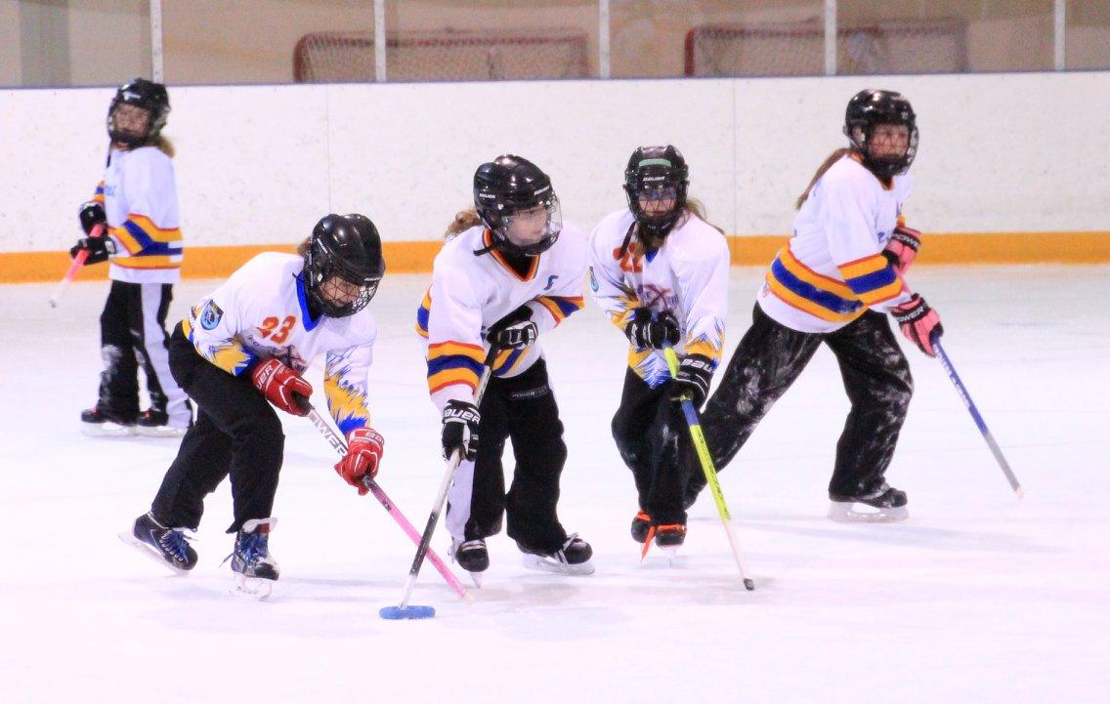
President’s Address
Rachel Orvis

Slide 6
Treasurers Report
This Photo by Unknown Author is licensed under CC BY-SA
Jenn Urbanski

Slide 7
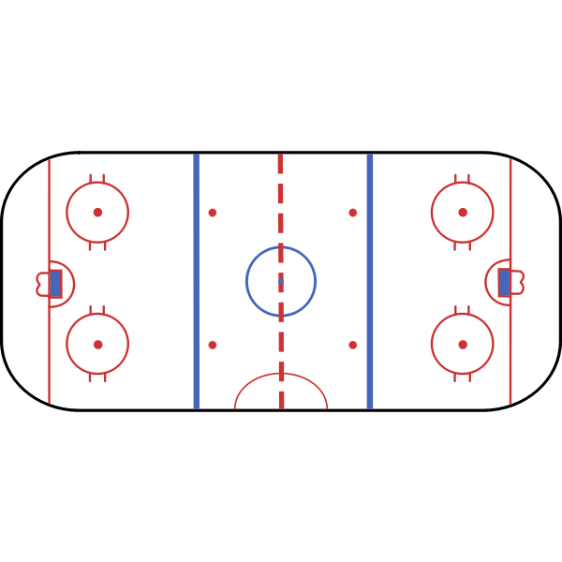
ICE SCHEDULE
Requests placed to the SHORES to be much the same as last year. Contracts signed with the Shores
Shores Ice pad
Mon evenings 7:15 -10:15 pm
Wed evenings 4:00 – 8:00 pm
Sat Day 8:00 am – 3:00 pm
Sun morning 8:00 am - 9:00 am
Legacy Ice Pad
Sat evenings 6:00 – 9:00 pm
Sunday Day 12:00 – 5:00 pm

Slide 8
By – Laws and ONCA Agreement
Drafting and review of current bylaws
Drafting and filing articles of amendment
Securing a corporate key
Update on Implementation of Review of Bylaws and ONCA agreements for Best Practices in Sport Governance

Slide 9
FRA Executive Board Elections
Rachel Orvis

Slide 10
Vacant Board Positions
Secretary
Referee Coordinator
(1 year)
Registrar
Vice-President
Volunteer Director
Tournaments Director 2
Coaching Director
Fundraising and Events Director

Slide 11
FRA
Coach applications and selections
Registration continues
FRA Summer Camp and Events
Moving to LORL League (Lower Ontario Ringette League)
Where do we go from here?

