Slide 1
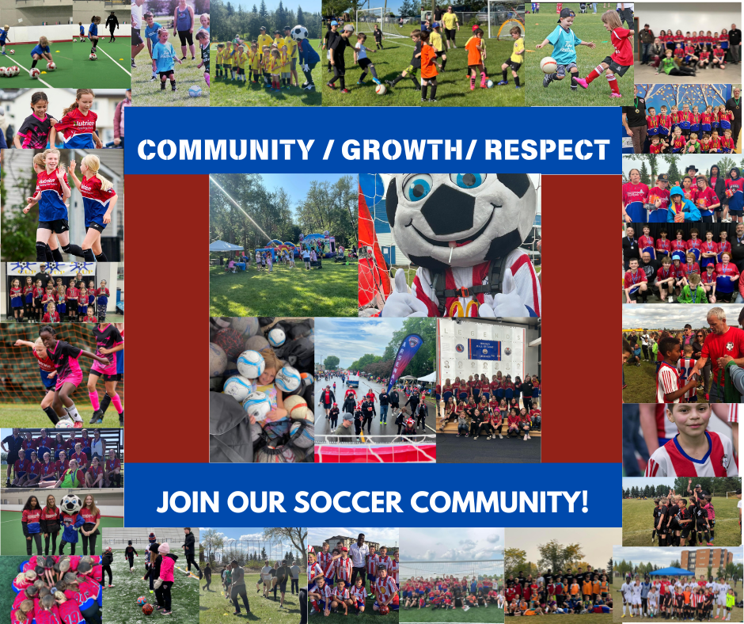
Fort Saskatchewan Soccer’s
Annual General Meeting 2024

Slide 2
1 | Call to order
2 | Minutes of the December 4,2023 AGM
3 | Business Arising out of the Minutes
4 | Executive Committee report 1)President- Shannon Rodgers 2) Vice President- Oscar Coreas 3) Registrar- Amanda Shand 4)Communications Director- Shannon Rodgers 5) Sponsorship Director- Micheal Richards 6) Fundraising director- Kelly Yanch 7)Sport Coordinator- Kelly Yanch 8)Equipment director- Shawn Merwin 9)Junior Arsenal Director- Lisette Brule 10) Arsenal Community Director- Matt Grosseth 11)Arsenal Club Director- Lisa Brooks
5 | Goals and Work Plans President- Shannon Rodgers
6 | Finance Overview Budget Auditors Report
7 | Approval of Executive committee Roles Policies Rules and Regulations
8 | New Business Elections of executive committee- 2year positions Elections of Executive committee – 1year positions
9 | Unfinished Business/ Open discussion
Annual General Meeting Agenda
December 2, 2024
7:00pm
MSA Office Board Room
Draw raffle for free 2025 outdoor season
Adjournment

Slide 3
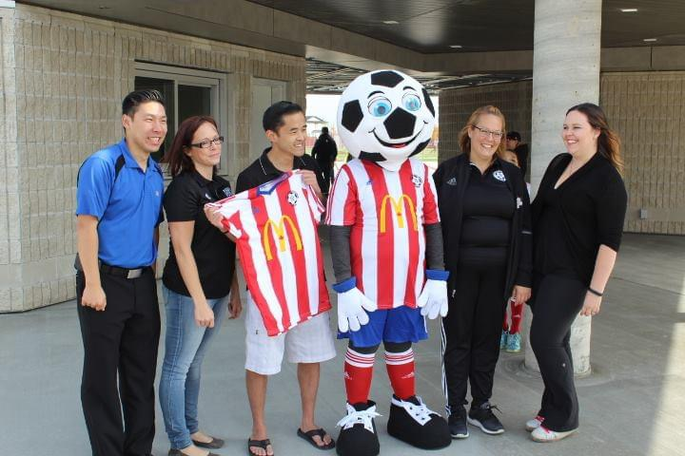
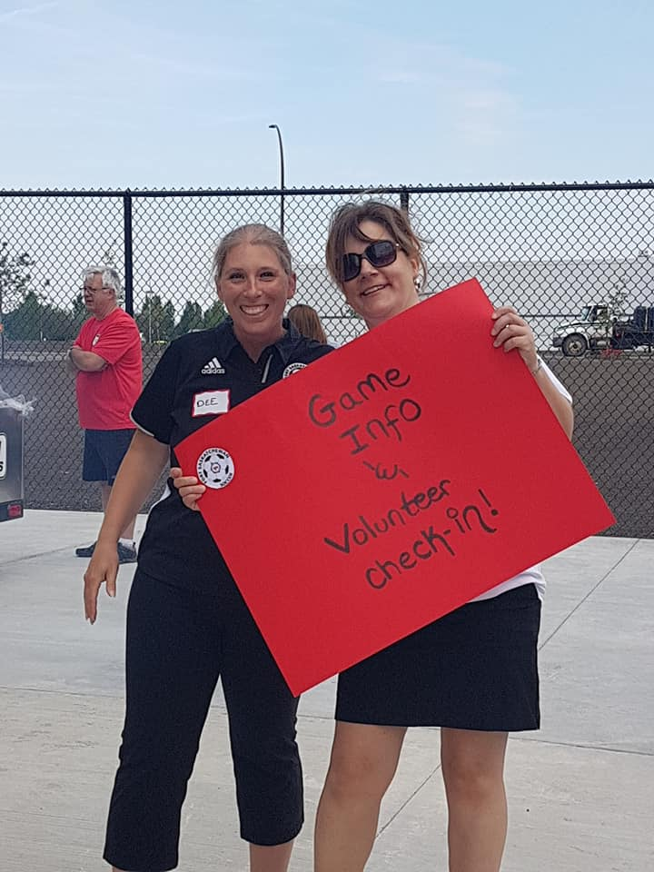
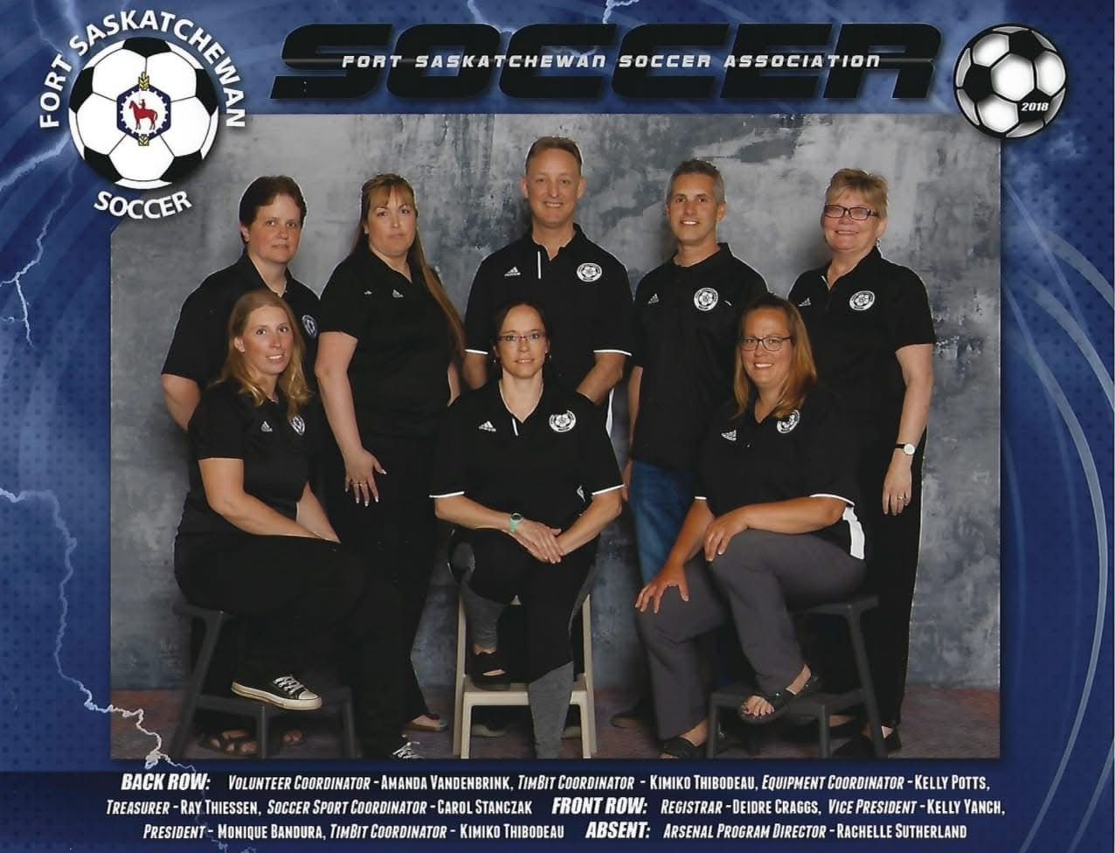
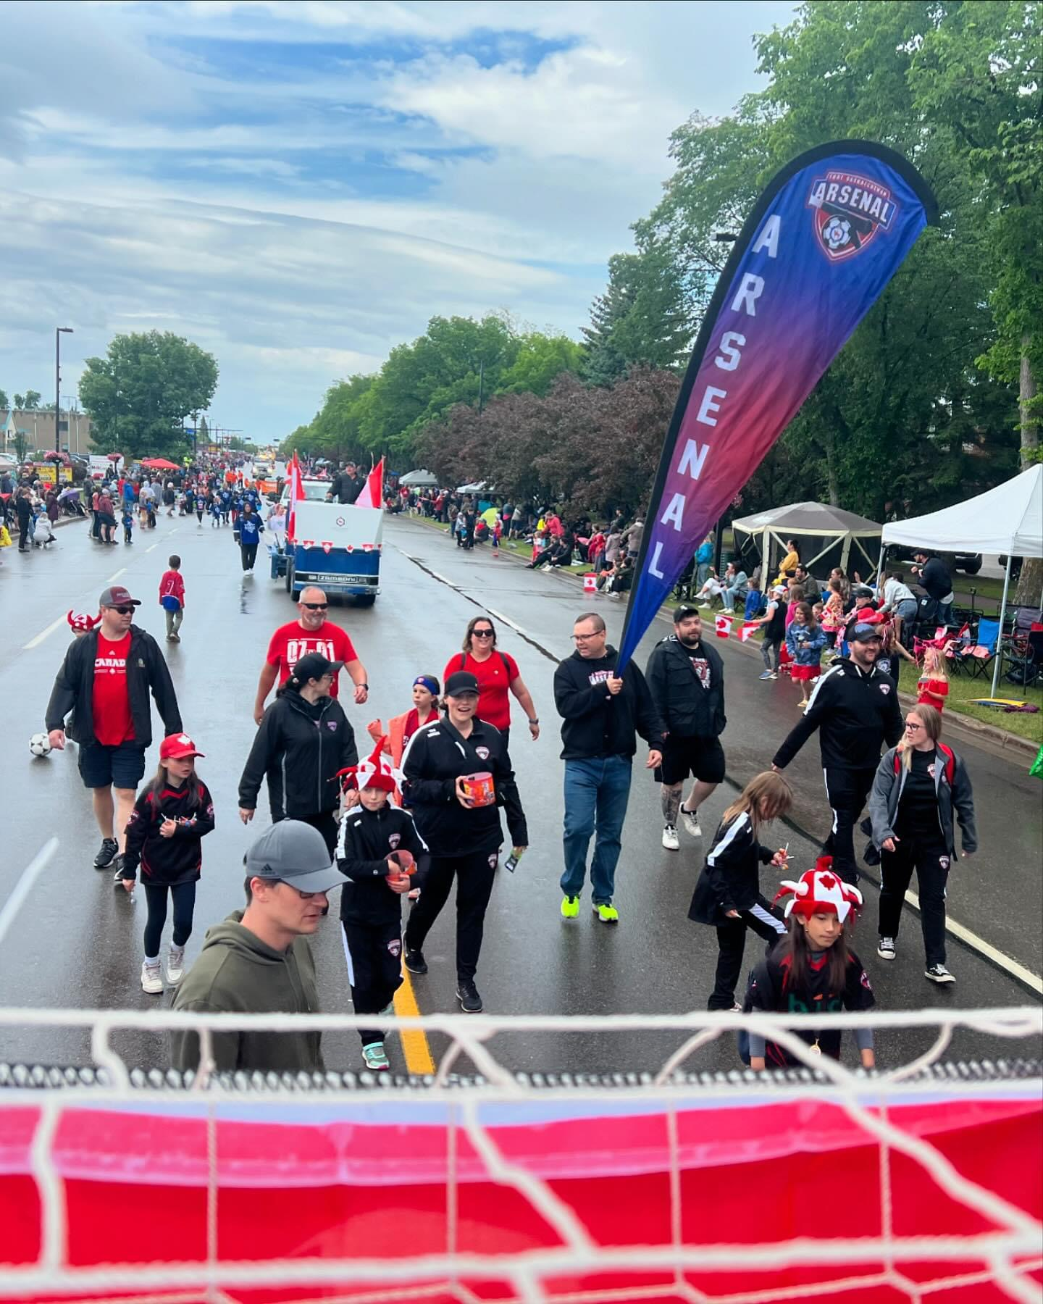
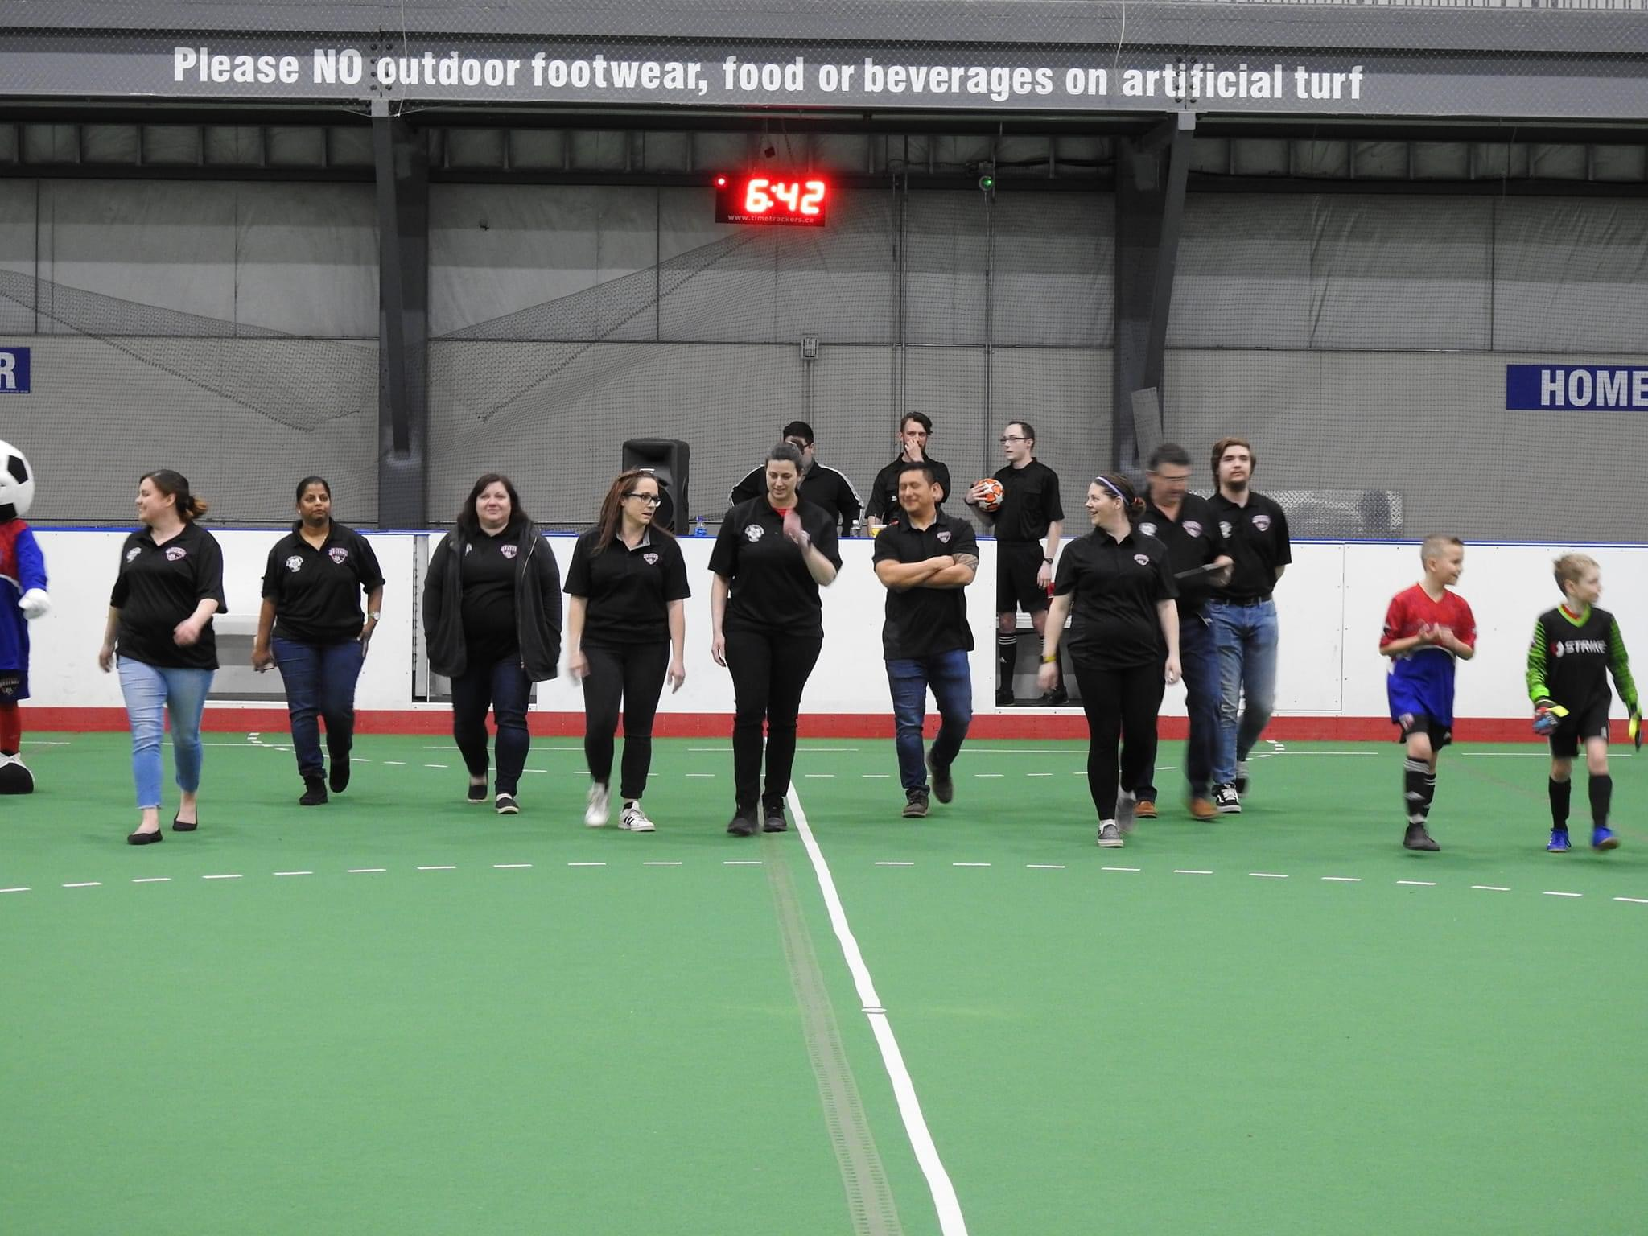
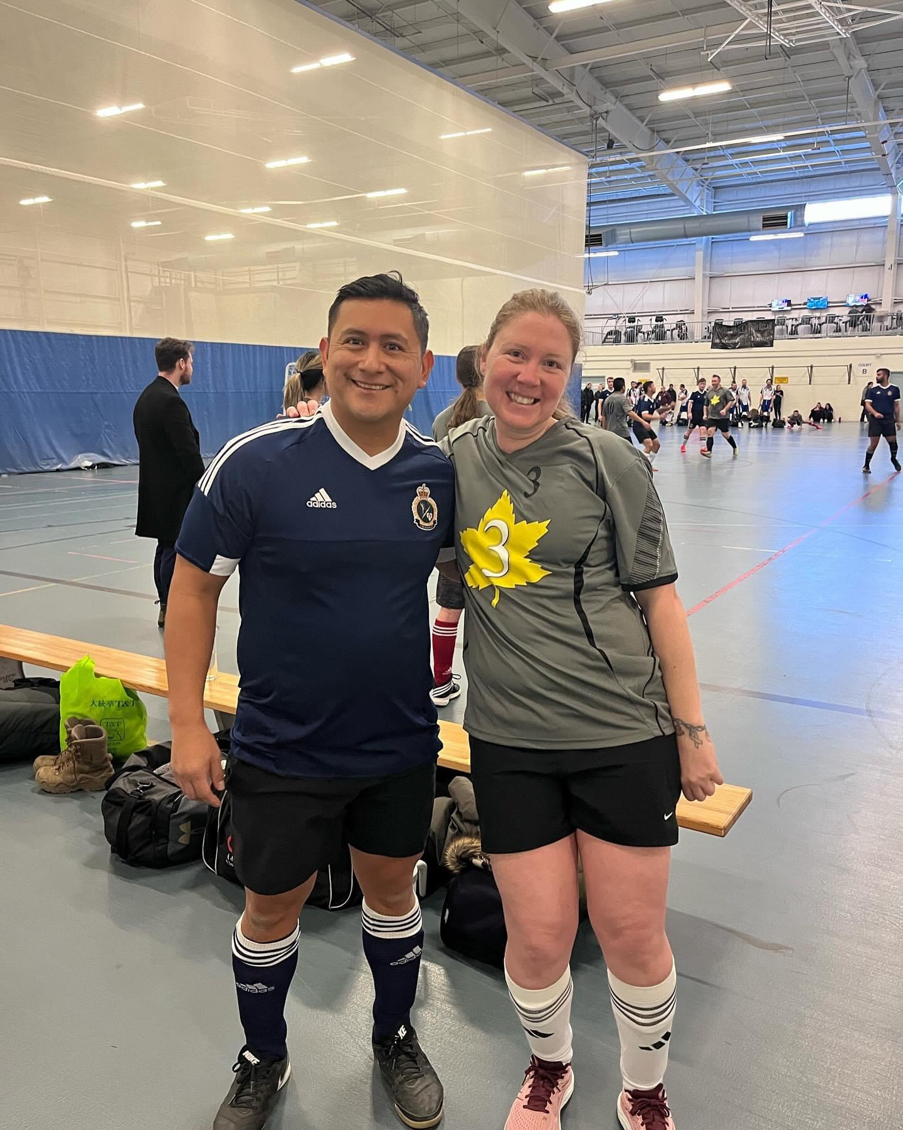
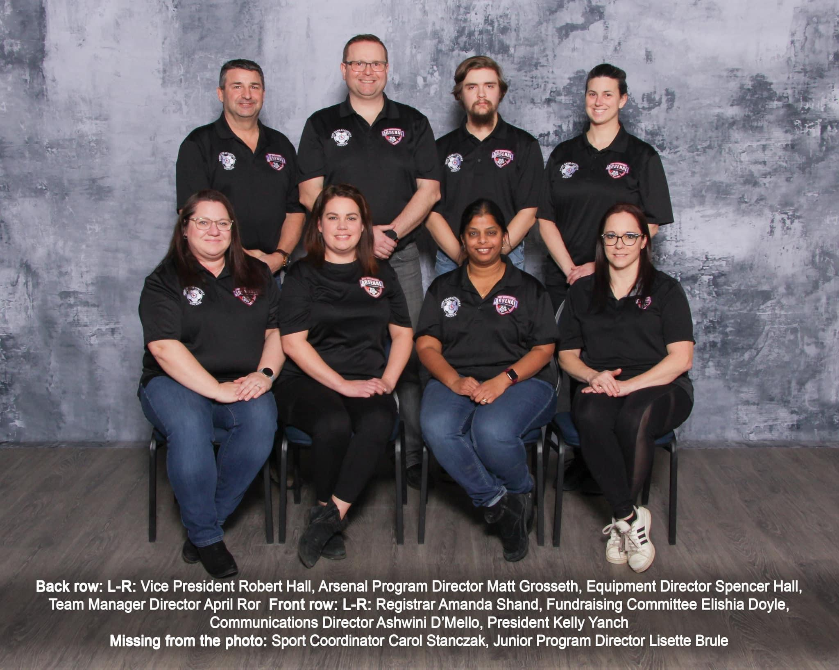
2 -year Terms
Arsenal Community Director
Finance Director- Vacant
Vice president- Secretary - Vacant
Fundraising Director- Vacant
It/media marketing Director- Vacant
Arsenal Club Director- Vacant
Technical Director- Goalie Lead- Vacant
1- Year Term
Interim president
Interim Equipment Director
Interim Sponsorship Director
Interim Assistant Arsenal Director- Vacant
Interim Governance Director- Vacant
Technical Director- offense/ Defense- Vacant

Slide 4
President’s Report
Summary of Current Activities:
Change in President in July 2024, with Kelly Yanch taking over the Sports
Coordinator position as Carol retired. Shannon coming in as interim until AGM 2025, as 1 year left on current president position.
Upcoming:
Working with the city to create Mowat 13 as the U9 Club field with nets owned by Fort Sask, so
league games are played within the community.
Looking at the refacing of Henderson fields, with possible changes into turf fields (proposal going in before
Christmas)
Girls in Sports night 20 December in MSA office to promote body positivity, social media usage, cards for seniors
and some fun Christmas crafts and snacks
Challenges:
Shortage of persons on the executive board in key positions prohibits a lot of focus on those
positions, as they are looked at as required.
Goals:
Development and growth of Fort Sask Soccer and Fort Sask Sports, working with other organizations to
increase visibility of the program, development of players, and incorporating local businesses in the success of
our program and their establishment.

Slide 5
Vice President Report
Summary of Current Activities:
Current activities include ongoing indoor season. As the chair for the
discipline committee, I am happy to report that this indoor season, there is nothing pending or that has
had to be brought up to my attention. This is very encouraging regarding our coaches. We must
continue to maintain a high level of integrity and maintain the focus on our players development.
Upcoming:
Testimonial Game in February. Currently trying to get the men's and women's soccer teams
from CFB Edmonton armed forces to join us in a friendly against our coaches.
Challenges:
Challenges include ways to support all our Fort Sask teams with the development that they
require. The difference in soccer level can be challenging and as a board we are producing ways to
support our lower tier teams. This includes creating Tech Director positions, one for player and one for a
goalie.
This role will assist our teams and provide guidance to those new coaches that are just starting out and
helping to create lesson plans for all teams with a focus on teams that require additional support.

Slide 6
Registrar Report
Summary of Current Activities:
Registration for the Outdoor 2024 season took place in February 2024. This was the first season available for registration to both community and club teams. A total of 471 registrations were entered into RAMP an increase of 12.5% from the previous outdoor season. 177 players were placed on teams in the Jr. Arsenal Divisions (U5-U7), and 223 were placed on Arsenal teams (U9-U15). 32 Players we placed on U9 teams for the newly formed Club program.
Registration for the 2024/25 Indoor season was open August 1- September 2nd. Some packages were opened longer to encourage enrollment in divisions that typically see overall lower registrations. In total, for the Indoor season, 364 players were registered in RAMP with 345 players being placed on teams. Registration numbers increased 18.75% from the previous indoor season.
Of the 345 players placed on teams, 65 were assigned to Jr. Arsenal Divisions U5 and U7, 241 players to Arsenal (U9-17), and 39 Players joined the club program.
Registration numbers show a slight decrease between registration and players’ assignments. The difference for the indoor season was 5% and 8 % for the outdoor. This is reflective of several withdrawals connected to players’ physical and/or mental health, players being accepted to other teams or activities, and finally, the need to fold teams due to low registration numbers in the designated division.
I am unable to speak to the registrations related to summer camps, or technical sessions as these were managed outside of the role of registrar the year.
Upcoming: Preparation for the upcoming outdoor season will commence in January.
Challenges: Communication. There are consistent challenges in receiving timely communication during registration periods. The registrar should be kept apprised of changes that impact registrations and communication to players and parents. This includes the decision to open or close packages or fold teams. The registrar is a key contact for families and the lack of information creates frustration and confusion.

Slide 7
Communications Director Report
Summary of Current Activities:
Using Instagram and Facebook to promote games to maximize support for
teams playing within the area, as well as tournaments. Using Insta and Facebook stories to provide drills and
skills training for the coaches and player to help increase their proficiency in the sport.
Upcoming:
Advertisement for sponsors to increase, promoting the teams and recognition to coaches etc.
Challenges:
Trying to get teams to submit pictures of games, so we can provide more recognition
-increase in viewership, and followers

Slide 8
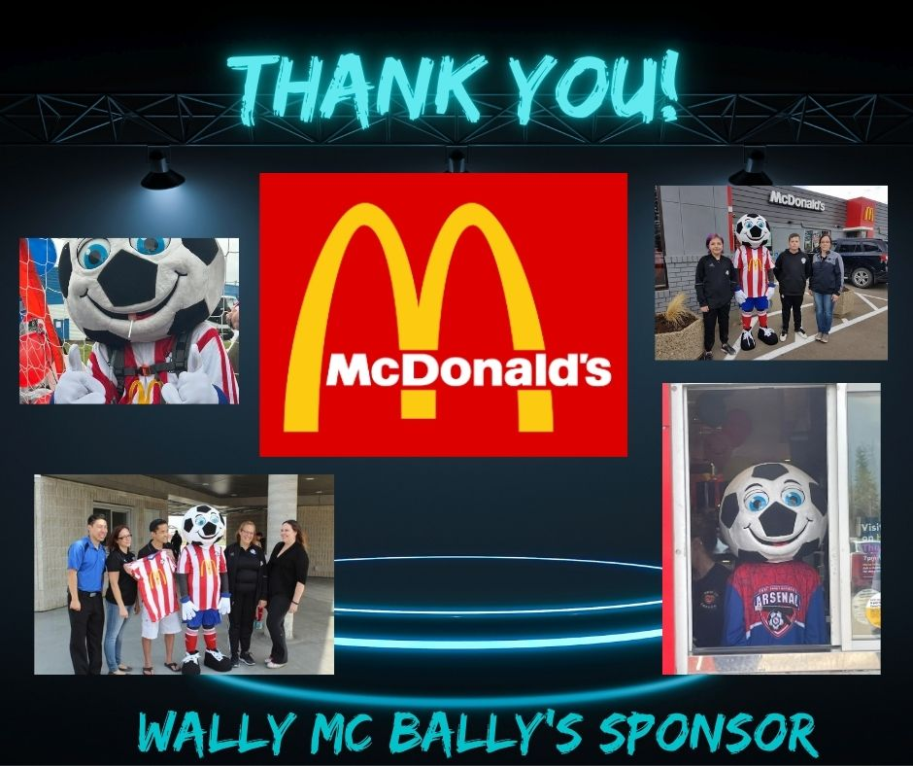
Sponsorship Director Report
Summary of Current Activities:
Currently reaching out to possible sponsors.
Review policy and procedures
Upcoming:
Review outstanding sponsorships and contact ones that have outstanding payments
Challenges:
Being late in the fiscal year may companies won’t commit until new budgets come out for 2025

Slide 9
Fundraising Director
Outdoor 2024-
We ran a Raffle Box Raffle that sold out two days before the deadline! Bringing in approximately $7,827.80. We had offered to waive volunteer deposits for any Family who raised $400.00 in tickets.
We Ran a Prize raffle – prizes were $1500 in Cash, a Blackstone grill, Yeti Cooler, Soccer net and 1:1 Lonestar technical session. We brought in approximately $18,236.
Bring our Outdoor Fundraising total to:$26,063.80
Indoor 2024- 2025-
Annual Bottle Drive took place beginning of September we handed out flyers, had Sherwood park bottle drive come out and we raised approximately $ 5299.20
Today is the draw for our Prize raffle - prizes are a Yeti Cooler, Blackstone grill, Blackstone accessories, $2000 in cash, and Soccer package valued at $300. We brought in approximately $14,800
We will be running a Raffle Box at the end January. There has been some issues with Raffle Box as they implemented using stripe. We now have those glitches fixed ( we think) again offering to waive volunteer deposits of those families who sell $400 or more.
As of right now for 2024- 2025 Indoor we have raised $20,099.20
Past Fundraising Seasons –
2023 season we Raised - $38,038.89.
We did a casino in 2023 raising $20,000
AGLC Account- We currently hold $54,000 in the AGLC account. We can use this account for Field Time, and new equipment. Every fundraiser that we pull an AGLC license for goes into this account.
Notes:
Do draw for raffle

Slide 10
Sport Coordinator Report
Indoor and Registration set up in Ramp and Website
Coordinate with all Directors to obtain information needed
Once registration goes live take registrations in person over phone
Arrange Payment plans
Support Registrar inputting players and coaches into the EMSA Portal
Coordinate with directors to schedule field time
Book field time and other rentals
Volunteer opportunity reimbursement
Chase coaches to get information for Mandatory coaches training
Organize Alberta Soccer’s coaches on field training clinics
Collect Jersey deposits from team Managers
Collect expenses and submit for signatures
Organize special events such as Testimonial Game, Arsenal Jamboree, Neighbor day, Legacy park fun festival, Parade floats, etc.
After 8 Years of Volunteering on the FSS Executive committee and representing FSS on other boards such as MSA and EMSA North. I decided to step down taking the Sport Coordinators position.
It was decided to make it into a fulltime role and extending the operation hours to better serve our growing membership. We rented an office in July from FSMSA for the Sport Coordinator to work from.
The last few months I have been working on getting comfortable in the new role, and training with Carol.
Carol Stanczak retired after 10 years of being the Fort Saskatchewan Soccer’s Sport Coordinator. She was a huge asset to Fort Saskatchewan and saw many, many executive committee members come and go.

Slide 11
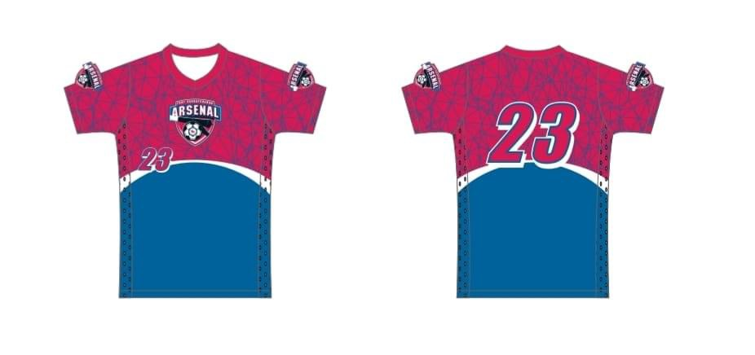
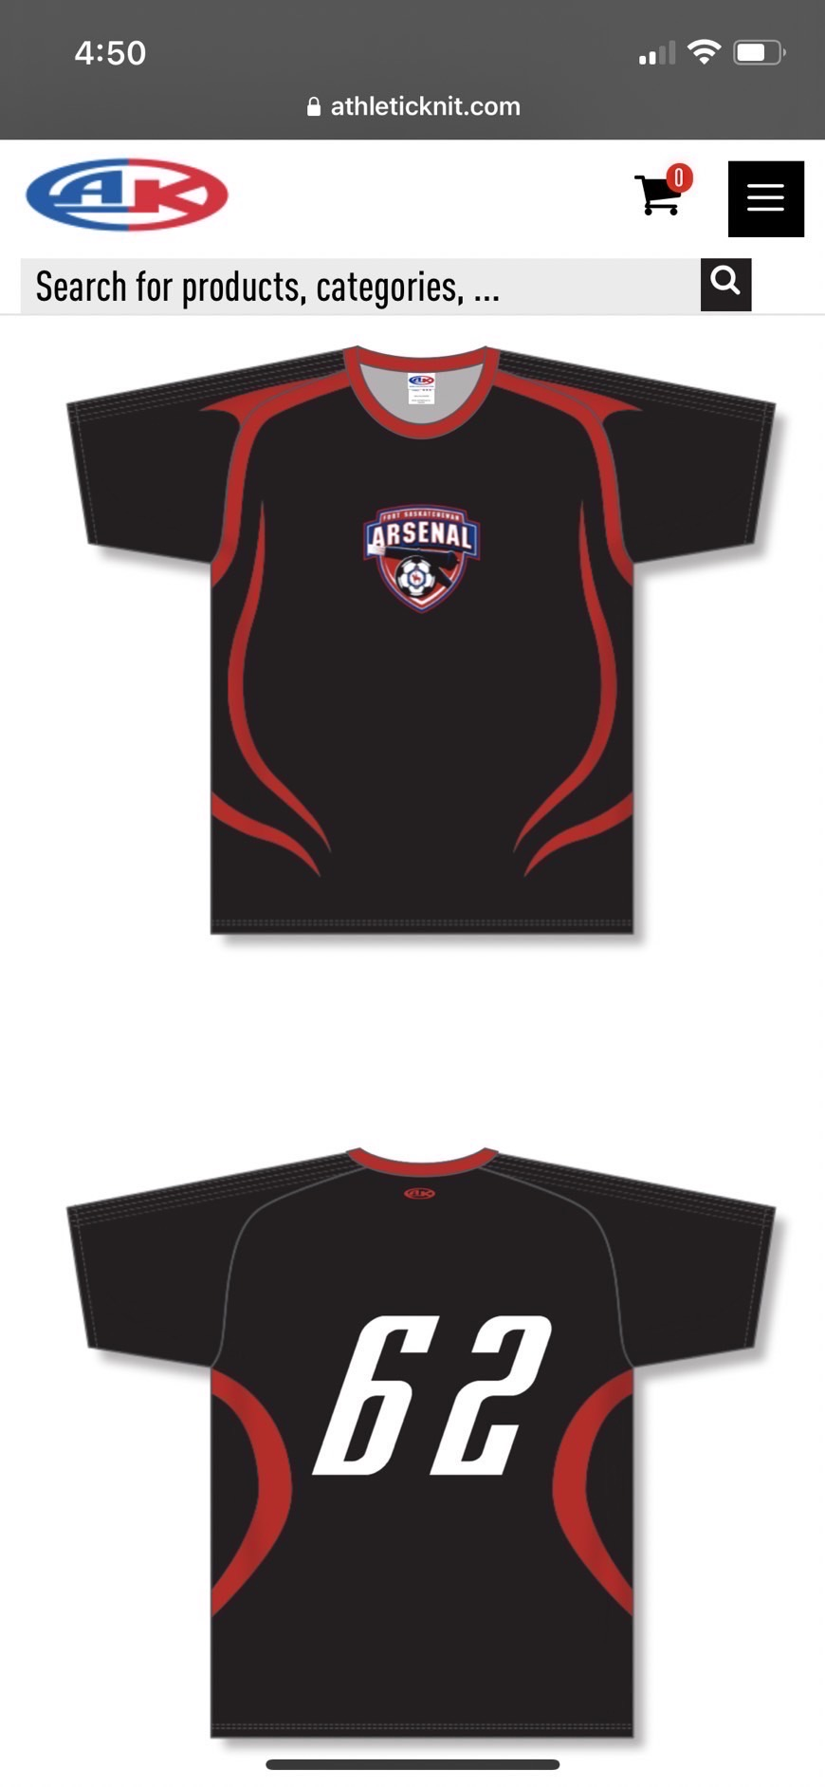
Equipment Director Report
Outdoor 2024
• Velcro straps and hammers purchased
Indoor 2024-2025
• 4 Community jersey sets – 2 sponsored
• 3 Club jersey sets – 1 sponsored
• Goalie gloves purchased
Size 4 balls purchased
Challenges:
• Learning new role – Everyone has been very supportive
• Cleaning the shed during winter months
• Inventory shed before Outdoor season planning starts
• Order necessary equipment before Outdoor season pre starts

Slide 12
Junior Arsenal Program
U5 outdoor -
4 teams /3 coaches per team (was not hard to get coaches)
Could not find a level age coordinator
Still did grassroots program with station rotation
U5 indoor-
* 2 teams (2 sometimes 3coaches per team)
We have an ALC coordinator
We are unable to do the grassroots program with the station rotation due to the lack of teams
U7 outdoor-
8 teams (3 coaches per team)
Following the grassroots program
We have a level age Coordinator
Lone star has been Valued asset for the program
Lone star came out four times to help coaches with drill set up and the drills also showing the coaches how to do the drills
Some of our coaches are brand new to Soccer so Lone star really is valuable to their growth as a coach at a young age
U7 indoor 4 teams/ (3 coaches per team)
We have a level age coordinator
Following the grassroots program with a station rotation
Lone star has been Valued asset for the program
Lonestar has been out two times so far this year will be out another two times as a season goes along
Lone star came out four times to help coaches with drill set up and the drills well showing the coaches how to do the drills
Some of our coaches are brand new to Soccer so lone star really is valuable to their growth as a coach at a young age
Growth for U5
Outdoor
We would love to have more than four teams come this outdoor season but other than that, I believe that the outdoor season is going great,.
Indoor
Would love to have four teams for the indoor season because what we’re finding is we are not getting enough numbers with the little guys and sometimes were not even breaking so would like to great, a plan to make it more affordable and people that have kids that are three and four years old
Growth U7
Outdoor
By having a teams, we tend to occupy every field at one time so for growth we may not require much growth and if we do, then we will require more field time
-Would like to continue having Lonestar to help develop those coaches
Indoor
We have four teams and 4/4 to the field, which makes it great, but we would love to add another four teams so that we can have a bigger program for the under seven, but we would require more field time
-would like to continue having lone star help develop those coaches

Slide 13
Arsenal Club Program
RECAP:
In the 2024 outdoor season, we progressed toward the vision of "A place where everyone belongs" by implementing the Lonestar Arsenal Training Center in Fort Saskatchewan. This initiative offered high-quality training for both premier and community players while bringing the LRA methodology and session plans to life.
Key Achievements : Lonestar Arsenal Training Center
Delivered training on premier fields, including Taurus Field.
Supported coach development through workshops and quality training sessions.
Engaged 38 community players and 28 academy players during Spring Camp, with consistent participation through May-June.
Results: Cultivated values of community, growth, and respect.
Retained most players, with one U9 departure to Sherwood Park.
Leadership Capacity Development
Hosted workshops emphasizing leadership and creating optimal learning environments.
Consulted with club leadership for strategic program development.
Provided consistent support to premier coaches both on and off the field.
Community Connection
Hosted Fort Saskatchewan’s first collegiate soccer match in partnership with The King’s University.
Offered mentorship opportunities for players with collegiate coaches and athletes.
Connected 6 community coaches to the Training Center through workshops.
Promoted visibility through digital marketing campaigns.
Results: Players displayed resilience and growth, standing out against Tier 1 competition.
Strengthened team camaraderie and understanding of the game.
Indoor Season 2024/2025
Player Performance
U10 Boys: Undefeated in league play with 4 wins. Champions of the Spruce Grove early bird tournament
U10 Girls: Ranked 4th of 8 teams in the Tier 2 league with 2 wins and 3 losses.
U9 Boys: Rapid development, outperforming previous U9 groups with the example set by older players. Two wins and three losses, scoring 16 goals and conceding only 5 in their last two games.
Community Involvement
All premier teams had the opportunity to act as ball boys and girls for The King’s University collegiate soccer season, strengthening ties and inspiring players.
Coaching Development
Hosted three coaching clinics, ensuring each team had representation. Coaches are rapidly implementing the LRA methodology in training and Matches. Provided a completed LRA curriculum aligned with Canada Soccer’s LTPD program. Established Google Classrooms for parents, coaches, and players to access session plans and resources.
Moving Forward
Expand the premier program from three teams to six teams. Enhance premier coach development to ensure consistent and sustainable growth. Strengthen partnerships with The King’s University’s Men’s and Women’s soccer programs. Continue developing the Lonestar Arsenal Training Center to support both player and coach development.
Arsenal Premier Club Program remains committed to fostering an inclusive environment where all players and coaches can grow, achieve, and belong.

Slide 14
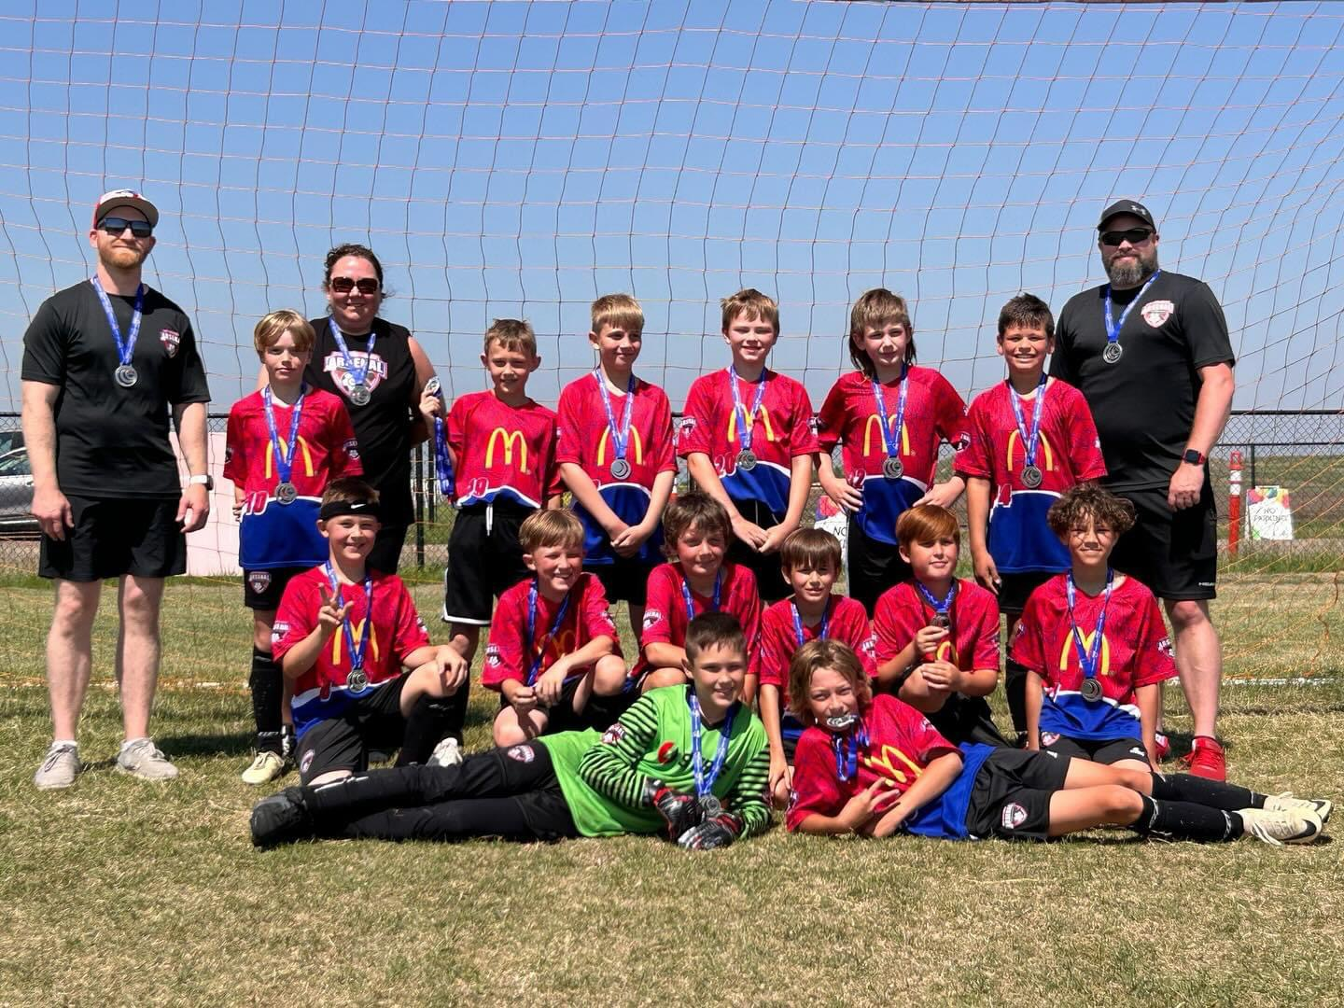
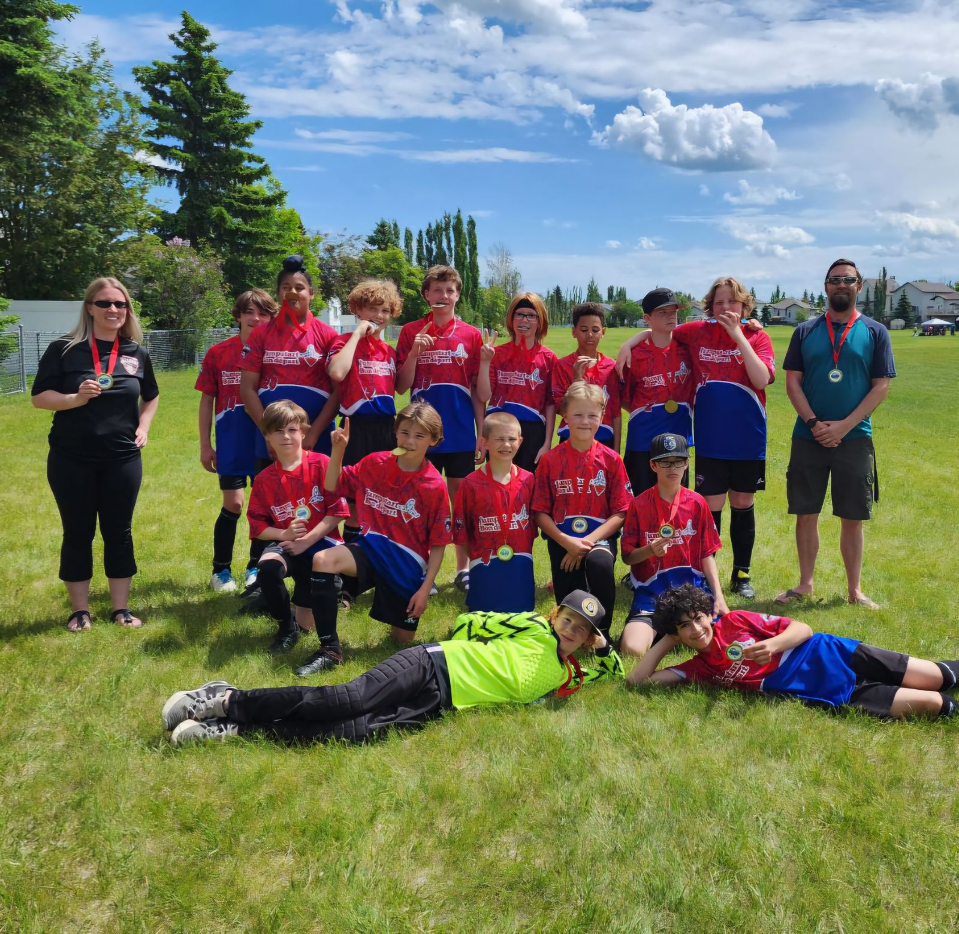
Arsenal Community Director
Summary of Current Activities:
Indoor 2023/2024
• 15 Teams
• 224 Players
• 4 Teams Qualified for City Finals, U11G Rodgers, U11B Gratton, U11B Shand, U13G Curran
• 1 Team Provincials U15G Lamarche
Outdoor 2024
• 21 Teams, 19 Community, 2 Club
• 303 all total
• 8 Teams qualified for City Finals, 7 attended
• 4 Medaled: U11B Gratton T5 Silver, U11G Coreas T4 Silver, U13B Grosseth T5 Bronze, U15G
Lamarche T5 Silver
Indoor 2024-2025
• 21 Teams, 18 Community, 3 Club
• 296 Players total
• Potentially 7 Teams moving to Tier 4 after first round
• We have seen tremendous growth in all the teams and players throughout the seasons.
• Focus going forward will be hosting Player Development session with our own Tech Team.
• Working with our Tech Directors to develop an Info Packet for all Coaches.
Challenges:
Finding Coaches for all teams is a continuous struggle

Slide 15
Auditors’ Findings
Audit of Fort Saskatchewan Minor Sports Association took place as of July 31,2024.
They also do an audit of each sports financials. The Audit is done by Givens LLP
Soccer Operations Fund
2023 Balance Excess revenue of revenues over expenses Interfund transfers 2024 Balance
137,634 63,953 (21,528) 180,059
Soccer’ s deferred Registration Fees
2024 2023
Balance, beginning of the year 2,870 44,042 44,042
Deferred contributions received - 2,870
Amount recognized as revenue (2,870) (44,042)
Balance, end of the year - 2,870

Slide 16
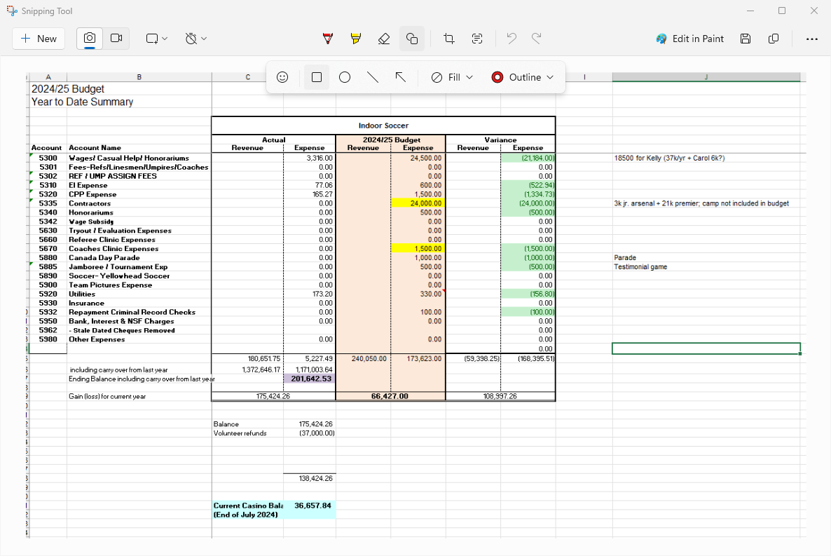
2024- 2025 Indoor Budget

Slide 17
Executive Committee Roles and Responsibilities overview
Duties of Governance director
Duties of IT/Market Media director
Duties of Fundraising director
Duties of Registrar
Duties of Finance Director
Duties of Sponsorship Director
Duties of Vice president- Secretary
Duties of Arsenal Club Director
Duties of Arsenal Community Director
Duties of Assistant Arsenal Director
Duties of Junior Arsenal Director
Duties of Technical Director- Goalie specialist
Duties of Technical Director- Offense- Defense
Duties of Equipment Director
Duties of Vice President- Soccer
Duties of President
Duties of Sport Coordinator

Slide 33
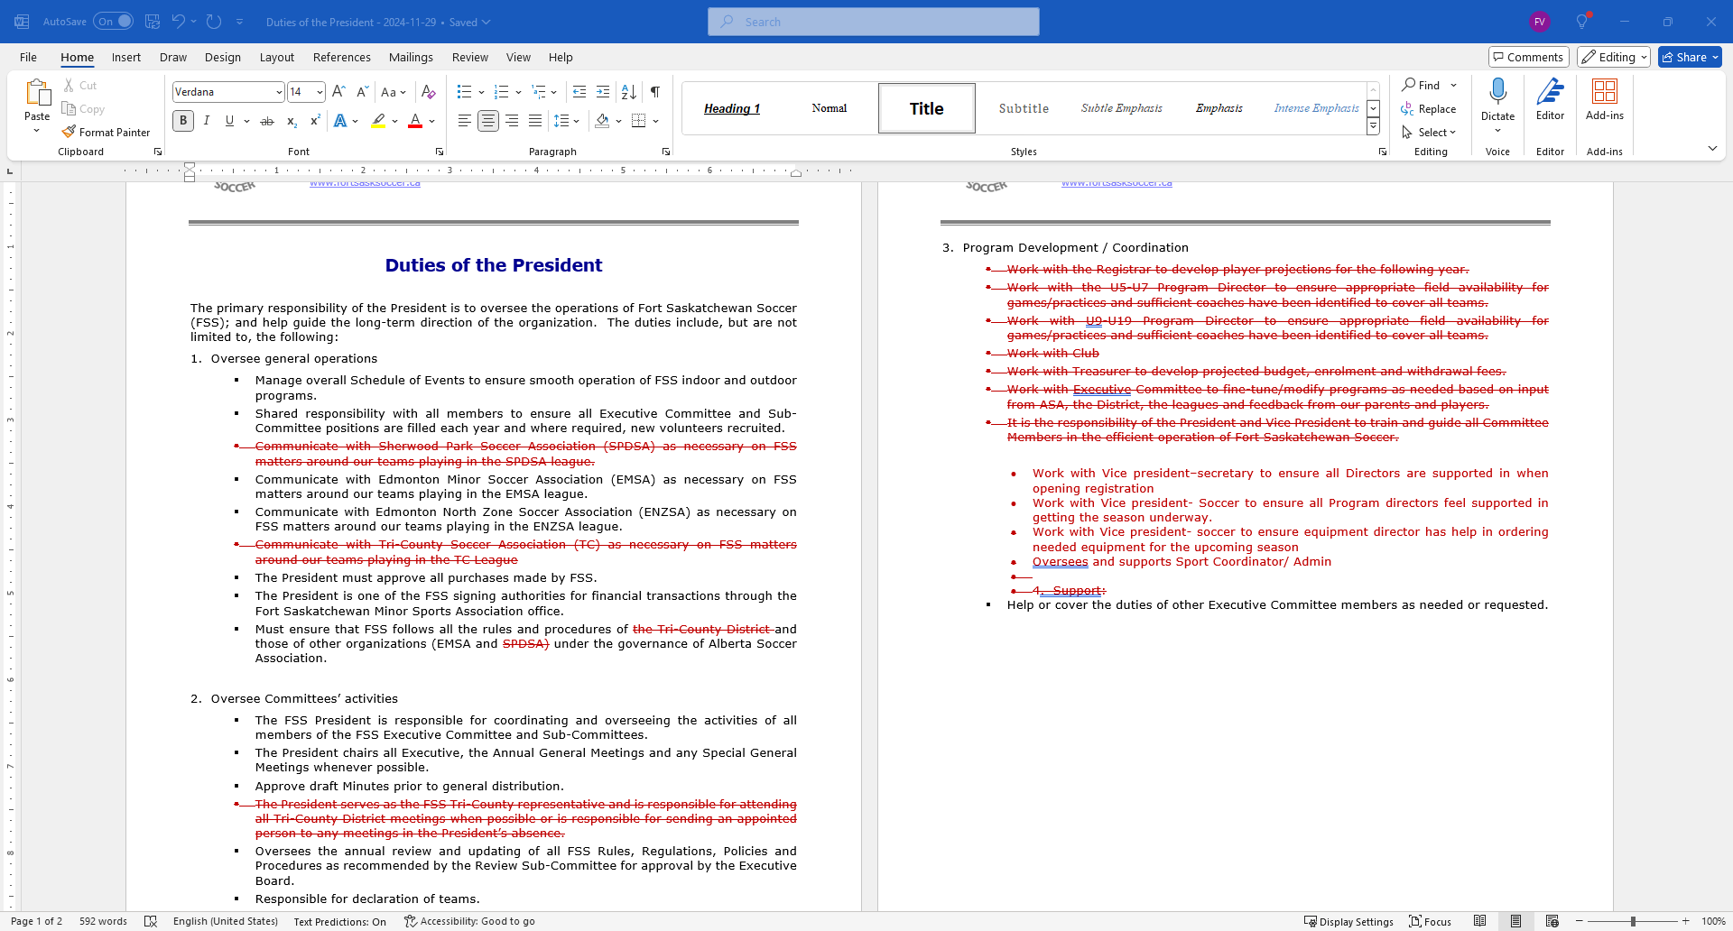

Slide 35
Policy overview
Policy- 1200 – Registration policy
Policy-1210- Team formations
Policy-160- Complaints/ Discipline/ Special requests
Policy-1230-Outstanding fees
Policy 2020- Travel policy
Policy 4000- Volunteer
Policy 4100- Executive Rebate
Policy 2030- Playing time
Policy 2011- Electronic
Policy 1201- Late Registration Policy
Policy 2015- Social Media Policy
Policy 1220- Withdrawals
Policy 2010- Change room
Vote To remove Policies:
Policy 2040- Provincials
Policy 2000- Trialist

Slide 36
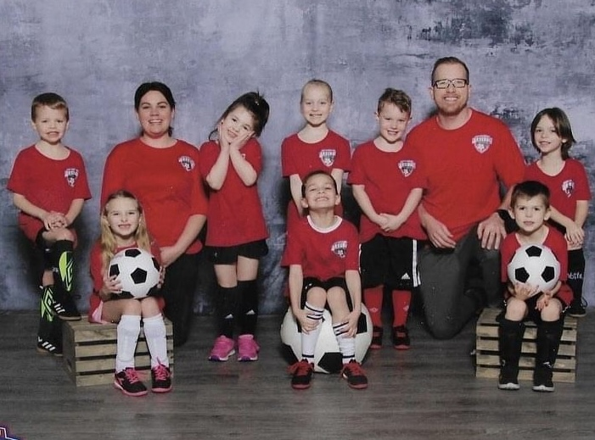
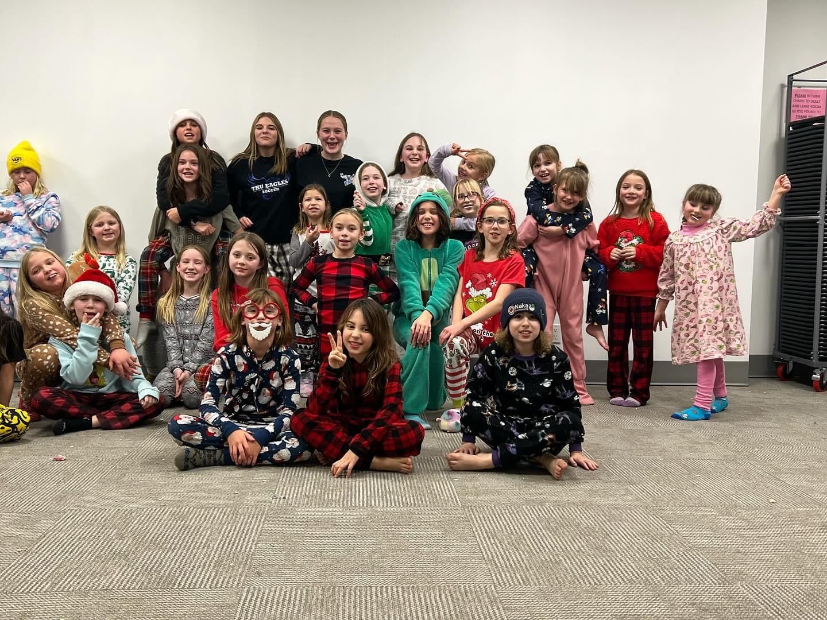
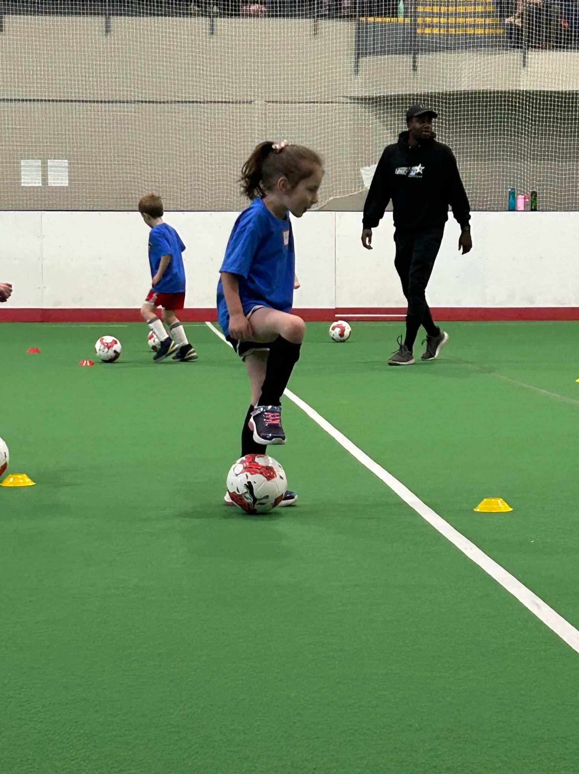
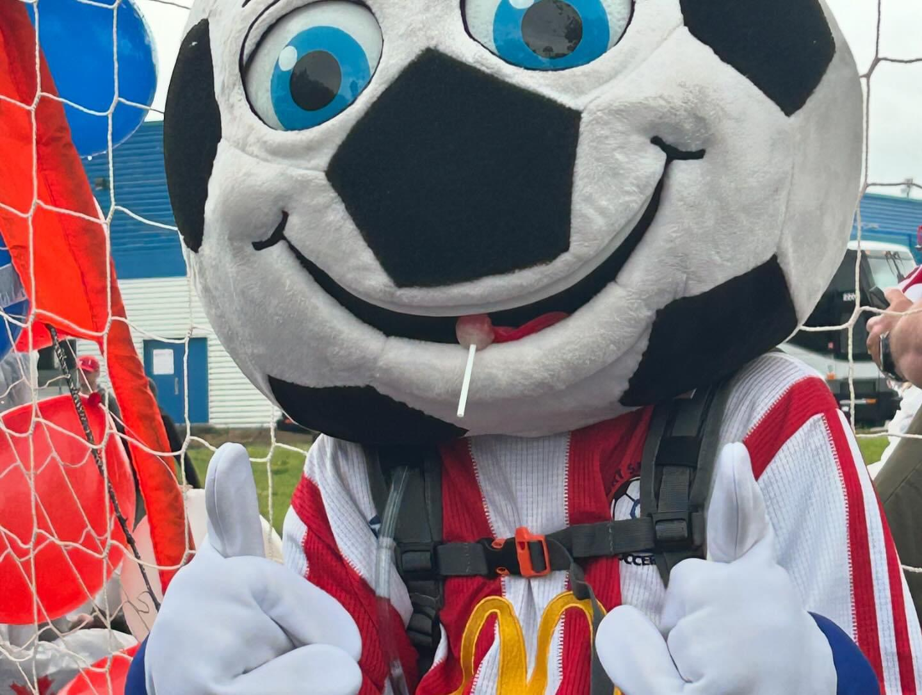
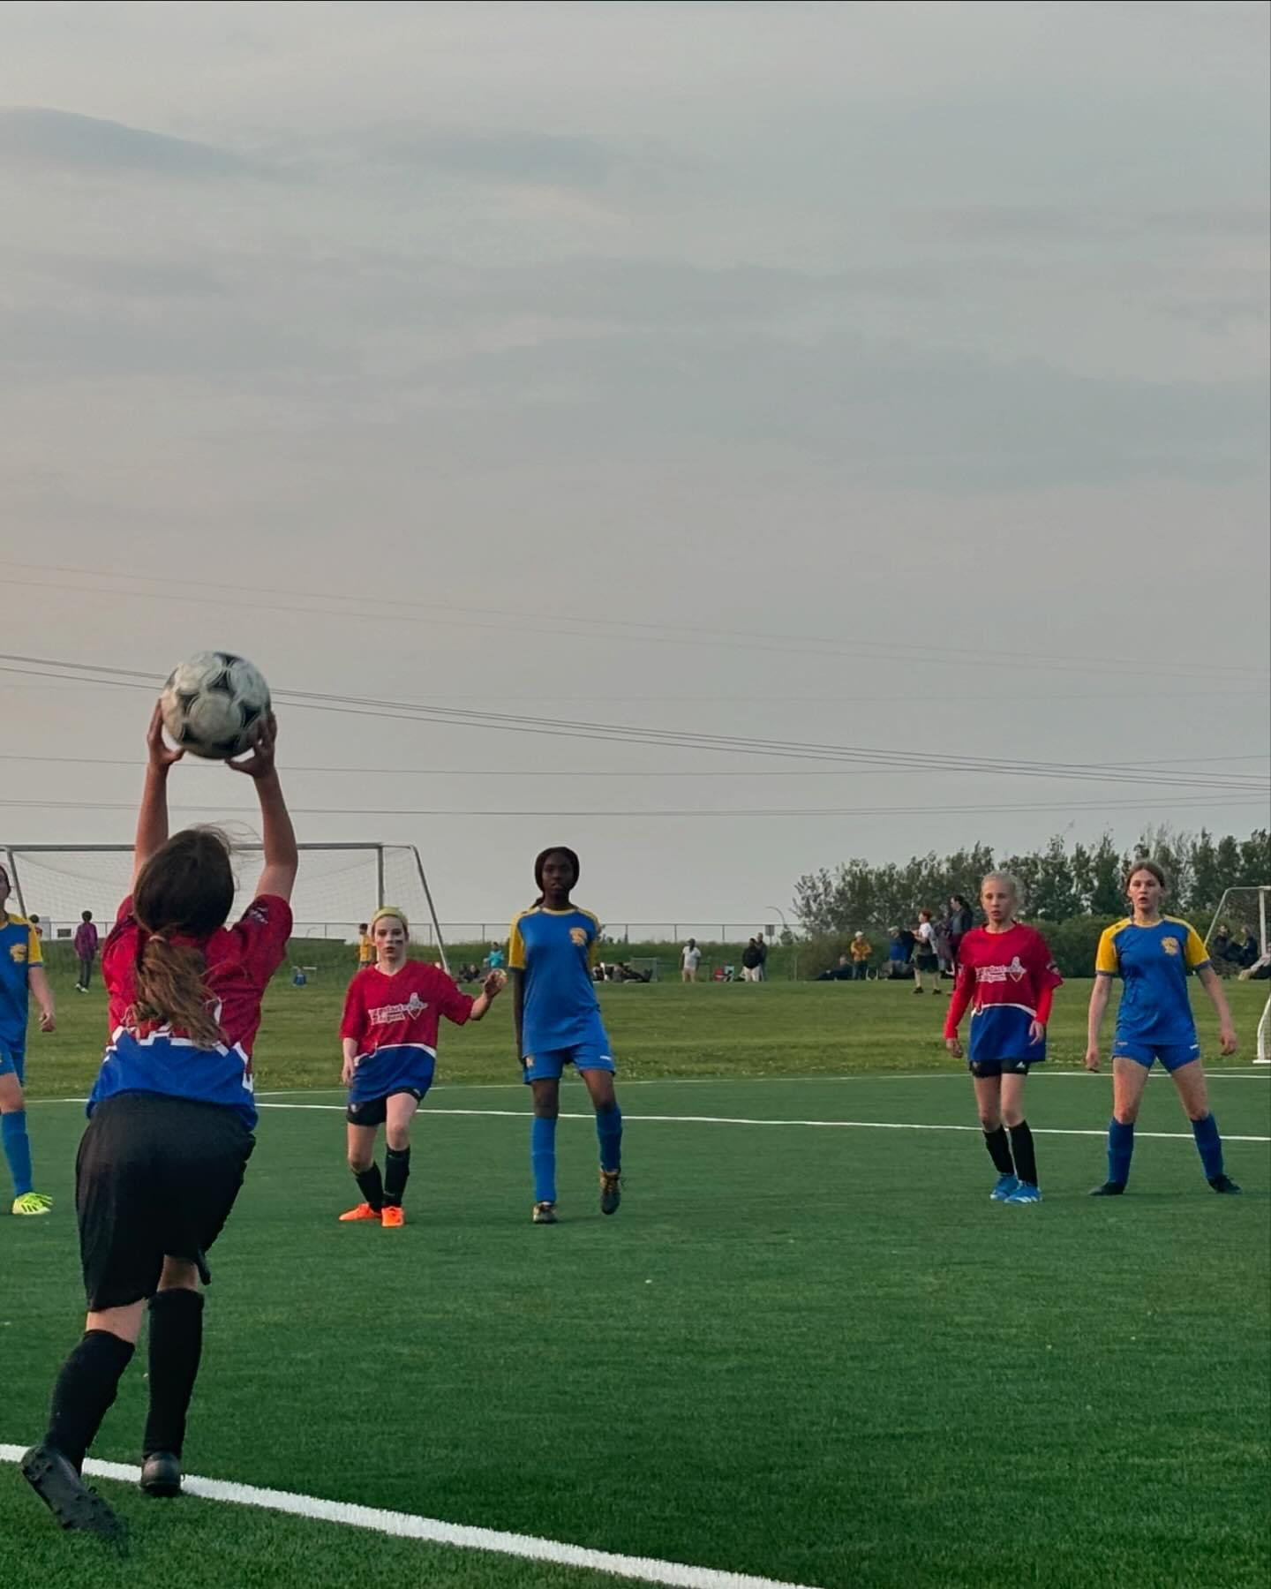
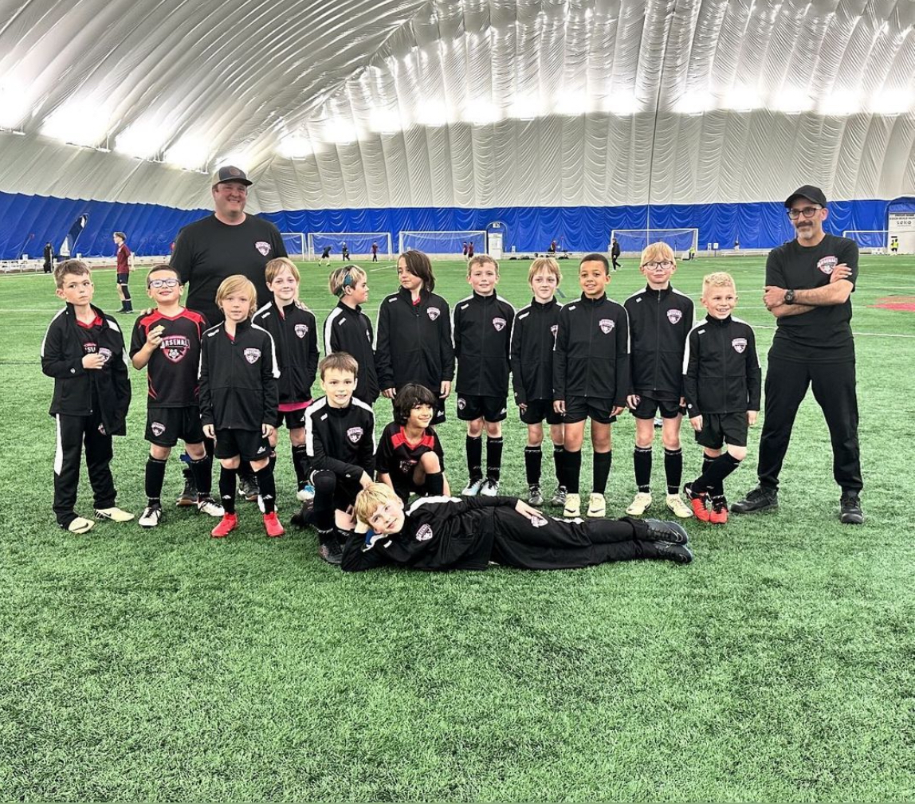
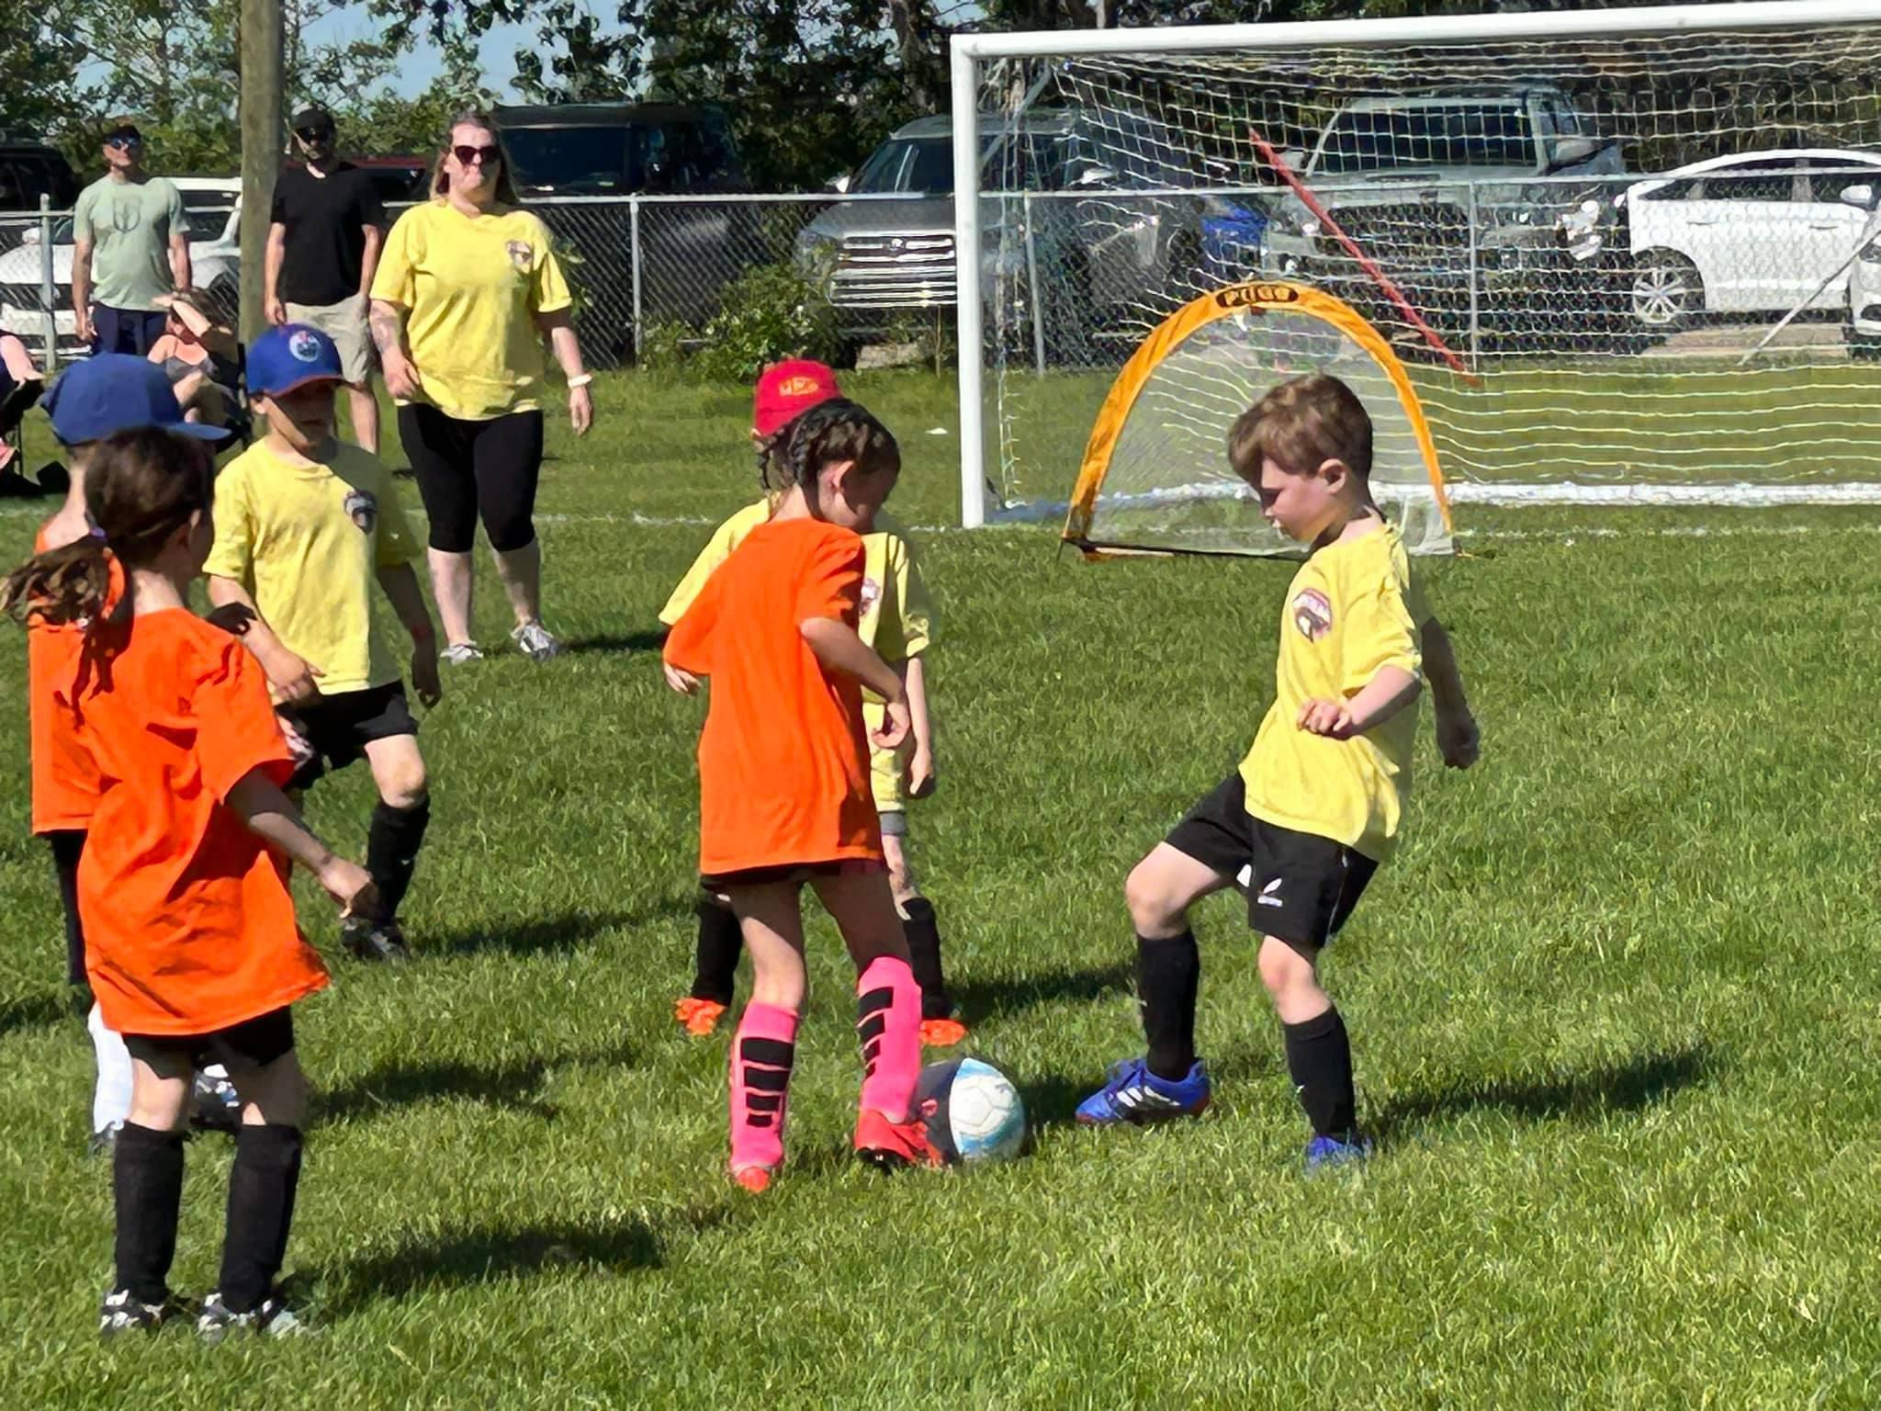
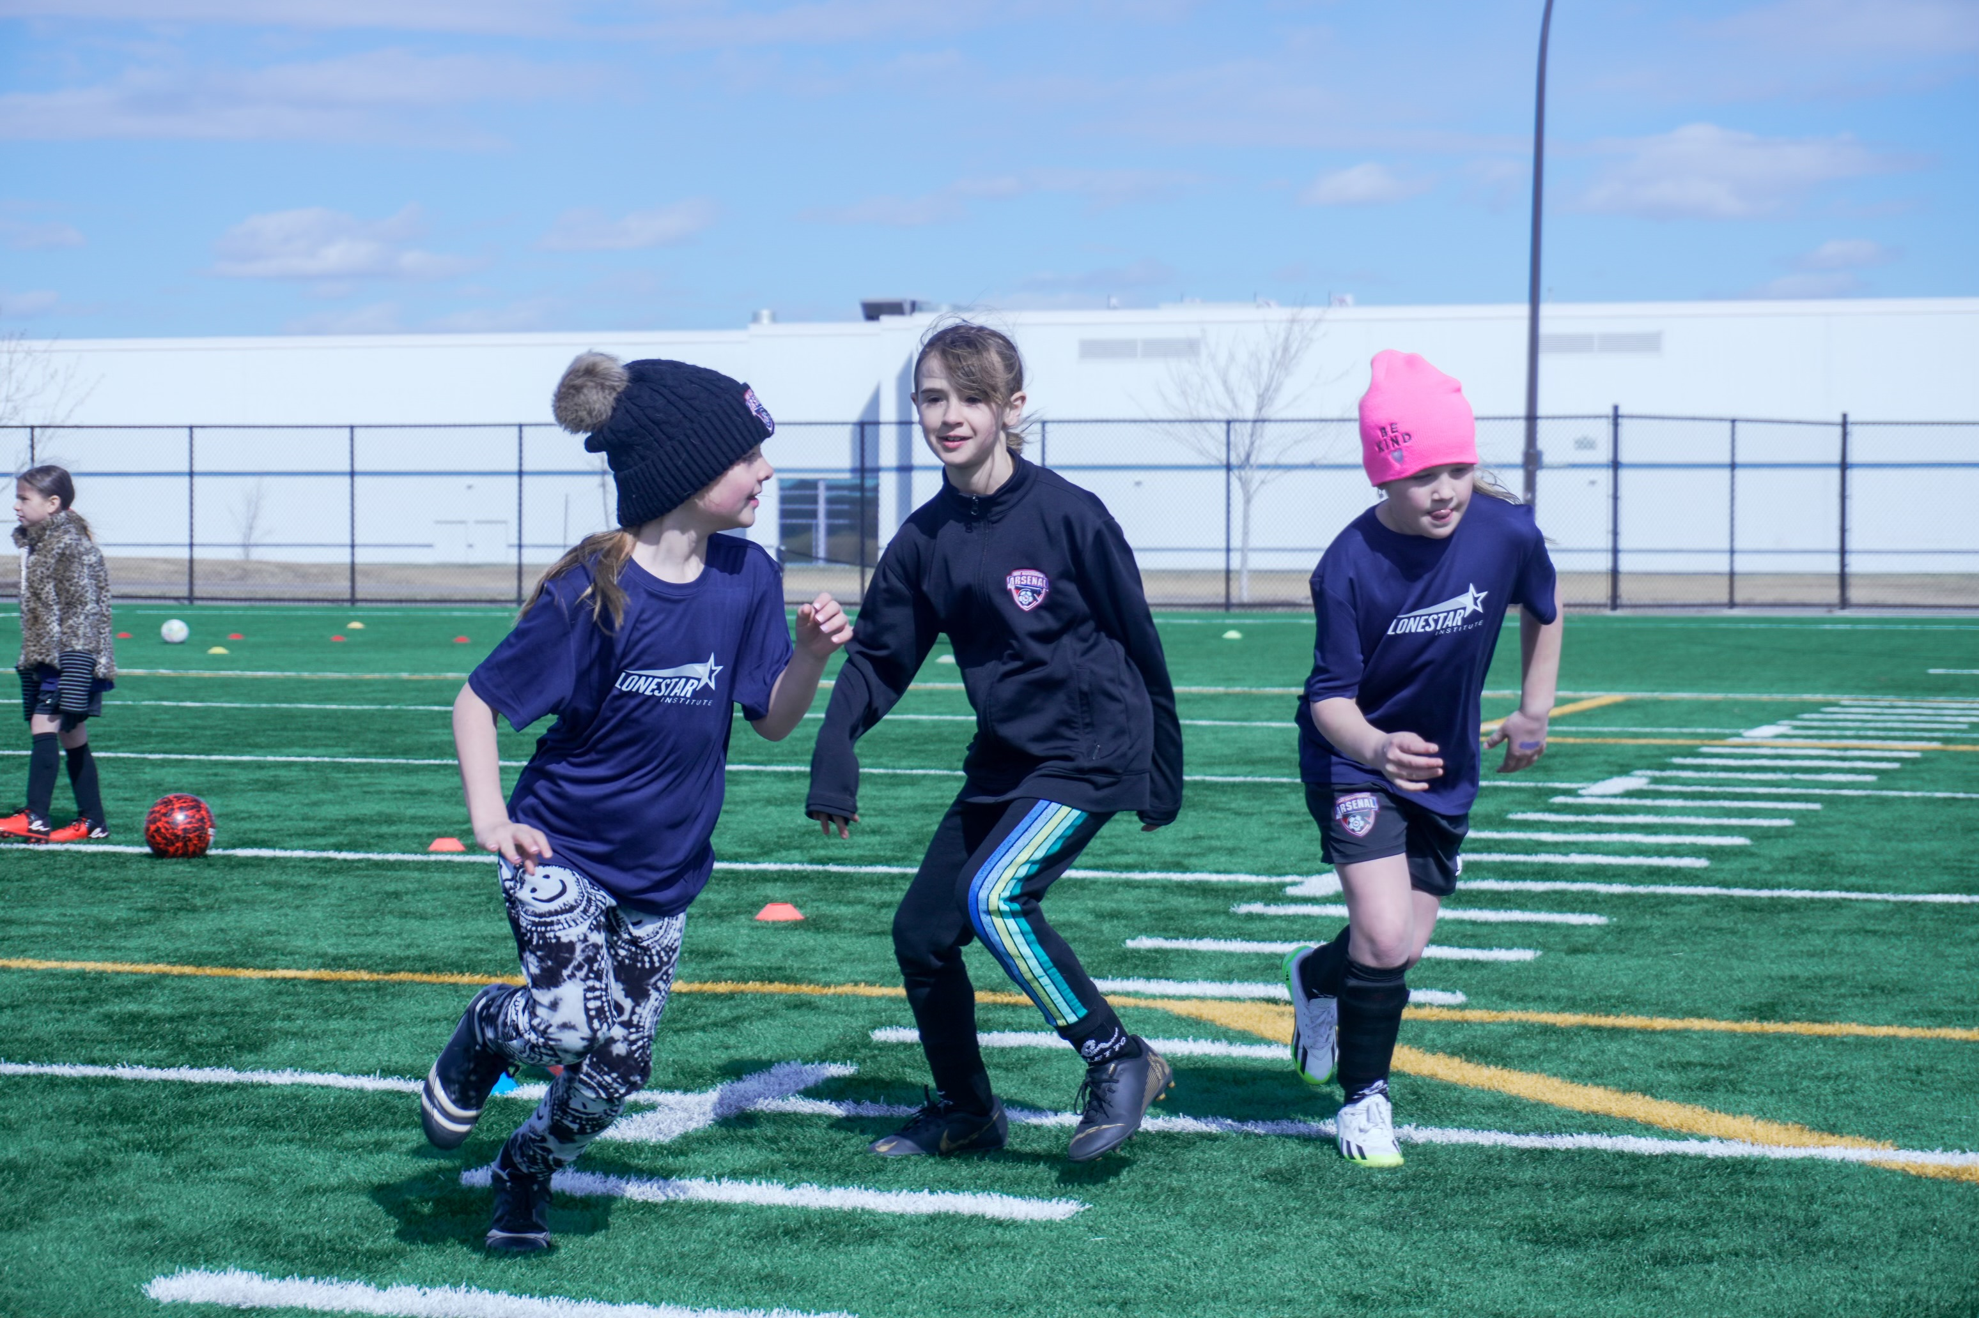
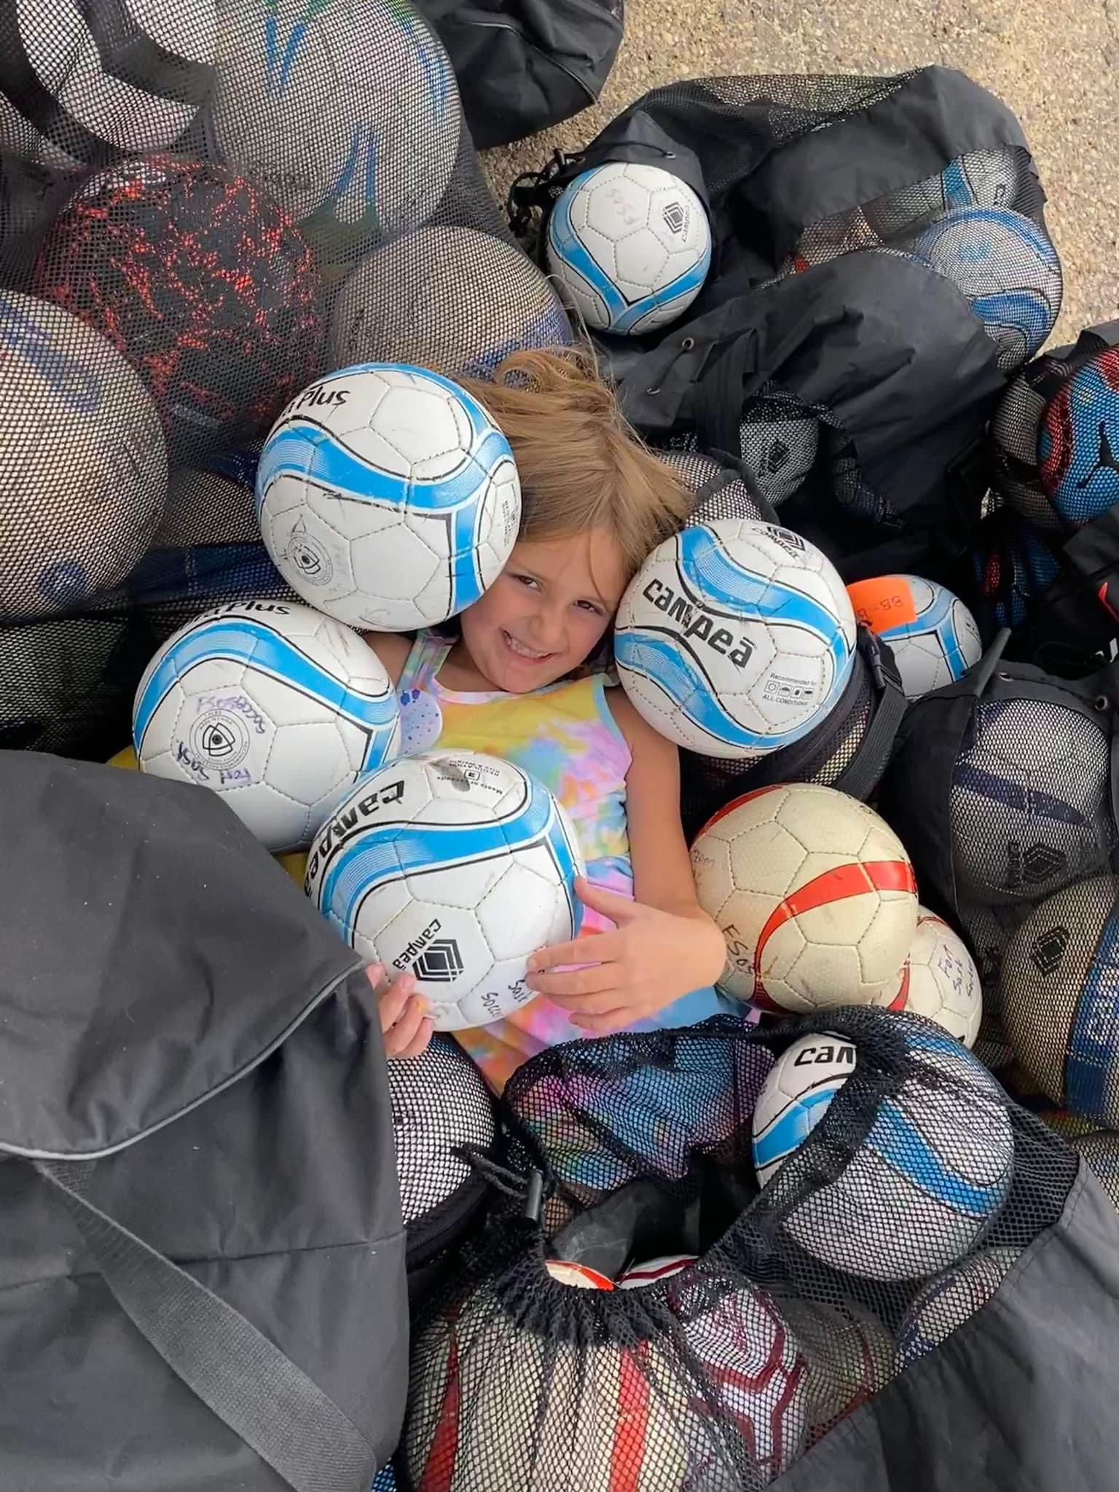
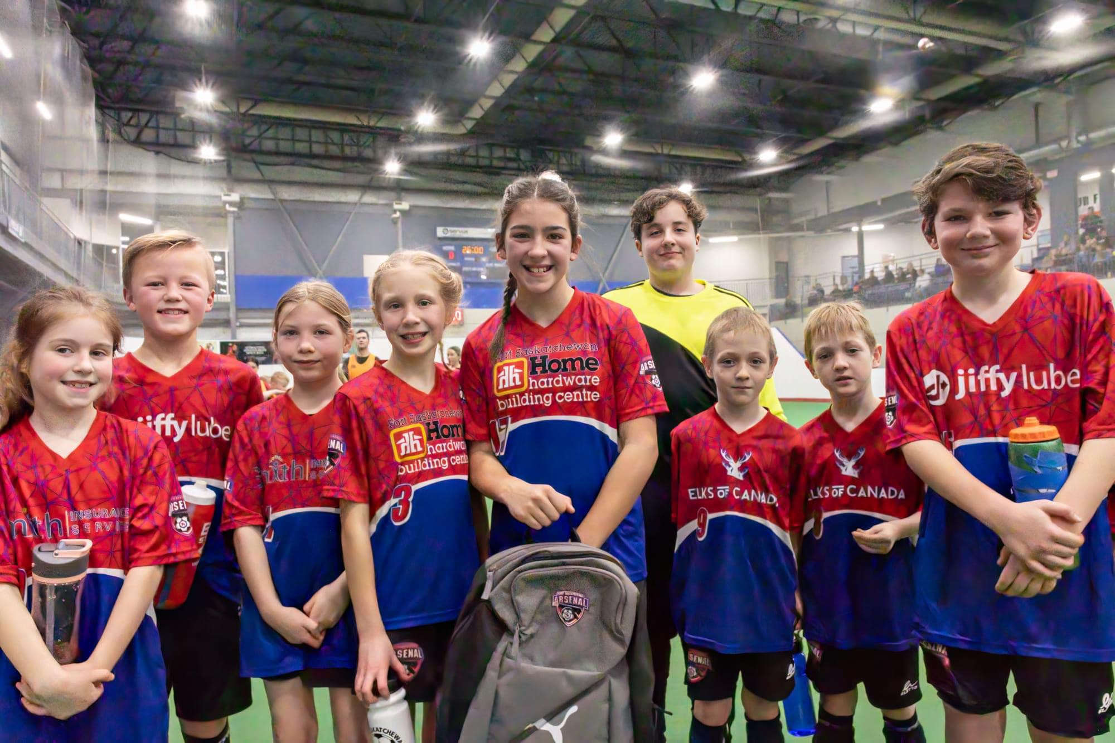
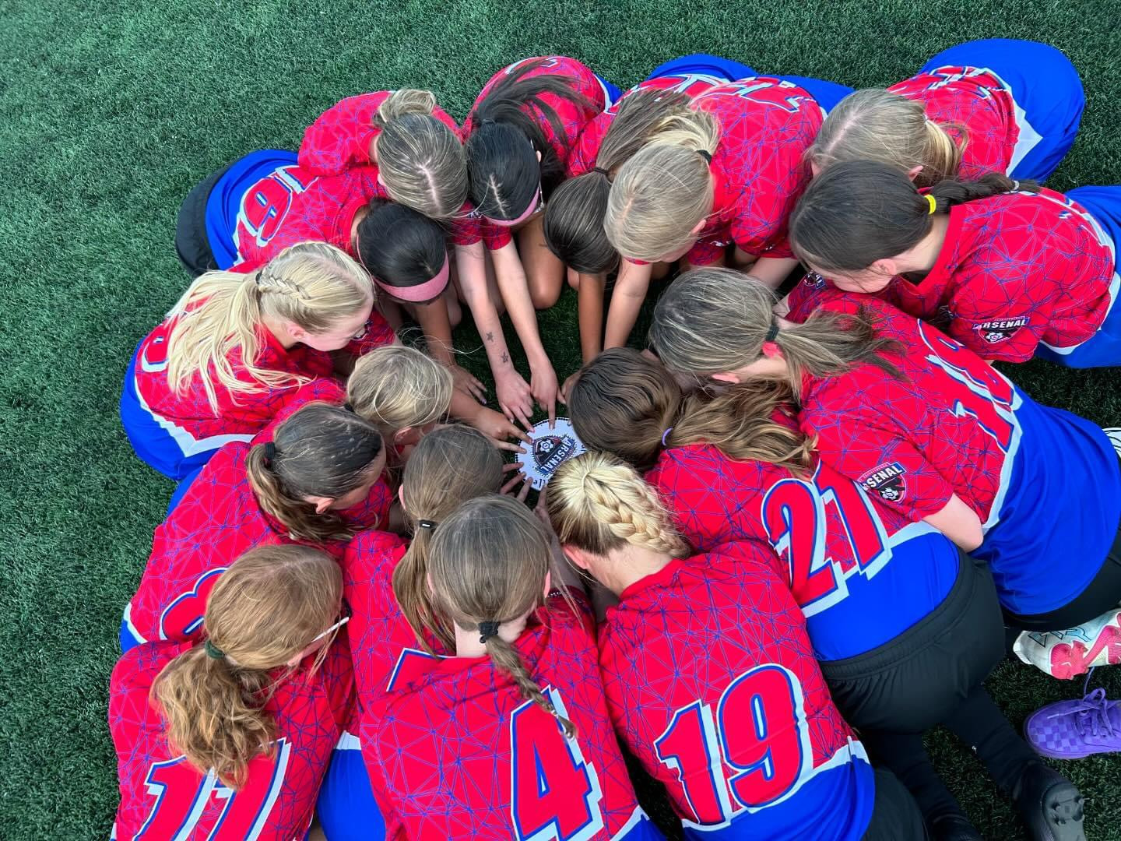
Review Of Rules And Regulations

