Slide 1
GIRLS MINOR HOCKEY
SUPPORT FOR THE EAST OTTAWA STARS XXXX

Slide 2
HELP MAKE A DIFFERENCE
The East Ottawa Stars is a non-profit minor hockey organization that is dedicated to the athletic and personal development of young female athletes in the Eastern Ottawa area.
We are seeking sponsors for the East Ottawa Stars XXXX team. Financial contributions are utilized to fund our program in a variety of ways including purchasing extra practice ice, assisting with tournament fees, team equipment, and the overall development of our female athletes.
Local business support goes a long way to eliminate economic borders and by doing so we are able to create opportunities for kids that may not have had that chance. In recent years, girls minor hockey has witnessed remarkable growth, with an increasing number of young athletes taking to the ice to pursue their passion for the sport. Despite this encouraging trend, it's important to note that girls minor hockey often finds itself overlooked when it comes to corporate sponsorships and financial support. Your contribution will help build confidence, create discipline, a sense of pride of being part of a team, and the joy and pride in providing young female athletes with the opportunity to be part of something special.

Slide 3
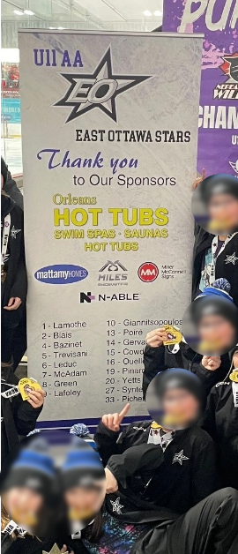
SPONSORSHIP PACKAGES
Sponsorship Package: A
Sponsorship value: Company Logo displayed on 50% of retractable banner displayed at all games. Three custom social media posts (Facebook, Instagram) promoting sponsor (tagging) to over 1,000 people reaching a targeted group of young families with an average household income of over $100K. Sponsorship recognition on team communication channels (e.g. emails, newsletters, etc.). Company logo our team webpage with link to your website. Rotating ad. A featured article on the team website promoting the company’s sponsorship with link to their business. | $3,000 1 available
Sponsorship Package: B
Sponsorship value: Company logo displayed on retractable banner displayed at all games. Two custom social media posts (Facebook, Instagram) promoting sponsor (tagging) to over 1,000 people reaching a targeted group of young families with an average household income of over $100K. Sponsorship recognition on team communication channels (e.g. emails, newsletters, etc.). Company logo our team webpage with link to your website. Rotating ad. | $1,000 6 available
Banner Example

Slide 4
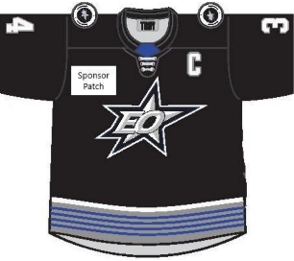
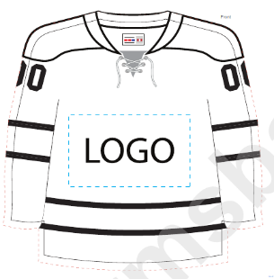
SPONSORSHIP PACKAGES
Sponsorship Package: C (Jersey Patch)
Sponsorship value: Company logo patch on our home and away team jerseys (on arm or chest area). One social media post (Facebook & Instagram) in March thanking all sponsors for their contributions. Our socials reach over 1500 people with majority young families with an average household income of over $100K. Your company will be tagged and you will be welcome to re-share it on your social media platforms. Company logo our team webpage with link to your website. Rotating ad. | $1,500 1 available Access Storage
SOLD
Sponsorship Package: D (Practice Jersey)
Sponsorship value: Company logo printed on player's personalized practice jerseys. One social media post (Facebook & Instagram) in March thanking all sponsors for their contributions. Our socials reach over 1500 people with majority young families with an average household income of over $100K. Your company will be tagged and you will be welcome to re-share it on your social media platforms. Company logo our team webpage with link to your website. Rotating ad. | $1,500 1 available

Slide 5
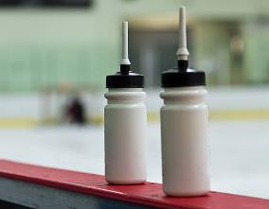
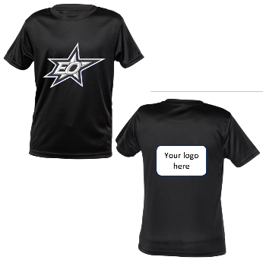
SPONSORSHIP PACKAGES
Sponsorship Package: E (Team Water Bottles)
Sponsorship value: Company logo printed on player's personalized water bottles. One social media post (Facebook & Instagram) in March thanking all sponsors for their contributions. Our socials reach over 1500 people with majority young families with an average household income of over $100K. Your company will be tagged and you will be welcome to re-share it on your social media platforms. Company logo our team webpage with link to your website. Rotating ad. | $750 1 available
Not Available
Sponsorship Package: F (Team Warm up Shirts)
Sponsorship value: Company logo printed on player’s dry fit warm-up shirts. One social media post (Facebook & Instagram) in March thanking all sponsors for their contributions. Our socials reach over 1500 people with majority young families with an average household income of over $100K. Your company will be tagged and you will be welcome to re-share it on your social media platforms. Company logo our team webpage with link to your website. Rotating ad. | $750 1 available

Slide 6
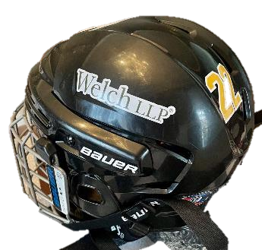
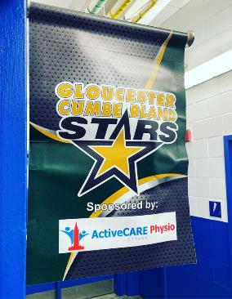
SPONSORSHIP PACKAGES
Sponsorship Package: G (Helmet Stickers)
Sponsorship value: Company logo stickers on player's helmets. One social media post (Facebook & Instagram) in March thanking all sponsors for their contributions. Our socials reach over 1500 people with majority young families with an average household income of over $100K. Your company will be tagged and you will be welcome to re-share it on your social media platforms. Company logo our team webpage with link to your website. Rotating ad. | $800 1 available
Sponsorship Package: H (Door Banner)
Sponsorship value: Logo placed on custom made magnetic double-sided dressing room banner / flag. Displayed at all team practices, games, tournaments. One social media post (Facebook & Instagram) in March thanking all sponsors for their contributions. Our socials reach over 1500 people with majority young families with an average household income of over $100K. Your company will be tagged and you will be welcome to re-share it on your social media platforms. Company logo our team webpage with link to your website. Rotating ad. | $500 1 available
Not Available

Slide 7
SPONSORSHIP PACKAGES
Sponsorship Package: I
Sponsorship value: One social media post (Facebook & Instagram) in March thanking all sponsors for their contributions. Our socials reach over 1500 people with majority young families with an average household income of over $100K. Your company will be tagged and you will be welcome to re-share it on your social media platforms. Company logo our team webpage with link to your website. Rotating ad. | $250 4 available (1 remaining) RBC Wealth Y. Potvin Interlock Myers Orleans

Slide 8
CONTACT INFORMATION
Team Manager: SheaLynn Carriere (sheacarriere@gmail.com)
https://www.facebook.com/GCGH.girls.hockey
@gcghgirls

