Slide 1

Hollandia Coach Night
Indoor 2025-26

Slide 2

Treaty Acknowledgement
Hollandia Soccer Club acknowledges that we are on Treaty 6 Territory and the Homeland of the Metis. We wish to pay our respects to the First Nations and Metis ancestors of this land and reaffirm our relationship with one another. Hollandia Soccer Club is committed to the principles of mutual respect, trust, and collaboration in recognition of the Truth and Reconciliation Commission Report.

Slide 3
Agenda
Introduction
Hollandia Development Philosophy
Development Stages & Goals
Club Technical Development Strategy
Coaching Standards
Role of the Coach
Coach Development
Role of the Manager & Resources
Questions?

Slide 4
Introduction
Austin Boryski – Male Technical Lead
Wamith Gorges – Female Technical Lead
Char Adamus – Coach Development Lead
Alison Neudorf – Club Administrator

Slide 5

Hollandia Development Philosophy
Hollandia Soccer Club is committed to a player-centric developmental philosophy, aligning with the Canadian Soccer Association’s Long-Term Player Development (LTPD) model and the four pillars of soccer development.
Our approach emphasizes technical proficiency and fundamental movement at younger age groups, establishing a strong foundation for tactical growth as players mature.
While we acknowledge the value of competition and winning, player development remains our top priority.

Slide 6

Development Stages & Goals: U7-U9
Individual Ball Skills
  Running with the ball
  Changing direction with the ball
  Shooting on goal
Fundamental Movement Skills/Physical Literacy
Goals: individual player development, comfort with ball, participation
What this looks like: 1v1 & 2v2 dribbling games, 1v1 & 2v2 training games, games with multiple goals, multiple mini pitches & training stations

Slide 7

Development Stages & Goals: U11-U13
Continued focus on technical proficiency
Fundamental Movement Skills
Introduction to age & level appropriate tactical concepts
Begin tiering players to match like-players to both technical and social growth
Begin to identify players for PSL, Alliance, & Provincial programs
Goals: solidifying technical skills introduced in U7-U9, developing new skills, growth as an individual and as part of a team
What this looks like: 3v3 & 4v4 training games, 3v2 tactical games, 6v6 with different formations, warmups with technical components

Slide 8
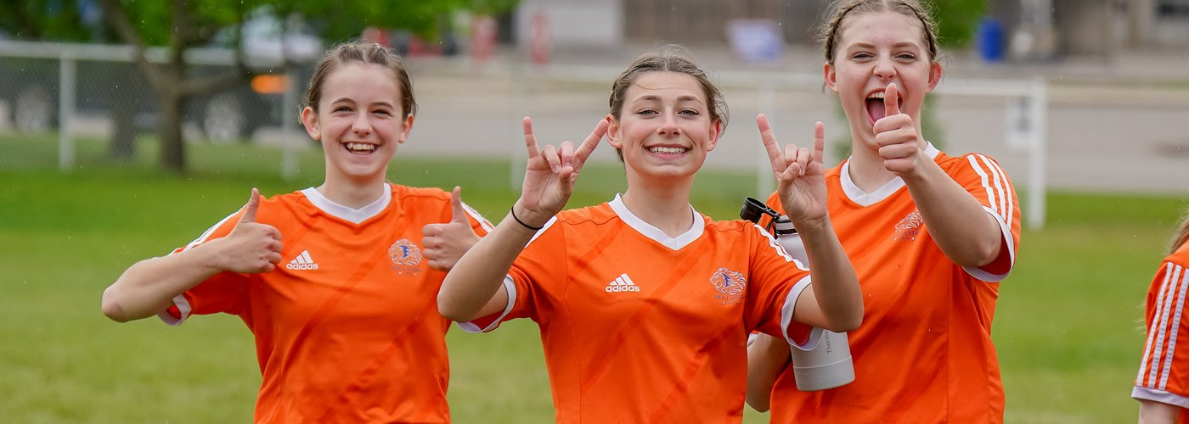
Development Stages & Goals: U15+
Continued focus on technical proficiency
Improved fitness and pace
Balance between technical and tactical development at appropriate level for players and teams
Identifying players for PSL, Alliance, and Provincial programs (Excel/CSG etc)
Goals: refining game play & situational understanding, improved decision making, continued technical improvement, player advancement & retention, transitioning players to adult soccer
What this looks like: tactical pressing drills, building from the back, tactical line breaking, 9v9 to 11v11 training games

Slide 9
Hollandia Technical Development Strategy
Hollandia has two technical leads who build and oversee a team of technical staff, as well as one coach development lead
Technical staff will run sessions for teams to provide consistent technical development across all age groups
These staff will run approximately one session per week for all teams. This is the club development strategy and is not optional.
Technical staff will reach out to coaches to communicate the schedule

Slide 10
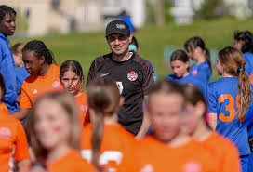
Technical Staff
Development League
U7 – Allison Berge & Austin Boryski : U9 – Austin Boryski
Alliance League
Male
U11 – Austin Boryski
U13 – Austin Boryski
U15 – Migen Masha
U17/19 - Sean Collins
Female
U11-U13 – Wamith Gorges & Anna Nguyen
U15-U17/19 - Wamith Gorges & Caydence Holowaty

Slide 11
Questions?

Slide 12
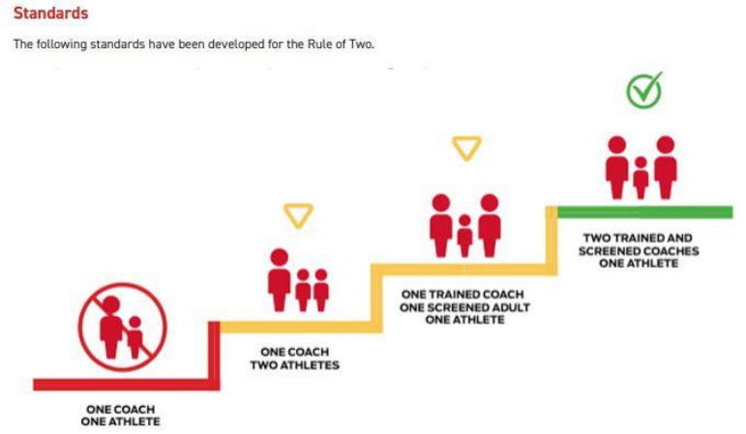
Role of the Coach
CREATE A SAFE ENVIRONMENT FOR PLAYERS
  Physical & emotional
  Respect from and for coaches, players, and parents
  Recognize that each athlete may need different things to be their best and adjust your communication and strategy
  Rule of Two
  Reporting Abuse & Misconduct – can be done anonymously through SYSI or through Hollandia: liasion@hollandiasoccer.com
Plan your season
  What tournaments?
  Other team events?
  Hold parent meeting early in season to communicate expectations, plan and team fees
Plan and run practices
  Explain activities and provide feedback so players learn
Manage games
  Playing time, substitutions, permit players etc
  Remember that games are where players have the opportunity to demonstrate what they’ve learned in practice
Lead by example
  Arrive on time, be prepared, be respectful
  Remember you are representing Hollandia

Slide 13
Coaching Notes
Managing multiple coaches & assistants
  Consider how many you need on a bench during a game
  Ensure players are not receiving instruction from multiple sources at once – coordinate between coaches how you are going to coach during games so players are not overwhelmed, and have the opportunity to make decisions themselves.
Other things to note:
  Ensure availability is being recorded in Playmetrics, and updated if players do not attend.
  Communicate with your players and parents the importance of attendance.
  The Hollandia staff will be attending games throughout the season so we can better support our players and coaches.

Slide 14
Coaching Requirements – Modified Safe Sport
Ramp Registration
Criminal Record Check (CRC) with Vulnerable Sector Uploaded into RAMP – Every 2 Years
Respect in Sport (RiS) – Every 5 Years
NCCP Understanding the Rule of Two
CSA’s NCCP Coaching Soccer in Canada – Not required for Gender Rep/Manager
These are the modified safe sport roster requirements.
Other than exception (last point) these are required for Head Coaches, Asst Coaches, Managers and/or Gender Reps
You must have a gender rep on the bench for all games and practices if there is not a same-gender coach present.
The modified safe sport roster requirements only allow you to compete against other SYSI teams.
You can not enter zone tournaments or participate in exhibition games with these.

Slide 15
Coaching Requirements – Full Safe Sport
All Modified Safe Sport Requirements PLUS
NCCP Online Module & On-Field Clinic:
  Active Start/Fundamentals: U5-U7
  Learn To Train: U11-U13
  Soccer for Life: U15-U19
Making Ethical Decisions (MED)
NCCP Making Headway in Sport
NCCP Emergency Action Plan Online Module
These are the full safe sport roster requirements.
You must have a gender rep on the bench for all games if there is not a same-gender coach present.
There are additional requirements for PSL & Sask Cup: C-License HC, True Sport Clean 101, and Role of Athlete Support Personnel
Once you have met these requirements you are able to coach in games against non-SYSI teams (ie tournaments, exhibition games)

Slide 16
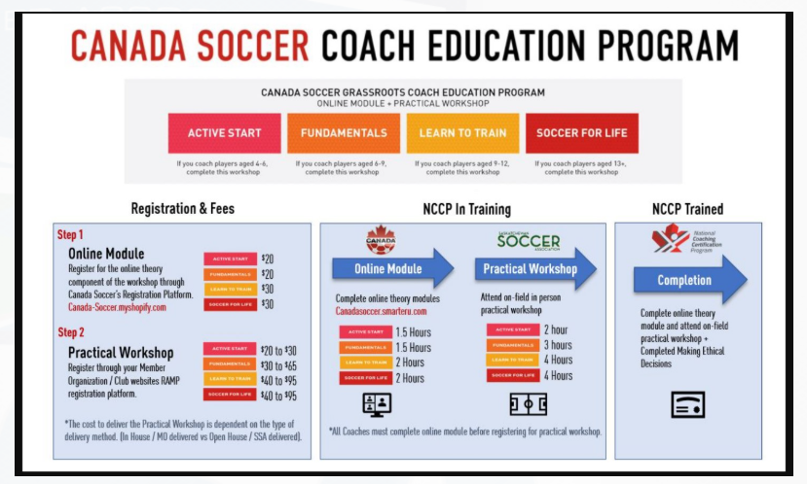
Hollandia will reimburse coaches for the online portion. You can register for the on-field through SYSI. Prices in the above graphic are estimates only.

Slide 17

Current Coaching Clinic Dates
FUNdamentals (U5-U9): Oct 15 615-915pm
Learn to Train (U11-U13): Oct 16 515-915pm
Soccer for Life (U15-U19): Oct 21 515-915
You need to complete the online portion before the on-field clinic
Make Ethical Decisions Online Cinic: Nov 6 & 11 6-10pm
This offering is free for SYSI coaches, and there are other opportunities through the Coaches Association of Saskatchewan for $45. The online evaluation is $85 if done outside this, Hollandia will only reimburse up to $45.
You must have all required certifications/qualifications before the season begins. If you need assistance, please reach out to either myself or Alison.

Slide 18
Further Coach Education
There are also a wide range of courses available online through NCCP (The Locker)
Please consider taking Keeping Girls in Sport Training if you are coaching a female team
Other courses recommended by SYSI are the Aboriginal Coaching Module, and Coaching Athletes with a Disability
Canada Soccer C-License – please contact the club if you are interested

Slide 19
Coach Recruitment, Development & Recognition
Hollandia is committed to providing resources and support to assist coaches and further their development. If you have questions, whether it is technical, tactical, or if you are in need of support please let us know.
Hollandia provides:
  Seasonal coaching honorarium for head coaches
  Reimbursement of volunteer fees for all team staff (per season)
  Swag/gear
    More info to come on indoor coach apparel
  Appreciation events
Professional development (other than required coaching courses) requires prior approval to be reimbursed – please reach out to one of our Leads (Austin, Wamith, Char)
If you know anyone who would like to coach please let us know!

Slide 20
Role of the Manager & Resources (for Managers & Coaches)
Organize team functions
Collect and manage team funds
Book hotels
Register for tournaments
Complete gamesheets
Assist in planning season with Head Coach
Assist on bench (if required)
Communicate with parents
Communicate with Coach
Managers Handbook on Hollandia website
Saskatoon Youth Soccer Website
  Schedules
  Game Sheets
  Rules
  Travel Permits
  Tournament Info
Hollandia website
SYSI Coach Night Presentation & Zone Coach Package

Slide 21
Questions?

Slide 22
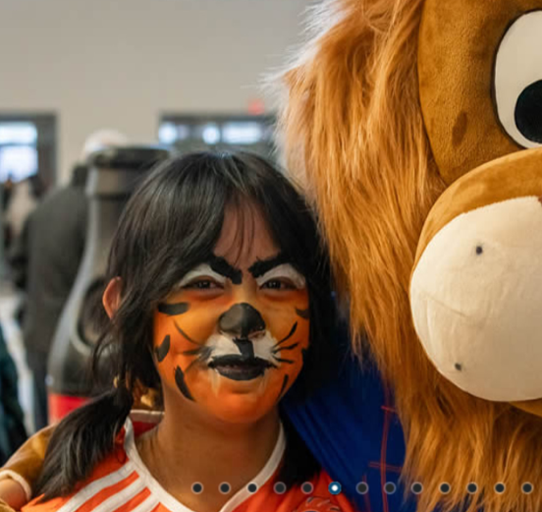
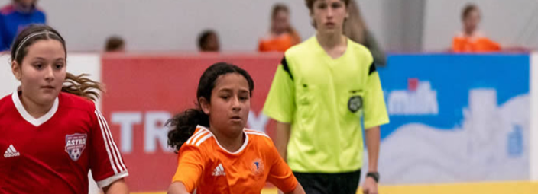
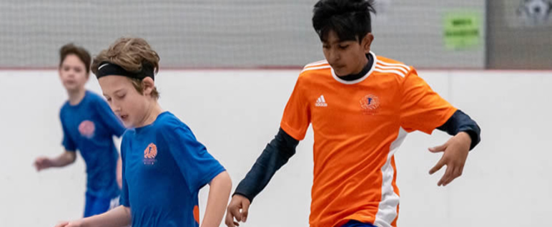
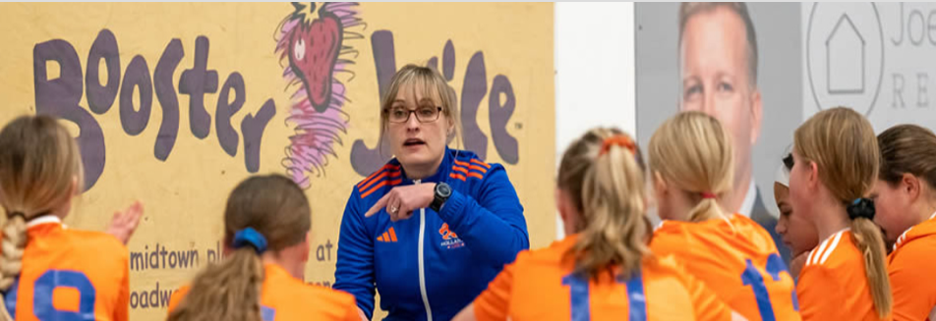
Off the Wall!
Off the Wall is Hollandia’s main indoor fundraiser. We use the revenues to invest back into the club and to keep fees as low as possible.
We would love to see all Hollandia teams register for the last remaining boarded tournament in Saskatchewan!
We will also be asking each team to donate a prize for our Raffle Table.

Slide 23
Thank You for Giving Your Time to Coach, Asst Coach, & Manage!

