Slide 1

Hollandia Coach Night
Outdoor 2026

Slide 2

Treaty Acknowledgement
Hollandia Soccer Club acknowledges that we are on Treaty 6 Territory and the Homeland of the Metis. We wish to pay our respects to the First Nations and Metis ancestors of this land and reaffirm our relationship with one another. Hollandia Soccer Club is committed to the principles of mutual respect, trust, and collaboration in recognition of the Truth and Reconciliation Commission Report.

Slide 3
Agenda
Introduction
Hollandia Development Philosophy
Development Stages & Goals
Club Technical Development Strategy
Coaching Standards
Role of the Coach
Coach Development
Role of the Manager & Resources
Questions?

Slide 4
Introduction
Austin Boryski – Male Technical Lead
Wamith Gorges – Female Technical Lead
Char Adamus – Coach Development Lead
Alison Neudorf – Club Administrator

Slide 5

Hollandia Development Philosophy
Hollandia Soccer Club is committed to a player-centric developmental philosophy, aligning with the Canadian Soccer Association’s Long-Term Player Development (LTPD) model and the four pillars of soccer development.
Our approach emphasizes technical proficiency and fundamental movement at younger age groups, establishing a strong foundation for tactical growth as players mature.
While we acknowledge the value of competition and winning, player development remains our top priority.

Slide 6

Development Stages & Goals: U7-U9
Individual Ball Skills
Running with the ball
Changing direction with the ball
Shooting on goal
Fundamental Movement Skills/Physical Literacy
Goals: individual player development, comfort with ball, participation
What this looks like: 1v1 & 2v2 dribbling games, 1v1 & 2v2 training games, games with multiple goals, multiple mini pitches & training stations

Slide 7

Development Stages & Goals: U11-U13
Continued focus on technical proficiency
Fundamental Movement Skills
Introduction to age & level appropriate tactical concepts
Begin tiering players to match like-players to both technical and social growth
Begin to identify players for PSL, Alliance, & Provincial programs
Goals: solidifying technical skills introduced in U7-U9, developing new skills, growth as an individual and as part of a team
What this looks like: 3v3 & 4v4 training games, 3v2 tactical games, 6v6 with different formations, warmups with technical components

Slide 8
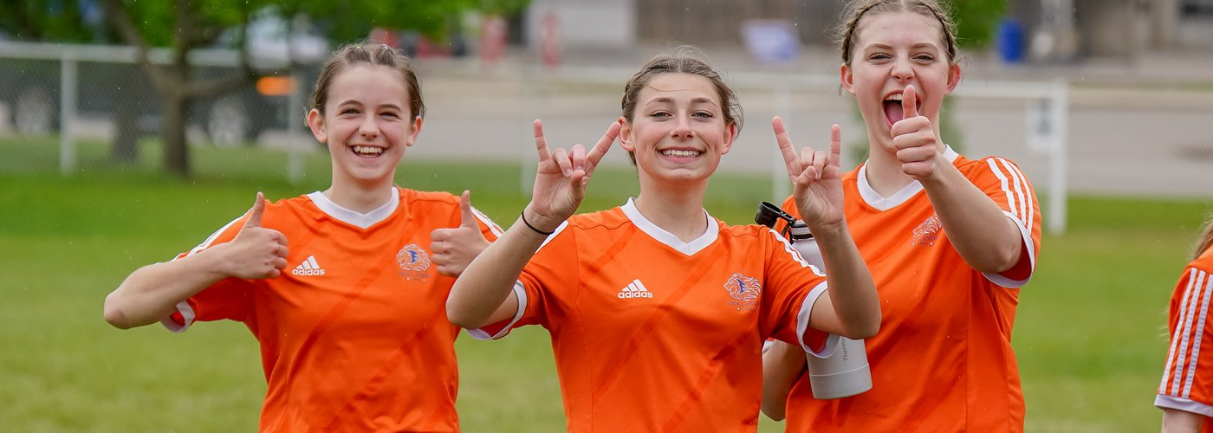
Development Stages & Goals: U15+
Continued focus on technical proficiency
Improved fitness and pace
Balance between technical and tactical development at appropriate level for players and teams
Identifying players for PSL, Alliance, and Provincial programs (Excel/CSG etc)
Goals: refining game play & situational understanding, improved decision making, continued technical improvement, player advancement & retention, transitioning players to adult soccer
What this looks like: tactical pressing drills, building from the back, tactical line breaking, 9v9 to 11v11 training games

Slide 9
Hollandia Technical Development Strategy
Hollandia has two technical leads who build and oversee a team of technical staff, as well as one coach development lead
Technical staff will run sessions for Alliance teams to provide consistent technical development across all age groups
These staff will run approximately one session per week for all Alliance teams. This is the club development strategy and is not optional.
Technical staff will reach out to Alliance coaches to communicate the schedule
If you coach a city team and would like some assistance, please reach out to us as technical sessions are not included in the city league program/fees.

Slide 10

We love our goalkeepers!
If you have a player(s) who are interested in goalkeeping Hollandia also offers goalkeeper training – more info to come regarding the outdoor season!

Slide 11
Questions?

Slide 12
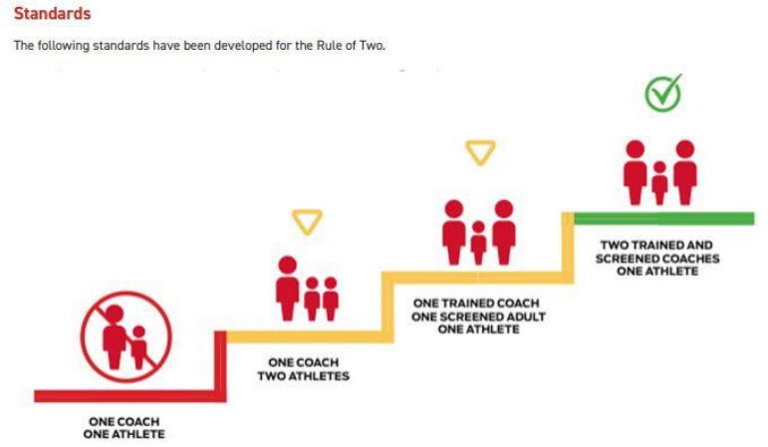
Role of the Coach
CREATE A SAFE ENVIRONMENT FOR PLAYERS
Physical & emotional
Respect from and for coaches, players, and parents
Recognize that each athlete may need different things to be their best and adjust your communication and strategy
Rule of Two
Reporting Abuse & Misconduct – can be done anonymously through SYSI or through Hollandia: liasion@hollandiasoccer.com
Plan your season
What tournaments?
Other team events?
Hold parent meeting early in season to communicate expectations, plan and team fees
Plan and run practices
Explain activities and provide feedback so players learn
Manage games
Playing time, substitutions, permit players etc
Remember that games are where players have the opportunity to demonstrate what they’ve learned in practice
Lead by example
Arrive on time, be prepared, be respectful (to players, competitors, officials, facility staff, etc)
Remember you are representing Hollandia

Slide 13
Coaching Notes
Managing multiple coaches & assistants
Consider how many you need on a bench during a game
Ensure players are not receiving instruction from multiple sources at once – coordinate between coaches how you are going to coach during games so players are not overwhelmed, and have the opportunity to make decisions themselves.
Other things to note:
Ensure availability is being recorded in Playmetrics, and updated if players do not attend.
Communicate with your players and parents the importance of attendance.
The Hollandia staff will be attending games throughout the season so we can better support our players and coaches. Feel free to reach out if you have any questions or concerns.

Slide 14
Coaching Requirements – Modified Safe Sport
Ramp Registration
Criminal Record Check (CRC) with Vulnerable Sector Uploaded into RAMP – Every 2 Years
Respect in Sport (RiS) – Every 5 Years
NCCP Understanding the Rule of Two
CSA’s NCCP Coaching Soccer in Canada – Not required for Gender Rep/Manager
These are the modified safe sport roster requirements.
Other than exception (last point) these are required for Head Coaches, Asst Coaches, Managers and/or Gender Reps
You must have a gender rep on the bench for all games and practices if there is not a same-gender coach present.
The modified safe sport roster requirements only allow you to compete against other SYSI teams.
You can not enter zone tournaments or participate in exhibition games with these.

Slide 15
Coaching Requirements – Full Safe Sport
All Modified Safe Sport Requirements PLUS
NCCP Online Module & On-Field Clinic:
Active Start/Fundamentals: U5-U7
Learn To Train: U11-U13
Soccer for Life: U15-U19
Making Ethical Decisions (MED)
NCCP Making Headway in Sport
NCCP Emergency Action Plan Online Module
These are the full safe sport roster requirements.
You must have a gender rep on the bench for all games if there is not a same-gender coach present.
There are additional requirements for PSL & Sask Cup which may include: C-License HC, True Sport Clean 101, and Role of Athlete Support Personnel
Once you have met these requirements you are able to coach in games against non-SYSI teams (ie tournaments, exhibition games)

Slide 16
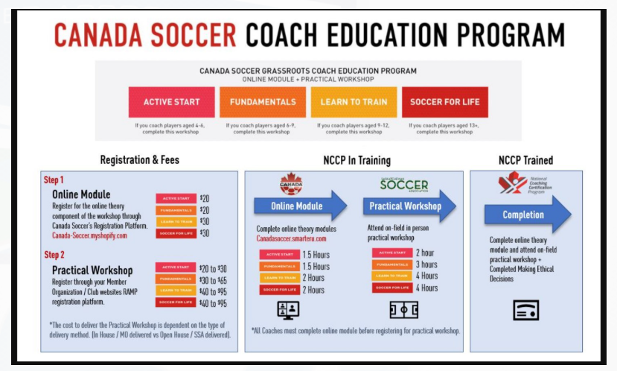
Hollandia will reimburse coaches for the online portion. You can register for the on-field through SYSI. Prices in the above graphic are estimates only.

Slide 17

Current Coaching Clinic Dates
FUNdamentals (U5-U9): May 1st 6-9pm
Learn to Train (U11-U13): May 2nd 8am-12pm
Soccer for Life (U15-U19): May 2nd 1-5pm
You need to complete the online portion before the on-field clinic
Register through SYSI website
Making Ethical Decisions is now online
The zone will reimburse you for required courses, please contact Alison once you have completed
You must have all required certifications/qualifications before the season begins. If you need assistance, please reach out to either myself or Alison.

Slide 18
Further Coach Education
There are also a wide range of courses available online through NCCP (The Locker)
Please consider taking Keeping Girls in Sport Training if you are coaching a female team
Other courses recommended by SYSI are the Aboriginal Coaching Module, and Coaching Athletes with a Disability
If you would like to take additional courses that have a cost associated with them, please reach out to us prior to registering. Reimbursement is not guaranteed without prior approval!
Canada Soccer C-License and higher – please contact the club if you are interested

Slide 19
Coach Recruitment, Development & Recognition
Hollandia is committed to providing resources and support to assist coaches and further their development. If you have questions, whether it is technical, tactical, or if you are in need of support please let us know.
Hollandia provides:
Seasonal coaching honorarium for head coaches
Reimbursement of volunteer fees for all team staff (per season)
Swag/gear
Remember to try on the outdoor coach apparel before you leave!
Appreciation events
Professional development (other than required coaching courses) requires prior approval to be reimbursed – please reach out to one of our Leads (Austin, Wamith, Char)
If you know anyone who would like to coach please let us know!

Slide 20
Role of the Manager & Resources (for Managers & Coaches)
Organize team functions
Collect and manage team funds
Book hotels
Register for tournaments
Complete gamesheets
Assist in planning season with Head Coach
Assist on bench (if required)
Communicate with parents
Communicate with Coach
Managers Handbook on Hollandia website
Saskatoon Youth Soccer Website
Schedules
Game Sheets
Rules
Travel Permits
Tournament Info
Hollandia website
SYSI Coach Night Presentation & Zone Coach Package

Slide 21
Questions?

Slide 22
Thank You for Giving Your Time to Coach, Asst Coach, & Manage!

