Slide 1
SPORDLE PLAY FOR OFFICIALS
Notes:
Either Anthony or Michele will open up the meeting and facilitate the event

Slide 2
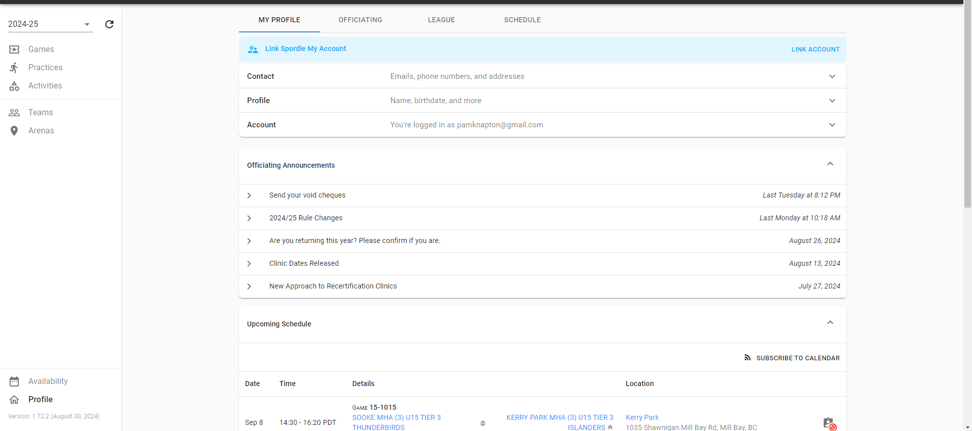
LOGGING IN
Once you log in, this is the screen that you come to. On this page you will find announcements sent out to officials, edit your profile and most importantly, set your availability.
LOGGING IN
Notes:
Once you log in this is the screen that you come to. On this page you will find announcements sent out to officials, edit your profile and most importantly, set your availability.

Slide 3
LOGGING IN
If you are in other sections of Spordle play you can always get back to this screen by clicking on profile on the bottom left
LOGGING IN
Notes:
Once you log in this is the screen that you come to. On this page you will find announcements sent out to officials, edit your profile and most importantly, set your availability.

Slide 4
RETURNING OFFICIALS: LOGGING IN
For returning officials, you may have to set your year as it may still be set to last season. This can be found on the top left of the screen right under Spordle and above games.
RETURNING OFFICIALS: LOGGING IN
Notes:
Once you log in this is the screen that you come to. On this page you will find announcements sent out to officials, edit your profile and most importantly, set your availability.

Slide 5
LOGGING IN
Any games that you have been assigned will show up on this screen
LOGGING IN
Notes:
Once you log in this is the screen that you come to. On this page you will find announcements sent out to officials, edit your profile and most importantly, set your availability.

Slide 6
LOGGING IN
Click on the clipboard icon to see assignment details
LOGGING IN
Notes:
Once you log in this is the screen that you come to. On this page you will find announcements sent out to officials, edit your profile and most importantly, set your availability.

Slide 7
NEW OFFICIALS : SETTING YOUR ASSIGNOR/ARENA
Click on availability
SETTING YOUR ASSIGNOR/ARENAS
Notes:
Once you log in this is the screen that you come to. On this page you will find announcements sent out to officials, edit your profile and most importantly, set your availability.

Slide 8
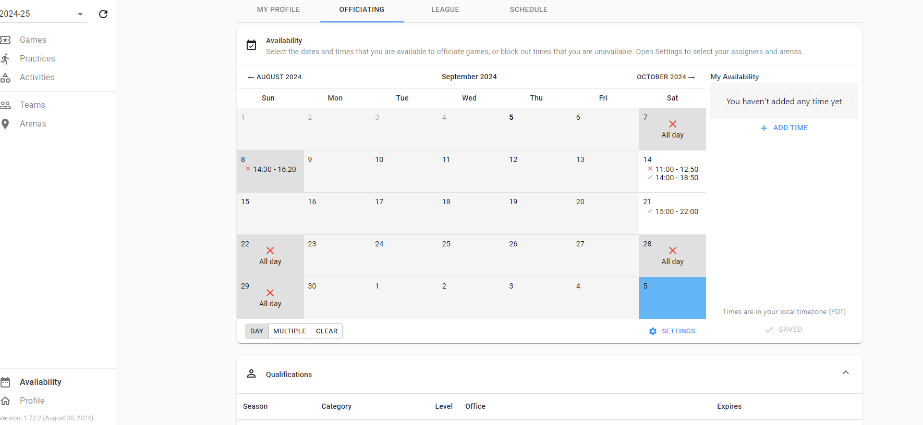
NEW OFFICIALS : SETTING YOUR ASSIGNOR/ARENA
Once to this screen click on the “blue setting tab” just under the calendar to set your arena
SETTING YOUR ASSIGNOR/ARENAS
Notes:
Once to this screen click on the “blue setting tab” just under the calendar to set your arena

Slide 9
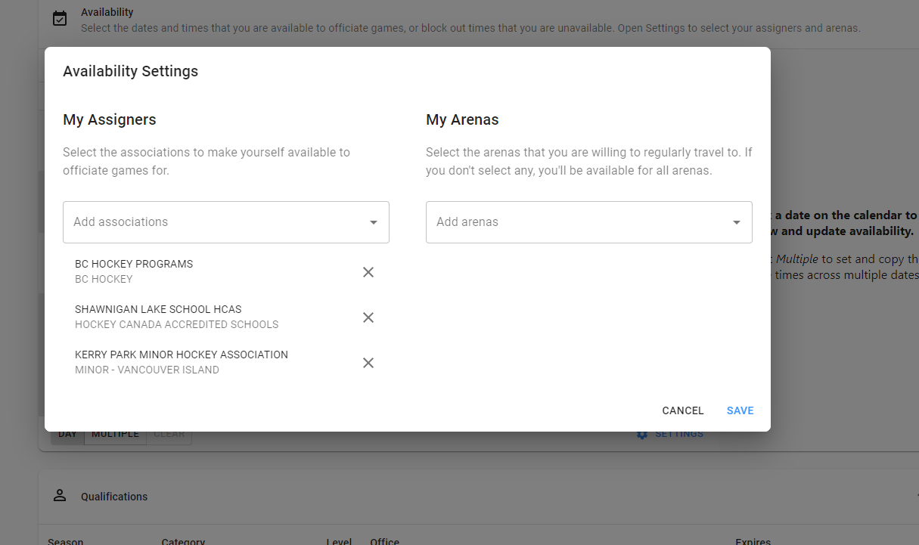
NEW OFFICIALS : SETTING YOUR ASSIGNOR/ARENA
Type in Kerry Park Minor Hockey Association and select them from the Dropdown. This will ensure you show up in the Kerry Park Minor Hockey assigning pool. Once you are finished, click save.
SETTING YOUR ASSIGNOR/ARENAS
Notes:
Type in Kerry Park Minor Hockey Association and select them from the Dropdown. This will ensure you show up in the Kerry Park Minor Hockey assigning pool. Once you are finished, click save.
( My slide shows BC hockey and SLS due to the fact that my son plays there and is in high performance ) black out or explain that these two are not ones to select????

Slide 10
SETTING AVAILABILITY
Click on availability to set your availability
SETTING AVAILABILITY
Notes:
Once you log in this is the screen that you come to. On this page you will find announcements sent out to officials, edit your profile and most importantly, set your availability.

Slide 11
SETTING AVAILABILITY
After you have your arenas set, go back to the availability screen (calendar page). On this page you want to select the dates that you are available. This can be done individually, or you can select multiple dates at one time when the times on those dates are the same. Click add time
SETTING AVAILABILTY
Notes:
After you have your arenas set, go back to the availability screen (calendar page). On this page you want to select the dates that you are available. This can be done individually, or you can select multiple dates at one time when the times on those dates are the same. Click add time

Slide 12
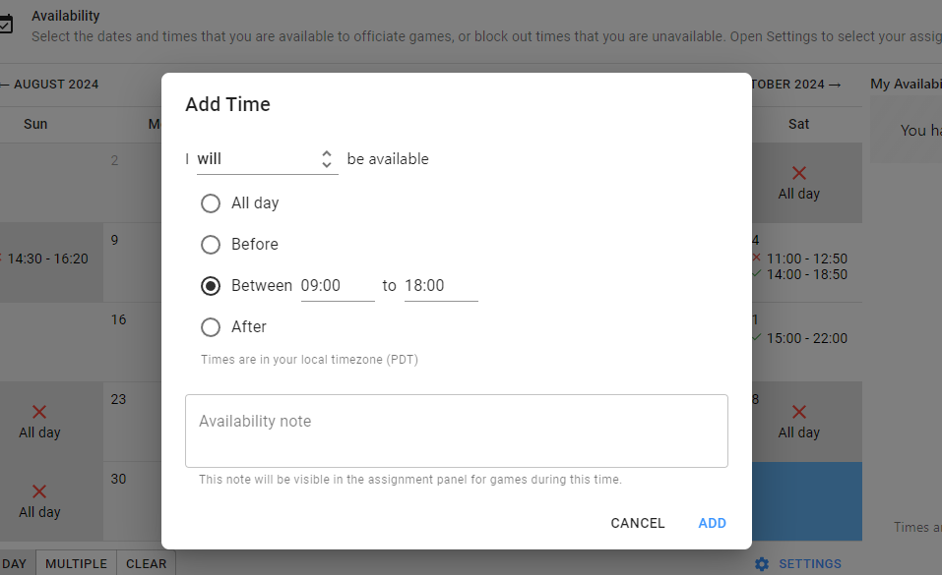
SETTING AVAILABILITY
After you click add time, you will be brought to this screen. Put in any notes that you may think is important. Once you are finished selecting when you are available, click add. Recommendation is to put when you are available as opposed to when not available.
SETTING AVAILABILITY
Notes:
After you click add time, you will be brought to this screen. Put in any notes that you may think is important. Once you are finished selecting when you are available, click add

Slide 13
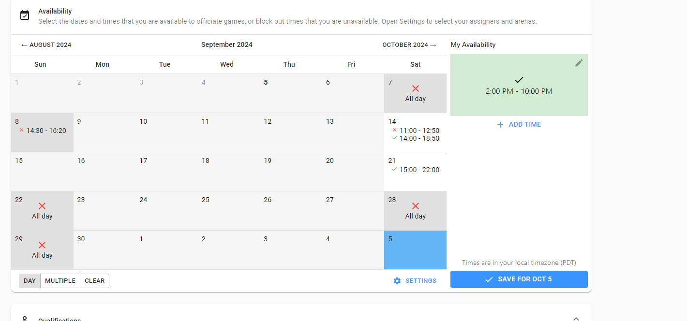
AVAILABILTY CALENDAR
When you have set your availability, your calendar will look a little different, red X’s showing when you are not available, and green check marks showing when you are available. Don’t forget to hit save for the dates that you edited.
If no availability is set, you will show as not available
AVAILABILTY CALENDAR
Notes:
When you have set your availability, your calendar will look a little different, red X’s showing when you are not available, and green check marks showing when you are available.
If no availability is set, you will show as not available

Slide 14
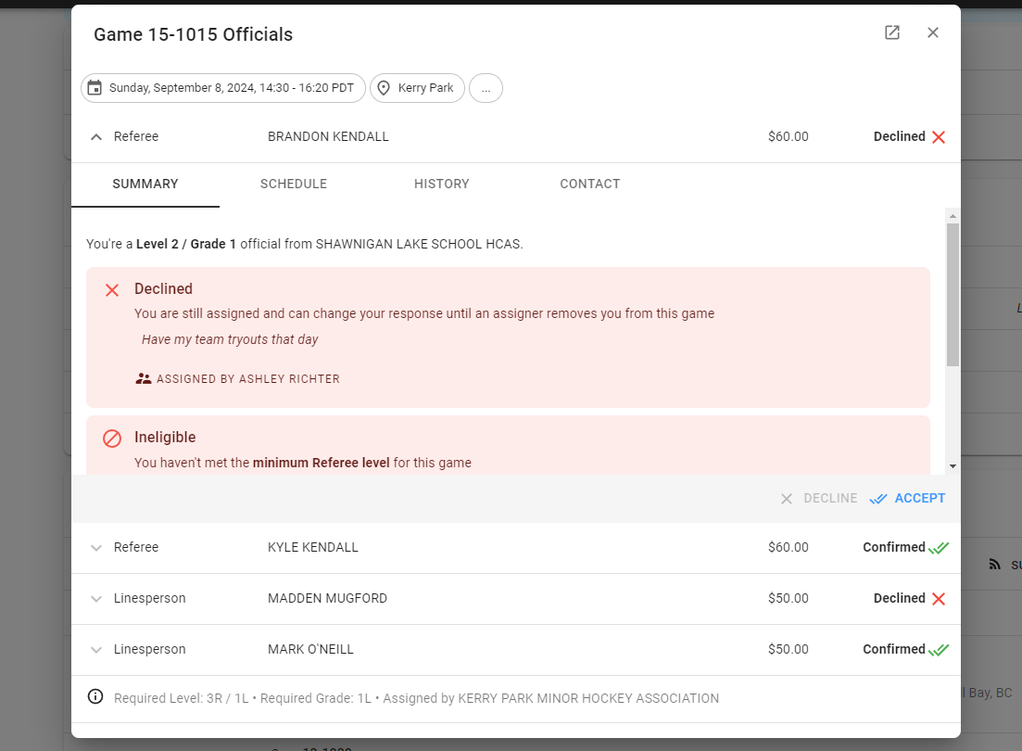
ACCEPTING ASSIGNMENTS
Once assigned a game you have the option to accept or decline a game. If declining, please provide a reason in the notes tab.
ACCEPTING ASSIGNMENTS

Slide 15
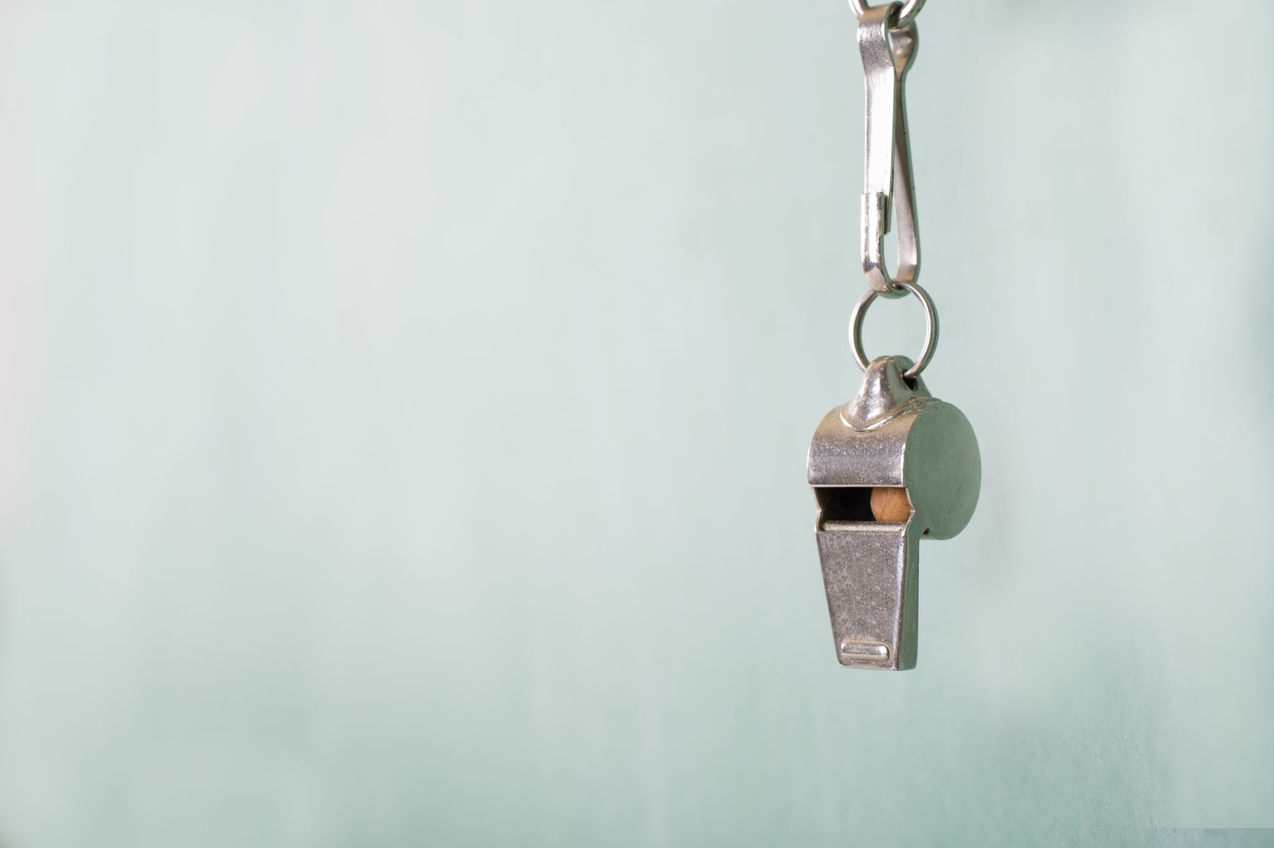
Questions
Questions

