Slide 1
Kootenay Rovers Football Club
REP & Development Outdoor 2025
Parent Meeting March 31, 2025

Slide 2
Agenda
The Club
The Player
The Coach
The Parent
The Manager
Q/A
Our philosophy, vision, and mission.
KRFC approach to player development.
Who is a KRFC Coach?
What do we expect of our parents?
Schedule, TeamSnap, Kit, Tournaments etc.
Additional details

Slide 3
The Club

Slide 4
Kootenay Rovers FC
Vision
Build and grow the East Kootenays to a place where it is known as a soccer region within British Columbia and Canada.
Mission
To promote, develop, and facilitate the game of soccer for all players regardless of gender, age and ability.
Philosophy
As many as possible, for as long as possible, in the best environment possible…

Slide 5
Our Programs
Players are where they can learn
Players are placed in environments where the can experience a good balance of challenges and success.
Sessions = the game
Everyone can play
Every session delivered allows players to learn under situations that are game realistic.
Our environment is inclusive for all. Love for soccer and physical activity is paramount.
Meaningful
Realistic
Accessible
Training is Active
Enjoyment is priority!
Players are moving 75-80% of the time at a session and everyone is involved.
This is a space where players get to enjoy the game they love!
Engaging
Fun
Notes:
Our programs aim to meet players at their current developmental level, keep training as active as possible, provide appropriate challenge for players and above all else ensure players

Slide 6
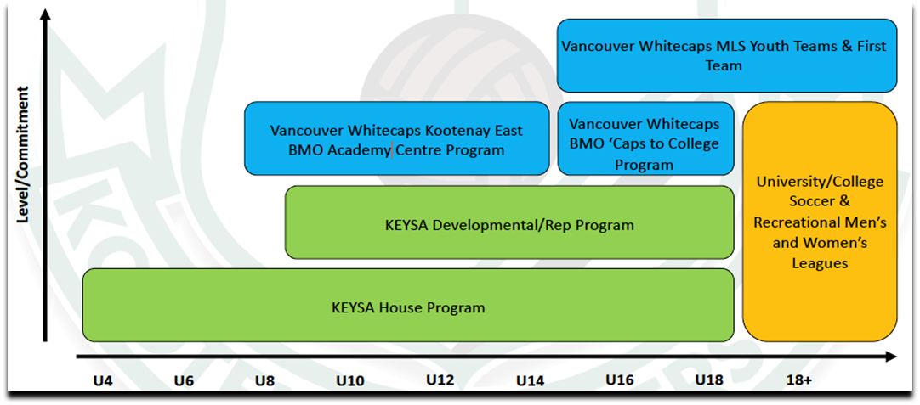
Player Pathway
Notes:
Note that we do not have a TDM or whitecaps head coach right now

Slide 7
KESA Board
KESA President Rima Amaechi kesasoccer.president@gmail.com
Vice President/Disciplinary/REP/DEV Chair Sally Paddock kesasoccer.vicepresident@gmail.com
Referee Chair Sergio Spadafora SergioS@kootenayeastsoccer.com
REP/Development Chair Terra Wilson kesasoccer.repdevchair@gmail.com
House Chair Chuck Downie chuckd@kootenayeastsoccer.com
House Co Chair Renae Peters kesasoccer.housecochair@gmail.com
Concession will be a sub committee during Spring House program and KESA Rovers Classic Tournament
Sponsorship Chair Scott Tracey ScottT@kootenayeastsoccer.com
Public Relations Chair Crystal Meyers kesasoccer.publicrelationschair@gmail.com
Adult League Chair Connor McCormack connorM@kootenayeastsoccer.com
Equipment/Lining Chair David Gibson kesasoccer.equipmentliningchair@gmail.com
Tournament Chair Carolyn Thibeault kesasoccer.tournamentchair@gmail.com
Tournament Co Chair Natalie Brons kesasoccer.tournamentcochair@gmail.com
Treasurer Gary McPherson
Non-Board Positions
Administrator Leah Welch kootenayeastsoccer@gmail.com
Notes:
As you may know at the last AGM there was a big shift with several new board members joining KESA, although there will be some growing pains, we are excited for the upcoming season and you may see a few changes. Meeting minutes and other board information on the website

Slide 8
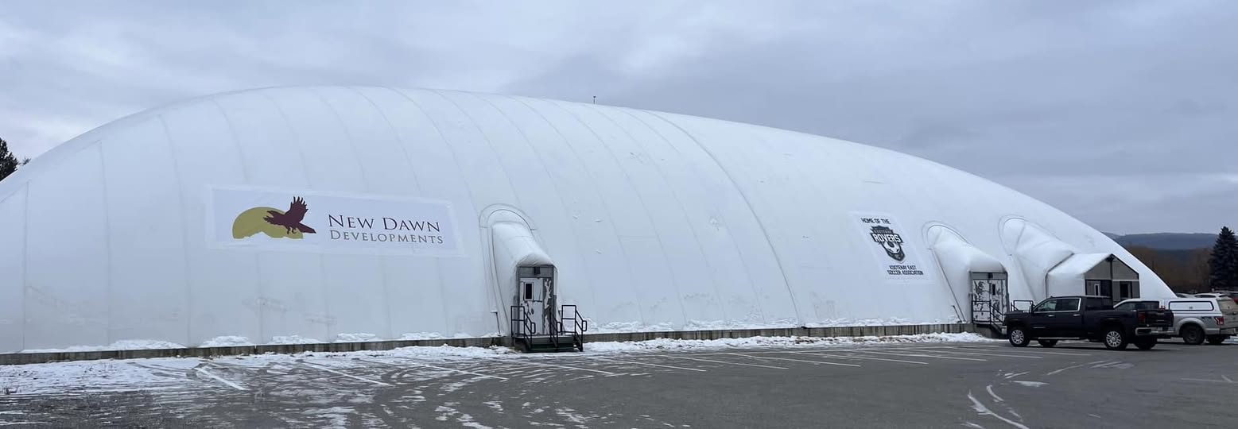
Vacancy!
One Position Still to be filled!
KESA is actively seeking to appoint an Indoor Facility Chair
Responsibilities encompass managing the opening and closing of the Dome for new users, demonstrating the batting cage procedures, overseeing the removal and reinstallation of fences during certain seasons, coordinating/completing line painting within the Dome, managing the janitorial contract, managing the dome maintenance contract and schedule, managing the maintenance of the snow blower for snow removal contracts, addressing/completing any repairs, and setting the heating system weekly, both online and in person for significant issues.
For further details, please contact kootenayeastsoccer@gmail.com

Slide 9
2025 Year In Review

Slide 10
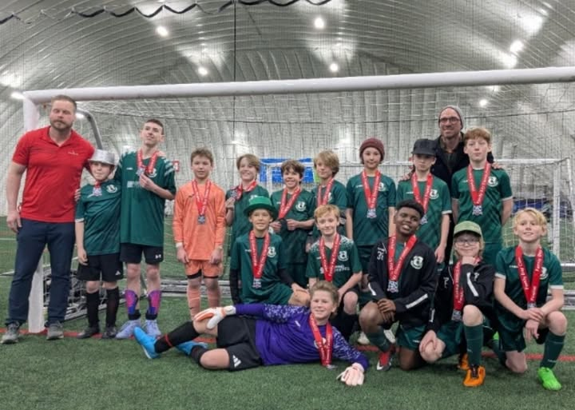
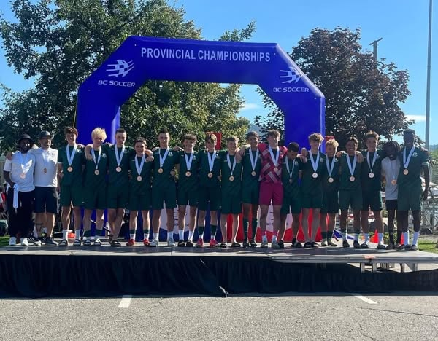
Progress!
Year round programs
Indoor and outdoor facilities
Tournaments during all seasons
BC Soccer Provincials
KESA Mixed League/ Adult Drop- in participation
Indoor tournaments
Upcoming Rome Trip for U17/18 players

Slide 11
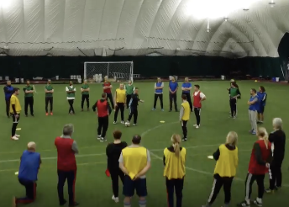
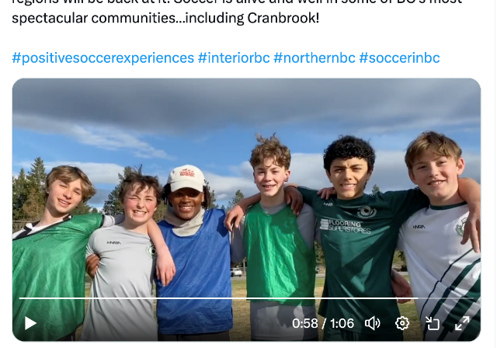
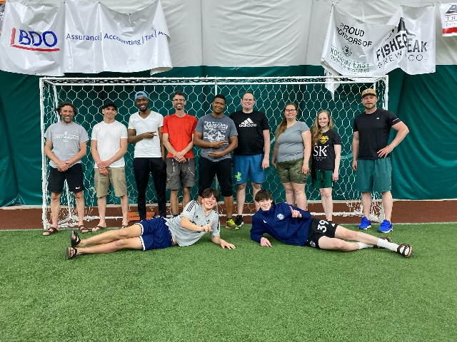
Coach Development
In 2023 over 30 Coaches across the Kootenays Attended the Canada Soccer C Diploma, several coaches certified
In 2024 several Coaches trained and certified through Canada Soccer Grassroots Education Program *Offering Foundations and Soccer for Life MAY 3!
Features on Rovers FC/ Cranbrook from BC Soccer on Social Media platforms

Slide 12
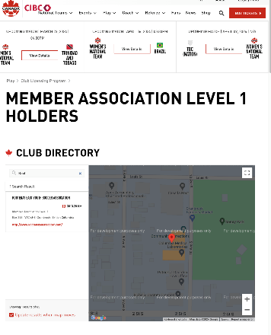
Canada Soccer Club Licensing- Member Association Level 1
In 2024 KESA received Canada Soccer Association Provincial/ Territorial Youth Club License- Level 1
Recognition of high-quality grassroots, community, and competitive organizations
Indication of quality in governance, operations, technical

Slide 13
The Player

Slide 14
Pillars to Player Growth
Versatility
Develop versatile players that can thrive in any set up and soccer environment
Community
Create and build a strong community through the sport
Resilience
Use competition and the challenges of sport to build resilience
Learning
Foster a positive learning environment
Life Skills
Help prepare for life beyond the sport

Slide 15
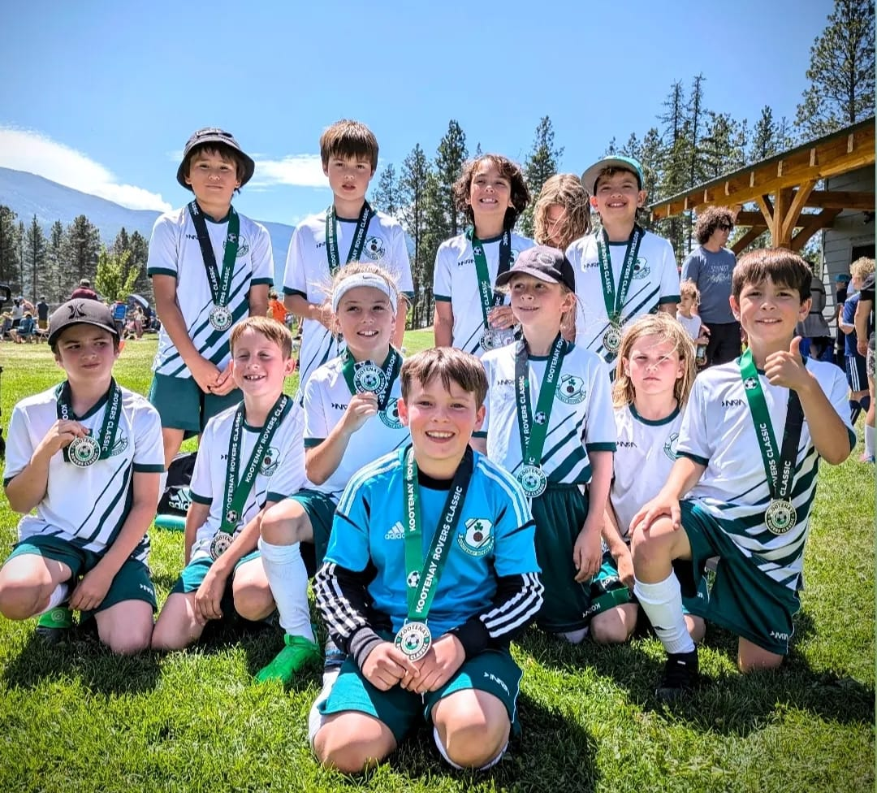
KESA Development
U9 to U13
Practice with age group
Varied teams
Participation > Results

Slide 16
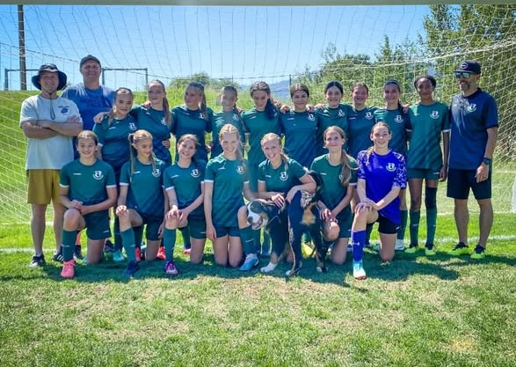
KESA
REP U14 to U18
Competitive
Travel
Retention > Results

Slide 17
PLAYER EXPECTATIONS SPORTSMANSHIP:
All players are expected to conduct themselves in accordance with the KESA FAIR PLAY CODE OF CONDUCT, in a sportsmanlike manner during training, games and at any club events. Any player who fails to do so will be subject to disciplinary action, which may include suspension by KESA Board.
ATTENDANCE: Players are expected to attend all scheduled training sessions. Any player that is consistently unable to attend training sessions can be subject to a reduction in playing time. Players are expected to attend all scheduled games, tournaments, and provincials should their team qualify.
ATTIRE: Players are expected to wear soccer appropriate apparel during training sessions and games. All players will be required to wear their KESA uniform kit for training and games. All players are required to wear appropriate equipment at all times on the field (see SAFETY section below).
SAFETY: All players shall conduct themselves in accordance with the KESA FAIR PLAY CODE OF CONDUCT. Safety is a core value within KESA. No player shall conduct them self in a manner that injures or has the potential to injury themselves or other players. Players will wear cleats and shin pads at all times on the field. Players will not wear watches, earrings, other jewelry, or hats while on the field. Contacts or sports glasses must be worn if your prescription requires. Standard glasses are not permitted.

Slide 18
Fair Play Code for Players
I will participate because I want to, not just because my parents or coaches want me to.
I will play by the rules, and in the spirit of the game.
I will control my temper - fighting and “mouthing off” can spoil the activity for everybody.
I will respect my opponents.
I will do my best to be a true team player. I will remember that winning isn’t everything - that having fun, improving skills, making friends and doing my best are also important.
I will acknowledge all good plays/performances - those of my team and of my opponents.
I will remember that coaches and officials are there to help me. I will accept their decisions and show them respect.
I will not discriminate on grounds of race, gender, or sexuality.
I will participate in soccer alcohol and drug free
I will support the KESA Concussion Policy
If I have a concern, I will appropriately communicate it to coaches, officials or KESA Contacts
I will respect the facilities that I use with my team: fields, hotels, restaurants, and washrooms, leaving them as they were or better than how I found them.

Slide 19
Player Expectations
COMMITMENT
Players and parents agree to play for KESA and Whitecaps only and will not compete with other competitive soccer clubs without prior, written consent from the KESA board. Any player who fails to follow this will be subject to disciplinary action, which may include suspension by the KESA Board. Players and parents acknowledge the required participation in multiple weekly training sessions, games, tournaments, provincials and associated travel costs. A signed deposit cheque is required to play on a KESA Rep team.
DETERMINATION OF PLAYING TIME
Rep players should expect to compete for playing time, but players who attend training and work hard should expect to play a minimum of 30% of the total game minutes on average per season. Playing time is determined by: training attendance, performance on the field, and work ethic/behavior in games and training.

Slide 20
The Coach

Slide 21
Coaches
Who is a Rovers FC Coach?
Below are the core behaviours of what we expect all of our coaches to abide by every time they wear the badge and engage our players…
Inspiring
Connect
Teach and Inspire
Always aim to have constant positive interaction with all players. Ensure that learning takes place and athletes are excited to come back the next week.
Prepared
Connect with Players
Lead
Humanize and personalize the environment by getting to know the person behind the player and show care for who they are as an individual.
Arrive Prepared
Ready upon arrival to deliver the best session possible. Session plans are made, equipment is set up, and proper attire is worn.
Lead by Example
Demonstrate behaviours that we want in our players (eg. showing up on time, respectful, positive body language, words and actions etc.)
Notes:
New coaching app to assist coaches, especially important while we wait to fill the KESA TD role

Slide 22
KRFC Session Delivery
Fun
04
All players will walk away from our sessions having learned something and excited to come back the next time.
Engaging
03
All players are involved for most of the session (avoid activities that use long lines/ wait times to get involved).
02
Active
The ball moves 70-80% of the time, so do the players.
01
Competitive
Healthy competition is implemented in all that we do to encourage the building of tools to use in a real game situation.

Slide 23
Coaches
Coaches may be parent volunteers or non-parent volunteers (we do not have paid coaches at this time)
If your team has a non-parent coach, the team is responsible for paying the travel expenses for that coach/coaches if going to optional tournaments
Travel ($0.52/km)
Food ($50/day)
Accommodation

Slide 24
Coaches Code of Conduct
I will be reasonable when scheduling games and practices remembering that young players have other interest and obligations.
I will teach my players to play fairly and to respect the rules, officials and their opponents.
I will ensure that all players get equal instruction, support in developing the skills and abilities of all players to the best of my ability.
I will not ridicule or yell at my players for making mistakes or for performing poorly. I will remember that children play to have fun and must be encouraged to have confidence in themselves. I will teach my players to participate fairly in the spirit of good sportsmanship.
I will make sure that equipment and facilities are safe and match the players’ ages and abilities.
I will remember that children need a coach they can respect. I will be generous with praise and set a good example.
I will obtain proper training and continue to upgrade my coaching skills and participate in KEYSA’s Technical Director initiatives and Coaching Workshops
I will not discriminate on grounds of race, gender, or sexuality.
I will participate in Soccer events alcohol & drug free during practice and game time.
I will support and adhere to the KESA Concussion Policy
I will be open and honest with players and parents about my coaching philosophy and have a full understanding and integrate the KESA Coaching Philosophy
I will lead by example by working cooperatively with officials, parents, and opponents. I will teach team spirit, and will lead players to treat one another in a supporting, inclusive and respectful manner.

Slide 25
The Parent

Slide 26
It goes without saying that parents play an important role in the development of youth athletes. At KRFC, it is one of our main priorities to work together with you to create a positive sporting experience for your child.
Who is a Rovers FC Parent?
Create a positive impact…
Apart of the Club…
As the landscape of sport evolves, the culture around parents is changing as well. Ensure that your actions and conduct reflect the movement towards being good sport parents. Be part of the change.
At KRFC, we view parents as part of the club. While the soccer is left to the kids and coaches, your role is to help us create a club that everyone is proud to be apart of. You represent the badge as much as the athletes do.

Slide 27
KESA Parent Expectations
Do’s
Don'ts
Let the kids play and the coaches coach
Encourage from the sideline
Help your athlete arrive on time and prepared
Respect volunteers, coaches, referees, managers, and the badge
Use proper communication channels
Coach from the sideline
Outburst at referees, opponents, coaches etc.
Make negative comments about opponents
Have negative discussions on other players in front of other parents
Complain about your athlete’s coach to other parents

Slide 28
Parent Expectations
COMMUNICATION: Parents will follow this line of communication when an issue arises:
Parents will refrain from approaching a manager with game related issues for a period of 24 hours.
Parents will inform a manager of any issue or concern through polite communication verbally or via email.
If an issue or concern persists, parents may contact the head coach who may contact the Technical Director for advice.
Any issues that the manager, coach and Technical Director cannot resolve, will be escalated to the Board. Please submit your concern in writing to info@kootenayeastsoccer.com
We do ask that all concerns are addressed through the appropriate channels. Most issues can be resolved very quickly once we are aware of a concern.
ATTENDANCE: Parents will support and ensure players are able to attend all training sessions, games, and tournaments as outlined under COMMITMENTS (above). The Rep environment requires a higher level of commitment throughout the season, as is respectful to the larger commitment of all other players and families on a team.
ATTIRE: Parents agree to purchase a full training kit for their player through KESA’s online store. Numbers will be assigned to players and will remain with that player for the duration of their playing years with KEYSA. This program provides better value to parents as kits are anticipated to be useable for multiple years.

Slide 29
Fair Play Code for Parents
I will not force my child to participate in sports.
I will remember that my child plays sport for his or her enjoyment, not for mine.
I will encourage my child to play by the rules and to resolve conflicts without resorting to hostility or violence.
I will teach my child that doing one’s best is as important as winning, so that my child will Never feel defeated by the outcome of a game/event.
I will make my child feel like a winner every time by offering praise for competing fairly and trying hard.
I will never ridicule or yell at my child for making a mistake or losing a competition.
I will remember that children learn best by example. I will applaud good plays/performances by both my child’s team and their opponents.
I will never question the officials’ judgment or honesty in public. I will support all efforts to remove verbal and physical abuse from children’s sporting Activities.
I will respect and show appreciation for the volunteer coaches who give their time to provide sport activities for my child.
I will respect the oppositions players, coaches, and parents
I will not coach my child from the sidelines, just support them positively from the sidelines
If I have a concern I will wait 24 hours, then will appropriately communicate it to Coaches, Team managers or the KESA Board of Directors as per the published Problem Solving Procedures.
I will participate in the operation of the team including prompt payment of fees, assisting with and participating in team activities.
I will not discriminate on grounds of race, gender, or sexuality. 16. I will participate in Soccer Games/Practice/Field Time alcohol & drug free

Slide 30
What goes into team selection?

Slide 31
Rovers FC Program
What it is:
Community run program dedicated to growing the sport
Platform for youth to develop and express their passion for soccer
For youth to develop social relationships and for everyone to give back to the community as a whole
Experience the highs and lows of sport to develop transferrable life skills such as resilience, work ethic, teamwork
What it isn’t:
High performance (ie. BCSPL, provincial program, full time Academy programs)
Win-at-all costs (especially at the expense of playing time/ opportunities to experience sport)
Strict ability-based selection processes, release players who don’t make ”the cut”

Slide 32
Rovers Reality (2025)
$$?$$
Mixed Ability
Growing Player Pool
Geographic Challenges
Moving players to age groups above and below their own
Working with the district and other communities/clubs
Mixed age teams
Developing Soccer Culture
$$?$$
$$?$$
Small age groups

Slide 33
Team Selection Process
Registration numbers of age group
Age bands are set depending on number of players per age
Ex. if there are 7 at U14 and 10 at U15, U14/15 squad is formed
For Development Phase Players (U9-13)
All train together per age group
Multiple coaches assigned to these groups to accommodate numbers
Tournament groupings will depend on number of committed players, if tiered tournament, will make 2 teams to register in 2 different tiers
For REP Phase Players (U14-18)
All train/ play together with team
Streaming/ Tiering will become evident at this point for some events
Mixing of teams/ age groups for tournaments may occur if needed

Slide 34
Guidelines for Roster Formation
Final roster formations will be determined in accordance with the following procedure, and in consultation with each age group’s coach, the Rep/Dev board chairs, and third party evaluators:
Every player in U14-U18 categories whose age group does not have a registered team, along with every player who has not previously been registered with KESA, will have a field evaluation following our Playing Up and Down Policy. These evaluations will take place during the first two weeks of practice.
Based on the recommendations from the field evaluations, the Board will determine which KESA age group roster is most appropriate for each player;
In addition to the Playing Up and Down evaluation placements, if roster sizes EXCEED 20 players, further evaluations will take place within each age group. These evaluations also will take place the first two weeks of practice, and will be overseen by team coaches. Each roster size will be limited to 20 players, in accordance with BC Provincial Cup Competition policy, and, most importantly, in order to be able to ensure each player assigned to a roster is provided minimum playing time* while still maintaining a competitive environment.
Based on team evaluations, the board, in consultation with coaches and evaluators, will determine the roster for each of KESA’s age group teams. If there are not enough roster spots for all registered players, due to maximum roster sizes, players who are not assigned a roster spot will be offered a practice position with the appropriate age group** and KESA will make every effort to confirm if there is a district team or other club team available for competition play.

Slide 35
Final Roster Formation Procedure
For oversized rosters:
Because all evaluations need to be completed in the first two weeks of practice in order to confirm final roster formations for all teams please ensure your player attends the first two weeks of practice.
*Players assigned a roster spot will receive a minimum playing time of 30% averaged over the duration of the season during game play. This means that each player will not necessarily be playing in every game and every tournament. It is expected that the coaches may limit individual game rosters to 18 players and tournament rosters to 20 players. Depending on roster sizes some players may be assigned to a different team/age group for tournament play in order for each KESA team to field a roster with the minimum number of players.
** Over-aged players are not eligible to play in Provincial Competitions

Slide 36
Play Up/Down Policy
Purpose: To allow a player the chance to play in an environment outside of their chronological age that best supports their physical and/ or learning needs when appropriate.
Standards: The following standards as per BC Soccer Playing Up and Down Policy will be taken into consideration when deciding on player movement:
Players may not register in an age group that is lower than the age attained by January 1st of the season ending
Players are not restricted to registering in an age group higher than the age attained by January 1st of the season ending
Players can play in a younger age group under the following circumstances:
A player that requires individual learning needs and is required to play in a younger age group as a result
A player that does not have a playing environment available in their designated chronological age group. o A player whose current stage of player development is deemed below their designated chronological age group.
Players can in an older age group under the following circumstances:
A player does not have a playing environment available to them at their designated chronological age group.
The players current stage of player development is deemed above their designated chronological age group.

Slide 37
Play Up/Down Policy: Procedure
All players must register and will be placed within their chronological age group.
To make a request to play outside of chronological age group, a written request will be made to both the KESA REP Chair and Technical Director.
Request will be reviewed by KESA REP Chair and Technical Director
An initial review will occur based on the BC Soccer Playing Up and Down Policy
Technical Director will form a committee to conduct an on-field evaluation to follow the initial review.
KESA rep/development chair will gather information from the party making the request and from the technical director and present to the board members for final approval of the decision.

Slide 38
Playing Up/ Down Considerations
A way to find the most appropriate environment for your athlete to develop
Playing Up/ Down may occur naturally depending on registration numbers
Ability is not the only factor in making these decisions- the pillars of Technical, Tactical, Social/ Emotional, Physical will all be considered when making a decision to move age groups, as well as available roster sizes

Slide 39
District Teams Policy
To provide the opportunity for KESA Coaches and Managers to form Flexible Rosters for KRYSA District Teams
participate in a tournament that the Players’ club team is not attending and cannot obtain enough players to field a team.
Every player must be currently registered within the KRYSA District, this includes players registered in Rep, Development, and House Programs with their home FC Club.
Permitted if:
The players’ Club teams are not able to obtain enough players to attend a desired tournament and their Club is not fielding a team that the players’ may be eligible to participate with.
The opportunity to join the District Team must be presented to all eligible Rep and Development players and selection to the roster is based on the principles of transparency and equality.

Slide 40
The Manager

Slide 41
Practice Time | Team
Monday 4:00-5:00pm | U9/10/11 Girls
Monday 5:00-6:00pm | U12 – U13 Girls
Monday 6:00-7:00pm | U14 Girls
Monday 7:00-8:00pm | U15 Girls
Monday 8:00-9:00pm | U17/18 Girls
Wednesday 4:00-5:00pm | U9/10 Boys
Wednesday 5:00-6:00pm | U11 Boys
Wednesday 6:00-7:00pm | U13 Boys
Wednesday 7:00-8:00pm | U15 Boys
Wednesday 8:00-9:00pm | U15/17 Boys
Friday 4:00-5:00pm | U12 Boys
Friday 5:00-6:00pm | U14 Boys
Friday 6:00-7:00pm | U117/18 Boys
Early Season Indoor Sessions
Starts week of April 7, 2025
Once weekly
Location:
New Dawn Place
17 Ave S, Cranbrook, BC V1C 5A8
Arrive 15 minutes early

Slide 42
Outdoor Sessions
Upper Far
Lower Far
Starts when the city opens the fields for use
Location: Moir Park
520 Industrial Road G, Cranbrook, BC V1C 6R4
Twice weekly on Mondays and Wednesdays
Upper Close
Lower CLose
Washrooms
Football
Parking

Slide 43
Schedule
Practices: 15 minutes early
Games: 30 to 60 minutes early *Coach to determine
Practice Time | Field Moir Park | Team
5:00-6:30pm | Upper FAR | U13 Girls |  | U11 Boys
5:00-6:30pm | Upper CLOSE | U13 Boys |  | U12 Boys
5:00-6:30pm | Lower FAR | U9/10/11 Girls |  | U12 Girls
5:00-6:30pm | Lower CLOSE | U9/10 Boys
6:30-8:00pm | Upper FAR | U15 Girls | U14 Girls
6:30-8:00pm | Upper CLOSE | U17/18 Girls
6:30-8:00pm | Lower FAR | U18 Boys | U14 Boys
6:30-8:00pm | Lower CLOSE | U15 Boys | U16/17 Boys

Slide 44
Volunteers
Parent Volunteers for Home Tournament
Each team needs 2 parents to represent the team as lead volunteers for our local tournament, Kootenay Rovers Classic
ALL Parents will have volunteer obligations during the tournament
Please send the contact information for these 2 parents to Carolyn and Natalie our wonderful Tournament organizers!
Kesasoccer.tournamentchair@gmail.com
Kesasoccer.tournamentcochair@gmail.com

Slide 45
Tournaments & Games
Nelson May 9-11
Calgary May 16-18
Cranbrook/Kimberley June 13-15
Play Downs Cranbrook (U14-18) May 31-June1
Kamloops Provincials (U14-18) July 10-13
Others
Additional tournaments will vary between teams (list online)
Airdrie, Invermere, Creston, etc.
Support local clubs!
Games with local teams encouraged
Not all age groups will have the same availability of other teams to play

Slide 46
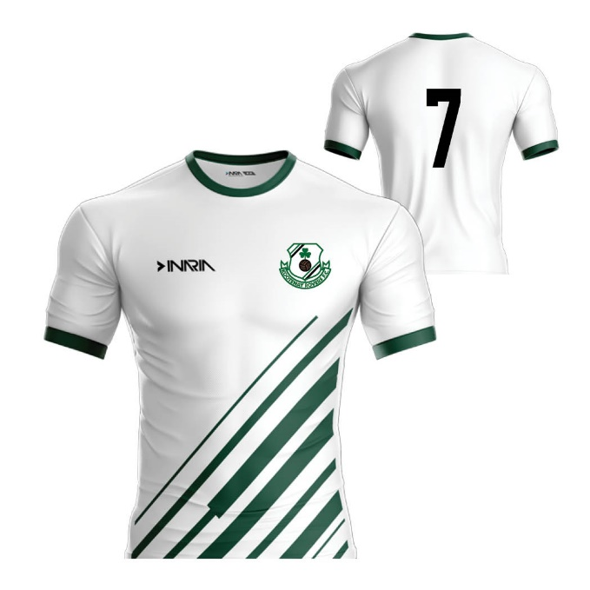
Uniforms
Expected to arrive by the end of April
If ordered late, they may not arrive until May (approx. 8 weeks turn around time)
For the link to order and for information on purchasing or reselling used kits ($150), please email kootenayeastsoccer@gmail.com
New vendor/Brand = Eletto (local rep)
Should look the same as Inaria except new logo
Online Store: https://www.mysoccerclubstore.com/en/kesa
Hope to have surplus of socks and some replacement items that can be purchased locally
Sponsorship (House Jerseys only)

Slide 47
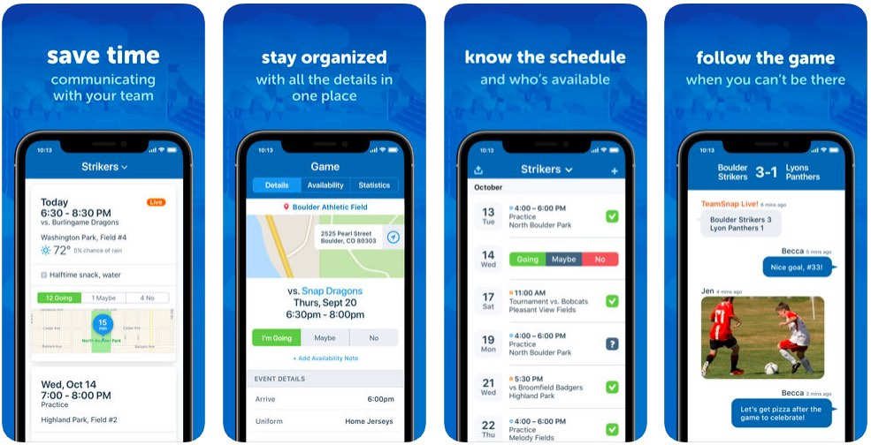
TeamSnap App
TeamSnap
Schedules and availability
Rosters and contact information
Team Chat and Emails
Invites have been sent
Please ensure correct contact information, birthdate, jersey number, etc.
Please add photos to help coaches learn names
For older players, they can also be added with their personal email
Account can be accessed on the APP or online
Notifications ON
How to videos on line, support link in email
Notes:
Share screen and go to teamsnap – demo the website, entering schedules, editing roster details, notify versus not to notify for schedules, check availability, up load files (health waivers, make private to coaches and managers only), send emails

Slide 48
Reminders
Field Set up at Moir Park – Sunday, April 13 @ 10am to 2pm *if weather and city permits
Apply netting to goal posts, Move nets onto each field
Filling and sorting balls, prep team bags, check and label tents and benches, etc.
Team Meetings – First 15min of the first practice (April 7, 9 or 11)
Held over the first weeks of practice
Managers, coaches, parents, technical director and board member to be in attendance
Summer Schedule – TBA
Varies between teams (regular practices April-June and Sept, reduced practices over the summer)
Ref Course April 12 **Encourage U14+ players to sign up!!
Coach Courses May 3 **Encourage U14+ players to help coach HOUSE teams!!
KESA Scholarships $1000 (details online, deadline is April 1)
http://www.kootenayeastsoccer.com/content/kesa-scholarship

Slide 49
Communication
If concerns arise, please bring them forward as soon as possible
If we don’t know that there is an issue, we can’t work towards a solution!
Parents encouraged to Email managers directly and they will send questions to appropriate person, ex. Rep/Development Chair for further information
Board meetings
Everyone welcome!
Monthly meetings
Minutes posted online
Resources
KESA Website http://www.kootenayeastsoccer.com/
BC Soccer Association https://www.bcsoccer.net/

Slide 50
Questions
Kootenayeastsoccer@gmail.com

