Slide 1
Lethbridge Soccer Association LYS Program Outdoor 2025
In Partnership with Vancouver Whitecaps Football Club

Slide 2
#LSAlearnthegamelovethegame

Slide 3
General Information
Online registration opens February 1, 2025 www.lethbridgesoccer.com
If you are using KIDSPORT or JUMPSTART, or City of Lethbridge FAP you MUST register and pay online. You will be reimbursed once we receive funds from funding organization
Start times are subject to change and are provided as a guideline only. Season runs from April 28 – June 28, 2025
Field locations for all age groups are listed on registration information sheet
#LSAlearnthegamelovethegame

Slide 4
LYS Technical Overview
Sessions
All practice sessions created and approved by Technical Director and based around LTPD as per Canada Soccer & ASA player development model;
LSA Sessions focus on CSA’s ‘Four Corner’ model of developing all players Technical, Physical, Psychological & Social skills;
All LYS Coaches and ‘LYS Helpers’ will be required to have completed LYS Coaches training prior to the start of the season.
Games
Matches are based around creating the best possible learning environment.
Results DO NOT MATTER.
Players, coaches and parents are asked to remember this at all times;
#LSAlearnthegamelovethegame

Slide 5
LYS U4 Program
(Parent & Tot)
U4 (Parent & Tot) - 2021 Boys & Girls (CoEd)
Physical literacy & beginner ball understanding;
Fantasy based games and basic introductory movements;
No games to be played at this stage of learning, purely discovery & learning to love the ball.
Monday’s Start times will rotate 5:00pm and/or 5:45pm
All session will be played at the Servus Sports Centre – Indoor Field
10 x 30-minute Active Start Sessions – Ball literacy.
Price - $150
#LSAlearnthegamelovethegame

Slide 6
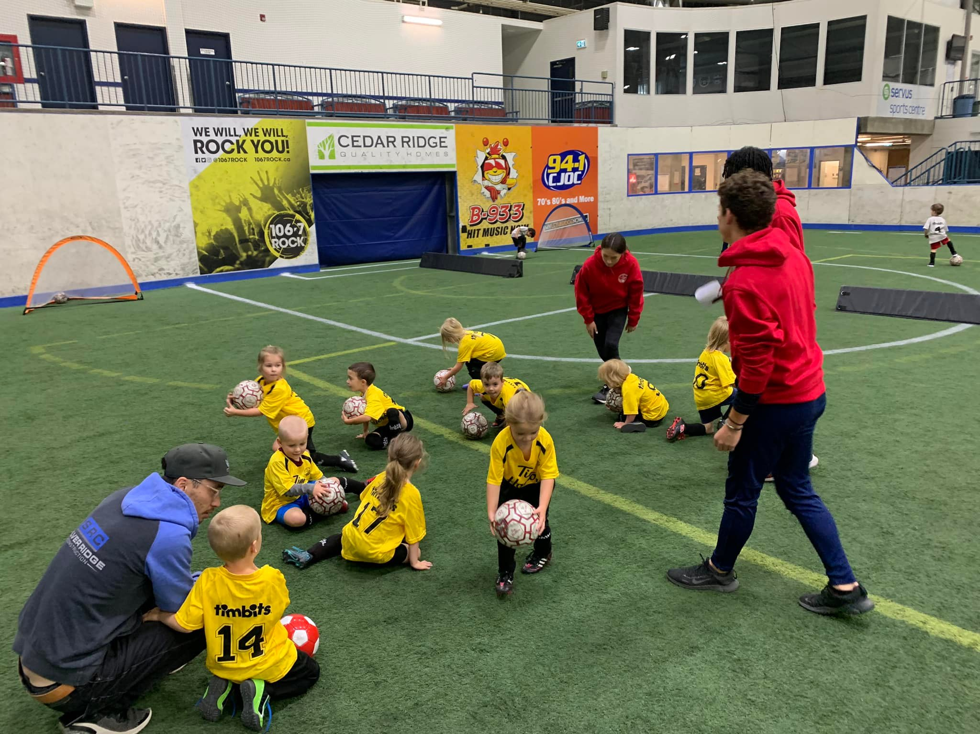
LYS U5 Program - Timbits
U5 – 2020 Boys & Girls (CoEd)
CSA Active Start Stage;
Physical literacy & beginner ball understanding;
Fantasy based games and movements;
Small sided games will be 4 vs 4 (no goalkeepers), ball continuously thrown back into play by coaches;
Discovery stage, ‘organised choas’.
Wednesday’s Start times will rotate 5:00pm and/ or 6:00pm
All session will be played at the Servus Sports Centre (Outdoor Field)
10 x 45-minute sessions
Price - $150
#LSAlearnthegamelovethegame

Slide 7
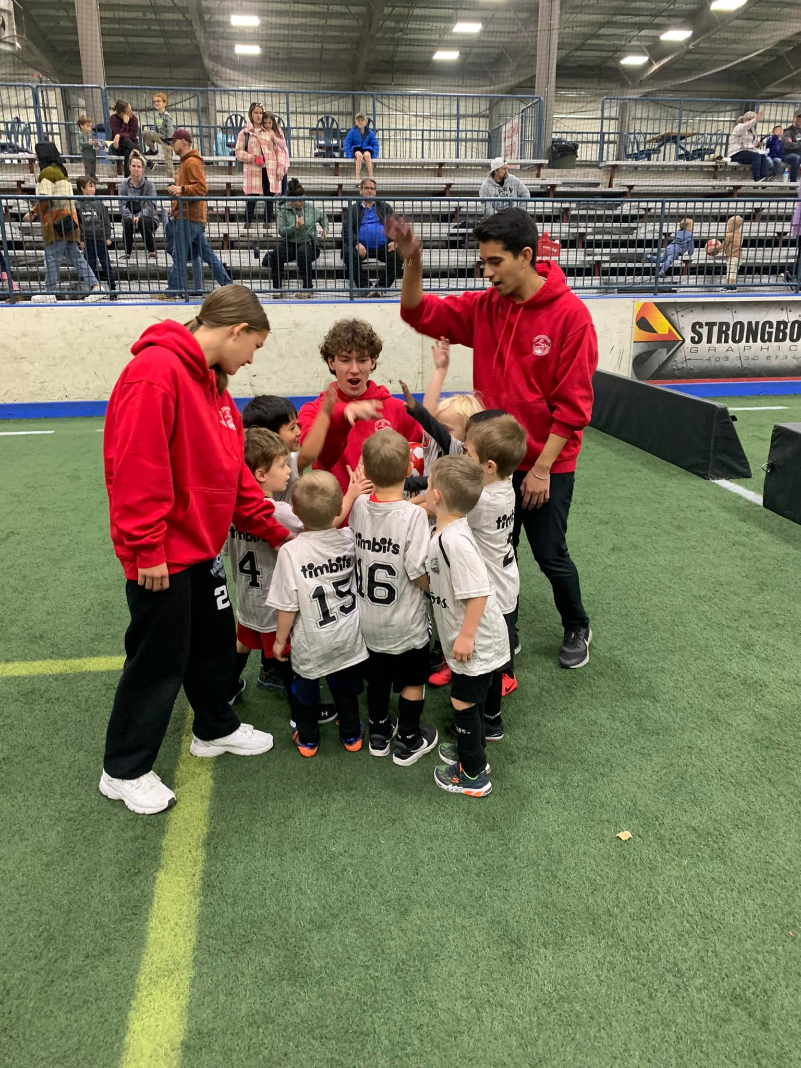
LYS U6 Program - Timbits
U6 – 2019 Boys & Girls (CoEd)
CSA Active Start Stage;
Physical literacy & beginner ball understanding;
Fantasy based games and movements;
Small sided games will be 4 vs 4 (no goalkeepers), ball continuously thrown back into play by coaches;
Discovery stage, ‘organised chaos’.
Wednesday’s Start times will rotate 5:00pm and/ or 6:00pm
All session will be played at the Servus Sports Centre (Outdoor field)
10 x 45-minute Sessions
Price - $150
#LSAlearnthegamelovethegame

Slide 8
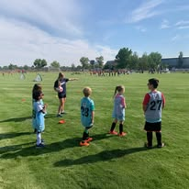
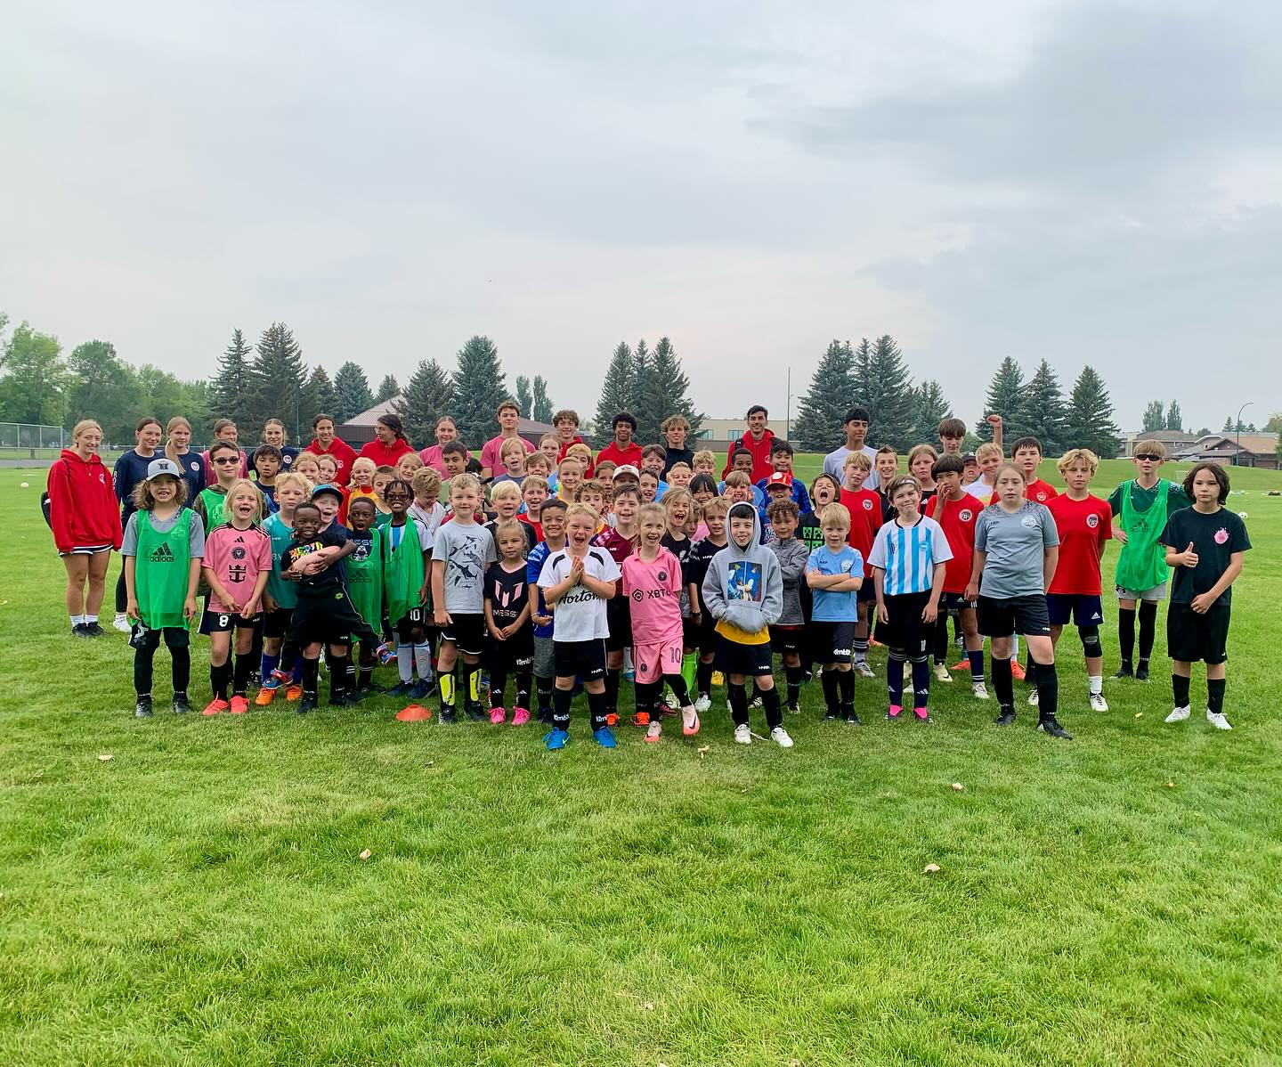
LYS U8 Program
U8 –Boys Division - 2017 & 2018
U8/ U10 – Girls Division - 2015, 2016, 2017 & 2018
CSA FUNdamentals Stage;
Introduction to basic soccer skills through fun-based learning, mostly dribbling with small amount of passing and shooting;
Small sided games will be 7v7(1 goalkeeper), Dribble-ins for restarts along sidelines. Retreat line in effect ( Halfway );
Introduction to structured game format.
Boys - Monday & Wednesday’s Start times will rotate 5:00pm, 6:00pm and/ or 7:00pm
Girls – Monday & Wednesday’s 6:00pm
All session will be played at the College Field (Outdoor Field)
18 x 55-minute sessions
Price - $225
#LSAlearnthegamelovethegame

Slide 9
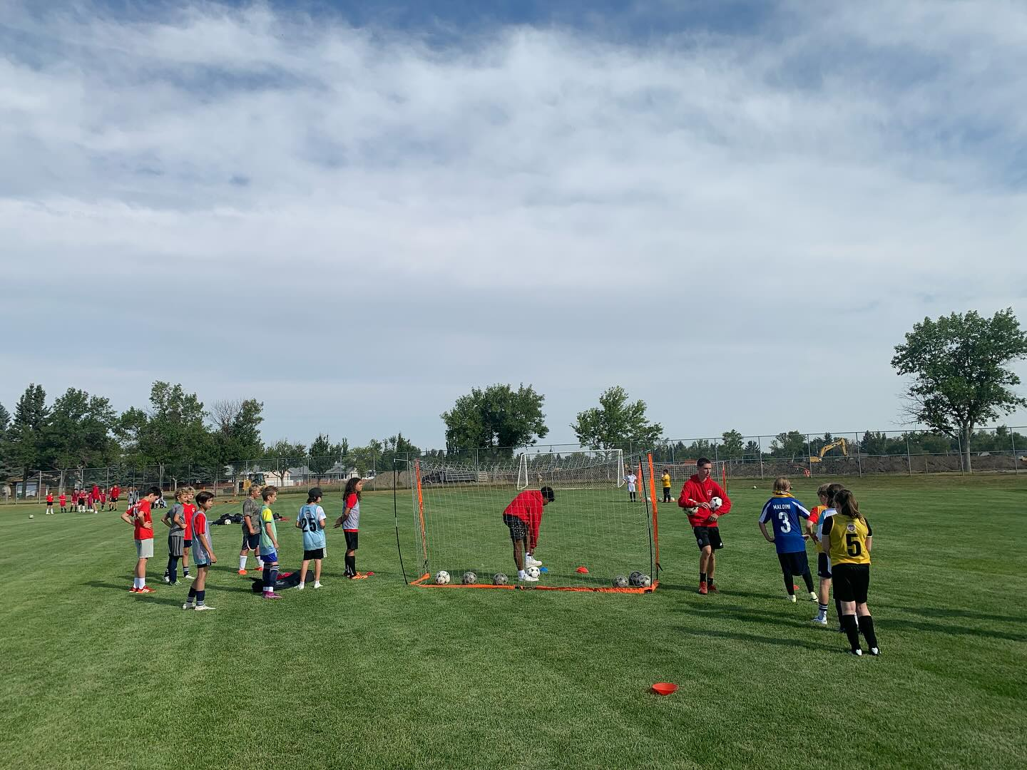
LYS U10 Program
U10 Boys – 2015 & 2016 Boys Division
CSA FUNdamentals Stage;
Introduction to basic soccer skills through fun-based learning, mostly dribbling with small amount of passing and shooting;
Each session will break down into 25 minutes of skill-based learning followed by 25 minutes of game time. Focus is on building advanced soccer skills & techniques (dribbling past defenders, pass and move, shooting, range of passing, defending etc)
Small sided games will be 7v7(1 goalkeeper), Dribble-ins for restarts along sidelines. Retreat line in effect ( Halfway );
Players will play a multitude of positions and with equal playing time for all.
Times will rotate between 5:00, 6:00 and/ or 7:00pm
Tuesdays & Thursdays
Field Location College Field
18 x 55-minute sessions
Price - $225
#LSAlearnthegamelovethegame

Slide 10
LYS U12 Program
U12 – 2013 & 2014 Boys Division
U12/ U14 - 2013, 2014, 2015 & 2016 Girls Division
CSA Learning To Train Stage.
The Season will be broken into a 3:1 ratio. 3 games to 1 team practice. Focus is on building advanced soccer skills & techniques (dribbling past defenders, pass and move, shooting, range/weight of passing, defending etc);
Games will be 7 vs 7 (6 players + 1 goalkeeper)
Beginner introduction to formations, game rules and tactical side of soccer;
Players will play a multitude of positions and with equal playing time for all.
Retreat line in effect, to encourage building from the back (halfway line)
Boys - Monday’s & Wednesday’s – Times will rotate 5:00, 6:00 and/ or 7:00pm
Girls – Monday’s & Wednesday’s – 6:00pm
All sessions will be played at St. Teresa School (North)
18 x 1 hour sessions.
Price - $225
#LSAlearnthegamelovethegame

Slide 11
LYS U14 Program
U14 – 2011 & 2012 Boys Division
The season will be broken into a 3:1 ratio, 3 games to 1 team practice. Focus is on building advanced soccer skills & techniques (dribbling past defenders, pass and move, shooting, range/weight of passing, defending etc);
Continued understanding of the tactical side of the game;
Games will be 9 vs 9 including goalkeepers (8 players + 1 goalkeeper)
Players are encouraged to play multiple positions.
Tuesday’s & Thursday’s Start Times will rotate 5:00pm, 6:00pm and/ or 7:00pm
All sessions will be played at Gilbert Patterson School (South)
18 x 1 hour sessions.
Additional LYS Rules
Should a team find themselves short and the opposition with multiple subs, coaches will be advised to send players to level out teams and give more playing time to all;
During ‘Blow-Out’ coaches will also be asked to make subtle changes to ensure games remain competitive and challenging for all.
Price - $225
#LSAlearnthegamelovethegame

Slide 12
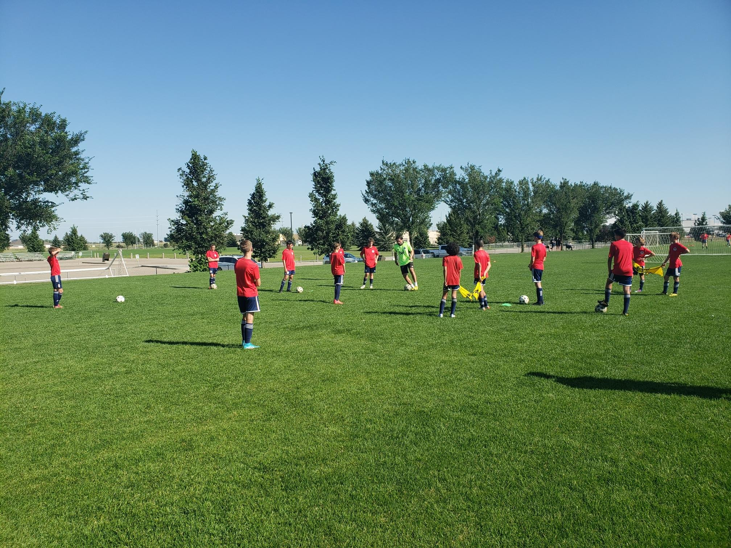
LYS U16 Program
U16 – 2009 & 2010 CoEd
The Season will be broken into a 3:1 ratio. 3 games to 1 team practice, Focus is on building advanced soccer skills & techniques (dribbling past defenders, pass and move, shooting, range of passing, defending etc);
Advanced understanding of the tactical side of the game;
Games will be 11 vs 11 (10 players + 1 goalkeeper)
To benefit full skill development, all players will play a multitude of positions and equal playing time for all.
Monday’s & Wednesday’s Start times will rotate
All sessions will be played at Winston Churchill School (North)
18 x 1 hour 10 minute sessions
Additional LYS Rules
Should a team find themselves short and the opposition with multiple subs, coaches will be advised to send players to level out teams and give more playing time to all;
During ‘Blow-Out’ coaches will also be asked to make subtle changes to ensure games remain competitive and challenging for all.
Price - $225
#LSAlearnthegamelovethegame

Slide 13
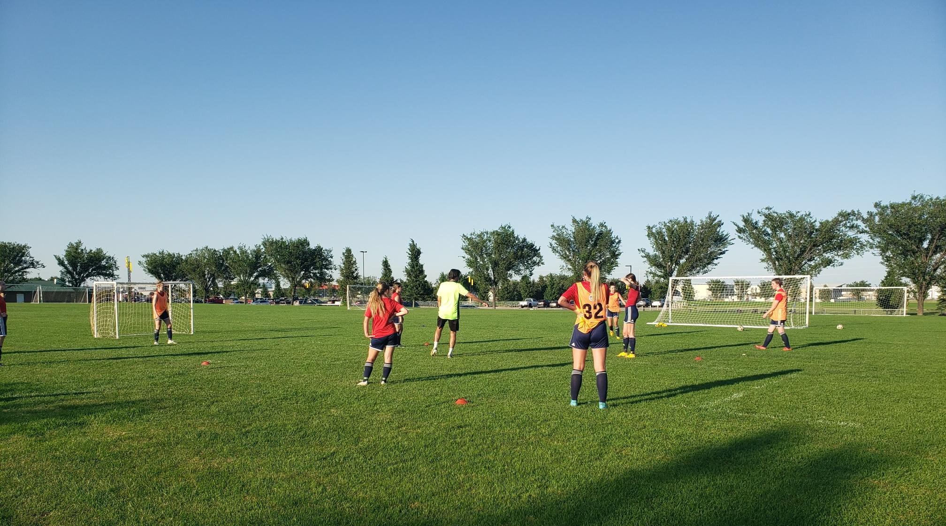
LYS U18 Program
U18 – 2007 & 2008 CoEd
The Season will be broken into a 3:1 ratio. 3 games to 1 team practice, Focus is on building advanced soccer skills & techniques (dribbling past defenders, pass and move, shooting, range of passing, defending etc);
Advanced understanding of the tactical side of the game;
Games will be 11 vs 11 (10 players + 1 goalkeeper)
Players will play a multitude of positions and equal playing time for all.
Tuesday’s & Thursday’s- Start times will rotate
All sessions will be played at Atsotawawa (West)
18 x 1 hour 20 minutes sessions.
Additional LYS Rules
Should a team find themselves short and the opposition with multiple subs, coaches will be advised to send players to level out teams and give more playing time to all;
During ‘Blow-Out’ coaches will also be asked to make subtle changes to ensure games remain competitive and challenging for all.
Price - $225
#LSAlearnthegamelovethegame

Slide 14
Contact Details
Executive Director – Steve Dudas
steve@lethbridgesoccer.com
Program Director – Kristy Lauzon
kristy@lethbridgesoccer.com
Technical Director – Sam Heap
sheap@whitecapsfc.com
Assistant Technical Director / LYS Lead - Chris Hayes
chayes@whitecapsfc.com
Soccer Office
Servus Sports Centre
T1K 7L6
Open Monday to Friday 9am-5pm
P: 403-320-5425
#LSAlearnthegamelovethegame

