Slide 1
OMHA COACH MEETING

Slide 2
AGENDA
▪ Player Health & Wellness ▪ Hard Truths of Coaching – Hockey Canada / Hockey Alberta
▪ Coach Responsibilities – Expectations ▪ Player Development ▪ Affiliation ▪ Officials/Equipment
▪ Coach Support ▪ Driving Policy ▪ Questions

Slide 3
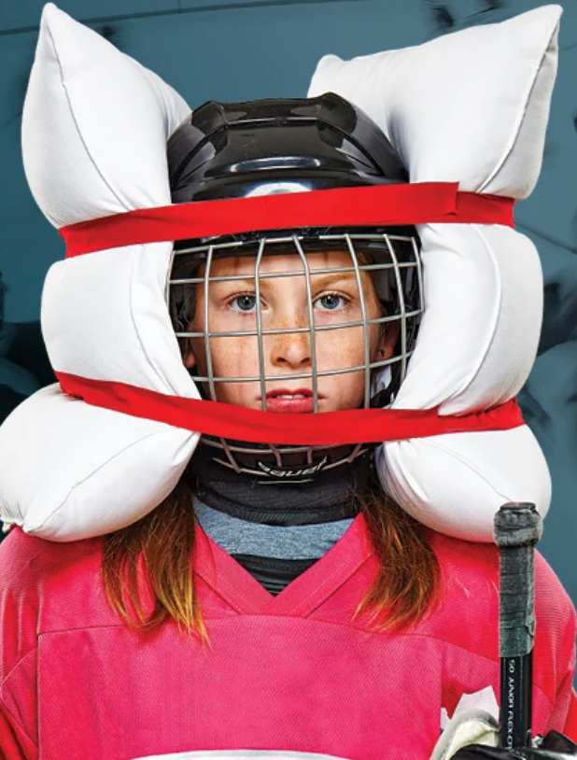
OMHA SAFETY PROGRAM
Player Health & Wellness
Safety Coach – (in place of paid trainer) - First on site for any and all injuries - First step to the Emergency Response Plan - Responsibility to the player to make sure that they are cleared to return
Emergency Response Plan - Charge Person – one in control directing personnel - Call Person – the one to call 911
-All teams should have one with the address of each rink you are playing at and the closest emergency venue

Slide 4
OMHA SAFETY PROGRAM
Player Health & Wellness
Head Check – Bantam and Midget levels - Coach and 1 assistant coach (Safety Coach) to take the online course - Reporting database and communication tool between all parties involved

Slide 5
HOCKEY CANADA & HOCKEY ALBERTA
Maltreatment cases increased regarding Code and Conduct over 75% last season
With ongoing investigations within Hockey Canada, they are clamping down releasing players, coaches and staff more than they ever have.

Slide 6
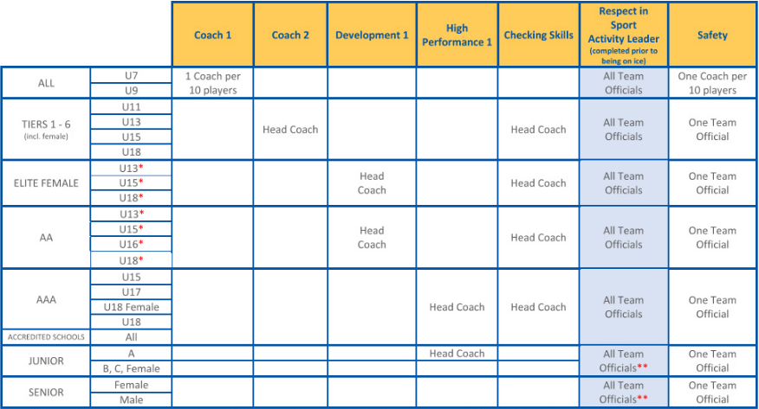
HOCKEY CANADA & HOCKEY ALBERTA
Hockey Canada / Hockey Alberta - Respect in Sport – Activity Leader
- Coach 1 (U7/U9) or Coach 2 (U11+)
- Hockey Alberta Safety Clinic
- Checking Skills Clinic – U11+
Suspensions
Affiliation
Players can not belong to another league (HSL. PHL, JPHL, ect.) while carded and insured through Hockey Alberta and Hockey Canada

Slide 7
COACH RESPONSIBILITY
Responsibility as an OMHA Coach
▪ Head Coach ▪ Coach Qualifications – One month left to get it done (Nov. 15th)
▪ Register online today ▪ Team Staffing – key rolls : Manager, Safety Coach, AC’s
▪ Team Finances – Budget for the team, stay on track, within REASON
▪ Fair Play Policy
▪ Players - Individual skill, individual tactics, team tactics, Systems
Development – Fun and Challenging, MAKE PLAYERS BETTER
The use of the Edge Boss tools, but PLEASE put them away.

Slide 8
COACH RESPONSIBILITY
GOALIES MATTER! DON’T FORGET THESE ATHLETES
▪ Jarret Finney – goaltending coach for Association ▪ Geoff Rollins– VP Player Development
▪ Hockey Alberta - Goalie Development Page (Visit it)
SUNDAY NIGHT Goalie Clinic – Starts in November & put on by HA
The clinics run from November 5- February 11th. No clinics on November 12th, December 24th and December 31st.
▪ Bus Travel Policy – Manager will be aware of this (Trip Roster)
▪ Jersey Management – Jersey Parents please

Slide 9
DEVELOPMENT
OMHA Player Development Groups
▪ C2C Hockey Development
▪ Hi-Tek Hockey
▪ K&M Hockey Development– Kris Foucault
▪ DMSG – Dave Marcoux School of Goaltending
▪ Evolution Goaltending - Nicolas De-Gaetano
▪ Score Hockey Range - Matt Kinch
▪ On The Edge Power skating – Jamie Slaney All Divisions
▪ Pam Hurst Power skating – All Divisions
▪ Built Strong Athletics – Jill Mathews & Sherrie Smith

Slide 10
AFFILIATION
Affiliation of Players
▪ OMHA Affiliation Procedure – website
▪ Dec 15 – Hockey AB ▪ Player/Goalie request ▪ Team Roster can not grow
▪ Goalies – Emergency based only ▪ Emergency call up MUST play ▪ Bring to Jamie Steer’s attention when you need one

Slide 11
Officials
Rule Changes – we will identify to Coaches/Team Staff following meeting on Oct 18th, 2023
NO Managers allowed in score keepers box
U7 – no officials
U9 – New officials/limited involvment
▪ U11/U13 House - on ice officials, new to officiating, up to 4 on the ice at a time
▪ CAHL/RMFHL/RHL – as per league guidelines

Slide 12
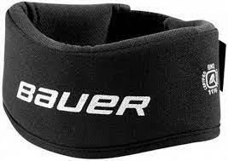
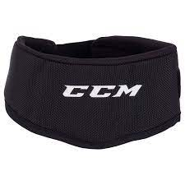
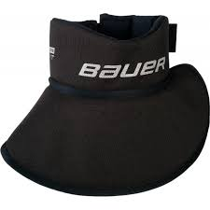
NECK GUARDS
Players will be asked to leave the ice.
No player can hit the ice unless they have a neck guard. Coaches will be suspended per ORA

Slide 13
COACH SUPPORT
Coach Mentoring
• Internal Resources:
• Jamie Steer–Operations Coordinator, AAA Coach, HA evaluator
OMHA Development Groups
OOAA Coaches–reach out for access to OOAA coaching staffs
Coach Talks to be setup this year
Use each other – Div Directors and Exec Team can help with introductions
External Resources:
If you need anything, please reach out to our Development Groups for help
• Practice plans
• Drills • Courses • Etc.

Slide 14
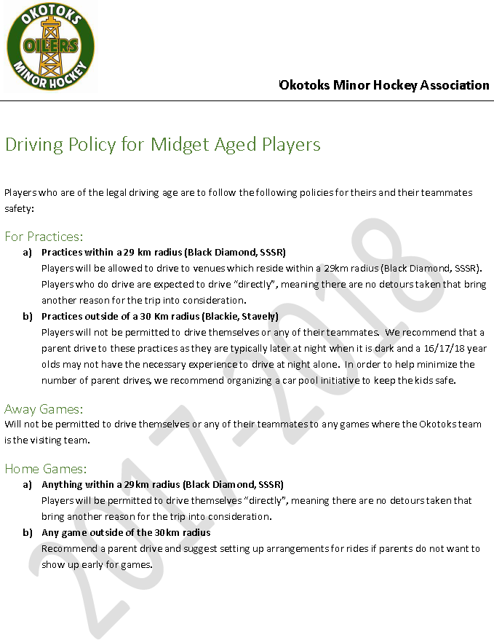
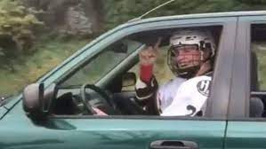
Driving Policy Players
On the OMNH website
U18 Coaches must review

Slide 15
QUESTIONS ?

