Slide 1
2022 Interim General Meeting (IGM)
Tuesday November 22nd, 2022
8 pm

Slide 2
OOAA IGM Agenda
Roll Call of Officers and Directors
Review of 2021 AGM Minutes
Executive Reports/Financial Reports
Ice Schedulers Report
Coach Director Report
Division Directors Reports
Q and A
Adjournment

Slide 3
Review o
2021 OOAA AGM MINUTES
Please refer to the AGM minutes posted to the OOAA website under meeting minutes.
Board Meeting/IGM/AGM minutes and Financials Minutes (ooaaoilerhockey.ca)

Slide 4
222
2021 OOAA AGM MINUTES
Motion 1 - to dispense with the formal reading of the minutes since they have been posted on the OOAA website for all meeting Attendees to review
Second to the Motion
Vote
Motion 2 - to approve the minutes of the 2022 AGM
Second to the Motion
Vote

Slide 5
OOAA IGM 2022 President Report
Storage project completed Oct 4th with installation of rain gutters
Internal hardware, security system, sealing of roof, concrete sidewalk, fencing c/w gate completed outside scope of original agreement
Project completed on budget
Successfully worked with Okotoks Oilers on Ethernet connections in Gold and green for stable streaming of hockey TV
Working with Oilers for Video Board for OOAA Home games
Academic Credit discussion with leadership at comp.
Town approved retrofit of Dressing rm#1 at Centennial Green
Budget of up to 32K approved – Bama Contracting commenced Oct 19th
Intent is to assign OOAA teams dressing room #1 when possible
Town to review and then discuss similar approach to retrofit dressing at Murray Arena in similar fashion
Team equipment deposit review
Volunteer commitment review
Thank you to all the volunteers who make it happen for OOAA

Slide 6
Practice Ice Current verses Future Potential
TEAMS | 20/21 | 21/22 | 22/23 | Net Impact/Year
U13, U15, U16 now U18 | 2 X week | 2.5 X week | 2.5 X week | 18.75 HRS
U13A (F) | 2 X week | 2.5 X week | 2.5 X week | 33.75 HRS
U15 AA (F) | 2 X week | 3 X week | 2.5 X week** | 30 HRS
U15 AAA | 2.5 X week | 3 X week | 3 X week | 18.75 HRS
U18 AA (F) | 2 X week | 3 X week | 2.5 X week** | 30 HRS
U18 AAA (F) | 2.5 X week | Up to 4 X week | Same | 56.25 HRS
U17 AAA (U16AAA) | 2.0 x week | 3 x week | Up to 4 X week | Up to 75 HRS
U18 AAA Bow Mark | 4 X week | Up to 4 X week | Same | Same
Assumes 1.25 hour practices and a 30 Week Schedule
**Exceptions: U15AAF and U18AAF 2 x 1.5 hrs / week plus 1.0 / 2nd week

Slide 7
OMHA Presidents Report- Geoff Stewart
OMHA IGM- Accounting delay, we will announce 3 weeks prior
PHL- Okotoks arena expansion

Slide 8
VP Report- Rob Ellis
AFHL Franchise application for U13AA team to be submitted Dec 15th
Will need ice support of draw zones association as a condition of application to AFHL
Male Elite Committee – lots of support from draw zone associations
U15AAA home game in Chestermere, U17AAA home game in Strathmore
Volunteer commitment policy review
NWCAA Mandates for both RMC and Macs
Equipment deposit policy review
NWCAA mandates 600.00 deposit / player
Currently OOAA is 1000.00/team
Goalie committee to bring forth recommendations regarding skills / support etc

Slide 9
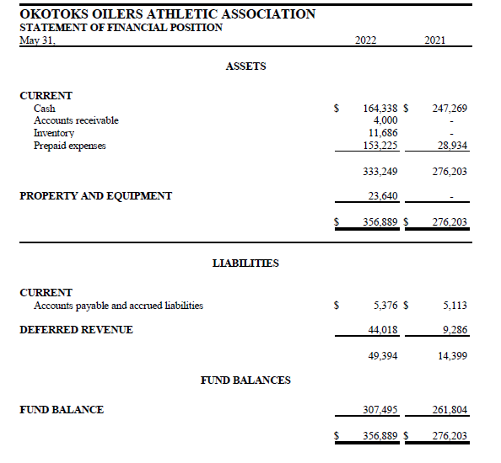

Slide 10
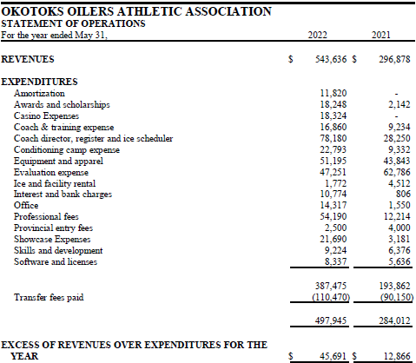

Slide 12
Q and A Financial Statements related

Slide 13
Motion 1
Move to approve the OOAA Financial statements as presented dated May 31st 2022.
Second to the Motion
Vote
Motion 2 Move to approve the appointment of an Internal audit committee “IAC” by the OOAA Board in accordance with section 14.3 of OOAA Bylaws
Second to the Motion
Vote

Slide 14
Coach Development- Mike Bara
2022-23 Coaching Staff
Per OOAA Policy, 4 coaches returned upon approval by the board
Amanda MacLeod since resigned and accepted the Head Coach position with the SAIT Trojans
7 new head coaches are in place at U13 A F, U13 AA M, U15 AA F, U16 AA M, U18 AA F, U18 AA M, U18 AAA F
21-22 U16 AA HC Gabe Amyotte, is now an Associated Head coach with the U17 AAA Oilers
2022-23 Coaching Education
Certified 3 Head Coaches, two at Development 1 and one High Performance 1
Trained 11 Head and Assistant Coaches, 10 at Development 1 and one at High Performance 1
Assistant coaches were required to complete Development 1 training this year, as per Director of Coach Development, the Executive and Board
In partnership with Hockey Alberta, Director of Coach Development will complete their required field evaluations (11 total) before the end of the 22-23 season
2022-23 Skill Program
Delivered by Village Sports (Global)
All AAA programs to receive 5 sessions, AA programs receive 7

Slide 15
ICE SCHEDULER- JAMIE STEER
League schedules all done and practice schedule done until X mas break.
Teams are responsible for renting their own ice when and where they want it over the X mas break.
Normal practices will resume January 2nd and the schedule for January and February will be released before we hit break.
Still working with Dan to get some ice support from our sister communities. This is something that should happen hosting as many of their players that we do

Slide 16
REGISTRAR- LINDSAY GRAW
Registration numbers
1st year of Showcase, total registered 234
Total registered for tryouts 677. This is up 70 players from last year

Slide 17
SAFETY- ORINDA MCCANN
All 11 teams have Athletic Therapists
Athletic Therapists supplied by 2 companies:
Prosport Therapy
Baseline Therapy
Head Check Health used by all teams for concussion management and baseline concussion testing

Slide 18
U13A Raiders and U13AA Oilers- Jason Marshall
U13AA Oilers
Very successful first tournament. Was in the running to win the “A” side.
8 / 9 games into season and are middle of pack and team seems to be progressing. Played the top team in division twice already.
U13A Raiders
Tiering rounds have finished and looks to be competitive in tier 3. That’s what’s proposed (asked to be placed with the teams that were competitive with. (I will send update once I hear from tiering meeting where they ended up.
Alberta hockey is starting the process of making associations aware of having u13A females league Joining AFHL.

Slide 19
U15AA Raiders- Carolyn Berven
U15 Raiders
HC- Keegan Thompson
AC- Jenna Beaton ( 6th year coaching Okotoks)
AC - Kennedy Moore ( 2nd season coaching Okotoks)
AC - Scott Lyons
AC - Devin McDonald
Record : 6 games 3 W 3 L
Sitting 4th of 6th teams in south
Team won Nova Female Hockey Tournament Vernon BC Nov 13th weekend

Slide 20
U15AA Oilers- Michelle Barratt
1st in south in SCAHL at 10-2 *as of Nov 17th
Played in the Graham Tuer Challenge in Regina - did not win a lot of games but played very well, would go back to that tournament
Community Projects - will be getting the players out to do various community service projects
Had expressed interest in hosting the SCAHL playoffs but there is a lack of ice in Okotoks that weekend.

Slide 21
U15AAA Oilers- Michelle Barratt
3rd in the south In AEHL at 7-1-3 *as of Nov 17th
Won the B division in OT at the Rocky Mountain Classic
Working on having a game in Chestermere as part of showcasing players from the draw zone
Community Projects - adopted a senior for the holidays, they are working with the hospice and will be doing a food drive for the foodbank. They will continue to have the OMHA U7 player of the game at their home games.
Team Development - Coach Daron communicates weekly with the players school principals regarding student marks, homework and assignments as well as general behavior. If there is an issue the team offers a time for the athlete to make it right on their own and if they can't, they work with the athlete to offer support. This will help players learn time management and helps prepare them for the daytime programming.

Slide 22
U16AA Oilers- Sheena Fox
Standings
Sitting in 5th in SCAHL with a 2-6-1 record
Silver in Edmonton tournament, November 11th weekend
Hosting a tournament in February. Hoping to profit 10k

Slide 23
U17AAA Oilers- Bruce Layte
HC- Kyle Finch
Manager- Shannon Hefferan
Regular season record after 10GP 8-3-0
Tied for 2nd in the South Division
Attended the Logan Boulet memorial Tournament in Lethbridge in October and finished 2nd

Slide 24
U18AA Oilers- Bruce Layte
HC- Nick Purves
Manager- Karla Wingate
Record after 9 GP 2-6-1
Very competitive and close games
Attending first tournament November 24-27th

Slide 25
U18AA Raiders- Nicki Simard
They are getting ready for our show case which starts December 2-4
They are third place in the South division With and over all record of 6-3
The players are mentoring and attending practices of atom and peewee female teams.
Mindfulness Coach Sarah, provides two team sessions a month and is at practice once a week providing support. Once the year is done we will look to see how this consistent weekly support has impacted the team.

Slide 26
U18AAA Raiders- Nicki Simard
U18AAA Raiders
HC- David Addison
AC- Malia Snyder
AC - Marlène Boissonnault
The Raiders received an invite to the “Mandy” The Largest female U18AAA tournament in Western Canada in Notre Dame Saskatchewan based on their early record this season.
Raiders have had a busy start to the season. The players will start their mentorship program with grassroots teams in January.

Slide 27
U18AAAA Bowmark- Rob Ellis
U18AAA Oilers
HC- Chris Beston
AC- Lars Pettersen
AC- Rolf Pettersen
AC –Lindy Greig
Team is currently in 4th position in the South Division with a 7-5-1-1 record
Team is preparing for the Circle K Classic (formerly Mac’s) starting December 27th
Thanks to all of the volunteers that have stepped forward to help at the Circle K

Slide 28
Q and A

Slide 29
Adjourn

