Slide 1
2024 Interim General Meeting (IGM)
Thursday November 28th, 2024
7 pm

Slide 2
OOAA IGM Agenda
Roll Call of Officers and Directors
Review of 2024 AGM Minutes
Executive Reports/Financial Reports
Ice Schedulers Report
Coach Director Report
Division Directors Reports
Q and A
Adjournment

Slide 3
Review o
2024 OOAA AGM MINUTES
Please refer to the AGM minutes posted to the OOAA website under meeting minutes.
Board Meeting/IGM/AGM minutes and Financials Minutes (ooaaoilerhockey.ca)

Slide 4
222
2024 OOAA AGM MINUTES
Motion - to approve the minutes of the 2024 AGM
Second to the Motion
Vote

Slide 5
President Report – Dan Laplante
Review of Team security Deposit, volunteer bond, coaching apparel allocation and team cash call structure compared to other associations
Mark Pederson Coach Director in place to support coaches and OOAA program – April 1st
Initial Cash call of 6000.00 and 3000.00 for AAA and AA teams respectively due Oct 15th – to support Managers / Treasurers resounding success
14 skills and 14 goalie sessions for AAA teams financially supported by OOAA
7 skills and 7 goalie sessions for AA teams financially supported by OOAA
Skill sessions to be delivered by both OOAA daytime Head coaches and Village Staff
2 weekly Academic sessions to support program in place for U18AAA and U17AAA Oilers

Slide 6
President Report – Dan Laplante
OOAA ran Dev 1 coaching program in Oct for OMHA, Foothills coaching staffs and any HC and AC that was interesting in participating
Evaluations shifting to spring model – OOAA reacting with HA approval
OOAA has signed a 5 year practicum agreement with MRU
Board is supporting U13AA Raiders South Div Playoff Tournament March 14th to 17th 2025
Board is supporting U17AAA Oilers bid for hosting provincials April 3rd to April 6th, 2025 as part of rotational strategy of AEHL / AFHL with HA endorsement
HA Elite Player / Parent survey launched Tues Nov 12th and closes Frid Nov 22nd. Coaches Survey to take place at the same time. It is our intention to post survey results once HA releases summaries to OOAA.
Thank you to all the volunteers who make it happen for OOAA

Slide 7
Practice Ice 2024/2025
TEAMS | 21/22 | 22/23 | 23/24 | 24/25
U13A (F), U13 AA, U16AA | 2.33 X week | minimum 2.33 X week | minimum 2.33 X week | minimum 2.33 X week
U15 AA(F) and U18AA(F) | 2.5X week | 2.5 X week** | 2.5 X week** | 2.5 X week**
U15 AAA | 3 X week | 3 X week | 3 X week | 3 X week
U15 AA | 2.5 X week | 2.5 X week | 2.5 X week | 2.5 X week
U18 AA | 3 X week | 2.5X week Day | 2.5 X week | 2.5 X week
U17 AAA was U16 AAA | 3 x week | Up to 4 x week | Up to 4 X week | Up to 4 X week
U18 AAA (F) | Up to 4 x week | Up to 4 X week | Up to 4 X week | Up to 4 X week
U18 AAA Bow Mark | Up to 4 X week | Up to 4 X week | Up to 4 X week | Up to 4 X week
Assumes 1.25 hour practices and a 30 Week Schedule
**Exceptions: U15AAF and U18AAF 2 x 1.5 hrs / week plus 1.25/ 2nd week

Slide 8
VP Report- Tony Fairfield
Look forward to working with the OOAA board
Many Policies updated this past year to reflect best practice
Cell phone policy
Transportation policy
Rooming policy
Fraternization policy
Other items to be considered this year
Thank you for to all the board members and volunteers on the teams

Slide 9
FINANCIAL STATEMENTS
An external auditor was engaged to audit the financial statements.
The statement of financial position reports the financial position at a point in time. It explains what we own (assets) and what we owe (our liabilities). The difference is our Equity or net assets.
The statement of operations and changes in fund balances explains the change in the overall financial position of the entity during the accounting period
The Statement of Cash Flows explains the changes in cash and details the sources and uses of cash
Notes to the financial statements is additional information added to help explain items in the statements and they clarify individual statement line items. The accounting policies in Note 1 document the policies chosen by the ASSOCIATION.

Slide 10
FFJGHGHAU
AUDITORS REPORT
The purpose of the auditor’s report is to provide an opinion for the validity and reliability of the financial statements.
The audit is conducted in accordance with Canadian generally accepted auditing standards. These standards require that the audit is planned and performed to obtain reasonable assurance whether the financial statements are free from material misstatement. The audit procedures selected depend on the auditor’s judgement and include the assessment of the risks for material misstatement. Whether due to fraud or error.
The auditors reports for the audit that was completed for the period has provided a qualified opinion. Overall, the opinion is positive because it indicates that nothing is wrong in the financial documentation. The qualification confirms that an inventory count was not attended by the auditors and therefore inventory was not audited.

Slide 11
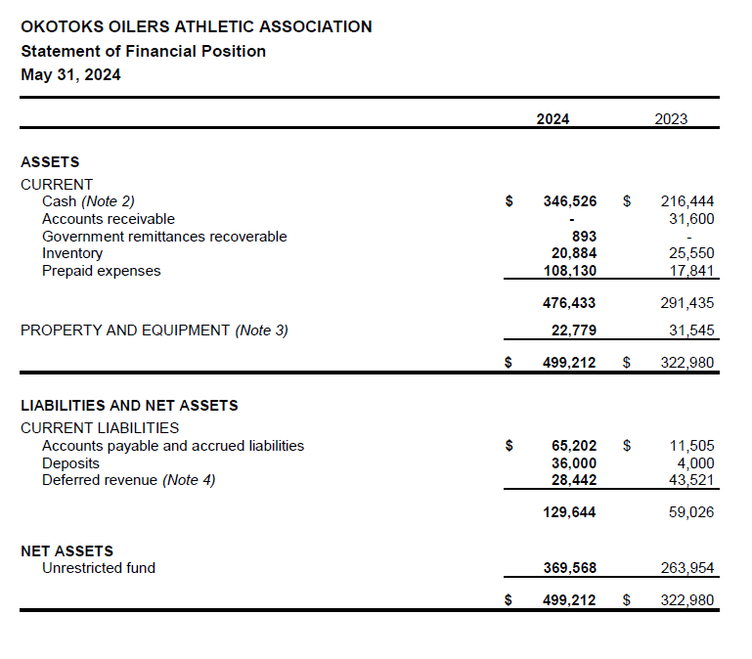

Slide 12
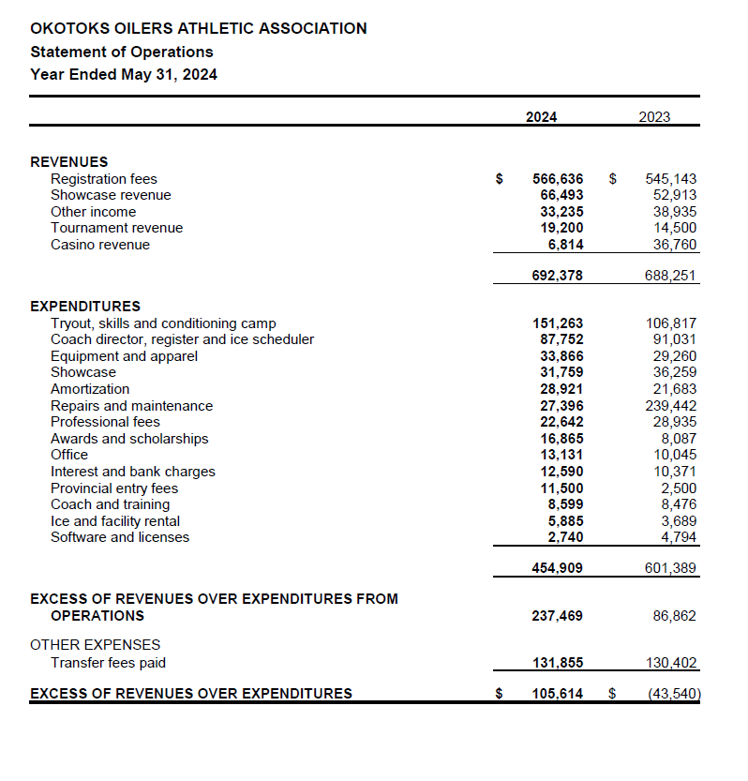

Slide 13
Director of Coach Development – Mark Pederson
Led Year end Coach review process
Chaired Coach Selection committee
Implemented Coach Stem – system wide skills program accessible for all OOAA coaches
MRU student (who is a current WHL Scout) provides 160 hours to OOAA as part of his practicum
Monitoring of skills and video sessions to ensure value for OOAA program
Ongoing support for OOAA coaches via practices
Potential of carding to various rosters to observe and support coaches
Functional Coaches office in Viking Rentals Center – thank you for this support to Lars and Ann Pettersen
Enjoyed working with all the volunteers who make it happen for OOAA

Slide 14
ICE SCHEDULER- JAMIE STEER
League schedules all done and practice schedule done until Xmas break.
Teams are responsible for renting their own ice when and where they want it over the Xmas break.
Normal practices will resume January 2nd and the schedule for January and February will be released before we hit break.
Working with town and executive on spring camps, dates and ice.
Still hoping we can get help from our sister communities for weekday practice ice to help better our practices and help OMHA

Slide 15
Administrator- LINDSAY GRAW
Spring Showcase 2nd season bring offered
2024-2025 247 registered up 5 from 2023-2024
Conditioning Camps
2024-2025 352 registered down 77 from 2023-2024

Slide 16
Administrator- LINDSAY GRAW
Tryouts
2024-2025 653 total registered down 49 from 2023-2024
Tryout | 23-24 | 24-25 | Diff
U13AA Oilers | 48 | 44 | Down 4
U15AA Oilers | 77 | 47 | Down 30
U15AAA 1st yr-open Oilers | 52 | 59 | Up 7
U15AAA Oilers | 84 | 54 | Down 30
U16AA Oilers | 35 | 53 | Up 18
U16/U18 Combined Oilers | 52 | 51 | Down 1
U17AAA/AAA 1st yr-open Oilers | 62 | 94 | up 32
U18AAA/U17AAA Oilers | 114 | 97 | Down 17
U13AA Raiders | 33 | 24 | Down 9
U15AA Raiders | 48 | 44 | Down 4
U18AA Raiders | 32 | 33 | Up 1
U18AAA Raiders | 47 | 41 | Down 6
U18AAA Raiders 2nd Tryout | 18 | 12 | Down 6
 | 702 | 653 | Down 49

Slide 17
SAFETY- Sine Macdonald
Athletic Therapy
All teams have an assigned AT.
Baseline Therapy and Prosport Therapy are our respective companies.
Any questions regarding athletic therapy please direct to ooaasafety@okotokshockey.com
Mental Health
Each team is allocated $500 for mental health well being. This can be used as team sessions with mental health counselor or individual sessions for a player on the team. It can also be sued for mental mindset sessions.
Teams must provide a receipt to OOAA for reimbursement

Slide 18
U13AA Raiders- Candice Wyma
Head Coach- Tristan Desmet
Okotoks hosted the Preseason tournament.
Season started Oct 18th. Currently sitting in 7th as of Nov 27th with a 0-6-1 record
Went to the Thanksgiving Tournament in Calgary, had 2 wins and 2 losses.
Participating in the Okotoks Female Tournament and the All Stars Tournament in Edmonton.

Slide 19
U13AA Oilers- Candice Wyma
Head Coach- Tyler Hilbert
The Pre-season tournament was held in Airdrie.
As of November 27th, the team is sitting 6th in division with a 4-9-0 record.
Team is struggling to get accepted into any tournaments so far.
Team is doing well with a positive outlook and supportive coaching staff.

Slide 20
U15AA Raiders- Nicole Brockhoff
Head Coach- Mark Hallam
The Raiders hosted a 4 team Pre-Season tournament in Medicine Hat. They had one win, one tie and a loss. All close games.
The Raiders attended The Firestarter Tournament in September.
Had 1 win, 1 tie and lost 2 games.
Regular season started Oct. 19/24.
Sitting in 6th as of November 27th with 6 W, 4 L, 1 T

Slide 21
U15AA Oilers- Michelle Barratt
U15AA Head Coach – Geoff Stewart
Currently as of Nov 27th sitting 3rd in the AEHL South Division 7-5 record
Attended a tournament in Bonnyville
Will be attending a tournament in Lethbridge in Jan 2025
Planning community projects for the season

Slide 22
U15AAA Oilers- Michelle Barratt
U15AAA Head Coach- Daron Dumanski
Signed 6 players from the spring ID skates
Changing the tryouts to having an Open camp and invite to Main camp was received positively and saw a way better Main camp tryout
Numbers were down for tryouts overall for U15AAA and U15AA
Currently as of Nov 27t sitting 2nd in AEHL at 9-3-1
Attended the Red Deer tournament
Attended the rocky Mountain Classic
Attending Crowne Invitational in January

Slide 23
U16AA Oilers- Katie Goulard
Head Coach - John Shaw
Record as of Nov. 1st: GP: 7; W: 2; L: 4; Sitting 4th out of 7 in AEHL South Division
Registered in the Tournament of Champions in Edmonton, Nov. 8-11th
Successes: valuable team building activities to increase team cohesiveness
John as a new coach, has expressed great appreciation for the support and mentorship of Mark Pedersen, Daron Dumanski, Ken Plaquin, Rob Hale and Geoff Stewart

Slide 24
U17AAA Oilers- Rob Ellis
Head Coach- Ken Plaquin
Placed second in Logan Boulet Tournament in Lethbridge
Currently 1st Place in South Division with 10-2-1 Record
Preparing for showcase in December at Winsport

Slide 25
U18AA Oilers- Katie Goulard
Head Coach- Rob Hale
Record as of Nov. 27th: GP: 11; W: 3; L: 5;3 T Sitting 4th place out of 7 in AEHL South Division
Participating in CAC Tournament in Edmonton Nov. 6-10th
Team requested bus exemption that was approved by Michelle/Transportation
Successes: To be determined as early in the season and coaching staff is confident these will come
Opportunities: Team chemistry, need to drive accountability/maturity with players

Slide 26
U18AA Raiders- Tamara Spencer
Head Coach – Dave Hayes
Currently sitting in 4th as of November 27th in the South Division. With a 4W, 5 L record.
Attended Firestarter - 4th place
Tournament in Prince Albert
AFHL U18AA Showcase in Lloydminster Oct 31 weekend

Slide 27
U18AAA Raiders- Tamara Spencer
Head Coach- David Addison
7th in standings as of November 27th(regular season)
Team is trending upwards in performance with Good Showing at the Crown tournament at NAX
Attended Firestarter
Looking forward to The Rink tournament in Kelowna in January
3 wins 6 losses and a couple overtime games. This year more points in the first month of the season than we did total last year
Numerous players in talks with usport and ncaa d3/acha teams for next year with the goal of providing an option to play for all of our graduating players
Recruitment for 25/26 to commence in the next week or two as we look to keep bringing in top players and re-establishing the raiders as a destination

Slide 28
U18AAA Bowmark Oilers – Rob Ellis
Head Coach- Mark Pederson
Currently 1st in south division and league with 12-4record
Island Classic tournament in Victoria Nov 14-17th
Top U18AAA teams from AB, BC, CSSHL
Invited to the Circle K 2024

Slide 29
Q and A
Before asking a question please state your name and team that your player is on

Slide 30
Adjourn

