Slide 1



Slide 2


WHAT IS PEI FC?
Soccer PEI’s year round high‑performance program for players aiming to compete at the top levels in Atlantic Canada and beyond.
Provides a development pathway—technical training, physical preparation, mental performance, and exposure to elite competition.
Those selected participate in the Nova Scotia Soccer League (NSSL) and attend national-level tournaments, including the Canada Soccer Club Nationals.
The program is built to challenge athletes and prepare them for collegiate, professional, or national team opportunities.

Slide 3
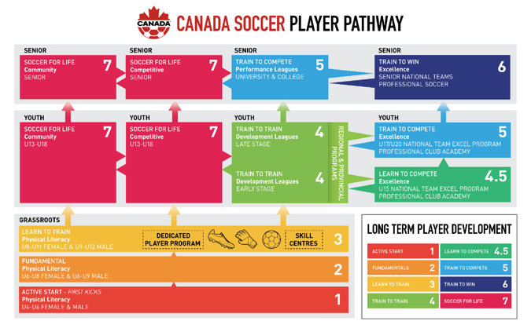

Slide 4
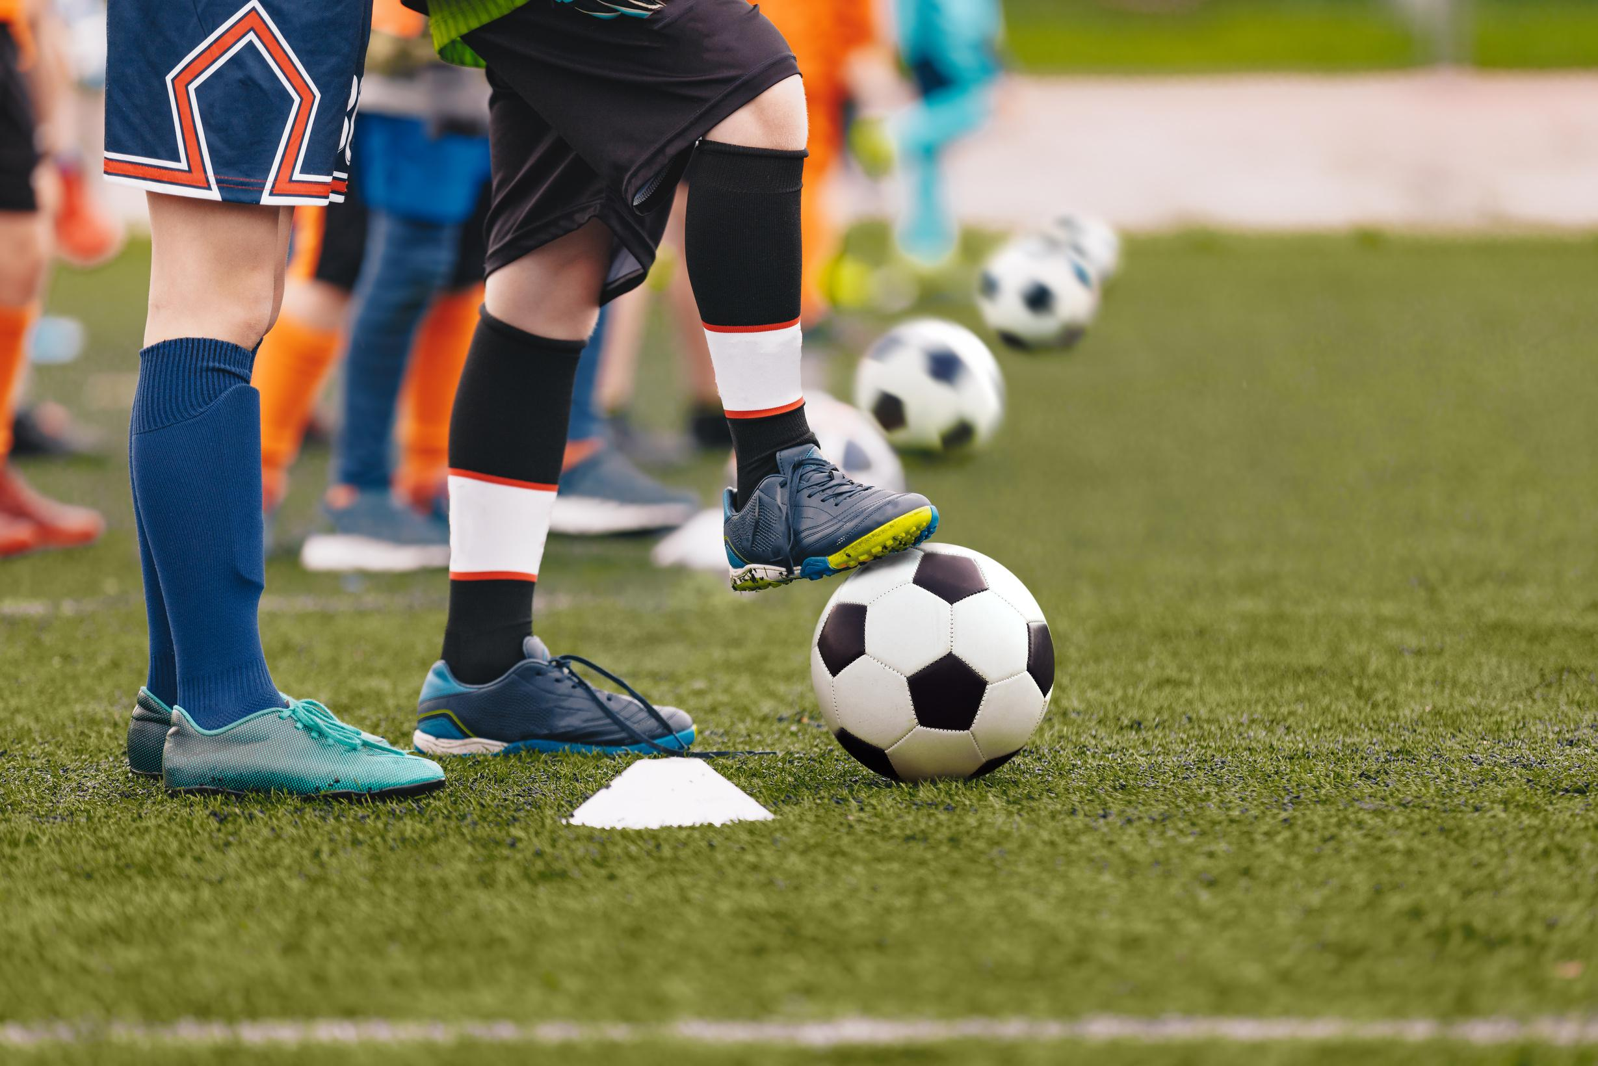
PLAYER CENTERED PROGRAM
Player‑centered programs focus on each athlete’s individual development, well‑being, and long‑term growth.
Training, communication, and decisions are shaped around what players need to learn, improve, and stay motivated.

Slide 5
PEI FC Mission
Our mission is simple; develop players the right way. Winning is the outcome, not the objective.

Slide 6
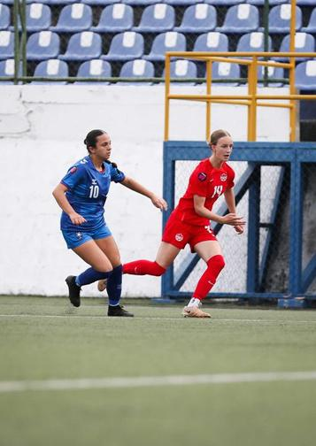
SELECTION
PROCESS
Fall Assessment Phase - November & December
Winter Training Phase - January -March
Training group
Continual assessments
Final roster - Mid April
16 - 18 Players
Maximum of 3 APs

Slide 7

LEAGUE PLAY
April - August
NS League AAA
Practices on Tuesday & Thursday
Games on weekends
Substitute card system used
September & October
Practices & Exhibition games
Fitness (Synergy) once a week in person plus at home app
Travel - approx. 4 weekends + 1-2 exhibition weekends

Slide 8



TOURNAMENTS
UMBRO SHOWCASE
May 15-18, 2026
Mississauga, Ontario
ATLANTICS
U15
July 30-Aug 3, 2026 - Halifax
Now Canada Youth Cup
U17
July 23-26, 2026 - Moncton, NB
NATIONALS
October 6-12, 2026
U15 - Surrey, BC
U17 - St. John’s, NL

Slide 9
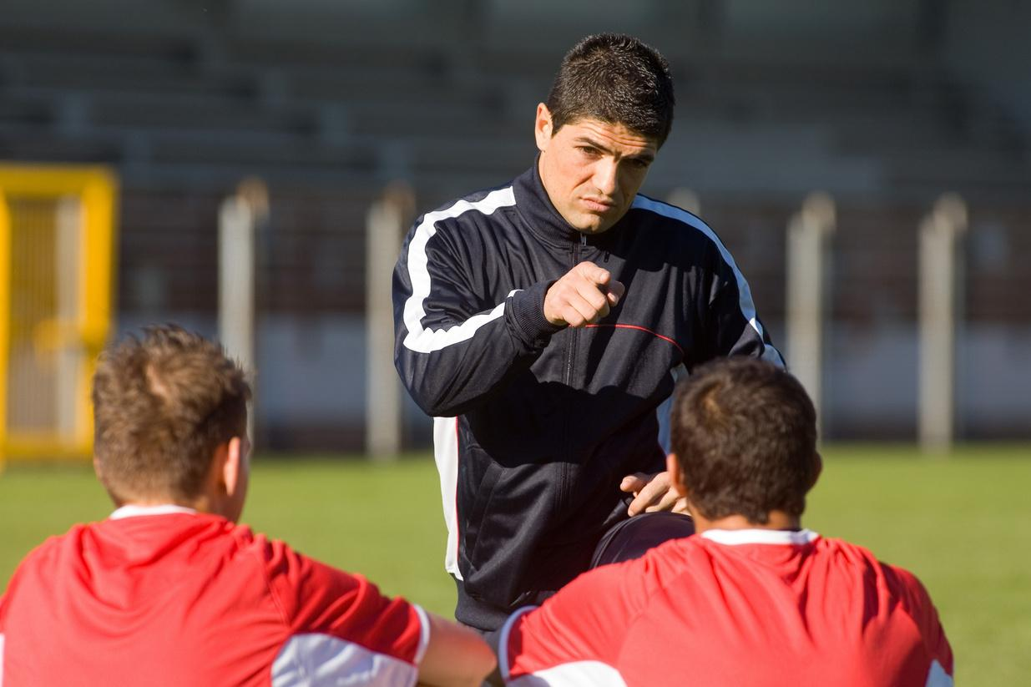
A
AP (AFFILIATE PLAYER)
Max of 3 AP’s per team - will pay $250 to offset expenses
Game Participation
APs can be called up for 5 games as needed
Participation approved by the Technical Director
After 5 games APs are to be offered a full roster spot
Practice Participation
When available encouraged to participate
Club Participation
AP’s must be part of local club team.
Club commitments are given priority over PEI FC practices, events and game

Slide 10
PLAYER COMMITMENT & EXPECTATIONS
Attend practices, league and exhibition games & fitness sessions and any other team events
Use RAMP app to keep coaches updated with participation for all events
Ensure school is a priority.
Travel to Halifax for league games (if travelling with another family, contribute to cost)
Adhere to the Player Code of Conduct
Be mindful that you represent your province and sport

Slide 11
PARENT EXPECTATIONS
Support player’s participation in training, games, and events, and to model positive behaviour and encouragement at all times.
Parents are expected to support and/or help organize fundraising initiatives.
Program fees paid on time.
PEI Soccer Policy
Consistent communication is essential to each player’s success.
Keep player availability in RAMP up to date
Inform coach/s if player is injured, sick, etc.
Be respected to all participants including, coaches, players and referees.
No yelling at referees
Refrain from coaching players from the sideline
Not able to approach or be on the bench side of the field during any games

Slide 12
COACH QUALIFICATIONS & EXPECTATIONS
Head Coaches - C Diploma Certified or higher
Assistant Coaches - C Diploma Trained or higher
Development Coaches - Learning to Train / Soccer for Life
All coaches must have:
Respect in Sport
Making Ethical Decisions
Making Headway
Expected to arrive on-time for all team events.
Be prepared for all sessions ahead of time
Rule of 2
Not communicate directly with athletes by text, snapchat, social media or email without including parents in communication. NO DM’s.
Provide constructive regular feedback to players regularly both verbal and in writing.

Slide 13
PEI FC CLOTHING
Training Kits
Black Adidas Shirt
Black Adidas Shorts
Black Adidas Socks
Dri-Fit Training Top
2 provided per player, including APs
Team Uniforms
Home kit
Away Kit
New socks every year - 2 sets (cut socks allowed provided they are taped and undersock matches main sock)
Replaced every 2-3 years.
Last replaced in fall of 2024 for use in 2025 season
Player Kits Required:
Adidas bag
Adidas Track suit - black track pants and grey or black quarter zip
Adidas Parka or Rain jacket depending on location of Nationals each year.
Teamware
teams can purchase additional branded items. ie. Hoodies, etc
All Star Cresting

Slide 14
PROGRAM COST
Event | Description | Cost estimate
Fall Assessment | November - December 2025 | $250
Winter Training | January - April 2026 Includes: 3 practices per week, fitness sessions, coaching costs, and participation in Indoor league. | $700
Summer Session, incl Nova Scotia League | May - October 2026 Includes: 2 practices per week, uniforms, fitness sessions coaching costs, and hotels when traveling for league games, ref fees, exhibition games, prep for Nationals | $2,000
Umbro Showcase | May 2026 in Mississauga, ON Includes: flights, hotel, food, tournament fee, staff expenses | $2,400
Atlantics | U17 July 23-26, 2026 U15 July 30-Aug 3, 2026 Includes: bus, hotel, food, tournament fee, staff expenses | $1,350
Canada Soccer Club Nationals | October 6-12, 2026 Includes; flights, hotel, food, tournament fee, staff expenses | $2,300
Total |  | $9,000 estimate

Slide 15
PROGRAM COSTS
Why are costs so high?
FC Program is 100% player funded. PEISA receives no grants or subsidies to offset costs.
Limited indoor turf availability → high rental costs
PEI Soccer does not have its own fields → high rental costs
Long winter season → extended indoor training
Significant travel requirements for competition
Small player pool → fewer economies of scale

Slide 16
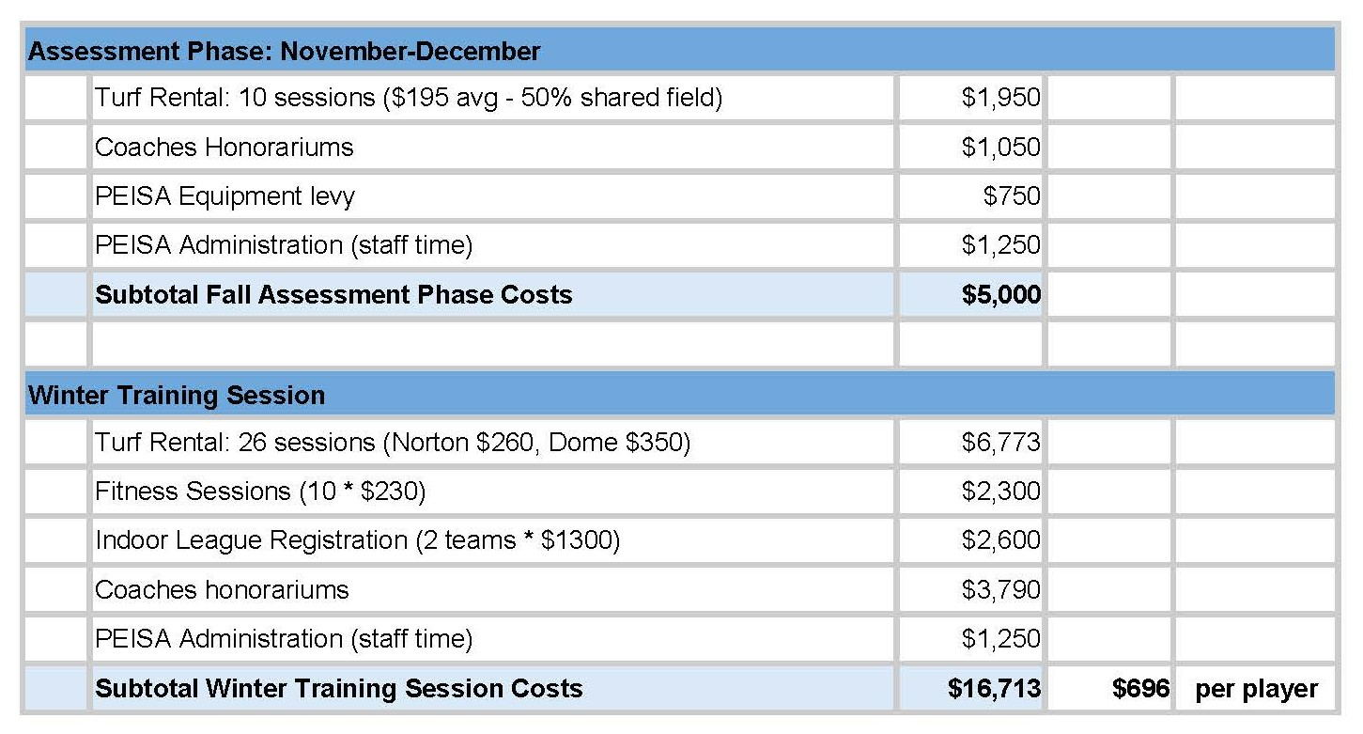
PROGRAM COST - Winter Training Session

Slide 17
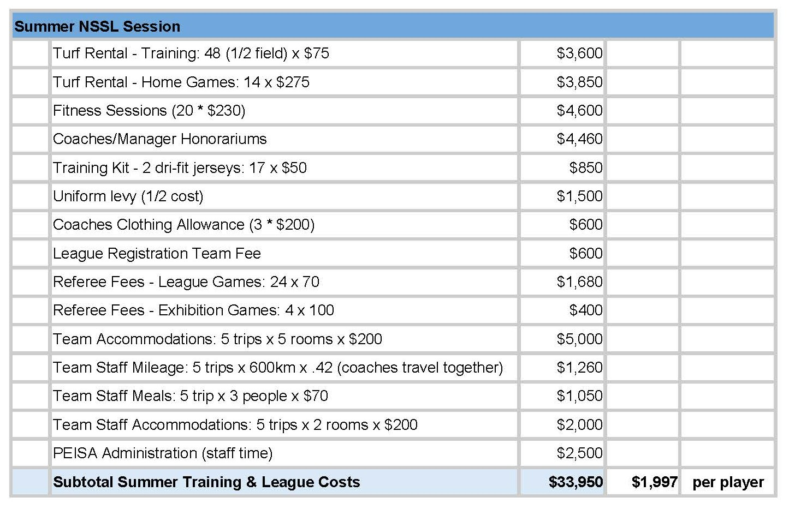
PROGRAM COST - Summer NSSL

Slide 18
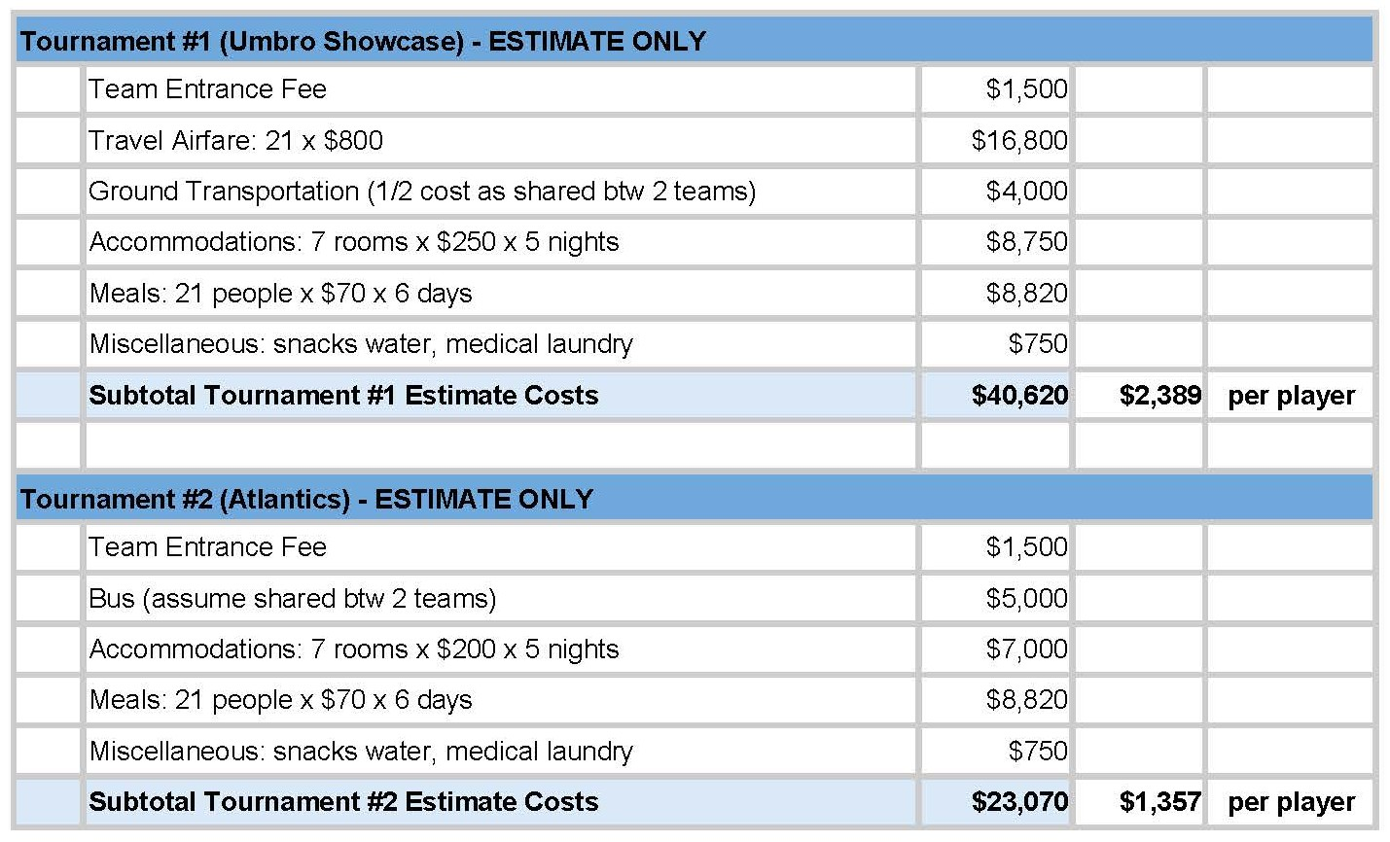
PROGRAM COST - Tournaments

Slide 19
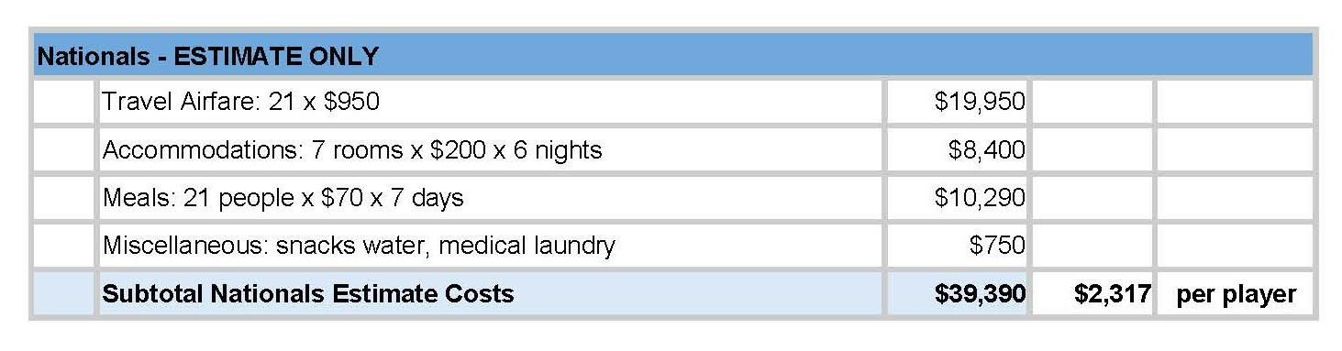
PROGRAM COST - Nationals

Slide 20
PROGRAM COST - Notes
Fees do not include team clothing and training kits of approx $400 per player (if req’d).
Nationals and tournament costs are estimates only. Tournament budgets will be revised based on parent committee determinations, and any amounts collected but not spent will be returned to player accounts.
Team tournament participation, except Nationals, will be determined by Parent Advisory Group in consultation with head coach.
Budget does not include any assumptions for fundraising or sponsorship.

Slide 21
PEI FC FUNDRAISING
Teams may choose to fundraise to help offset program costs.
Teams are responsible for organizing and managing their own fundraising activities.
All fundraising initiatives must be submitted to PEI Soccer for approval to ensure alignment with applicable policies and guidelines.
Fundraising opportunities:
Flip-Give - https://shop.flipgive.com/
Causable - https://cospei.goldrush.causable.io/
Solicitation by players/parents for donations from companies or private individual
Teams are responsible for tracking all fundraising and are required to submit the approved - Fundraiser Tracking Form - when submitting amounts to be applied to player accounts.

Slide 22
Parent Advisory Group
2 parents from each team
one parent member must be the Manager of each team.
Chair will be a member of the PEI Soccer Board
9 members total
Will coordinate fundraising and sponsorship of teams
All sponsorship will be coordinated with ED of Soccer PEI to ensure compatibility
Will liaise with coaching staff regarding tournament participation
Parent group and coaches will ensure parity between teams on tournament participation and balance required tournament play with optional tournaments

Slide 23
QUESTIONS?

