Slide 1

Team Nb
Canada Winter
Games 2027
Identification camp

Slide 2

Coaching staff
Head Coach - Jésika Savoie
Assistant Coach - Annie Cormier
Assistant Coach - Megan Williston
Assistant Coach - Miguelle Proulx
Contact us : cwg2027rnb@gmail.com

Slide 3

Go For It
Rise to the challenge - always strive for excellence. Discover how good you can be.
Play Fair
Play honestly - obey both the letter and spirit of the rules. Winning is only meaningful when competition is fair.
Respect Others
Show respect for everyone involved in creating your sporting experience, both on and off the field.
Win with dignity and lose with grace.
Keep It Fun
Find the joy of sport.
Keep a positive attitude both on and off the field.
Stay Healthy
Place physical and mental health above all other considerations - avoid unsafe activities.
Respect your body and keep in shape.
Include Everyone
Share sport with others. Ensure everyone has a place to play.
Give Back
Find ways to show your appreciation for the community that supports your sport and helps make it possible.

Slide 4
  Inclusive
  Psychologically safe ||
  Sécurité psychologique
  Training and support ||
  Formation et soutien
  Screening || Filtrage
Safe Sport Experience /
Expérience sportive en toute sécurité
  Inclusive - InCLUSIF
  Psychologically safe -Sécurité psychologique
  Training and support -
  Formation et soutien
  Screening - Filtrage

Slide 5
BEHAVIOURS, EXPECTATIONS - ATTENTES
The CWG program is rooted in I-CARE core values:
Innovation
Community Accountability
Respect
Excellence
Le programme des JDC est ancrés dans les valeurs fondamentales de I-CARE :
Innovation
Communauté Responsabilité
Respect
Excellence

Slide 6
Phase 1
Phase 2
Phase 3
Questions
RNB Website

Slide 7
Phase 1 - Phase 2
Invitation will be sent out to athletes end of February 2026
Registration and Fee: $375
Tryout Dates:
  Sunday, April 26th, 2026 - Cap-Pelé
  Tuesday, April 28th, 2026 - Cap Pelé
  Thursday, April 30th, 2026 - Cap Pelé
  Saturday, May 16th, 2026 - Cap-Pelé
  Sunday, May 17th, 2026 - Cap-Pelé
  Monday, May 18th, 2026 - Dieppe - Fitness Testing 12pm
** First cut
May 23 and 24 - TBD
June 27 and 28 - TBD
July 3 – 5 – TBD
*********
CWG Challenge Cup #1 (August 5th - August 9th, Regina, Saskatchewan)
  Fee: Estimate $2000 (Training and travelling cost to Regina )
ID SESSIONS - $175
#1 – Fredericton
#2 - Shediac

Slide 8
Phase 3 - TEAM TRAINING & COMPETITION
August 2026 - March 2027
Training Camps and pre-games tournaments ○ Practices, off ice, fitness testing, games, bonding, strategy sessions, mental performance.
CWG Challenge Cups:
○ October 7th - October 11th – St. Albert, Alberta
○ November 26th – 29th – Quebec City
TEAM NB Rally, Sunday January 10th, Fredericton
Canada Winter Games ● Quebec City, February 27 – March 6, 2027
Registration fee – Estimate $6000

Slide 9
AFFILIATE - ALTERNATES
The cost will be $1,000. Alternates will receive team equipment and will practice with the team.
Alternates will not travel to the CWG unless they are replacing an injured or ineligible athlete. The coaching staff, with executive approval, may reduce the number of alternates as needed.
Fees may vary if an alternate is added as a full-time player or is required to replace a player attending a Challenge Cup. Each case will be evaluated individually.

Slide 10
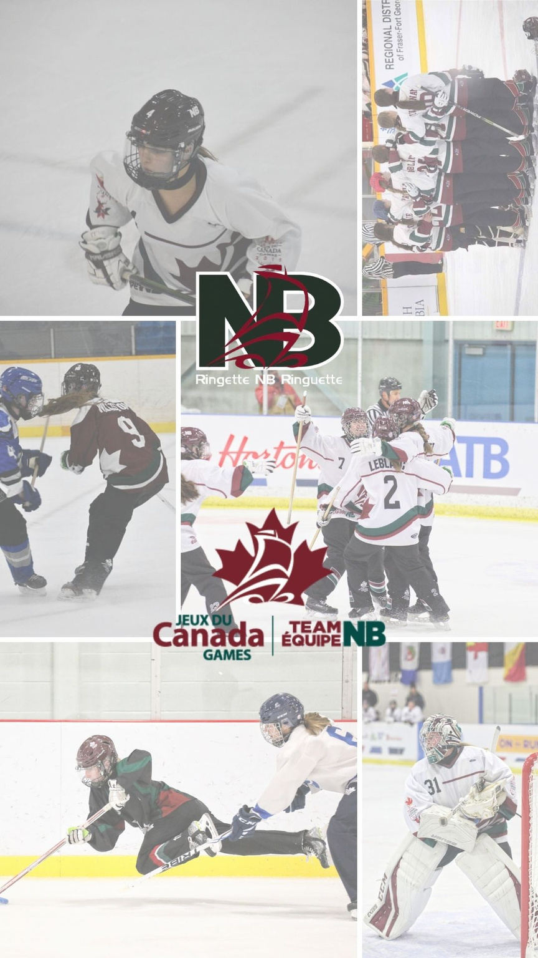
RNB WEBSITE
Questions?

Slide 11
FAQs
Q. Are CWG Selected Athlete’s required to double card with RNB?
Yes, as per the 6.3 Athlete Eligibility in the technical package from RC
Q. Do the Athletes receive any financial support from RNB? If so, what does this look like?
Yes, RNB provides $16,000 that goes toward the team expense.
Q. Does the Team receive funding from the province?
Yes, the province fund the team for all expenses during the games.
Q. Are Parents expected to Travel to the Hubs?
A. No, the team is travelling and staying together.

Slide 12
FAQs continue
Q. Will the Team have fundraising opportunities to offset expenses.
A. The team and or RNB can seek out sponsorships, but we need to be clear about what the sponsorship is for and refrain from saying it's for the team's participation in the Canada Games. All expenses related to the actual participation in the Canada Games are paid by (GNB/Team NB) and the Federal Government/Sport Canada (eg. travel, accommodation, food and ceremonial uniform). We are not permitted to use the Canada Games or Host Society logos in promoting these sponsorships ( eg. social media ) etc as they could be competitors of their own sponsors. Also note that at Games, no corporate sponsor marks are allowed on competition uniforms, warm up uniforms or team bags.
Ringette NB can do any fundraising or sponsorship request as they please for their participation in events that are NOT the actual Canada Games so fundraising for the 3 hub events ( Regina, Alberts and Quebec) are considered events that our team participates in. We can't mislead sponsors into thinking that they are supporting the athlete's participation at the Canada Games because that would be false.

Slide 13
HAVE FUN! ENJOY THE MOMENT!

