Slide 1

Ringette Ontario
Executive Director Report
ANNUAL GENERAL MEETING
JULY 25, 2020

Slide 2
Mission, Vision & Values
We are an athlete centric organization who makes value driven decisions.
Community: We build community on mutual respect
Collaboration: We work as a team to achieve our goals
Character: We build character, resilience & dedication
Challenge: We view challenge as an opportunity for growth
Competition: We seek out and embrace good competition
VISION
MISSION
Ringette is recognized as a sport which builds Character through Community & Competition
Ringette Ontario is committed to Nurture, Promote and Advocate for Ringette

Slide 3
Focused on our Strategic Priorities
Operational Excellence
Participant Pathways
Partnerships & Awareness
Safe Sport Environment

Slide 4
Safe Sport Environment
Brand new suite of Safe Sport Policies
Partnership with Sterling BackCheck
Updated complaint management process
Improved injury management and tracking process
Successful implementation of Rowans Law
Risk Registry review completed

Slide 5
Operational Excellence
Successful implementation of RAMP (MMS)
Increased registration by 5%
Increased communication pathways and opportunities
Operating plans were close to 90% complete with some areas pushed forward or revised based on resources/timing
Provincial Accommodation process created and implemented
Active within the sport community in Ontario seeing an inclusion of Ringette at the table for Provincial and multi-sport working groups
Finalization of Club Playbook for launch in August

Slide 6
Participant Pathways
Coaching
22 Clinics were held for new coaches this season (10 CSI and 12 CI)
50 CI Certifications completed by 6 Coach Evaluators
6 new Coach Evaluators (including RO TD) trained and 3 current Coach Developers completed refresher in February funded by Coach Association of Ontario/Canada
New Junior Coach Role was popular and effective way to get our younger players interested in coaching – 64 registered on TRF’s this season
Officiating
Total of 60 Clinics this fall (12 Level 1, 6 Level 2/3, 1 Level 4 , 3 Online Instructor Clinics and 38 Refreshers)
Expanded the POD program to a regional based program. The program included 22 officials this season and all were invited to attend the U12 Provincial Event in Sault Ste Marie
575 Evaluations completed this season, 62 Upgrades in Officiating Levels
Supported 8 officials through the 3 scouting programs
Athlete Development
OWG was a success – improved location
AAA program was well received but more work to be done
RO Talent Scouting program launched at AA Provincials
Competition Review took place with participation from across the province
Children’s Ringette program finalized and ready to launch for 2020-2021 season
Active & engaged Athlete Advisory Committee

Slide 7
Partnerships & Awareness
Social Media & Communications
Launched RO Rundown and monthly blog.
Increased communication database from 564 to 986 subscribers.
  Average open rate of 59.1%
Further increased traction through paid advertisements.
Association Marketing
RO Roadshow
  Attended tournaments in each region to highlight ringette and safety.
Worked directly with struggling associations to improve marketing efforts.
Partnerships, Sponsors & Opportunities
Girl Expo
Gracie's gals
  Love Week Collaboration
MLSE Launchpad
  Gym ringette initiative
See What She Can Do
  Blog and digital marketing
iSI Live
  Ringette broadcasting
Hometown
  Merchandise and Apparel provider
#WeWill
Marketing Campaigns
We Will (Entire Season)
  Shared stories of members at all levels
Rowan’s Law (September)
Love Week (February)
Banner Season (February/March)
Safe Sport (May)
Introduction of our new Online Engagement Program: Team Talk

Slide 8
2019-2020 BUDGET REVIEW & PROJECTIONS

Slide 9
2019-2020 BUDGET REVIEW & PROJECTIONS

Slide 10
MEMBERSHIP FEES
 | U8 & lower | U10-35+ | Bench Staff | Officials
% of RO Membership | 16% | 57% | 23% | 4%
Registration Fee (incl Dues & Insurance) | $34.50 | $48.00 | $33.50 | $42.00
Payable to Ringette Canada | $20.00 | $20.00 | $9.00 | $16.00
Allocated to Participant Insurance (direct to RC) | $2.50 | $2.50 | $2.50 | $2.50
Dues (including MMS) | $4.50 | $4.50 | $4.50 | $4.50
Amount RO retains to fund the programs & services you receive | $10.50 | $24.00 | $20.50 | $22.00

Slide 11
2020-2021 Season

Slide 12
Safe Sport Environment
Continue work on injury management & tracking system
Complaint management moves to Office
Use of outside resources for investigation, appeals, screening and discipline
RO Screening Committee for Associations
Tracking of suspensions of coaches/athletes
Rule of Two strategies
Rowan’s law management
Respect in Sport for parents

Slide 13
Operational Excellence
Associations Online Programming
Creation of Return to Ringette protocols and resources
Moving programming online to adapt and reach more individuals
New operating quarterly plans that are priority focused
RO Team will stay at 3 paid employees for this season
Revision of the RO Membership Policy
Zoom account and conference lines available for Associations use
Club Playbook
ONCA requirements
Complaint Management
Conflict Resolution
Good Governance
Insurance
Volunteer Management
Financial Management

Slide 14
Participant Pathways
Going Virtual – online & on ice programming
Athletes
Coaches
Competition Review
Technical Skill Development
Virtual Training Sessions
Strength & Conditioning
Mentorship
Goal Setting
Dietician/Nutrition
Mental Health
Virtual White Board Sessions
Athlete Round Tables
Coaching Clinics
PD Opportunities
Virtual White Board Sessions
Mentorship
LTAD Working Groups:
FUNdamentals
Learn to Train
Train to Train
Train to Compete
Train to Win
Active/Competitive for Life
Competition Structure
Provincials Organization
AAA Program
Officials
Officiating Clinics
POD Program - Online
Virtual Training Sessions
Mentorship

Slide 15
Partnerships & Brand Awareness
We are All in
New marketing campaign for the season
Focused on online resources, online programming, education on COVID and Association support
Team Talk, Athlete Round Tables, FB Live Events and other online events & initiatives
Develop Marketing network for Associations
Use of external marketing tools (Rogers Digital) for targeted marketing
Diversify – translations of materials
Live coverage when we get back on the ice
Continued partnerships with SeeWhatSheCanDo, Lead Thru Sport, Gracie’s Gals, Hometown Rivalry, isi Live, True Sport, SheIs and Canadian Women & Sport.
Continue to seek out partnerships

Slide 16
2020-2021 BUDGET PROJECTIONS*
*Does not include Provincials
*Based on 50% membership contraction

Slide 17
2020-2021 BUDGET PROJECTIONS
Revenue | Projections
Grants | $ 140, 148
Registration Fees | $ 306, 269
Total | $ 446, 417
Expenses
Office/Business Services | $ 292, 851
Ringette Canada | $ 111, 000
Programming* (cash flow dependent) | $ 42, 566
Total | $ 446, 417
Total Revenues | $ 446, 417
Total Expenses | $ 446, 417
Profit/Loss | $ ----

Slide 18

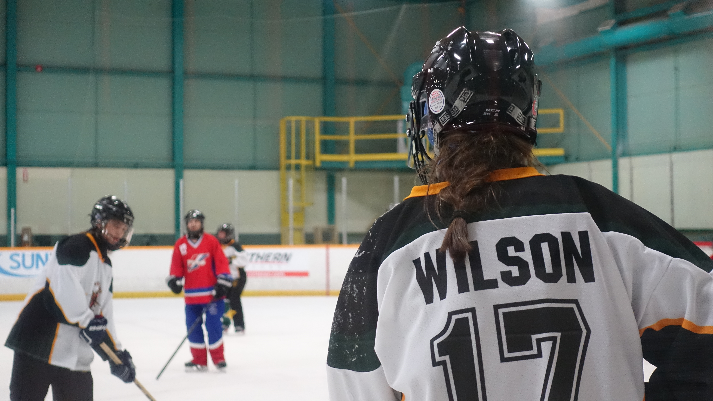
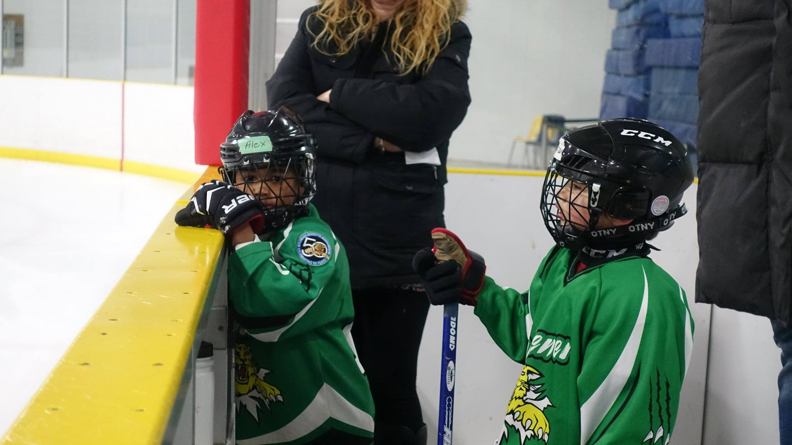
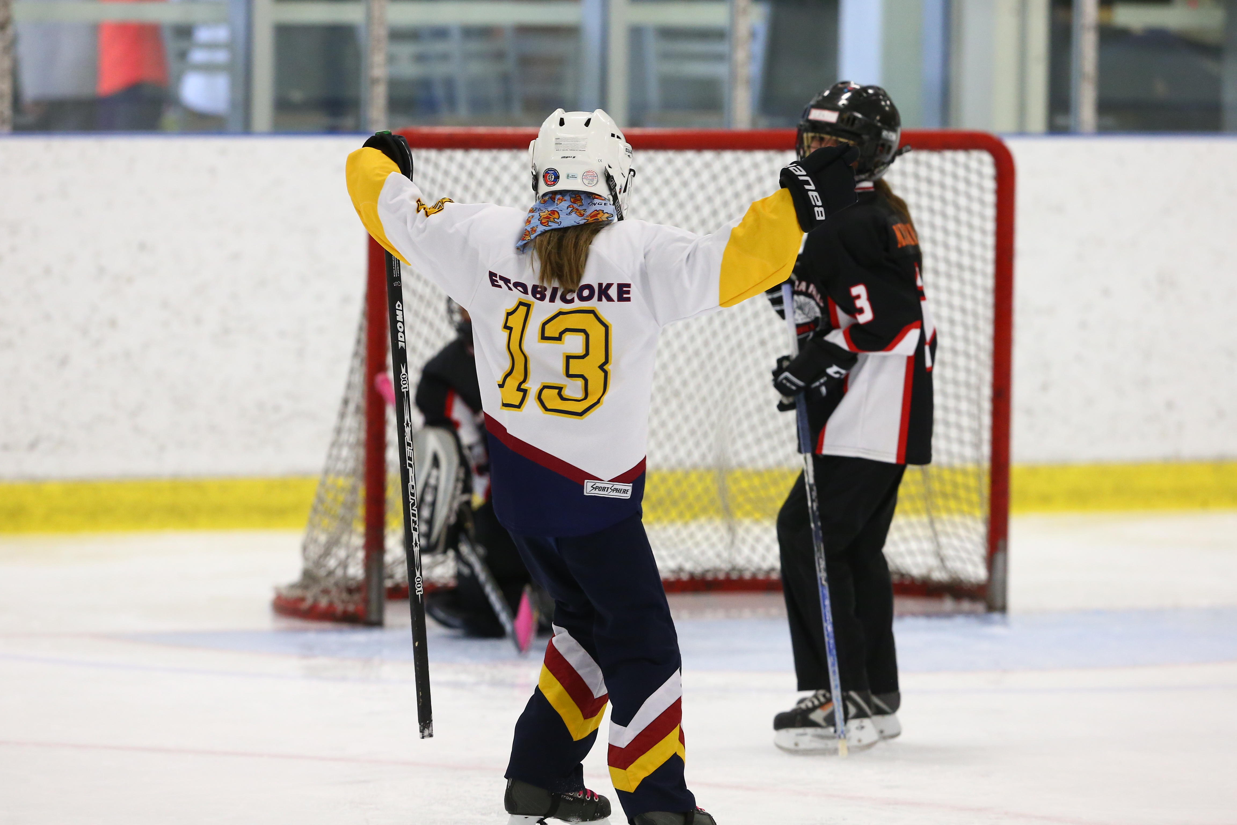
Value led, Value Based
Community Collaboration Character
Competition Challenge

