Slide 1
Ringette Ontario
Report to the Membership
Annual General Meeting 2022

Slide 2
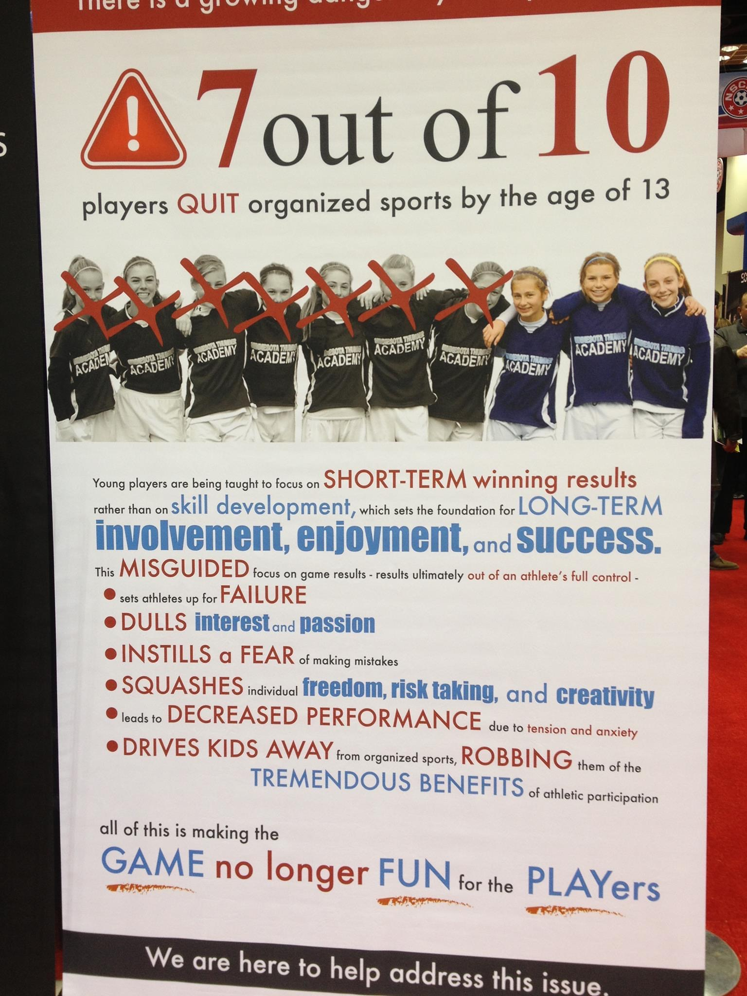
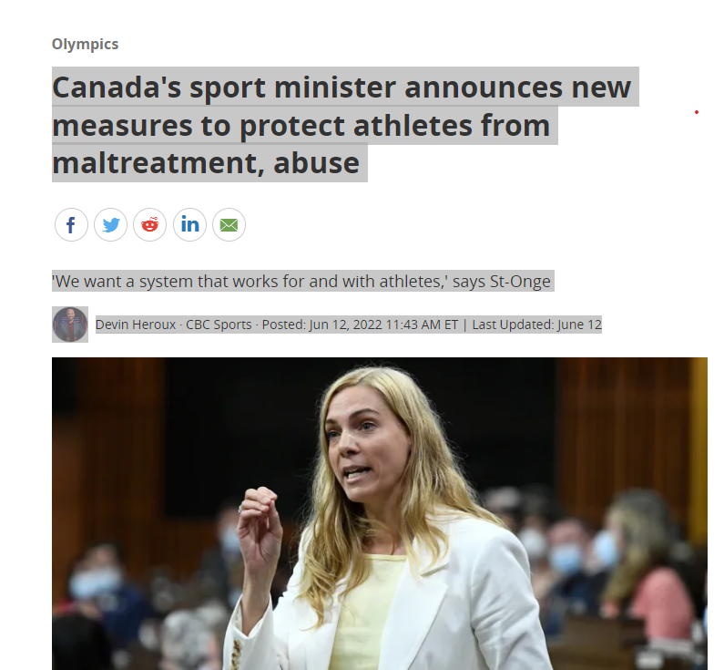

Slide 3
Process Overview
February/March 2022
Facilitate a kick-off meeting and a planning meeting with the Strategic Planning Committee.
March/April 2022
Background research of existing materials including the current strategic plan, stakeholder survey results and other relevant material.
April/May 2022
Develop a comprehensive initial findings report summarizing the results and insights from the Learn phase.
August - September
Facilitate decision-making sessions with the Strategic Planning Committee.
Create an actionable multi- year strategic plan endorsed by the Board of Directors and key stakeholders including members.
Produce a detailed outline of process and product objectives.
SWOT Analysis
Present the key findings and insights to the Strategic Planning Committee and the Board.
Stakeholder Interviews and Focus Groups including representatives of Staff, Board, Regions, Associations, Players, and Coaches
Develop a detailed engagement schedule including key milestones and timeframes.
Gather feedback through member engagement survey.

Slide 4
Stakeholder Groups Consulted
Consultations | Stakeholders
3 Focus Groups | Association Presidents
Focus Group | Regional Coaches
Focus Group | Provincial Coaches
2 Focus Groups | Players (regional and provincial)
Focus Group | Adult Players
Interviews | All staff members
Interviews | All Board Members
Interview | Coaching Committee Chair
Interview | Officiating Committee Chair
Interview | Representative of the NRL
Interview | Representative of the Games and Tournaments Committee

Slide 5
Key Learnings – Focus Groups & Interviews
There is widespread belief and confidence that ringette, and the rules associated with the sport, encourage teamwork, build character, and foster a strong community. There is a true love for both the learning and the values that are instilled on and off the ice.
Those associated with the sport of ringette are extremely passionate, in which many have been involved in the sport for decades. The level of volunteerism and the life-long dedication to the sport should be considered a major asset.
There is a widespread belief that ringette must continue to grow in order to survive as a sport.

Slide 6
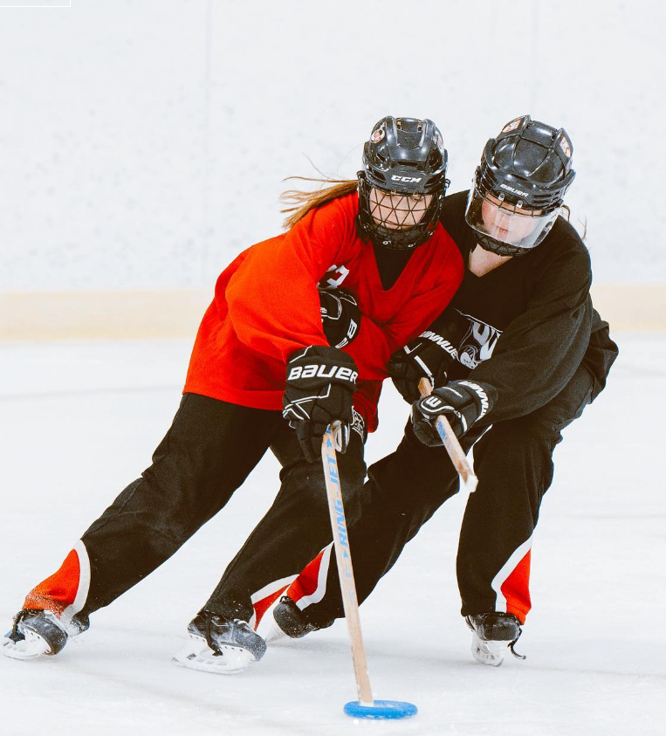
Key Learnings – Focus Groups & Interviews
4. There are signs of “us” vs. “them” emerging between those who feel RO needs to stay the course and stick with their historical tried and true methods, and those who feel that change is necessary for growth.
This is particularly evident in the differing views on the regional structure in Ontario.
5. Perspectives and opinions on the role of Ringette Ontario are divergent amongst the community. The mandate of the organization and the unique value it provides is not well understood by members.

Slide 7
Ringette Community Engagement Survey 531 Responses
Ranking:
Parent
Coach
Player/Club
Leadership
Other Responses:
Manager
Volunteer
Team trainer
Past player
Note: Many respondents had multiple roles within the organization, which they indicated in the comments.

Slide 8
What is one word you would use to describe the culture of ringette in Ontario?
Note: Only words mentioned 3 or more times were included in the word cloud

Slide 9
What is one word you would use to describe Ringette Ontario as the governing body for ringette in the province?
[out-of]
Note: Only words mentioned 3 or more times were included in the word cloud

Slide 10
Key Learnings / Takeaways
Player development and opportunities
Grow the grassroots program
Offer competitive play at all levels
Players should be able to choose where they play
More coach development opportunities
Transparent policies on try-outs, team formation
Member Retention
RO has rules and regulations that make it harder to be involved in the sport. For example, the rule mentioned dictating where players are allowed to play.
Barriers that allow coaches and volunteers to contribute
Allow all members to be involved to the degree that they want

Slide 11
Key Learnings / Takeaways
Gender Inclusivity
Right to play
More Active Regulation and Support for Associations
RO needs to take more responsibility in overseeing Associations
Ensuring Associations are accountable and enforcing RO’s policies
RO more purposeful in supporting smaller associations
Member Relationships
More frequent, clear and transparent communications from RO - transparency
Sport Promotion and Awareness
Lack of Awareness of the sport

Slide 12
Strategic Plan Elements
WHAT ARE WE ABOUT:
Mission: Delivering a lifelong sport community that promotes teamwork and leadership development in an inclusive and safe environment.
WHERE ARE WE GOING:
Vision: Be the leading ringette organization in the country, strengthening communities in Ontario through our sport.

Slide 13
Strategic Plan Elements
Values:
Dedication – We share a collective commitment and passion for the game.
Respect – We recognize everyone’s contribution to our community.
Teamwork – We achieve our goals together.
Inclusion – We welcome all who want to join our safe sport community.
Integrity – We deliver and govern our sport with transparency and fairness.

Slide 14
Strategic Plan Elements
Strategic Objectives:
Create a culture that promotes respect, integrity, and delivers a positive ringette experience for all
Deliberately grow the sport
Provide value-add development opportunities to the ringette community
Be a leading sport organization delivering best practices in governance
Ensure operational excellence is the foundation for all we do

Slide 15
Next Steps and Where to from here……
Development of tactics that align with and support our strategic objectives
Concerted Board effort to review and develop a new model and potential new structure for Ringette Ontario
Plan for change

