Slide 1







Gamesheet App
Meeting
November 1st , 2023

Slide 2
Introductions
President: Erin Huta
Vice President: Cara Jean Clarkson
Governor In Chief: Michelle Anhorn
Administrator: Angela Sellwood
Notes:
Please check the website for our new email addresses as we have created new addresses for our board executives. This is going to allow us to have continuity when one member leaves and another comes on.

Slide 3

Gamesheet App Basics
Download RAMP Gamesheets, log in using your own account
Download your Game Codes
  Home Team: Home, Gamesheet, Officials
  Visitor Team: Visitor Code
    HOME Code- verify roster, coach sign
    Gamesheet Code- Score the game, add goals, penalty and goalie shots here
    Officials Code- Officials sign gamesheet, add writeups
    Visitor Code- verify roster, coach sign
Open the app
  Enter relevant codes under ADD GAME CODE
Score your game
Don’t forget to add your goaltender stats
Officials log in using officials code under ADD GAME CODE and sign off
Don’t forget to end your game
Away teams login to RAMP (website) and verify game
If you do not have strong wifi in the arena, take your device to where you do and open the necessary page. The app should continue to function without wifi if it is started where there is a strong signal, don’t close the app until you get back to the stronger signal.

Slide 4
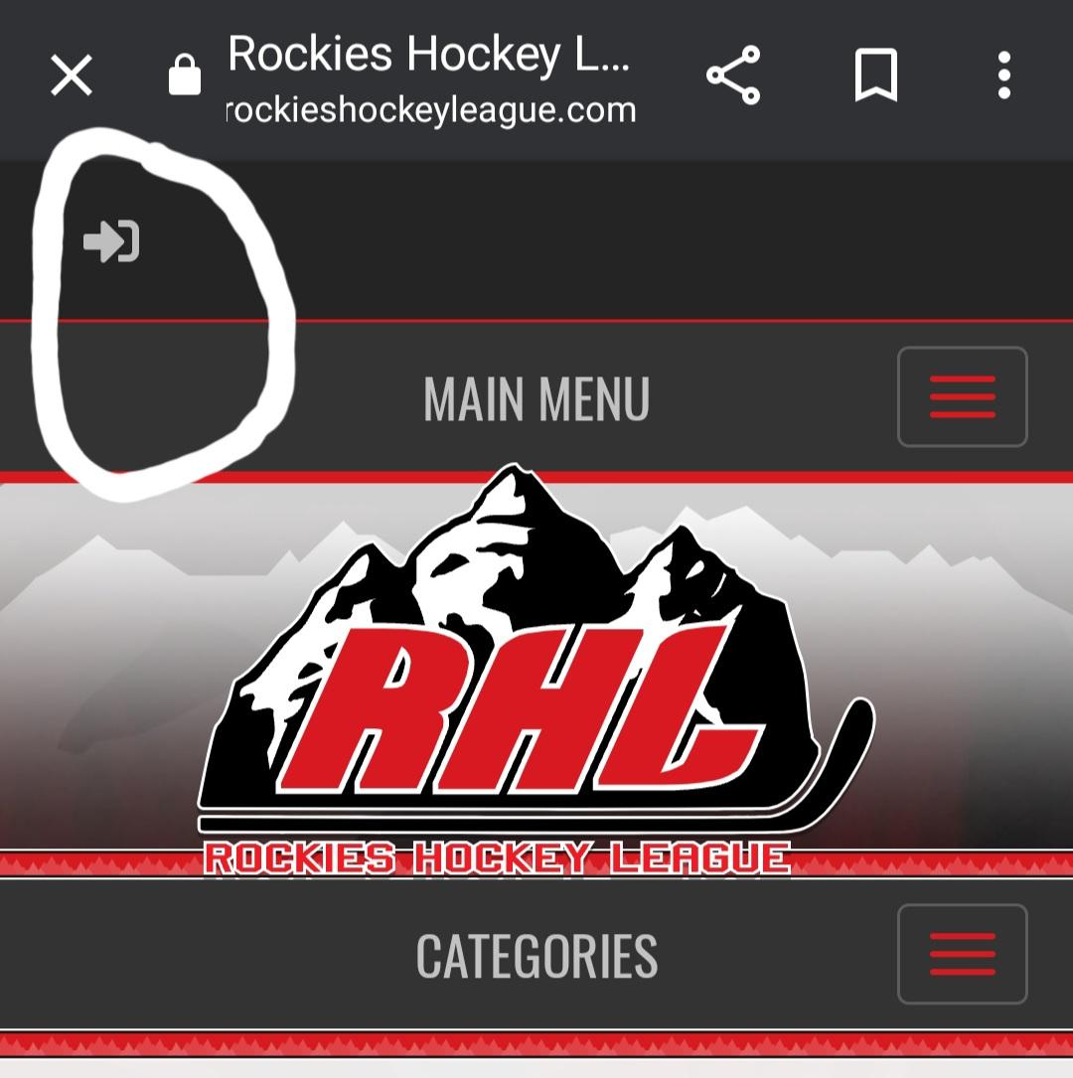
Downloading Game Codes
Step 1 - Make sure you have your RHL manager login and password. If not, email
governorinchief@rockieshockeyleague.com
Please note that league logins are different from association RAMP logins.
It will look like this: u11 cochr55555
Step 2 - Log into the Rockies Hockey League admin portal through the RHL website using your RHL manager login.

Slide 5
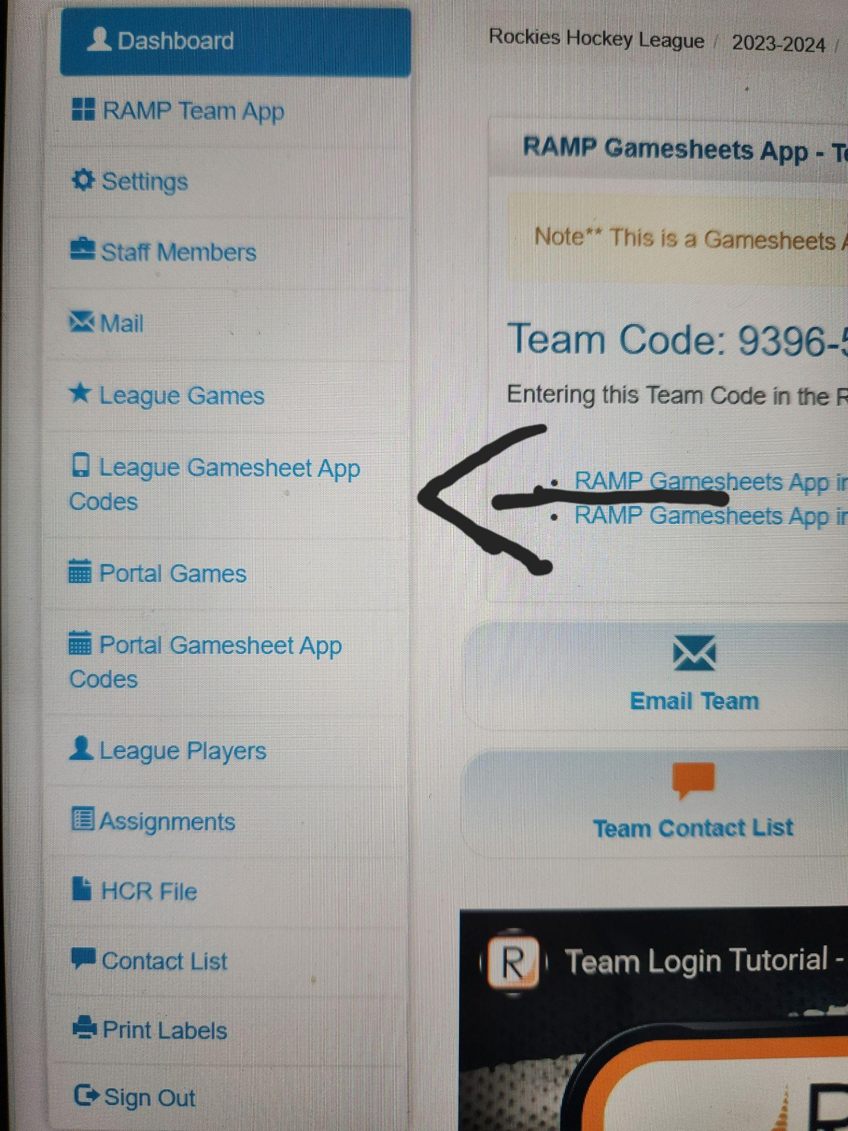


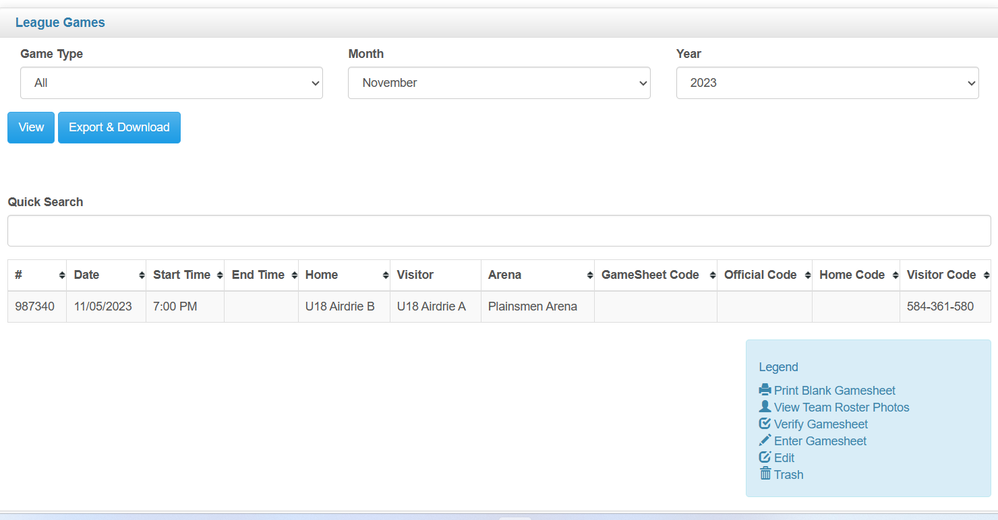
On a Computer:
Step 3 - Click the link: League Gamesheet App
Codes found in the menu on the left hand side of your screen
This is what it looks like. As games are added to RAMP they will be available here. You can export and download all codes at once. (First half to christmas will come first, then the second half to follow). Please remember if a game is changed the codes will change. As the visiting team this is all you will see. The home team has access to all the codes

Slide 6
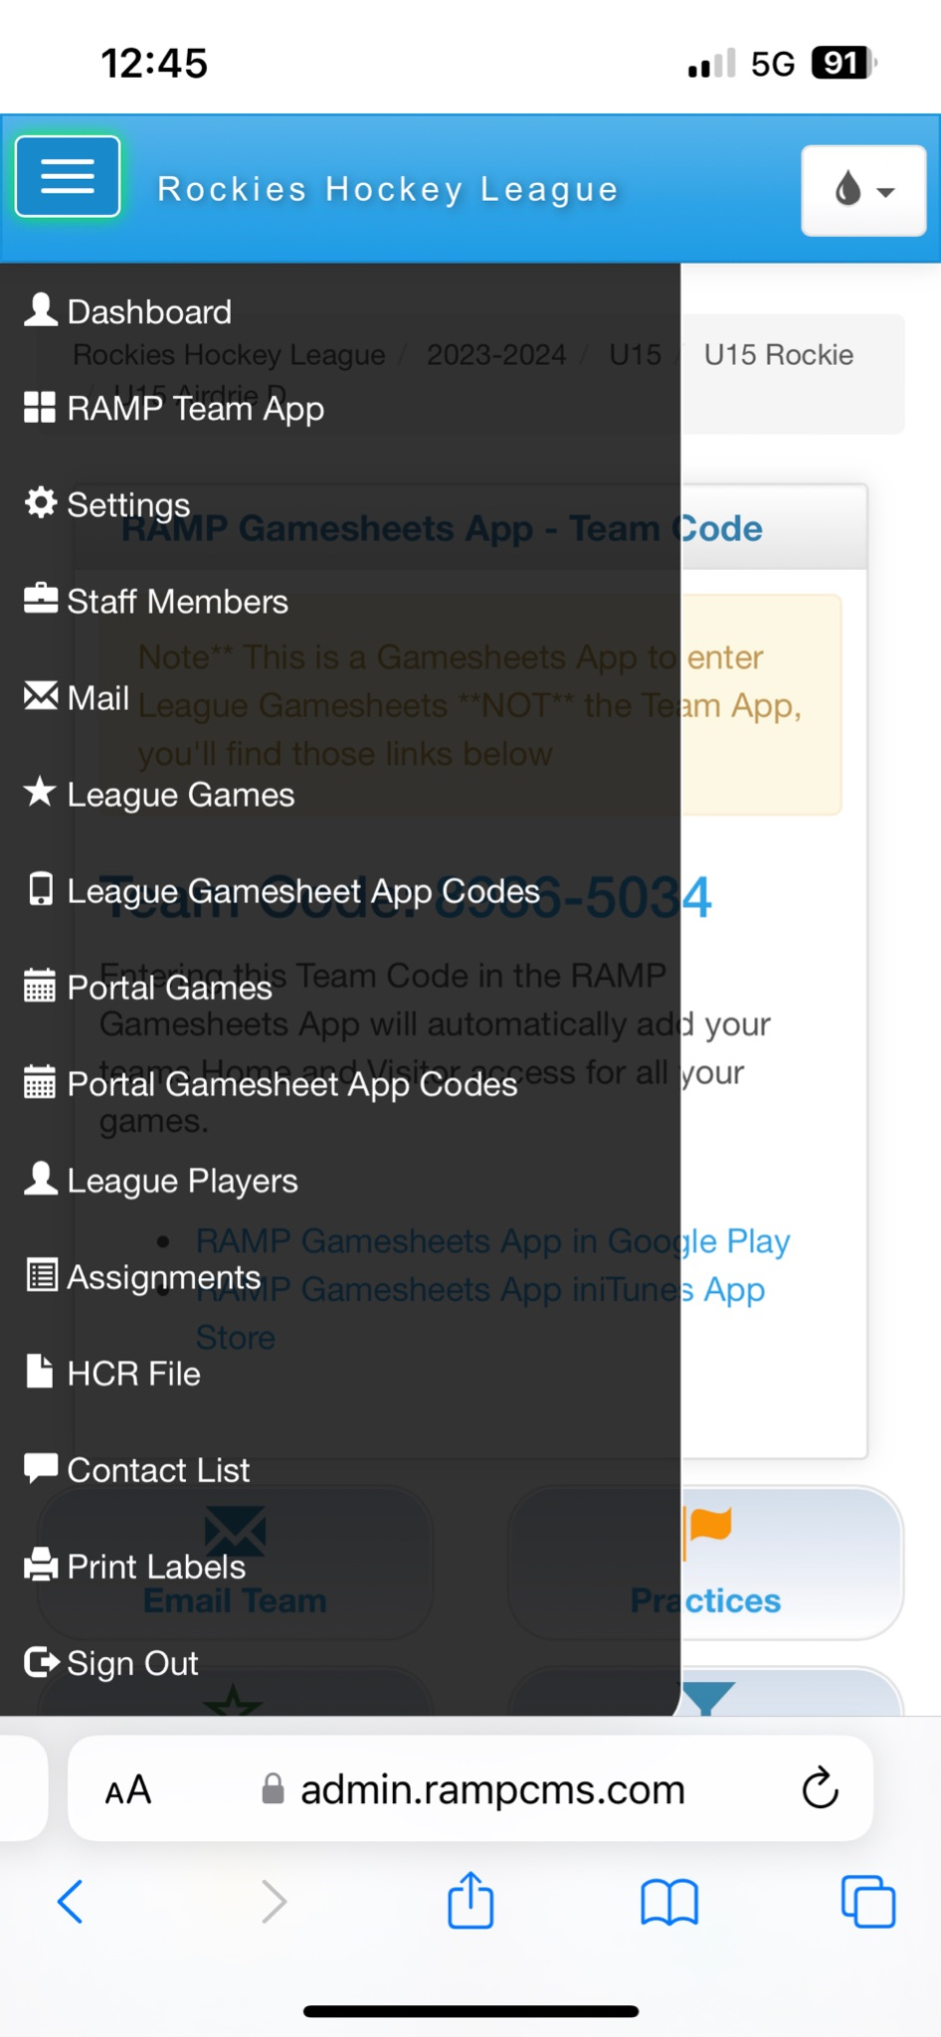
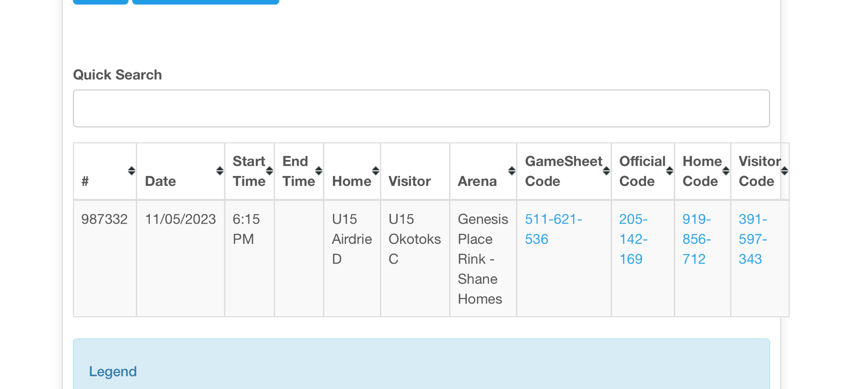
ON A CELLPHONE
(Same instructions different look)
Go to www.rockieshockeyleague.com
Use the admin login
Enter your RHL Login
Click on the menu
Click on League Gamesheet App Code
All relevant codes will be listed for any scheduled games
Notes:
Currently, Hockey Alberta seems to see us a recreational league. Is that what we see? What changes can we make to move towards defining who we are and what we want to be.

Slide 7
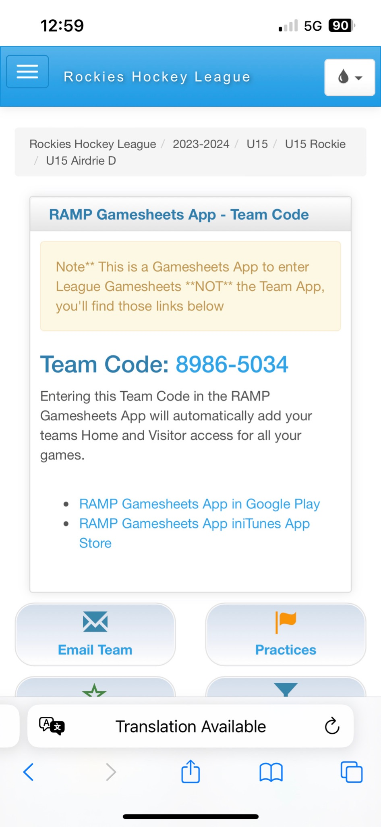
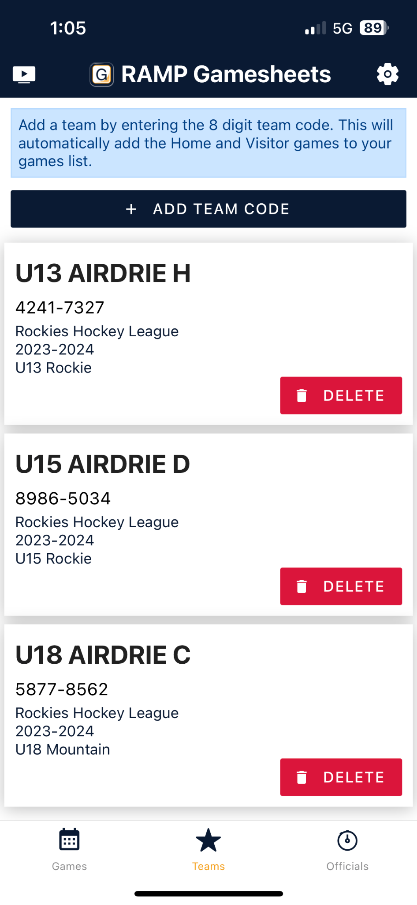
TEAM CODE
Using RHL Login you will see a team code on the main page
You can add this to your RAMP Gamesheets App on the team page of the app
Click ADD TEAM CODE
Enter the 8 digit code
You can enter multiple teams
You do not HAVE to enter your team code to use the app
This will auto populate all of your games but only the home or visitor code. It only serves to shortcut adding your roster.

Slide 8
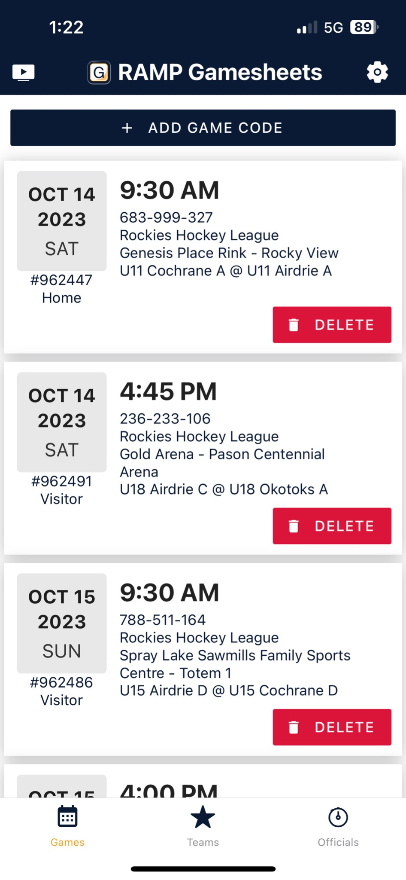
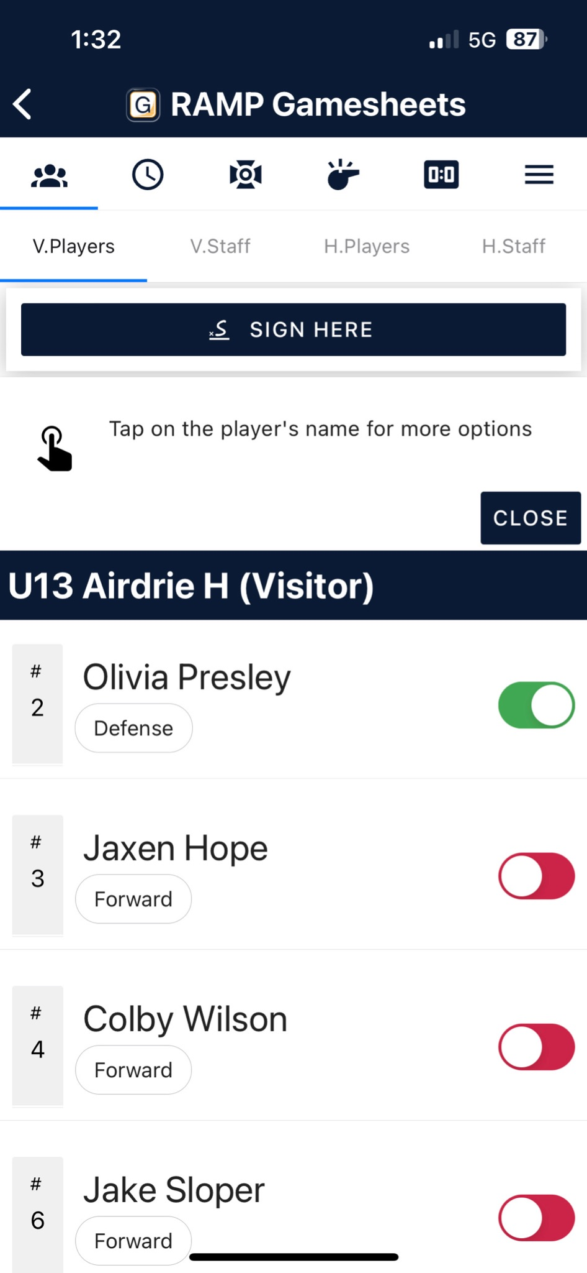
Home Code &
Visitor Code
Enter the 9 Digit Home or Visitor Code
  If you have entered your team code you may skip this step
Click on the relevant game to add your roster
  Ensure you have selected the correct game. It should say either visitor or home in the fine print
Add your players by toggling them to green
If needed assign Captains and Assistants by holding down on the player and selecting Captain or Assistant
Click Sign Here and have your Coach sign the box
YOU’RE READY TO START YOUR GAME!
Please note that it can take a few minutes to upload the games so it is best to enter all necessary codes in advance of your games.

Slide 9
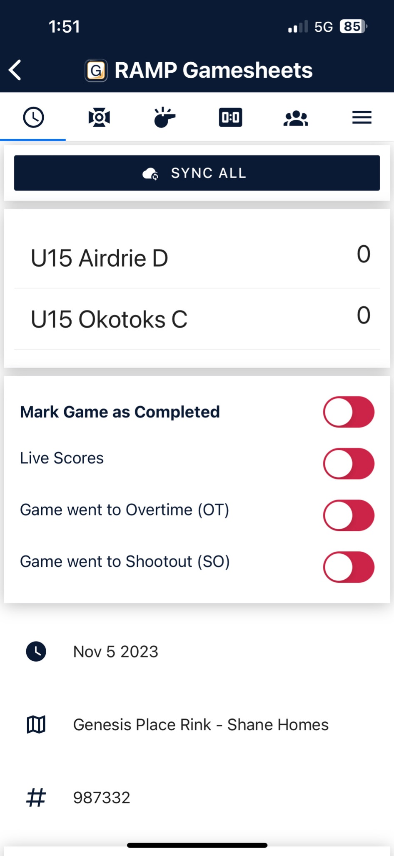
GAMESHEET CODE
Enter the Gamesheet Code under Add Game Code
Open the Gamesheet
Add goals
Add penalties
Add goalie stats
  Goalie stats cannot be added until the end of the game
Have officials sign
  Ref’s may use their own device and login if they prefer or you can provide it to them.
Mark game as completed

Slide 10
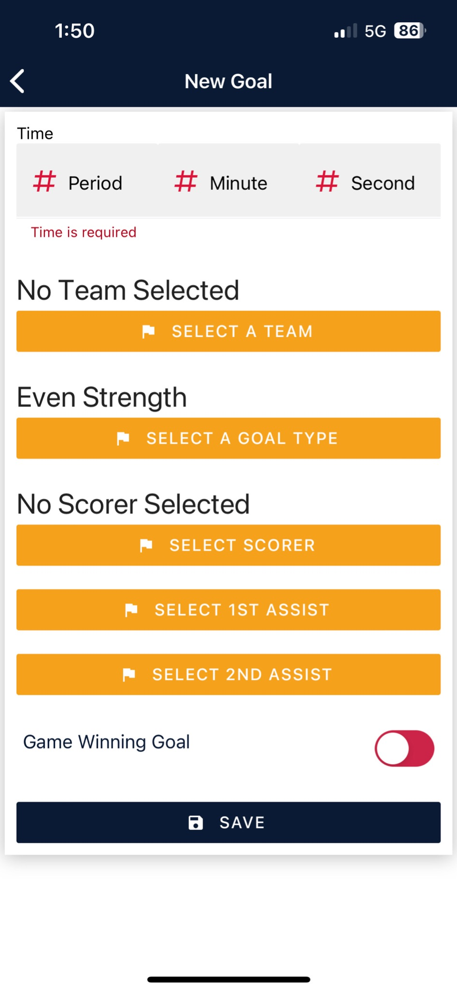
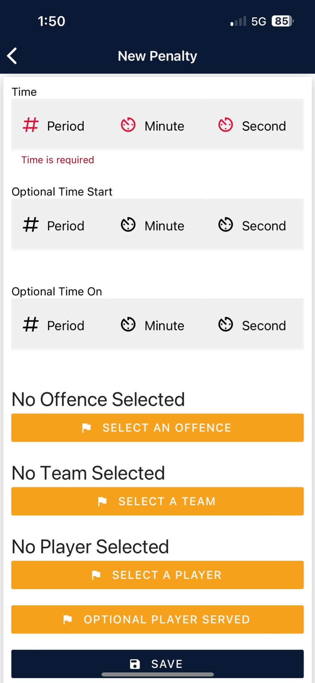
Adding
Penalties
Adding Goals
Enter time of the goal
Select a team
Select a Goal Type
  Make sure you are using the correct type, even strength, power play or shorthanded
Select scorer and assists
Save goal
Enter time of penalty
Skip the optional times
Select Offence
Select Team
Select Player
Save Goal

Slide 11
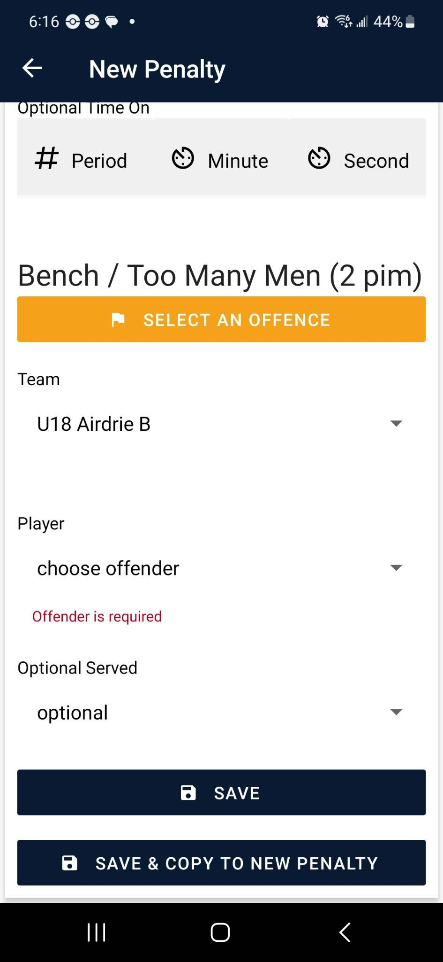
Penalties
Please make sure to pick the correct penalties when in the
app.
A Too Many Men penalty should be assigned to the bench rather than the player who served it. You do not need to complete the optional player who served the penalty.
A referee can go back to penalties page a change it before you hit end game so then they don’t need to give a write as to how it was wrong.

Slide 12
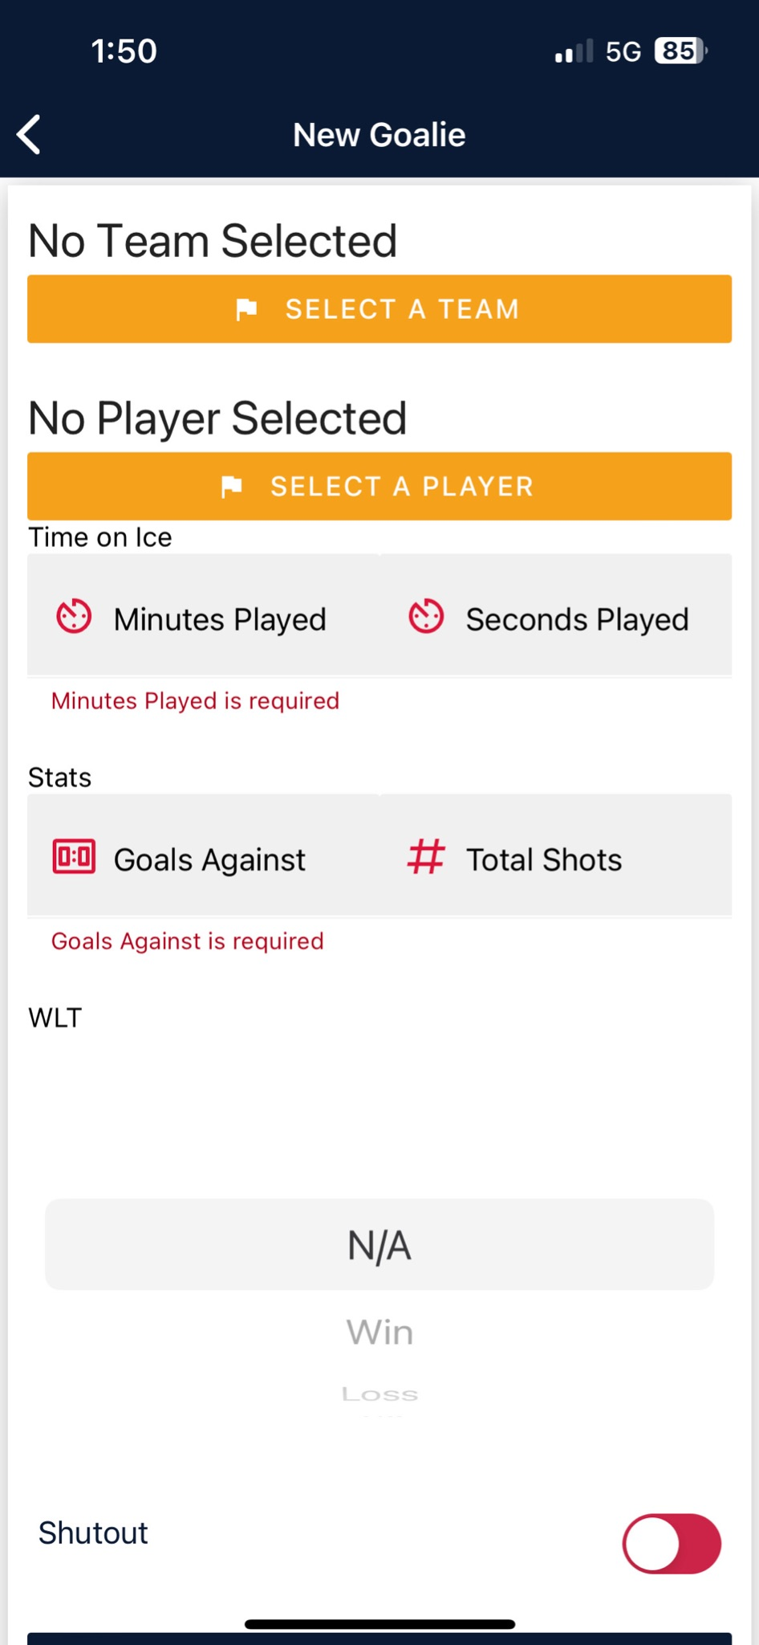
Adding Goalie Stats- Must be done from the Gamesheet NOT the home or visitor code
At the end of the game, before you mark the game as completed, enter your goalie stats
Click New Goalie
Select a team
Select the Goalie
Enter minutes played
Enter the shots on the goalie taken by the opposing team
Select W/L/T
Please track your stats on a scratch sheet during the game because you can’t update the goalie stats during the game. It needs to be the last thing you do before you mark the game as completed.

Slide 13
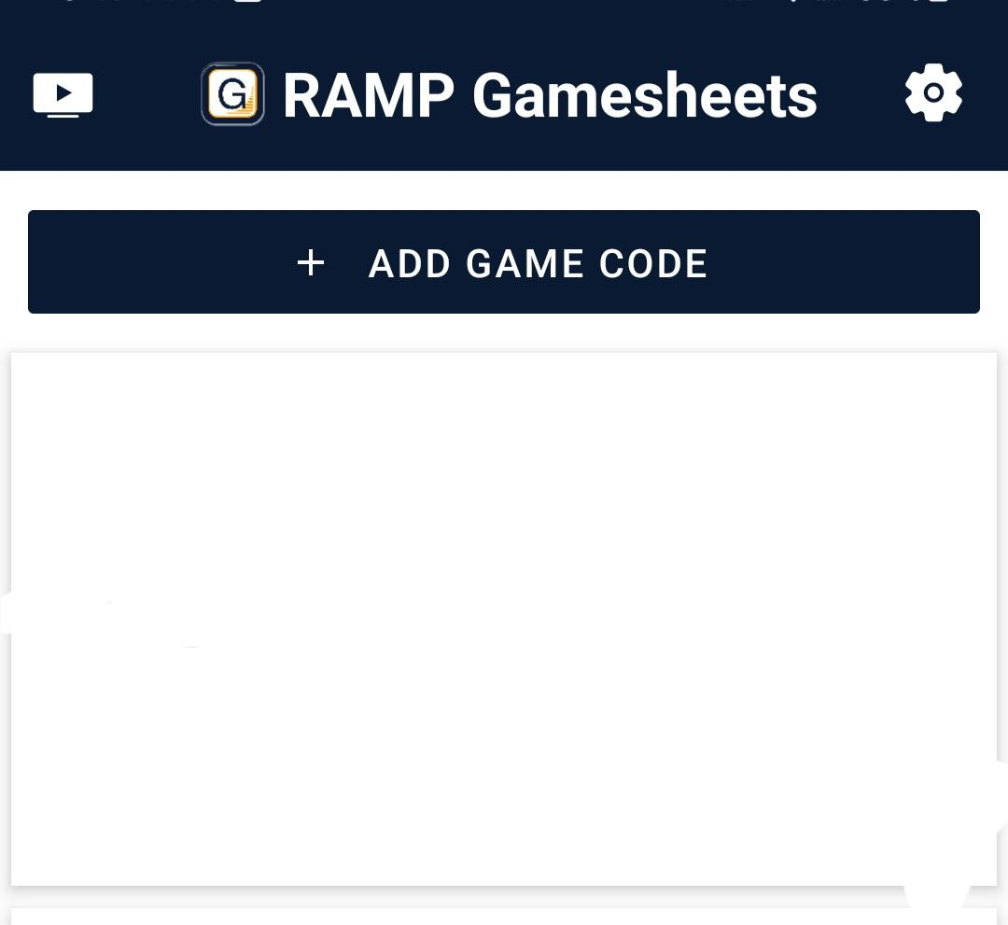
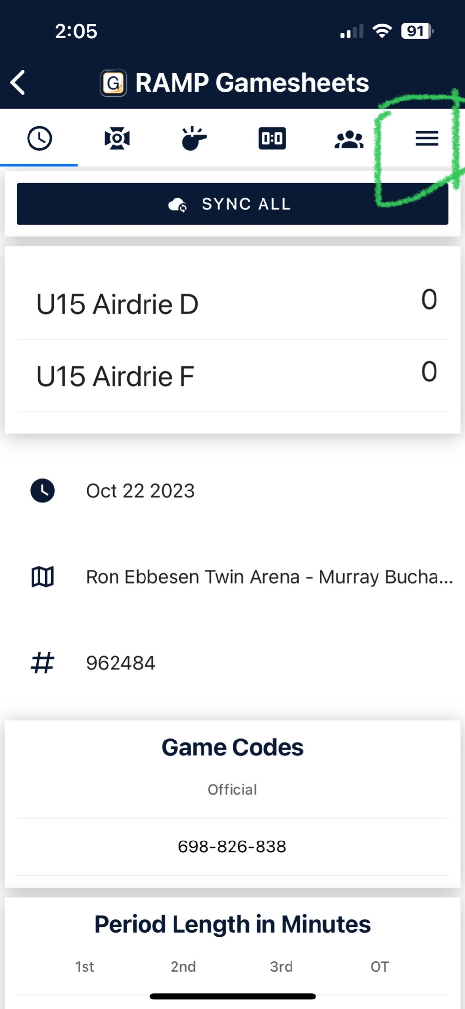
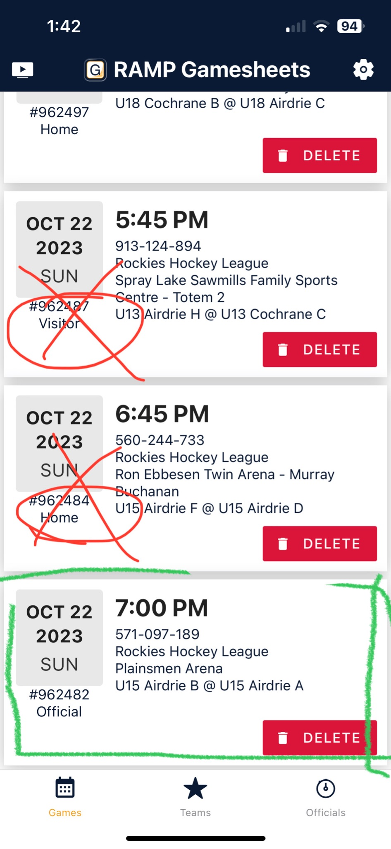
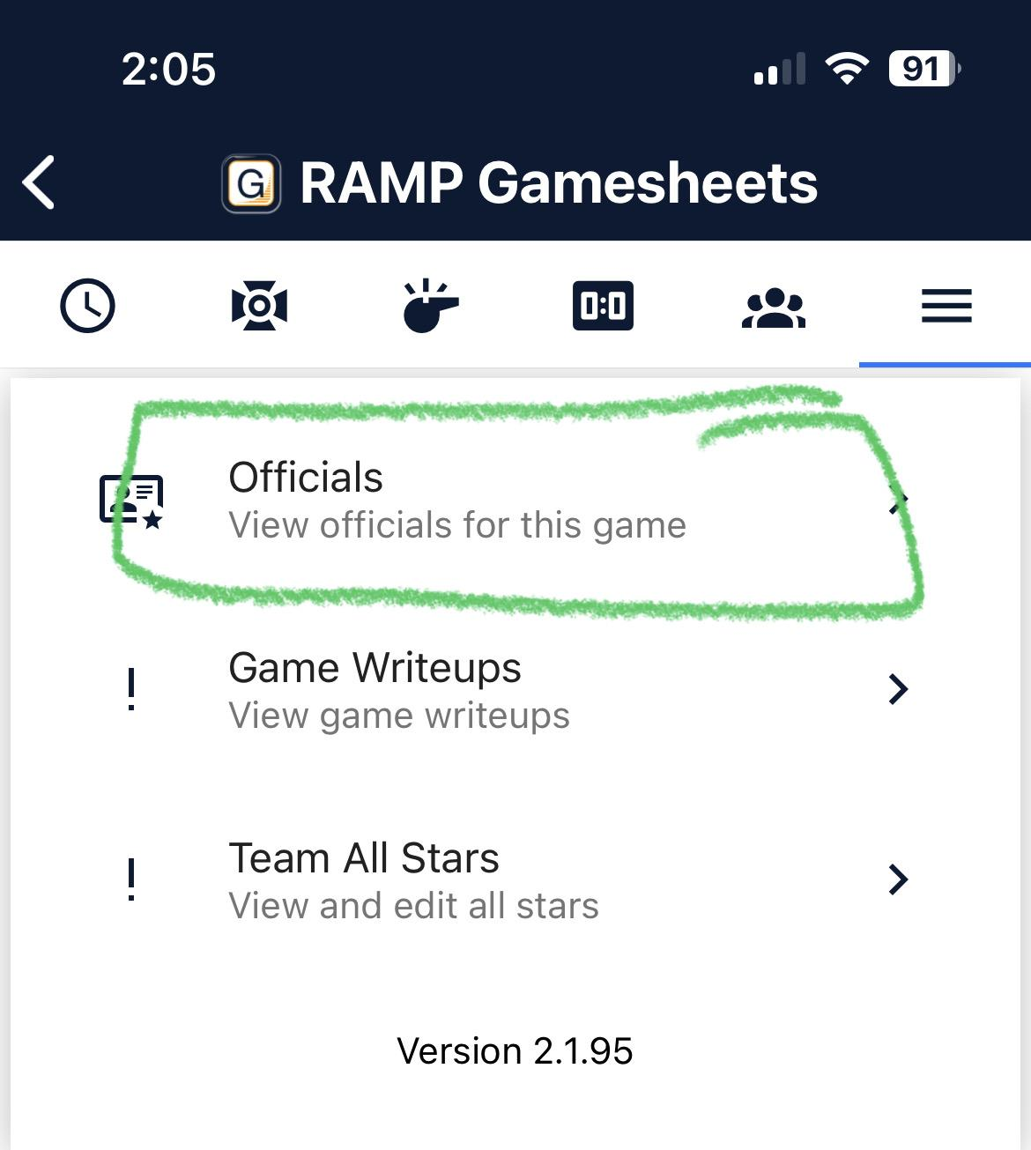
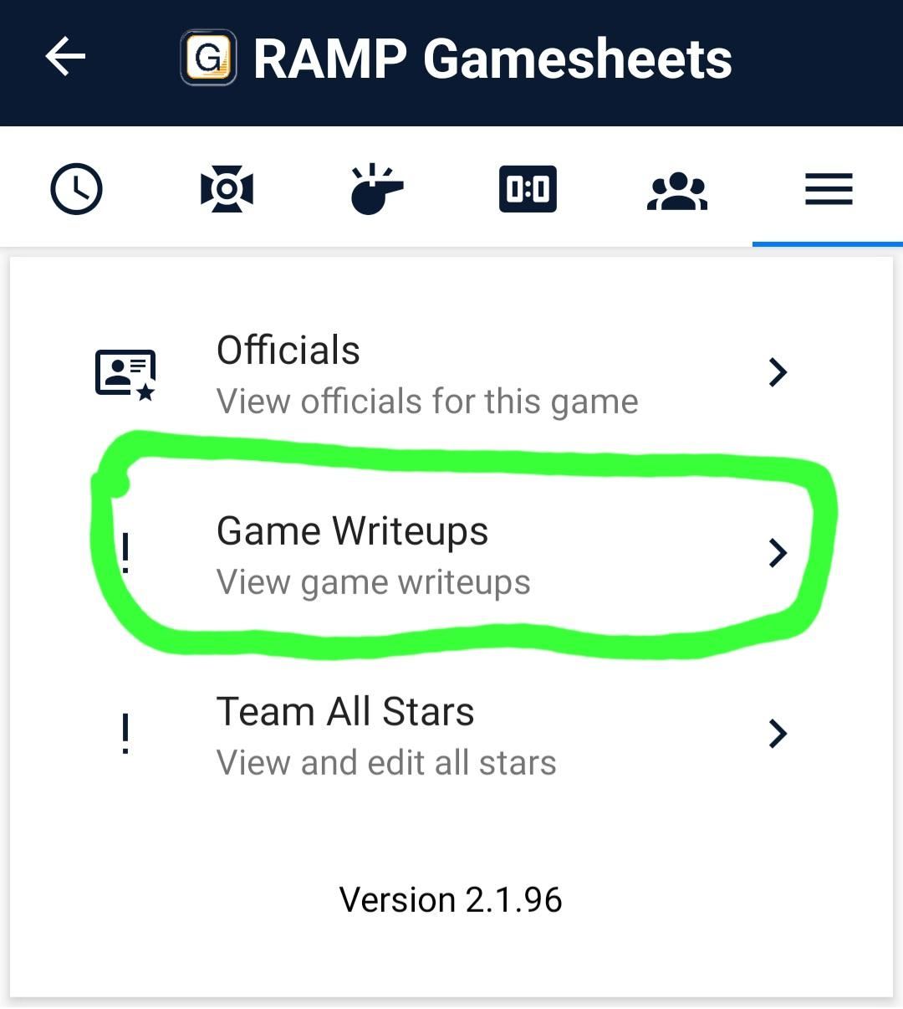
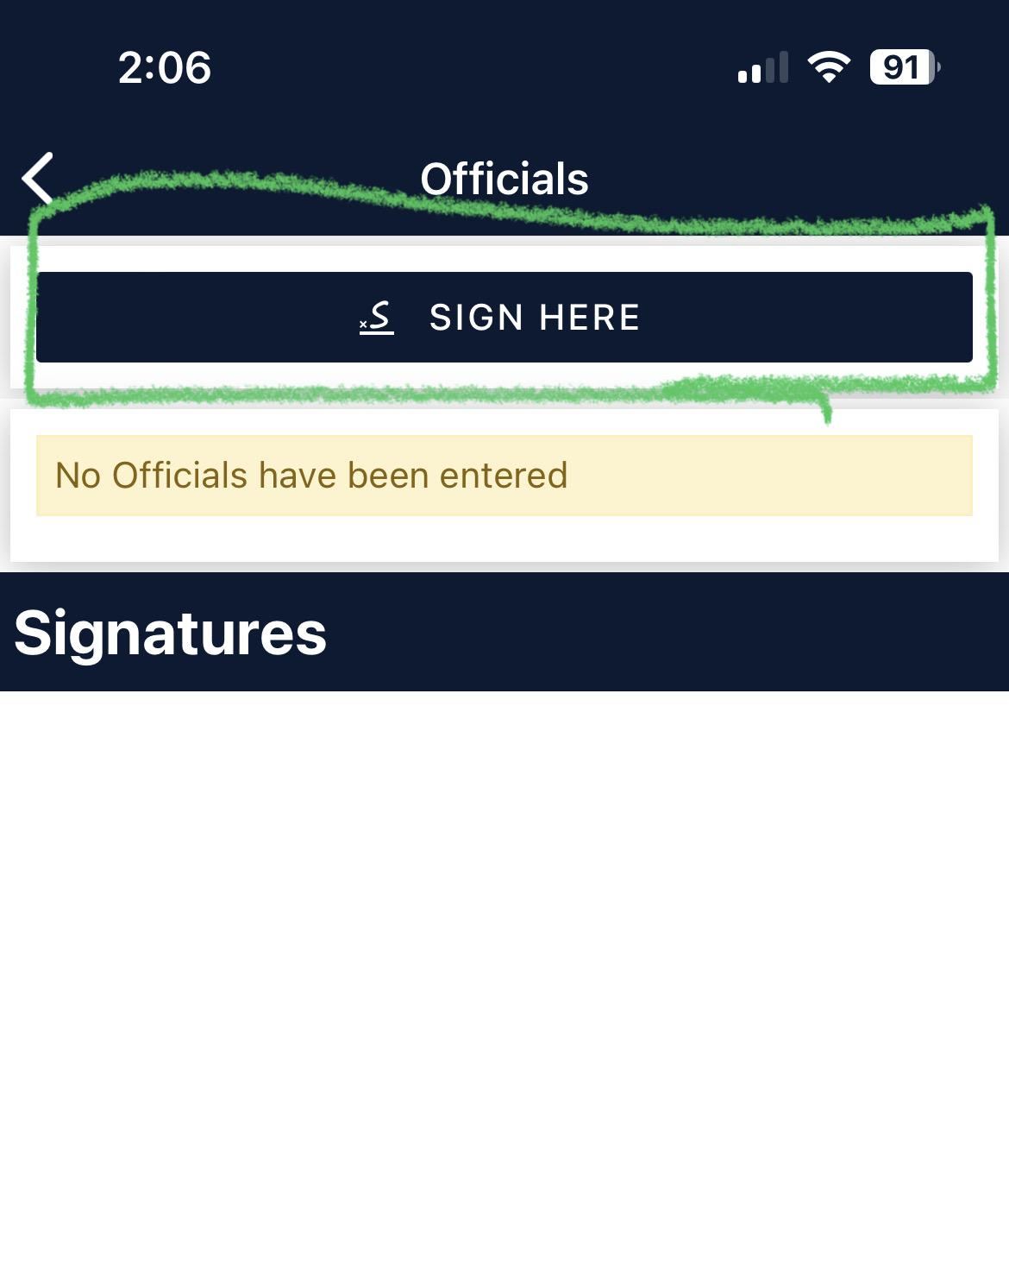
Officials Codes & Responsibilities
Enter Officials Code on Game tab- same as home code or gamesheet code
Click on Game that says Officials
Click the dropdown menu
Select Officials
Enter officials names, and the officials sign by clicking sign here at the end of the game
If a game write up is required the official will add it here
1
3
6
2
4
5

Slide 14


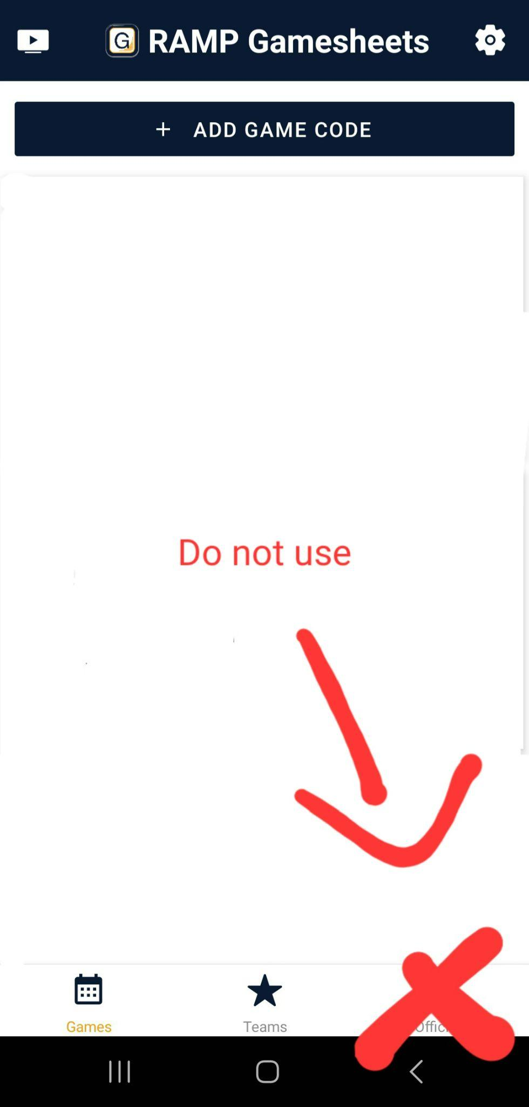
Airdrie & Okotoks
Cochrane
Do not log into this part for the officials as they do not use Ramp Assigning
They do use Ramp Assigning and can log in either way
They will need a 10 digit code if they want to enter through the bottom tab
Notes:
Confirm what all associations use for officials assigning

Slide 15
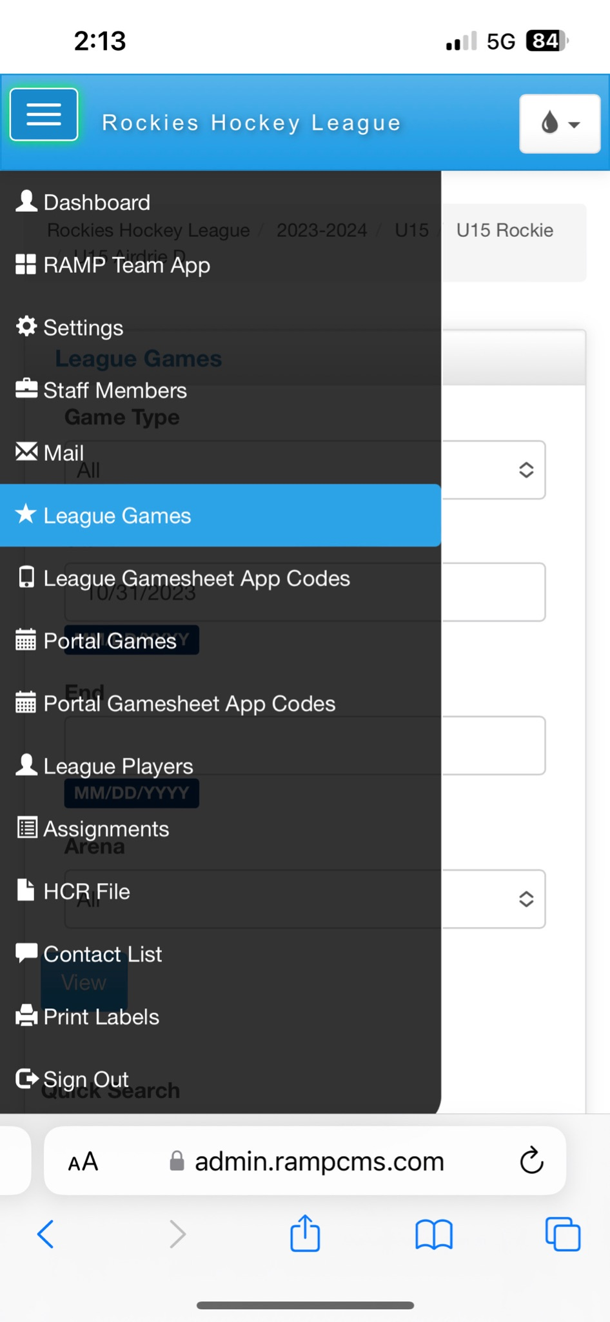
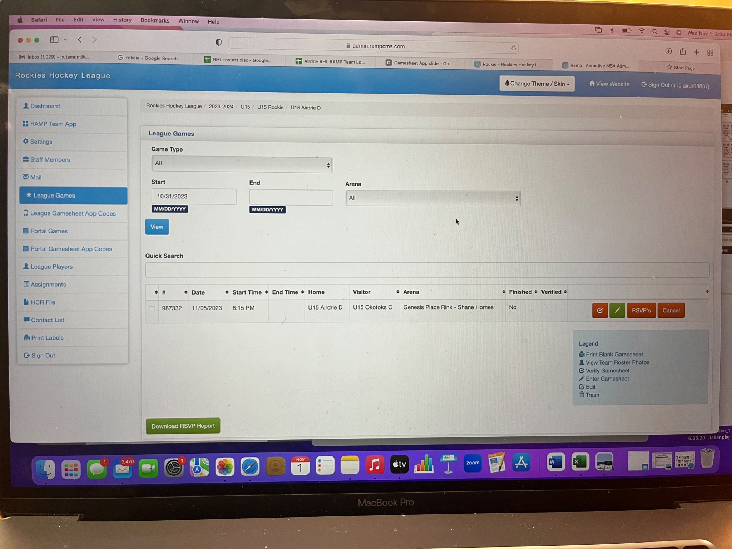
Visiting Team Verification
Step 1: As the visiting team you must go into your RHL Admin login to verify the game you just played. You can do this one of two ways on your phone or on a computer
The computer From your
looks like this phone

Slide 16

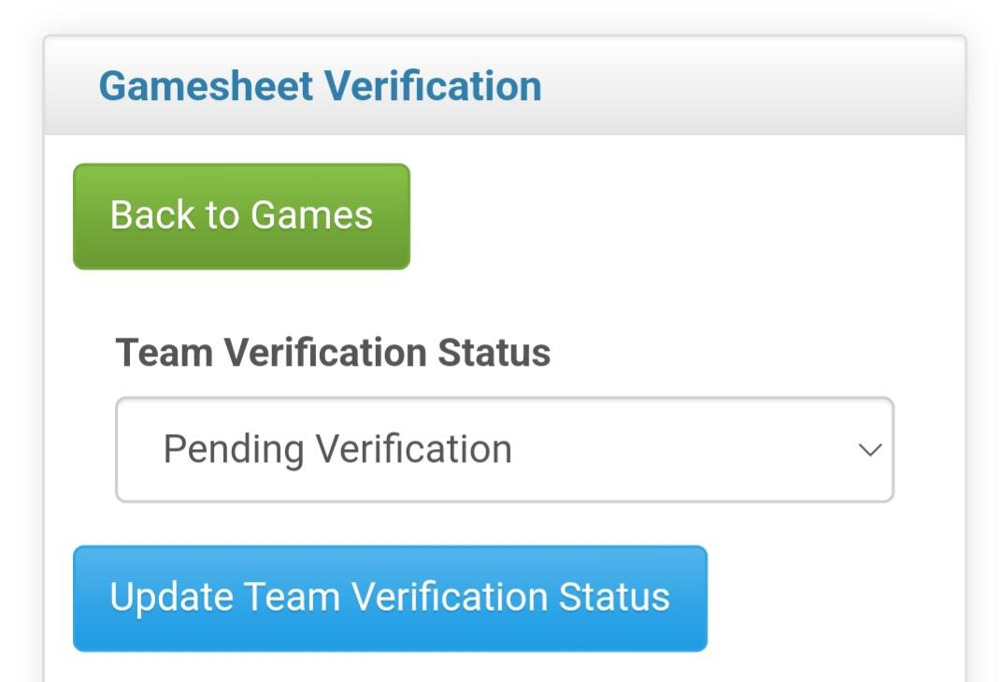
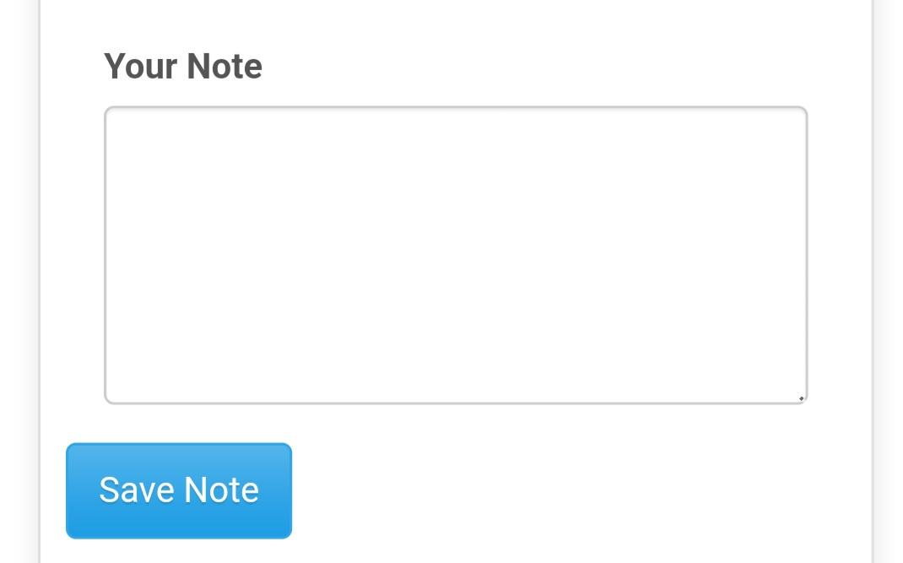
Step 2: Click the orange box with the check mark
Step 3: Look over the stats from the game you just played to make sure everything looks okay. Are the goals correct? Are the penalties correct? Are the goalie stats in?
Step 4: Click the verification tab at the top and select one of the 2 drop down options
Option one- Verified (everything is good)
Option two- There are Errors (if you pick this one you need to go to notes section and write a description of the error(s))
Please try to do this with 24 hours of the game as it will still be fresh in your mind

Slide 17
THANK YOU
The Rockies Hockey League appreciates your help as we all learn the ropes of this new system. We understand that there have been some bumps along the road for the first few games of the season but we hope by now you have developed some understanding of how it all works. Hopefully this presentation has cleared up any final questions you may have had.
Moving forward, the RHL will be implementing a 100.00 fine for teams who do not complete their digital gamesheets. If you have a problem with your app let us know while it is happening so you are not fined.

