Slide 1


Postseason Parent Survey
Measure and Improve Player Experiences
Presented
March 22, 2025

Slide 2
Postseason Parent Survey
The purpose of this program is to help clubs in Saskatchewan measure and improve player experiences.
We ask questions that are highly correlated with retention.
If you improve your scores on these questions,
your retention is likely to improve.
Enjoyment, Improvement, Belonging, Coach Satisfation, Club Satisfaction

Slide 3
Participation
The higher the response rate, the more representative the results
July 24, 2024 Survey
Of clubs with 100 players or more:
32%
27%
25%
Apr 17, 2024
Oct 4, 2023
Jul 24, 2024
How to increase response rate
Send advance notice
Send “you should have received” reminder
Close Loop after survey results received
Higher response rate in winter than summer; maybe due to higher commitment of players?
How do we make upcoming Apr 16 survey highest response rate?

Slide 4
Key Questions (plus comment box)
My player enjoyed their overall experience this season (1-5 rating)
My player improved as a soccer player this season (1-5 rating)
My player has positive social connections on the team and feels like they belong (1-5 rating)
How likely is it that you would recommend your child’s coach to a friend or colleague? (0-10 rating)
How like is it that you would recommend the club to a friend or colleague? (0-10 rating)

Slide 5
Retention Analysis – Competitive
How much do changes in player experience impact retention?
Situation: In Spring 2023, Satori collected 4,417 Postseason Parent Survey Responses of 7U-13U Competitive players. Those data were combined with Fall 2023 player retention data to better understand the impact player experience has on retention.
Findings
Club Net Promoter Score had the strongest overall relationship with Retention—increasing an average of 5.9% for every rating point increase in survey response score (scale 0-10). The effect was especially strong when growing Club NPS from 1 to 6.
Every increase in Improvement score had a steady increase in Retention (8.8% increased retention per 1 point increase in 1-5 rating scale question).
Enjoyment scores of 1-3 had similar levels of Retention. However, Retention skyrocketed 14.5% when Enjoyment grew from 3 to 4, and grew another 13.3% when Enjoyment was a 5.

Slide 6
Retention Analysis – Recreational
How much do changes in player experience impact retention?
Situation: In Spring 2023, Satori collected 3,763 Postseason Parent Survey Responses of youth Recreational players of all ages. Those data were combined with Fall 2023 player retention data to learn the impact player experience has on retention.
Findings
As with Competitive results, Club Net Promoter Score had the strongest relationship with Retention. However, the average increase per rating point was 4.1% compared to 5.9% for Competitive.
For ratings of 3 to 5 (‘6’ to ‘10’ on chart), Improvement saw steady Retention increases of 9.5% per point increase.
For Enjoyment, a rating of 3 (‘6’) was only a small increase over a 2. However, big increases of 14.4% and 12.5% were seen when Enjoyment increased to 4 (‘8’) and 5 (‘10’).

Slide 7
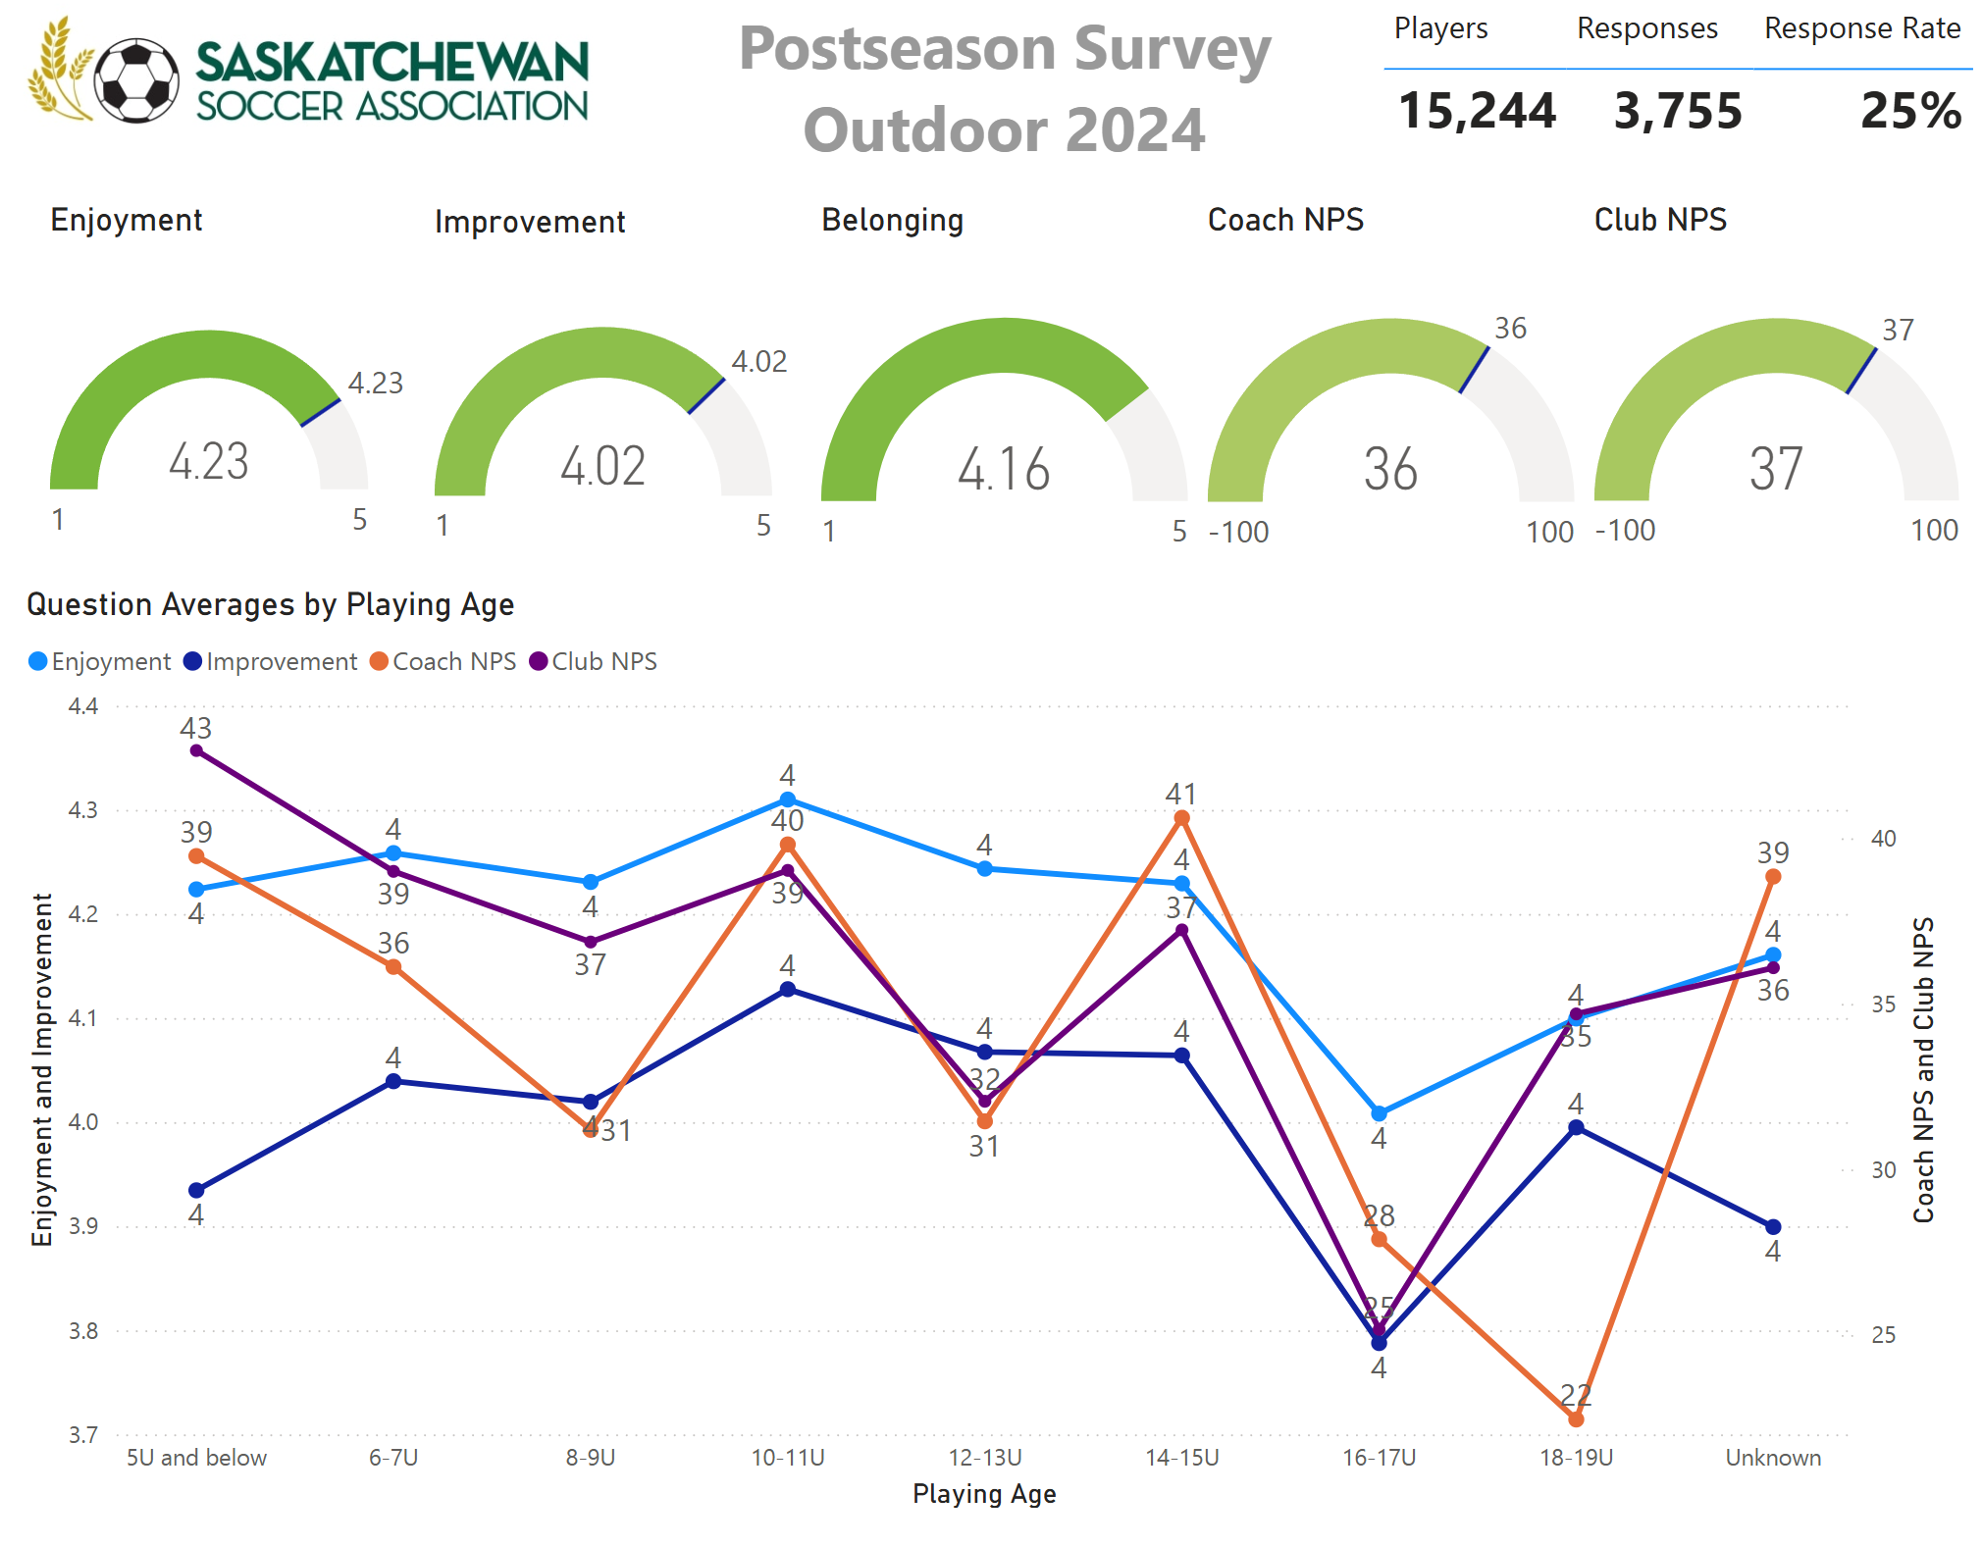
Summary Results – Fall 2024
Expected ordering of Enjoyment, Improvement, and Belonging
Unexpected Club NPS greater than Coach NPS
36 Coach NPS is 56% Promoter, 25% Passive, 19% Detractor
37 Club NPS is 55% Promoter, 29% Passive, 16% Detractor
Expected overall downward trend as players age
Largest overall drop in measures for 16-17U age. Drop didn’t occur last outdoor survey.
Use these results as Benchmarks when looking at your club’s results

Slide 8
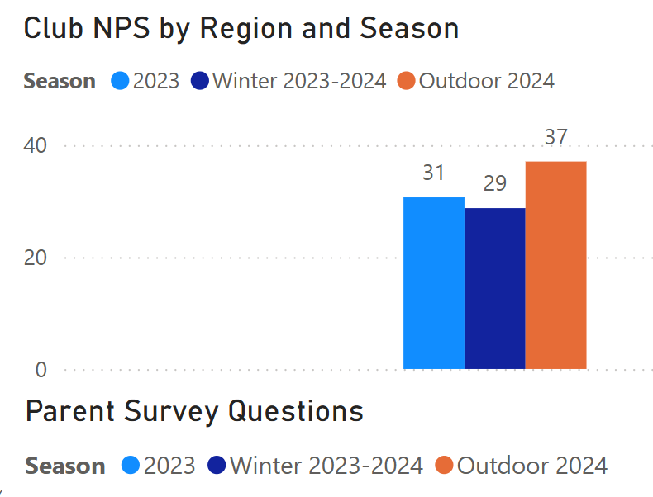
Trends – Overall Club NPS
Highest results in most recent survey

Slide 9
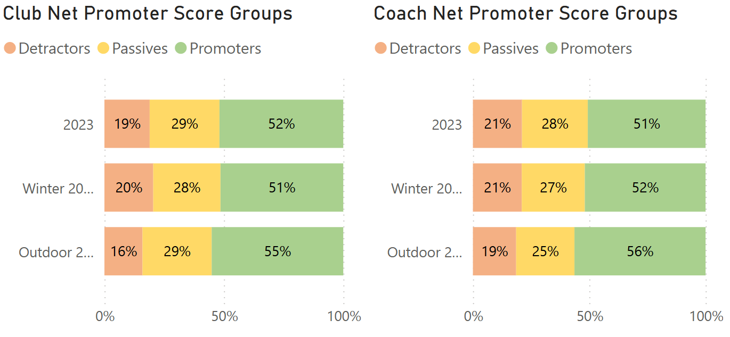
Trends – NPS Breakouts
Detractor percentages lower for both NPS measures
Promoter percentages higher for both NPS measures
84% of responders to Fall Club NPS scored at least a ‘7’
Notice how there are more Promoters and Detractors for Coach NPS than Club NPS; evidence of stronger like/dislike dynamic for a person than an overall club

Slide 10
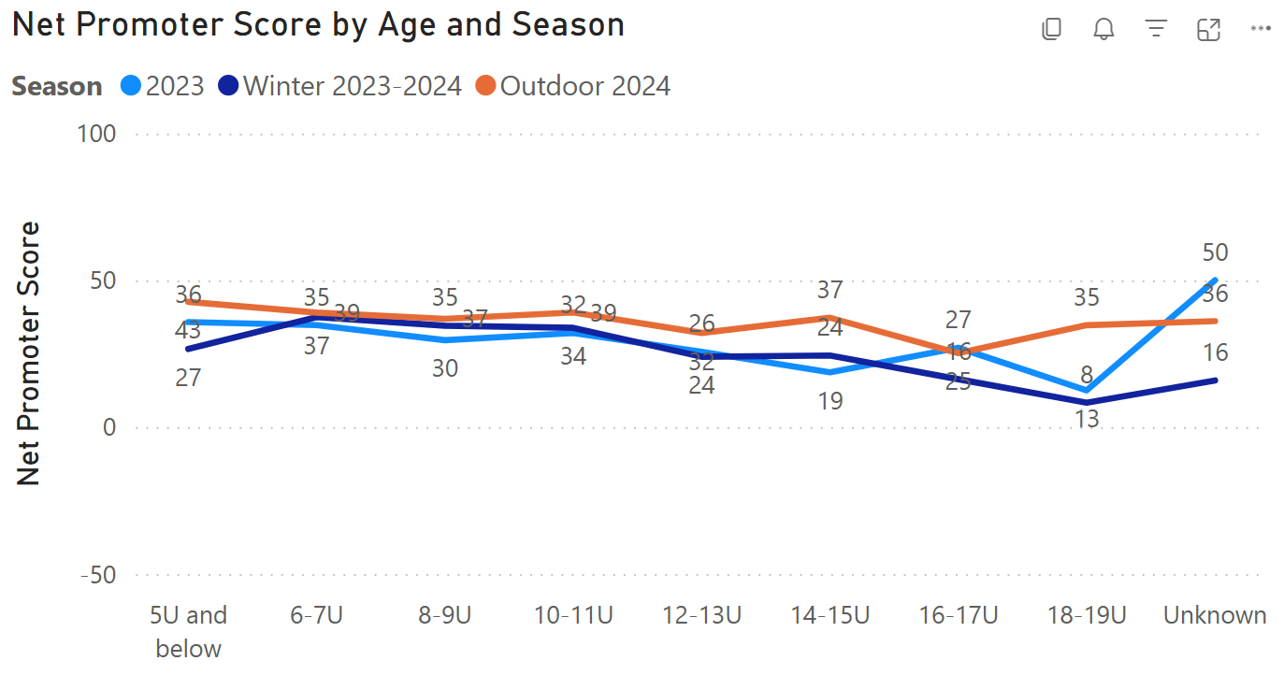
Trends –NPS Breakouts
NPS scores higher for every age group other than 16-17U

Slide 11
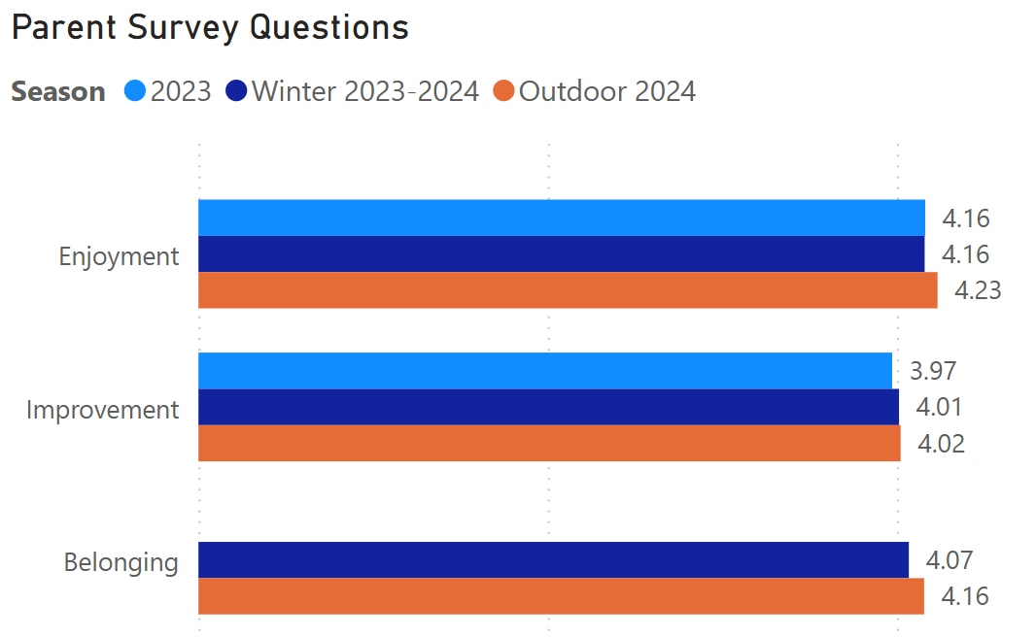
Trends – Other Questions
Highest scores seen for all questions was in Fall 2024 survey
It will be interesting to compare dark blue bar, previous winter, to results from upcoming survey

Slide 12
Trends – AI Comment Analysis, Fall 2024
The most common things that parents liked about their experience
Effective Coaching: Coaches were frequently commended for their enthusiasm, patience, and supportiveness.
Sense of Community: Parents appreciated the local team structures that enabled children to play alongside their classmates and foster friendships.
Convenient Scheduling: The consistency of weekly games occurring on the same day was valued, as it facilitated family planning and participation.
Supportive Atmosphere: The overall environment among coaches, parents, and players was characterized as collaborative, friendly, and centered on growth and enjoyment.

Slide 13
Trends – AI Comment Analysis, Fall 2024
The most common things that parents disliked about their experience
Variable Quality of Practice: Some parents expressed concerns regarding the lack of enthusiasm or energy from specific coaches, along with a scarcity of drills focused on skill development or effective gameplay during practice sessions.
Difficulties with Social Integration: New children or those unfamiliar with their teammates occasionally felt excluded, particularly when other players had already formed friendships.
Conflicts with Scheduling: Weekend practice sessions, particularly when there were two each week, posed difficulties for many families with young children and hectic schedules.

Slide 14
Trends – AI Comment Analysis, Fall 2024
The most common ideas for improvement
Refine Practice Format: Incorporate additional drills and active play to strike a balance between skill development and enjoyment, while maintaining consistency among teams.
Increase Coach Involvement: Provide coaches with training or resources to enhance the energy and structure of their sessions.
Promote Social Inclusion: Think about gathering data on friend preferences during registration to create more balanced teams and foster social connections.
Reassess Practice Scheduling: Limit or eliminate weekend practices for younger age groups to improve attendance and overall satisfaction.

Slide 15





Upcoming Survey Timeline
underway
Acquire and Prepare Data. Satori will get data from RAMP, remove duplicates and other errors, and prepare the data for the survey.
April 16 – April 26
Administer Survey. Satori will lead each step of the process, but SSA, and each club, can contribute to increase response rates.
Survey again to measure progress and the effectiveness of your actions which leads to faster learning and improvement
Provide Results. Satori will provide reports to SSA staff who will distribute to member clubs. Contact Satori if you’re interested in access to Power BI analysis tool.
May 2
Find Insights and Take Action. Use the reports and recommended actions to improve and grow.

Slide 16
Take Action
What are some specific things I can do to get value from the results?
Macro Quantitative Analysis
  Strengths, weaknesses, and trends
Macro Comment Analysis
  Theme and Sentiment analysis
    Human, AI (ex. ChatGPT)
    Ex. Most Common Positives, Negatives, and Ideas for Improvement
Close Loop
  Gratitude
  Learning
  Example Action
Develop Coaches and Teams

Slide 17
Member Survey
Measure and Improve Membership Experiences
Presented
March 22, 2025

Slide 18
Member Survey
The purpose of this program is to help Saskatchewan SA measure and improve member club experiences.

Slide 19
Participation
The higher the response rate, the more representative the results
53%
52%
August 2023
October 2024
Rural: 44% → 39%
Urban: 73% → 77%

Slide 20






Question #1 – Strategic Plan
I am familiar with the Saskatchewan Soccer Association strategic plan
Overall
Rural
Urban
2023
2024
3.60 → 3.61
Decrease in ‘Agree’ largely offset by increases in ‘Neutral’ and ‘Strongly Agree’
3.62 → 3.65
More 1s and 2s offset by more 5s
3.59 → 3.57
Less 1s and 2s offset by less 5s

Slide 21
Question #1 – Strategic Plan
Key Themes from 2024 Strategic Plan Feedback
Areas of Support
- Several members noted that the **structure and principles of the plan are strong** and appreciated the overall direction.
- There is **support for growth and retention efforts**, especially those that aim to engage youth and build the sport across the province.
Areas of Concern
- **Lack of inclusion for futsal** was a prominent concern. Futsal stakeholders expressed disappointment that the plan does not acknowledge or integrate futsal, despite it being under SSA's governance.
- Some members felt the plan appeared to **prioritize larger centers**, with rural or specialized areas feeling overlooked.
- A few respondents showed **disinterest or disconnect** from the plan, indicating a need for better engagement and explanation of its relevance.
Suggestions for Improvement
- **Include Futsal** explicitly in strategic goals and initiatives to reflect its growing role and importance in player development.
- **Broaden youth engagement and retention strategies**, especially focusing on keeping players involved after age 19 and developing clear post-competitive pathways.
- **Enhance club engagement** by seeking more direct input and involvement from Member Organizations (MOs) in ongoing planning and implementation.
- Consider **better communication strategies** to ensure the plan reaches and resonates with all members.

Slide 22






Question #2 – Services
SSA member services have been useful to my club
Overall
Rural
Urban
2023
2024
3.84 → 3.77
Similar 4s but less 5s and more 3s
3.99 → 3.94
Nothing below a 3
Similar overall but less 3s and 5s
3.66 → 3.60
Eliminated all 1s
Decrease in 5s and 4s

Slide 23
Question #2 – Services
Key Themes from 2024 Member Services Feedback
Positive Feedback
- **General Value of Services:** Some members stated that **all SSA services are valuable**, especially **coaching clinics** and the **RAMP registration system**, which continue to be useful tools for club operations.
Areas of Concern
- Smaller, rural organizations expressed frustration with the **expectation to meet SSA directives** that may be better suited to larger clubs.
- These clubs often lack the **resources, staff, and infrastructure** needed to fully implement SSA’s frameworks, leading to a sense of being overwhelmed or left behind.
- **Administrative Burden:**
- There is a call for more **ready-to-use templates and streamlined processes** to reduce the workload and make compliance more accessible.
- **Communication Gaps:**
- Some members felt that SSA’s communication feels **one-sided** or like a “checkbox exercise” rather than a genuine dialogue, leaving members feeling unheard or unsupported.
- **Disconnect Between Theory and Practice:**
- While services are theoretically beneficial, members noted a **lack of practical application or follow-up** that limits their effectiveness, especially when hands-on help is needed.
Suggestions for Improvement
- **Tailored Support for Rural Clubs:** Develop **flexible, scalable tools** (e.g., editable templates, dropdown-based forms) that reflect the needs and realities of smaller clubs.
- **Improve Communication Quality:** Foster **two-way engagement** that feels collaborative, not just procedural.
- **Increase Hands-on Support:** Provide **clearer guidance, more mentorship, or access to implementation help** to bridge the gap between policy and practice.

Slide 24






Question #3 – Staff
The SSA staff has been responsive and helpful
Overall
Rural
Urban
2023
2024
4.05 → 3.50
Far fewer 5s, more 1-3s, similar amount of 4s
4.10 → 3.59
Far fewer 5s, more of everything else
3.99 → 3.41
Far fewer 5s, more 2-3s, similar 4s

Slide 25
Question #3 – Staff
Key Themes from 2024 Staff Feedback
Areas of Concern
- **Lack of Responsiveness:**
- Multiple members reported **delayed or no responses to emails or outreach**, with one stating they had never received a reply when attempting to discuss futsal development.
- While a few members described interactions as "satisfactory" or noted that “most are helpful,” there were also concerns about **inconsistent service quality and unclear accountability** for member engagement.
Isolated Positive Interactions
- Despite overall negative sentiment, some comments mentioned that **interactions were acceptable or helpful**, suggesting that positive experiences exist but may not be widespread or consistent.
Suggestions for Improvement
- **Strengthen Communication Protocols:** Establish clear expectations and response timelines for member inquiries, and ensure all staff are equipped to follow through reliably.
- **Improve Accountability and Visibility:** Assign and clearly communicate who is responsible for specific areas (e.g., futsal, rural support), and ensure they are accessible to members.
- **Rebuild Trust Through Active Engagement:** Proactively reach out to members who have voiced dissatisfaction, and take steps to **repair strained relationships** through listening, transparency, and follow-up.

Slide 26






Question #4 – Future
I am excited about the future of soccer in Saskatchewan
Overall
Rural
Urban
2023
2024
4.07 → 3.78
More 2-3, Less 4-5
4.05 → 4.02
Nothing below 3, more 4s, less 5s
4.09 → 3.54
Far more 2-3s, less 4-5s

Slide 27
Question #4 – Future Growth
Key Themes from 2024 Future “What do you think would grow soccer in Saskatchewan?”
Support for Rural and Underserved Areas
- Strong calls for **more resources, support, and programming in rural areas**, where clubs face limitations such as mixed teams and limited competitive options.
- Members asked for **tailored support to help rural organizations thrive**, rather than expecting them to conform to urban-centered structures.
Collaboration Over Competition
- Members emphasized the importance of **cooperation between clubs and member organizations**, urging SSA to foster a culture of **shared growth rather than rivalry**.
- Suggestions included **regular idea-sharing sessions**, where organizations can collaborate and learn from one another’s successes.
Gender-Inclusive Programming
- There was a clear desire for more **opportunities for all-girls games and programs**, particularly in rural areas where mixed-gender teams are often the only option.
- Members want to ensure that **girls have equitable access to development and competition**.
High-Level Adult Opportunities
- Respondents noted a gap in **competitive adult-level soccer**, advocating for more high-level playing options that can help retain athletes and create long-term pathways.
Learning and Networking
- Members asked for **annual or seasonal in-person and online events** where clubs can share growth strategies, discuss challenges, and build relationships across the province.
Suggestions for Improvement
- **Provide dedicated support and programming for rural clubs**, including travel support, flexible competition models, and tailored development tools.
- **Encourage inter-club collaboration** through SSA-facilitated networking sessions and cooperative initiatives.
- **Prioritize gender equity in programming**, especially in remote regions.
- **Invest in adult-level competitive infrastructure** to support retention and build a more complete soccer ecosystem.

Slide 28
Question #4 – Future Decline
Key Themes from 2024 Future “Are there any aspects of soccer in Saskatchewan that lessen the future of soccer?”
Rising Costs and Accessibility
- A recurring concern was that the **increased professionalism and travel expectations** are driving up costs, making soccer **less affordable for families**, especially in rural or low-income communities.
- **High fees for coaching courses** and **club licensing requirements** were also seen as **barriers to participation and development**, particularly for volunteer-run clubs.
Administrative and Volunteer Burden
- **Volunteer boards** are struggling with the volume and complexity of administrative demands (e.g., licensing, compliance).
- Members feel that the expectations placed on small or rural organizations are **not realistic without more direct support**.
Decreased Competitive Opportunities
- Concerns were raised about a **lack of meaningful game opportunities**, especially for rural players, which negatively impacts player development and retention.
- Access to other clubs and structured competition was cited as **limited or declining** in some areas.
Disengagement of Rural Communities
- Some rural organizations have **disaffiliated or reduced involvement** due to **feeling unsupported or overlooked** by SSA.
- Members want more inclusive and equitable support that reflects the **diversity of club structures and geographic realities**.
Concerns Around Organizational Priorities
- A few comments expressed concern about **SSA staffing levels and focus**, suggesting a disconnect between internal operations and grassroots needs.
Suggestions for Improvement
- **Control cost escalation** by offering scalable participation models, subsidies, and reduced fees for underserved regions.
- **Simplify licensing and course requirements** for small or volunteer-driven clubs, or provide more administrative support.
- **Revitalize local game structures**, particularly for rural clubs, to ensure consistent, meaningful competition.
- **Re-engage rural communities** with hands-on outreach, equity-focused policies, and better recognition of their unique challenges.
- **Improve transparency and resource allocation** to rebuild trust and align staff efforts with member needs.

Slide 29






Question #5 – Overall
Overall, I am happy with the work SSA does for soccer in Saskatchewan
Overall
Rural
Urban
2023
2024
3.92 → 3.60
Same 1-2s, more 3s, less 4-5s
3.94 → 3.90
More 3s and 5s, less 4s
Nothing below 3 in either year
3.89 → 3.29
Same 1-2s, far more 3s, less 4s, 5s almost gone
Largest total drop in survey

Slide 30
Question #5 – Overall
Key Themes from 2024 Overall feedback
Recognition of Progress, but Expectation for More
- Members acknowledged that **SSA has made strides** but emphasized there is **still significant work ahead** to make soccer more appealing and accessible across the province.
Demand for Province-Wide Adult Competition
- There is strong interest in creating or expanding **a structured adult league**, particularly for those who have aged out of youth programs but still want to play competitively.
- Suggestions included **tournament-based leagues** or **expanded provincial championships** that offer consistent play for both men and women.
Rural Club Support and Equity
- Members noted a need for **better organization and direct support for rural clubs**, who often feel overshadowed by the focus on larger urban centers.
- Feedback emphasized the importance of ensuring **equal opportunities and resources** across all geographic areas.
Continued Direct Member Engagement
- Respondents appreciated **personal, direct interactions from SSA staff** (e.g., calls, visits, check-ins), and encouraged continuing this approach to strengthen relationships.
- Members value **engagement beyond emails or announcements**, preferring a more personal, relationship-based style of communication.
Emphasis on Soccer Culture and Standards
- Some members stressed the importance of **holding clubs accountable to consistent values**, such as sportsmanship and integrity.
- There’s a call for SSA to play a leading role in **promoting a respectful, inclusive soccer culture** across all levels.
Suggestions for Improvement
- **Develop or expand adult competitive options** through leagues or structured provincial tournaments.
- **Provide hands-on support and tailored resources to rural clubs** to reduce disparity.
- **Maintain strong personal engagement efforts** with Member Organizations (MOs).
- **Continue building a strong provincial soccer identity** with shared values, opportunities, and visibility.

Slide 31
Thank You

