Slide 1
Info Session
2023/24 U10 Season

Slide 2
Agenda
What is Children’s Ringette?
History
Structure and Approach
Evaluation Process and Guidelines
Drills overview
Team Selection Process
Team Selection Committee
RAB Target Scores
Friend Requests
Season Info
Schedule
League Play
Tournaments
Key Dates and Special Events
Coaching and other Volunteer Roles
Recap

Slide 3
What is Children’s Ringette?
Originally: Ringette in Canada was organized around the structure of the adult game, using only chronological age as a guide for athlete grouping
In 2009 Ringette Canada released its Long-Term Athlete Development Model which was then followed by a growing body of research in support of making adjustments to “Children’s Ringette” (the Active start through U10 divisions) – SPRA followed suit in approx. 2019
We now group children by “step” using resources like the Ringette Essentials, rather than sticking to rigid chronological age groups, although age is a factor and used as a guide.
The ultimate goal of Children’s Ringette is to eliminate progressing through age-based levels without regard to the players readiness and relying more on the Long Term Athlete Development Matrix which considers multiple elements of the athlete’s readiness.

Slide 4
Structure and Approach
U10 is divided into 3 stage-based ‘Steps’
Gradually more competitive and more skill required as a player moves up the steps
Step 1 and 2 will be half-ice and Step 3 is full-ice
Step 1 and 2 have 1-2 hours of ice per week on average - scores kept informally – not published
Step 3 averages 2 hours of ice per week – scores kept formally
Goal is to allow athletes to be in multiple diverse activities
Net size is scaled and rules are scaled
No dedicated goalies
Players learn the fundamentals of the sport on a smaller surface that reflects their size and allows for maximum ring touches
Questions?

Slide 5
Evaluation Process and Guidelines
Players run through 2 sets of evaluations at the start of the season
Universal Athlete Assessments (UAAs) – 3 drills sanctioned by RAB
Competitive Thread runs players through them on Sept 3
Timing chips attached to each player at sign in
Game Play Evaluations – U19AA players will evaluate U10 3v3 (half ice or full) on either Sept 7, 9 or 10
Pinnies dedicated to each player at sign in
Stage/level appropriate Evaluation Rubric currently under review by SPRA eval committee
Scores for both are collected by VP, Div Director, and Eval Director
Coaches on ice for both as familiar faces and to keep things moving but are not permitted to coach
RAB mandates a Pre-UAA skate for all players – optional for player – Aug 27th to prep for UAAs
Missed UAAs contingency

Slide 6
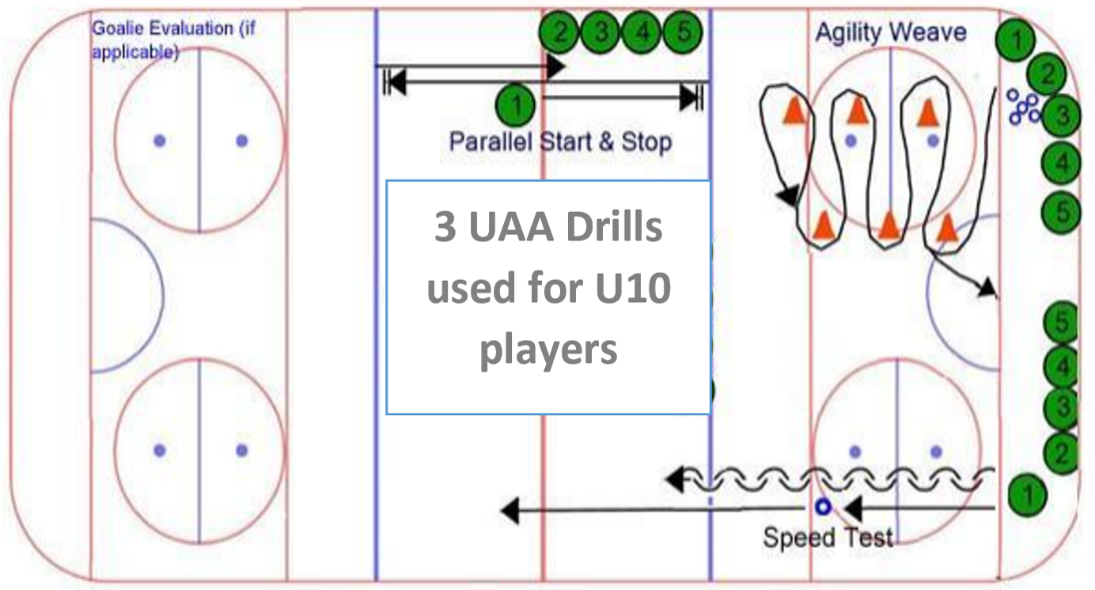
Universal Athlete Assessment Drills
**Full Detailed Description and Demos available on Ringette Alberta Website

Slide 7
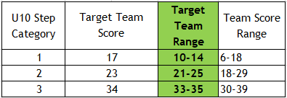
Team Selection Process
UAA times and Eval Scores received from evaluators and aggregated
Sept 3 UAA scores will determine skate groups on Sept 7, 9, and 10
Teams of equal caliber formed within each step considering the following player attributes:
UAA and Gameplay Evaluation Scores
Ringette IQ and/or Previous experience
Age, maturity, size
Readiness to learn/readiness for competition
Team balancing/size
Team Selection committee meets to confirm teams created match the above criteria and team sizes are appropriate
Head coaches are identified and notified – provided with their team and then reach out to players
Outliers and kids on the bubble (multiple eval skates)
Friend Requests

Slide 8
Scenarios
Optional – Questions about any athlete placement scenarios we could walk through?

Slide 9
Season Info
U10 is in the Black Gold League which covers Sherwood Park, Beaumont, St Albert, Spruce Grove, Drayton Valley, Pembina, Fort Sask, Leduc, Lacombe, and Fort McMurray
Season Starts Sept 28th and schedule for Session 1 received shortly after that – practice and exhibition in the mean-time
Christmas Break – typically Dec 22- Jan 2 ish
U10 practices are weeknights at 4:00 MLP (Step 3 TBD) – games on weekends
Practice Ice will be same day/time/place every week but won’t be determined until after evals
6 power skating sessions in addition to schedule as well as goalie clinics
Recommend no more than 3 tournaments per season for each team (RAB rec. 1-2)
Step 1 and 2 goes to the SPRA Mini Platinum Ring Jamboree – January 19/20/21 (Tentative)
Step 3 goes in the SPRA Platinum Ring Tournament (November)
Players can affiliate to Step 2 from Step 1 and to Step 3 from Step 2 (Step 1 affiliates from itself)

Slide 10
Key Dates and Special Events
Sign Up Sheet for Pre- Season Skates and Evaluations – Thank you and More to Come
Note: Aug 27, Sept 3, and Sept 7/8/10 may be assigned ice times – wait for confirmation
Key Dates
Friend Request forms Due | August 9th
Knock the Rust Off Skates | Saturday, August 12th - 11:00 and 12:15 - SHELL
Pre-Evaluation UAA “Prep” Skates | Sunday, August 27th – 10:45, 12:00, and 1:15 – MLP CHEV
Universal Athlete Assessment (Skill Evaluations) | Sunday, September 3rd – 10:30, 12:00 and 1:15 - GARC
Game-Play/Scrimmage Evaluations | September 7, 9, and/or 10th – These will be assigned
Team formation completed | Mid-September
Coaches Meeting | Tuesday, September 26th - In Person for Coaches and Managers
U10 First Ice Times | Starting September 28th
SPRA Day | Saturday, Oct 21st @ Millennium Place
Team Photo Night | TBD – Late Oct/ Early November
SPRA Platinum Ring Tournament | TBD – Early November
SPRA Mini-Platinum Ring Jamboree | TENTATIVE – January 19th – 21st, 2024
Year End U10 Championships | TBD – March 2024 on a weekend

Slide 11
Coaching and other Volunteer Roles
Coaching – Need at least 1 certified female at all times but should have at least 2 in addition to certified male coaches
Certification Required:
Current Criminal Record Check
Coach Initiation in Sport (CIS) eModule
Making Ethical Decisions Course
Making Ethical Decisions Online Evaluation
Ringette Specific Community Sport Initiation Clinic *** Online offering now available for August
Team Manager, Treasurer, Social Commitee etc – cash call, season budget, tournaments, team apparel, team-building events NOTE: tournaments can be hard to get into – check RAB website ASAP at the start of the season
Jamboree – Committee and shift volunteers needed. Each SPRA team is responsible to provide a raffle basket of 150.00 value for the jamboree – will be coordinated through team manager

Slide 12
Recap
Probably missing something – reach out if so
My role – support, guide, provide resources, advocate for U10 players and families, facilitate a positive experience for all
Remember the 24 hour rule
Additional resources available on U10 page on our website
Questions?

