Slide 6
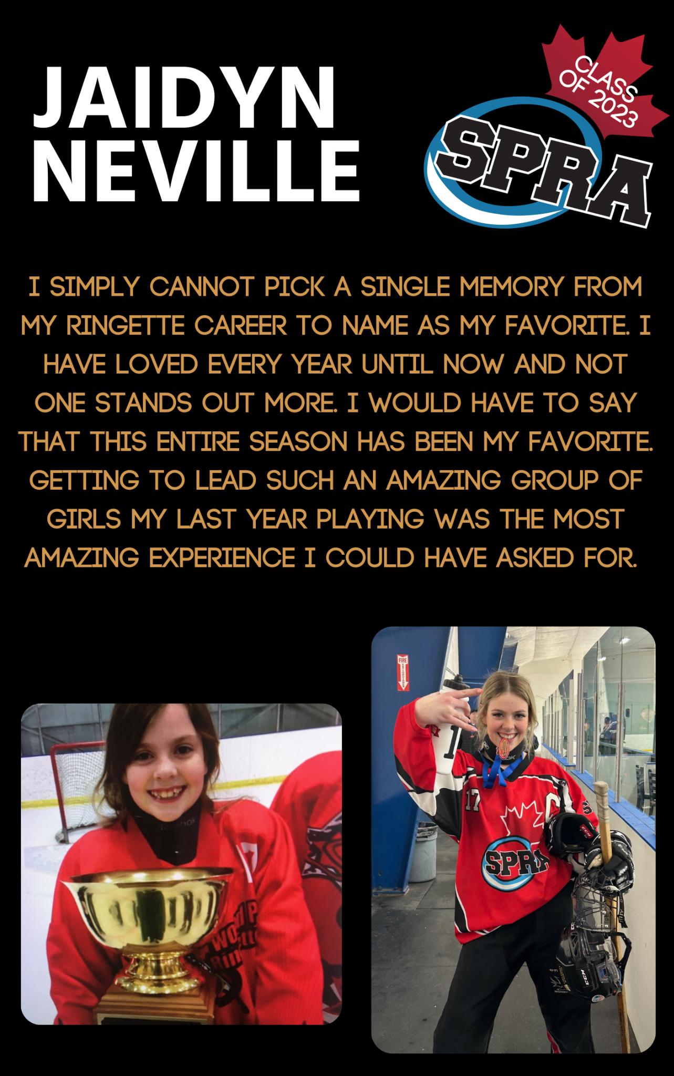

Slide 14
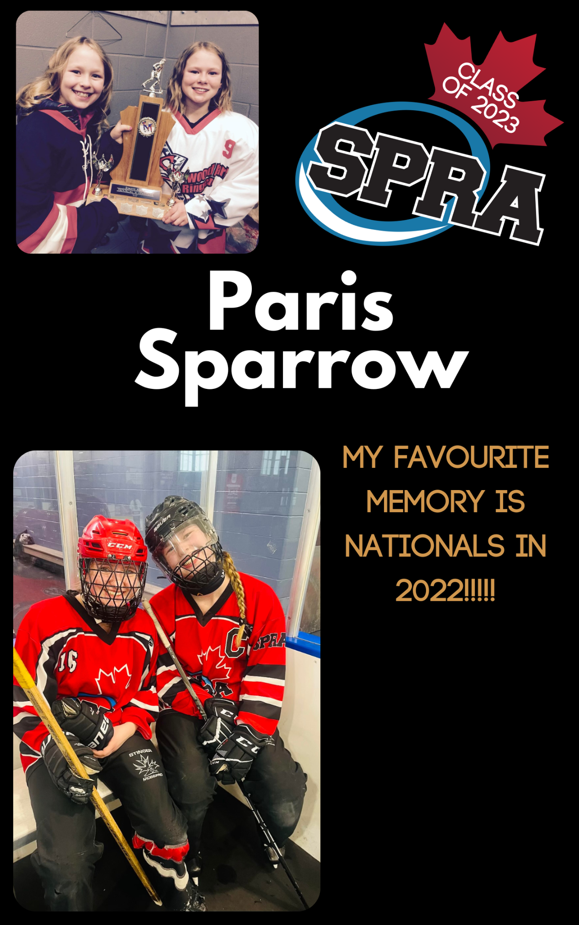

Slide 21
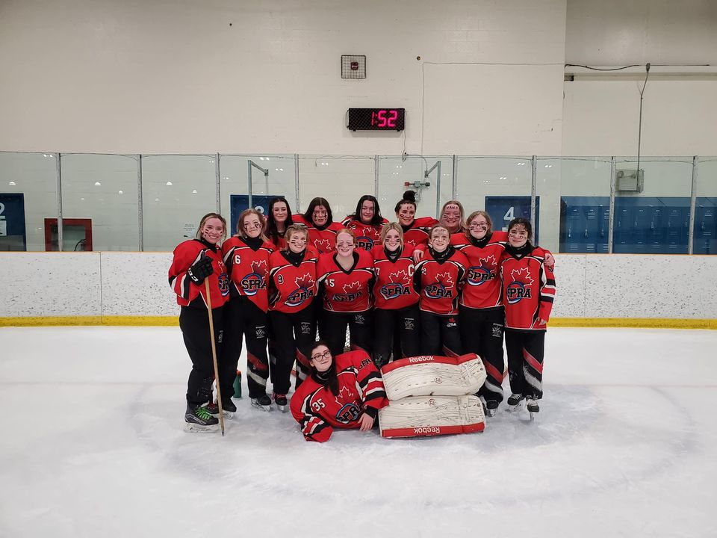
19B Voltage! Such a fun year!
#spra #ringette

Slide 22
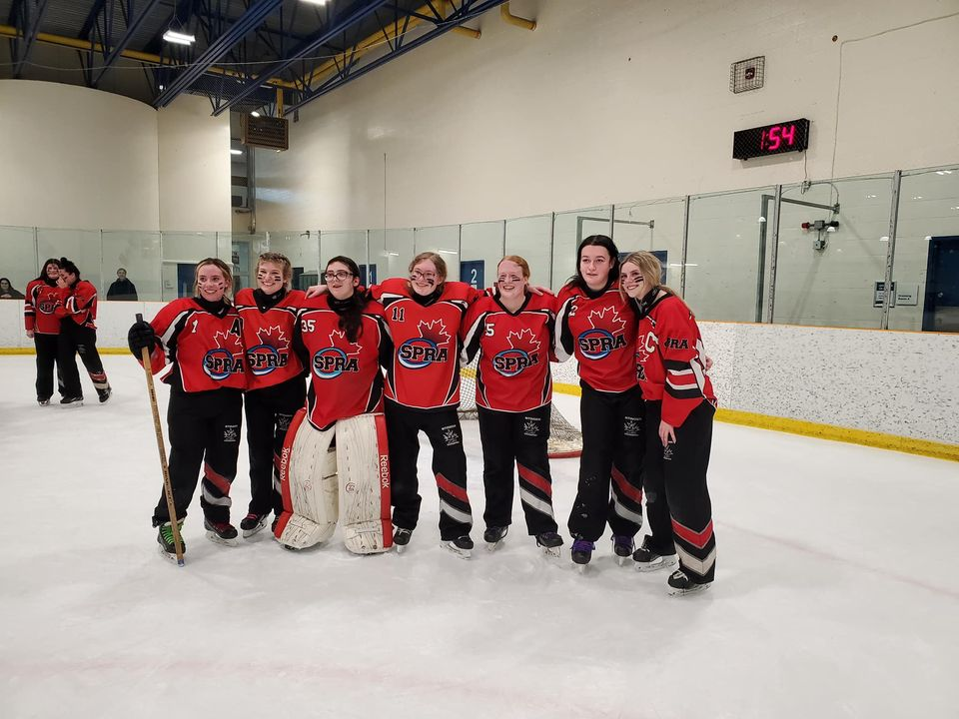
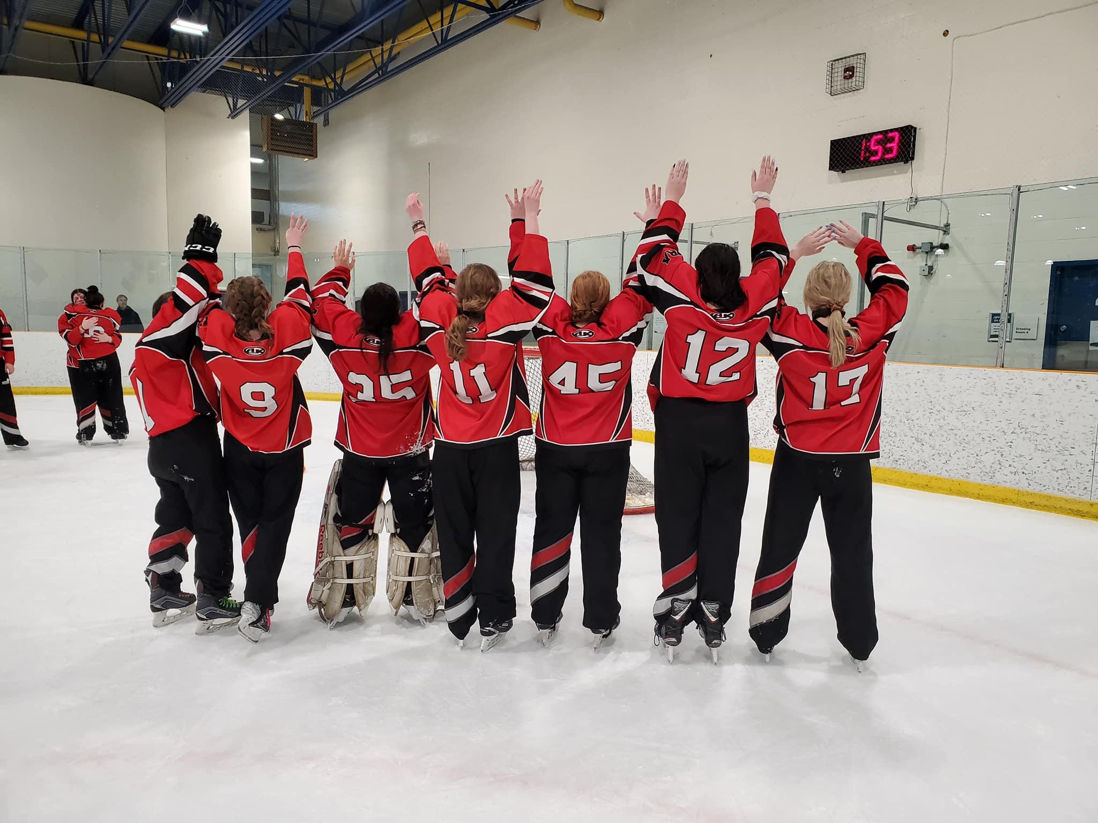
19B Voltage Grads!
#spra #ringette

Slide 23
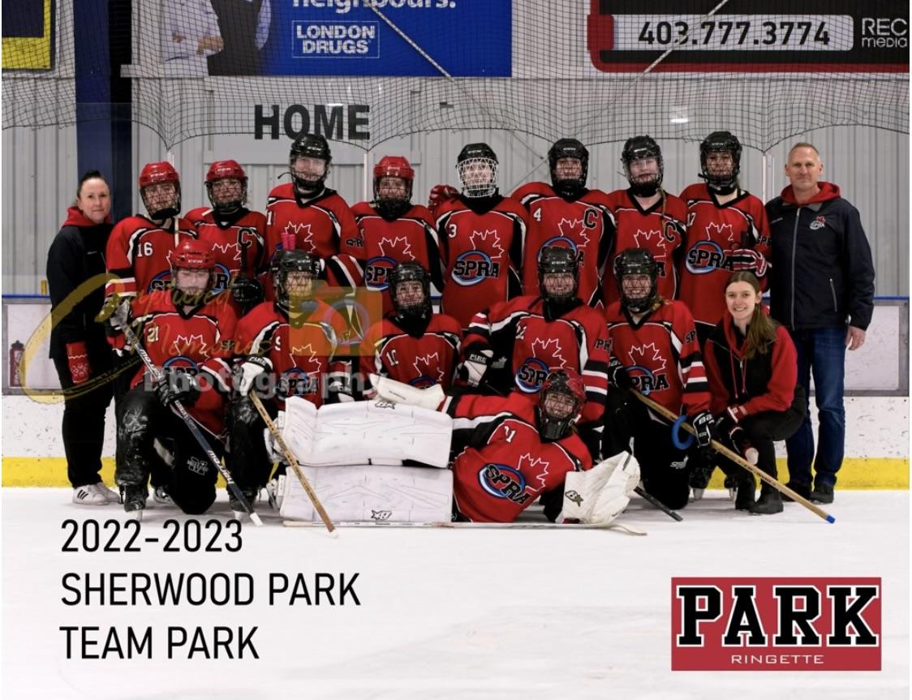
19A Park!
#spra #ringette

Slide 24
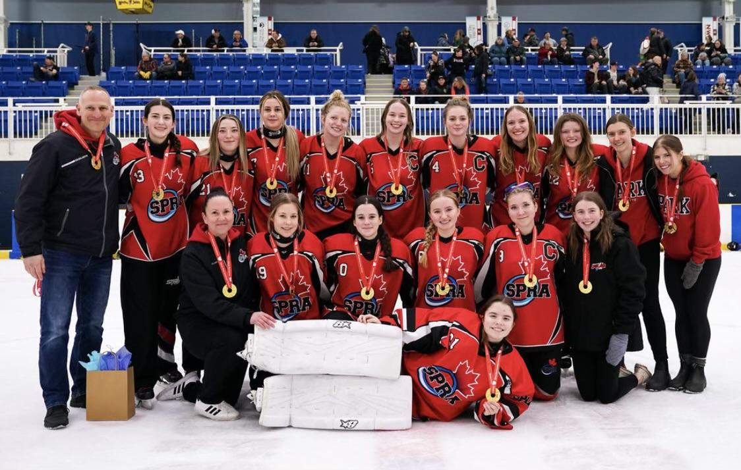
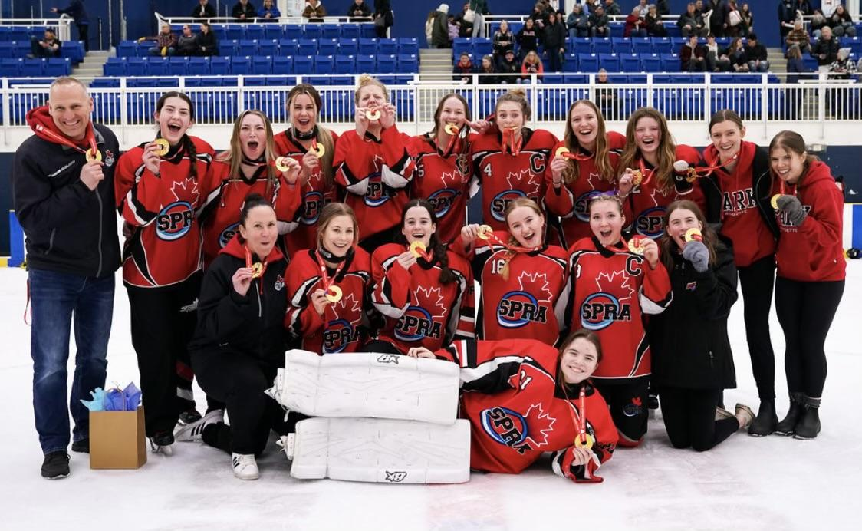
19A Park Gold!!
#spra #ringette #sweethearttourney

Slide 25
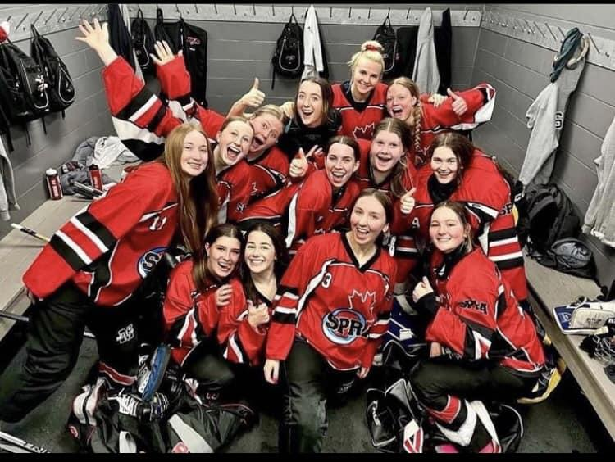
19A Pursuit!
#spra #ringette

Slide 26
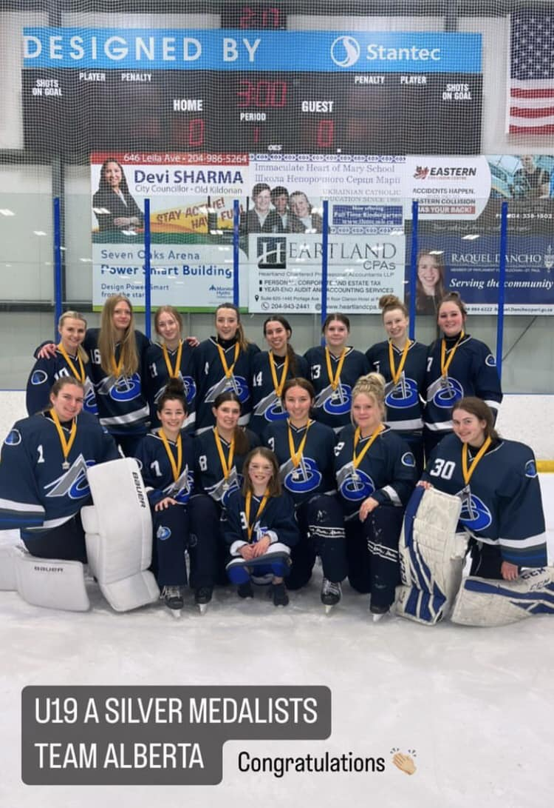
19A Pursuit - Congrats on Silver at Westerns!
#spra #ringette

Slide 27
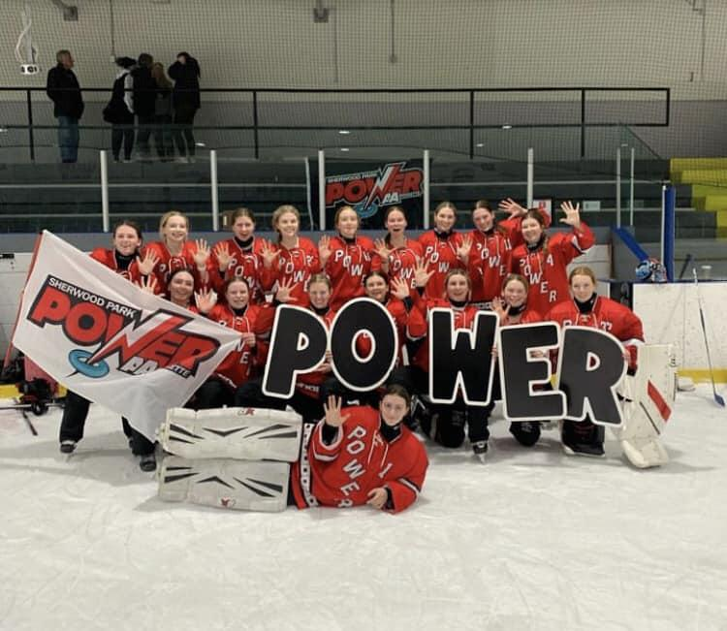
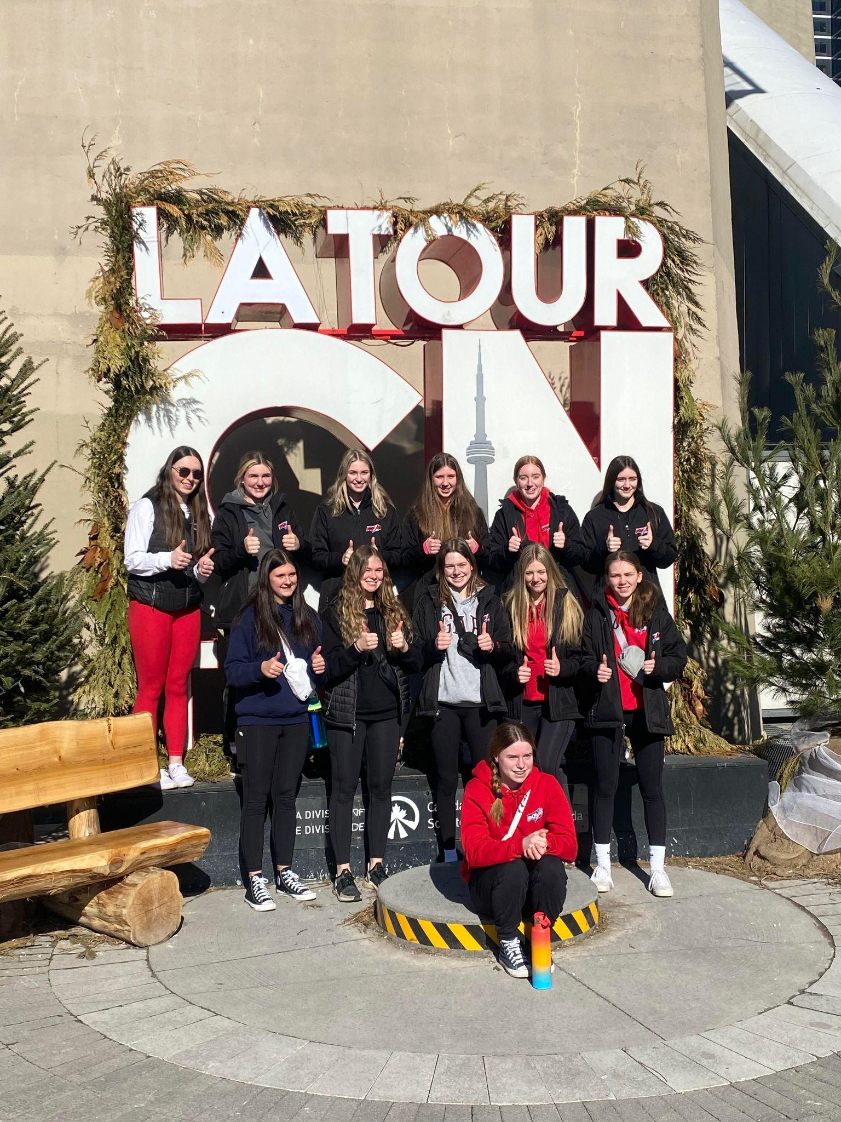
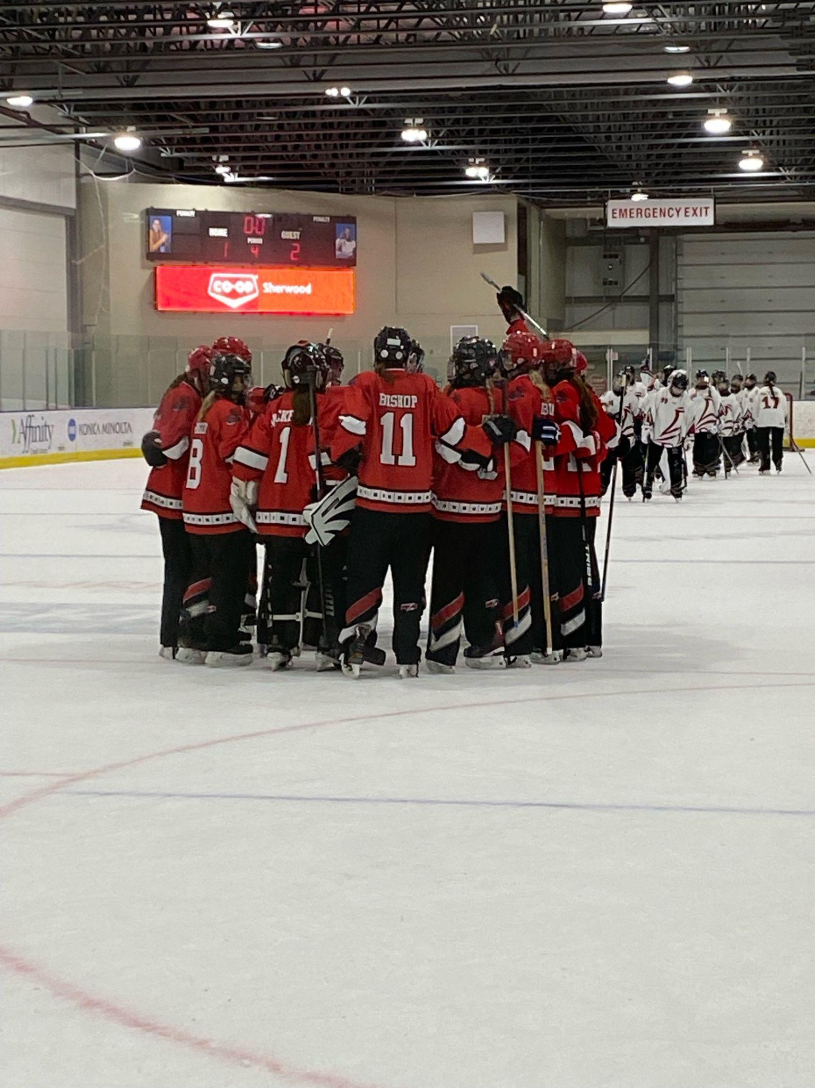
19AA Power! CRCs!
#spra #ringette

Slide 28
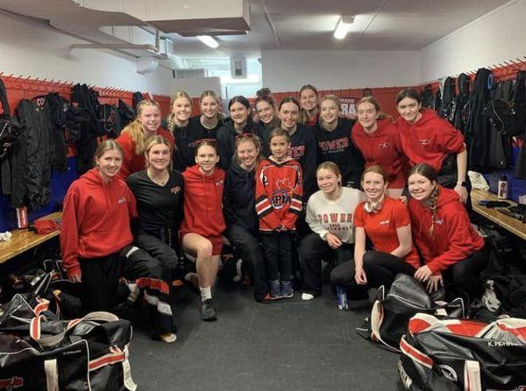
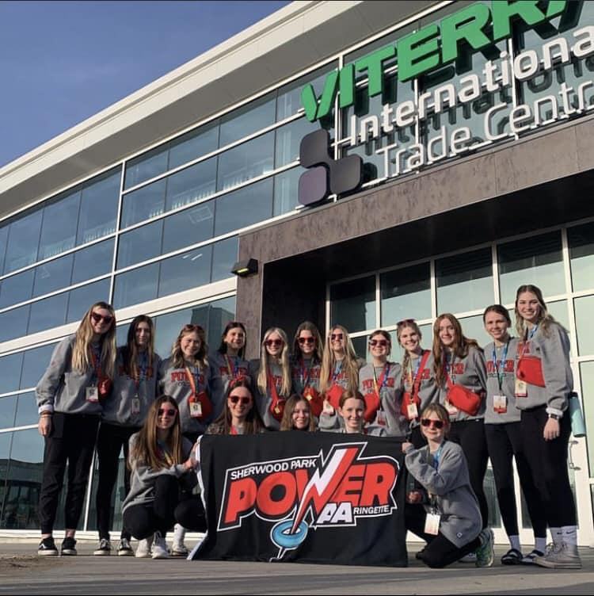
19AA Power!
#spra #ringette

