Slide 1



Sylvan Lake Minor Ball Association AGM
January 24, 2023, 7pm

Slide 2



Agenda
Call to Order
Adoption of Agenda & Previous Minutes
President’s Report
Board Introductions
Recap of 2022
Projects completed in 2022
Treasurer’s Report
Treasurer’s Update
Fundraising Update
Orders & General Business
Plans for 2023
Adoption of New Bylaws
Registration & Fees
Open Board Positions
Draw for Baseball, Fastball & Rally Cap/9U
Q&A

Slide 3

Board Introductions
President
Dave Darbel
Vice President
Brett Therriault
Secretary-Registrar
Gillian Olson
Treasurer
KaryAnne Caines
Director –
PCU Development
Ryan Lucas
Director –
‘A’ Baseball
Dan Williams
Director –
‘AA’ Baseball
Dave Pengelly
Director –
9U Baseball
Kyle Munro
Director –
Rally Cap
Chelsey Simpson
Director –
Rep Softball
Kelly Ulseth
Director –
Comm. Softball
Melanie Campbell
Baseball Tournament Chair
Kyle Munro
Softball Tournament Chair
Vacant
Fundraising Coord.
Deanna Stefaniuk-McWhirter
Casino Coordinator
Jen Dixon
Team Photos Coordinator
Vacant
Social Media & Website Coord.
Nikole Munro
Apparel & Uniform Coordinator
Andrea Weist
Equipment & Facilities Coord.
Kelly Ulseth
Diamond Coordinator
Simon Pollock
Umpire Coordinator
Ryan Lucas

Slide 4
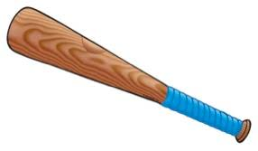
2022 Registration Recap
Registrations for 2022:
Rally Cap & 9U (136)
50 Rally Cappers
86 9U
Softball (146)
11U - 49
13U - 35
15U - 31
17U - 21
19U – 13
Baseball (188)
11U - 87
13U - 39
15U - 31
18U - 28
470 Players Total
Other Programs:
Umpire Bootcamp – 16
Coaching Applications - 29
Fall Ball – 112
Pre-School Fundamentals – 15
Winter Baseball Camp - 36
Notes:
2019 we had 350
2020 we had 308
2021 we had 325
45% increase from 2021 to 2022

Slide 5

2022 Highlights
Added 2nd 11U AA Team & 2nd 13U A Teams
REP Softball had most teams ever registered for GPLS
Fall Baseball for all levels including 9U
Coach selected to Girl’s 14U Team Alberta & Won Westerns
Won U15B Provincials
Won 11UAA Provincial Silver
Variety of Tournament Golds, Silvers & Bronzes
Fielded 9 9U Teams with 2 teams of all girls
Pre-School Fundamentals offered for the first time
Purchased New Softball Uniforms
Soft launch of 9U Program
Organized Big Summer Swing Baseball Tournament
Hosted 11UAA, U15B, 18UAA Provincials
Softball was part of the new CASL League

Slide 6
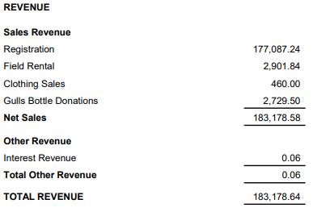
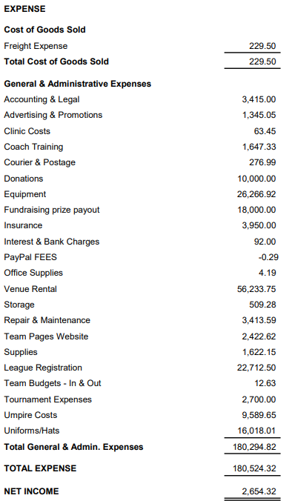

Treasurer’s Report
Income Statement 01/01/2022 to 12/31/2022
Notes:
Big thanks to the SL Gulls for the Bottle Donation

Slide 7

Fundraising for 2023
Raffle
Approx. 5000 Tickets Printed
$10/ticket
Prizes:
1st Prize: $10,000
2nd Prize: $5,000
3rd Prize: $2,500
Revenue to SLBMA if Sold Out: $32,750
Draw Date: TBD
Casino
Casino - Completed January 13-14

Slide 8
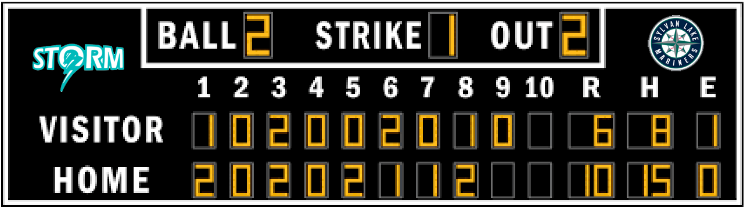
Plans for 2023
Booked space at the Dome for 2023 Try Outs
Offering ‘A’ Softball for the 1st Time
Revamping 9U Program
Baseball Winter Camps (Late December – Mid February)
Continued Equipment Purchases & Repairs
Baseball Umpire Development Bootcamp
Planning for 2nd set of jerseys for AA Mariners
Big Summer Swing Tournament
Baseball tournament, player skills competition, games, prizes and special guests featured from within our community
Digital Pitch Count & Scoreboard
Purchase Drop Down Nets for Curling Rink (Pending Community Spirit Grant)

Slide 9

Policies & Bylaws Review
Engaged a lawyer to review & revise existing Policies & Bylaws
These were shared with all 2022 members prior to the meeting
Posted on the SLMBA Website
Need a motion to pass the new Policies & Bylaws

Slide 10

Rally Cap
Athletes are typically 4,5, or 6 years old depending on birthday
Program based on FUNdamentals
Skills based on basic baseball movements
Movement skills are applied to sport situations
6-9 Athletes per Team
60-75min circuit-based training session
Practice plans
Provided for coaches & parents/guardians
End of Season Skills Demonstration & Evaluation for all Players to earn their Rally Cap

Slide 11
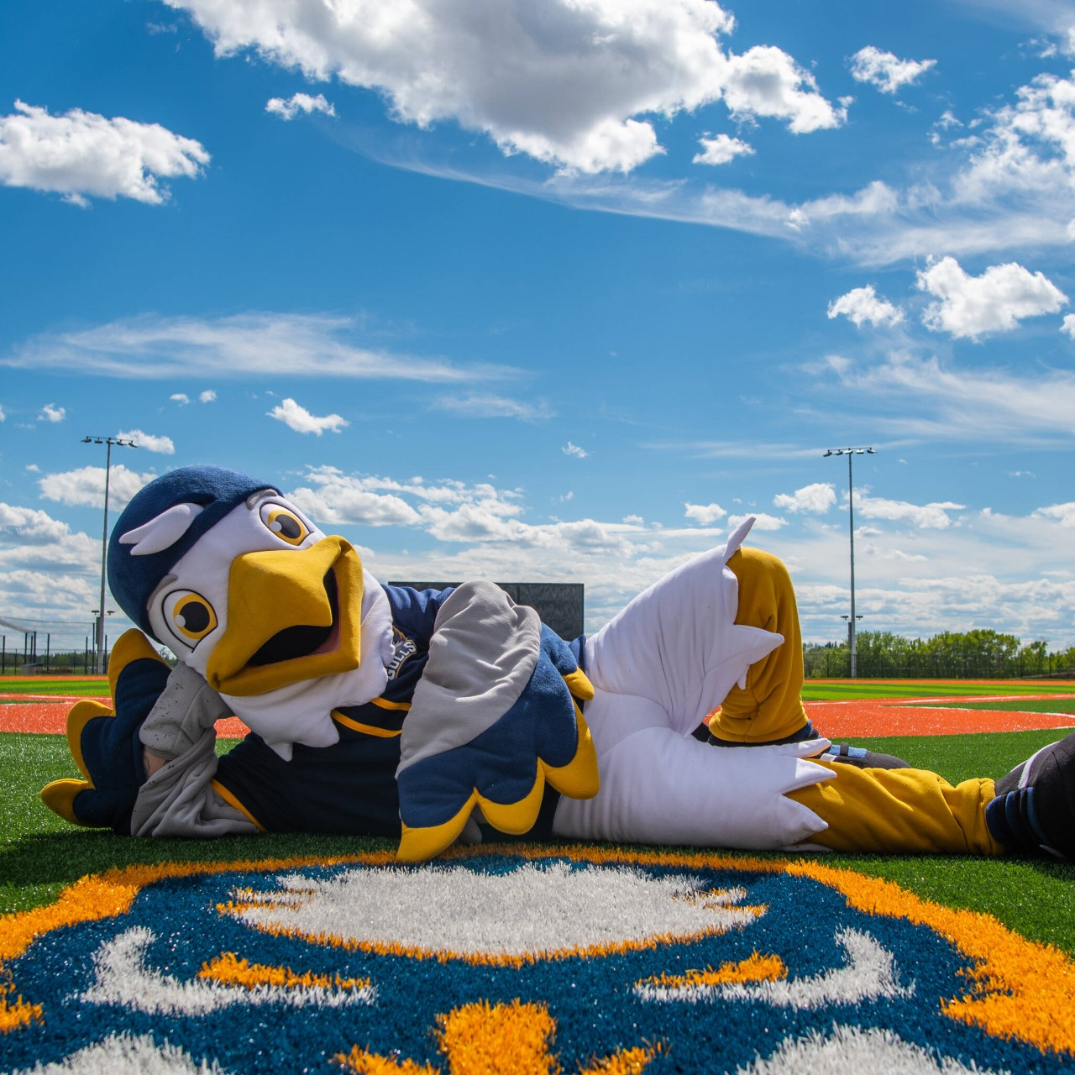

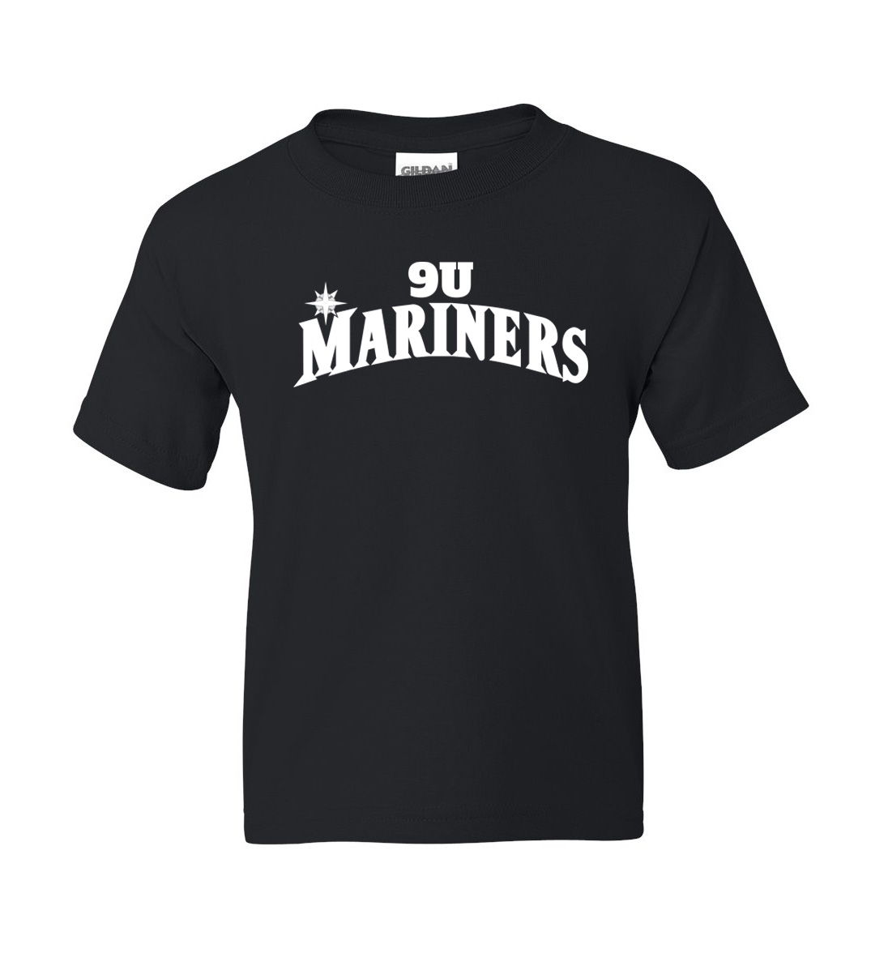
9U
FAQ's
Are we going to expect more out of our coaches?
What is the goal of the 9U program?
Is my player going to get to play on a baseball diamond?
T-Shirts & Hats
The Program (Compared to Rally Cap)
The Gulls & 9U?!
Rally Cap | 9U
White Cap | On Deck
Grey Cap | At Bat
Black Cap | Single
Green Cap | Double
Blue Cap | Triple
Red Cap | Home Run
Notes:
Parents - Parents are also essential to the success of the 9U Program. This is not a “drop-off” program, and it is encouraged that parents/guardians be involved on the field to assist the coaches in the following areas:
a. Setting up bases
b. Organizing equipment
c. Helping athletes find their equipment
d. Assisting players with rotating positions
e. Directing baserunners
f. Umpires
g. Take cues from the coaches and encourage good sportsmanship
It is not the intent that parents will be responsible for skill development activities, they are there to “assist” the coaches with these activities.

Slide 12
Softball 'A' GPLS Program

Slide 13
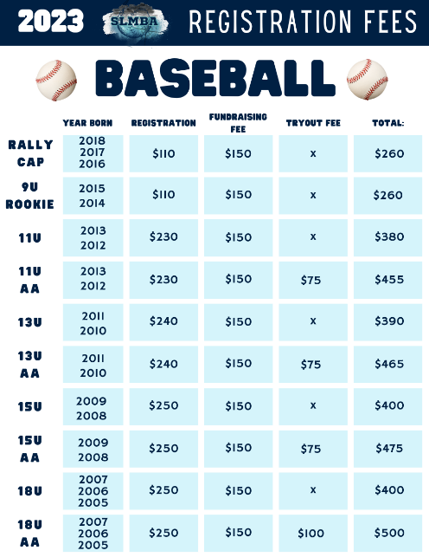
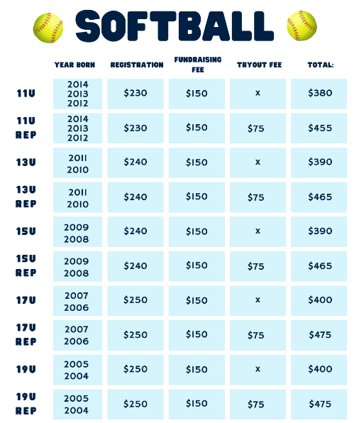
2023 Fees

Slide 14
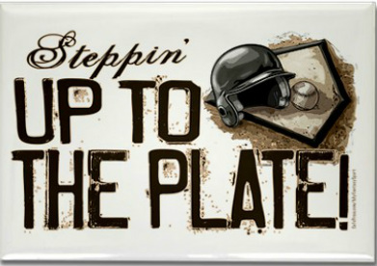
Volunteers Needed!
Coaching application/ registration closes at the end of January / start of February
Board Positions to be filled:
Softball Tournament Coordinator
Notes:
- Thank you to our coaches, managers and the rest of our volunteers but a very special thank you to Jodie Turner who’s been on the board for nearly 20 years and has wrapped up her final term as secretary. THANK YOU Jodie!

Slide 15

Draw for Free Registration
RallyCap/9U Ball Winner
Softball Winner
Baseball Winner
“Strangers are just friends I haven’t played catch with yet.”

Slide 16



THANK YOU FOR ATTENDING
Questions? Contact Us:
Email Us:
General - sylvanlakeminorball@gmail.com
President - ddarbel@outlook.com
Social Media:
Facebook, Twitter, Instagram, TikTok - @sylvanlakeminorball

