Slide 1

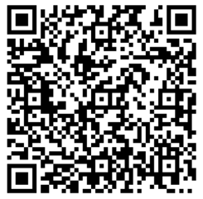
Welcome to the Annual General Meeting
Sign In Please!
By Signing in, you will be automatically entered to WIN 1 of 3 FREE Registrations!
January 16, 7pm

Slide 2



Agenda
Adoption the Agenda
Adoption of Previous AGM Minutes
Introductions
President’s Report
Special or Sub-Committee Reports
Treasurer’s Report
Resolutions (as applicable)
Nomination and Election of Directors;
Orders & General Business
Adjournment
Note: Business will be conducted in accordance with Robert’s Rules of Order.

Slide 3

Adoption(s)
“I, (state your name for the minutes), would like to make a motion to ….”
… Adopt the Current Agenda
… Adopt 2023 AGM Minutes

Slide 4

Introductions
President
Dave Darbel
Vice President
VACANT
Secretary-Registrar
Gillian Olson
Treasurer
KaryAnne Caines
Director –
PCU Development
Ryan Lucas
Director –
‘A’ Baseball
Dan Williams
Director –
‘AA’ Baseball
VACANT
Director –
9U Baseball
Kyle Munro
Director –
Rally Cap
Chelsey Simpson
Director –
Rep Softball
VACANT
Director –
Comm. Softball
VACANT
Baseball Tournament Chair
VACANT
Softball Tournament Chair
VACANT
Fundraising Coord.
Jen Dixon
Casino Coordinator
Jen Dixon
Uniform Coordinator
VACANT
Social Media & Website Coord.
Nikole Munro
Equipment & Facilities Coord.
Kelly Ulseth
Diamond Coordinator
Tara Williams
Umpire Coordinator
Ryan Lucas

Slide 5

President’s Report
2023
  Registration Recap
  Highlights
2024
  Fundraising
  Plans
  Registration Fees

Slide 6

2023 Registration Recap
Registrations for 2023:
  Rally Cap & 9U (101)
    69 Rally Cappers
    32 9U
  Softball (125)
    U11 - 32
    U13 - 38
    U15 - 30
    U17 - 15
    U19 – 10
  Baseball (164)
    11U - 63
    13U - 48
    15U - 27
    18U - 26
  390 Players Total
Extra Programs:
  Coaching Applications - 23
  Fall Ball – 79
  Winter Baseball Camp – 19
  Pre-School Fundamentals
  Softball Pitching/Catching Clinic
  Umpire Clinic
Notes:
2019 we had 350
2020 we had 308
2021 we had 325
2022 we had 470
2023 we had 390
17% decrease from 2022 to 2023

Slide 7

2023 Highlights
U11 Softball 2 Silver Tournament Wins, 15-5 record over all
GPLS Gold Weekend in B Division
U15B & U23 U15B Softball Gold Medal Provincial Champions
Bronze Provincial Medal for U13 & U17 Softball
Bronze Provincial Medal for 11UAA Baseball
Big Summer Swing Baseball Tournament (May 19)
9U Baseball Registration completely FULL
Successful Casino (January)
Not for Profit Microsoft Licensing for SLMBA Board

Slide 8

Fundraising for 2024
Raffle
Approx. 5000 Tickets Printed
$10/ticket
Prizes:
1st Prize: $10,000
2nd Prize: $5,000
3rd Prize: $2,500
Revenue to SLBMA if Sold Out: $32,750
Draw Date: June/July* TBD
Casino
Waiting for Next Casino Information (2025?)

Slide 9
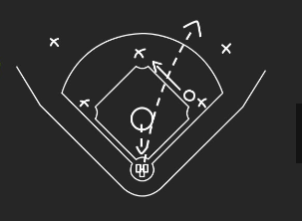
Plans for 2024
Space at the Dome for 2024 Try Outs
Offering ‘A’ Softball for the 1st Time
Continue to Grow Grassroots & Girls Baseball Programs
Baseball Winter Camps (Late December – Mid February)
Continued Equipment Purchases & Repairs
Baseball Umpire Development Bootcamp
More Provincial Hosting & Wins!
Sylvan Mariners & Storm Gear
Continue to grow players’ love of the game and their skills

Slide 10
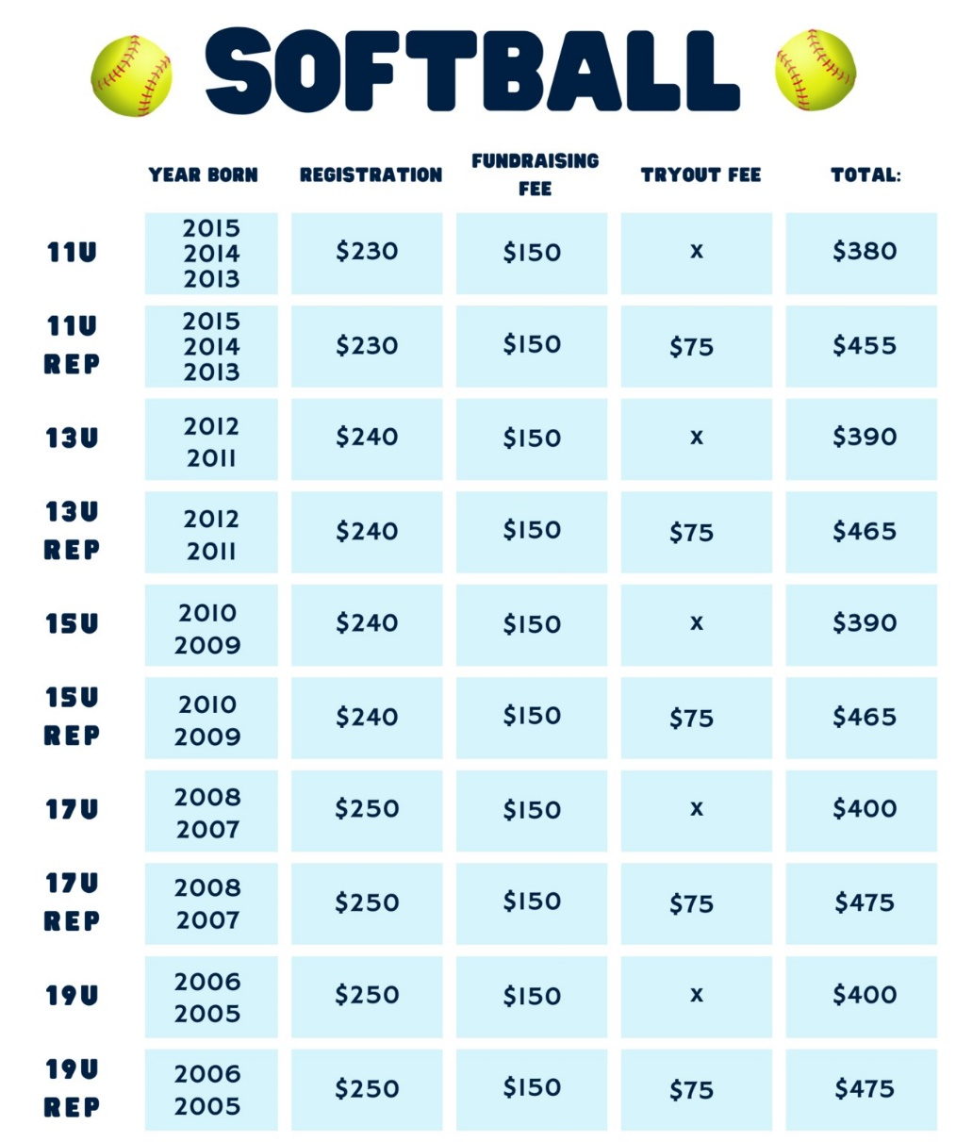
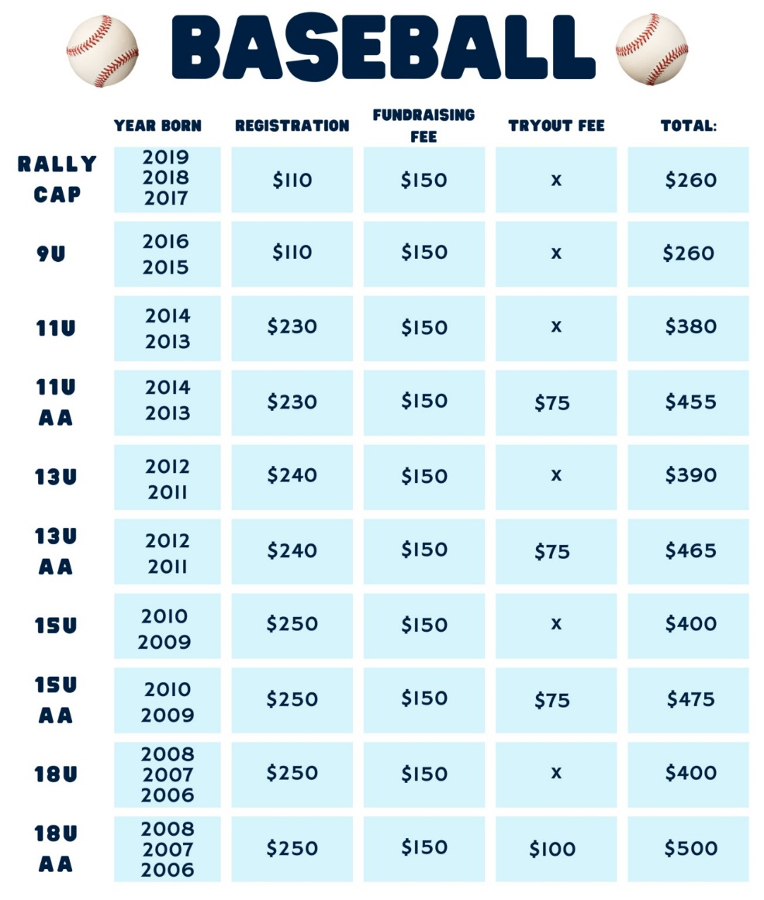
2024 Fees

Slide 11

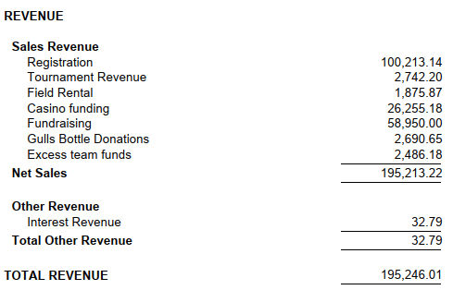
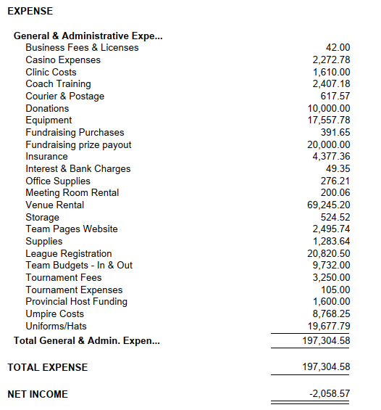
Treasurer’s Report
Income Statement 01/01/2023 to 12/31/2023
Notes:
Big thanks to the SL Gulls for the Bottle Donation

Slide 12
Resolutions
N/A
2023 New Bylaws & Guidelines were passed

Slide 13

Nominations & Elections of Directors
Board Members Up for Election/Re-Election
Vice President: Seeking Election - Crystal Walker*
Treasurer: Seeking Re-Election - KaryAnne Caines
Director: Player, Coach and Umpire Development: Seeking Re-Election - Ryan Lucas
Director: Rally Cap: Seeking Re-Election - Chelsey Simpson
Director: AA Baseball: Seeking Election - Kyle Munro* (Note: 2 Year Term)
Vacant Board Positions (Voting Position)
Director: Rep Softball* - Vacant (Note: 1 Year Term, up for re-election again in 2025)
Director: Community Softball*: Seeking Re-Election - Vacant
Vacant Coordinator Positions (Non-Voting Position)
Coordinator: Softball Tournament - Vacant
Coordinator: Baseball Tournament – Vacant
Coordinator(s): Baseball & Softball Uniforms - Vacant
“I, (state your name for the minutes), would like to nominate xxx for the position of xxx”.
Notes:
Softball Open Discussion (Dave)
‘A’ Level Rep Program Starts this season (2024)
In need of leadership for the program to set the direction, future and growth of the SLMBA Softball Program

Slide 14

Orders & General Business
Recognition & Thank You's (Dave)
Softball Discussion (If Necessary) (Dave)
9U & Tournament Update (Kyle, Dan)
Rally Cap Update (Chelsey)
Other Updates (Other Directors)
Notes:
Recognition
Brett Therriault, Melanie Campbell, Kelly Ulseth & Dave Pengally for everything done for SLMBA over the year
Thank You
Jill Olsen & KaryAnn Cains
All Board Members

Slide 15


Draw for Free Registration
Draw 1 Winner:
Draw 2 Winner:
Draw 3 Winner:
Any Questions/Comments?
“A Glove, Cleat, Helmet & Travel for ball isn’t cheap, but for a lifetime of friends & memories you’ll never forget, it’s a bargain.”

Slide 16










THANK YOU TO....

Slide 17


Adjournment – Thank you for Attending
Questions? Contact Us:
  Email Us:
    General - sylvanlakeminorball@gmail.com
    President – president@sylvanlakeminorball.ca
    Share Your Photos – media@sylvanlakeminorball.ca
  Social Media:
    Facebook, Twitter/X, Instagram, TikTok - @sylvanlakeminorball

