Slide 1

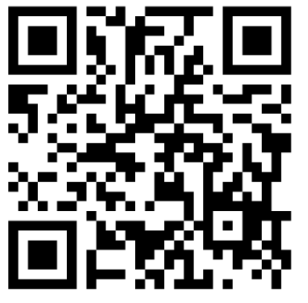
Welcome to the Annual General Meeting
Sign In Please!
By Signing in, you will be automatically entered to WIN 1 of 3 FREE Registrations!
January 6, 7pm

Slide 2



Agenda
Adoption of the Agenda
Adoption of Previous AGM Minutes
Introductions
President’s Report
Special or Sub-Committee Reports
Treasurer’s Report
Resolutions (as applicable)
Nomination and Election of Directors;
Orders & General Business
Adjournment
Note: Business will be conducted in accordance with Robert’s Rules of Order.

Slide 3
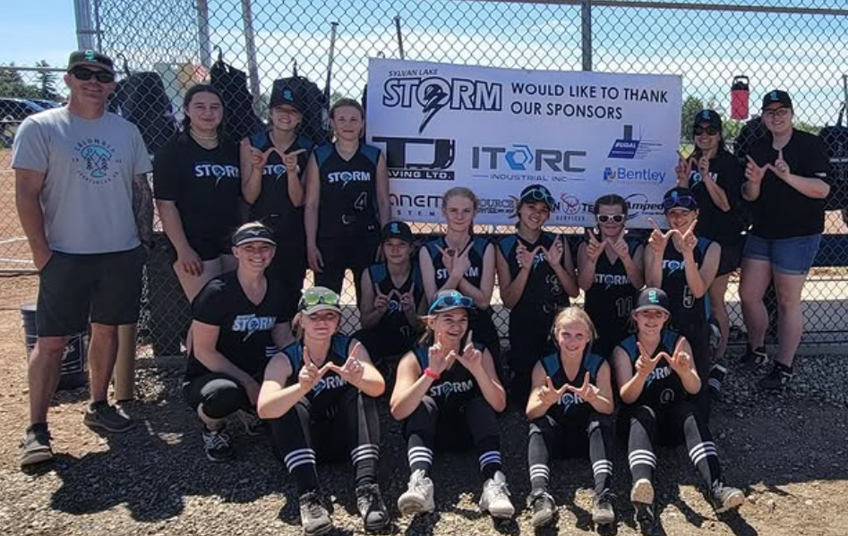
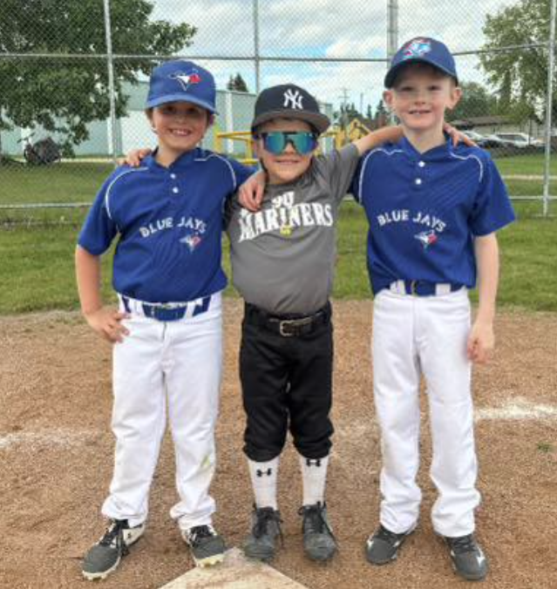
Adoption(s)
“I, (state your name for the minutes), would like to make a motion to ….”
… Adopt the Current Agenda
… Adopt 2024 AGM Minutes

Slide 4

President
Dave Darbel
Vice President
Crystal Walker
Secretary-Registrar
Gillian Olson
Treasurer
Kristin Boomer
Bookkeeper
KaryAnne Caines
Director –
PCUG Development
Ryan Lucas
Director –
‘A’ Baseball
Dan Williams
Director –
‘AA’ Baseball
Kyle Munro
Director –
9U Baseball
Josh Potts
Director –
Rally Cap
Chelsey Simpson
Director –
Rep Softball
Dallas Olson
Director –
Comm. Softball
Amanda Olson
Baseball Tournament Chair
Janelle Qualie
Softball Tournament Chair
VACANT
Fundraising & Casino Coord.
Jen Dixon
Donatin Coordinator
Chris McKenna
Uniform Coordinators
Simon P. & Phil R.
Social Media & Website Coord.
Nikole Munro
Equipment & Facilities Coord.
Kyle Munro
Diamond Coordinator
Tara Williams
Umpire Coordinator
Ryan Lucas

Slide 5
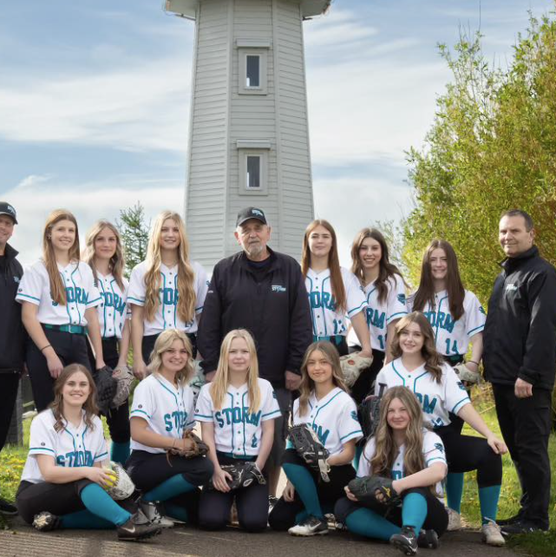
President’s Report
2024
Recap & Highlights
2025
Fundraising
Plans
Registration Fees

Slide 6
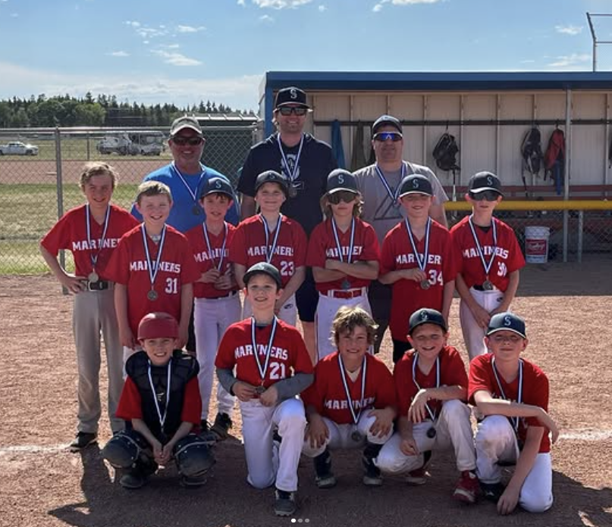
2024 Registration Recap
Registrations for 2024:
Rally Cap & 9U: 100 (101)
Softball: 104 (125)
Baseball: 163 (164)
367 Players Total
Extra Programs:
Fall Ball
Winter Baseball Camp
Pre-School Fundamentals
Pitching/Catching Clinic
Umpire Clinic
Notes:
2019 we had 350
2020 we had 308
2021 we had 325
2022 we had 470
2023 we had 390
2024 we had 367
6.5% decrease from 2022 to 2023

Slide 7
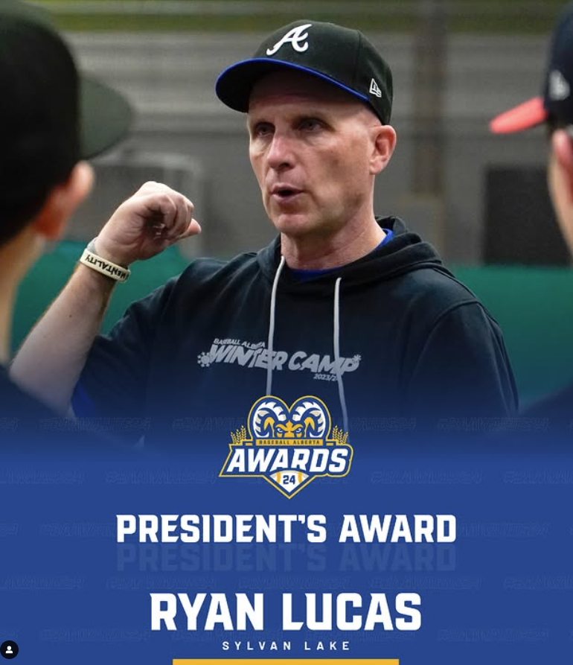
2024 Highlights
Aydan Slade (18UAA) battled & beat Cancer
Local Sylvan Lake Mariners Austin Munro (15U) & Brayden Williams (13U) travelled to Seattle to rep SLMBA after winning their divisions in the MLB Pitch, Hit & Run Contest
'A' Baseball
CABL Playoffs
11 T2 Bronze
11U T3 Silver
13U T2 Silver
13U T3 Silver
A Provincials
13U T4 Silver in Westlock
Big Summer Swing
28 teams from all over Alberta & 1 team from Sask. with over 300 athletes
'AA' Baseball
AA Provincials
18U Won T2 Provincials
15U Hosted Provincials
Notes:
15UAA National Anthem Sung by Missy Hnderson, Ceremonial First Pitch Thrown by local vet. Darryl Lickers. First pitch caught by Fire Chief Cliff Brausen and RCMP constable Ryan Ducalfe was flag beear

Slide 8
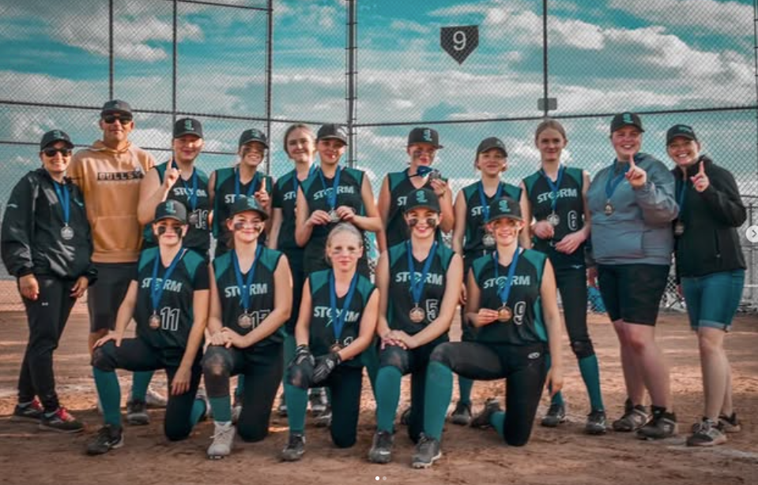
More 2024 Highlights
Softball
U17 Storm took Silver at Provincials & competed in Westerners
U15 Storm Rep 1 took Gold in Mother’s Day Tournament
U13 Storm Rep 2 took Bronze in Okotoks Tournament

Slide 9

Fundraising for 2025
Raffle
Approx. 5000 Tickets Printed
$10/ticket
Prizes:
1st Prize: $10,000
2nd Prize: $5,000
3rd Prize: $2,500
Revenue to SLBMA if Sold Out: $32,750
Draw Date: June/July* TBD
Casino
Waiting for Next Casino Information (could be late 2025)

Slide 10
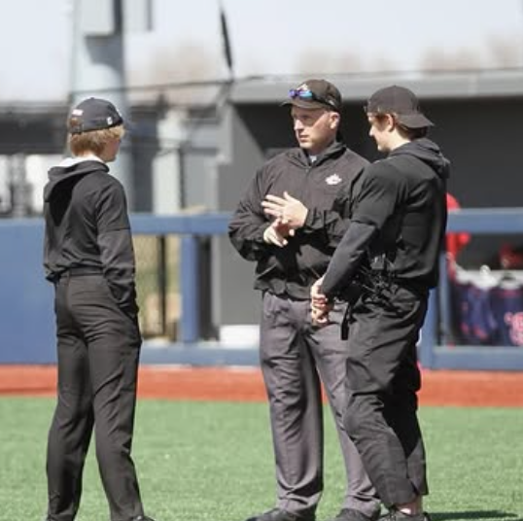
Plans for 2025
Space at the Dome for 2025 Try Outs
Offering 9U Softball for the First Time
Continue to Grow Grassroots & Girls Baseball Programs
Baseball Winter Camps (November through to February)
Inventory of Equipment, Additional Purchases & Repairs
Scheduled Equipment & Jersey Pick Up with Acknowledgement of Inventory
Baseball Umpire & Coach Development Camps
Specific Coaching Camps for Rally Cap & 9U
Forever A . . .
More Provincial Hosting & Wins!
Continue to grow players’ love of the game and their skills

Slide 11
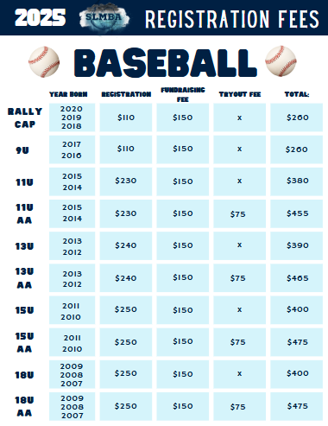
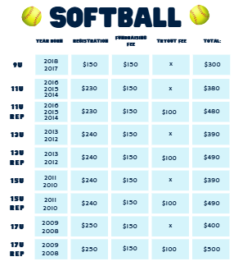

2025 Fees

Slide 12

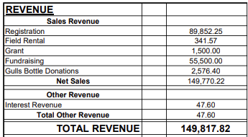
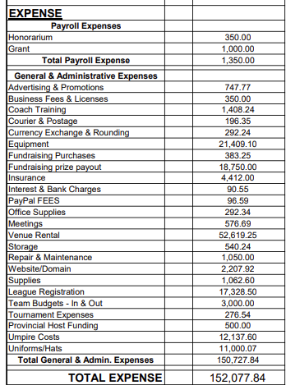
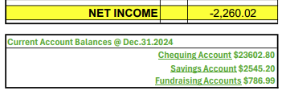
Treasurer’s Report
Income Statement 01/01/2024 to 12/31/2024
Notes:
Big thanks to the SL Gulls for the Bottle Donation

Slide 13
Resolutions & Changes
The Board passed a motion in November 2024 to split the Treasurer Role into Treasurer & Bookkeeper.
Hiring KaryAnne Caines to act as the Bookkeeper.

Slide 14

Nominations & Elections of Directors
Board Members for Re-Election
President: Seeking Re-Election - Dave Darbel
Secretary-Registrar: Seeking Re-Election - Jill Olson
Director of 'A' Baseball: Seeking Re-Election - Dan Williams
Proposed Board Positions (Voting Positions)
Treasurer: Seeking Election - Kristin Boomer
Director: Softball: Seeking Election - Dallas Olsen
Director: 9U Baseball: Seeking Election - Josh Potts
Vacant Coordinator Positions (Non-Voting Position)
Coordinator: Softball Tournament - Vacant
Coordinator: Baseball Tournament – Vacant
“I, (state your name for the minutes), would like to nominate xxx for the position of xxx”.
Notes:
Softball Open Discussion (Dave)
‘A’ Level Rep Program Starts this season (2024)
In need of leadership for the program to set the direction, future and growth of the SLMBA Softball Program

Slide 15

Orders & General Business
??
Notes:
Recognition
Kelly Ulseth for everything done for SLMBA over the year
Thank You
Jill Olsen & KaryAnn Cains
All Board Members

Slide 16
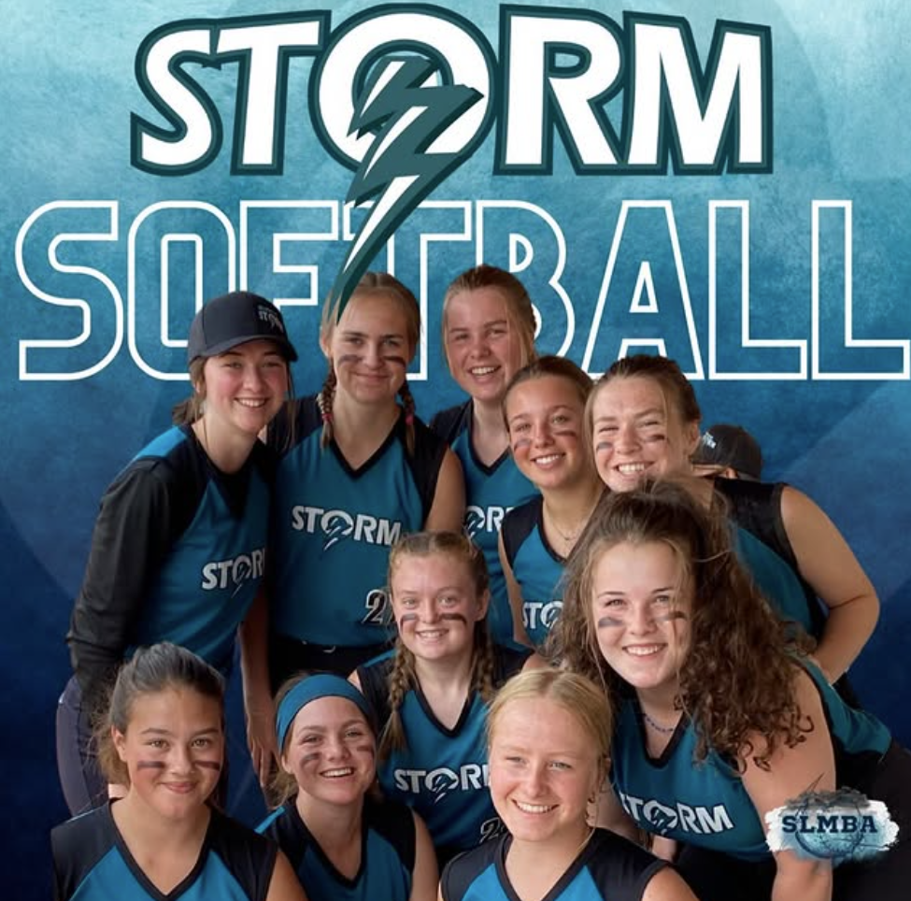

Draw for Free Registration
Draw 1 Winner:
Draw 2 Winner:
Draw 3 Winner:
Any Questions/Comments?
“A Glove, Cleats, Helmet & Travel for ball isn’t cheap, but for a lifetime of friends & memories you’ll never forget, it’s a bargain.”

Slide 17









THANK YOU TO....

Slide 18



Adjournment – Thank you for Attending
Questions? Contact Us:
Email Us:
General - sylvanlakeminorball@sylvanlakeminorball.ca
President – president@sylvanlakeminorball.ca
Share Your Photos – media@sylvanlakeminorball.ca
Social Media:
Facebook, Twitter/X, Instagram, TikTok - @sylvanlakeminorball

