Slide 1
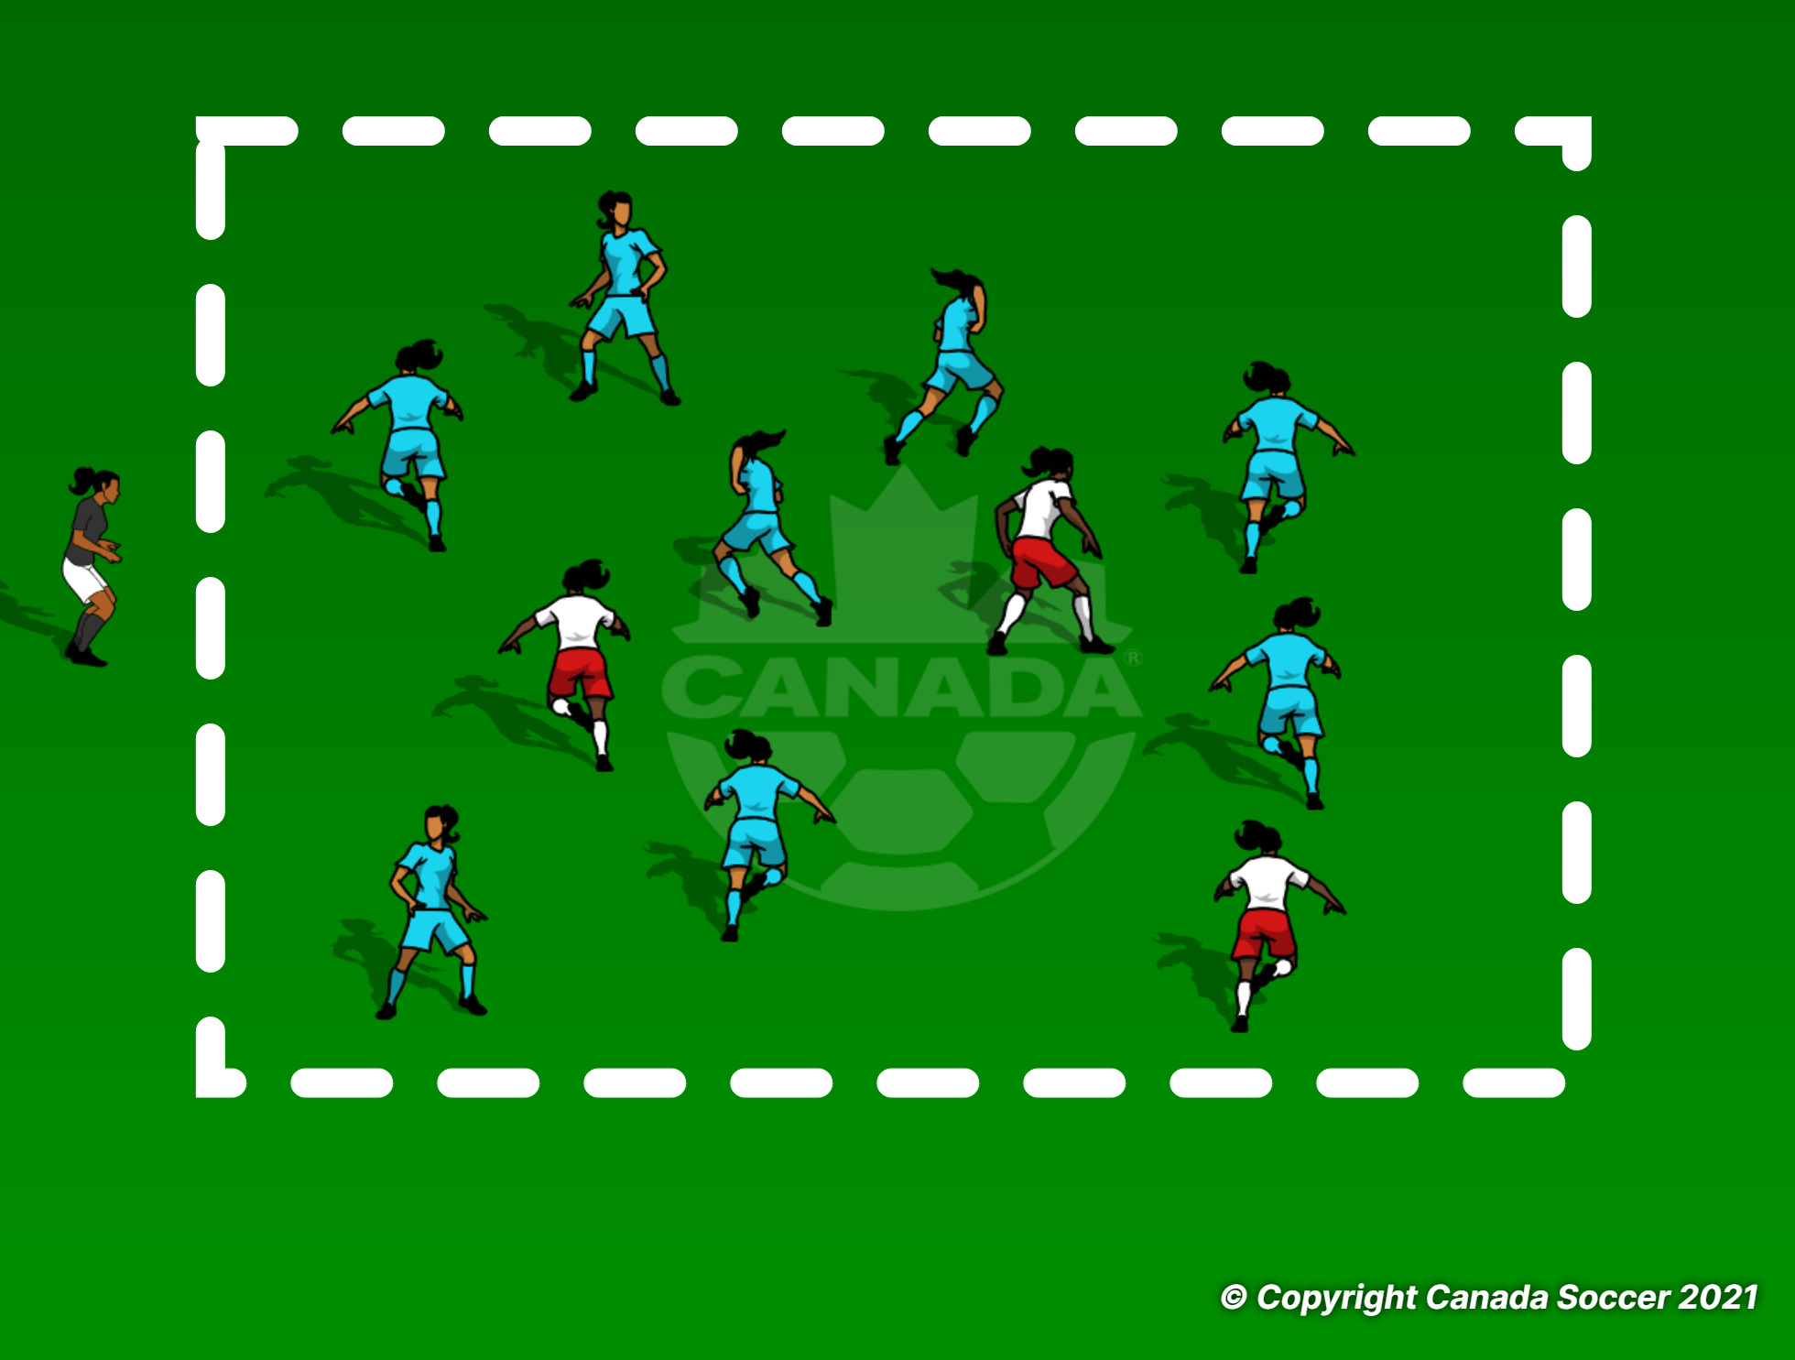
Tag
Change the tagger every 1 min.

Slide 2
SNATCH
Coach to ask the players to perform different move when coach calls the SNATCH, first player to take the ball wins the game.
Rotate one side, to create different competition every game.

Slide 3
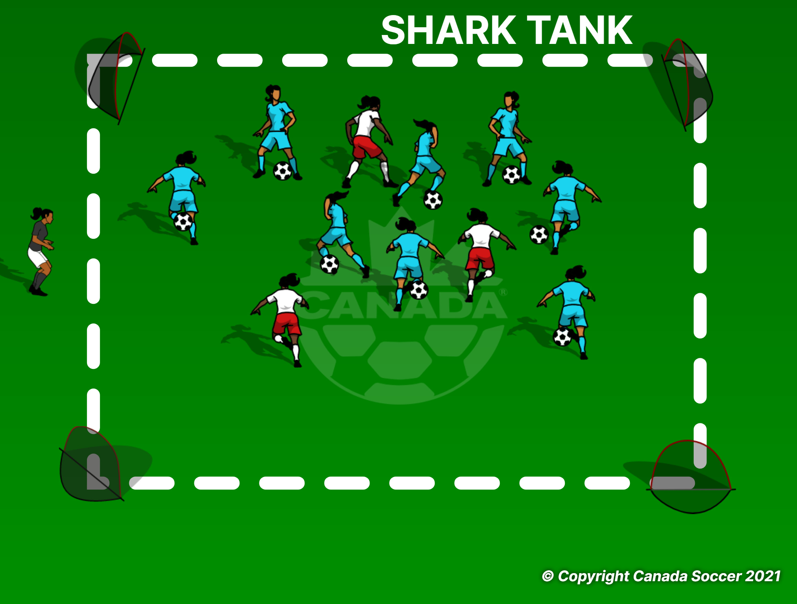
SHARK TANK
3 Sharks trying to win the ball from the MINNOWS and score a goal.
Minnows trying to keep the ball away from the shark for 1 min.
1 min game and change the Sharks.
Extra point for any dribbling tricks.

Slide 4
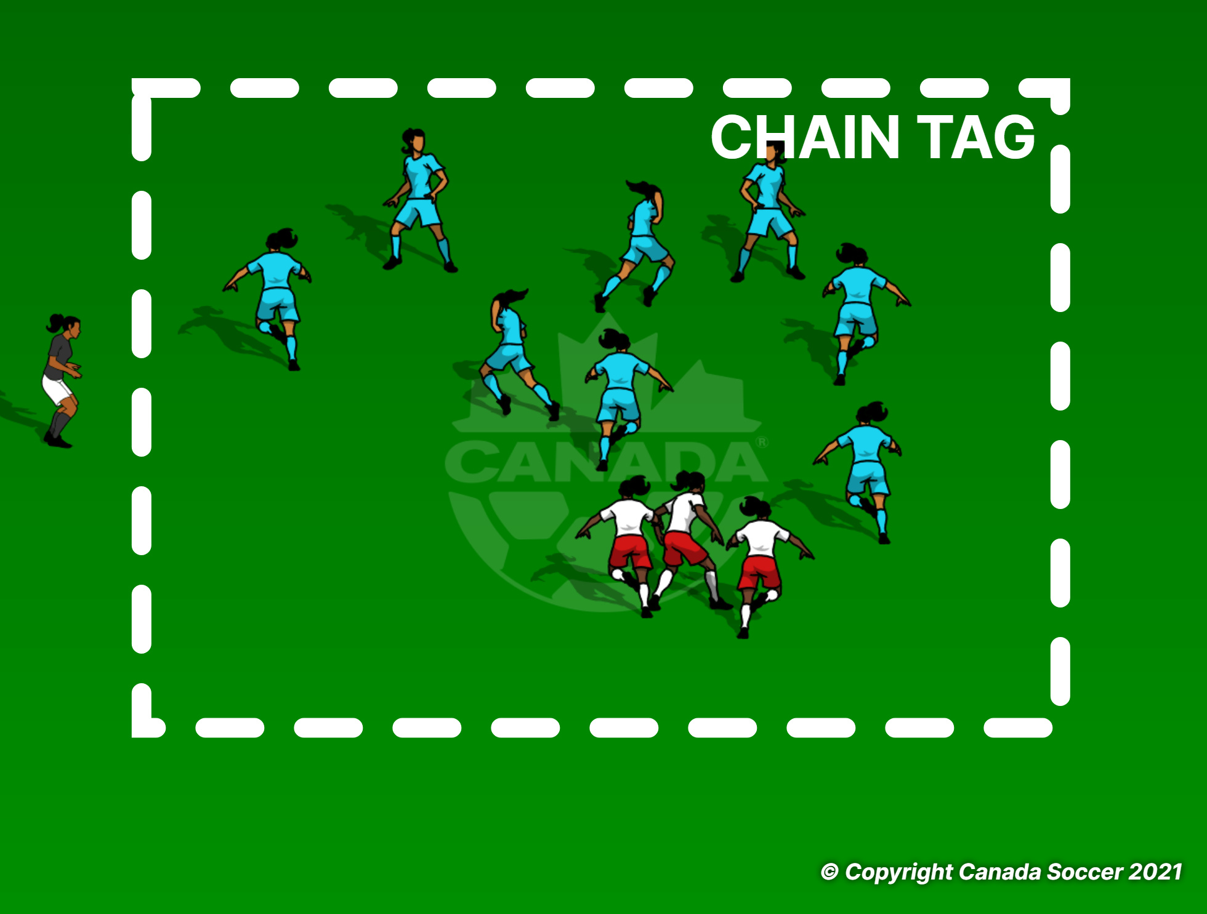
CHAIN TAG
Every time players get tagged they hold hand with the tagger to form a team of chain taggers.
Last player without getting tagged wins.2 min games.

Slide 5
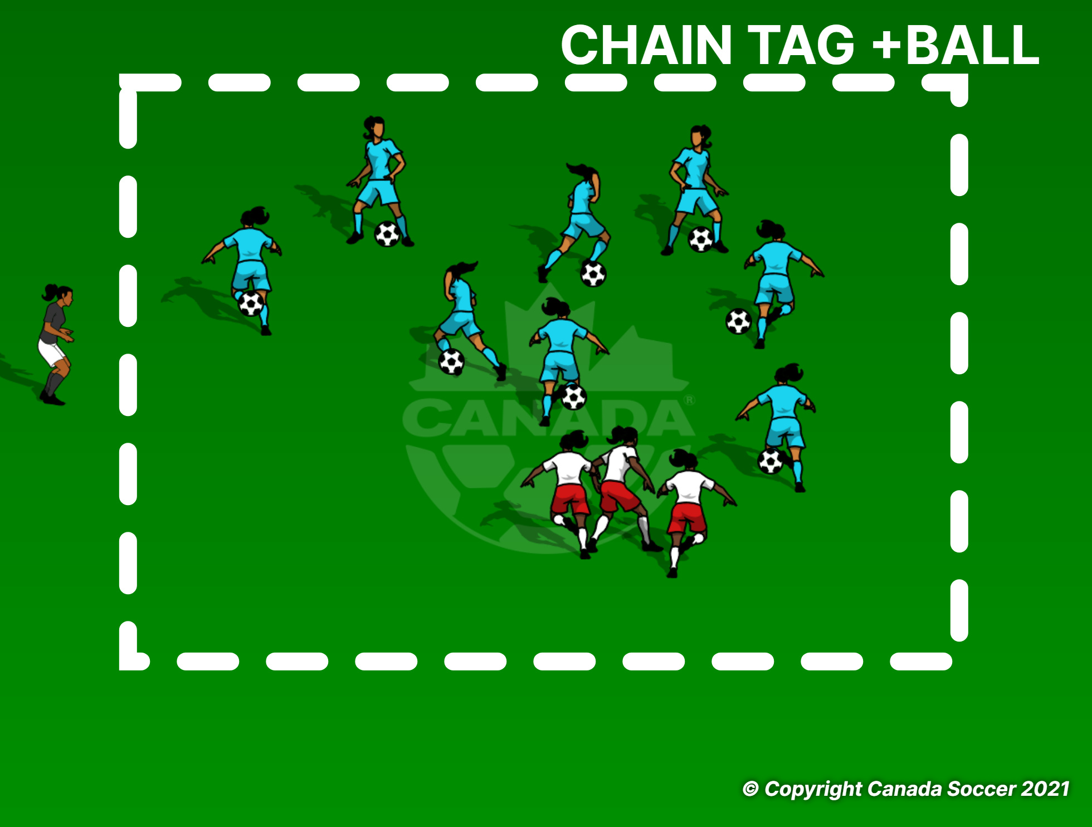
CHAIN TAG
Every time players get tagged they hold hand with the tagger to form a team of chain taggers.
Last player without getting tagged wins.2 min games.

Slide 6
DONKEY TAIL
Players to tuck their bibs in the shorts or pockets, tagger trying to steal the bibs from the running players, if you lose your bib you have to perform a move before joining the game again.
2 min games.

Slide 7
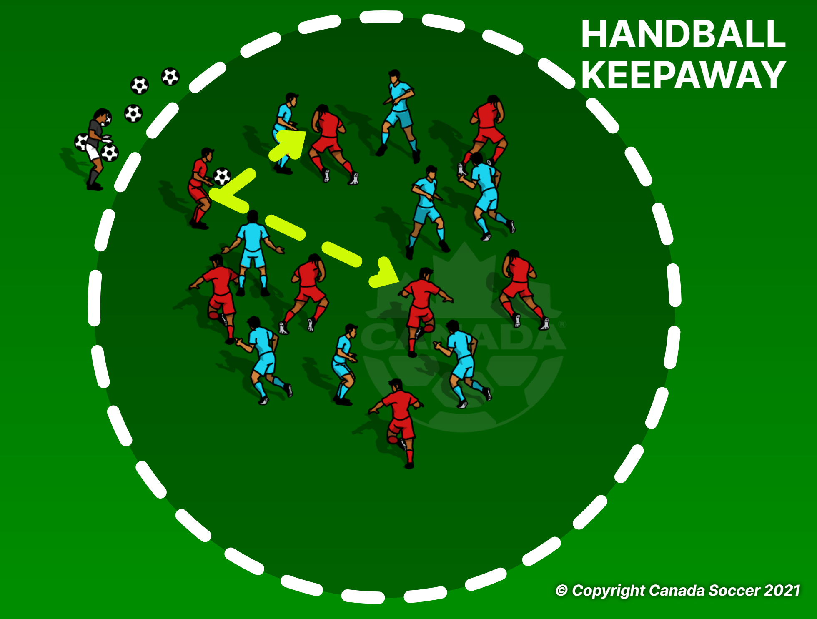
HANDBALL
BLUE S RED
Each team is trying to keep the ball away from the other team.
Every 10 consecutive passes is a 1 point.
3 min games.

Slide 8
TAG
Taggers can only tag the players who has the ball,every time a player gets tagged eliminate a ball, 1 min games.

Slide 9
SHARK TANK
3 Sharks trying to win the ball from the MINNOWS and score a goal.
Minnows trying to keep the ball away from the shark for 1 min.
1 min game and change the Sharks.
Extra point for any dribbling tricks.

Slide 10
. Ball TAG
REd(the taggers) tries to tag the Blue players by hitting the blue players' ball using their ball.
1min games.

Slide 11
SNATCH
Coach to ask the players to perform different move when coach calls the SNATCH, first player to take the ball and clear the cline without getting tagged wins the game.
Rotate one side, to create different competition every game

Slide 12
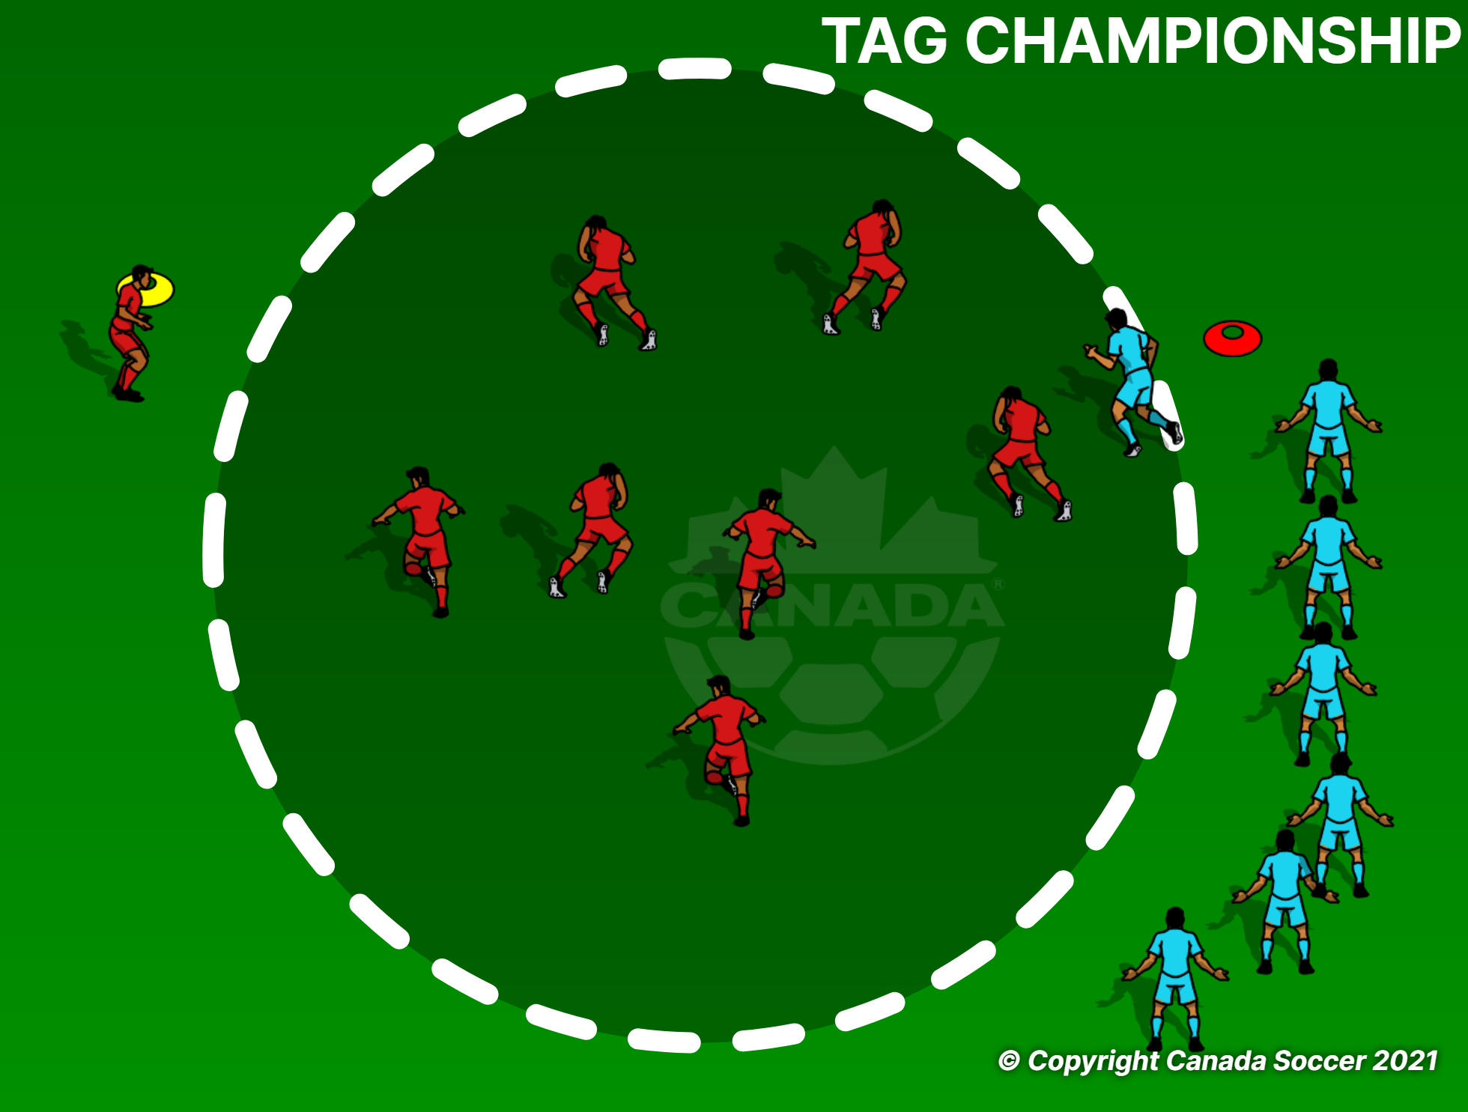
TAG CHAMPIONSHIP
Blue team has 1 min to try and tag all the red players team, only one player can go ech time from blue team, if red get tagged they have to leave the circle.
If blue is not successful in 10 seconds next player in line can go in.

Slide 13
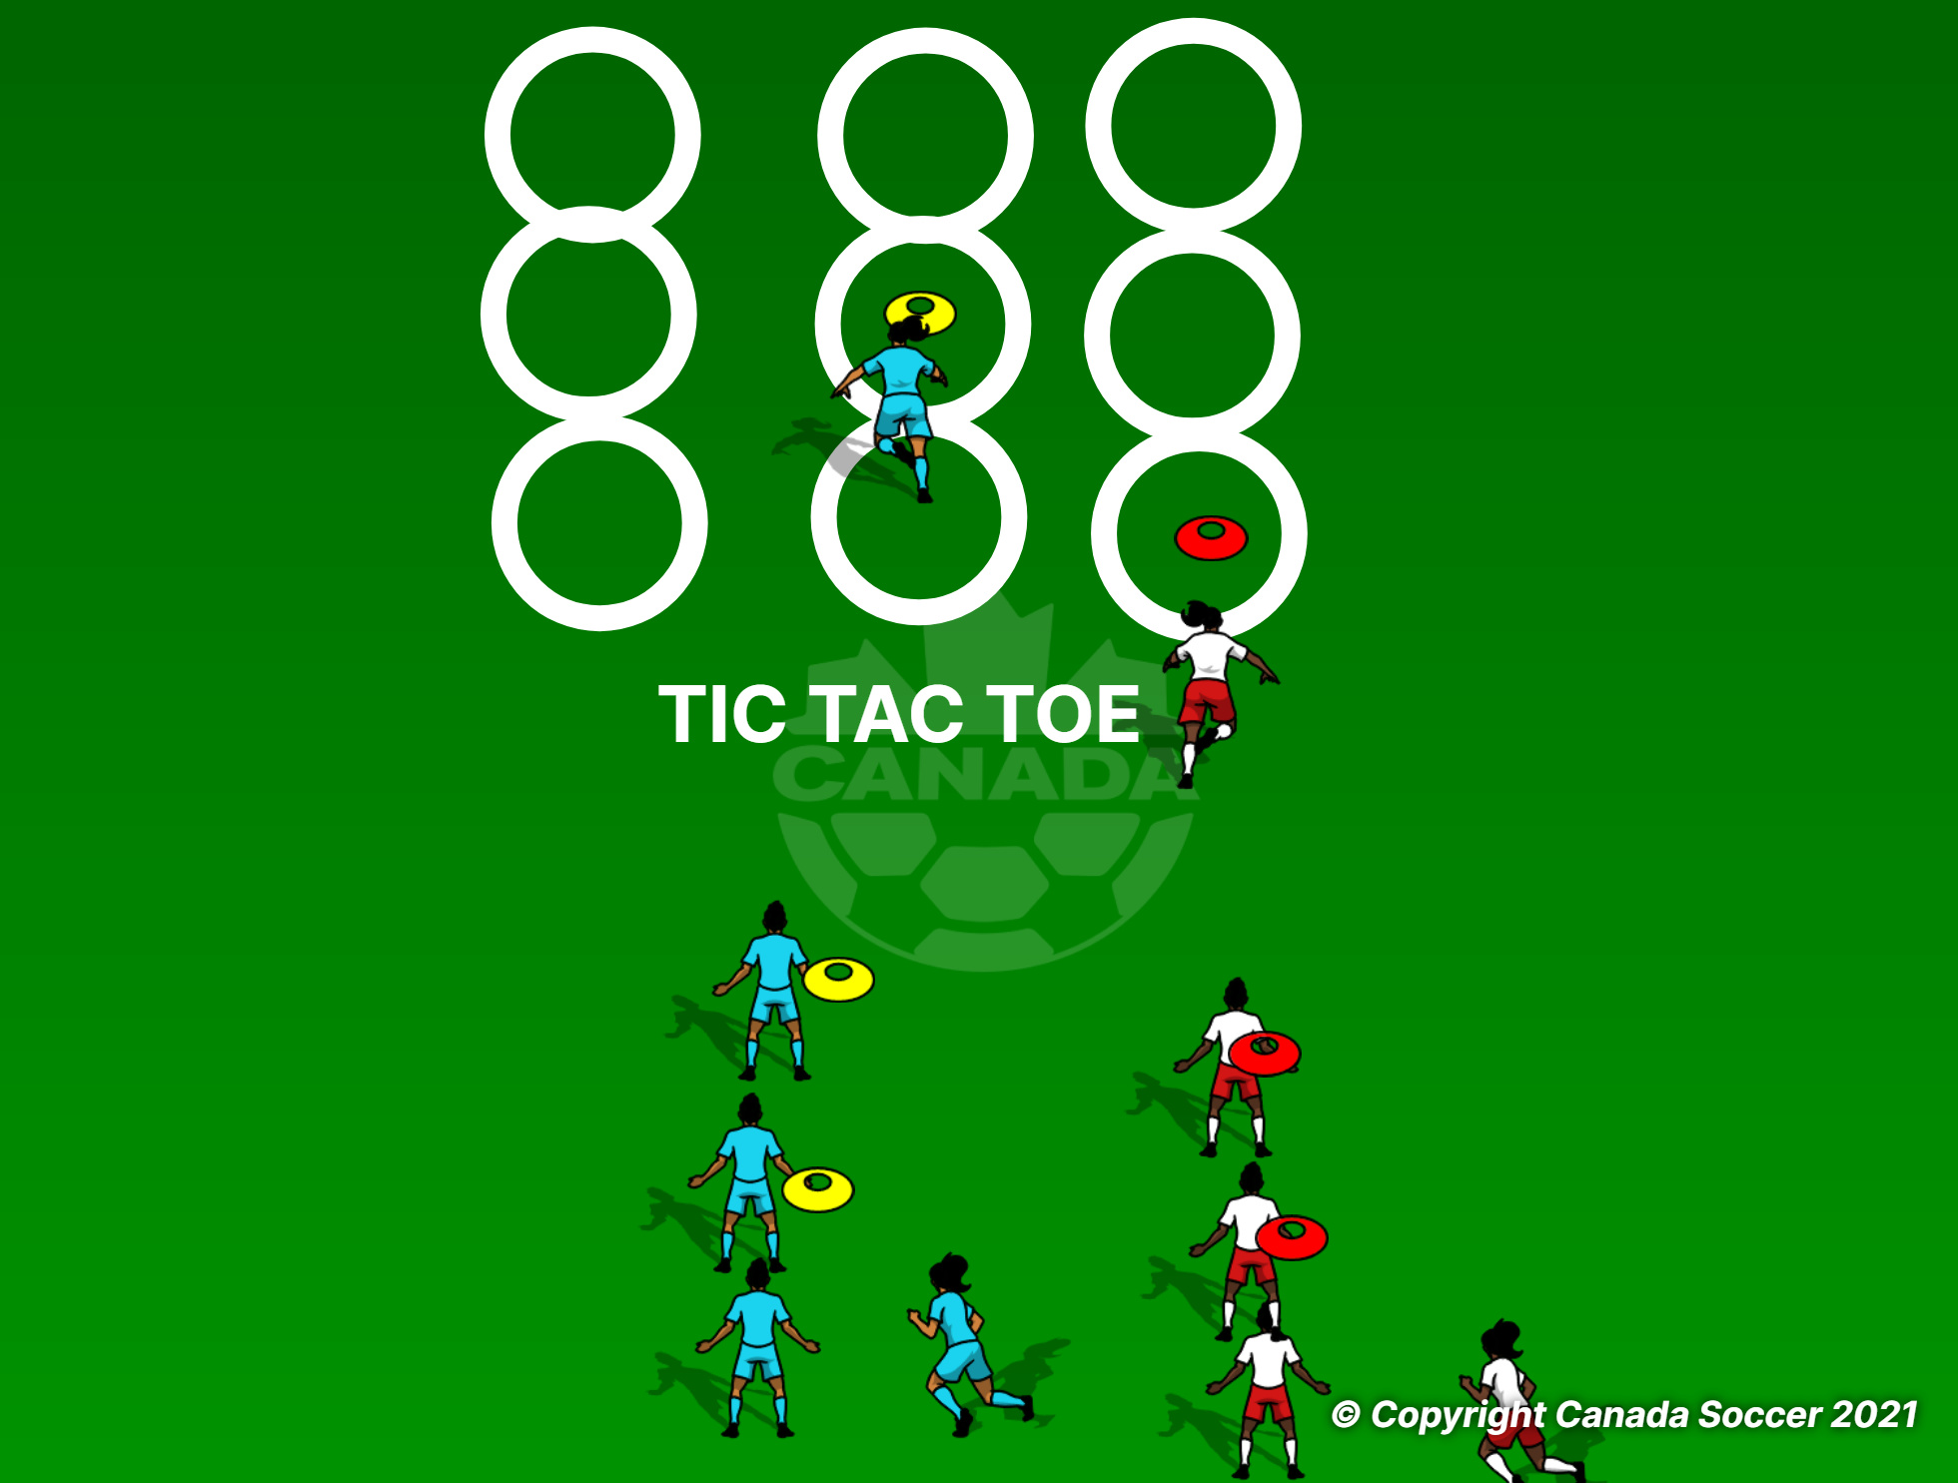
TIC TAC TOE
Each team trying to create a line up before the other team.
Players can use the ball instead of the cones.

Slide 14
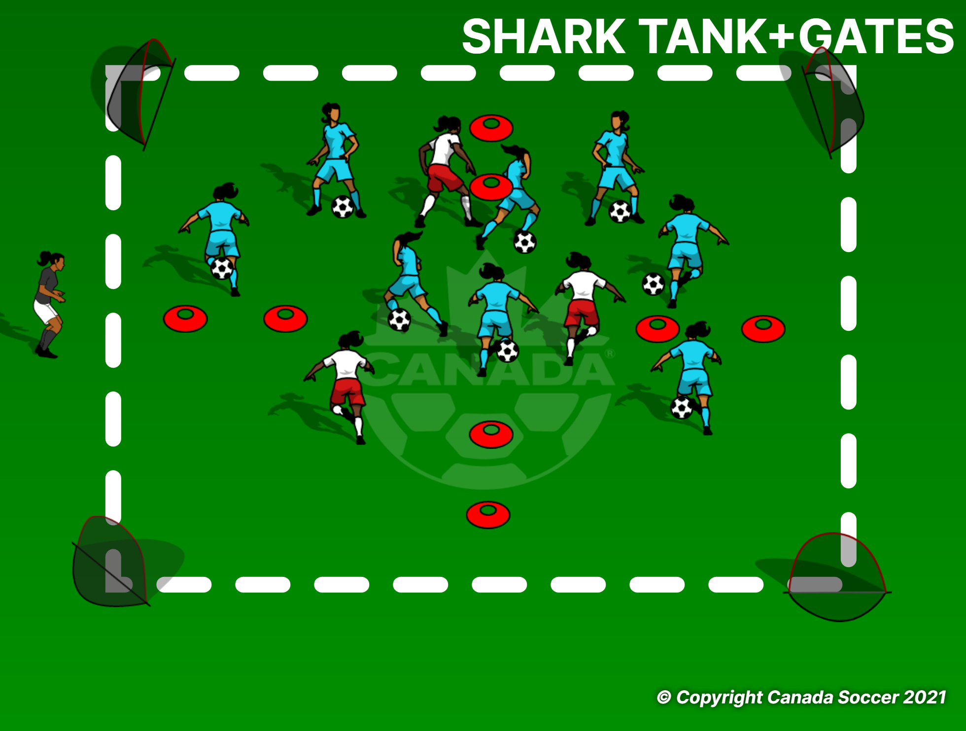
SHARK TANK
3 Sharks trying to win the ball from the MINNOWS and score a goal.
Minnows trying to keep the ball away from the shark for 1 min.Minnows can score a point by dribbling through the gate.
1 min game and change the Sharks.
Extra point for any dribbling tricks.

