Slide 1
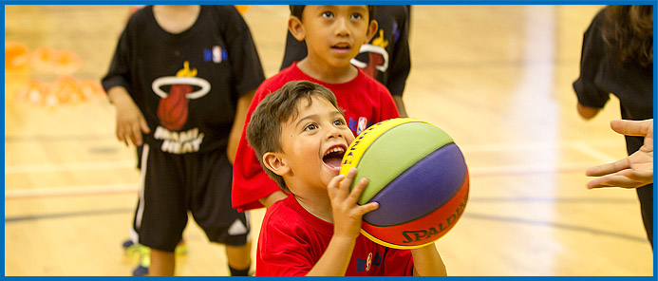

CMBA ESSENTIALS
2024 Fall & 2025 Winter
Coach Education & Coach Development Program

Slide 2

Welcome
to
CMBA Coach Education & Development
Page 2 in Essentials Manual

Slide 3
CMBA Coach Education & Development
is designed to
Promote Style of Play with an emphasis on Actions & Concepts
Promote Best Practices & leading Coaching Methods
Promote a Decision-Making Model for players
Defensive Considerations (Paris 2024)

Slide 4
CMBA Coach Education & Development
is designed to teach players:
How to Play!

Slide 5
CMBA Coach Education & Development
Page 3 in Essentials Manual
Why do players play basketball?
Why do you coach?
What is your Style of Play?

Slide 6
CMBA Coach Education & Development
Page 4 in Essentials Manual
CMBA Requirements
Your Expectations
CMBA Administration
Parent Meeting

Slide 7
CMBA Coach Education & Development
CMBA Online Information
Pages 6 in Essentials Manual

Slide 8
CMBA Coach Education & Development
Getting to Know the CMBA Website
www.cmba.ab.ca
Explode—Explore—Execute
Reporting Game Scores
Game Reports
Resources
Schedules
Links

Slide 9
Calgary Minor Basketball Association (CMBA)
Participation Agreement
Governing Conduct for All Coaches, Players and Spectators
Mission Statement - CMBA provides basketball opportunities for youth in and around Calgary that is accessible, positive, fair and safe. CMBA will also provide leadership, promoting the values of teamwork, integrity and commitment, while developing skills at all levels of competition and a lifelong love of the game.
Understanding and Abiding by the Rules is Your Responsibility
The rules of basketball should be regarded as mutual agreements, the spirit of which no one should try to evade or break. They exist for safety, proper order and enjoyment of the game for all involved
Respect Referees, Minor Officials, Coaches, and Spectators
All officials play an integral part of the game. They must be regarded as honest in intentions. Decisions of the officials must be accepted with good grace. Failure to do so may result in your removal from the gym. It may also result in a subsequent suspension.
The coach is volunteering his/her time so you/your child can enjoy basketball. Without the coach, there is no team, so be respectful and grateful for the coaches at all times.
Respectful behavior is required before, during, and after the game.
Respect the Rights, Dignity and Worth of Every Person
All persons connected with basketball are entitled to equal treatment and respect.
Respect the Facilities and Equipment Provided, Including the Gym Floor
Abuse of the facilities results in the loss of the gym for CMBA.
Guests of any player, coach, official or spectator are the responsibility of that person and must abide by the same code of conduct.
Other expected behaviors within the code of conduct:
Coaches
When you win, be respectful and gracious toward you opponent. When you lose, be congratulatory and respectful
Winning is desirable, but winning at any cost defeats the purpose of the game
When your team is well ahead, take the opportunity to try new lines, plays and skills with your players, rather than running up the score
Set a good example of sportsmanship for all children in the gym
Players
When you win, be respectful and gracious toward you opponent. When you lose, be congratulatory and respectful
Be fair always, no matter what the cost
Parents
Set a good example of sportsmanship for all children in the gym
Help make participation in CMBA a positive experience for your child and others
Applaud good plays by both team

Slide 10

CMBA Coach Education & Development
White Whistle Program
To create a positive experience and gym environment for
new basketball officials.
A referee wearing a white whistle is not to be challenged before, during, and/or after games.
Remember we are all here for the kids!

Slide 11
CMBA Coach Education & Development
Addressing Officials
If you have a concern about either how the game is being officiated or calls that are being made:
Please address officials in a timeout, quarter, or half time break.
Please use the official(s) first name when addressing them. If you forget their name(s) refer to your team stat sheet, note pad, or whiteboard for their name.
Please keep in mind the CMBA trains and has 14 year old officials that are just starting out in officiating (beginners). Keep your points limited in what you are concerned about. Then there isn’t confusion about what you are primarily concerned about.

Slide 12
CMBA Coach Education & Development
What is a Game Report?
A game report gives anyone playing, coaching, officiating, and attending a CMBA game the opportunity and ability to report both positive acts of sportsmanship, outstanding performance of officials and negative acts of sportsmanship, or poor performance that occurred in or around the game played in the CMBA League.
Game Reports are used by CMBA to identify both positive and negative behavior of players, coaches, officials, and fans. It is also used to support disciplinary action after investigation.

Slide 13
CMBA Coach Education & Development
Pre-game Meeting—Referee Lead
Coaches / Officials / Gym Monitors / Team Captains
What is a Gym Monitor?
How effective is your Gym Monitor?
Do your Players/Parents understand the Participation Agreement?

Slide 14
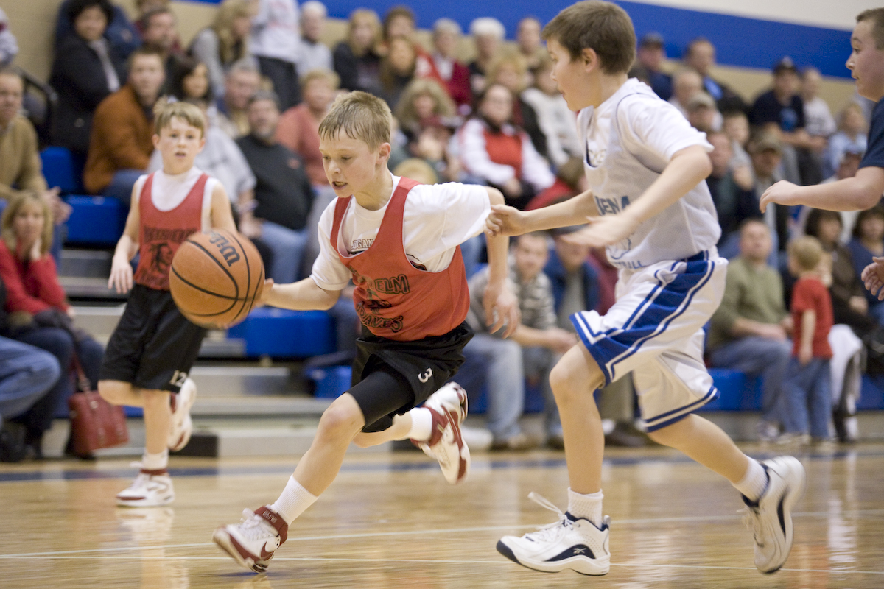
CMBA Coach Education & Development
Parent/Player Team Expectation Meeting
Partner With A Coach To Discuss The 3 Questions Below
1. Why have a Parent/Player Meeting?
2. What topics do you cover in your Parent/Player meeting?
3. Is the Parent/Player Meeting required by CMBA?

Slide 15
CMBA Coach Education & Development
Parent Meeting
Pages 7-9 in Essentials Manual
Dealing with Difficult Parents
Pages 10-12 in Essentials Manual

Slide 16
CMBA Coach Education & Development
Coaches Association of Canada
Responsible Coaching Movement
Rule of Two
Background Screening
Ethics Training

Slide 17
CMBA Coach Education & Development
Page 13-15 in Essentials Manual
Practice Planning
Do you have a Practice Plan (PP)?
Do you have 5 Segments in your PP?
Can your PP be enhanced?

Slide 18
CMBA Coach Education & Development
Page 16 in Essentials Manual
Actions, Style of Play & Concepts
Do you have an established Style of Play?
Actions
Style of Play
Coaching Concepts

Slide 19
CMBA Coach Education & Development
Page 18-20 In Essentials Manual
Every Practice Needs a Little TLC
Create a list of effective Teaching techniques.
How do you know that your players are Learning?
What is your favourite Competitive drill?

Slide 20
CMBA Coach Education & Development
Games Approach To Teaching Skills
FUN is an Important Component of Teaching
FUN Competitions
Big Island, Small Island
35-25
72 | 52 | 51 | 31

Slide 21
CMBA Coach Education & Development
Games Approach To Teaching Skills
More FUN Games
T-Rex
Pirates
Super 7
Octopus
Frozen Cones
British Bull Dog
Dribble Knockout
Sharks & Minnows
Red Light Green Light
Rock Paper Scissors Football

Slide 22

CMBA Coach Education & Development
31 Drills & Games for Kids email: markjonhogan@gmail.com

Slide 23
CMBA Coach Education & Development
Page 17 In Essentials Manual
B1-E2-C4
A Simple Concept that Works!
B1 BEAT ONE Defender
- Attack The Defender
- Read The Shoulder / Sever the Angle
E2 ENGAGE A SECOND Defender
- Pass To A Teammate
- Pass Before A Double Team Or Trap
C4 SEE Your FOUR Teammates
- Know Where Your Teammates Are
- Decision-making

Slide 24
CMBA Coach Education & Development
Good Offense Starts with Good Spacing
SPACING—a vital Concept

Slide 25
CMBA Coach Education & Development
Page 20 In Essentials Manual
Five Stage Teaching Method & Learning Styles
Explanation—Demonstration—Application—EDC—Repetition
Watch Your Language (Elephant & Giraffe)
The Greatest (Kenny Rogers)

Slide 26
CMBA Coach Education & Development
Page 21 In Essentials Manual
ABCD Teaching Technique
A = No Defense
B = Guided Defense
C = Live Breakdown Drills
D = Live 5v5 (4v4 for U11)
Training Ugly!

Slide 27
CMBA Coach Education & Development
Page 22 In Essentials Manual
ABCD Debrief Technique
Arguably the most important technique to teach Decision-making
A = Agree
B = Build
C = Challenge
D = Deeper

Slide 28
CMBA Coach Education & Development
Page 23 In Essentials Manual
Measuring Drills
Measuring Drills will Produce Greater Results
Rebounding Example
Lay-up Example
Share your Favourite Drills that can be Measured…

Slide 29
CMBA Coach Education & Development
Page 24 In Essentials Manual
ROB Shot—BRAD Shot—REP’ing
ROB Range
Open
Balanced
BRAD Back
Rim
And
Down
REP’ing Reminders
Encouraging
Praise

Slide 30
CMBA Coach Education & Development
Page 25 in Essentials Manual
Scoring the Ball
Canada’s SWNT Top 4 Scoring Priorities
1. Attack the Rim
2. 3 Point Shots (long-range shots)
3. Free Throws
4. Mid-range Shots
Coach Activity—what drills do you do to support these Top 4 Priorities?

Slide 31
CMBA Coach Education & Development
Page 25 in Essentials Manual
Scoring the Ball
Canada’s SWNT Top 6 Scoring Priorities
1. Attack the Rim
2. Attack the Paint
3. Free Throws
4. 3 Point Shot from the Corner
5. 3 Point Shot from the Top
6. Mid-range Shots

Slide 32
CMBA Coach Education & Development
Page 26 In Essentials Manual
Explode—Explore—Execute
The Foundation of Team Development
See Resources on CMBA Website (E3)

Slide 33
CMBA Coach Education & Development
Page 27 In Essentials Manual
Global Player Development
Trend for Player Development
How would you coach a delayed player?
What drills do you do to support/hinder Global Player development?
Share your favourite Global Player development drill…
Nikola Jokić Article
Page 28-33 in Essentials Manual

Slide 34
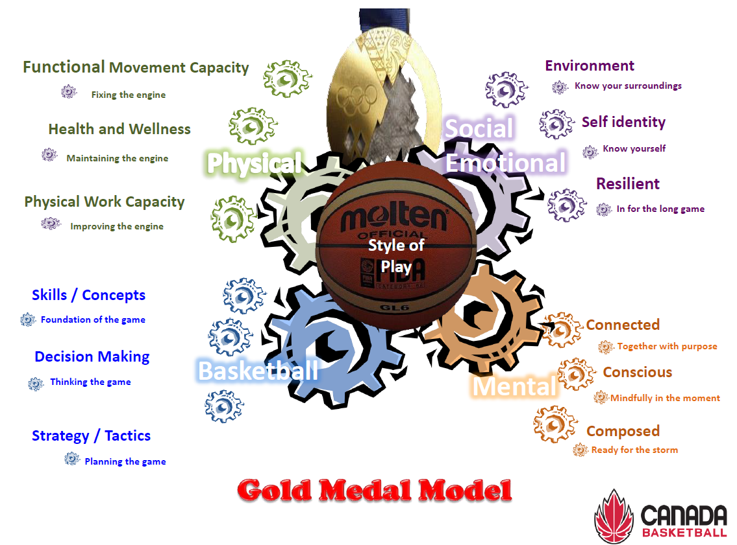
CMBA Coach Education & Development
Page 34 In Essentials Manual
Gold Medal Model (Profile)

Slide 35
CMBA Coach Education & Development
Page 35 In Essentials Manual
Style of Play Summary & Outline
Where it all began
Why it is important
How to establish a Style of Play

Slide 36
CMBA Coach Education & Development
Page 36 In Essentials Manual
Style of Play Summary & Outline
Outline for
Sequencing Style of Play

Slide 37
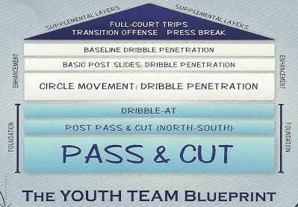
CMBA Coach Education & Development
Page 37 In Essentials Manual
Read & React Basketball—Rick Torbett
Read & React—9 Layers for Youth Basketball

Slide 38
CMBA Coach Education & Development
Read & React Actions
Read & React Basketball—Rick Torbett
Single Gap Actions
Pass & Cut, Pass & Slip, Pass & Pick
Pass & Get
Dribble-At Backdoor
Dribble-At Post-up
Dribble-At Laker Cut
Dribble-At Draft Drive or COD Move

Slide 39
CMBA Coach Education & Development
Read & React Actions
Read & React Basketball—Rick Torbett
Double Gap Actions
Attack the Double Gap—Attack the Rim/Paint
Dribble-At DHO (Dribble Hand-off)
Dribble-At Slip

Slide 40
CMBA Coach Education & Development
Read & React Basketball—Rick Torbett
Circle Movement
(see Video)

Slide 41
CMBA Coach Education & Development
Page 38 In Essentials Manual
Top 3 Defensive Priorities
Defend the Basket
Pressure the Ball
Guard 1.5 Players
What drills do you do to support these 3 defensive priorities?

Slide 42
CMBA Coach Education & Development
Page 39 In Essentials Manual
Solving Defensive Problems
Preventer
Fixer
Eraser
Players tend to enjoy being a defender based on being one of these 3 problem-solvers.

Slide 43
CMBA Coach Education & Development
Mike MacKay discussion notes
Paris 2024 Trends
Mike MacKay
Discussion Notes

Slide 44
CMBA Coach Education & Development
Page 40 In Essentials Manual
LTAD—Long Term Athlete Development
Not only are you developing Basketball Players, you are also developing Athletes!

Slide 45
CMBA Coach Education & Development
Supplemental Notes
Feedback 101, 201 & 301
Feedback 101
Technical Skill Feedback
Feedback 201
Feedback after the Feedback
Feedback 301
Decision-making Feedback

Slide 46
CMBA Coach Education & Development
Prep for the On-court Session
Be Prepared To Participate On-court…
As with Players, Coaches Learn Better via Experiential Learning…
Competency Based Coaching is the New Standard for NCCP…
We have an Outline to Follow, Unless… Bring Your Questions!
We will Spend More Time on Style Of Play than on Individual Skill Development…
Offense takes Longer to Teach than Defense so We’ll do more Offense…
Emphasis: Establishing Style of Play, Actions & Concepts | Read & React Offense…
Scrimmage (D Phase) vs. Breakdown Drills (ABC Phase) | Training Ugly Works!

